Slide 1
8 Opportunities to Connect With Future Wine Consumers
Dr. Liz Thach, MW
Distinguished Professor of Wine & Management
Sonoma State University

Slide 2
Wine in the Year 2399
Star Trek: The Next Generation
(Photo Credit: Paramount Studios)

Slide 3
Wine from 2023 to 2040
Based on data & studies from:
US Census
Pew Research Center
National Intelligence Council
McKinsey & PWC
Wine Market Council
Wine Intelligence
Gomberg-Fredrikson
Other Sources
(Photo Credit: Free Pexels.com)

Slide 4
Major Drivers of Future Change
Demographics
Environment
Economics
Social Trends
Your
Wine
Business
Regulatory/Political
Technology

Slide 5
#1) Demographics – Connect With Younger Multicultural Consumers

Slide 6
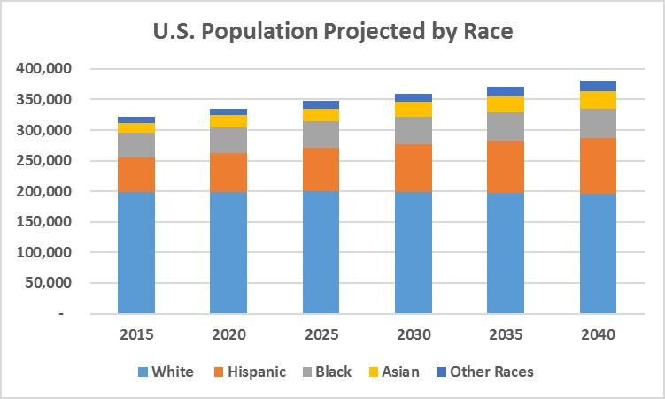
Demographics to 2040
World population = 9.7 billion (up from 7.9 today)
U.S. population = 380 million (up from 334 today)
55% of 30-year-olds will be multi-cultural
Minorities will become the majority in the U.S.
Source: Census Bureau U.S. population projections.

Slide 7
#1) Demographics – Connect With Younger Multicultural Consumers
U.S Wine Consumption by Ethnicity
“Younger multicultural consumers (21-29) are least likely to be weekly wine drinkers.” (Ethnifacts, 2022)
The reason many ethnic and younger consumers report for not drinking wine is “they do not like the taste.” (Ethnifacts, 2022)
Source: Wine Marketing Council, 2021-2022 Consumer Benchmark Report

Slide 8
Opportunities to Connect With Younger Multicultural Consumers
GATEWAY WINES - Need for more “gateway wines” that taste attractive to young multi-cultural consumers
- Positive first experiences mentioned were sweet reds, moscato, and sparkling wines
INCLUSIVE ADS - Make sure marketing materials/ads are inclusive and show younger, multi-cultural consumers.
LIFESTYLE LINKAGES – communicate how wine enhances everyday occasions, e.g. to relax
FOREIGN PARNTERSHIPS - U.S. wineries may want to consider import partnerships, JVs, or acquisitions with international wineries:
66% of Hispanic-Americans drink wines from Spain and 25% drink wine from Chile & Argentina (Ethnifacts, 2022)
Photo Credit: Getty

Slide 9
#2) Demographics – Enhance Loyalty Efforts With Older Consumers

Slide 10
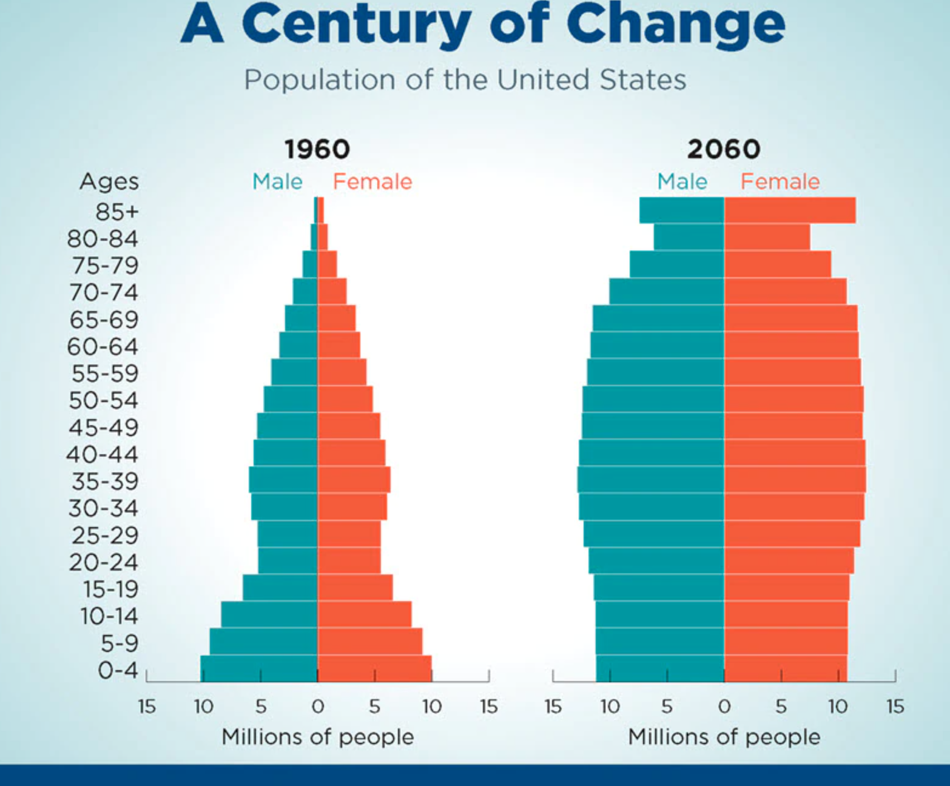
#2) Demographics – Enhance Loyalty Efforts With Older Consumers
By 2040, 1 in 5 Americans will be over 65 (AARP)
There will be more old people than children (US Census)
Baby Boomers will all be 65 by 2030 (US Census)
Source: Census Bureau U.S. population projections.

Slide 11
Opportunities to Enhance Loyalty Efforts with Older Consumers
UPDATE LOYALTY PROGRAMS – Expand current DTC wine club options, and create more innovative ones.
LIFESTYLE LINKAGES – provide wine options/ads that match lifestyles and interests of older consumers
THANK YOU GIFTS – Provide thank you gifts to loyal consumers.
FEEDBACK FROM OLDER CONSUMERS – Reach out to older wine consumers and ask them what changes they would like to see.
45% of consumers changed brand preferences during the pandemic (Ketchum Survey, 2021)
Photo Credit: Getty

Slide 12
#3) Global Warming – Consider New Grape Varieties and Regions

Slide 13
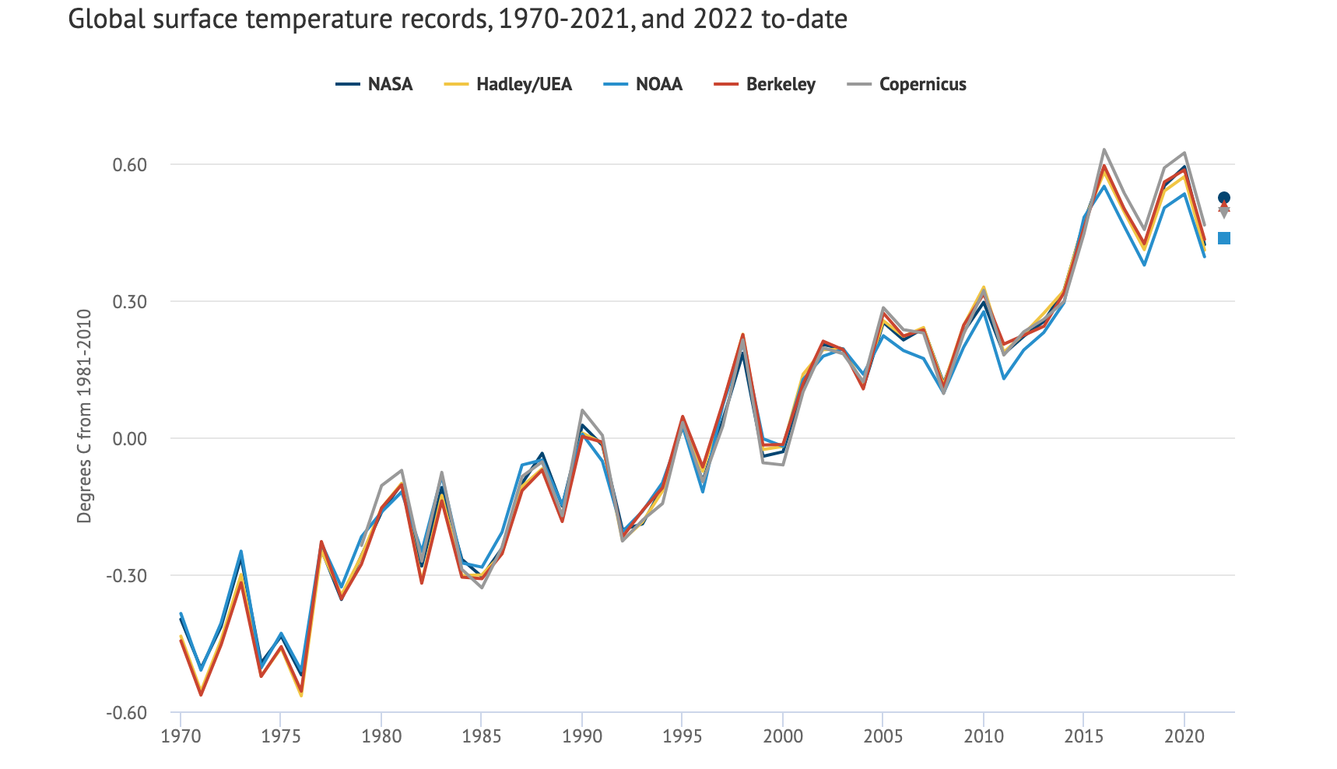
#3) Consider New Grape Varieties & Regions
2022 one of warmest on record (NASA, NOAA, et al).
82% of Americans, aged 18-34, believe CO2 should be regulated (Yale Study, 2022)
Bordeaux has earliest harvest ever in 2022. (NBC News, 2022)

Slide 14
Opportunities to Communicate New Varieties & Regions
Due to global warming, wine consumers open to new varieties/regions (Veranda, 2022)
HEAT-LOVING VARIETIES – Consumers understand – especially younger ones – the need to explore new grape varieties due to global warming.
e.g. Grenache, Tempranillo, Chenin Blanc, etc.
DROUGHT-RESISTANT ROOTSTOCK
NEW, COOLER WINE REGIONS
Millennials are variety-seeking wine consumers & Gen Z internationally-focused
COMMUNICATE RATIONALE – Plus other efforts to reduce CO2
Photo Credit: Pexels

Slide 15
#4) Sustainability – Provide Real Numbers to Consumers

Slide 16
#4) Sustainability – Provide Real Numbers to Consumers
80% = of U.S. consumers consider sustainability when purchasing some products (J&J Study, 2022)
75% = of Millennials will pay more for environment-friendly products (Greenprint Survey, 2021)
Wine = Younger consumers especially seek organic and sustainable wines (WMC and Wine Intelligence, 2021)
However, 50% of Americans say they don’t trust companies’ claims about protecting the environment.
(Mintel, McKinsey, 2022)

Slide 17
Opportunities to Provide Real Sustainability Numbers
INCLUDE STATS – include simple and clear numbers on wine packaging
50% water conserved in grape growing since 2015
Reduced energy usage by 25% in cellar since 2018
Carbon footprint reduced by 34% since 2020
SUSTAINABILITY TAB – Create a separate sustainability tab on your website menu describing goals and results to date.
EXPLAIN CERTIFICATIONS – If you have multiple environmental certifications, explain them on website in simple language.

Slide 18
#5) Incorporate Growing Desire for Transparency in Food & Beverages

Slide 19
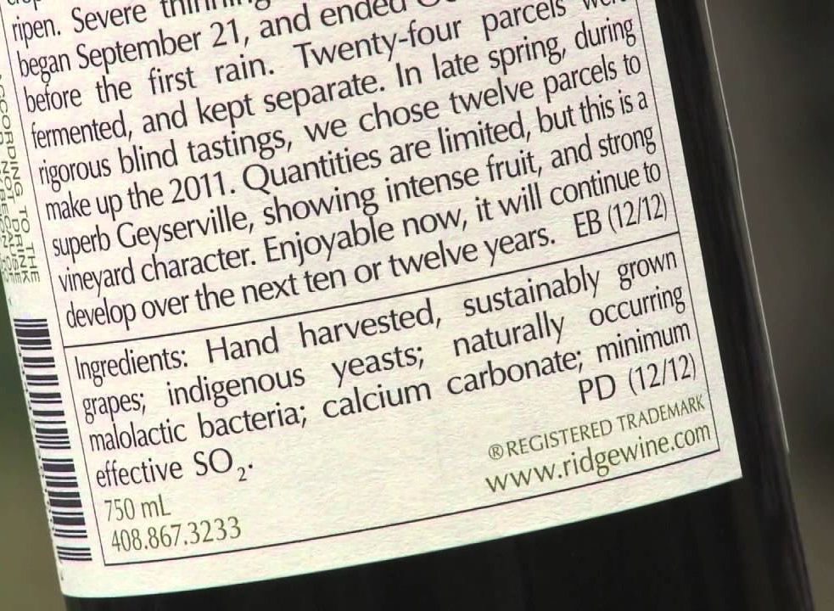
#5) Incorporate Growing Desire for Transparency in Food & Beverages
EU will require ingredient labeling for wine starting Dec. 2023. (USDA, 2022)
TTB considering similar requirements after lawsuit filed (Nutrition Insight, 2022)
Wine Market Council 2022 study of wine consumers finds:
22% want ingredient labeling
26% want nutrition labeling
50% believe wine has high sugar
Photo Credit: Ridge
Since 2011, Ridge lists ingredients on wine labels.

Slide 20
Opportunities to Enhance Wine Ingredient Transparency
BE AN EARLY ADOPTER – Get ahead of the curve and add ingredient and nutrition labeling.
QR CODE/WEBSITE SUPPORT – Consider adding info. to a QR code with more detailed information on website.
USE POSITIVE, HONEST TERMS – Plant-based, no sugar-added, only 120 calories, low carb, gluten free, keto friendly, vegan friendly, etc.
Photo Credit: Getty

Slide 21
#6) Engage the No/Low Alcohol Consumer

Slide 22
#6) Engage the No/Low Alcohol Consumer
79% = of global consumers identify wellness as important, with 42% as priority (McKinsey, 2022).
$9 Trillion + size of wellness market by 2040 – doubling in size (Delaware North, 2021)
54% = of consumers willing to pay more for healthier food/beverage options (PWC, 2021)
39% of consumers cutting down on all alcohol, not just wine – especially ages 18-34 (Wine Intelligence, 2021).

Slide 23
Opportunities to Engage No/Low Alcohol Consumer
CONSIDER PREMIUM LOW/NO OPTION
IF ALREADY LOW ALCOHOL, COMMUNICATE
RESEARCH BETTER TASTING OPTIONS – some consumers complain that low/no alcohol wine doesn’t taste as good as low/no alcohol beer
CONSIDER VARIETAL GRAPE JUICE – e.g. Pinot Noir or Chardonnay grape juice
“Brand owners need to diversify into the soft drinks space as alcohol declines.” Mintel Report on the Future of Wine & Spirits, 2022

Slide 24
#7) Create New Purchasing Experiences With Technology

Slide 25
#7) Create New Purchasing Experiences With Technology
Growth of voice shopping & live-stream shopping via mobile
Digital wallet expanding, e.g. Venmo, WeChat with touchless technology
By 2040, physical stores as we know them will completely change (Euromonitor).
The Metaverse (3-D Internet that transitions virtual & physical spaces) is currently being offered by some brands, e.g. Heineken & Jose Cuervo
https://www.youtube.com/watch?v=-9-lhuSkiMs&t=15s
54% = of experts say by 2040 the metaverse will be a well-functioning aspect of daily life for .5 billion people globally. (Pew Research)

Slide 26
Opportunities to Create New Purchasing Experiences
RAMP UP VIRTUAL TASTING OPTIONS WITH EASY ONLINE PURCHASE
ENSURE FAST MOBILE WEBSITE & ONLINE SHOPPING CART
CONSIDER ADDING DIGITAL PAYMENT SYSTEM
EXPLORE LIVE-STREAM & VOICE-SHOPPING FOR WINE – “Alexa, which wines pair well with tacos?”
EXPLORE METAVERSE OPTIONS – how to transition online shopping into virtual/physical experience
Photo Credit: Getty

Slide 27
#8) Adopt Technological Changes for Smart Packaging

Slide 28
#8) Adopt Technological Changes for Smart Packaging
Smart (or Intelligent) Packaging uses technology sensors to determine:
Freshness
Temperature
Shelf-life
Distribution tracking
Ingredient tracing,
Reduce counterfeiting & waste generation, and
Other product specific purposes
Smart Wine Bottle of the Future
Ingredients
Calories
Sugar
SO2
Temp
TCA
Nutrients
Carbs
85% = of the younger generation prefers intelligent packaging (Future Market Insights, 2022)

Slide 29
The 8 Opportunities
#1) Demographics – Connect With Younger Multicultural Consumers
#2) Demographics – Enhance Loyalty Efforts With Older Consumers
#3) Global Warming – Consider New Wine Varietals and Regions
#4) Sustainability – Provide Consumers With Real Numbers
#5) Incorporate Growing Desire for Transparency in Food & Beverages
#6) Engage the No/Low Alcohol Consumer
#7) Create New Purchasing Experiences With Technology
#8) Adopt Technological Changes for Smart Packaging

Slide 30
Thank You!
Questions or Comments?

