Slide 1


“State of the Industry”
Grape Supply and the Winegrape Market-
What to expect as we move forward…
Jeff Bitter
January 25, 2023

Slide 2
Presentation Themes
Apprehension (2023)
Recovery (2022)
Uncertainty (2021)
Correction (2020)

Slide 3
Presentation Themes
Apprehension (2023)
Recovery (2022)
Uncertainty (2021)
Correction (2020)

Slide 5
Definition of Apprehension
“Anxiety or fear that something bad or unpleasant will happen”
Source: Oxford Languages, 2023

Slide 6
Why Apprehension?
Economic Pressures
  Interest Rates
  Inflation (increasing costs)
  Recession Potential
  Waning Consumer Confidence

Slide 7
Why Apprehension?
Global Pressures
  Strength of US Dollar
  Declining World Consumption
  “Long” Southern Hemisphere
  Conflict in Ukraine

Slide 8
Why Apprehension?
Consumer/Beverage Market Pressure
  No/Low Alcohol Popularity
  Alternative Drink Options
  Demographic/Generational Concerns
  Lack of Industry Growth (Volume)

Slide 9
Why Apprehension?
Grape Prices Are
….and supply is generally tighter

Slide 10
Why Apprehension?
and also, there’s the news…..

Slide 12
So, there’s lots of
“glass-half-empty”
talk these days…

Slide 13
What our headlines should be…..
“California wine industry bobs, weaves and plows through pandemic, with level shipments and increased sales…”
“California vineyards sustain environment with minimal carbon footprint and limited water use…”
“California wine…..the natural choice - low in sugar, carbs and calories…”

Slide 14
What’s been securing
supply/demand stability?
Three short crops
Anchoring pessimism regarding weather/perils
Modest planting rates
“Reduced” impact from imports
More contracted grapes, less on spot market
Common Theme: Supply Limitation

Slide 15
…..And what’s threatening
supply/demand stability today?
Economic uncertainty
Global competition/pressure of various kinds
No material proof of a growing consumer base
“Under-performance” of the largest wineries
Common Theme: Demand Pessimism

Slide 16
The current state of our grape market is a function of challenged demand being offset by limited supply.

Slide 17
Moving into the data…..
Annual Nursery Survey Review
and
Vineyard Removal Estimates

Slide 18
Nursery Survey Participants

Slide 19
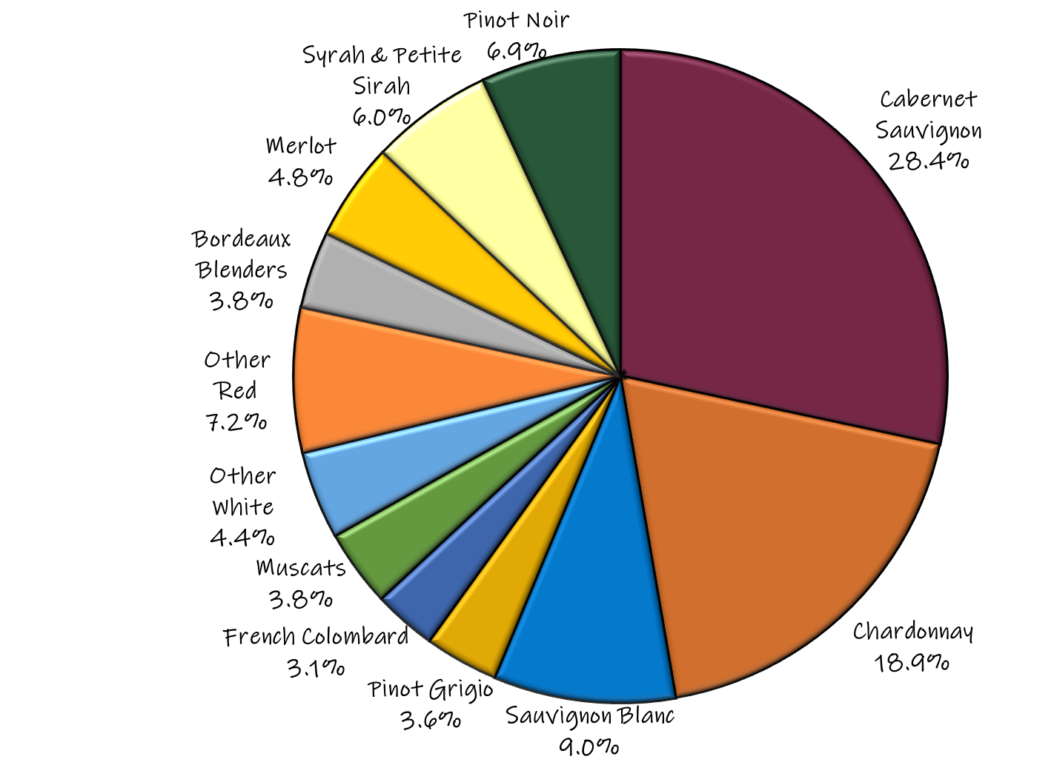
2023 Survey of
Grapevine Nurseries
11 nurseries
18 million vines sold
20,000 acres planted
Chart shows
percentage
of all vines sold,
by variety/category

Slide 20
2023 Survey of
Grapevine Nurseries
43% White, 57% Red
Cabernet Sauvignon and Chard still King & Queen
Pinot Noir pulls back significantly once again
Merlot, Syrah and Petite Sirah plantings continue to be relatively strong
SB planting increases significantly again, more than doubling in 2022

Slide 21
2022 Plantings as a percentage of bearing acres,
by variety
and category

Slide 22
Oregon
vineyard acreage, with
2022 planting estimates

Slide 23
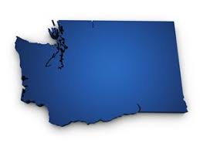
Washington
vineyard acreage, with
2022 planting estimates

Slide 24
Focus on California….

Slide 25
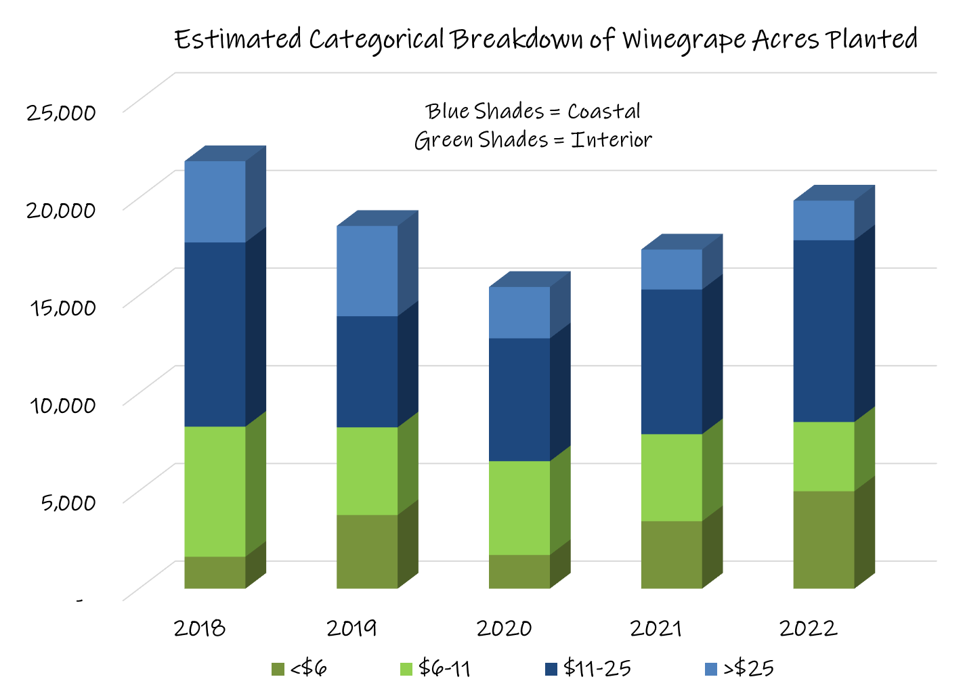
Retail bottle price segment

Slide 26
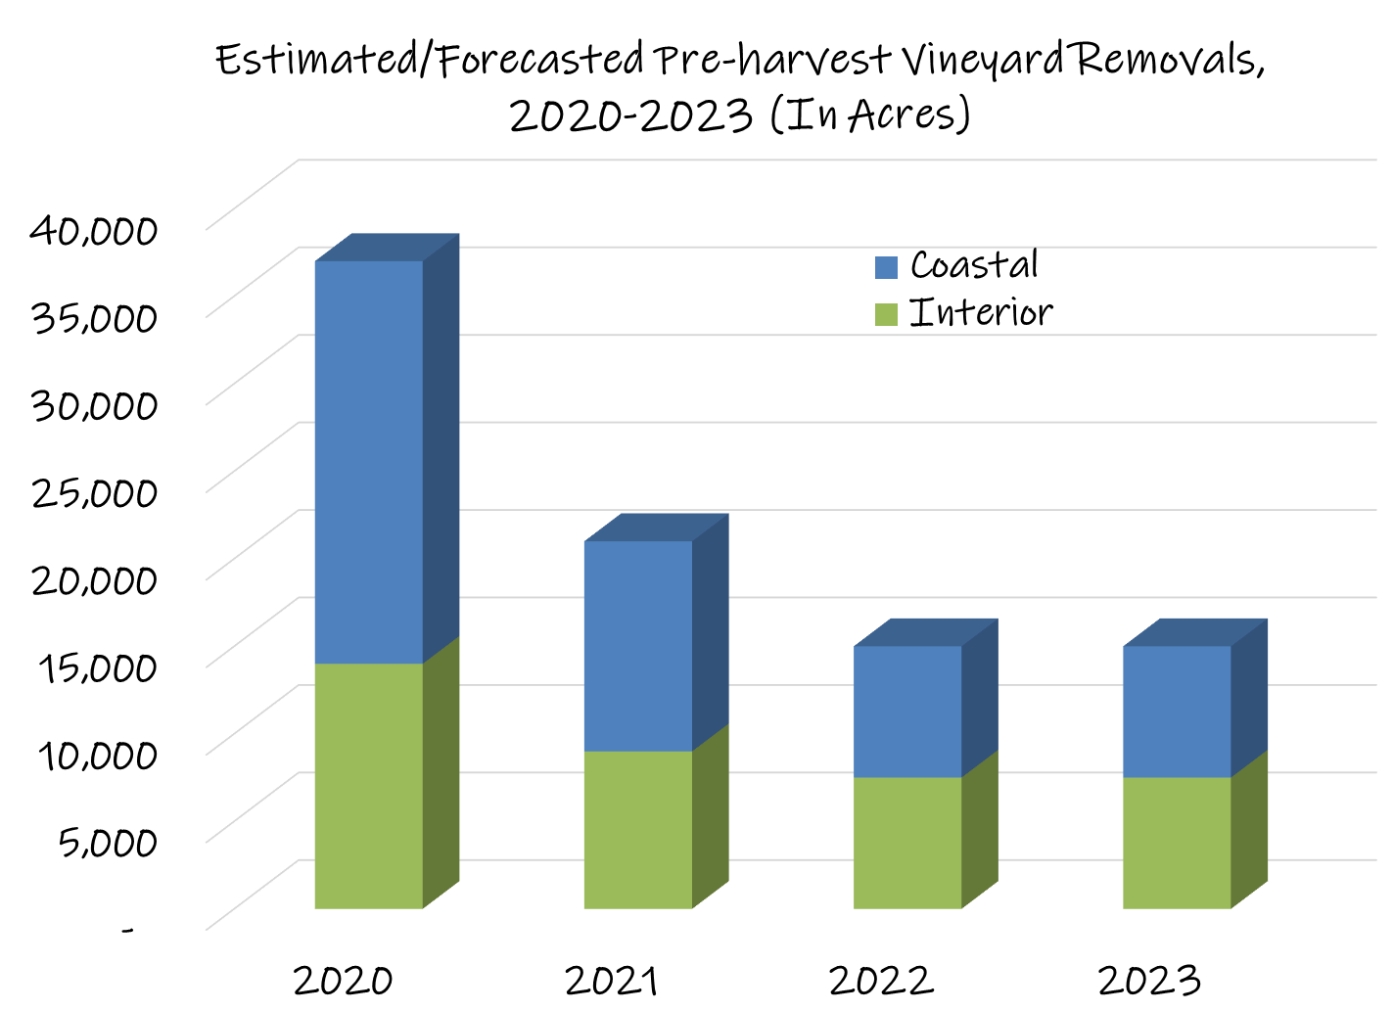

Slide 27
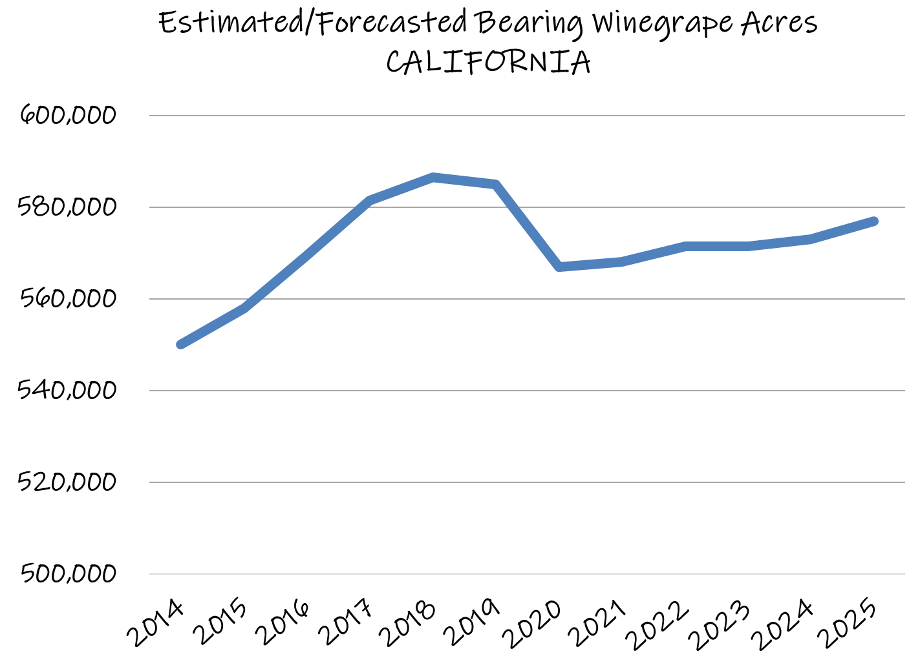
Three short crops offset reality that we aren’t in the range.
Bearing Acreage Target Range

Slide 28
California Production & Yield

Slide 29
Forecasted Bearing Acres,
by Variety and Price Point..….

Slide 30
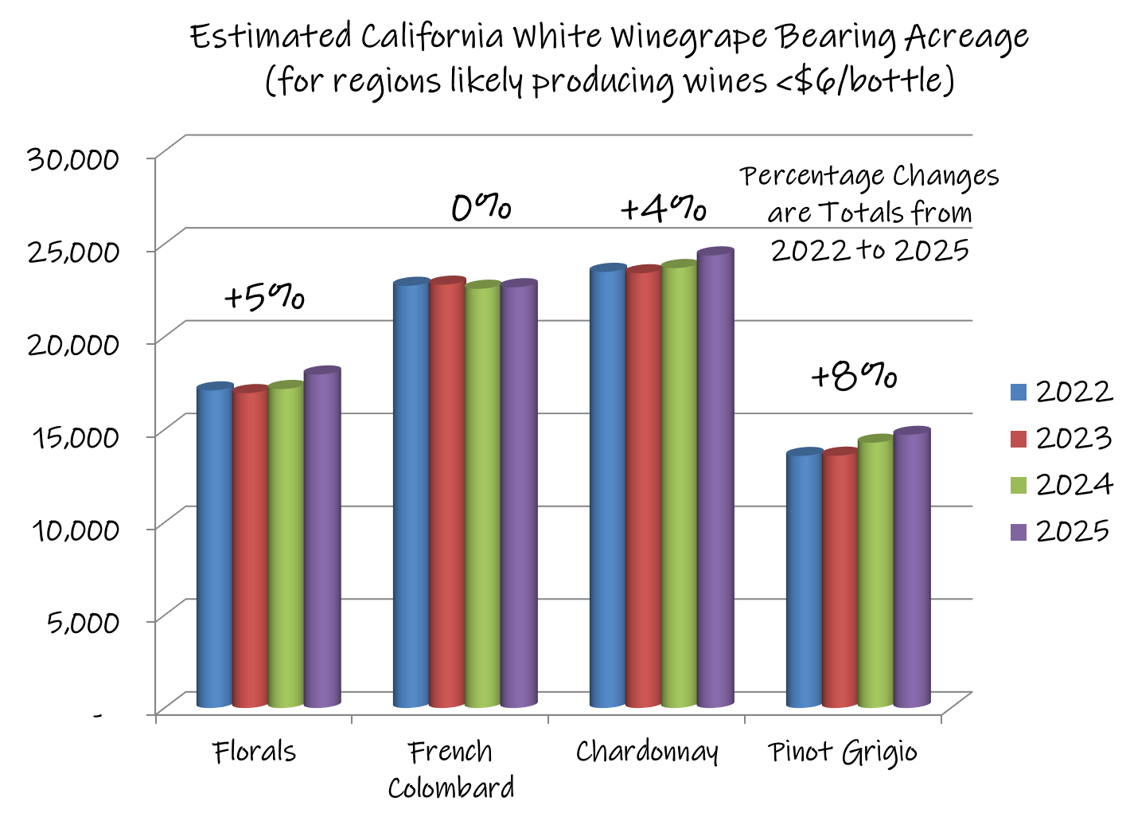

Slide 31
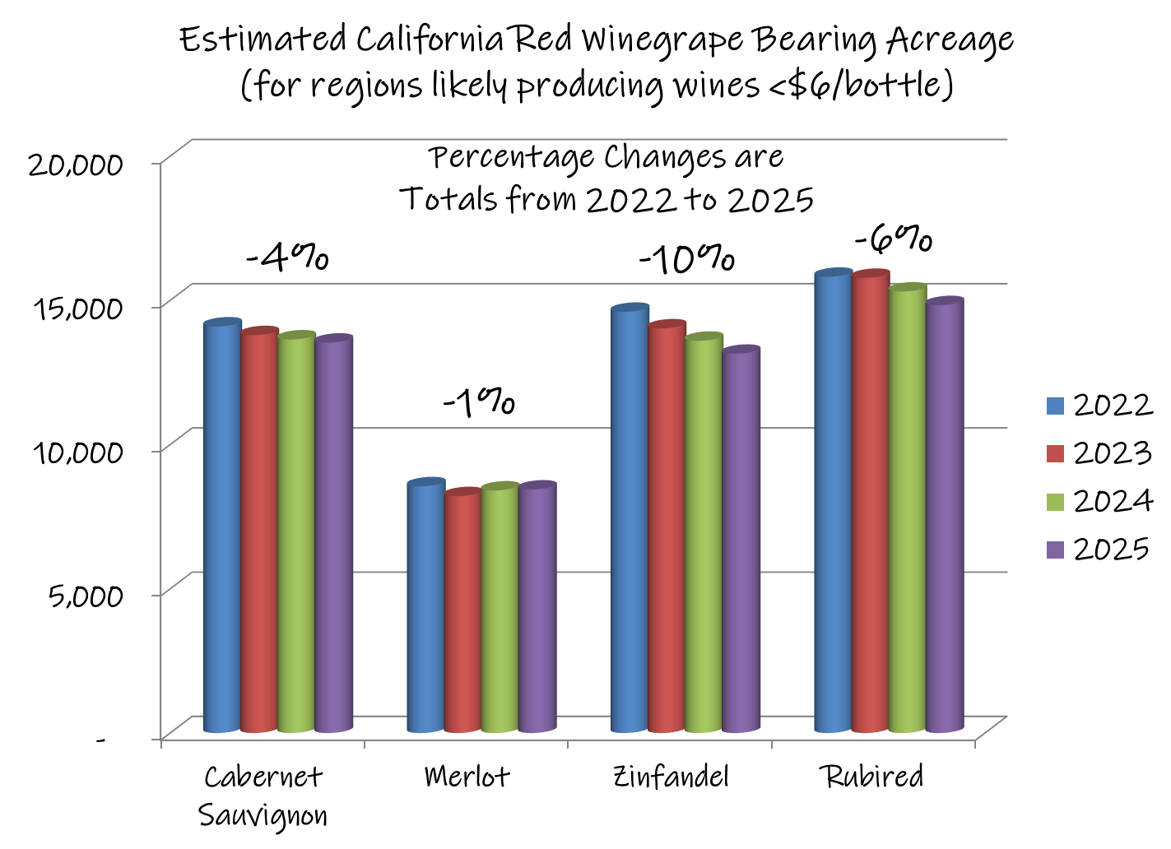

Slide 32
Comments and Considerations
For Regions Likely Producing Grapes for Wines <$6
Very few grapes available on spot market; supply mostly contracted
Development skews toward varieties that have above average production, are easily “mechanized” and likely to be harvested early
Market dynamics, water limitations and vineyard removal regulation will continue to encourage overall reductions in acreage
Opportunity comes from need for low-cost grapes, not from growth of wines <$6

Slide 33
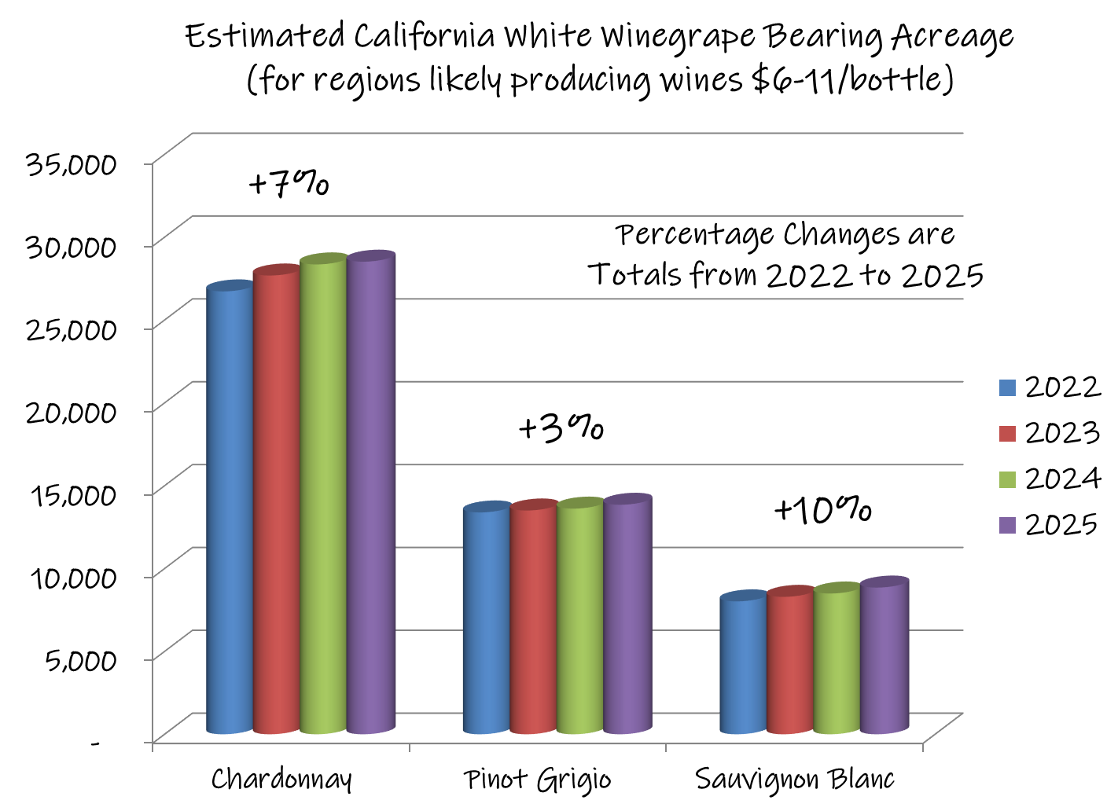

Slide 34
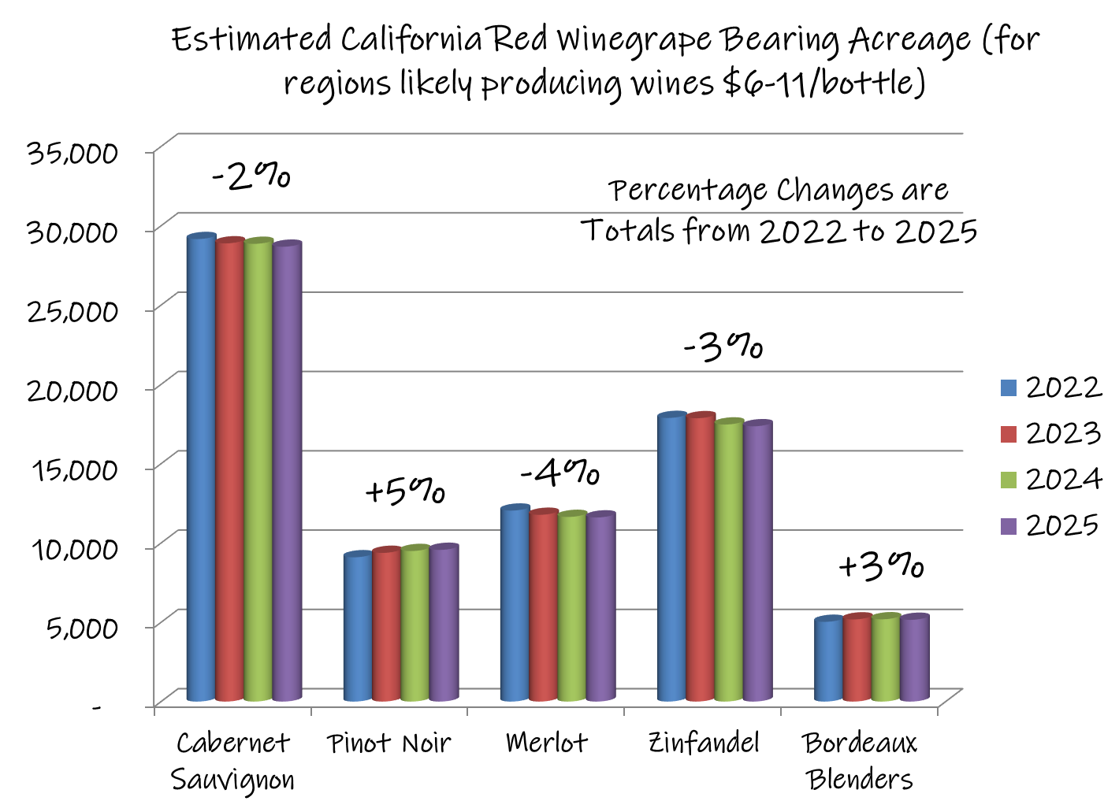

Slide 35
Comments and Considerations
For Regions Likely Producing Grapes for Wines $6-11
Some buyers adjusting inventory by selling grapes
Pressure to commoditize varietal grape production
Increasing opportunities to provide lower cost supply for wineries producing wines >$11
Gap is widening between grower and winery price expectations
  (Creates disagreements about “market value” of grapes)
Lack of re-investment persists amongst “traditional” growers

Slide 36
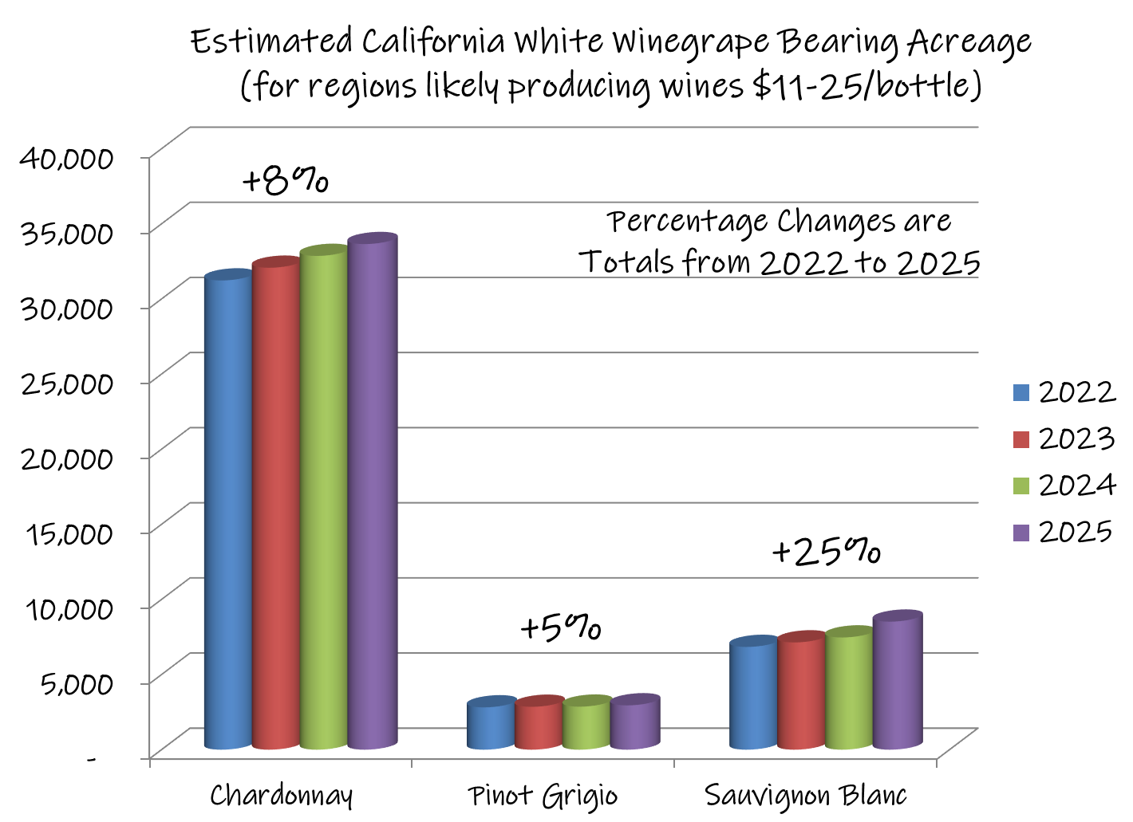

Slide 37
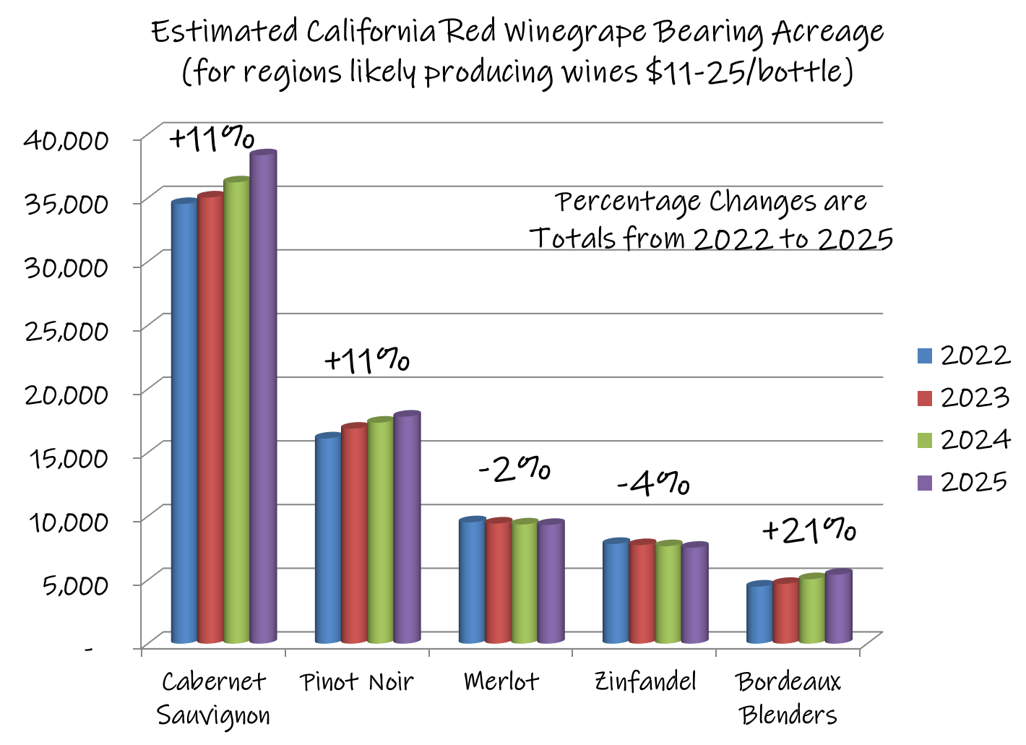

Slide 38
Comments and Considerations
For Regions Likely Producing Grapes for Wines $11-25
Continuing opportunities exist to provide lower cost supply for wineries producing wines >$25
Simultaneous growth in supply and demand can create imbalance, making for unpredictable markets
With Pinot Noir widely felt to be in oversupply, focus shifts back to Cabernet Sauvignon, Chardonnay and now Sauvignon Blanc
Vineyard expansion continues to be mostly tied to private investment money and wineries, but not independent growers

Slide 39
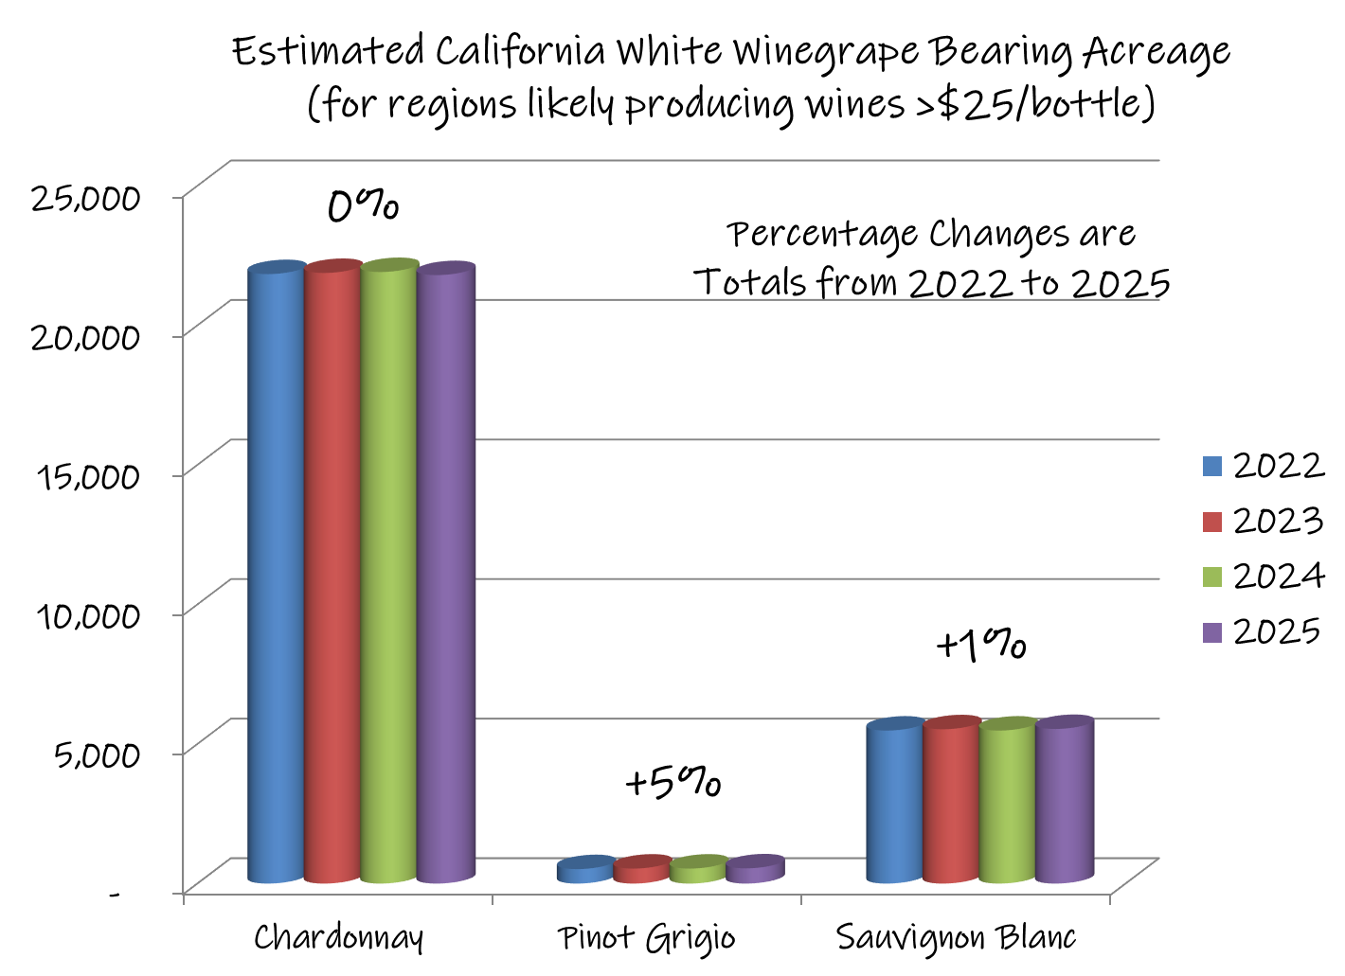

Slide 40
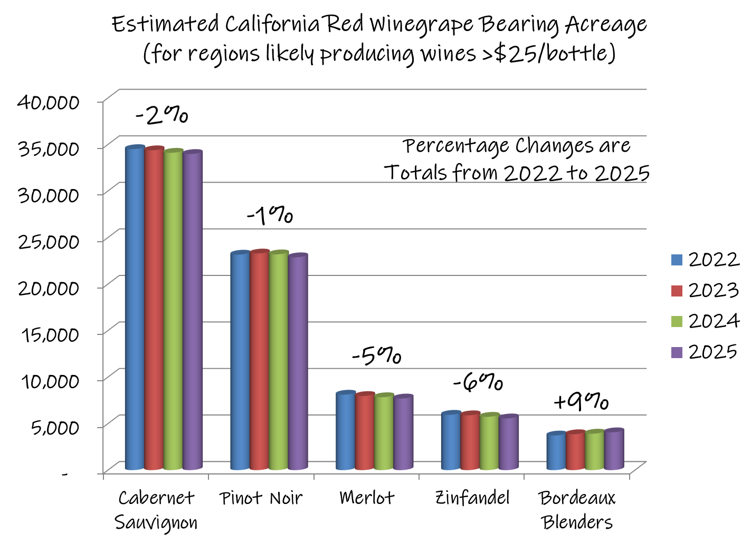

Slide 41
Comments and Considerations
For Regions Likely Producing Grapes for Wines >$25
AVA-based programs continue to move to “coastal” or even “California” due to rising grape cost and limited supply
Overall acreage will not be increasing; grape demand/pricing will be mostly driven by smaller, high-end programs/labels
Pressure for production to homogenize around a few key varieties within regions will continue – mostly shifting to reds
Drastic changes in the economy or stock market are of concern

Slide 42
Wrapping it up:
Conclusions & Cautions

Slide 43
In General…..
The winegrape market might be frustrating in 2023
  hot/cold, up/down, start/stop
“Apprehension” is currently tempering buyer response
Opportunities exist side-by-side with challenges
Planting remains moderate, concentrated in growth areas
An above-average crop can still cause market disruption
Any significant market disruption will likely spur vineyard removals

Slide 44
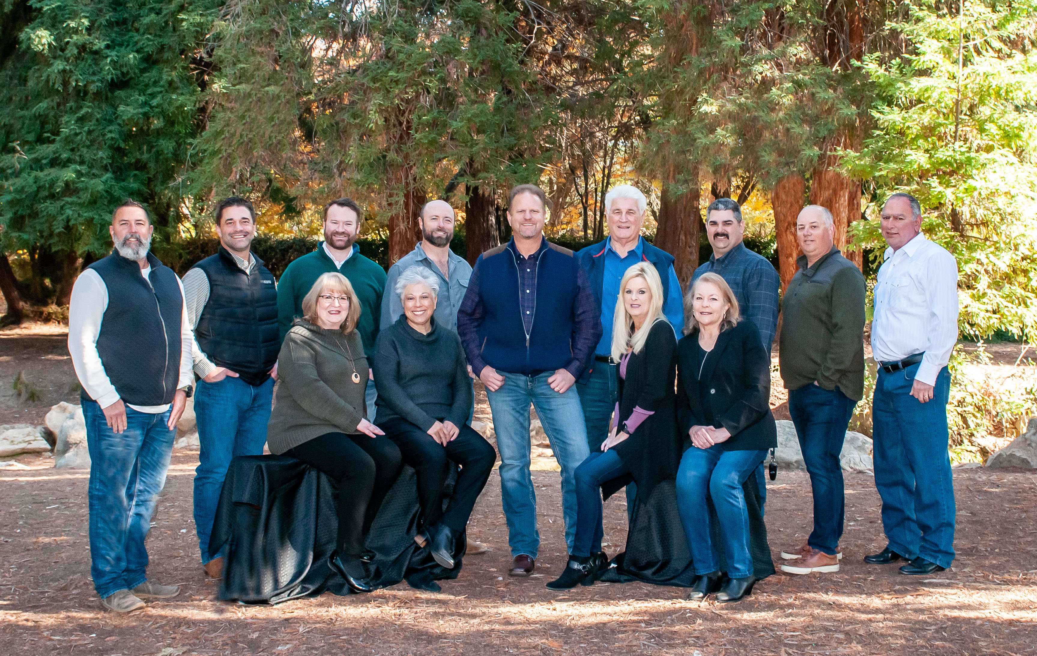

For more information,
visit us at booth 304…
Thank you!

