Slide 1
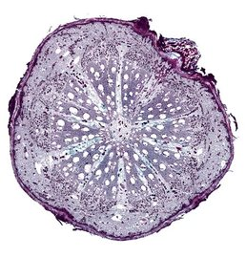
Turning Water Savings Into Wine: Adapting Grapevines to a Drier Future
Megan K. Bartlett
University of California, Davis
2023 Unified Symposium

Slide 2
Growers are facing increasing drought and limitations on irrigation
Most Western US vineyards are irrigated
Groundwater is becoming increasingly scarce and restricted
Climate change is expected to reduce snowpack and increase evaporative demand over the growing season
Can we adapt grape plant material to reduce dependence on irrigation?

Slide 3
Strategies to reduce irrigation demand
Increase capacity to extract the soil water reserves from winter rainfall and reduce dependence on supplemental irrigation over the growing season -> rootstock selection
Reduce canopy transpiration and water requirements -> altering scion traits
Atmosphere
Transpiration
Plant
Uptake
Soil

Slide 4
Root system architecture: steep, deep, and cheap?
Improve exploration of deeper, wetter soil layers by investing in vertical root structure – less lateral root proliferation at the surface
‘Cheap’ roots facilitate rapid growth –how will these roots deal with soil hardened by drought and compaction?
Smart 2006 AJEV 57: 89 – 104, Correa 20019 JXB 70: 6019 - 34

Slide 5
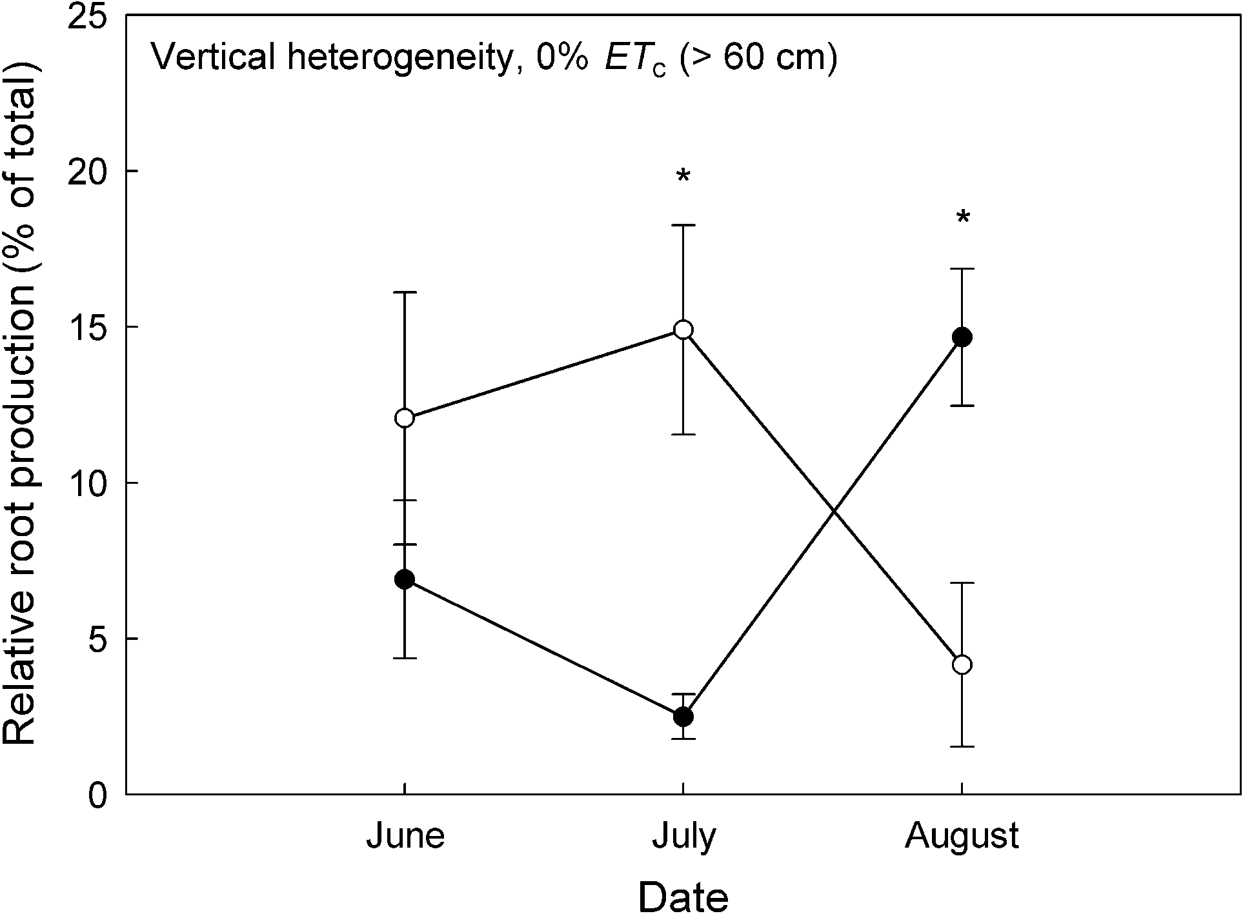
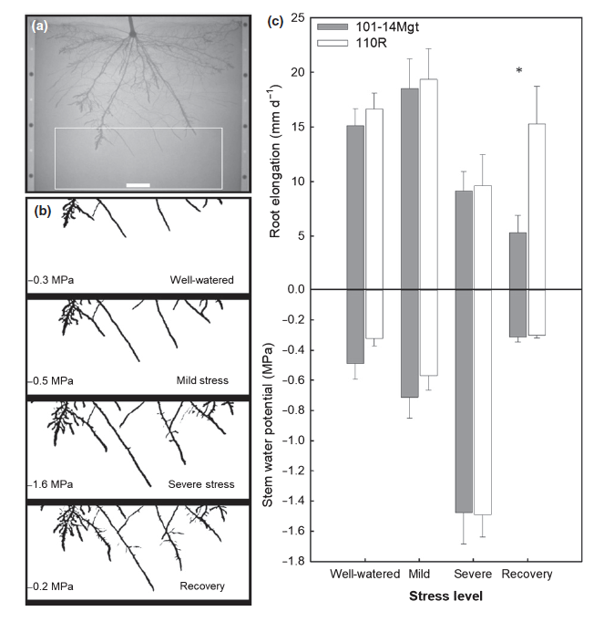
Root growth: targeting the optimal time and place
Root growth is most limited after veraison, when water stress is often worst
Drought tolerant rootstocks have proportionally more growth at depth, especially after veraison
Use rapid pulses of growth after irrigation to capture new water resources
1103P
% growth below 2 ft
101-14
Jun
Jul
Aug
Alsina 2011 JXB 62: 99-109, Baurle 2008 New Phytol 179: 857-66, Cuneo 2021 New Phytol 229:272-83

Slide 6
Root hydraulics: maintaining water uptake from drying soil
All water taken up from the soil must cross a narrow band of living cells – what cellular traits allow roots to extract more water from drying soil?
Maintaining greater activity of water transport proteins (aquaporins)
Maintaining spatial connectivity at the soil/root interface
Bartlett 2022 AOB 129:389-402, Gambetta 2017 Plant Aquaporins

Slide 7
Ongoing work in adapting rootstocks for drought tolerance
Parsing control of rootstock traits between genetics and environment
Clarifying root/scion interactions
Identifying genetic markers for drought tolerance traits to accelerate rootstock breeding

Slide 8
Water-saving scion traits
Stomata directly regulate gas exchange -> transpiration & photosynthesis
Downstream impacts on fruit development and water use efficiency
Water stress
Photosynthesis
Transpiration
Yield
Water use efficiency
Quality

Slide 9
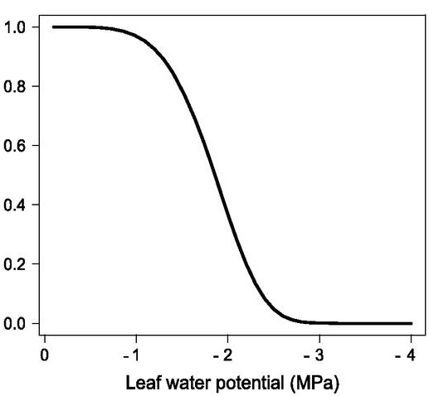
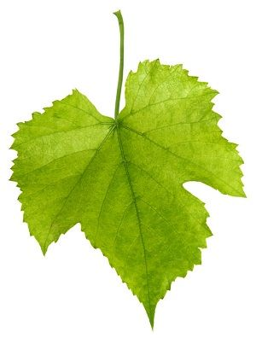
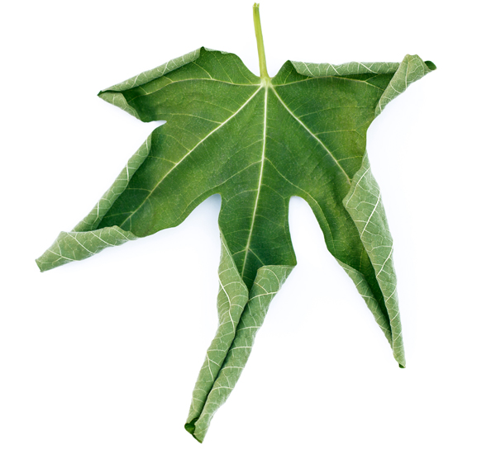
Stomatal traits capture transpiration responses to water stress
Stomatal traits characterize the relationship between stomatal conductance (g_{s}) and leaf water stress (𝚿_{L})
  g_{max}: maximum stomatal conductance
  g_{s} 𝚿₅₀: leaf water potential inducing 50% stomatal closure -> stomatal sensitivity to water stress
Would grapevines benefit from water-saving stomatal traits under hot, dry conditions?
g_{max}
Stomatal conductance (mol m⁻² s⁻¹)
g_{s} 𝚿₅₀

Slide 10
Cultivars grown in hotter, drier regions have water-saving stomatal traits
Maximum stomatal conductance is lower in cultivars grown in regions with a greater vapor pressure deficit (VPD)
Extends soil water resources longer into the growing season
Is this also true under future conditions?
Bartlett & Sinclair 2021 JXB 72: 1995-2009

Slide 11
Modeling effects of stomatal traits under future conditions
Traits
Regions
Climate scenarios
Risky
Average
Safe

Slide 12
Water-saving stomatal traits reduced water stress and improved water use efficiency
Risky
Average
Safe
Napa - Future
SJV - Future
Transpiration (L h⁻¹)
Leaf Water Potential (MPa)
Risky
Average
Safe
Risky
Average
Safe
Transpiration
Photosynthesis

Slide 13
Potential benefits of water-saving stomatal traits for fruit yield and quality
Reducing g_{s} to conserve soil water and prevent strong declines in canopy water potential could maintain larger berry sizes and avoid excessive sugar concentrations
Limiting water stress could also reduce leaf wilting and shedding
  Improve shading and reduce degradation of acids & anthocyanins
Keller 2015 PCE 38:1048-59, Martínez-Lüscher 2020 Front Plant Sci 10.3389

Slide 14
Limitations on selection for water-saving stomatal traits
Could minor declines in carbon gain prevent fruit from reaching target Brix in high-production regions?
  Yield targets can be 10x higher
Comparing mean to extreme future conditions -> would water-saving behavior put grapevines at a disadvantage under severe heatwaves?

Slide 15
Approaches to select for stomatal traits
Genetic markers identified to support breeding for stomatal traits, but there is little demand for new cultivars
Genetic engineering provides an approach to specifically target stomatal traits and avoid changing the genes directly regulating ripening -> suitable for any sectors of the wine industry?

Slide 16
Conclusions
Research has identified a wide range of traits that could reduce irrigation demand by improving rootstock capacity for soil water extraction and reducing canopy transpiration
We need more information on how the traits impact fruit development and respond to the abiotic and biotic environment
Identifying the genetic basis of these traits would unlock technologies that could rapidly accelerate the development of new plant material

Slide 17

Acknowledgements
Bartlett Lab: Gabriela Sinclair, Gabriela Fontanesi, Gianna Disco
Andrew McElrone, Andy Walker, Thorsten Knipfer, Clarissa Reyes, Rami Albasha
UC Davis Department of Viticulture & Enology
Louise & Ray Rossi Foundation
California Department of Food & Agriculture
American Vineyard Foundation
Title photo: Lodi Growers

