Slide 1
Exploring Rose Taint in Washington State Cabernet Sauvignon
Scott Frost
Danni Fox
Tom Collins
Markus Keller
Jim Harbertson
Notes:
HI my name is Scott Frost, and I will be presenting reserach that ...

Slide 2
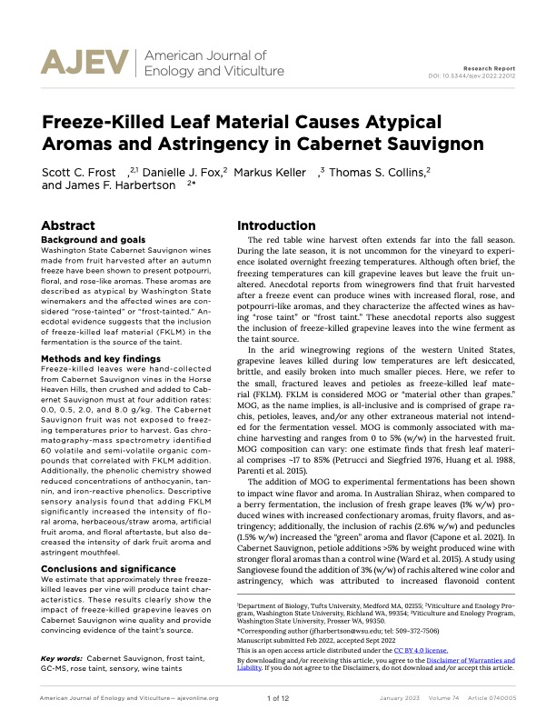

Slide 3
Wine Faults and Taints
Faults – Off aromas and/or tastes that are related to fermentation or the winemaking process
Taints - Off aromas, taste, and/or aftertastes that originate from foreign or external sources.

Slide 4
Wine Faults and Taints
Faults – Off aromas and/or tastes that are related to fermentation or the winemaking process
Reductive faults
Sulfides
Disulfide
Dimethyl sulfide
Oxidation faults
Acetaldehyde
Volatile acidity (VA)
Ethyl acetate
Microbiological faults
Dekkera/Brettanomyces yeast
Acidic acid bacteria

Slide 5
Wine Faults and Taints
Taints - Off aromas, taste, and/or aftertastes that originate from foreign or external sources.
Cork Taint
2,4,6-trichloroanisole
  Incredibly intense
  consumer detection threshold 1 - 2 ng/L
“Cork taint” responsible compounds. Determination of haloanisoles and halophenols in cork matrix: A review. Tarasov et al. Tantala, v175, 2017, 82-92.

Slide 6
Wine Faults and Taints
Taints - Off aromas, taste, and/or aftertastes that originate from foreign or external sources.
Smoke Taint
Smoke exposure
Aroma and taste of ash/smoke
Yountville, CA

Slide 7
Rose Taint?
Cabernet Sauvignon harvested after freezing temperatures presents a wine with floral, rose, and potpourri like aromas
Aromas are atypical and problematic
Suggested cause - terpenes/ norisoprenoids generated by different plant tissues.
  Leaves, petioles, grape skin, grape pulp
Leaves are likely … fruit is typically mechanically harvested and brittle frozen leaves stick to cold fruit
Notes:
Major early season freeze in 2011 and 2017 --- not a major concern, but relevant!!

Slide 8
Rose Taint
Also called “frost” taint or leaf taint.
The dead leaf matter is primarily introduced via machine harvesting

Slide 9
Freeze Kills!
Rose Taint
Atypical aromas from wines produced after a freeze in the vineyard
  Floral, rose, potpourri
Cabernet Sauvignon is primarily afflicted
Masks varietal character
Its though freeze killed leaves are the taint source
Notes:
2019 was a special year!!
WA was hit with back to back frost in late September and Early October.
Informal estimate by industry members found
800,000 gallons of wine in tank and ~25,000 tons of fruit that was unharvested.
In 2018 ~74,000 tons was harvested
~40% of the harvest was left on the vine.
The state declared an emergency with allowed insurance claims to be paid.

Slide 11
Project Workflow
Experimental Questions –
Does the addition of freeze killed leaf material alter sensory profile of Cabernet Sauvignon?
Can we identify causal chemistry?
Produce Cabernet Sauvignon wine with controlled additions of freeze killed leaf material
Headspace
Solid Phase Micro Extraction
Gas Chromatography
Mass Spectrometry
HS-SPME-GC-MS
Descriptive Sensory

Slide 12
COLLECTION OF FREEZE KILLED LEAVES
~3 kg of dried leaves
Leaves smelled like
hay or alfalfa.
Did not smell floral, but somewhat potpourri-like
Notes:
Leaves were hand collected from Austin Sharp Vineyard in Alderdale, WA om October 21. --- DO WE KNOW WHEN THE FREEZE HIT AND KILLED THESE LEAVES?

Slide 13
Experimental Design
0.0 g FKLM per kg must
n=3 for each Treatment & Control
EC118 & VP41 co-inoculation
10 Days Skin Contact
136 kg/TJ ~ 140 L of must
0.5 g FKLM per kg must
2.0 g FKLM per kg must
8.0 g FKLM per kg must
Rep 1
Rep 2
Rep 3
Notes:
Fruit was harvested seven days after the collection of the Freeze killed leaf matter. ~1900 kg of cabernet was machine harvested from the Cold Creek Vineyard in Columbia Valley American Viticultural Area. Fruit was crushed destemmed and equally filled in to 12 stainless-steel TJ fermenters. 136 kg/TJ ~ 140L of must into each TJ. The average Brix across the 12 fermenters was 28.6, this was then adjusted to 25.0 Brix by watering back with 5 g/L tartaric acid solution

Slide 14
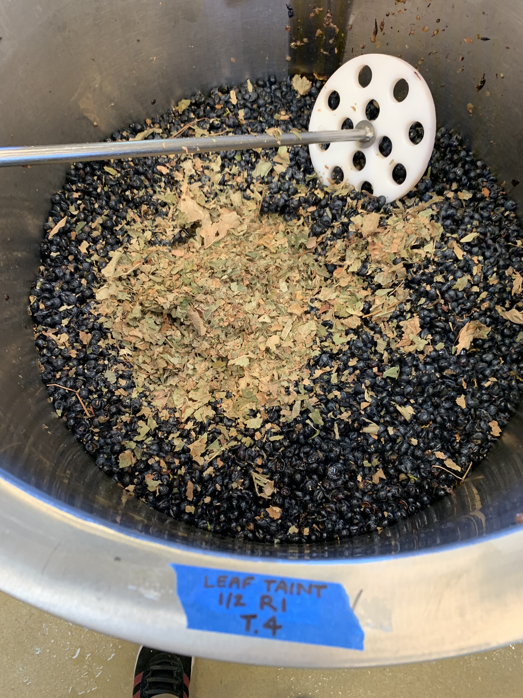
Experimental Design
0.0 g FKLM per kg must
68 g of FKLM
0.5 g FKLM per kg must
2.0 g FKLM per kg must
8.0 g FKLM per kg must
Rep 1
Rep 2
Rep 3
Notes:
Fruit was harvested seven days after the collection of the Freeze killed leaf matter. ~1900 kg of cabernet was machine harvested from the Cold Creek Vineyard in Columbia Valley American Viticultural Area. Fruit was crushed destemmed and equally filled in to 12 stainless-steel TJ fermenters. 140L of must into each TJ. The average Brix across the 12 fermenters was 28.6, this was then adjusted to 25.0 Brix by watering back with 5 g/L tartaric acid solution

Slide 15
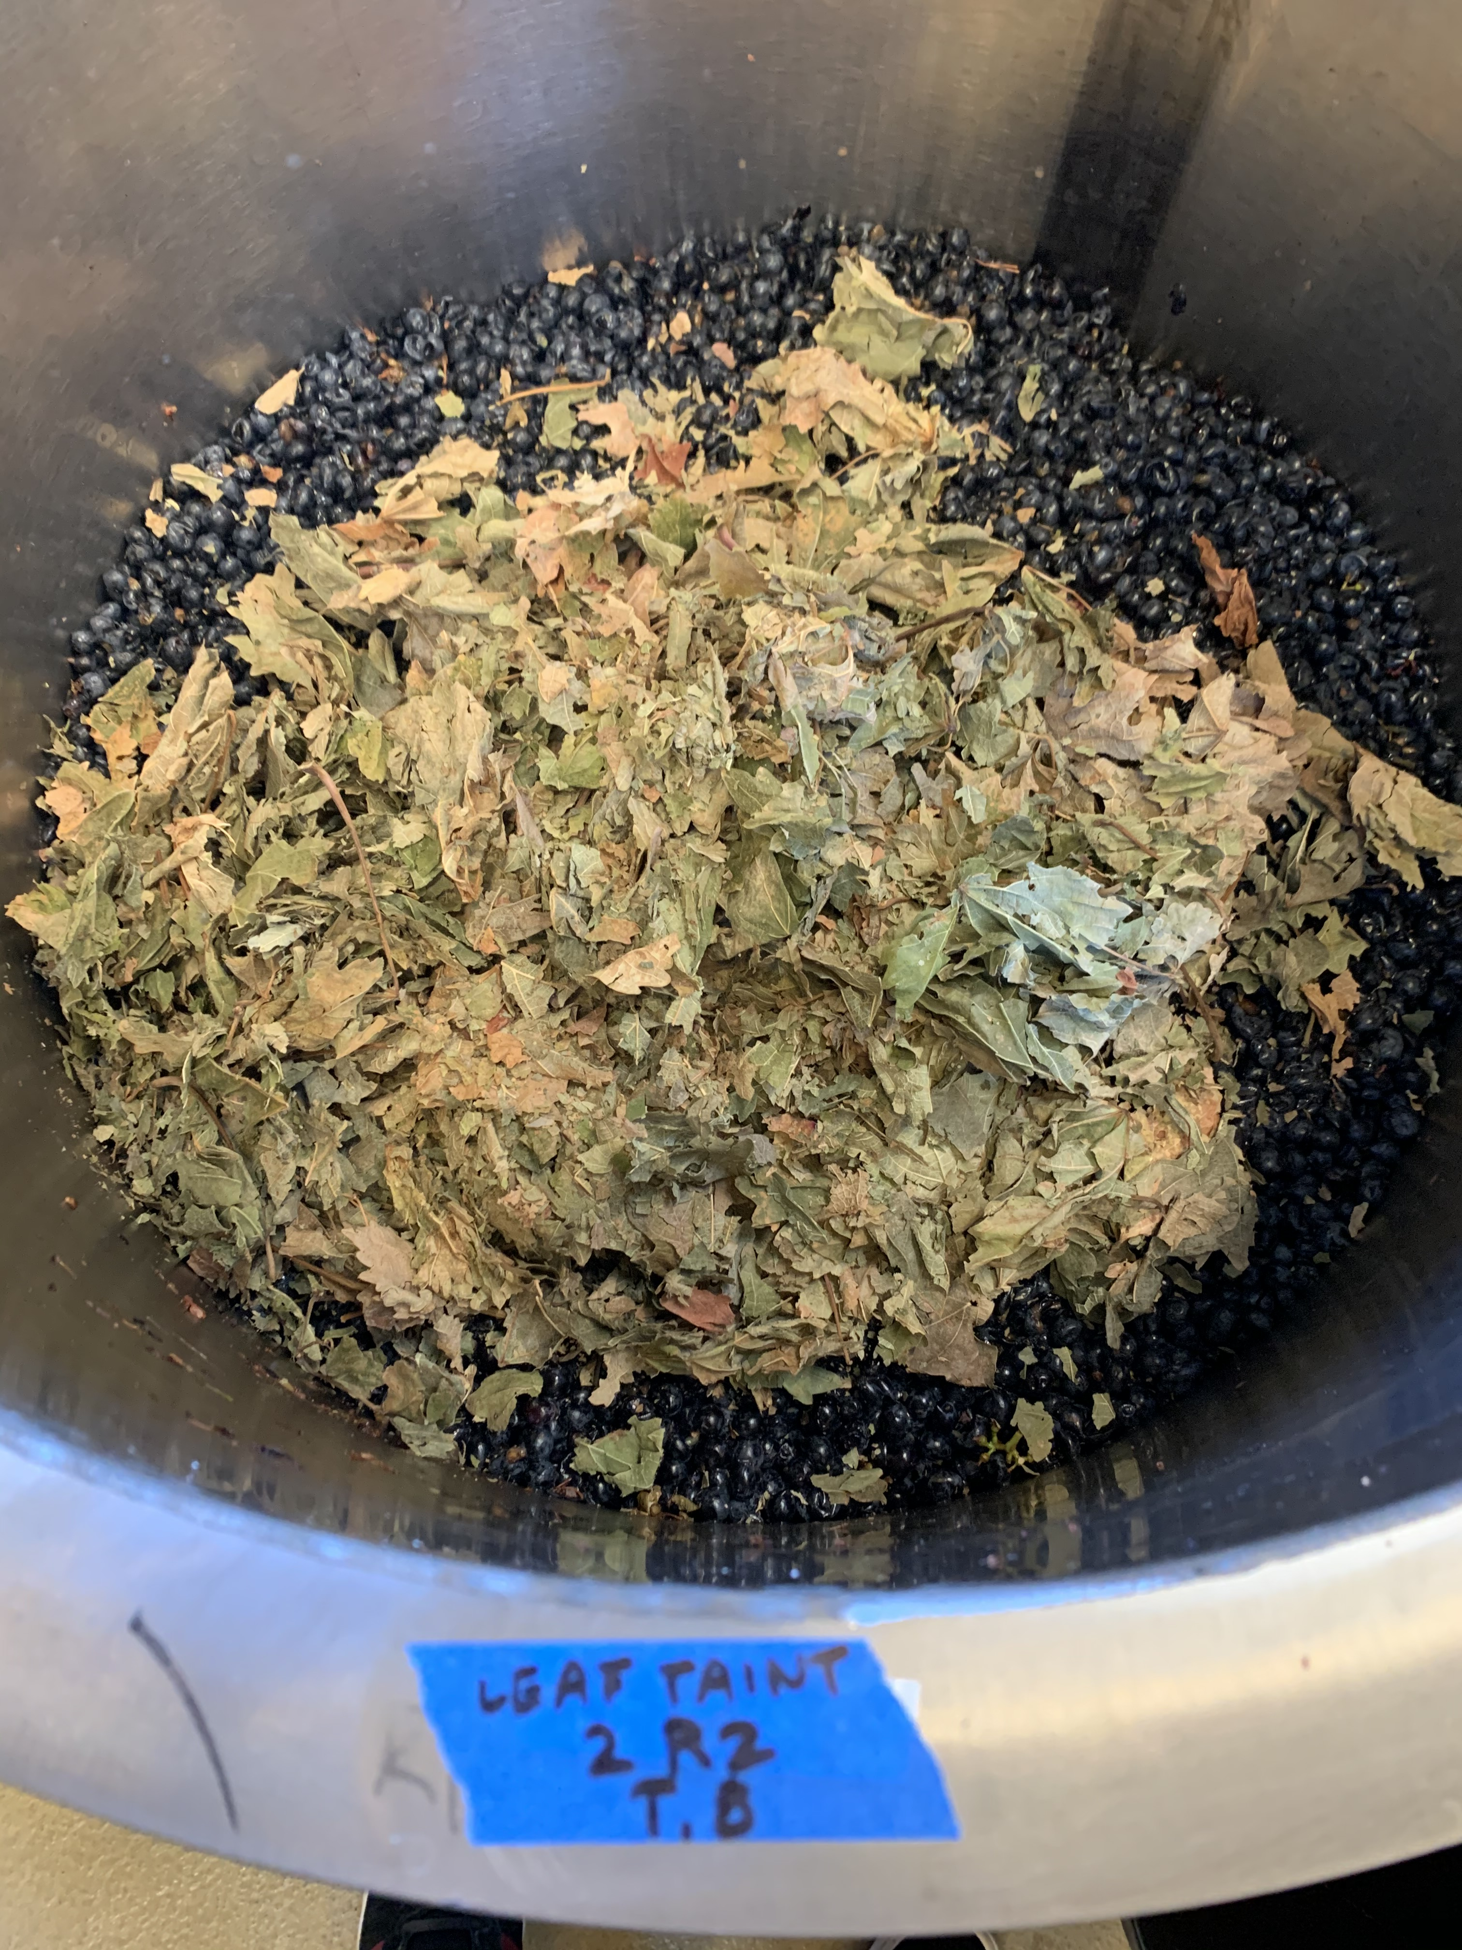
Experimental Design
0.0 g FKLM per kg must
272 g of FKLM
0.5 g FKLM per kg must
2.0 g FKLM per kg must
8.0 g FKLM per kg must
Rep 1
Rep 2
Rep 3
Notes:
Fruit was harvested seven days after the collection of the Freeze killed leaf matter. ~1900 kg of cabernet was machine harvested from the Cold Creek Vineyard in Columbia Valley American Viticultural Area. Fruit was crushed destemmed and equally filled in to 12 stainless-steel TJ fermenters. 140L of must into each TJ. The average Brix across the 12 fermenters was 28.6, this was then adjusted to 25.0 Brix by watering back with 5 g/L tartaric acid solution

Slide 16
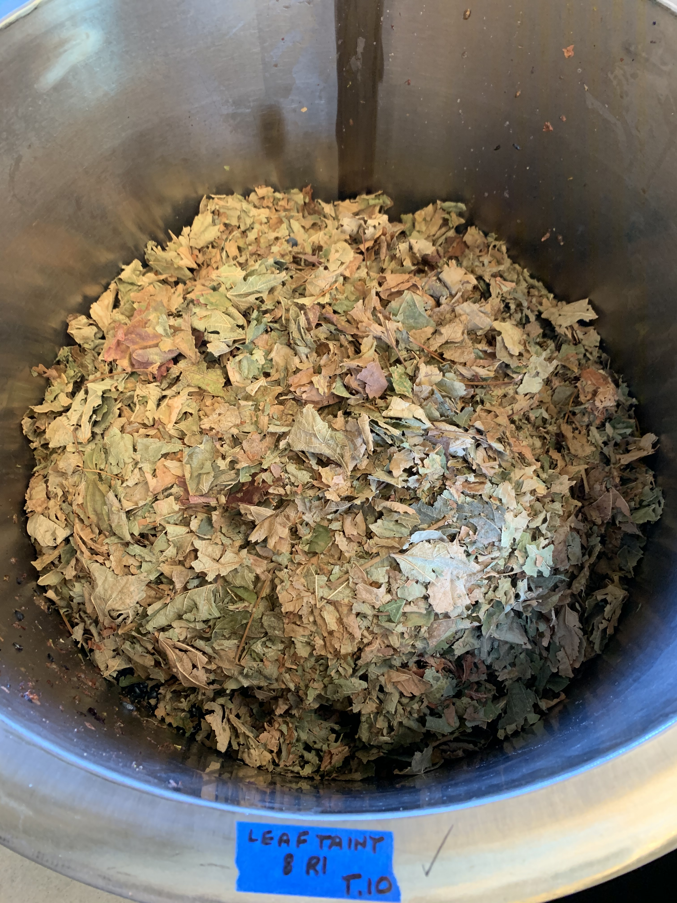
Experimental Design
0.0 g FKLM per kg must
1089 g of FKLM
0.5 g FKLM per kg must
2.0 g FKLM per kg must
8.0 g FKLM per kg must
Rep 1
Rep 2
Rep 3
Notes:
Fruit was harvested seven days after the collection of the Freeze killed leaf matter. ~1900 kg of cabernet was machine harvested from the Cold Creek Vineyard in Columbia Valley American Viticultural Area. Fruit was crushed destemmed and equally filled in to 12 stainless-steel TJ fermenters. 140L of must into each TJ. The average Brix across the 12 fermenters was 28.6, this was then adjusted to 25.0 Brix by watering back with 5 g/L tartaric acid solution

Slide 17
Wine Chemistry
 | pH | TA (g/L) | Malic (g/L) | Lactic (g/L) | VA (g/L) | RS (g/L) | Alcohol % (v/v)
Control | 3.68 | 6.23 | 0.04 | 1.13 | 0.14 | 0.13 | 14.01
Low (0.5 g/kg must) | 3.55 | 7.19 | 0.04 | 1.11 | 0.13 | 0.13 | 13.77
Medium (2 g/kg must) | 3.60 | 6.95 | 0.05 | 1.02 | 0.14 | 0.13 | 14.11
High (8 mg/kg must) | 3.56 | 7.07 | 0.04 | 1.02 | 0.16 | 0.13 | 14.21
Notes:
The final wines had

Slide 18
Descriptive Analysis
Method Summary
Panel of 13 judges
Each of the 12 wines evaluated in triplicate
21 Attribute were assessed
Notes:
The DA was completed in March of 2020

Slide 19
Sensory Attributes
Dark Fruit
Red Fruit
Dried Fruit
Stone Fruit
Artificial Fruit
Tropical Fruit
Citrus
Floral Aroma
Herbaceous/Straw
Baking Spice
Fresh Green Veg
Black Pepper
Sulfurous
Cooked Veg
Oxidized
Sweet
Sour
Hot
Bitter
Astringent
Floral Aftertaste
Notes:
21 taste and aroma attributes 13

Slide 20
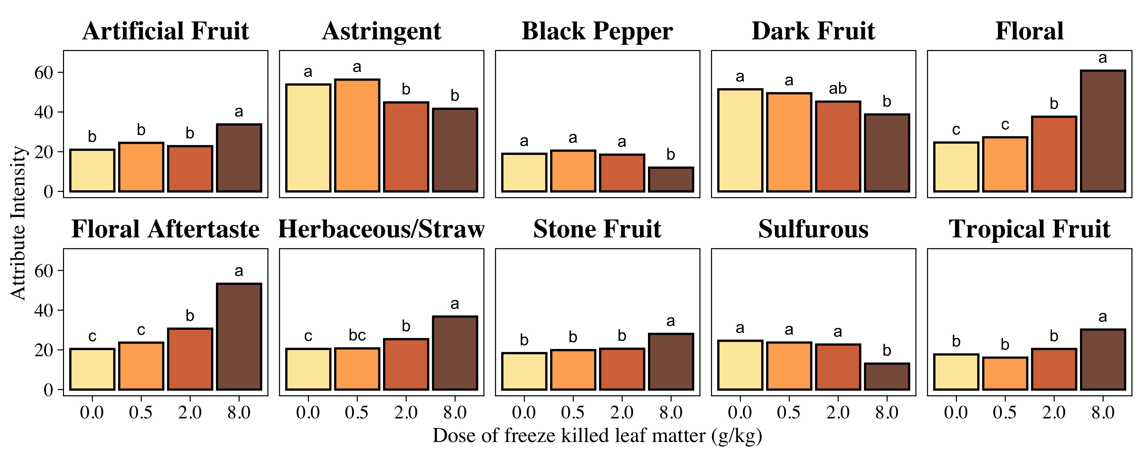
Descriptive Results
No difference between 0.0 g/kg dose and 0.5 g/kg dose for any attribute
Increase in floral, floral aftertaste, herbaceous/straw, and reduction in the Cabernet Sauvignon varietal character!!
Notes:
Fixed effect ANOVA with the fermentation replicates nested within the treatment effect.
Letters indicated significant post hoc testing Tukey HSD
Identical letters – no difference
Of the 21 attributes – 10 were found to significantly vary by treatment.
We begin to see a strong treatment effect at ~2.0 g/kg

Slide 21
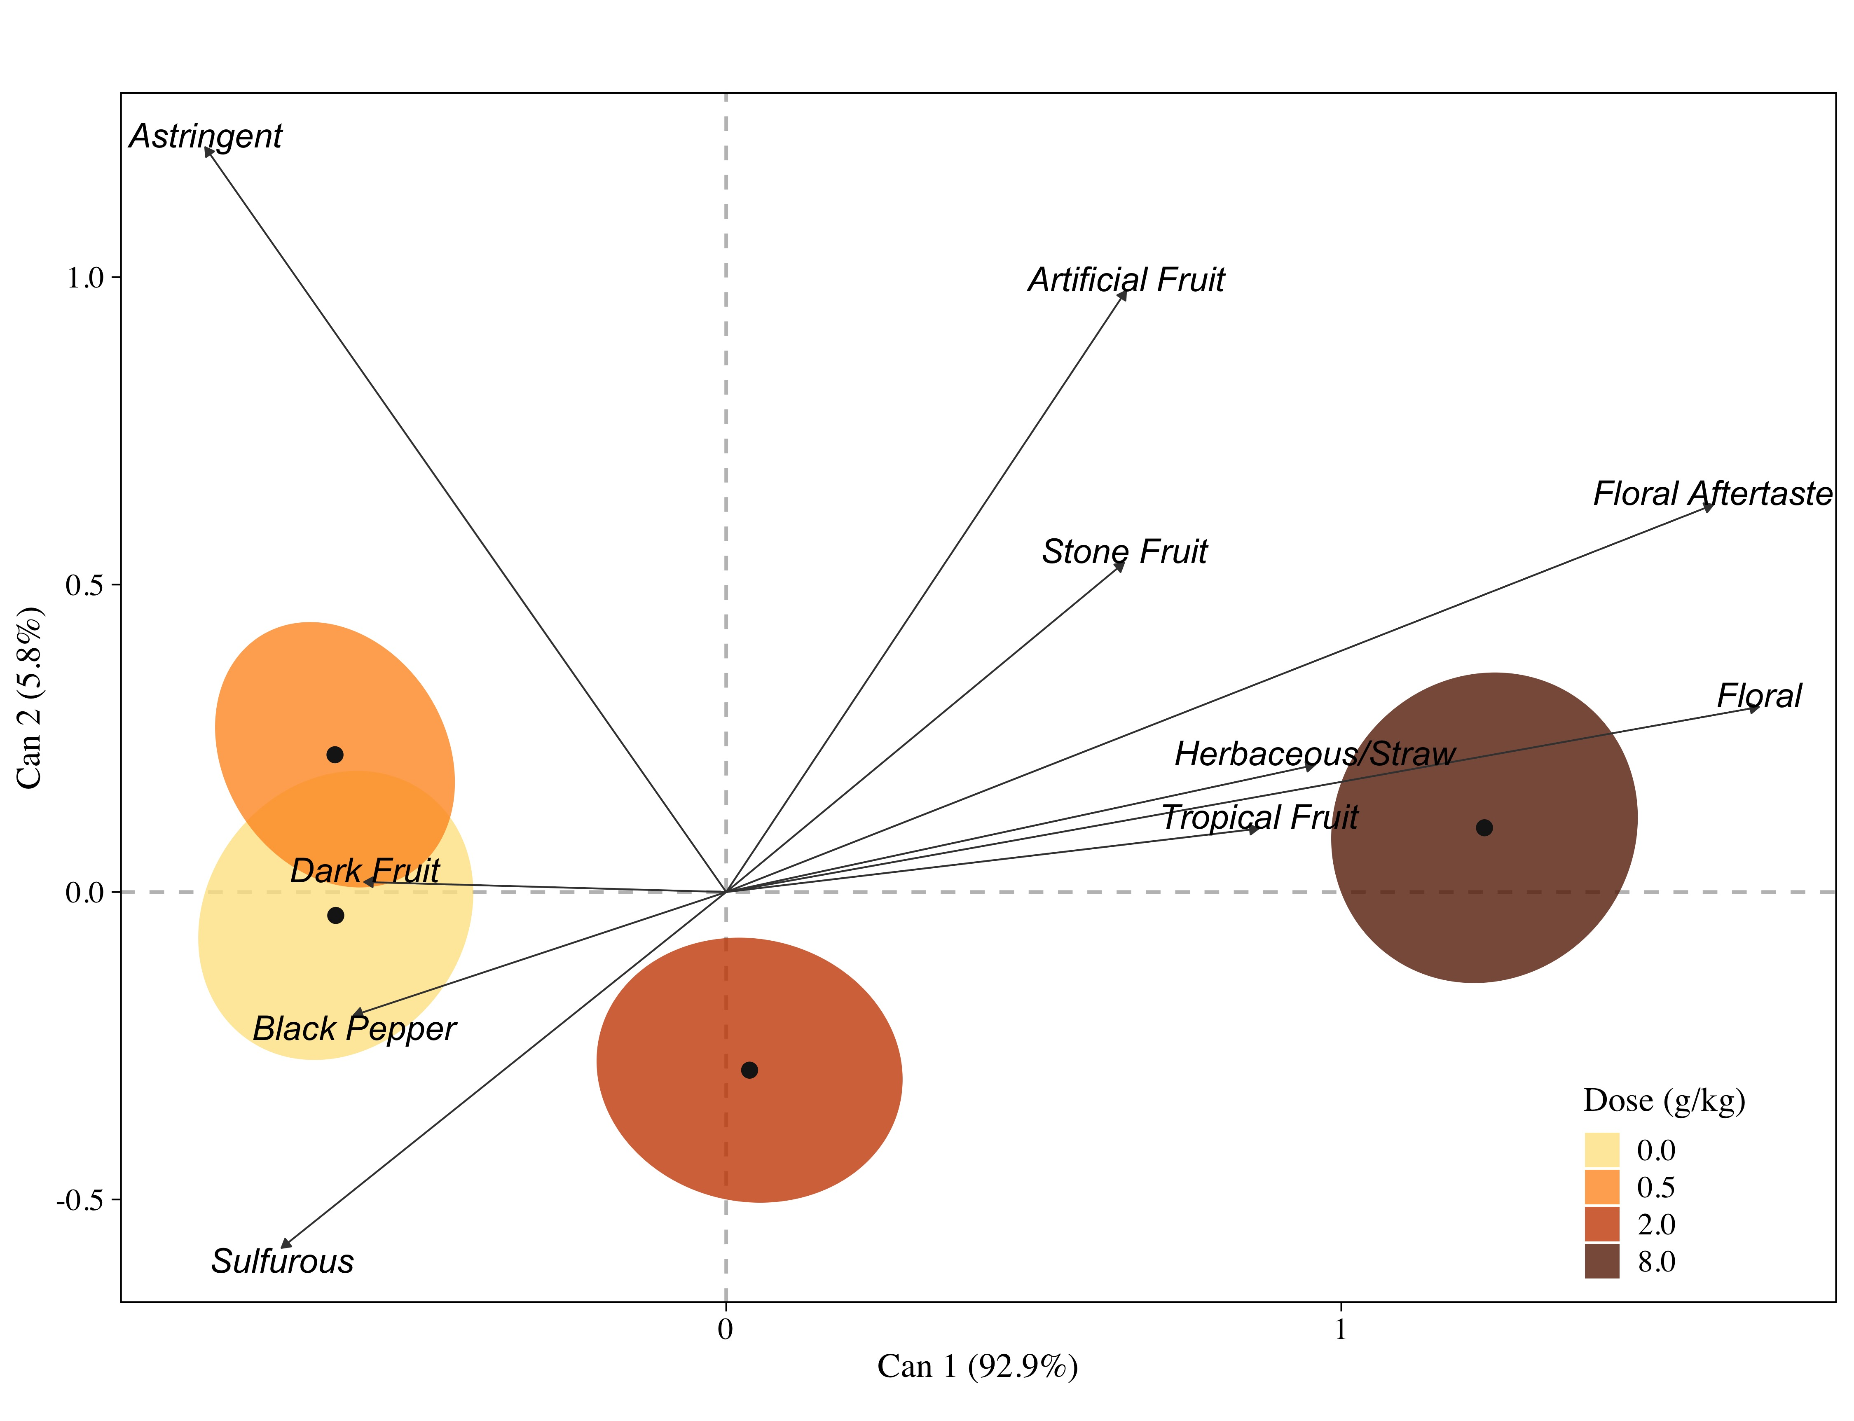
Descriptive Results – Canonical Variate Analysis
No difference between 0.0 and 0.5 g/kg Dose
Loss of varietal character in the 8.0 g/kg Dose
Floral, floral aftertaste, herbaceous straw
Lack of astringency
Notes:
We visualize the descriptive results using Canonical Variate Analysis. The analysis captures 98.7 % of the variation within Canonical 1 and 2.
We see a strong treatment effect at 2.0 g/kg Dose

Slide 22
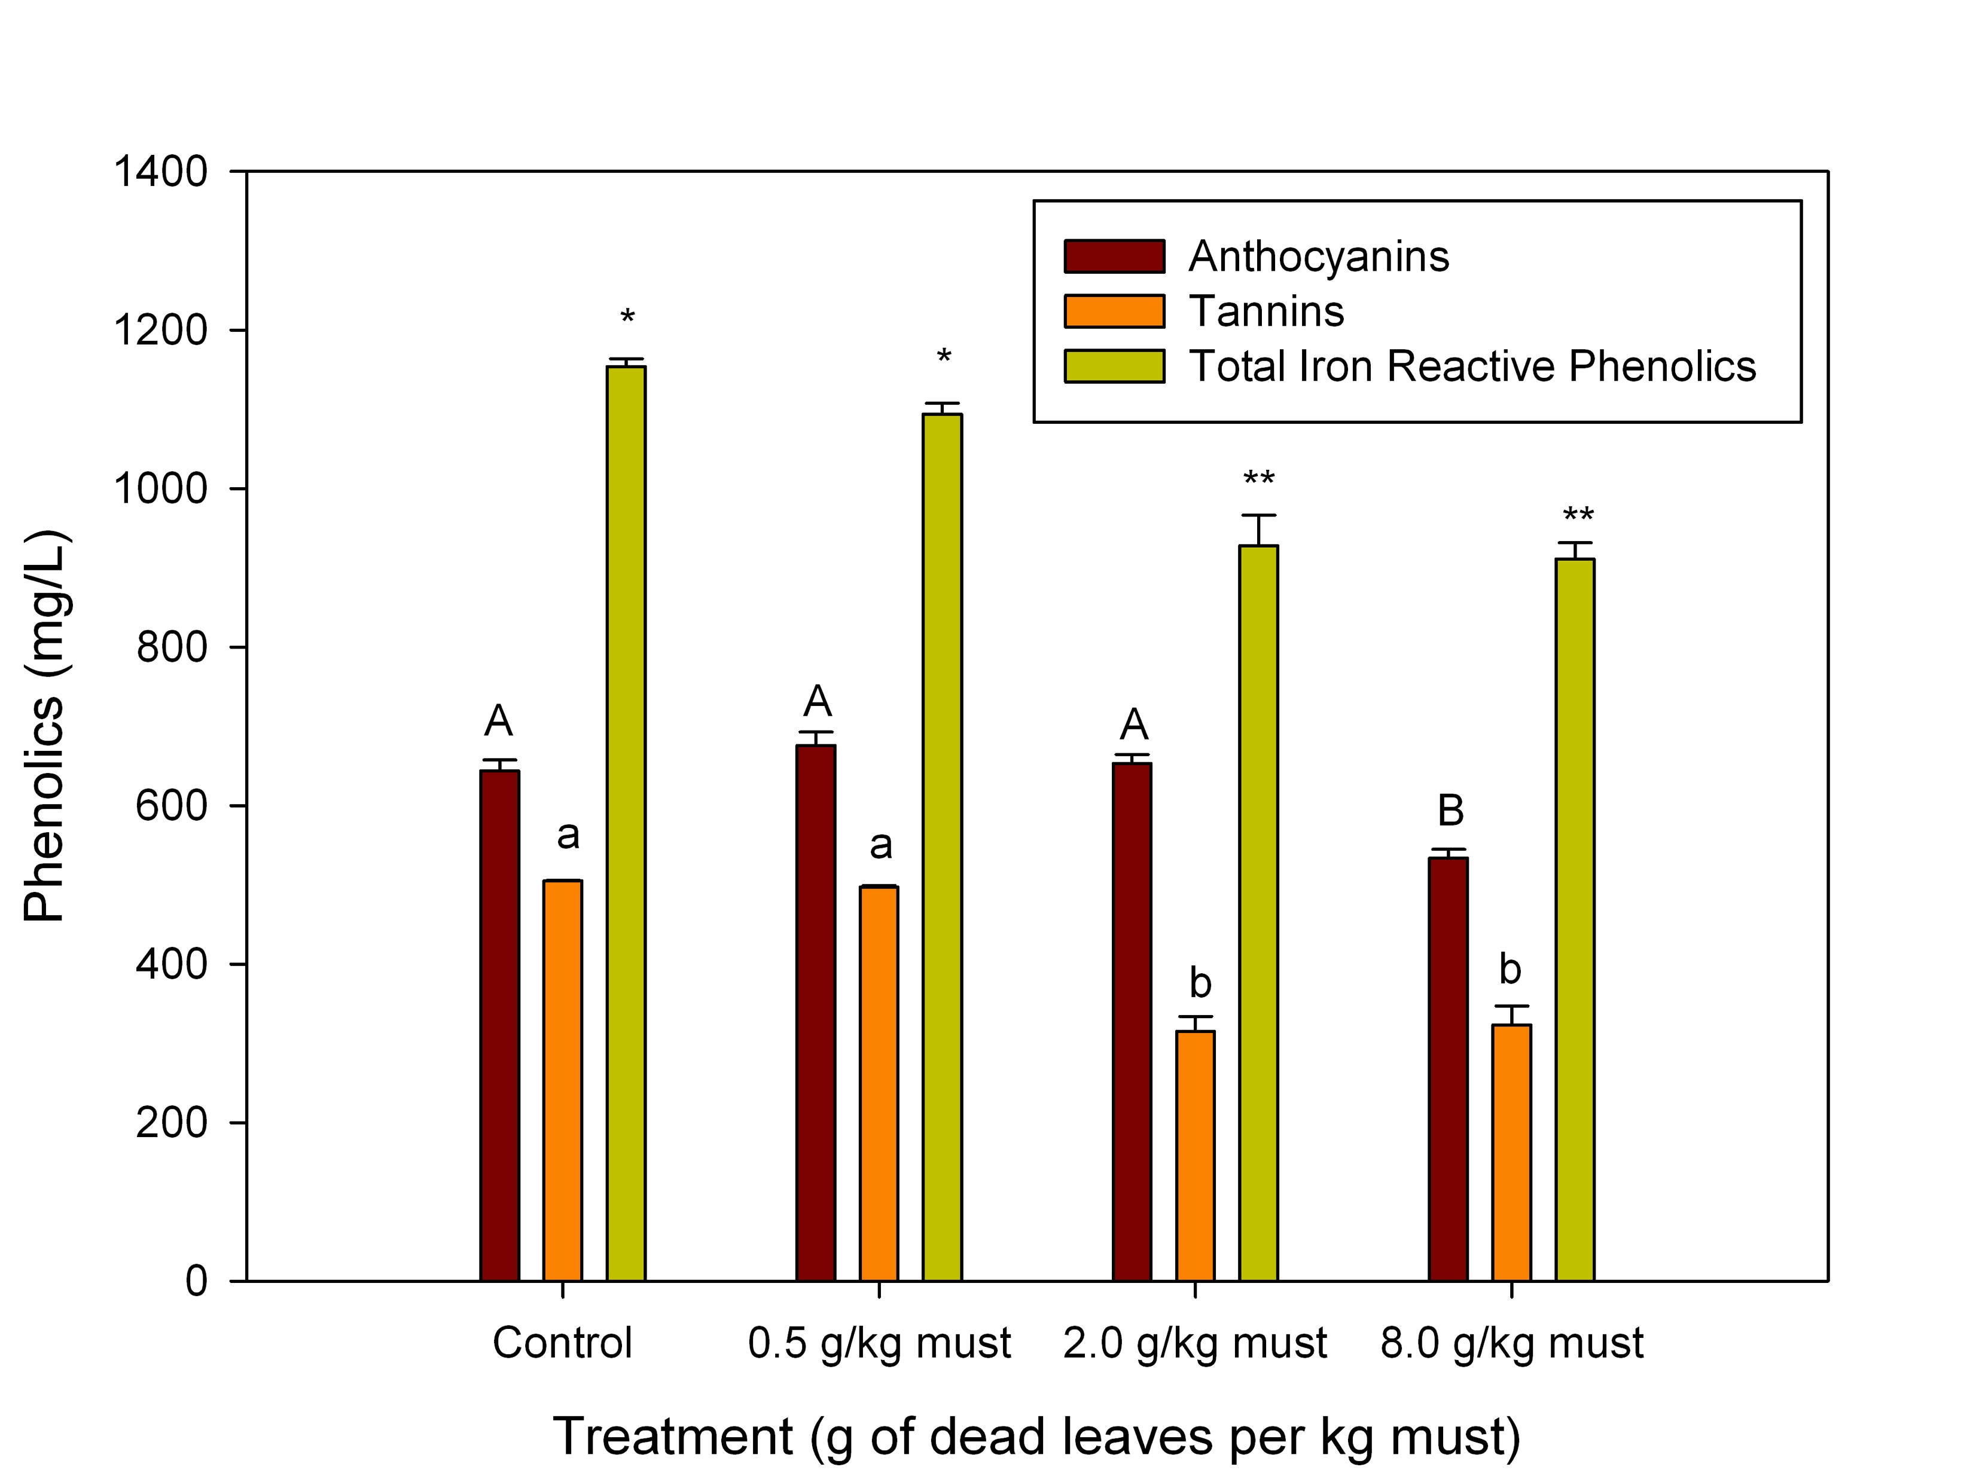
Chemical Results - Tannin
Tannin and Astringent mouthfeel decrease!

Slide 23
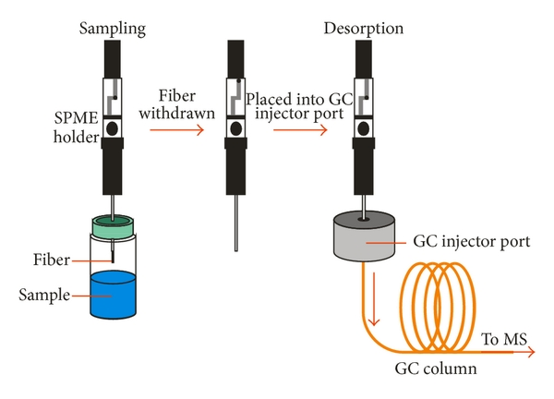
Chemical Results - HS-SPME-GC-MS
126 compounds were found using AMDIS deconvolution
62 compounds were retained for statistical analysis
48 compounds were identified using NIST and calculated retention indices
17 compounds confirmed via authentic reference material
Notes:
We didn’t exactly know what we were looking for, so we used an untargeted analytical approach.
In order to determine which compounds are changing in relation to the FKLM treatments we chose to apply a Fold Change Analysis.

Slide 24
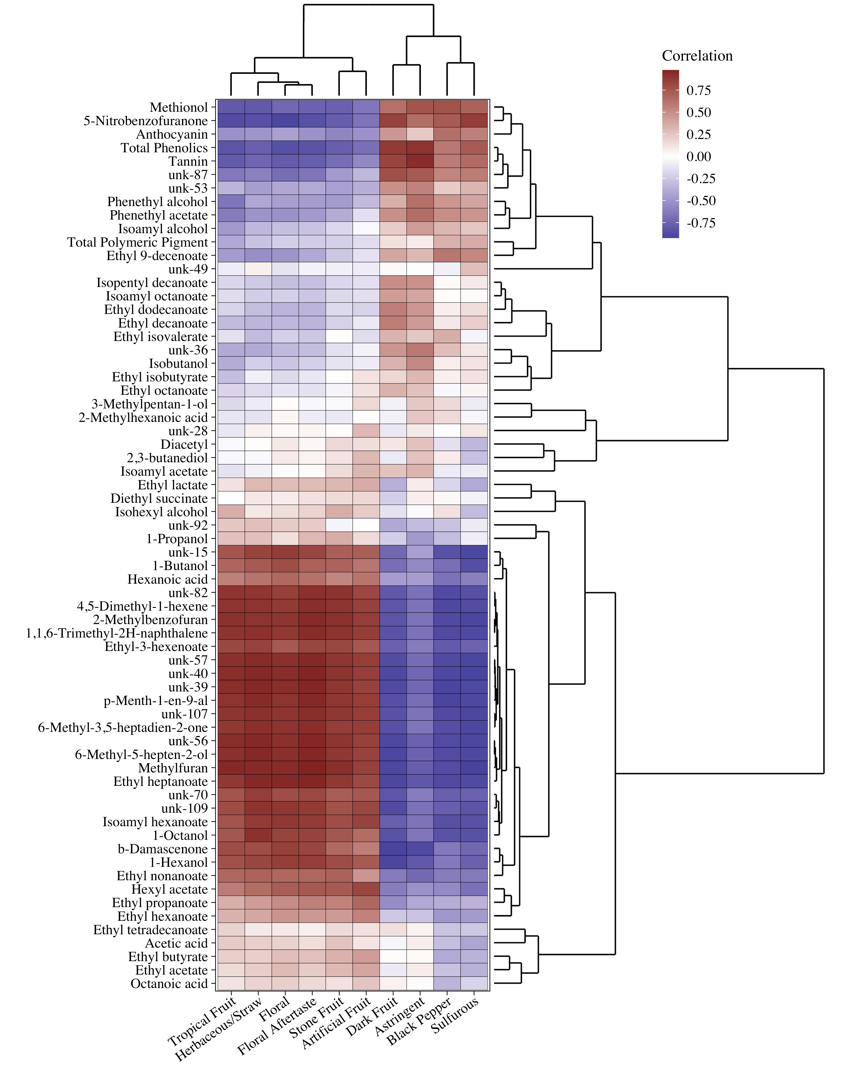
Correlation
Analysis
Sensory Chemistry HEAT MAP!!!
Notes:
Sensory along the bottom
Chemistry up the side

Slide 25
Correlation
Analysis
1
3
splits into four “zones”
1 – Negative correlation with rose taint attributes
2 – Positive correlation with rose taint attributes
3 – Positive correlation with Cabernet Sauvignon varietal character
4 – Negative correlation with Cabernet Sauvignon varietal character
2
4
Notes:
The sensory attributes cluster by Cab varietal character to the right and rose taint to the left.

Slide 26
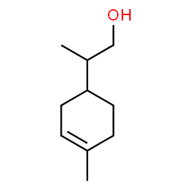
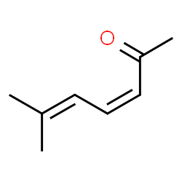
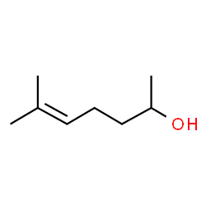
Correlation
Analysis
1
3
Suspect Compounds!!
p-Menth-1-en-9-al
Herbal, spicy
Commonly found in wild celery
6-Methyl-3,5-heptadien-2-one
Herbal, spicy, woody
Impact chemistry for basil, thyme, green tea, rooibos tea
6-Methyl-5-hepten-2-ol
“Coriander Heptenol”
Coriander, dill, cumin
2
4
Unknown 40
Unknown 109

Slide 27
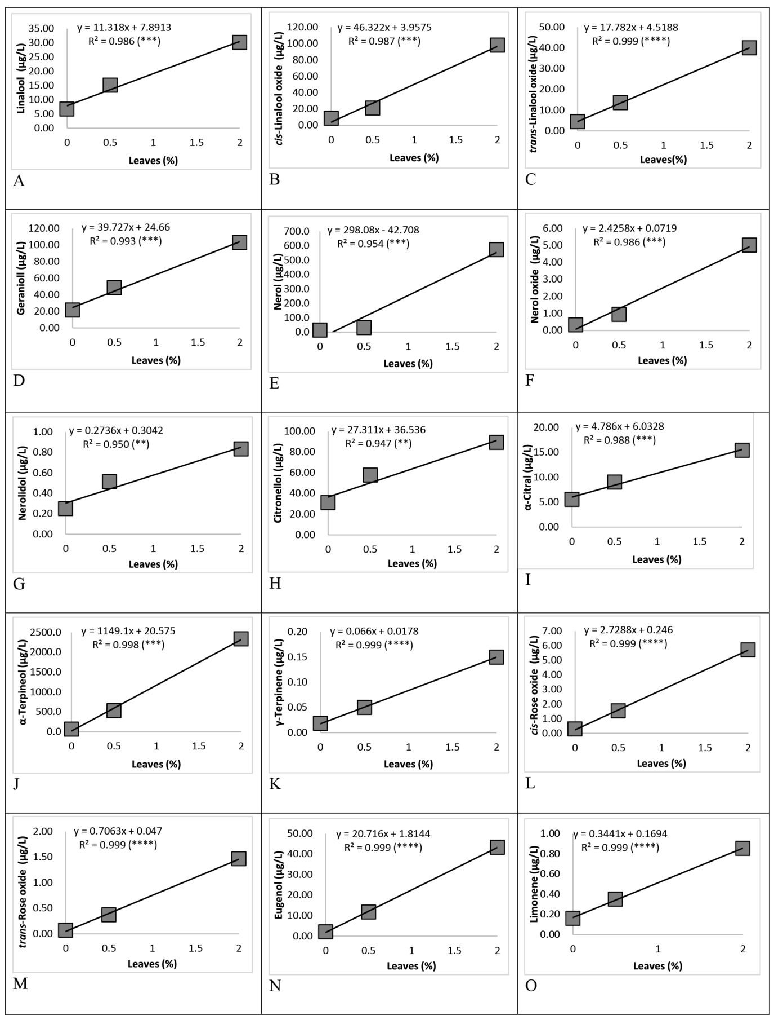
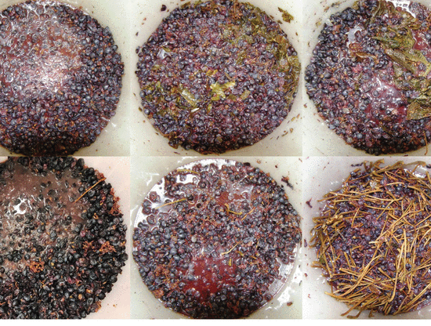

Slide 28
Actionable winemaking levels?
DOSE g of leaf per kg of fruit | g of leaf per TJ | ~leaf per TJ | ~clusters per TJ | leaf per cluster | leaf per lbs of fruit | leaf per US ton | leaf per metric ton
0 | 0 | 0 | 736 | 0 | 0 | 0 | 0
0.5 | 68 | 65 | 736 | 0.09 | 0.23 | 454 | 500
2 | 272 | 261 | 736 | 0.36 | 0.91 | 1816 | 2000
8 | 1089 | 1045 | 736 | 1.4 | 3.6 | 7264 | 8000
Approximate threshold ~1 g of FKLM/kg of fruit
Notes:
~0.96 g/Leaf
~185g/Cluster
16 clusters a vine ~ 185g clusters ~ one dried leaf was about 1g. = 3 leaves for vines to realize the taint.

Slide 29
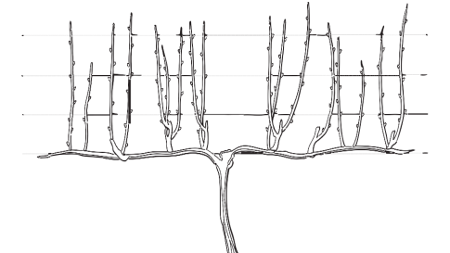

Actionable winemaking levels?
1 g FKLM per kg of fruit
16 clusters a vine ~ 3 dried leaves per vine to realize the taint
Notes:
~0.96 g/Leaf
~185g/Cluster
16 clusters a vine ~ 185g clusters ~ one dried leaf was about 1g. = 3 leaves for vines to realize the taint.

Slide 30
WSU Viticulture and Enology

Slide 31
WSU Viticulture and Enology
Funding Acknowledgment
Wine Research Advisory Committee
Washington Wine Commission
Washington Grape and Wine Research Program
WSU Agricultural Research Center
Dr. Andrew Reynolds
Notes:
Acknowledgments
Jim Harbertson would like to acknowledge the Wine Research Advisory
Committee, the Washington Wine Commission, the Washington Grape and
Wine Research Program, and the WSU Agricultural Research Center. The
authors would like to acknowledge our NIFA USDA Hatch Project #1016366.
Dr Andrew Reynolds is thanked for helpful and informative discussions.

Slide 32
Notes:
But in the end we all know where excellent wine starts

Slide 33
Notes:
These leaves are so brittle and are not able to be removed at the sorting line.

