Slide 1
Preventing and Mitigating Low Temp Injury(cold damage) in Grapevines
Jason Magnaghi
Viticulturist
Figgins Family Wine Estates

Slide 2
When Does Cold Damage Occur?
October-November(early acclimation period)
December-January(cold hardiness)
February-March (de-acclimation)

Slide 3
What Influences Hardiness
Overly vigorous vines
Overly stressed vines
Irrigation Strategies
Vine Age

Slide 4
Mitigation Strategies

Slide 5
Split Infn Se
Wind Machines
Burial Canes
Is there and inversion?
0-3 degrees F temperature change
Snow or Ice?
Time consuming
Expensive($600-700/acre)
2/3 normal crop
Weed control?

Slide 6
Mitigating Cold Damage- Wind Machines
Wind machines can be effective in raising temperature even in artic situations. Sometimes the difference in picking a crop and not picking a crop can be 1-2 degrees. Wind machines only work if there is an inversion.

Slide 7
Mitigating Cold Damage- Burial Cane Program
Canes are grown from crown and spur pruned.

Slide 8
Mitigating Cold Damage- Burial Cane Program
Canes are trained to the drip wire during growing season

Slide 9
Mitigating Cold Damage- Burial Cane Program
Canes are removed from drip wire and laid on ground with a shovel full of soil to hold them down.

Slide 10
Burial Cane Program
Canes are covered with soil using hilling discs

Slide 11
Chart Title

Slide 12
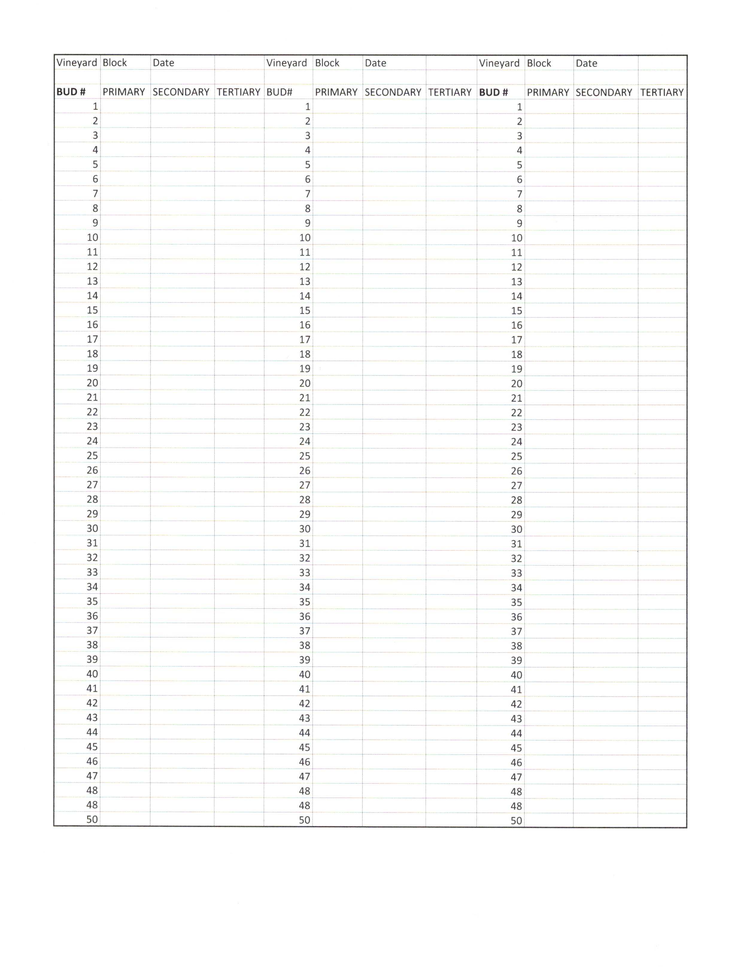
Cold Damage Evaluation
Presence/absence sampling
Vascular damage
50-100 buds/block
1-4 bud positions on cane
Place image here

Slide 13
Evaluating Bud Damage
All Buds Alive

Slide 14
Bud Damage Assesment
Dead Primary Bud with Live Secondary and Tertiary Buds

Slide 15
Chart Title
Place chart here

Slide 16
Evaluating Vascular Tissue
Damage Phloem and Live Xylem Tissue

Slide 17
Vascular Damage
Any wounds to vascular tissue can allow pathogens in including crown gall.

Slide 18
Pruning After Cold Injury

Slide 19
Pruning After Cold Injury
Depending on variety(sangiovese) and clone(cab sauv cl 6) we will prune normally with 20% or less primary damage. On most vineyard blocks (6x9) we will prune to 24 buds with 12 two-bud spurs.

Slide 20
Pruning After Cold Injury
Damage between 20-50% we will prune vineyard blocks(6x9) to 12 three-bud spurs increasing our bud count from 24-36.

Slide 21
Pruning After Cold Injury
On varieties(merlot, sangiovese) that have issues with apical dominance we will generally leave more spurs than longer spurs so we don’t end up with elk horns like this.

Slide 22
Pruning After Cold Injury
Bud damage from 50-80% we will dog ear prune leaving 2-two bud spurs at each position increasing the bud count from 24 to 48 buds/vine.

Slide 23
Pruning After Cold Injury
Damage of 80% or more we will pre-prune the block and then wait for budbreak to determine next steps.

Slide 24
Pruning After Cold Damage
Riesling after -12F leaving 95% bud damage as well as phloem and xylem damage.

Slide 25
Pruning After Cold Injury
This vine will be retrained from suckers that grew from the crown.

Slide 26
n Slide
Own Rooted Vines
Grafted Vines
Easy to retrain if severely damaged
Difference in cold hardiness?
Site selection most important
Need to re-graft if severely damaged

Slide 27
Chart Title
Place chart here

Slide 28
Preventing and Mitigating Low Temp Injury(cold damage) in Grapevines
Jason Magnaghi
Viticulturist
Figgins Family Wine Estates

Slide 29
Chart Title

