Slide 1
Preventing and Mitigating Low Temp Injury (or Cold Damage) in Grapevines
Ken Kupperman

Slide 2
Willamette Valley
2022 Season

Slide 3
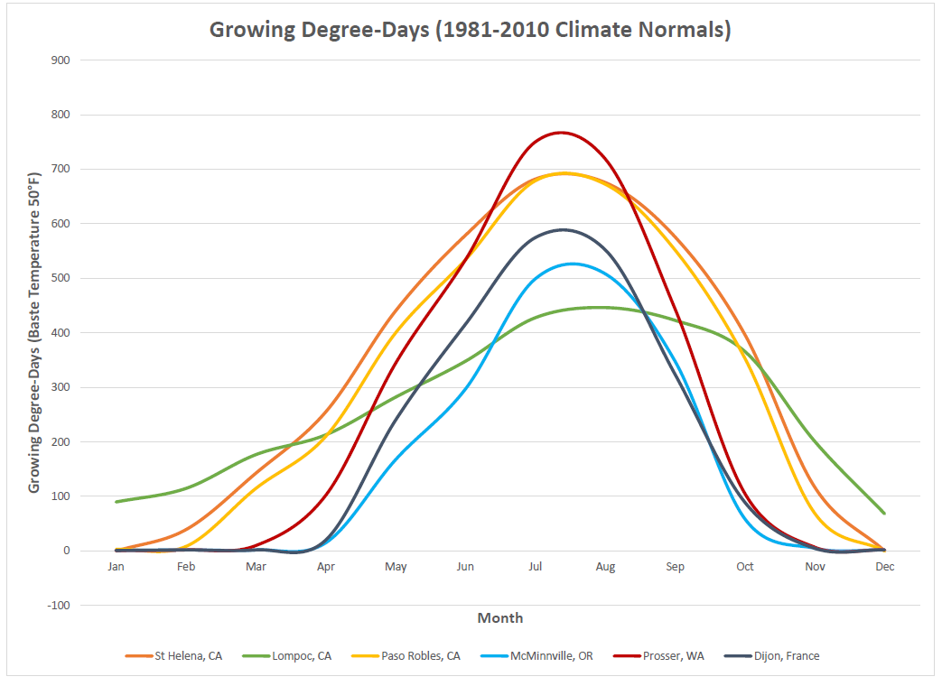

Slide 4
25 days post freeze event

Slide 5
Pinot Noir damage 50-70% primaries, Chardonnay 90%

Slide 6
Pinot Noir Compound Bud

Slide 7
Compound Buds
Multiple compound buds
Inside of single compound bud
Damaged
Damaged
Survived
Inflorescence primordia of primary bud
Photo courtesy of Patty Skinkis, OSU

Slide 8
Crop Load (Ravaz Index)
Vegetative
(Canopy)
Reproductive
(Fruit)
Yield ≠ Crop Load
Location | Optimum
California | 5 to 10
Oregon | 3 to 6

Slide 9
Conclusions
Site Selection
Type of freeze event, how often
Delayed pruning, Chardonnay last
Keep cover crops low in vulnerable areas
Healthy balanced vines, nutrition-YANS, Ravaz index

