Slide 1
Wine Business Institute
Growing our Future Leaders
Ray Johnson, Sonoma State University

Slide 2
Who we are
What sets us apart

Slide 3
Focus
Notes:
Focus
The business of wine is our exclusive focus in our research and programs.
Public Policy
Consumer Insights
Leadership and Strategy
Economic Impact
Wine MBA Degrees
Undergraduate Wine Business Degree
Wine Business Certificates

Slide 4
Transform Someone’s Career
Sonoma Executive Wine MBA
Integrated leadership development
Connect them with us.
Classes begin annually.
Meet our alumni: wbi25.sonoma.edu
Notes:
Focus
Our exclusive focus is on the business of wine.
If you have a friend, a colleague, an ambitious employee, thinking of taking their career to the next level, share the word.
We’re enrolling our next cohort right now.

Slide 5
Network
Notes:
Network
Our board members and their companies span the wine industry value chain, including wineries large and small.
We host important wine industry gatherings like the annual Wine.com Industry Growth Summit.
Our alumni are the next generation of the wine industry’s leadership, leaders at every level.

Slide 6
WBI Board Member Organizations

Slide 7
Our alumni…
Growing leaders in wine business.
Notes:
An expanding network of wine business alumni.
Our flagship program is our Executive Wine MBA and its Global counterpart.
Our graduating class in August 2018

Slide 8
Wine Business Institute
Inclusive Excellence

Slide 9
Leaders who champion inclusive excellence
will ensure the wine industry’s success
for future generations.

Slide 10
JOINT INFORMATIONAL HEARING
Senate Select Committee on California’s Wine Industry
Assembly Select Committee on Wine
“Cultivating the Next Generation of Wine Industry Leaders and Emerging Markets in California”
June 28, 2019~1:30 PM
Sonoma State University
Wine Spectator Learning Center
Welcome (1:30pm-1:45pm)
Sonoma State University President Judy Sakaki
Senator Bill Dodd, Co-Chair Senate Select Committee on California’s Wine Industry
Senator Mike McGuire, Co-Chair Senate Select Committee on California’s Wine Industry
Assemblymember Cecilia Aguiar-Curry, Chair Assembly Select Committee on Wine
Panel 1: State of Wine Industry Education & Research (1:45pm-2:30pm)
(Moderator: Asm. Aguiar-Curry)
Ray Johnson, Executive Director SSU Wine Business Institute
David E. Block, UC Davis Department Chair of Viticulture and Enology
Claire Hobday, Chief Financial Officer C. Mondavi & Family
Shannon Walker-Hyde, Estate Manager Hyde Estate Winery
Tony Stephen, Board Chairman American Vineyard Foundation
2019 Hearing with Elected Officials
Sonoma State Alumni:
Claire Hobday – C. Mondavi & Family
Shannon Walker-Hyde – Hyde Estate

Slide 11
2020, 2021, 2022 Vinexpo America Webinars:
Growing Brands in the US Market
Andrew Blok – Delicato Family Wines
Martha Vicedomini – Southern Glazer’s
(formerly Martha was at Empson)
Juliana Colangelo – Colangelo & Partners

Slide 12
2022 Panel:
Moderated by leaders of the
Wine Business Institute at
Sonoma State University
Prema Behan
Co-Founder & General Manager
Dana Sexton Vivier
Chief Financial Officer
Emily Porter
Business Operations Manager
Ray Johnson
Executive Director

Slide 13
Moderator: Julie Lumgair, Art Nouveau Wines, California
Speakers: William Allen, Two Shepherds, California Prema Behan, Three Sticks, California Lulie Halstead, The IWSR Group, England Christine Moll, O’Neill Vintners & Distillers, California Dale Stratton, Wine Market Council, California Aly Wente, Wente Vineyards, California
A Focus on the Future:
Trends and Opportunities from Across the Globe
General Session

Slide 14
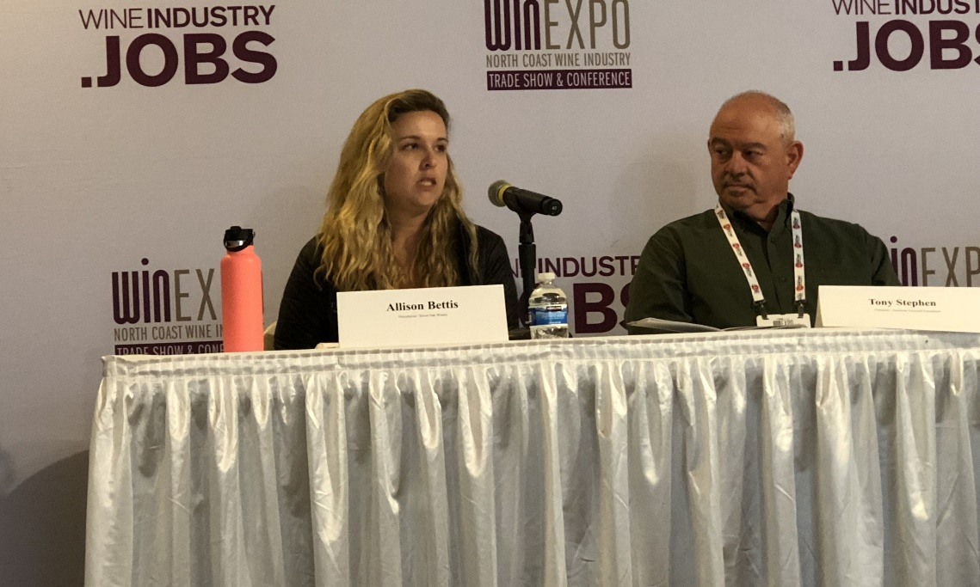
Exploring Water Conservation Practices in the Vineyard
Moderator
Allison Jordan
Executive Director / California Sustainable Winegrowing Alliance
Allison Bettis
Viticulturist / Silver Oak Winery
Adam Koeppel
CEO / Agrology
Tony Stephen
Chairman / American Vineyard Foundation

Slide 15
Scholarships
$100,000+ Wine Business Scholarships
100+ Wine WISP Students
Notes:
Thank you for your support of our mission; we appreciate it.

Slide 16
Gabriel Valenzuela
Winemaker
Jackson Family Wines
Notes:
Gabriel Valenzuela
Winemaker
Jackson Family Wines

Slide 17
Stacey Vogel
Winemaker
PLATA WINE PARTNERS

Slide 18
William Thomas
Director of Winegrowing
Foley Family Farms
Thomas-Hsi Vineyard

Slide 19
Shannon Donnell
Grower Relations and Vineyard Operations Manager
Sonoma-Cutrer Vineyards

Slide 20
John McCarthy
Director of Vineyard Operations
Far Niente Winery

Slide 21
Trini Amador
Senior Manager, Stagecoach Vineyard,
Pahlmeyer Estate & Monte Rosso Vineyard
E. & J. Gallo Winery
Notes:
Trini Amador ‘17
Sonoma Executive MBA in Wine Business

