Slide 1
Winemaking and Vineyards Manager Teams
Chris Louton, St. Francis Winery & Vineyards, California

Slide 2
Session: Winemaking and Vineyards Manager Teams
Owned Acreage
4 Ranches
500 Acres Total
15 Different Varietals
Contracted Tonnage
- 40 Growers
10 AVAs
10 Different Varietals
“You know it’s harvest season when the winemakers emerge from their cavernous abodes and start making appearances in the vineyard. It’s a magical time, I mean, sometimes they bring donuts! “
M. Greenspan advancedvit.com Aug 2022

Slide 3
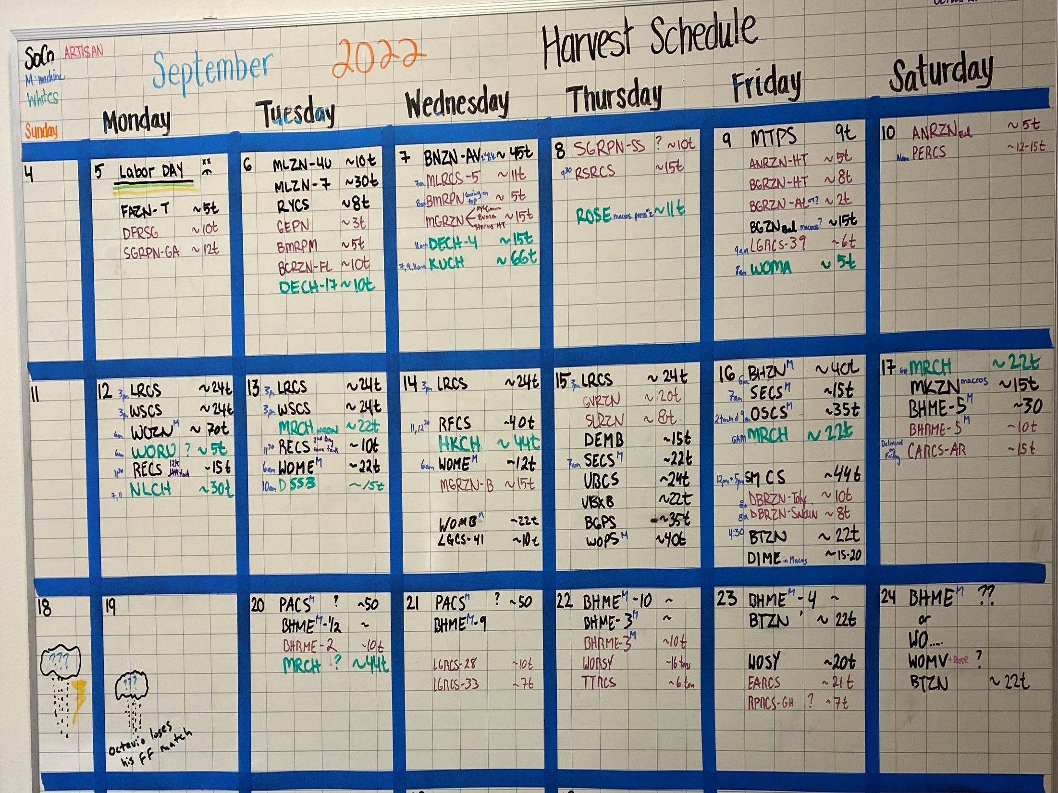
Year-Round Communication

Slide 4
