Slide 1
Our mission is simple; Grow U.S. manufacturing and manufacturing jobs.
Celebrating 29 Years | 1995 - 2024

Slide 2
Discovering ETP for your Business
The Employment Training Panel (ETP) is a joint business-labor state agency that funds training to ensure employers have the skilled workers they need to compete locally and globally. By 2023, the ETP program has allocated over $1.5 billion to 80,500 businesses to train 1.1 million workers.
ETP’s success is the result of several unique features: employer-driven training, business investment, performance-based contracting, and customization.

Slide 3
Discovering ETP for your Business
ETP operates on performance-based contracts. The required performance metrics are:
Trainee’s must complete a minimum of 8 hours of training;
Trainees must be employed full-time;
Trainees must complete a post-training employment-retention period;
Trainees must be paid at least the ETP minimum wage during retention
*Employer-paid health benefits (medical, dental, vision) of up to $2.50 per hour may be included, if received by the employee, with the trainee’s hourly wage to arrive at the ETP minimum hourly rate of $24.72 for Alameda, Marin, San Mateo, Santa Clara and San Francisco Counties; $23.59 for Contra Costa County; $22.66 for Los Angeles County; $22.66 for Orange County; $22.66 for San Diego County; and $22.66 for all other counties.

Slide 4
Discovering ETP for your Business
Managers and supervisors can participate in ETP funded training with the following exceptions:
Limited to 20% or less of the training population
Cannot include policy-making (level) employees (top level executives may be included in Small Business projects only)
Can only include Frontline managers/supervisors if funded under the Special Employment Training (SET) Program
If your organization does not have sufficient staff to develop and administer an ETP training project, you may consider waiting to submit an application until your organization has the staff and resources - - or utilize the services of a multi-employer contractor in the areas in which you need to train. An example in production and manufacturing is Manex.

Slide 5
Multi Employer Contractor handles Admin and Training
Manex will handle all aspects of the ETP application process for your company. This allows you time to stay focused on your own business instead of wasting time learning state funding qualification regulations, application process, and creating proposals.
Manex's experienced consultants coach you in developing your training program specific to your business needs while making ETP program choices to maximize funding.
Eligibility is determined within 48 hours with a simple two-page application.
Employees can begin training using ETP funds within one month.
Earned rebates take approximately six months to payout.

Slide 6
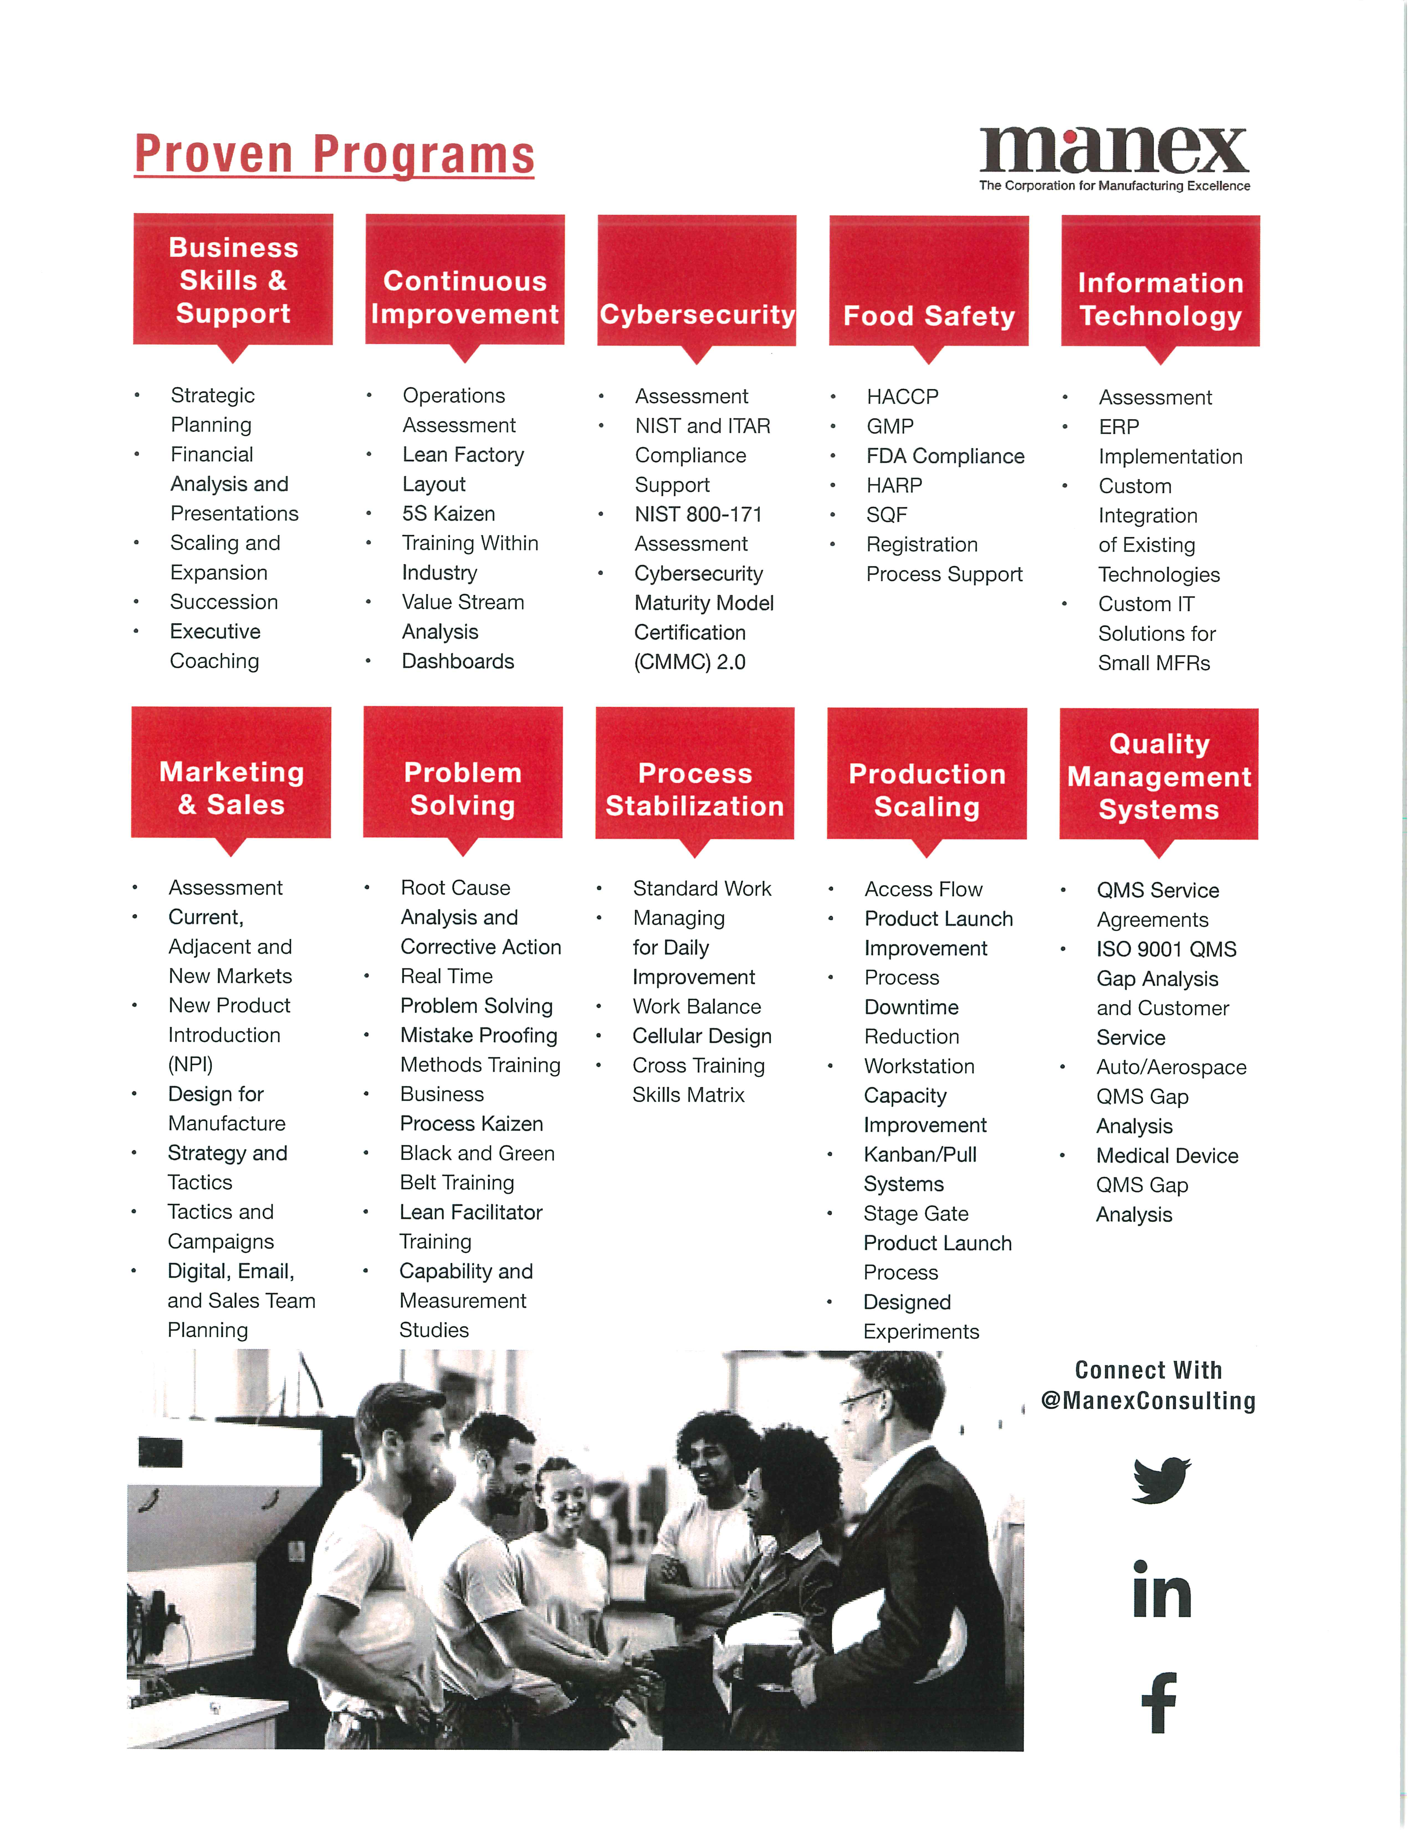

Slide 7
Published Case Studies Utilizing ETP Cost Offsets with Manex

Slide 11
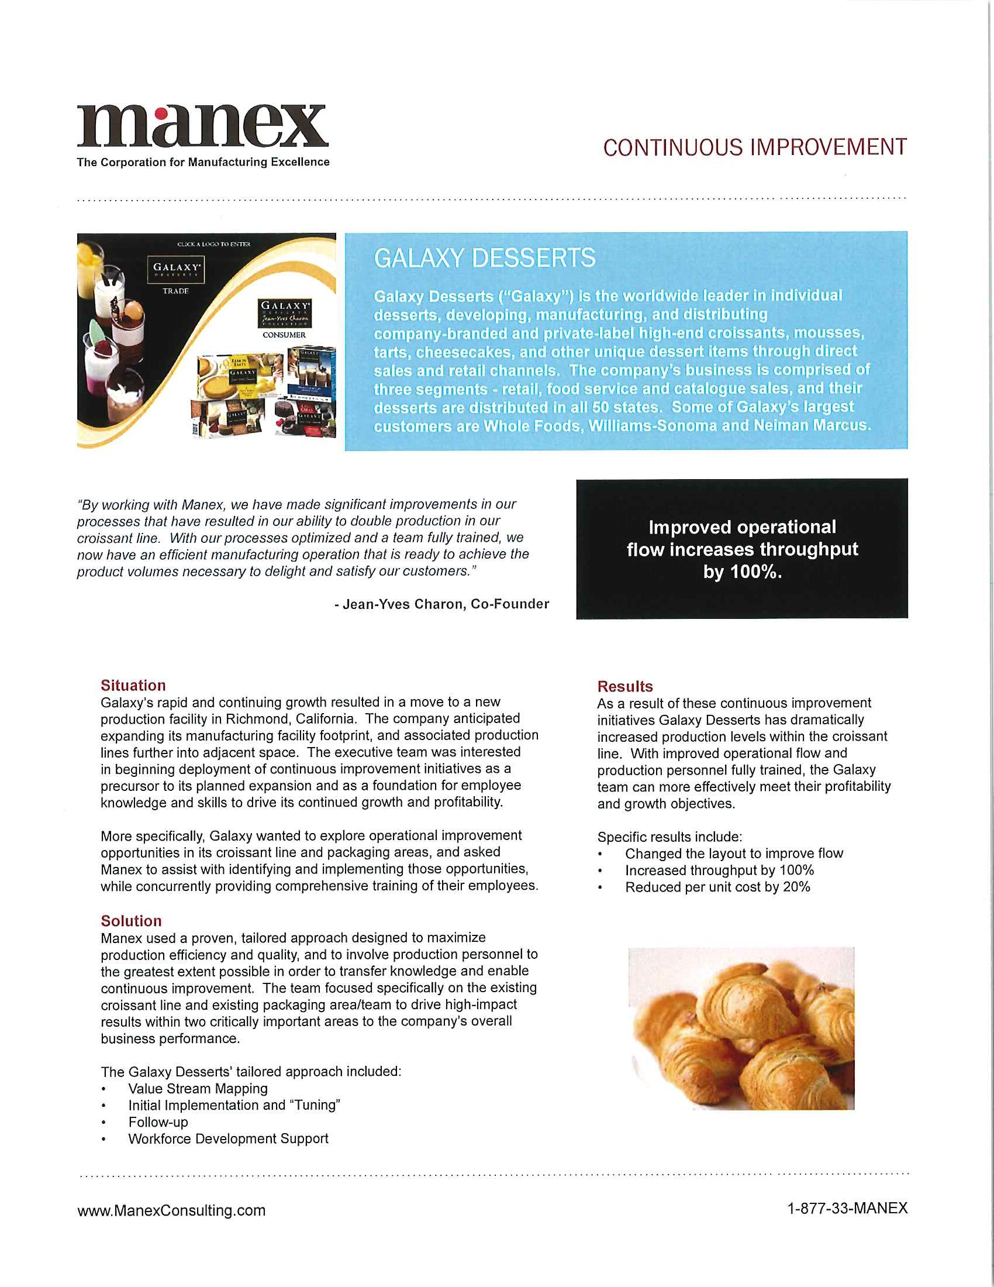

Slide 15
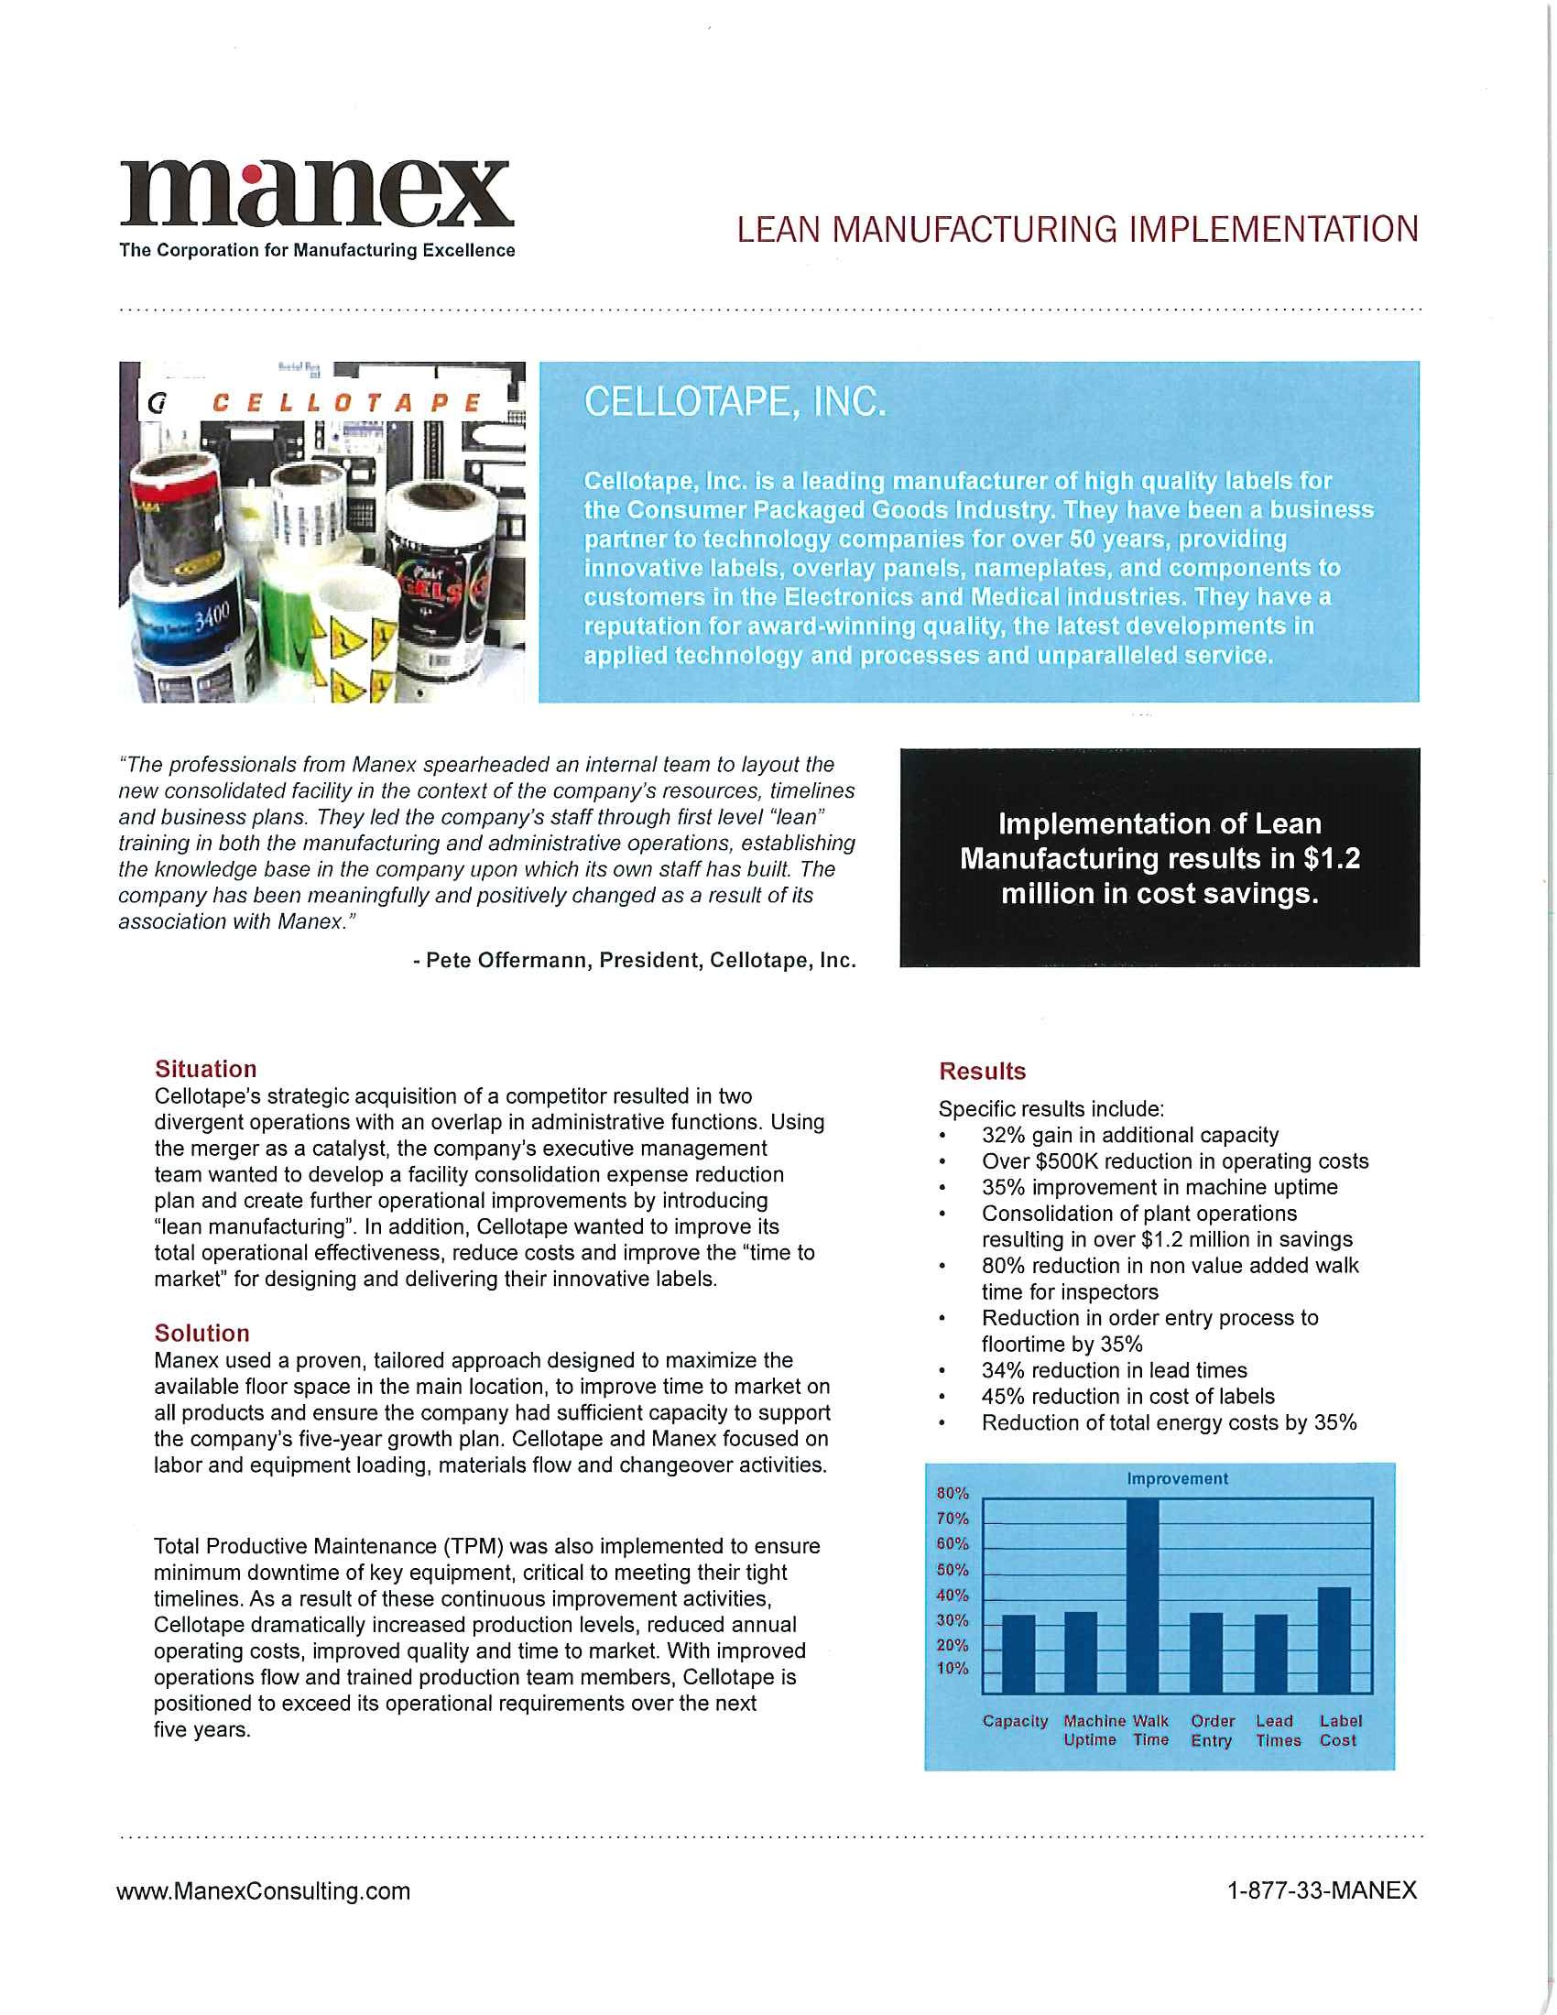

Slide 17
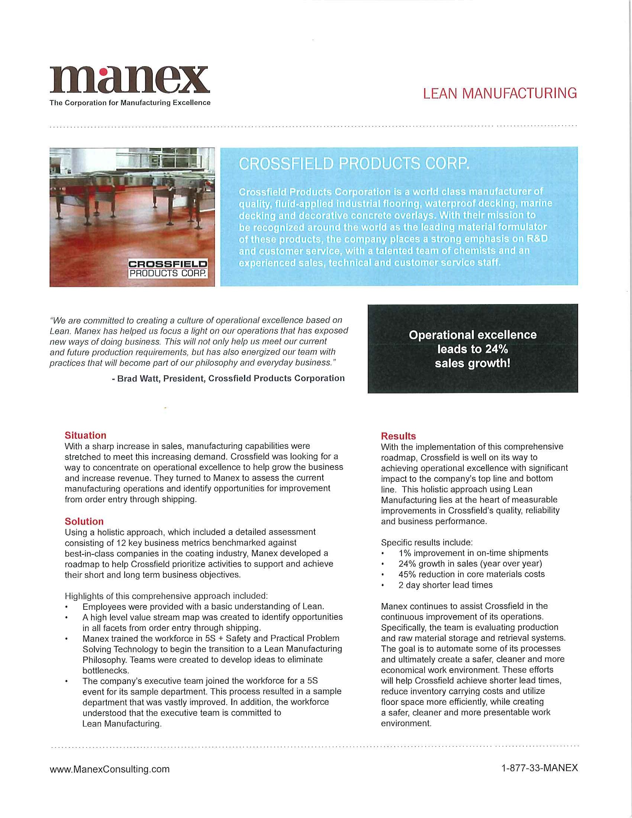

Slide 22
manexconsulting.com
@manexconsulting
@manexconsulting
@manexconsulting
Celebrating 29 Years | 1995 - 2024

