Slide 1
Why Short Videos Are
Essential To Your Business
Moderator: Brianne Cohen
Speaker: Jasmine Yook

Slide 2
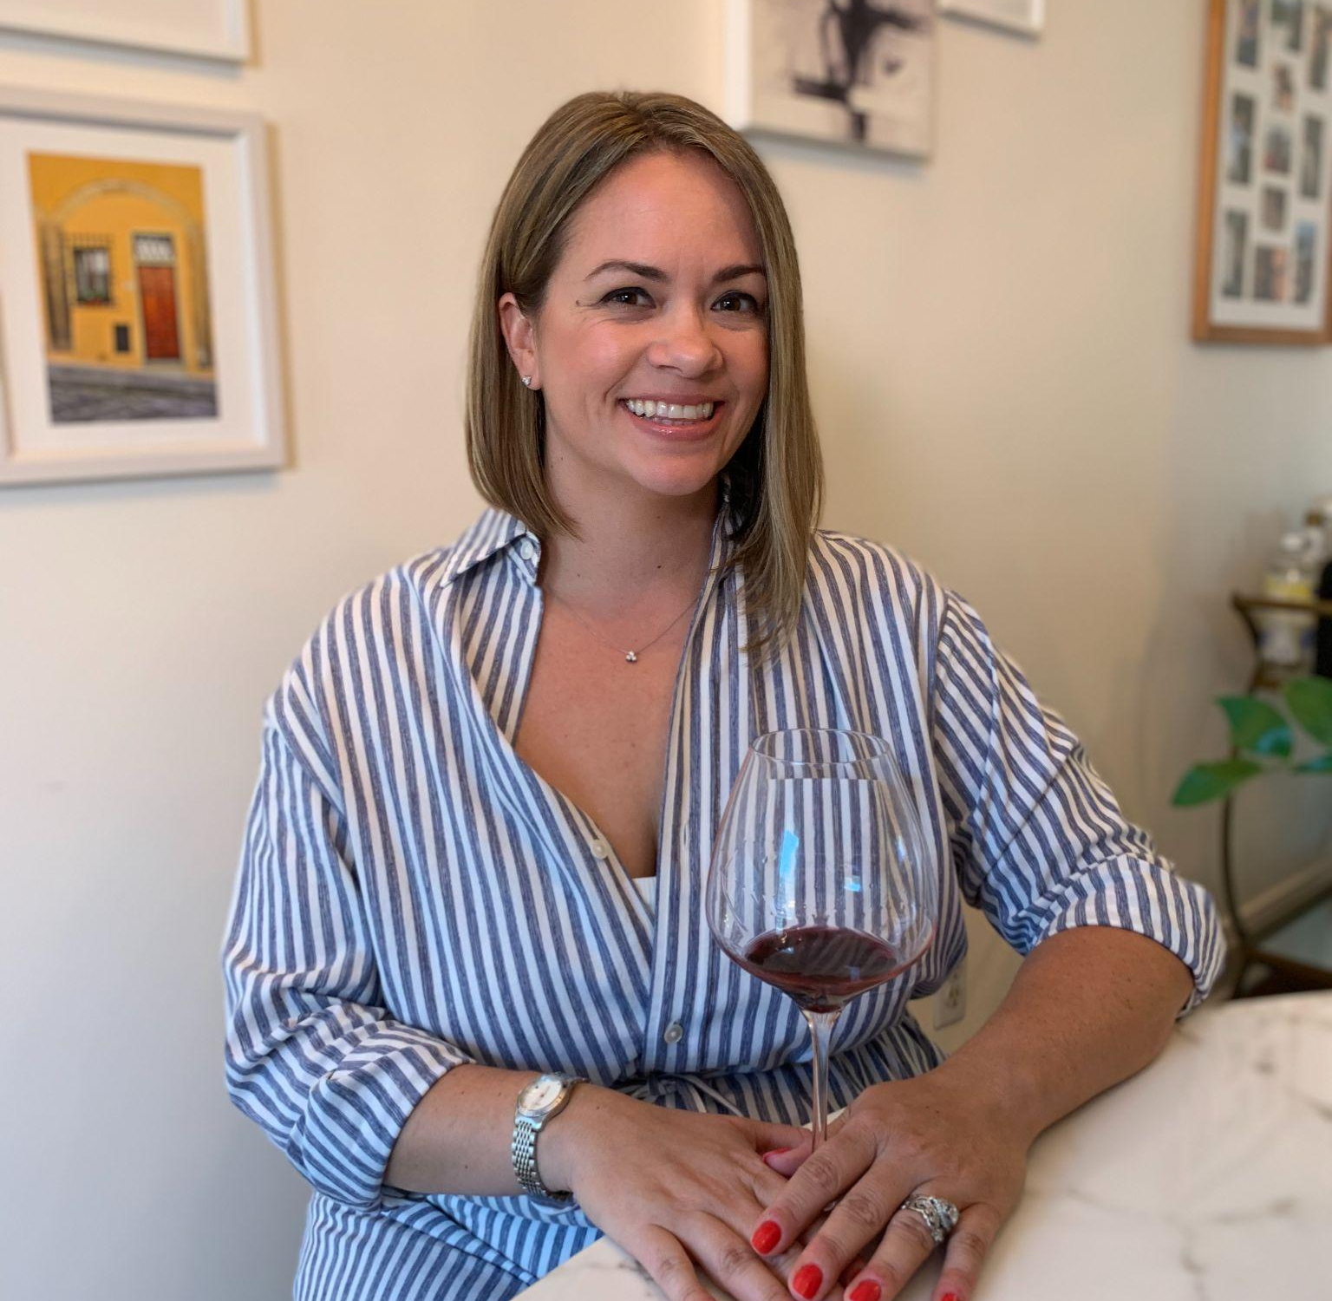
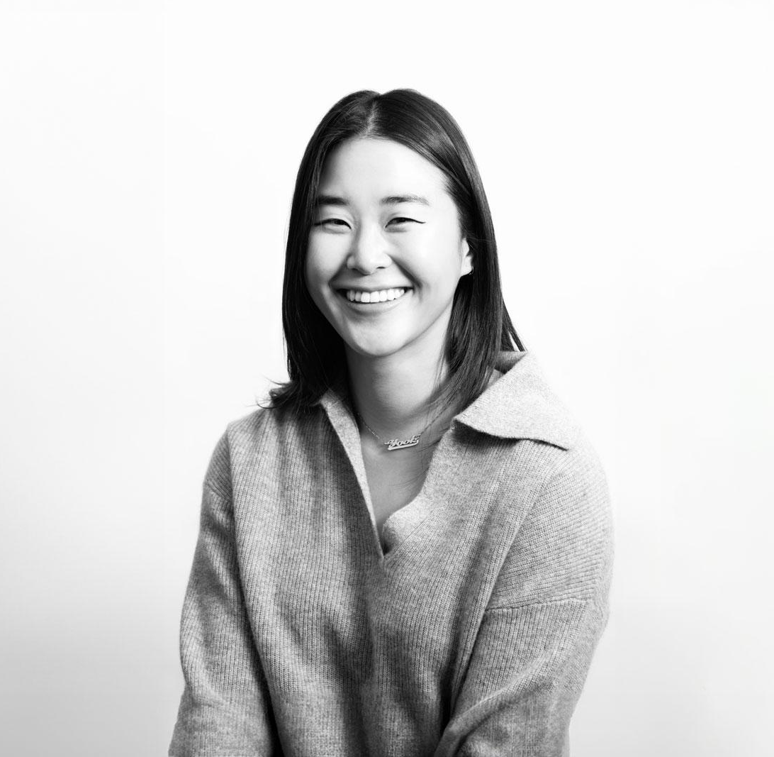
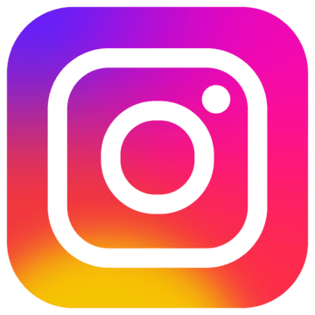
Brianne Cohen
Certified Sommelier, Wine Educator,
Wine Journalist, and Event Producer
WSET Diploma
Jasmine Yook
Head of Marketing, Hashflow
Ex: Amazon, Nike, Victoria’s Secret
Launched Amazon Fashion + Amazon Alexa TikTok Accts
WSET III

Slide 3
Chart Title
The Landscape of Wineries & Digital Presence
Notes:
-We’ve come a long way from the dreaded stock image of a cluster of grapes in a hand (image HERE) and basic vineyard imagery (stock or not) - example images HERE

Slide 4
“We are evolving our investments so that our brands reach the right consumers, at the right time, in the right place, with the right messages.”
- Spencer Gordon
Director of Digital, Anheuser-Busch

Slide 5
Myths to Bust 🍇
The wine industry has a digital presence delay
Social media doesn’t impact the bottom line
It’s too late for me to start
Content takes too much (“fill in blank”)

Slide 6
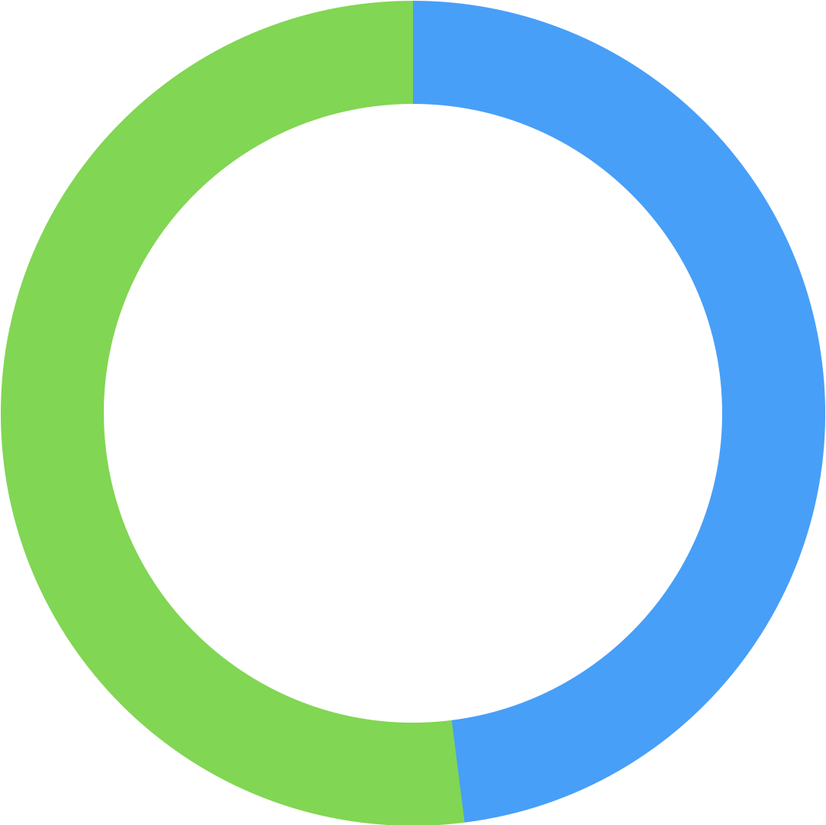
State of the Short Form Video Union 🎬
Chart Title
1.1B Global
150M USA
2.35B Global
159M USA
MONTHLY ACTIVE USERS (MAUs)
USA has the most amount of TikTok Users
USA has the most amount of IG Users
AUDIENCE BREAKDOWN
75%
of our audience is over 20yo
80%
of our audience is over 20yo
49%
51%
52%
48%
FEMALE
MALE
FEMALE
MALE
TIME SPENT
59 minutes
spent on the app/user/day
97.8M Hours
Viewed per day
29 minutes
spent on the app/user/day
17.6M Hours
Viewed per day
https://www.demandsage.com/instagram-reel-statistics/
https://newsroom.tiktok.com/en-us/150-m-us-users
https://backlinko.com/tiktok-users
Notes:
TIkTok has given Meta/IG a run for its money - with only 5 years (08) in the game (vs. IG’s 13 years - 2010) - it has quickly achieve parity to IG’s activities.
US population - 331M (2021)
TIkTok 19 times users open the app per day

Slide 7
TikTok ←→ IG Reels Symbiotic Relationship

Slide 8
The Value of Short-Form Videos 📶
03.
Easily Syndicated
Repurpose for site, other video-led platforms (IG, YT)
04.
Quicker Absorption + Visual Search
02.
More Engagement
Reels gain 67% more engagement than photos.
For Gen Z, TikTok Is the New Search Engine + Google has noticed.
01.
05.
Brand Affinity / Awareness
Algorithm Prioritization
Video is the new King. Attention is the new capital.
IG Feed Ranking
TikTok’s FYP + Interest Graph
Most convenient way for carve out market share and consumer trust. #TikTokMadeMeBuyIt
Notes:
Define “short form” vs “long-form”
Algo prioritization = Better Engagement
Reels gain 67% more engagement than photos (C&P influencer survey, 100 wine niche influencers)
Syndication/Scaling (more bang for your buck)
Put on site, other video platforms
Quicker for consumers to understand and learn
Brand awareness / affinity - hashftags building an audience, 1/1 interaction, more targeted reach due to interest graph
https://www.nytimes.com/2021/12/05/business/media/tiktok-algorithm.html
https://www.nytimes.com/2022/09/16/technology/gen-z-tiktok-search-engine.html

Slide 9
Myth
Reality
The wine industry has a digital presence delay
The wine industry is evolving and catching up
Social media doesn’t impact the bottom line
It can, but goal clarity is key
It’s too late for me to start
Just get started and be consistent
Content takes too much (“fill in blank”).
Find ways to make it low-fi and easy to fit into your everyday life

Slide 10
Best-in-Class Examples
Notes:
My two contenders here:
https://www.instagram.com/reel/C1vMo88Pjpo/?igsh=MzRlODBiNWFlZA%3D%3D
and
https://www.instagram.com/reel/CzhlexrpmMe/?igsh=MzRlODBiNWFlZA%3D%3D

Slide 11
STEP 1:
MAKE A PLAN
Determine what platform(s) to focus on
Who will be in charge of posting
Create a content plan and schedule
Set goals for your content
Notes:
I’ve got 2 video examples here.
HERE and HERE

Slide 12
STEP 2:
LEARN TO EDIT
Heartbeat Story Arc
CapCut App (free video editor) - templates
TikTok/IG native editor - templates
✨ Try to Include✨
Graphic Overlay / Visual Cues for Sound-Off (IG)
captions, cover images/text, copy callouts, emojis
Technical Setting (iPhone only)
Notes:
https://www.tiktok.com/@americanbaron/video/7200803390081748267?lang=en

Slide 13
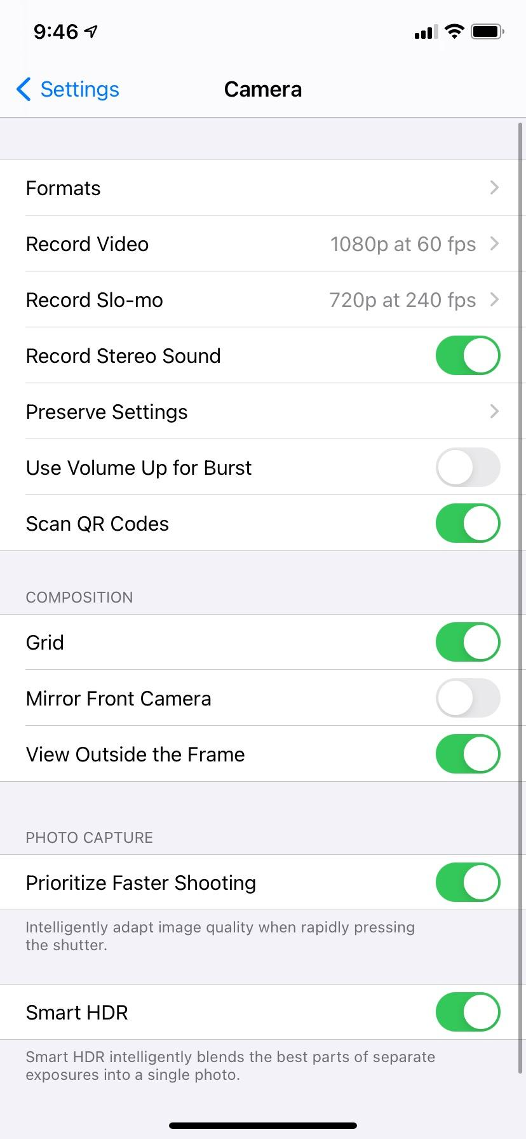
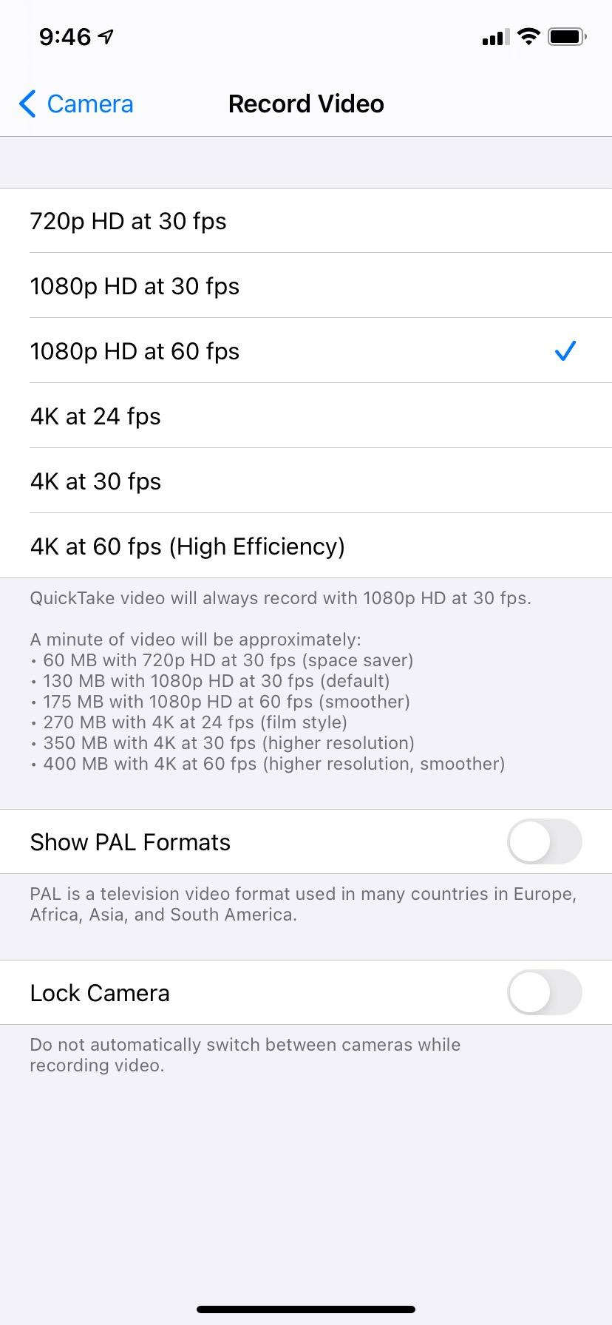
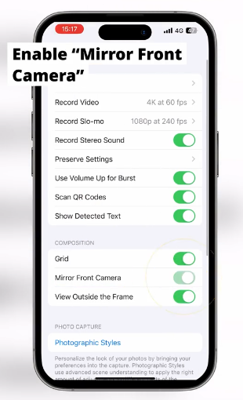
IPHONE TECH SETTINGS 🤳
SHOOTING REQUIREMENTS:
Note: If shooting on iPhone, please try to shoot with the camera/video and not within an app’s camera (i.e. TikTok or IG) as it compresses quality.
Images/Stills:
Vertical (min. 3000px width x min. 3645 height)
Horizontal (min. 1808 width)
Resolution: 72 dpi
Format: JPEG
Videos:
1080px x 1920px (mobile vertical video specs - see screenshot)
30 FPS (frames per second)
250px safe pace on top & bottom (see next slide)
All videos to be 7 - 15s (max.) long
Sound:
For content to be shared on your channels, please select music in the following locations:
TikTok Commercial Library
Instagram Commercial Library
Notes:
https://www.tiktok.com/@iphonephotographyschool

Slide 14
STEP 3:
USE SOUND
Optimize for discoverability
Find trending sounds right in the app
Saving Sounds
CapCut
Saving Feature (IG/TikTok)
Choose the right sound and quickly hop on viral sounds with unique take
Lipsync - Low Lift
Voice-overs (VO) - High lift
VO + trending sound - You’re ready for the big leagues 😎
Notes:
important for discoverability
Where can you find trending sounds? (show on IG and TikTok)
What do the icons mean

Slide 15
STEP 4:
OTHER TIPS
Showcase faces and people
Follow trends and virality
What I’m Drinking
5 Things
BTS
“We Are” Trend
OOTD/GRWM
Notes:
https://www.instagram.com/reel/C04aLWOirRF/?igsh=MzRlODBiNWFlZA%3D%3D

Slide 16
🍷 Alcohol Policies on Social Media 🍷
Branded content from a 3rd party (i.e. an influencer) is not allowed.
Ads promoting alcoholic beverages (wine, beer, spirits, etc.) alcohol clubs/subscription services, alcohol making kits, or alcohol sponsored events are prohibited in North America.
Showing or promoting recreational drug use, or the trade of alcohol, tobacco products, and drugs is not allowed.
We do not allow showing or promoting young people possessing or consuming alcohol, tobacco products, and drugs.
Content is age-restricted and ineligible for the FYF if it shows adults consuming excessive amounts of alcohol or tobacco products.
Branded content promoting or referencing alcohol must comply with all applicable local laws, required or established industry codes, guidelines, licenses and approvals, and include age and country targeting criteria consistent with targeting guidelines and applicable local laws.

Slide 17
Self-Regulation? 🤔
Wine Institute’s Ad Code provides that:
“
Digital marketing communications should not be placed in media where more than 28.4% of the audience is underage.
”
NOTE: TikTok does not communicate confidence in its current ability to verify user age.

Slide 18
Is It Working? 🏋️
Brand Building
Conversion
Building community
Adding value
Awareness with target audiences
Engagement
Gain followers
Newsletter sign ups
Tasting room visits
Sell wine?
Notes:
Video #1 HERE
Video #2 HERE

Slide 19
Questions?

Slide 20
THANK YOU
Follow Brianne and Jasmine on Social

