Slide 1
Unified Wine and Grape Symposium Sacramento, CA January 24, 2024
USDA / Risk Management Agency
Jeff Yasui, Director Davis Regional Office

Slide 2
Benefits of Crop Insurance
Low Premiums
Safety Net
In Place: Legislated and Funded
Flexible and Adaptable
Interaction with FSA Disaster Programs
Uses your yields
May be required for loans
Responsive
Peace of Mind

Slide 3
Grape Provisions 101
Basics
Available Since 1990
Insured in 23 states in 2023
Policies are provided by an Approved Insurance Provider and purchased from an agent
All policies utilize the same actuarial data, as provided by RMA
Agents and Insurance Providers compete with service
Insures grapes grown for wine, juice, or raisins

Slide 4
Grape Provisions 101
Basics
Indemnifies production and quality losses due to Adverse Weather, Natural Disasters, Wildfire (including Smoke)
Disease
Hail
Insects
Wildlife
Wind
…

Slide 5
Grape Provisions 101
Basics
California and Arizona:
Insure by Type/Variety as a basic unit (46 Varieties + “All Others”) – Unique to CA and AZ
Insured over 430,000 acres in 2023 with total liabilities over $2 billion

Slide 6
Grape Provisions 101
Flexible
Coverage levels from 50% to 85%.
Supplemental Coverage Option available to provide additional coverage between your elected coverage level and 86%
Price Elections from 59% to 100% of the RMA Price
Contract prices accepted
RMA Prices vary by crush district
Catastrophic Coverage Available
50% CvL / 55% PE @ $655 per crop per county
Must have a loss greater than 50% to receive indemnity
No options or endorsements
Does not meet FSA Linkage Requirements
Other requirements: Minimum age (4th/3rd leaf grafted) and minimum production (2 tons/acre → exceptions)
Sales Closing Date: January 31
Policy must be in effect before loss occurs
Basics

Slide 7
Grape Provisions 101
Basics
Amount of Production to be indemnified = Difference between the Production Guarantee and the Production to Count
$ = Production Shortfall x Price Election. Adjustments may apply
Production Guarantee
Coverage Level x Yield x Acres
Indemnity based on this amount times Price Election (Adjustments may apply)
Production to Count
(Quality Adj may apply)
Indemnity:
(640 – 600) x ($648 x 90%)
= $23,328
SJ Cab Sauv Example:
100 Acres
8.0 Ton Yield
80% Coverage Level
90% Price Election ($648 Price)
Harv: 6 tons/acre (25% loss)
Production Guarantee:
80% x 8.0 x 100 = 640 tons (6.4 tons per acre)
Production:
6 tons/acre x 100 acres
= 600 tons
Premium: $8900

Slide 8
Favorable Premium Rates
Affordable
Premium rates are reviewed and routinely adjusted
Rated by County
Actuarially Sound
Conceptually, premium rates are calculated so that the projected premium intake and indemnities “break-even”
The “effective” premium rate cannot increase or decrease by more than 20% for any given year
Base Premium Rates: High Loss County (Napa) vs Low Loss County (San Joaquin)
Rates went up mostly due to high amount of indemnities paid in 2020
Fires

Slide 9
Premiums
Affordable
Actual premium based on:
Rate data in the Actuarial Documents, Acreage, Coverage Level, Price Election, and options/endorsements
Subsidy is deducted from the calculated premium (67% to 38%)
Subsidy amount is lower for higher coverage levels
Beginning Farmer or Rancher / Veteran Farmer or Rancher
Not farmed/ranched more than 5 years or a Recent Veteran
As applicable, Reduced premium or Exemption from CAT fee
Yield adjustments
No rebates, “special” deals, or “extras”!
Examples: Superbowl tickets, cash, offer to pay the premium…

Slide 10
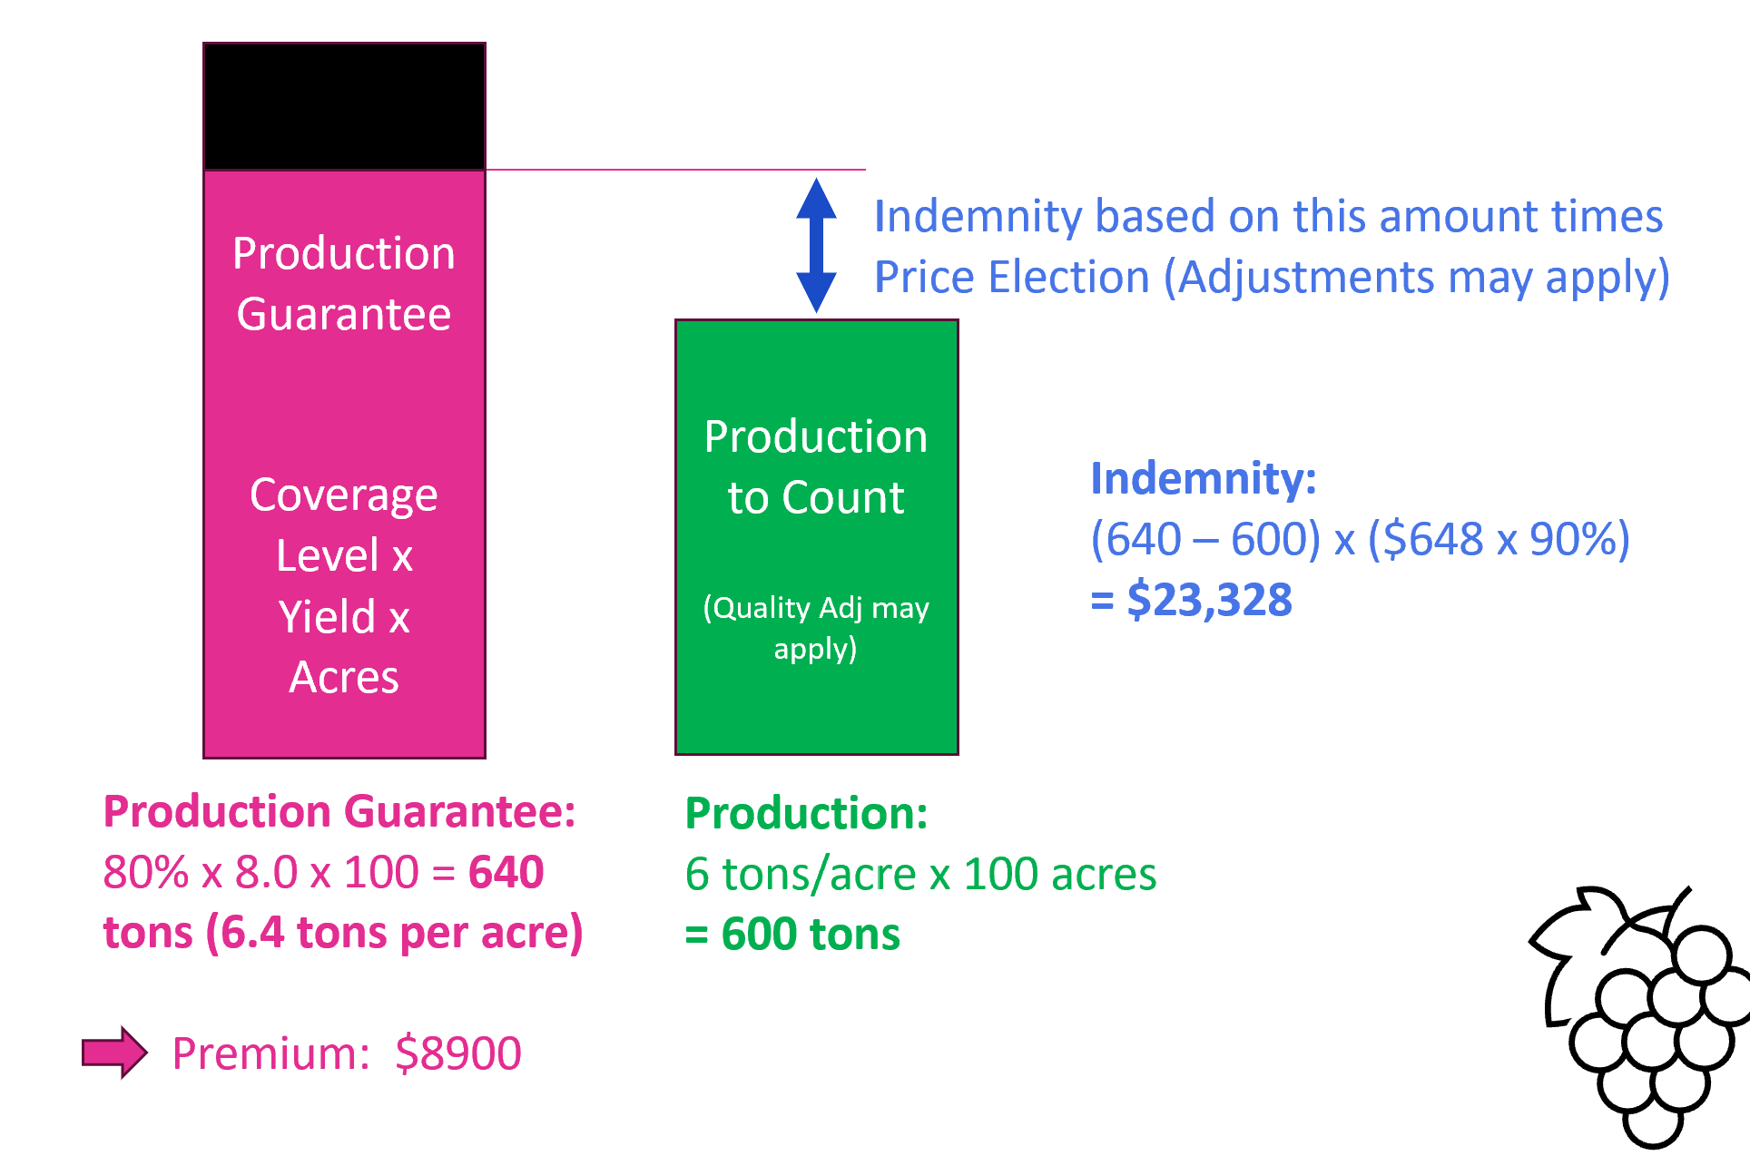
Estimated Premiums
Estimates from RMA website (RMA.USDA.Gov > Tools > Cost Estimator > Plan Comparison)
Estimated amounts without adjustments. Contact an agent for the actual premium amounts and to inquire about indemnity scenarios.
$?
2024 SJ Cab Sv
100 acres, 8 t/a
No options
 | Coverage Level % (Guar. tons) | Price Election % (Amount/ton) | Producer Premium per acre (PP w/o Subsidy) | Indemnity
Prev Ex | 80% (640) | 90% ($583) | $89/a (171/a) | $23,328 | $186,560
Max Buyup | 85% (680) | 100% ($648) | $148/a (239/a) | $51,840 | $233,280
Mid | 70% (560) | 80% ($518) | $38/a (92/a) | 0 | $124,320
Min Buyup | 50% (400) | 100% ($648) | $13/a (39/a) | 0 | $51,840
60% Linkage | 60% (480) | 100% ($648) | $24/a (67/a) | 0 | $103,680
CAT | 50% (400) | 55% ($356) | $655 FEE | 0 | $28,480
6 t/a
25% Loss
3.2 t/a
60% Loss
Takeaways
Coverage Level has more impact than price election on cost
Subsidy factor decreases as Coverage Level increases
CAT coverage affordable but covers only the most severe losses
Buyup could be less expensive than CAT for small acreage policies
Options can increase or decrease the premium amount.

Slide 11
Paid Premiums vs Indemnities
301
CaliforniaGrapes
2023 not yet complete (as of Feb 22, 2024)
More indemnity was paid than premium was collected in these years

Slide 12
Paid Premiums vs Indemnities
Works!
Indemnity to Paid Premium Ratio:
Represents amount of indemnity paid per $1 of paid premium
Excluding 2020, $2.38 indemnity paid for ever dollar of premium collected
$17.29
2023 to date: $1.49 paid out per dollar of paid premium
Break even

Slide 13
Trends
Popular!
Average Coverage Levels – Increasing
Buyup vs CAT Acreage % - More policies with buyup than CAT coverage

Slide 14
Recent Program Improvements and the Future (?)
Program Improvements
Modified Unharvested Factors (2023)
Added another option to increase approved yields (2024)
Future?
Adding option to provide coverage up to 95% in 2025
Analyzing Smoke-Taint Research by Universities
Potential Endorsement to easily cover some of the smoke damage
Program design similar to Hurricane Program
Utilizes satellite imagery on a county by county basis
No loss adjustment for the endorsement indemnity
Endorsement will cover losses between 95% and the coverage level based on smoke “events”
Individual Policy Covers Losses up to the Coverage Level

Slide 15
Whole Farm Revenue Protection (WFRP) & Micro Farm
Revenue based program for considers revenue from all crops on a farm, including livestock
Guarantees your revenue for the year
Utilizes tax records (minimum five years with exceptions)
May be purchased with the grape policy or stand-alone
Subsidy factor depends on number of commodities and coverage level
Catastrophic WFRP coverage not available
Sales Closing Dates for CA Calendar Year and Early Fiscal Year Filers:
February 28 for WFRP
March 31 for Micro Farm
196 Policies, Indemnities Pending

Slide 16
Whole Farm Revenue Protection (WFRP) & Micro Farm
Micro Farm
WFRP for smaller operations
Only three years of tax records required
More beneficial subsidy factor structure (same as multiple commodity table for WFRP)
Option available to remove lower years of historic revenue
RMA made significant improvements for 2024, including:
Maximum WFRP coverage level of 85% available to all
Increased subsidy factors for single commodity WFRP producers
Underlying policies can be at the CAT level for WFRP
Micro Farm Sales Closing Date moved back
Micro Farm can now be purchased with other crop insurance policies.
Sales Closing Dates for CA Calendar Year and Early Fiscal Year Filers:
February 28 for WFRP
March 31 for Micro Farm

Slide 17
Grapevine Crop Insurance Policy
Covers “destroyed” vines damaged within the insurance period (Dec – Nov) due to freeze, hail, flood, fire, or a naturally occurring failure of the irrigation water supply
Losses due to insects and disease not eligible
Eligible only in Lake, Mendocino, Monterey, Napa, San Luis Obispo, and Sonoma
Other counties being considered for future years
Doesn’t affect Grape Crop Insurance Policies
Vineyard must have 600 vines per acre
Coverage Levels Available: CAT, 50% to 75%
Sales Closing Date Passed for 2024:
November 1, 2023

Slide 18
Grapevine Crop Insurance Policy
7.5 million Vines insured in CA in 2024
94% at the CAT level ($655 fee)
Average Paid Premium per vine insured at buyup coverage levels: $0.21
Sales Closing Date Passed for 2024:
November 1, 2023

Slide 19
A Few Other Takeaways…
Grape Policy has many unique features that are beneficial and can be customized
Rates are not calculated to result in a profit
Cost of the insurance does not vary by company or by agent
Losses can't be the result of marketing issues or farming practices
Future premiums are not based on your own losses
A good business decision
We hear you…

Slide 20
Risk Management Agency
Davis Regional Office (AZ, CA, HI, NV, UT)
RSOCA@usda.gov
Phone: 530-792-5870
Voice Messages Generate an Email
Director Jeff Yasui
Jeff.Yasui@usda.gov
Phone and Voice Message: 530-792-5871
Deputy Director Ruben Saavedra
Ruben.Saavedra@usda.gov
Subject Matter Experts
Specialist Thalia.Barajas@usda.gov
Senior Specialist Laura.Hernandez@usda.gov

