Slide 1
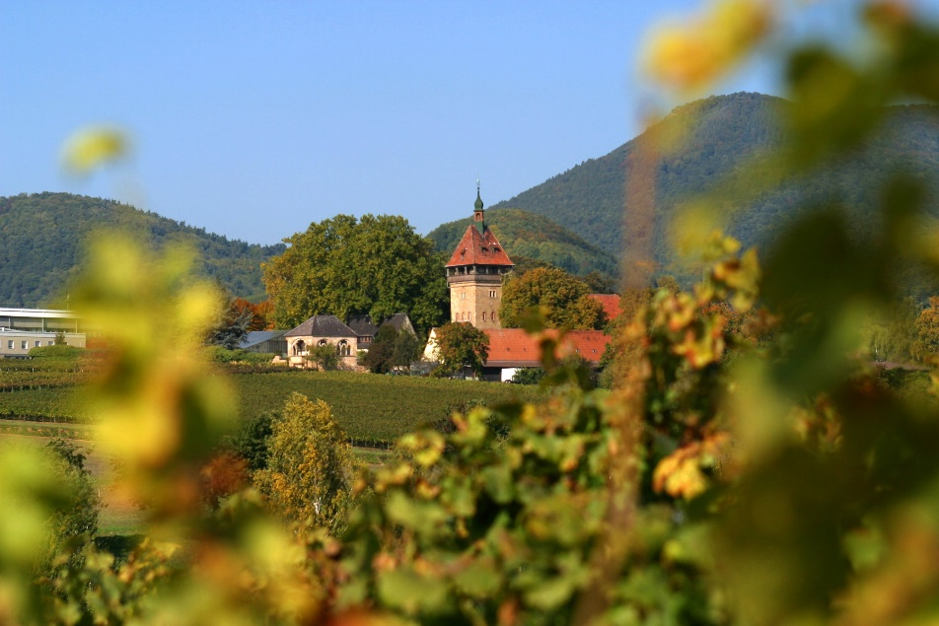
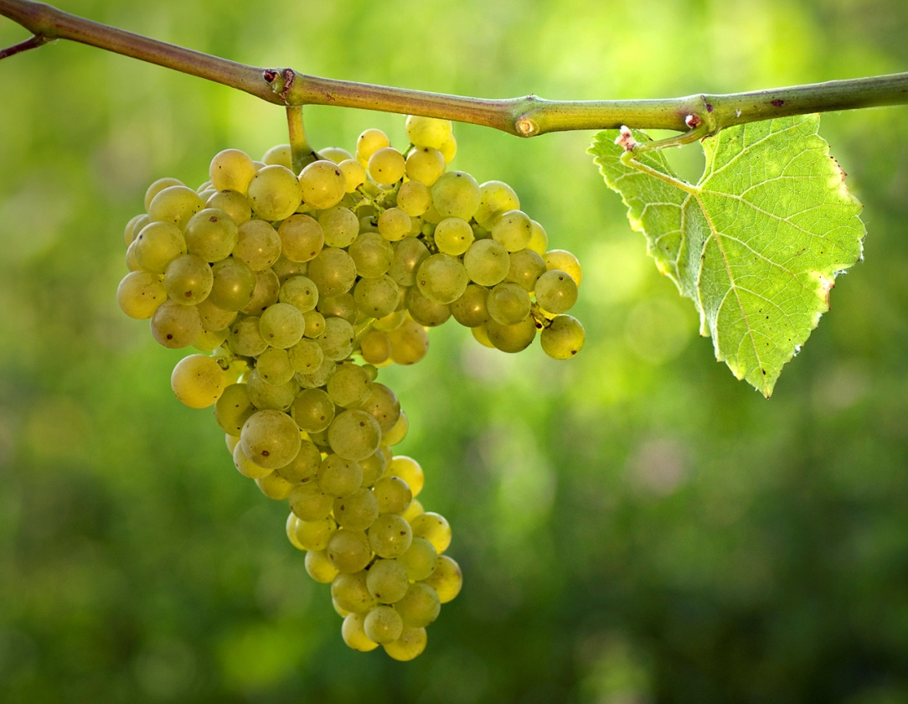
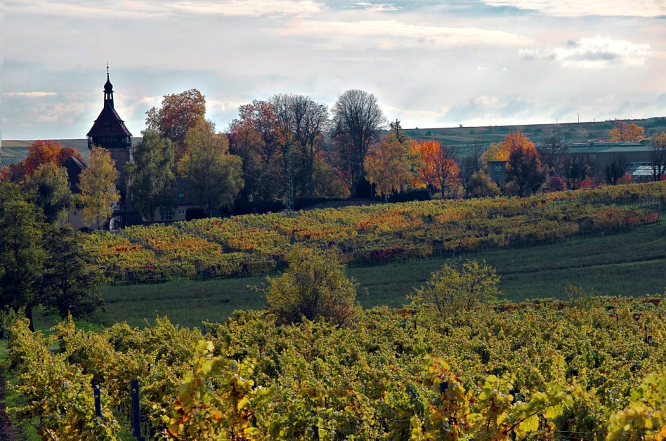
New Disease-Resistant Grapevine Cultivars for a Sustainable Viticulture
2024 Unified Symposium - January 23rd, 2024
Oliver Trapp
Julius Kühn Institute – Institute for Grapevine Breeding Geilweilerhof
Germany

Slide 3
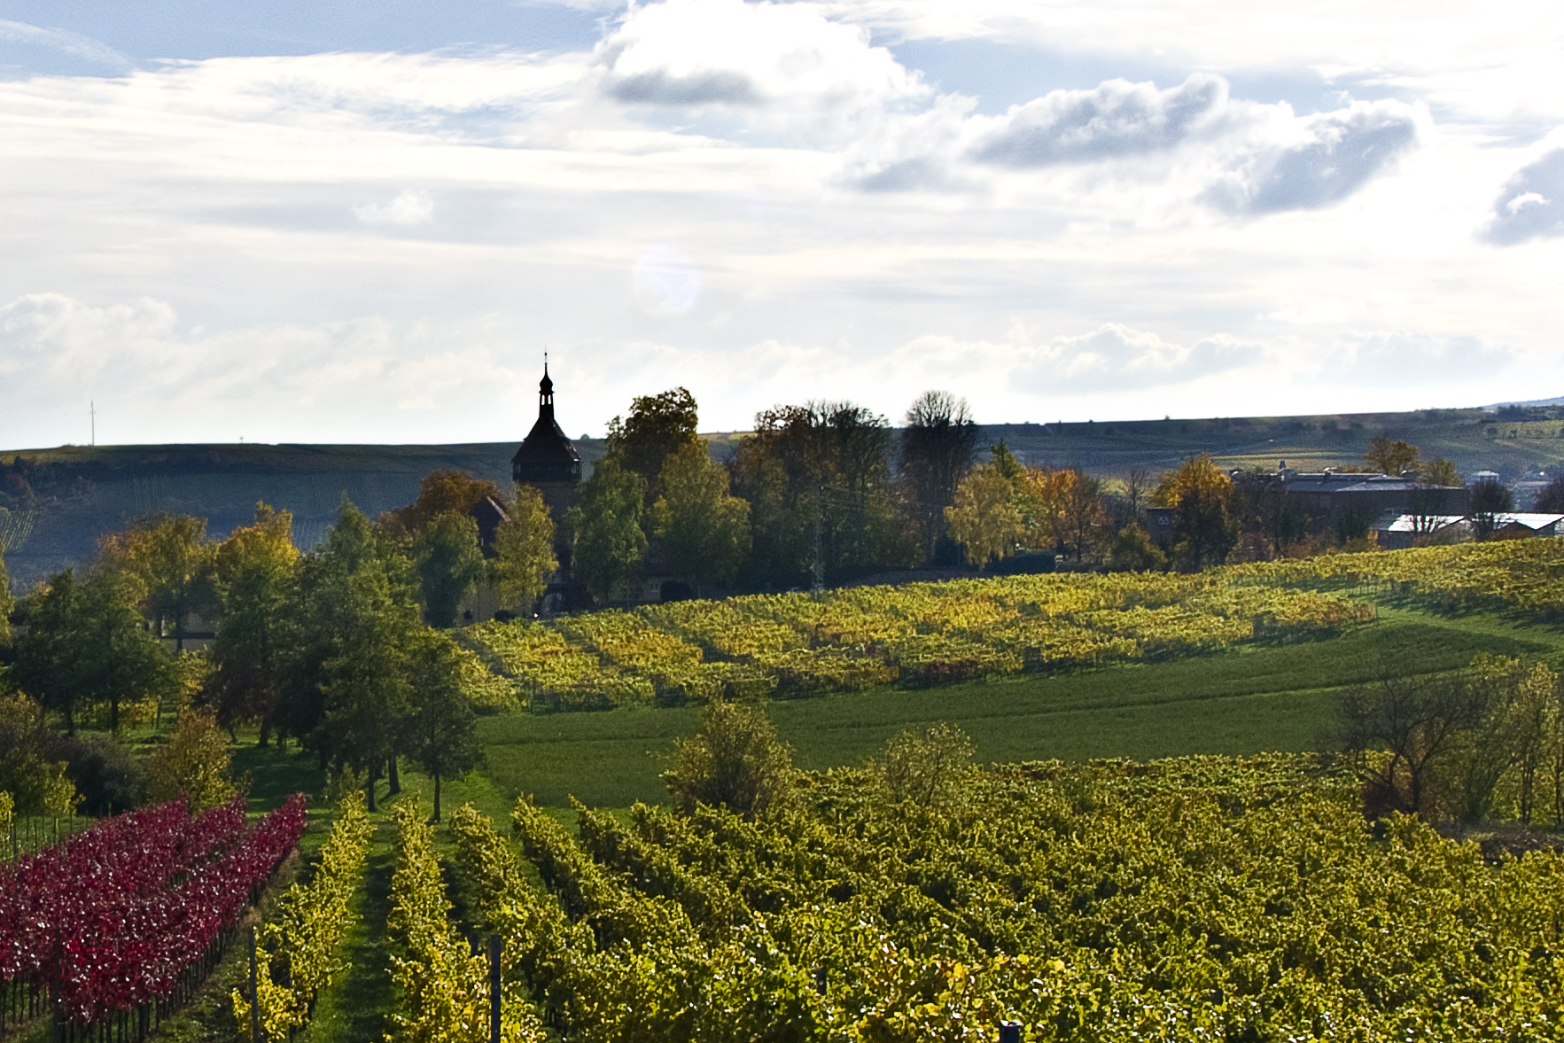
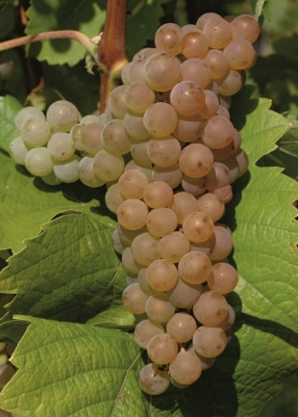
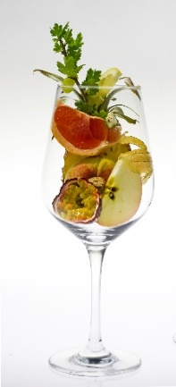
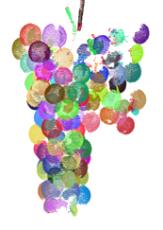
Overview of the Institute for Grapevine Breeding Geilweilerhof
Genetic Ressources
Collection, preservation and exploitation of grapevine genetic ressources
Information network for vine and wine: Databases (e.g. VIVC and Vitis-VEA)
Breeding
Breeding Research
Digitalization:
HT Phenotyping
Precision Viticulture
Genetics: HT Genotyping and marker development:
Resistence (biotic and abiotic)
Wine quality
Genetic Ressources
Breeding
Breeding Research
new grapevine cultivars for sustainable viticulture
Development of new, climate-adapted and disease-resistant grapevine cultivars with high quality wines

Slide 4
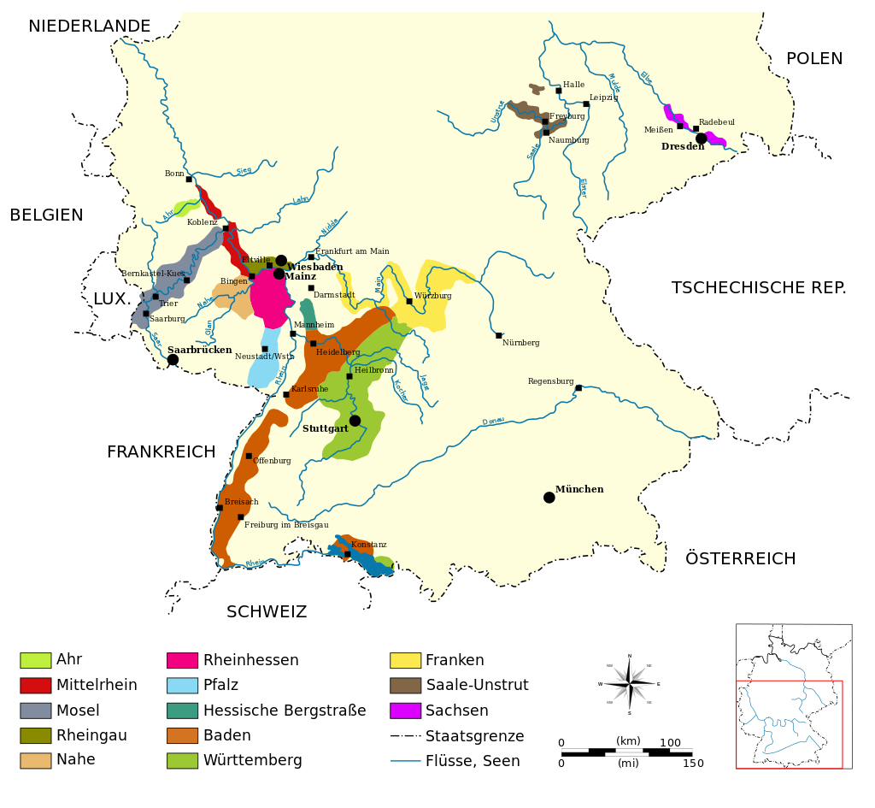
Viticulture in Germany
103.500 ha planted with grapevines mainly in the southern part of Germany
Focus on wine grapes
Annual production of around 9 mil. hl wine
Annual export of 1 mil. hl wine (19% to the US (2018))
No varieties with taste of wild Vitis species (such as Isabella, Concord, Niagara)
Vitis vinifera shows no resistance against the main grapevine pests
50° lat.
Notes:
256.000 acre

Slide 5
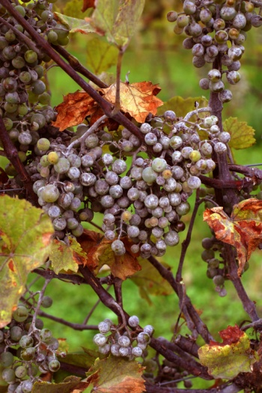
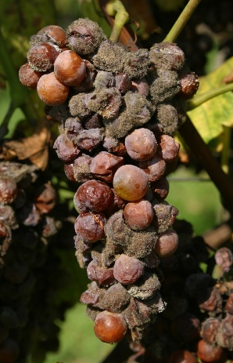
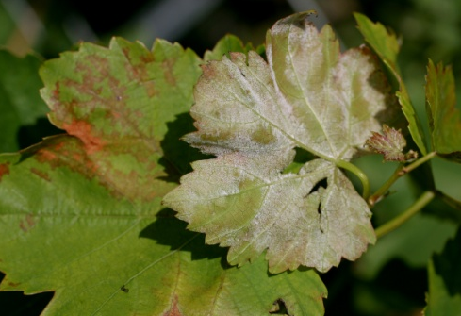
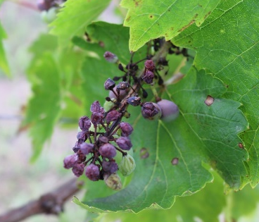
Fungal Diseases in European Viticulture
Downy Mildew
Black rot
Powdery Mildew
Botrytis cinerea
→ Need for intense fungicide treatments
Notes:
Quantity of PPP sold

Slide 6
Fungicide Use in Viticulture
(Eurostat, 2007)
Around 2/3 of the fungicides used in agriculture in the EU are used in viticulture
Viticulture constitutes ~4% of the agricultural area in the EU
Notes:
Quantity of PPP sold

Slide 7
European Green Deal
„The Commission will take additional action to reduce the overall use and risk of chemical pesticides by 50% and the use of more hazardous pesticides by 50% by 2030.”
Reduction of fungicide use is the main goal for grapevine breeding
Notes:
Transform the EU into a modern-resource efficient and competitive economy and be the first climate-neutral continent

Slide 8
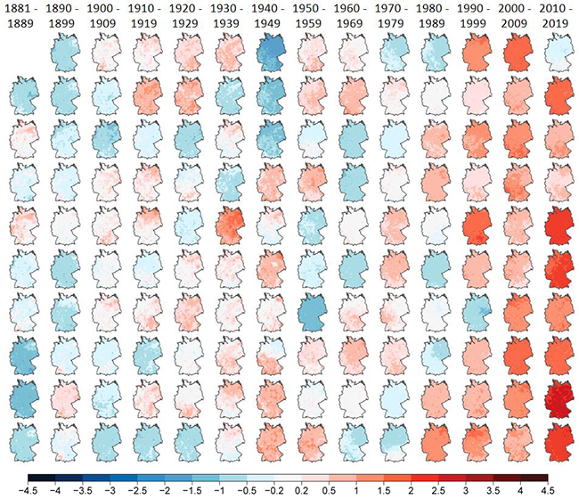
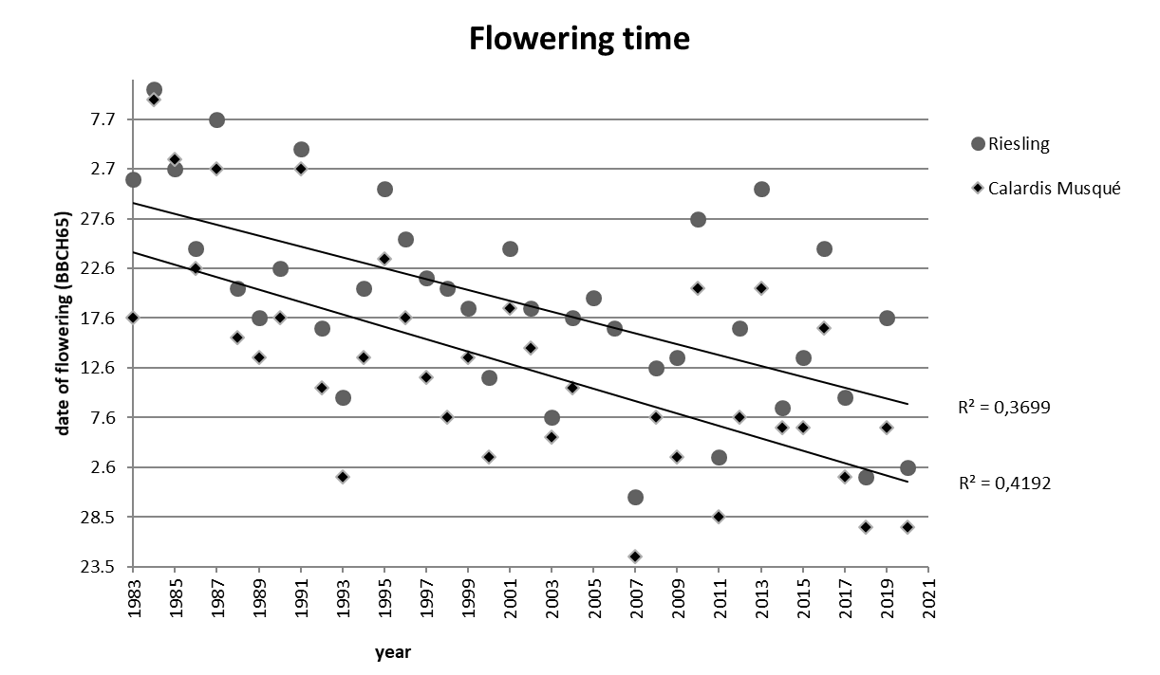
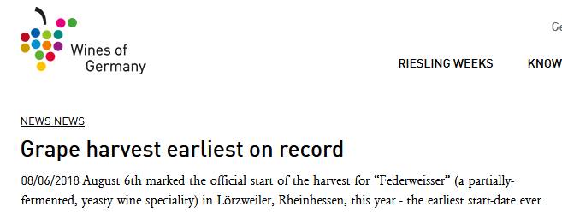
Climate Change as driving force for varietal change
Late spring frost (Anna Schwandner, JKI)
Sunburn on grapes
(Source: Rebecca Höfle, JKI)
(Florian Schwander, unpublished)
Temperature anomalies for Germany (1881 - 2019) compared to the mean of 1961-1990. Source: DWD
(www.germanwines.de)

Slide 9
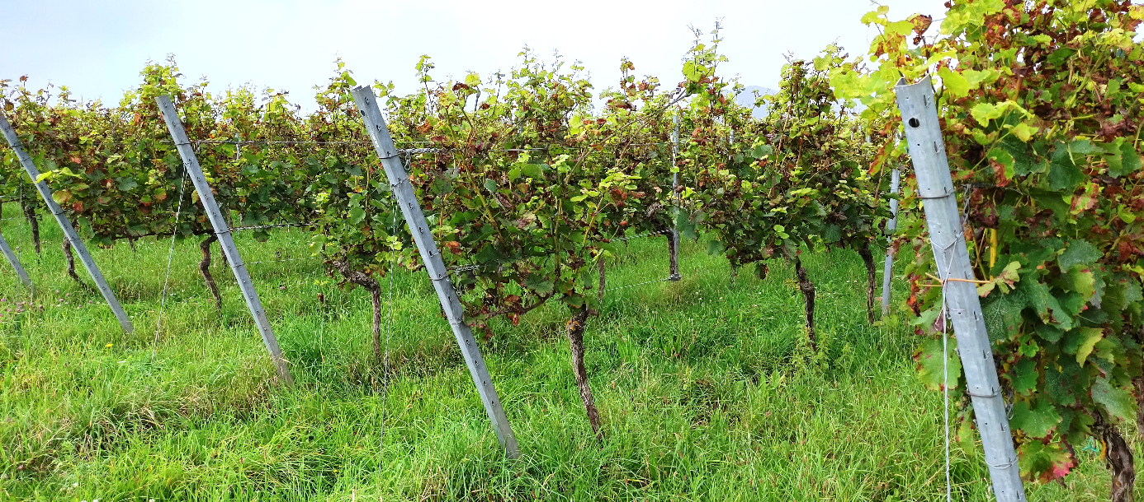
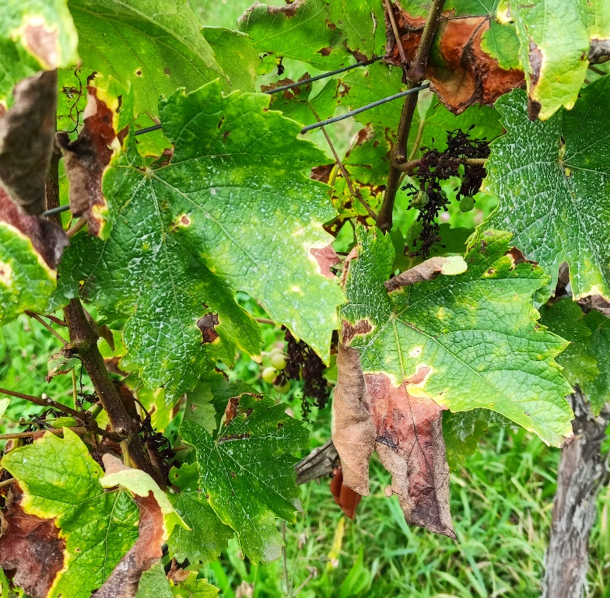
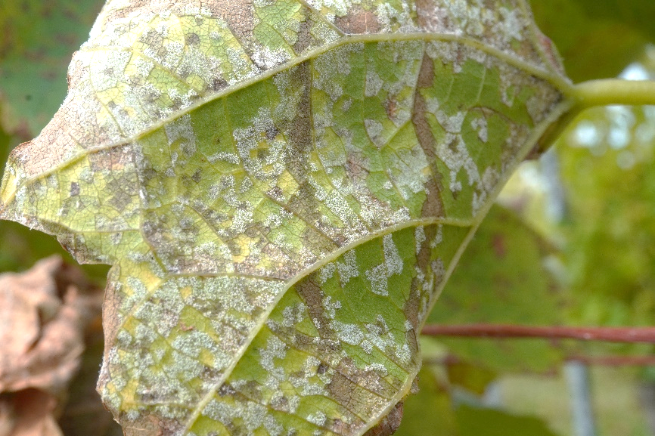
Extreme weather conditions
Extreme weather events are occurring more often:
2016: very wet spring
2017: late spring frost
2018-2020: very hot and dry
2021: extremely wet and rainy
2022 & 2023: hot and dry
(2021)

Slide 10
Breeding Categories and Selection Criteria at the JKI
Quality of Wine
Seeds generated each year by crossing: 20.000 – 80.000
Seedling
Resistance
Primary
Intermediate
Main
1
10
50
500
Viticultural characteristics
MAS
app. 25 years

Slide 11
Marker Assisted Selection (MAS)
„Resistance loci“ can be traced with molecular markers (similar to paternity tests)
Molecular markers allow an estimation of the level of resistance already at the seedling stage
Mainly resistances against Downy and Powdery Mildew are traced and used for selection at the JKI
Downy Mildew
Locus | Rpv1 | Rpv3.1 | Rpv3.2 | Rpv3.3 | Rpv10 | Rpv12
Estimated Strength | medium | weak | medium | weak | strong | strong
Powdery Mildew
Locus | Run1 | Ren1 | Ren3 + Ren9 | Ren4
Estimated Strength | very strong | strong | medium | very strong
No suitable markers for Botrytis resilience, abiotic stress tolerance, phenology, yield … yet.

Slide 12
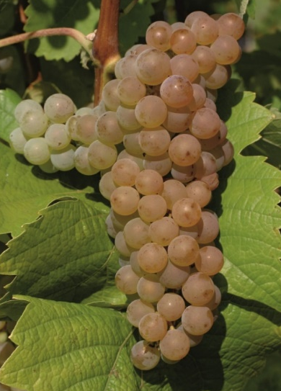
Grapevine Varieties of the JKI
Resistance loci
# | Variety | Protection | Registration | Color | Rpv1 | Rpv 3.1 | Rpv 3.2 | Rpv3.3 | Rpv10 | Rpv 12 | Run1 | Ren1 | Ren3/9 | Ren4
1 | Phoenix | 1992 | 1992 | B |  | X |  |  |  |  |  |  | X
2 | Orion | 1994 | 1994 | B |  | X |  |  |  |  |  |  | X
3 | Regent | 1994 | 1995 | N |  | X |  |  |  |  |  |  | X
4 | Calandro | 2009 | 2011 | N |  | X |  |  |  |  |  |  | X
5 | Villaris | 2004 | 2011 | B |  | X |  | X |  |  |  |  | X
6 | Reberger | 2004 | 2011 | N |  |  |  |  |  |  |  |  | X
7 | Felicia | 2004 | 2020 | B |  | X |  | X |  |  |  |  | X
8 | Calardis Blanc | 2018 | 2020 | B |  | X | X |  |  |  |  |  | X
9 | Calardis Musqué | 2023 |  | B |  |  | X |  |  |  |  |  | X
10 | Artaban | 2018 |  | N | X | X |  |  |  |  | X |  | X
11 | Vidoc | 2018 |  | N | X | X |  |  |  |  | X |  | X
*
*
*
ResDur1 collaboration
→ Overall, there are more than 30 disease-resistant varieties officially registered in Germany and more than 100 are allowed for planting and winemaking.

Slide 13
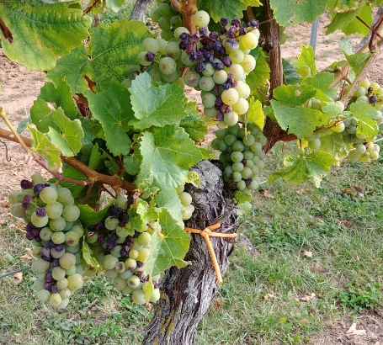
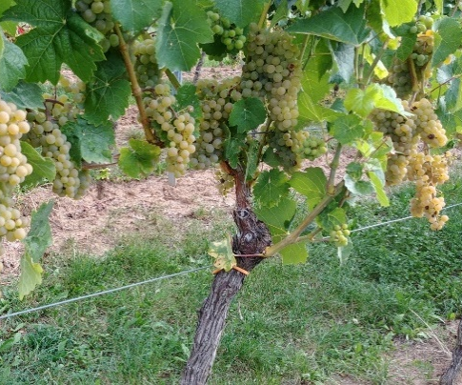
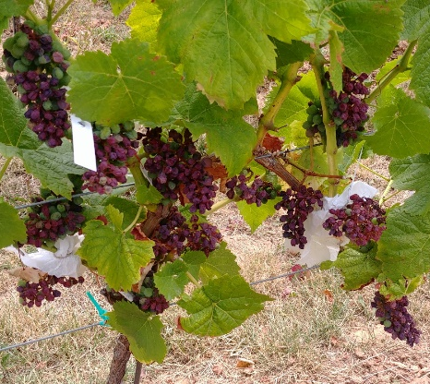
Calardis Blanc
Breeding goal:
Development of new, climate-adapted and disease-resistant grapevine cultivars with high quality wines
Adaptation to climate change:
Most disease-resistant varieties in Germany are early ripening, Calardis Blanc is medium-late ripening
Calardis Blanc exhibits slow sugar accumulation
Calardis Blanc is highly resilient to sunburn:
Harvest date comparison:
Days of the year
Sylvaner
Calardis Blanc
Breeding line
Notes:
Silvaner was present in Sonoma, also called Sonoma Riesling

Slide 14
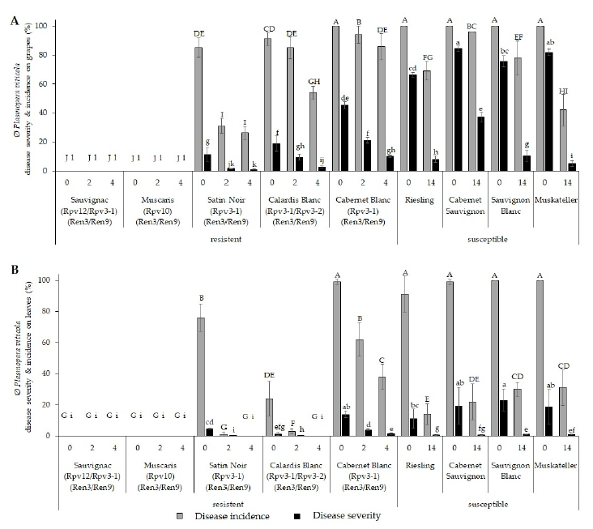
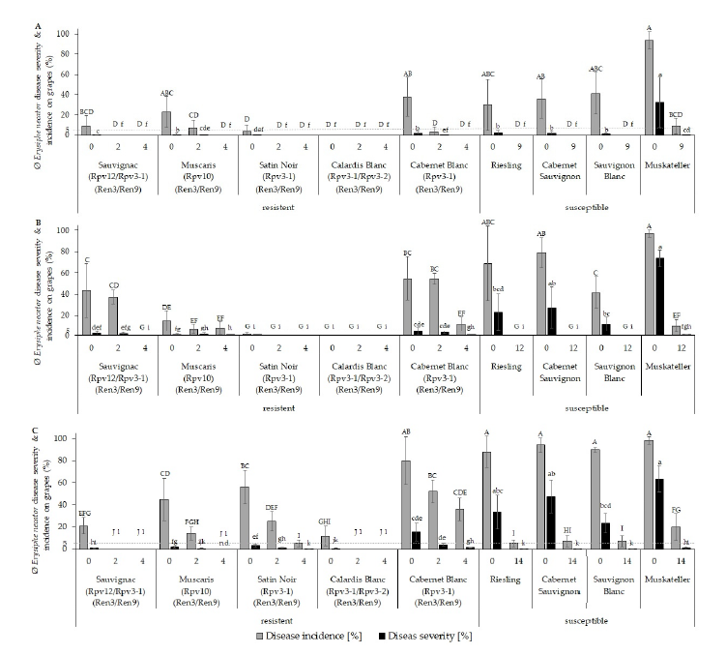
Calardis Blanc
Breeding goal:
Development of new, climate-adapted and disease-resistant grapevine cultivars with high quality wines
Disease resistance and fungicide saving potential:
Downy Mildew in 2021
Powdery Mildew
2019
grapes
2020
leaves
2021
Eisenmann, Wingerter et al., 2023

Slide 15
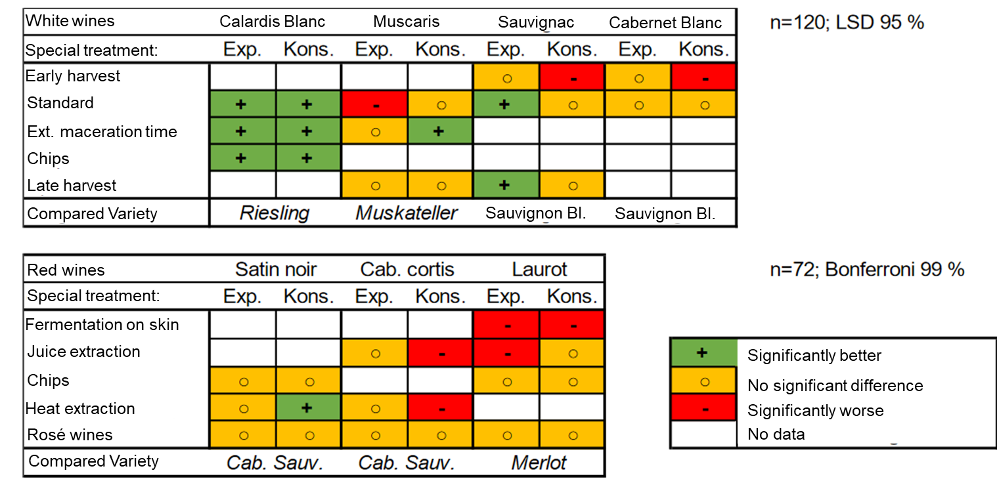
Calardis Blanc
Breeding goal:
Development of new, climate-adapted and disease-resistant grapevine cultivars with high quality wines
High wine quality:
(modified from Weber, Kohlmann, Fischer, 2021)
Notes:
Silvaner was present in Sonoma, also called Sonoma Riesling

Slide 16
Calardis Blanc - A Solution for Sustainable Viticulture
Good resistance against Downy and
Powdery Mildew
Black rot resistance
Loose bunches → good resistance against Botrytis (gray mold)
Upright growth
Flowering and harvest time shortly before Riesling, moderate sugar accumulation
Very resilient to sunburn
High potential for sparkling
wine production
Fungicide reduction of
more than 70% possible
Calardis Blanc
(Calardis Musqué x Seyve Villard 39-639)
Rpv3.1
Rpv3.2
Ren3/9
Rgb1.3
Light summer wine with a very nice and tangy acidity and light aromatic bouquet with traces of grapefruit, passionfruit and gooseberry

Slide 17
Adoption of Disease-Resistant Varieties in Germany
Consumer have a deep attachment to traditional European grapevine varieties
Preference for varietal wines of familiar varieties
‚Regent‘ broke the ice in 1995 as first disease-resistant variety allowed for quality wine production
Years with high disease pressure and political and public pressure for more sustainability are now leading to a change of mind of the winegrowers
Area under disease-resistant vines saw a significant increase in the last two years in Germany and other European countries and is going to rise even faster
Rank | Disease-resistant Variety | Acreage 2022
 |  | in ha
1. | Regent | 1.618
2. | Cabernet Blanc | 260
3. | Solaris | 207
4. | Souvignier Gris | 204
5. | Johanniter | 141
6. | Muscaris | 117
7. | Cabernet Cortis | 60
8. | Calardis Blanc | 52
9. | Phoenix | 46
10. | Pinotin | 36
11. | Helios | 22
12. | Prior | 21
13. | Cabertin | 19
14. | Monarch | 13
15. | Saphira | 11
16. | Rondo | 10
17. | Cabernet Carbon | 7
18. | Hibernal | 8
19. | Cabernet Carol | 5
20. | Piroso | 5
21. | Bronner | 6
22. | Merzling | 3
23. | Staufer | 0
24. | Villaris | 0
 | Others* | 647
 | Total | 3.518

Slide 18
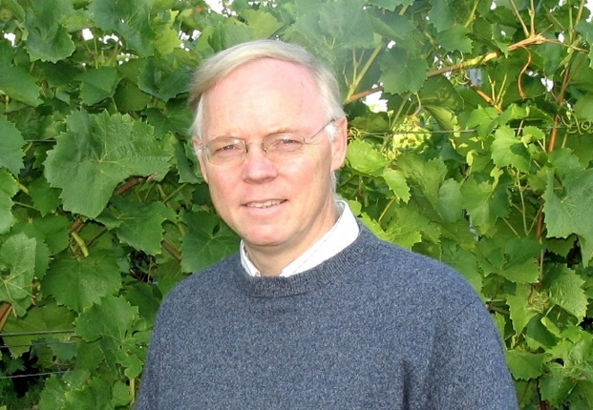
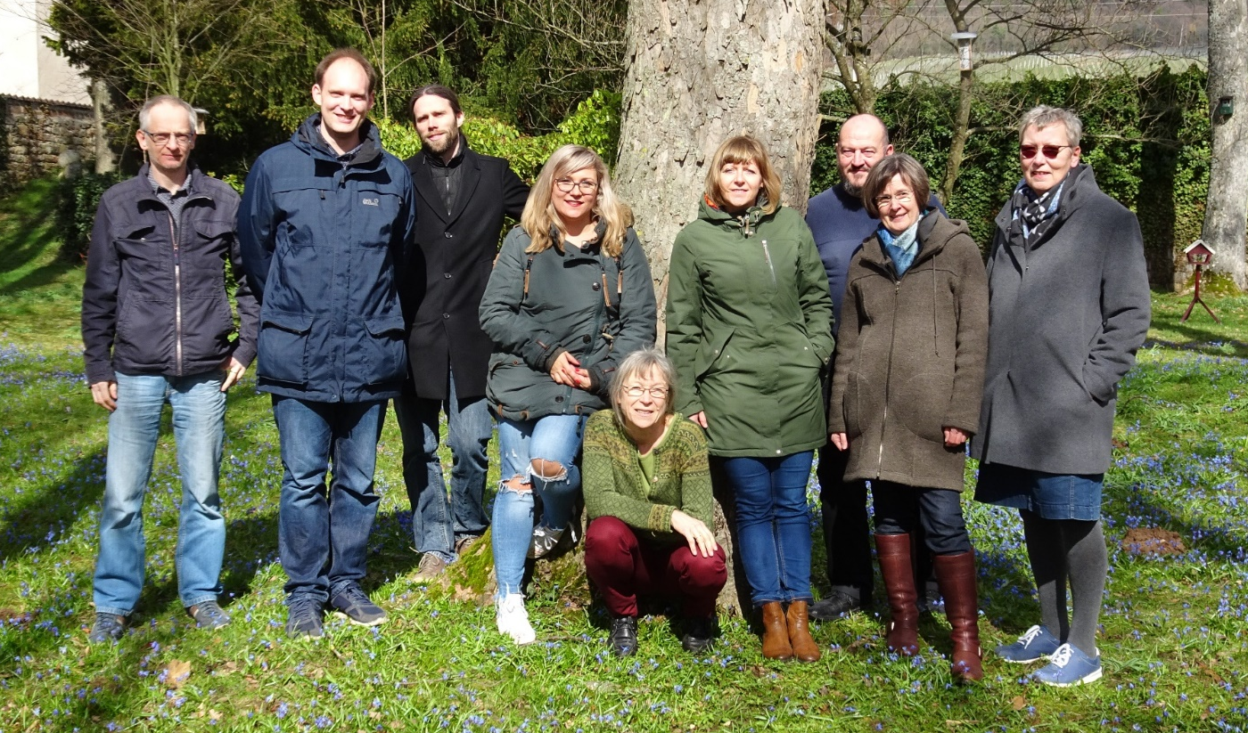
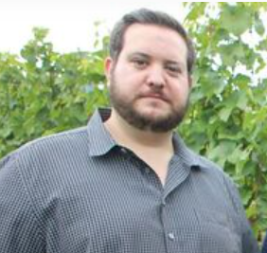
Acknowledgements
Prof. Dr. Reinhard Töpfer (Head of the Institute)
Ludger Hausmann, Florian Schwander, Oliver Trapp, Anna Kicherer, Erika Maul, Katja Herzog, Werner Köglmeier, Margit Harst, Eva Zyprian and Franco Röckel
…and their respective teams.

Slide 19
Contact:
Oliver Trapp
Julius Kühn Institute
Institute for Grapevine Breeding
Geilweilerhof
76833 Siebeldingen
Germany
E-Mail: oliver.trapp@julius-kuehn.de

