Slide 1
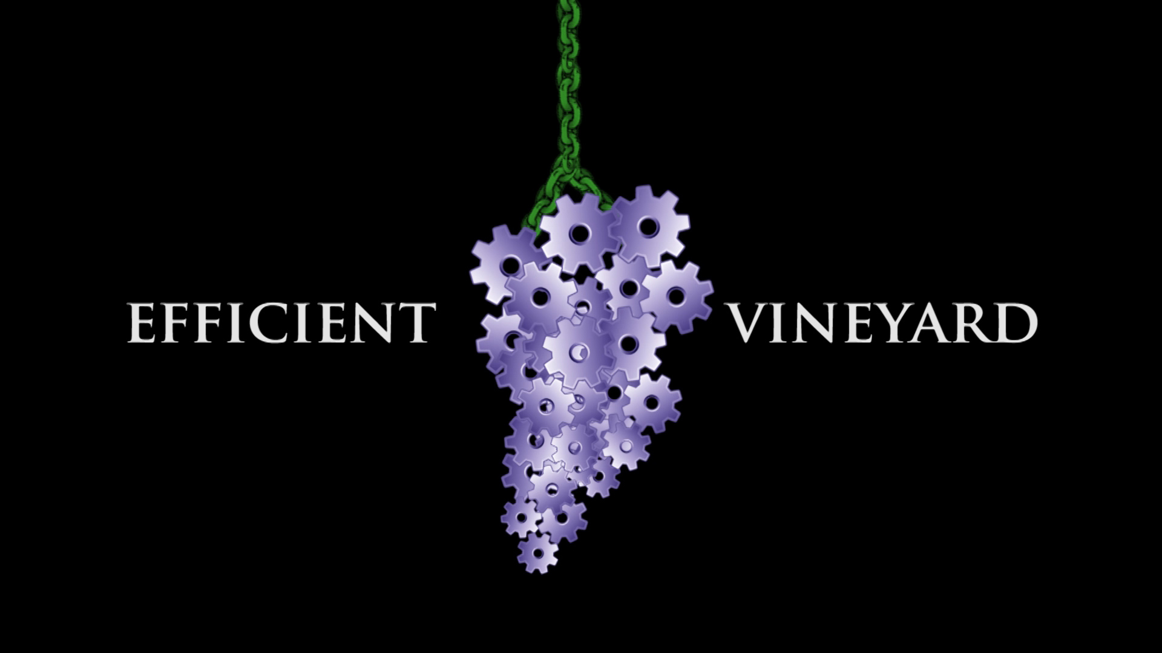

Slide 2
To Use Spatial Vineyard Data to Make More Informed Vineyard Management Decisions
… Not just about cool Tech

Slide 3
The Efficient Vineyard Approach
Measure
Model
Manage
Measure vineyard soil, canopy, and crop characteristics using mobile field sensors
Model multi-layer spatial data needed for perennial cropping systems
Manage vineyards by integrating spatial information with variable-rate technology

Slide 4
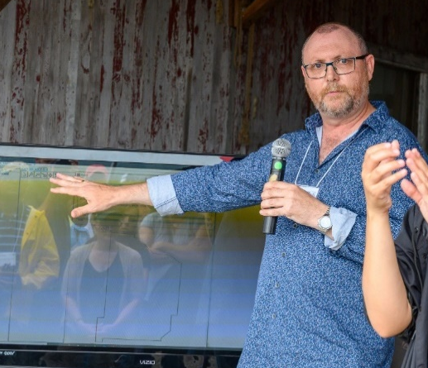
Martin Heidegger: The Question Concerning Technology
“We will never experience our relationship to the essence of technology so long as we merely represent and pursue the technological.”
James Taylor:
Too many existing 'gimmicks' in this space without content. It is still about decisions, which few people get. They think it is tech.

Slide 5
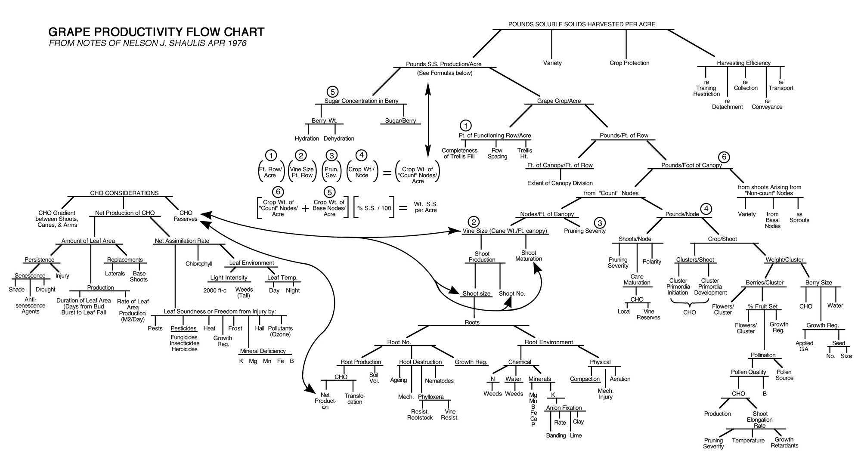
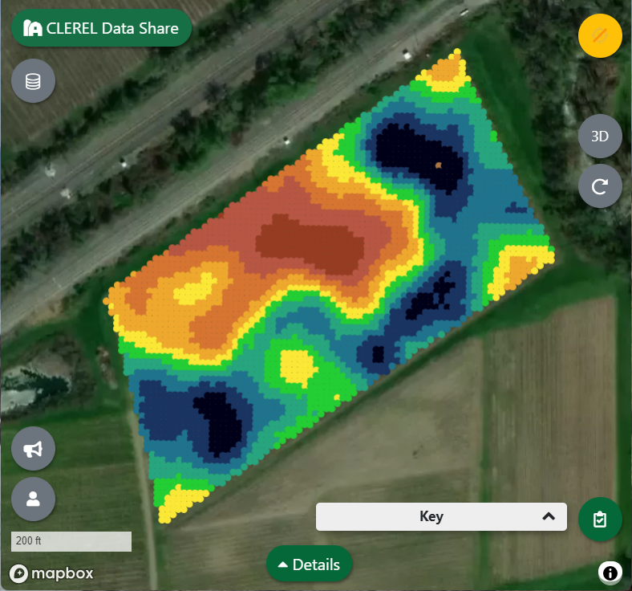
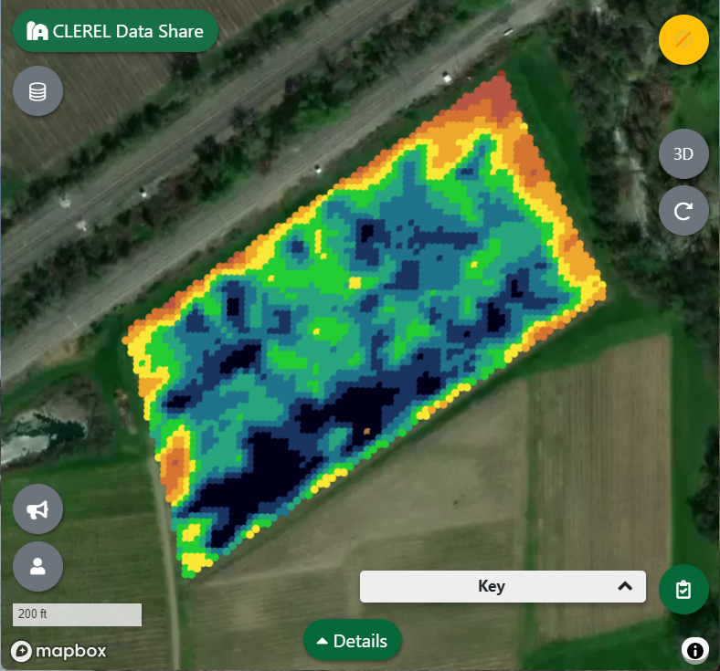
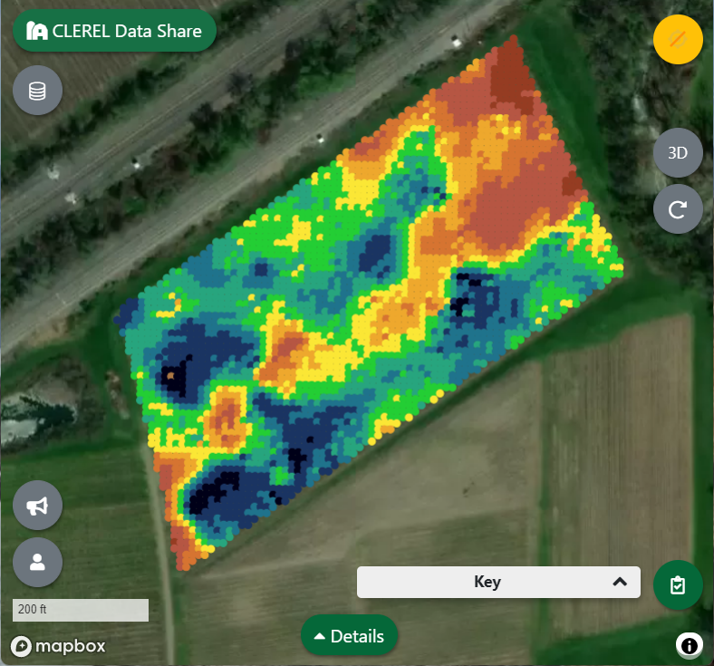
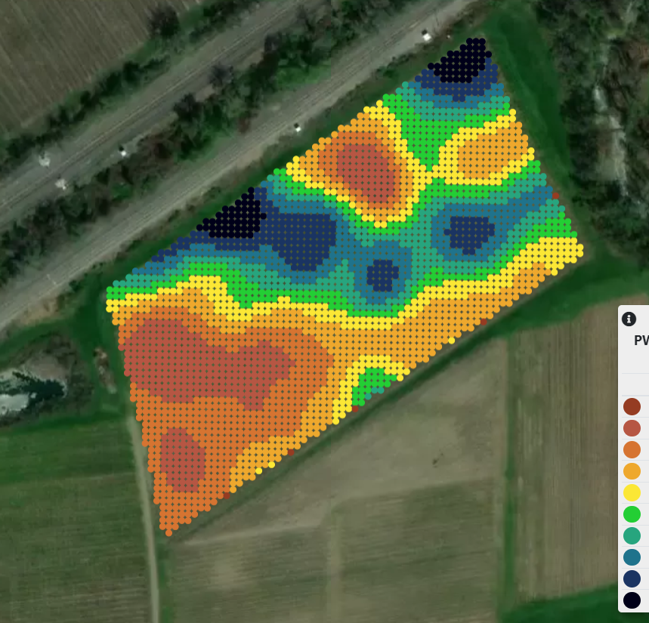
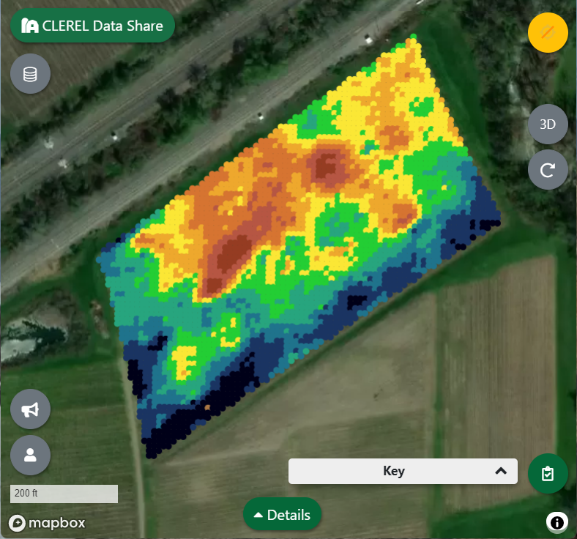
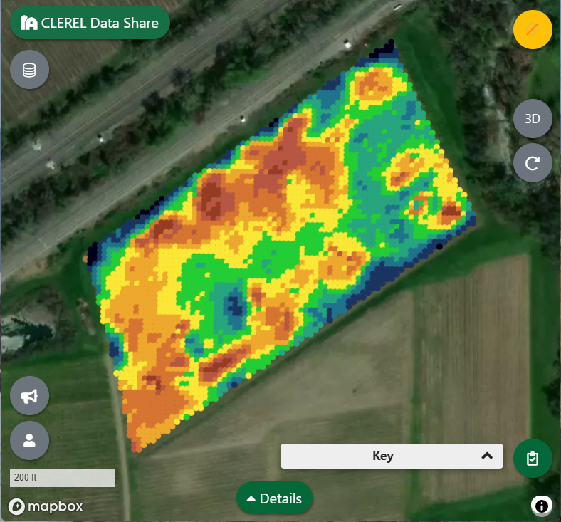
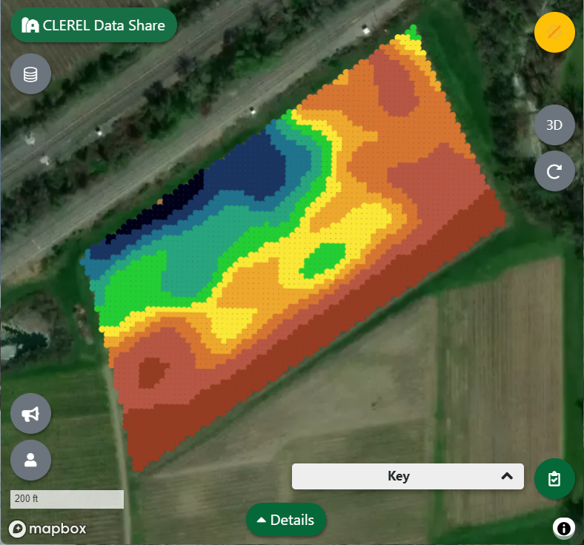
Technology is a Process of Revealing Truths in Nature
Fruit Quality
Fruit Yield
Vine Size
Canopy growth
and
Light Interception
Yield
Components
Leaf Nutrient
Status
Soils and Roots
Notes:
You must feel the Force around you. Here, between you, me, the tree, the rock—everywhere, yes. Even between the land and the ship.”

Slide 6

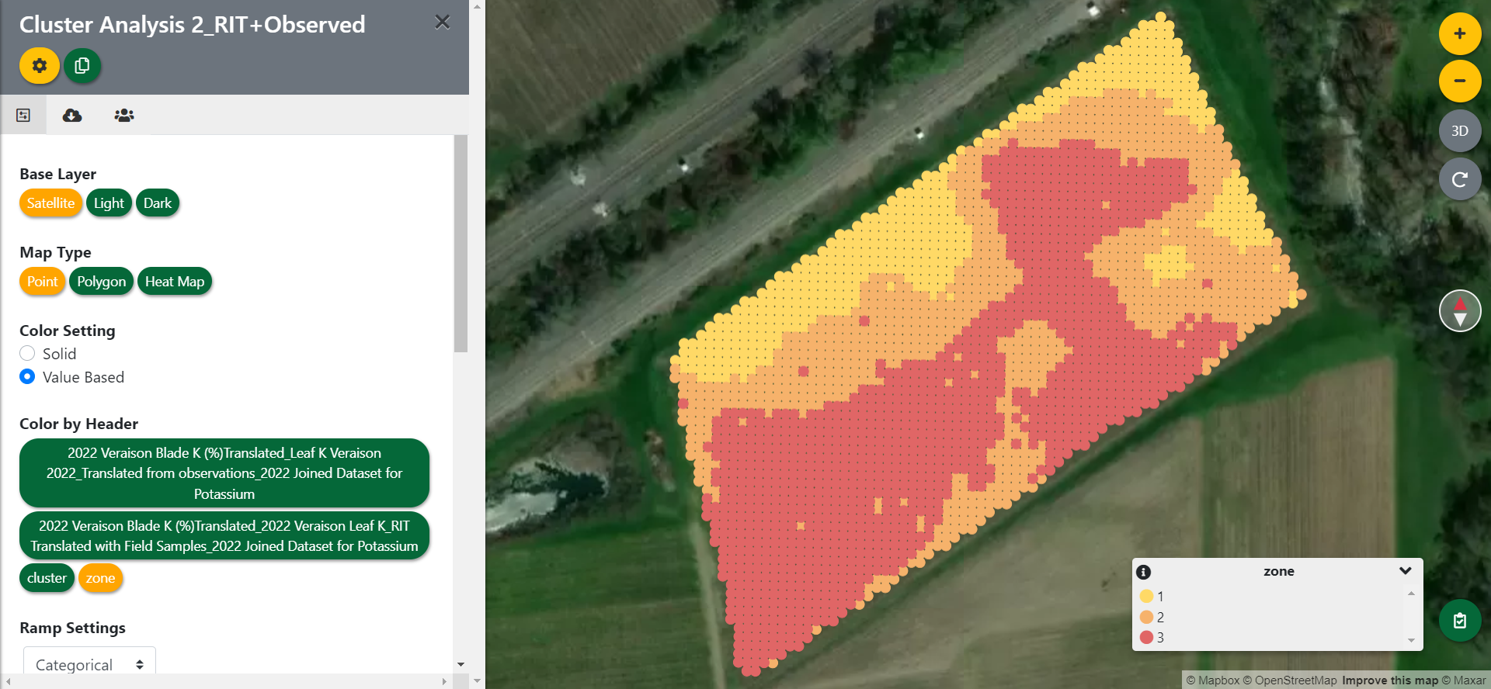
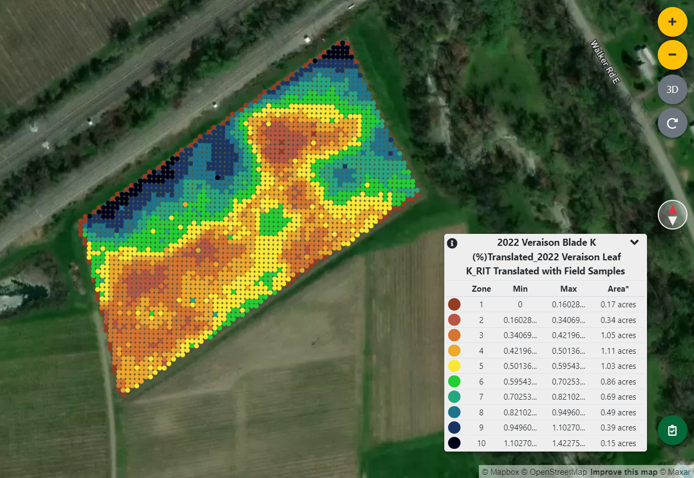
Nutrient Uptake
“Straight-line” Thinking
Hyperspectral Sensor
Tissue Nutrient

Slide 7
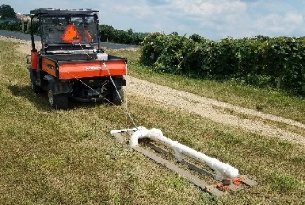
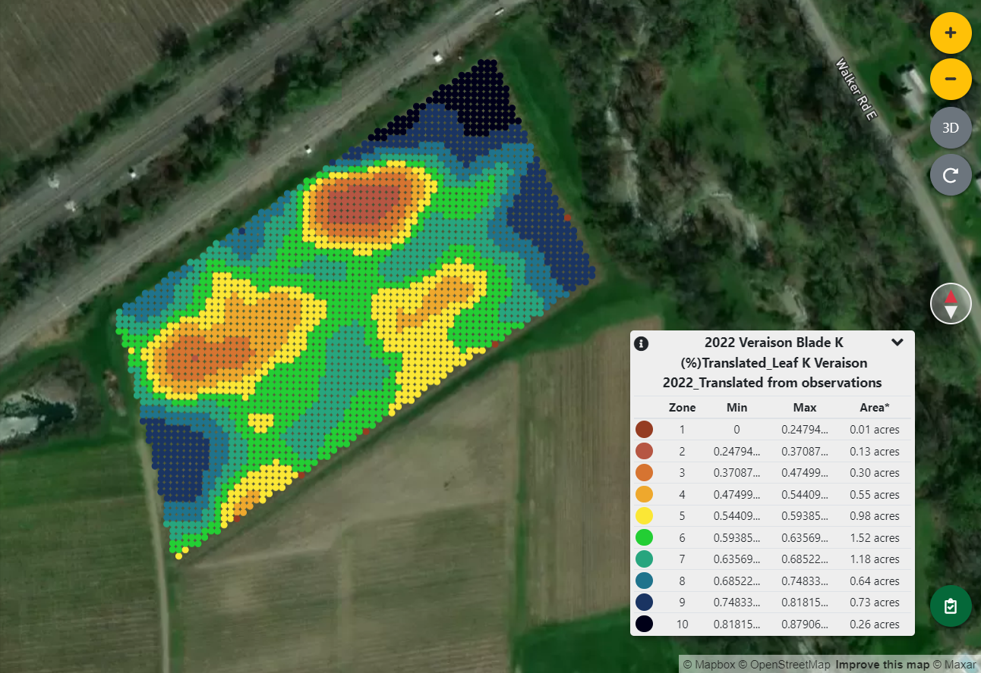
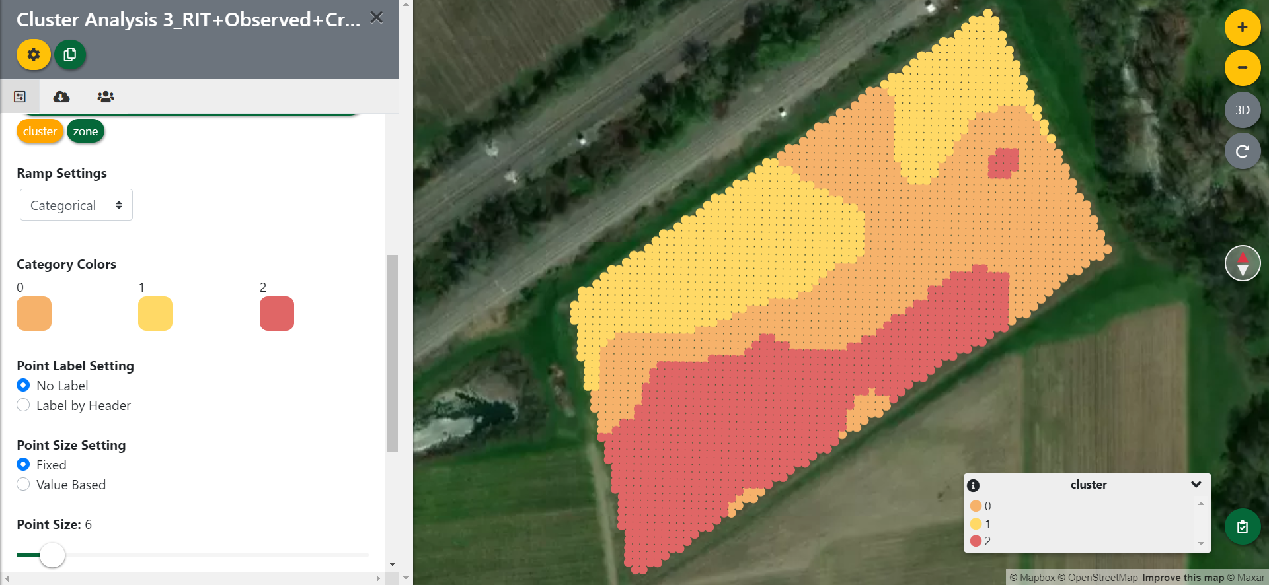
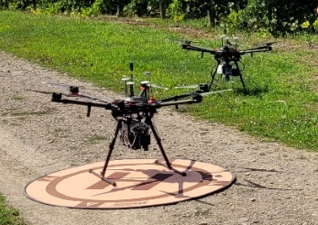
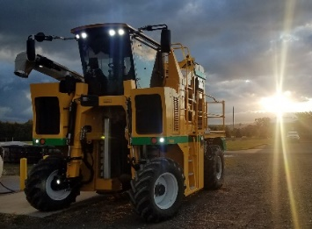
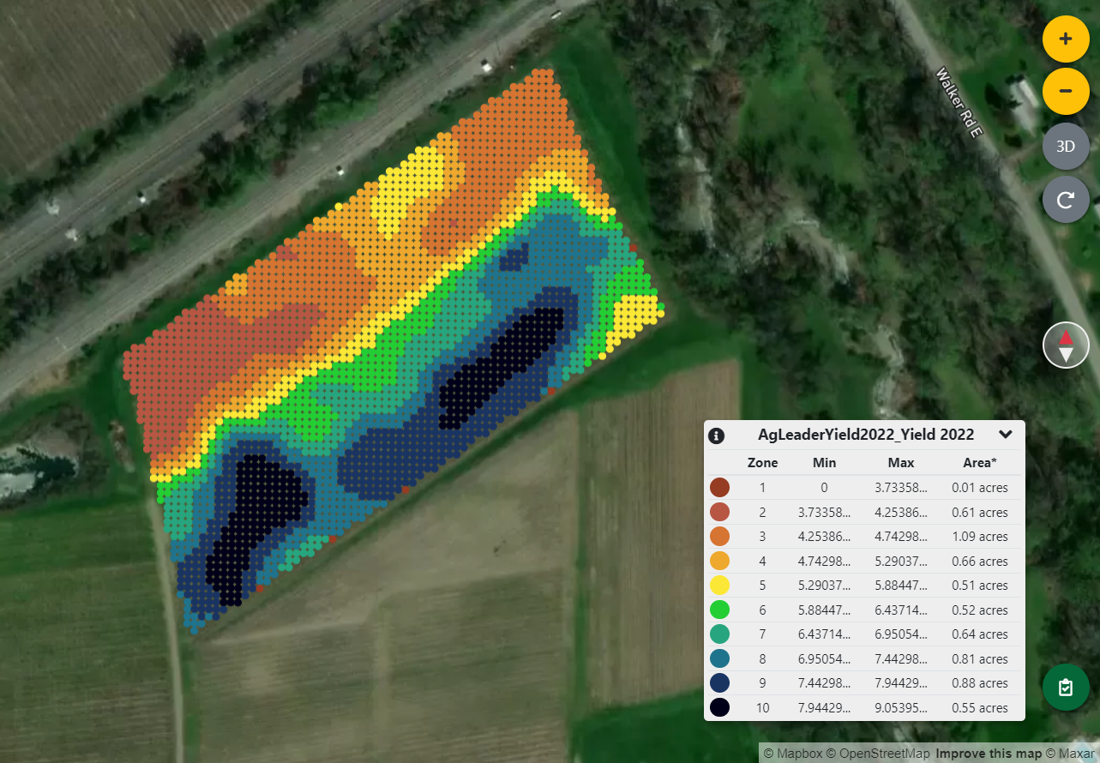
Nutrient Supply
“Multi-Layer” Thinking
Electromagnetic Sensor
Soil ECa
Nutrient Uptake
“Multi-Layer” Thinking
Hyperspectral Sensor
Tissue Nutrient
“Multi-Layer” Thinking
Nutrient Demand
Electromechanical Sensor
Crop Yield

Slide 8
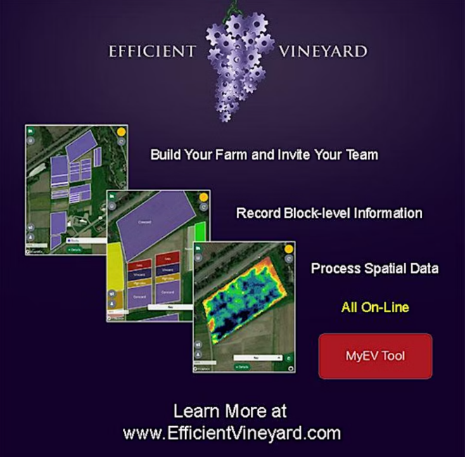
Accessible Outreach Tool for Vineyard Managers
Import and Process Spatial Vineyard Data from a Variety of Sources
Offer a Method to Validate Relative Sensor Data with In-field Observations
Allow for Multi-Layer Prescription Mapping

Slide 9
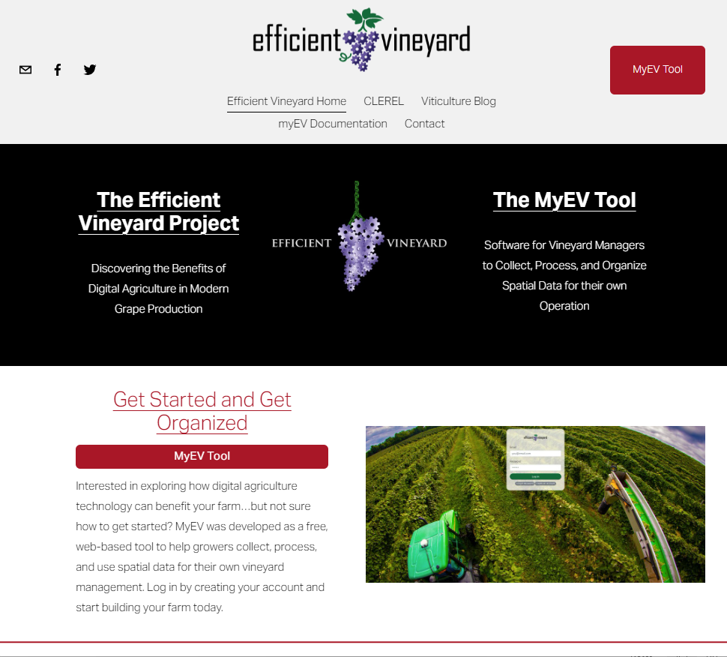
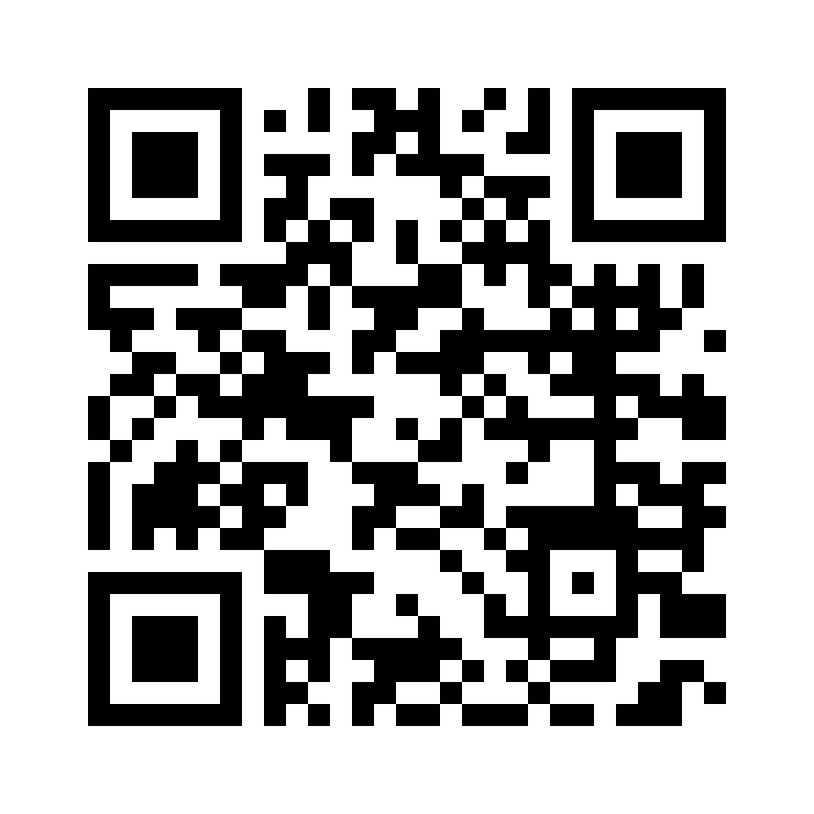
www.efficientvineyard.com

Slide 10
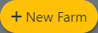

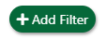
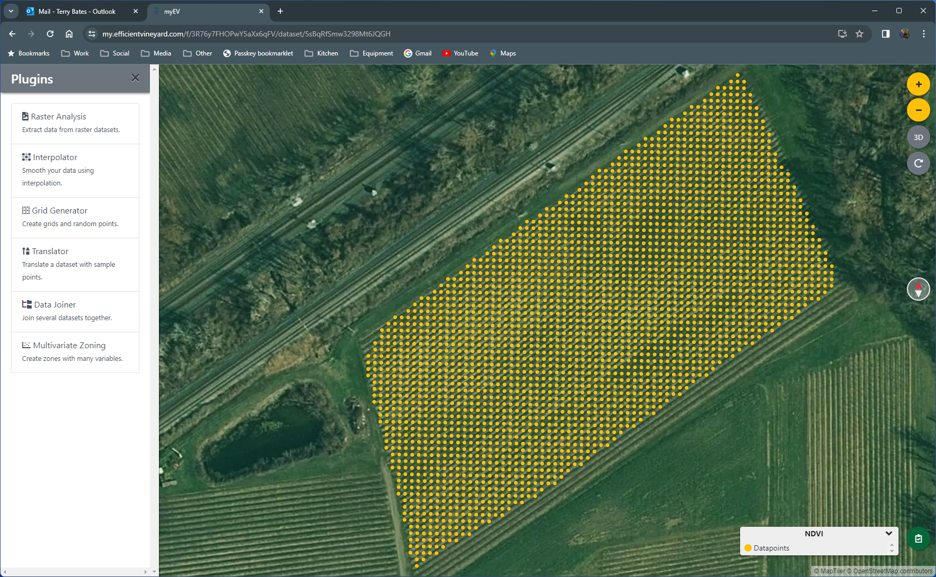
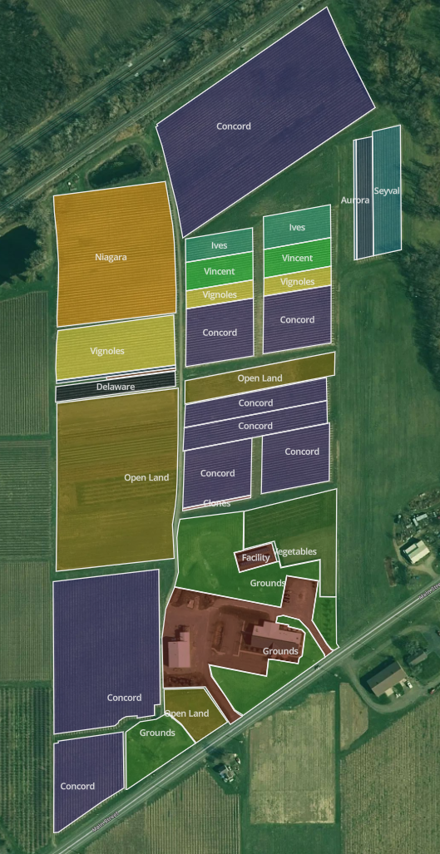
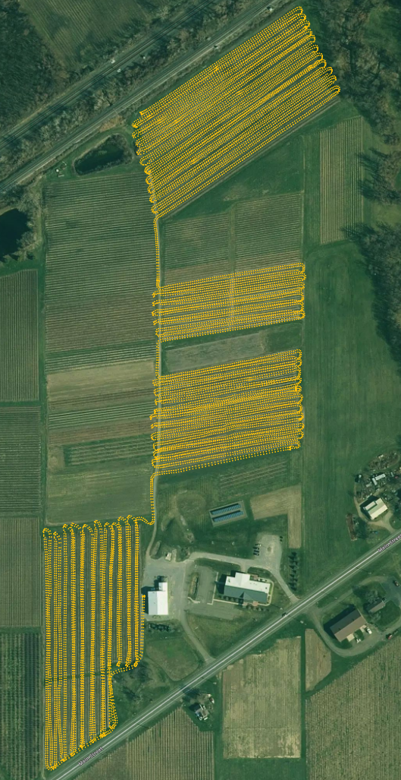
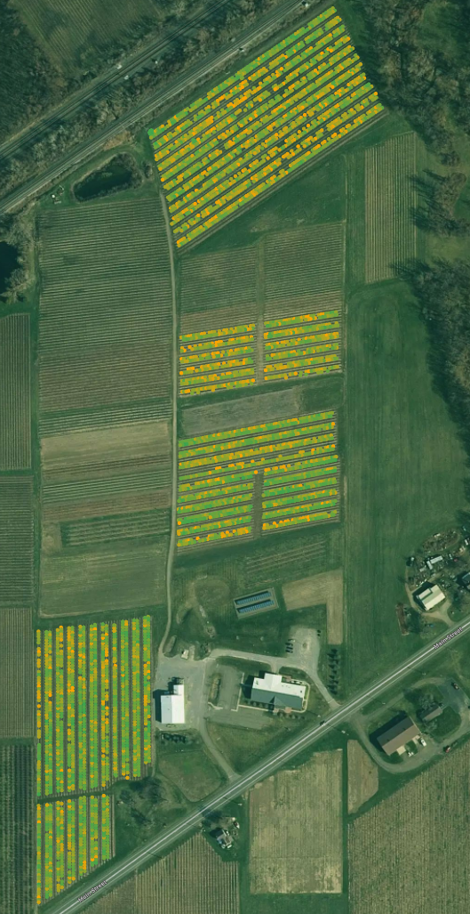
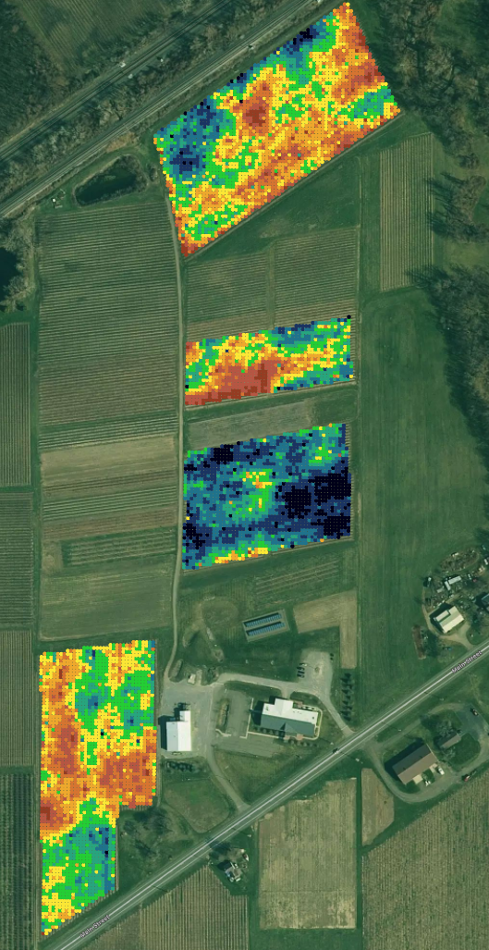
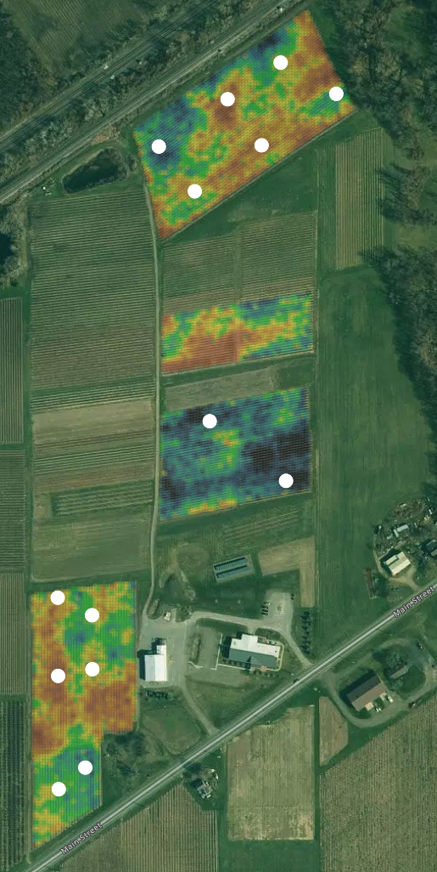
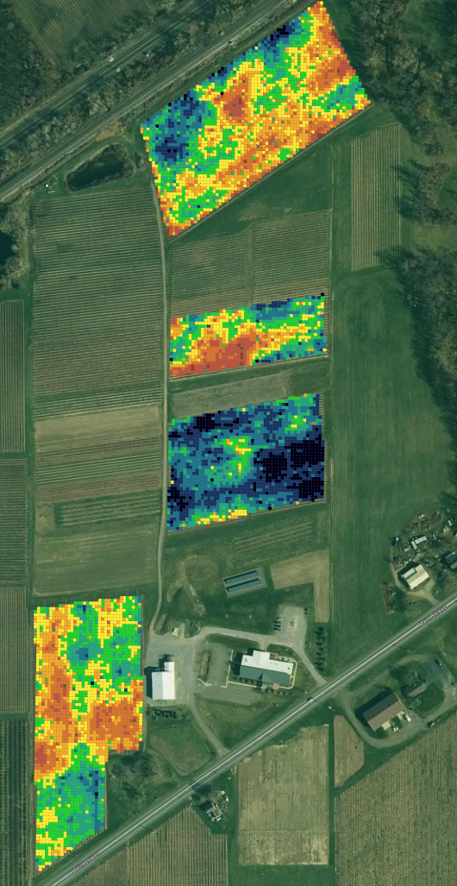
MyEV Data Process and Tools
Build Farm
Block level information
Invite collaborators
Import Data
Generic Lat/Long Data
Raster Conversion Tool
Smartphone Data Collector
Data Clean-up
Filter by header (attribute)
Trim to desired blocks
Interpolation
IDW to a Common Grid
Important for later multi-layer management
Field Validation
Directed field sampling
Manual or Generated
Share with field staff
Map Translation
Turn relative sensor data into absolute viticulture maps
Cornell Lake Erie Research and Extension Laboratory
Raw
Bloom time NDVI from proximal CropCircle sensor (2 sensors in use)
Cleaned
Sensor 1 data filtered by NDVI and trimmed to just the Concord blocks
Relative
Interpolated bloom NDVI of Concord canopies
Validated
Mid-season crop estimation locations stratified across NDVI values
Viticulture
Predicted Concord Yield Map (tons/acre)

Slide 11
Nutrient Supply
“Multi-Layer” Thinking
Electromagnetic Sensor
Soil ECa
Potassium Availability
Nutrient Uptake
“Multi-Layer” Thinking
Hyperspectral Sensor
Potassium Uptake
Tissue Nutrient
“Multi-Layer” Thinking
Nutrient Demand
Electromechanical Sensor
Potassium Demand
Crop Yield

Slide 12
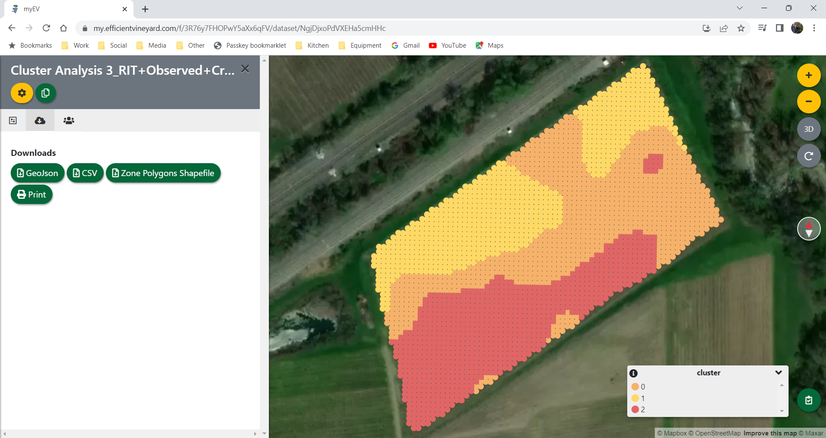
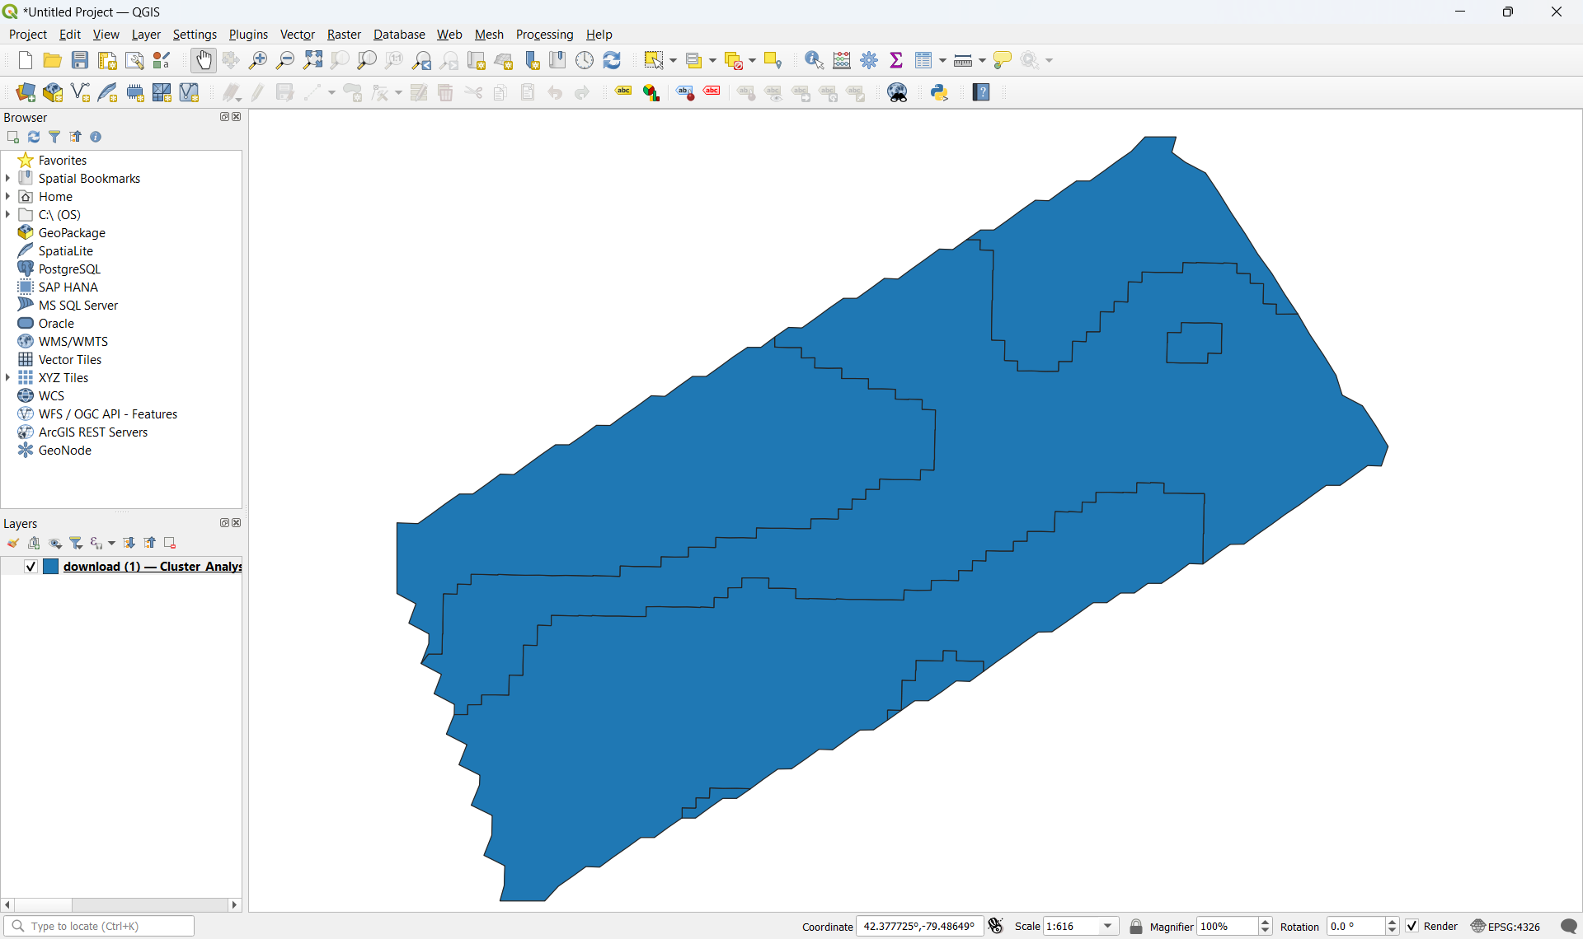
Point File
Commercial equipment and rate controllers
Polygon (shape) File
Variable Rate Fertilizer Spreader

Slide 13
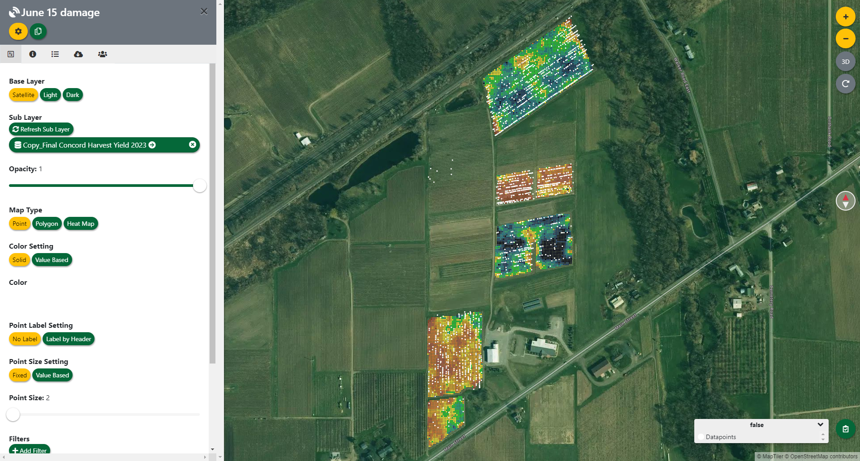

Slide 14
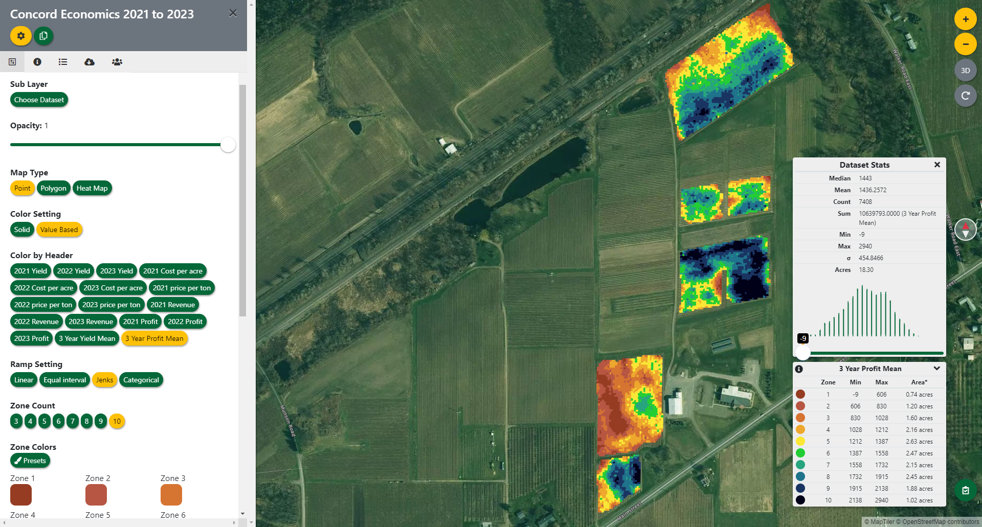
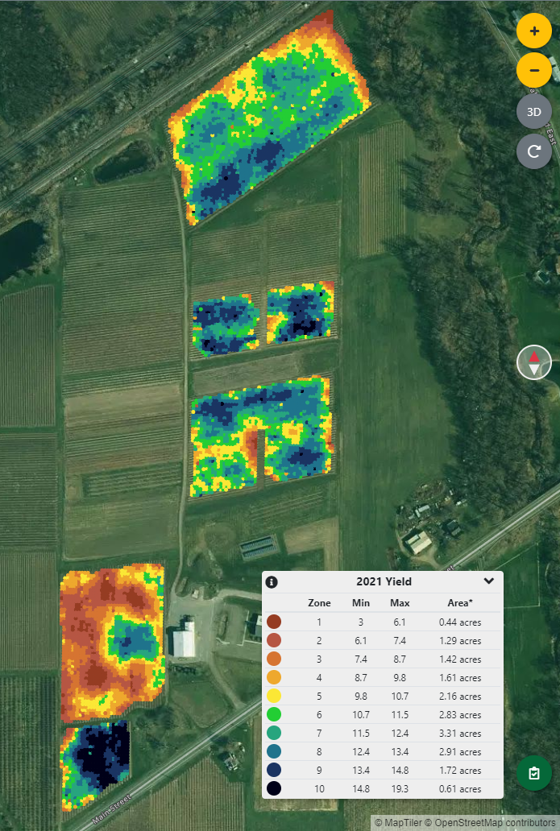
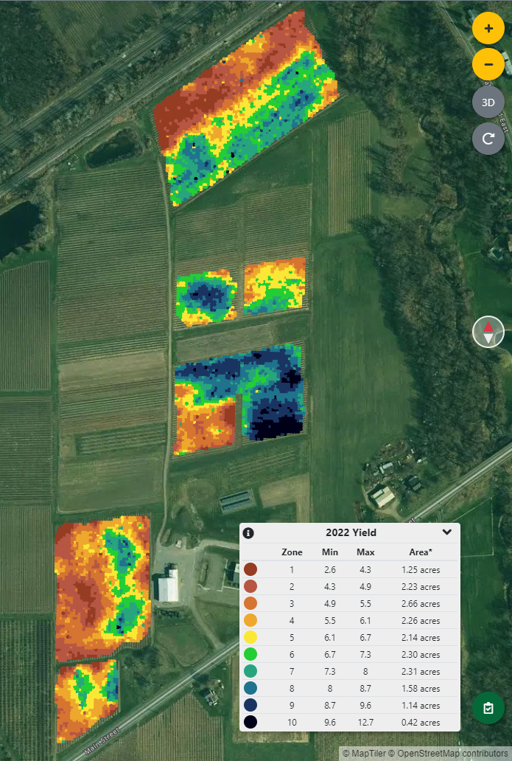
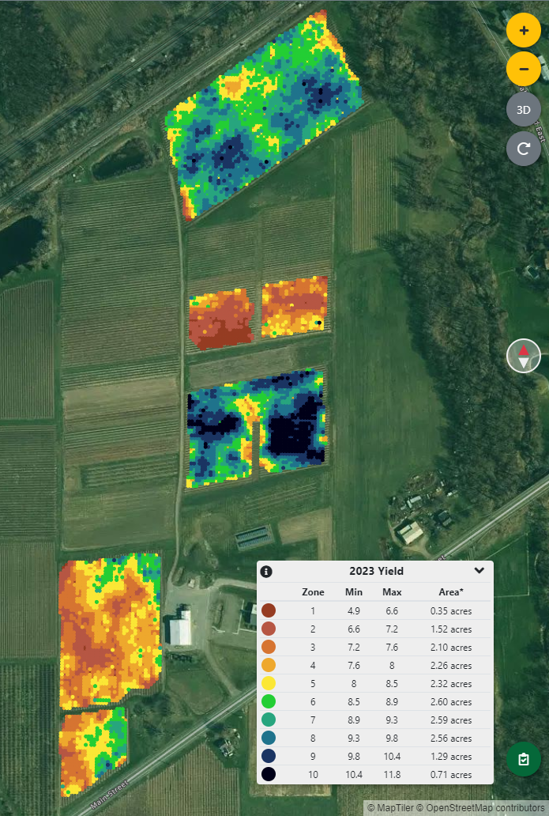
Yield (Tons/acre)
Production Cost per Acre
Price per Ton

Slide 15
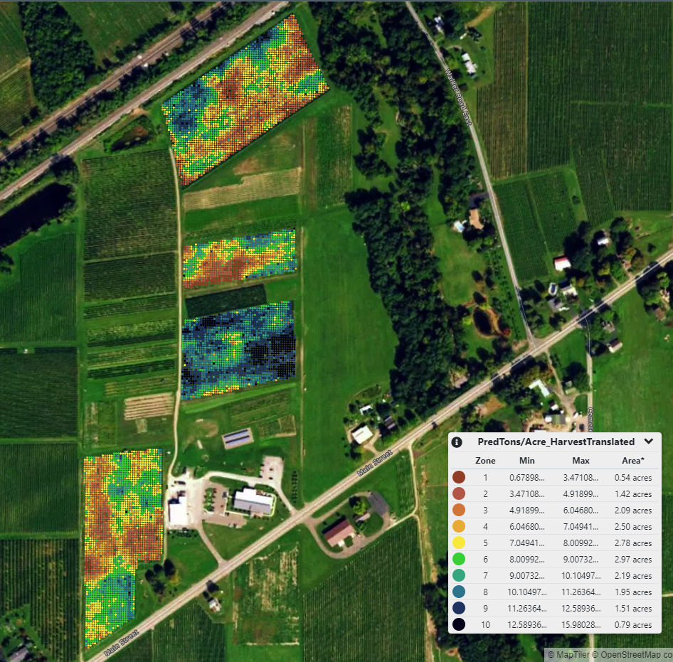
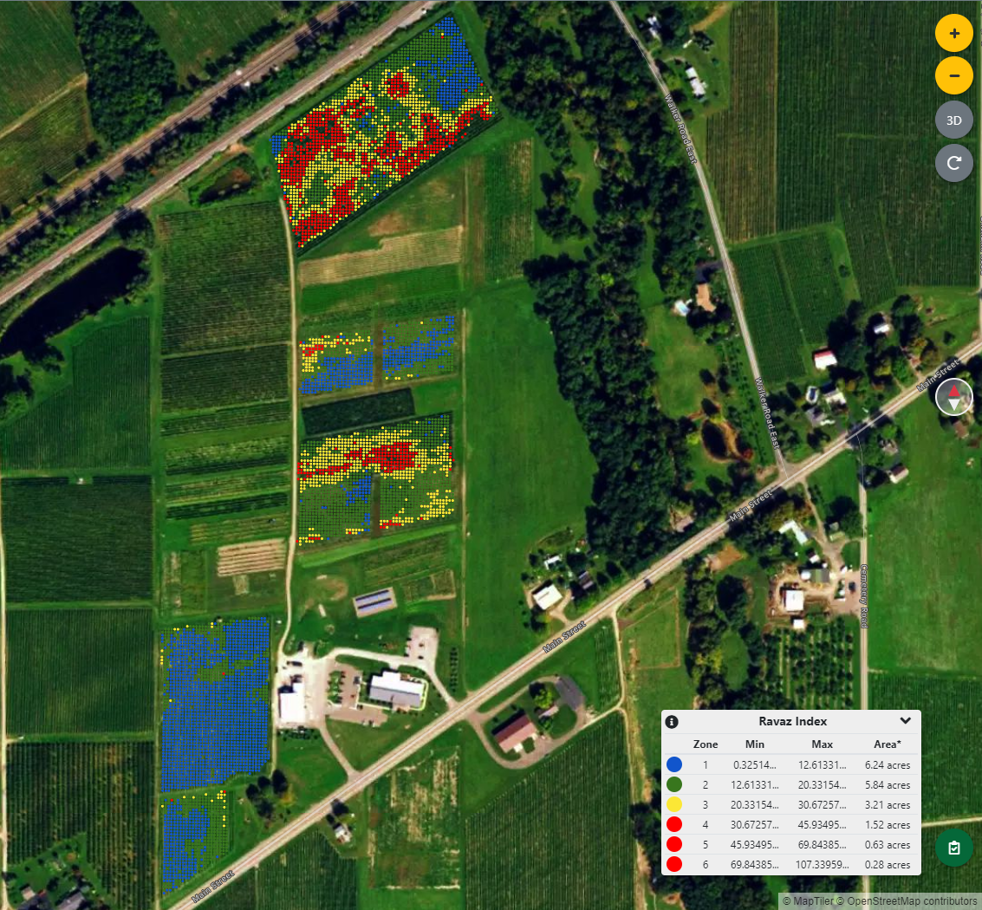
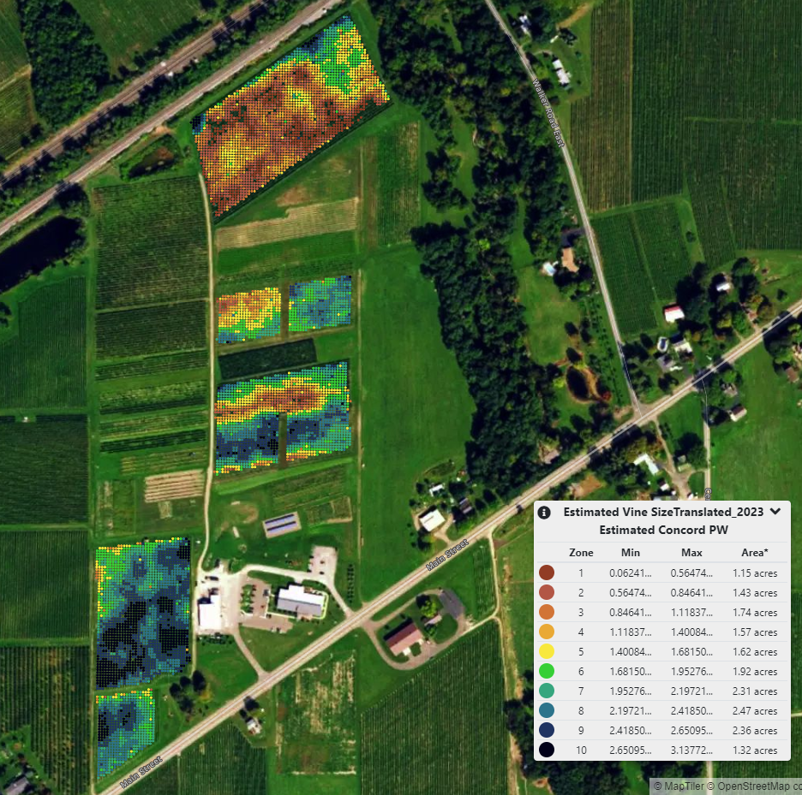
Predicted Yield
Calculated
Predicted Crop Load
(Y:PW, Ravaz Index)
Predicted PW

