Slide 1
The Threat of
Spotted Lanternfly
Julie Urban
Penn State University
jmu2@psu.edu

Slide 2
Spotted Lanternfly is a Planthopper
Phloem feeders: piercing-sucking mouthparts

Slide 3
Chart Title

Slide 4
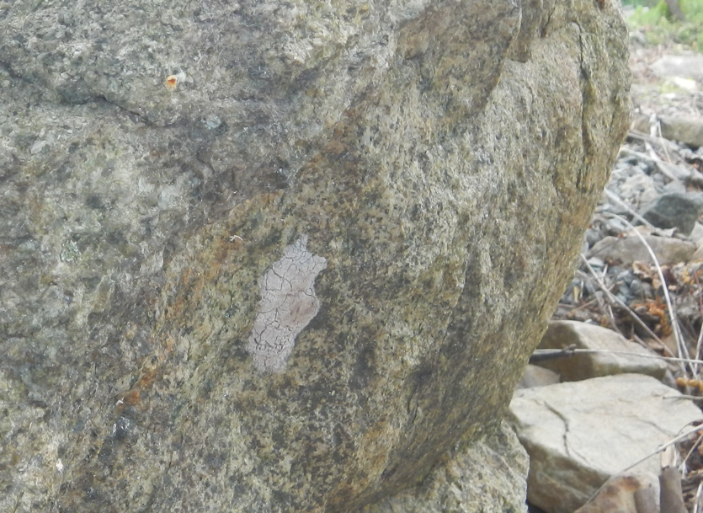
In the Beginning…
SLF detected in Berks County, PA on Sept. 22, 2014
Chart Title
SLF Egg Mass, May 12, 2015;
photo J. Urban
Day of first observed hatch,
May 12, 2015; photo G. Hoover

Slide 5
Chart Title

Slide 6
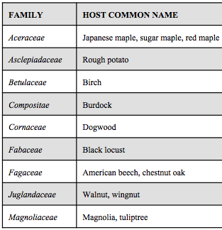
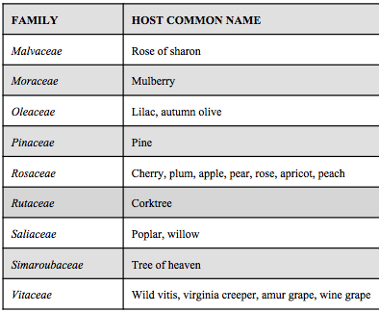
SLF Host Plants
Feeds on >100 species of plants and trees
Chart Title
X X X X

Slide 7
Young Nymph (1st-3rd instar) Survival & Damage
Host | Field reports of populations/ damage? | Survivorship > 50%? | Damage documented in controlled experiments? | Anticipated risk
Strawberry | No | Yes | No. Results are not clear. | Unknown
Blueberry | No | Yes | No. Results are not clear. | Unknown
Hops | Low levels | Yes | Low levels | Low risk from nymphs
Cucumber | Low levels, backyard growers | Yes | No observed damage | Low risk from nymphs
Pumpkin | Low levels, backyard growers | Yes | No observed damage | None
Watermelon | Low levels, backyard growers | Yes | No observed damage | None
Sunflower | Low levels, backyard growers | Yes | No observed damage | None
Tomato | Low levels, backyard growers | Yes | No observed damage | None
Chart Title

Slide 8
4th Instar Nymph Survival & Damage
Host | Field reports of populations/damage? | Survivorship > 50%? | Damage documented in controlled experiments? | Anticipated risk
Peach | Medium- low levels | Yes | Yes, fruit drop and defoliation | Medium-high
Avocado | No | Yes | No observed damage | Low
Kiwi berry | High density reports from Asia | Yes | No observed damage | Medium-Low
Fig | No | Yes | No observed damage | Low
Hops | Low levels | Yes | Low levels | Low risk from nymphs
Raspberry | Low levels | Yes | Reduction in shoot growth | Medium- low
Cucumber | Low levels, backyard growers | Yes | Reduction in yield | Medium-low
Pumpkin | Low levels | Yes | No observed damage | Low
Watermelon | Low levels | Yes | No observed damage | Low
Chart Title

Slide 9
What is Risk from SLF on other specialty crops?
Chart Title

Slide 10
Percent Nymphal Survival on Citrus & Avocado

Slide 11
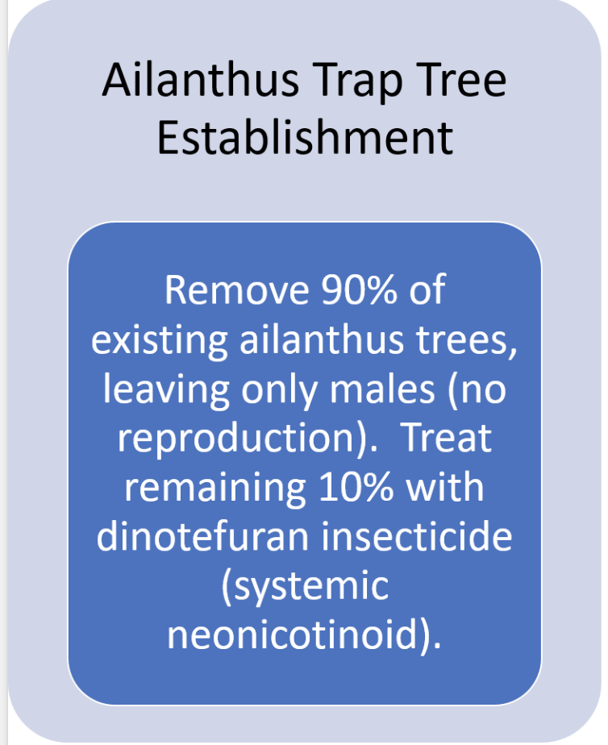
Pennsylvania Treatment for SLF in 2015
Chart Title

Slide 12
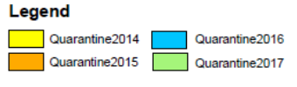

PA SLF Quarantine Map by Year: 2014-2017
Chart Title

Slide 13
Pennsylvania Treatment for SLF
LESSONS LEARNED
Treating Ailanthus (TOH) trap trees is not enough:
Inherent bureaucratic time delays:
  Funding
  Lining up contractors
  Permission to treat private properties
  Logistics of removing trees in hilly, rural eastern PA
SLF is highly mobile and feeds on other plants
  Does SLF “require” TOH to complete life cycle? NO!!
Chart Title

Slide 14
Pennsylvania Treatment for SLF
LESSONS LEARNED
Improved Solutions:
Government agencies (PA Dept. of Ag., APHIS, etc.) also use knock-down contact applications (bifenthrin) for pop-ups and critical areas at risk of further spread (airports, ports,…)
PA Dept. of Ag. (PDA) now trains their own operations staff to perform their own treatments
  In 2024, contractors treated ~500 properties
  PDA staff treated >200 properties in 2024
Chart Title

Slide 15
Jan. 2018: SLF Detected in Winchester, VA
LESSONS LEARNED
Chart Title
SLF spreads on and in conveyances transporting goods and people
At detection site, surveys found old egg masses: once SLF is detected, it is found to have been there 1-2 years prior -- true for VA, TN, IL populations (likely in other states as well)

Slide 16
Chart Title

Slide 17
Early instars (1-3): broad ranging on herbaceous plants
Late season adults:
Bouts of flight
SLF LIFE CYCLE
(in eastern PA)
Begin to feed on woody tissues

Slide 18
2017: SLF Population in PA Seemed to Boom
Chart Title

Slide 19
2017: SLF Population in PA Seemed to Boom
Chart Title

Slide 20
SLF Feeding and Damage
Not a Problem in Apple, Stone Fruit Orchards, Ornamentals
Chart Title

Slide 21
SLF Feeding and Damage
To Date: SLF is Damaging to Grapes and Tree of Heaven
(and somewhat to Black Walnut – causes yellowing, flagging, branch dieback)
Chart Title

Slide 22
SLF Feeding and Damage
To Date: SLF is Damaging to Grapes and Tree of Heaven
(and somewhat to Black Walnut – causes yellowing, flagging, branch dieback)
Chart Title

Slide 23
Late Season Movement of SLF into Vineyards
https://extension.psu.edu/spotted-lanternfly-management-in-vineyards
Adult SLF moving into vineyards from surrounding areas is biggest threat, often within 50 ft. of vineyard edge
Chart Title

Slide 24
Late Season Movement of SLF into Vineyards
Chart Title

Slide 25
SLF Feeding and Damage
Economic Impact on Grapes
(survey by Harper, Kime, Leach, Centinari, 2018)
Recorded damage:
In 2017, 90% yield loss in 40 acre planting
In 2018, 100% death of a 8 acre Pinot Noir planting
From 2016-2018, 45% yield reduction in 10 acres Chardonnay planting
Increased application and cost of insecticides (5 vineyards in SE PA):
The number of insecticide applications in 2016-2018 increased from an average of 4.2 applications to 14.0
This increases the average insecticide cost from $54.63/acre in 2016 to $147.85/acre in 2018 (+171%)

Slide 26
SLF Feeding and Damage in Grapevines
(Harner, Leach, Briggs, Centinari, 2022)
Heavy and extensive SLF feeding:
Reduces accumulation of sugars and nitrogen
Decreases vine capability to produce sugar
Chart Title

Slide 27
Effects of SLF Feeding on Grapevines for 1 Year
Soluble sugars (Brix) decreases with increasing number of SLF
Centinari & Acevedo, in progress

Slide 28
Effects of SLF Feeding on Grapevines for 1 Year
Soluble sugars (Brix) decreases with increasing number of SLF
Centinari & Acevedo, in progress
Chart Title

Slide 29
Effects of SLF Feeding on Grapevines for 1 Year
Wine total phenolics decrease with increasing number of SLF
Cabernet franc – 2022 harvest
Chart Title

Slide 30
Effects of SLF Feeding on Grapevines for 1 Year
Linear decrease in root starch with increasing number of SLF
Chart Title

Slide 31
Effects of SLF Feeding on Grapevines for 2 Years
Linear decrease in root starch with increasing number of SLF
Chart Title
Chardonnay 2023 (year 2)
Yield / vine
Cluster and berry weight
Number of clusters / vine
Range: 0 –> 200 SLF / vine

Slide 32
Chart Title

Slide 33
Oct. 2024: SLF Detected in Fulton Co., GA
Confirmed by USDA APHIS Nov. 14, 2024
Chart Title

Slide 34
Is it Too Hot, Dry for SLF to Establish in CA?
NO Evidence that Disqualifies this Possibility
Chart Title

Slide 35
Chart Title
Penn State Extension Spotted Lanternfly site regularly updated with new management recommendations based on ongoing research findings
https://extension.psu.edu/spotted-lanternfly

Slide 36
Insecticides for SLF in Vineyards in PA
https://extension.psu.edu/spotted-lanternfly-management-in-vineyards
Chart Title

Slide 37
Targeting Egg Masses
Efficacy of ovicides is variable: kills up to ~75% of treated eggs
Registered insecticidal oils most effective if applied between Feb. and April in high enough volumes to provide very good coverage
Mechanical removal: scraping
Chart Title
Recent findings show Malathion to have high efficacy on egg masses

Slide 38
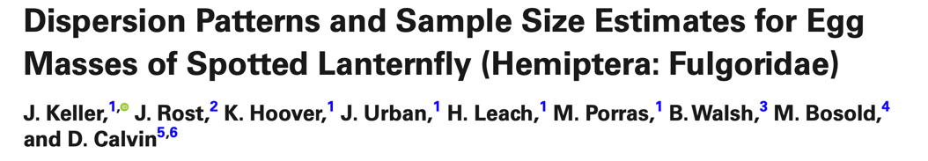
Targeting Egg Masses
Chart Title
Most egg masses over
6m above ground

Slide 39
Degree Day Model for SLF Egg Hatch
At StopSLF.org (under Resources tab)
Chart Title

Slide 40
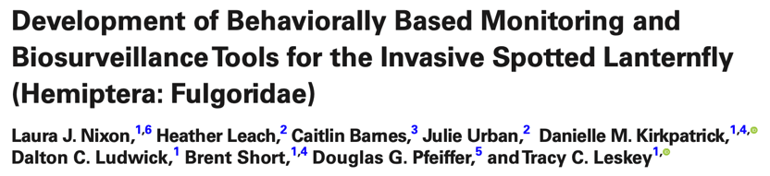
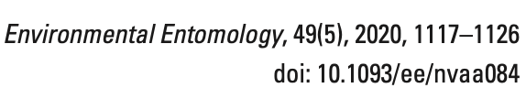
SLF Monitoring and Trapping
Chart Title
Circle trap (cone trap) is comparable to sticky band traps AND reduces bycatch
Effective in areas with high SLF populations; not as effective in low density sites
Sticky band
Small circle trap
Modified circle trap
TR 290 trap

Slide 41
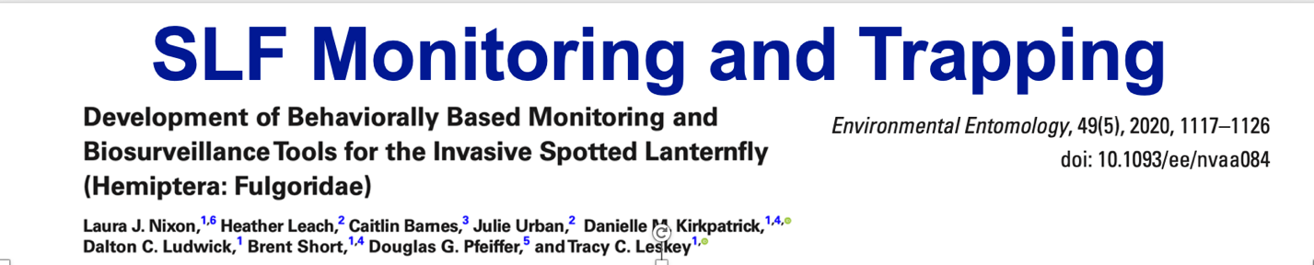
Chart Title
Results: No difference in capture rates in unbaited traps vs. those with methyl salicylate bait

Slide 42
Predicting Key Periods of Activity of SLF in Southeastern PA
Chart Title

Slide 43
SLF Collected Across Life Cycle from each of the same 20 Red Maple Trees in 2019 & 2020 in Wyomissing, PA
Chart Title

Slide 44
SLF Collected Across Life Cycle from each of the same 20 Red Maple Trees in 2019 & 2020 in Wyomissing, PA
Chart Title

Slide 45
SLF Collected Across Life Cycle from each of the same 20 Red Maple Trees in 2019 & 2020 in Wyomissing, PA
Chart Title

Slide 46
Average # SLF Captured for each Life Stage Over the Season on 20 Red Maple Trees in Wyomissing, PA in 2019
Chart Title

Slide 47
Average # SLF Captured for each Life Stage Over the Season on 20 Red Maple Trees in Wyomissing, PA in 2019
Chart Title

Slide 48
Average # SLF Captured for each Life Stage Over the Season on 20 Red Maple Trees in Wyomissing, PA in 2019

Slide 49
Late Season Movement

Slide 50
Total Numbers of each SLF Life Stage Collected on 20 Red Maple Trees in 2019 and 2020
Life Stage | A. rubrum 2019 | A. rubrum 2020
First Nymph | 4,928 | 85,206
Second Nymph | 3,358 | 6,500
Third Nymph | 680 | 1,575
Fourth Nymph | 347 | 506
Adult Males | 5,931 | 3,990
Adult Females | 5,718 | 5,621
Total Adults | 12,300 | 9,611
Total Egg Masses | 1,910 | 2,486

Slide 51
Developed models to estimate the growing degree days accumulated for each life stage
* Key to knowing when and where to treat at area-wide scale

Slide 52
Improving Monitoring and Management Tools

Slide 53
Does Removing Ailanthus altissima Reduce or Prevent SLF?
  Or does removing TOH push SLF onto other hosts?
  Efficacy has not been formally evaluated
  Is potential opportunity for sentinel / trap tree

Slide 54
Does Removing Ailanthus altissima Reduce or Prevent SLF?
  Where is the “Source” of SLF for this vineyard?

Slide 55
Does Removing Ailanthus altissima Reduce or Prevent SLF?
  Where is the “Source” of SLF for this vineyard?

Slide 56
Does Removing Ailanthus altissima Reduce or Prevent SLF?
  Where is the “Source” of SLF for this vineyard?

Slide 57
Monitoring with Utility Pole Traps
Brian Walsh, Penn State
Poles treated with Deltamethrin Impregnated Netting installed around ports and sites at high risk of spread – takes advantage of attraction to tall objects (tree-like)

Slide 58
SLF shows preference to certain individual trees in landscape (“hot trees”)
-- Can we create trap trees or trap crops?
-- Use TOH as a trap tree or sentinel tree for monitoring
Chart Title
Video by Christopher Jordan

Slide 59
Other Behavioral Approaches: Mating Disruption
Miriam Cooperband (USDA APHIS) and Rodrigo Krugner (USDA ARS) have recorded (and are analyzing) substrate-borne vibration of SLF
  Goal to develop system of mating disruption

Slide 60
Classical Biological Control – USDA APHIS
Nymphal parasitoid: Dryinus sinicus
-- USDA APHIS has established colonies (Hannah Broadley leading this work in MA)
-- Results to date are very promising

Slide 61
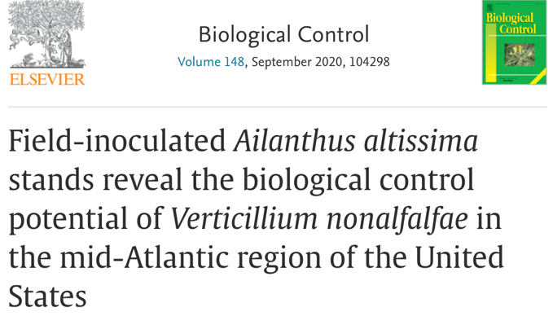
Biological Control of TOH

Slide 62
Acknowledgements
Thank You!
Urban Lab
Holly Shugart
Tess Kaveney
Elena Gomez
Heather Leach
Liz Deecher
Erica Smyers
Mariam Taleb
Ju-Che Lo
Sarah Henderson
Sampurna Sattar
Holly Shugart
Dana Roberts
Liana Wodzicki
Mitchell Hornberger
Brian Walsh
John Rost
Dennis Calvin
For latest recommendations visit:
Penn State SLF Extension Website
https://extension.psu.edu/spotted-lanternfly
SLF SCRI CAP Project
Project website:
StopSLF.org
Funding
USDA APHIS
Penn State College of Agriculture
Pennsylvania Department of Agriculture
USDA NIFA
CA Dept. of Food and Agriculture
New Zealand Institute for Plant
and Food Research, Ltd.

