Slide 1
Maximizing Sales
Harnessing Next-Gen Metrics to Optimize Winery Marketing Strategies

Slide 2
“You’ve always had the power, my dear, you just had to learn it for yourself.”

Slide 3
For wine brands, leveraging DATA has never been more important…
*note the ellipsis

Slide 4
We’re not in Kansas anymore

Slide 5
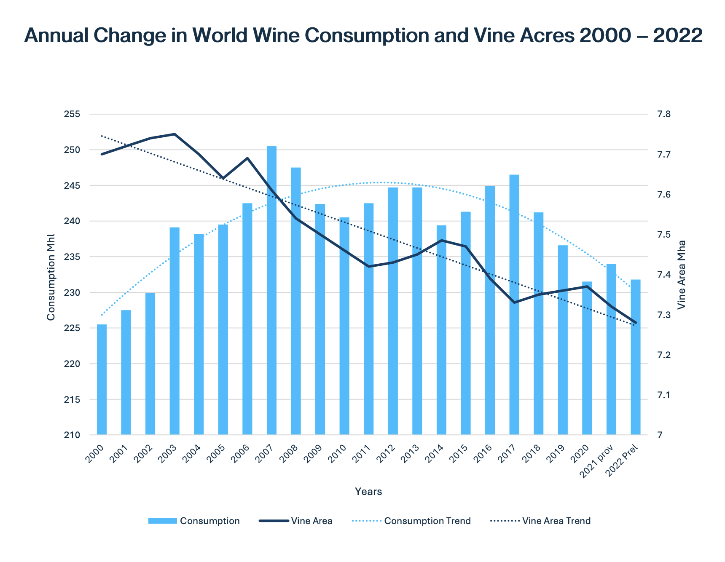
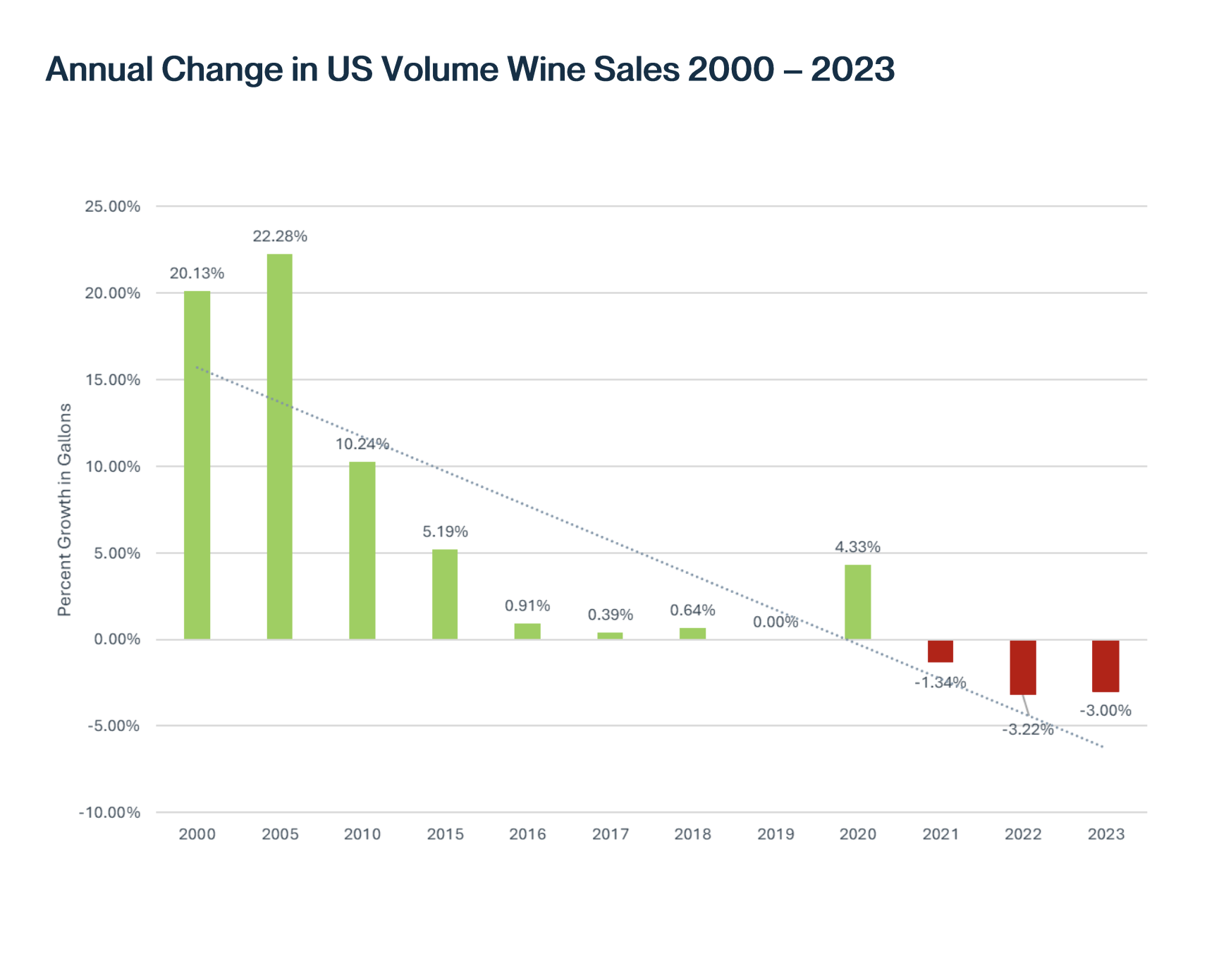
We’re not in Kansas anymore
Major buzzkill provided by 2024 SVB State of US Wine Industry Report

Slide 6
…but the good news is...

Slide 7
…leveraging DATA has never been more accessible.

Slide 8
Meet Your Data Wizards
Cathy Huyghe
Enolytics
enolytics.com

Slide 9
Meet Your Data Wizards
Erica Walter
Email Mavens
emailmavens.com

Slide 10
Meet Your Data Wizards
Molly Bossardt
Bread & Butter Digital Marketing
breadandbutterdigitalmarketing.com

Slide 11
Introducing Emerald Estate

Slide 12
We’re going to harness our DATA to launch, connect, and promote a new sub-brand.

Slide 14
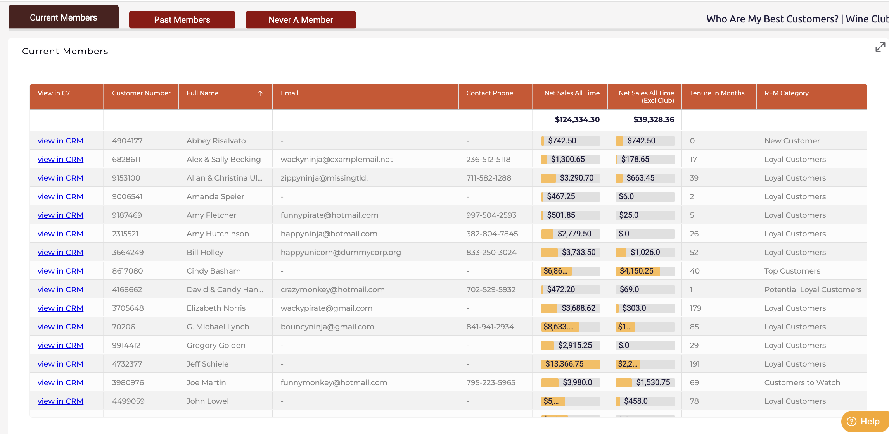
Leverage DTC Data for Wholesale Markets
Cathy Huyghe | Enolytics

Slide 15
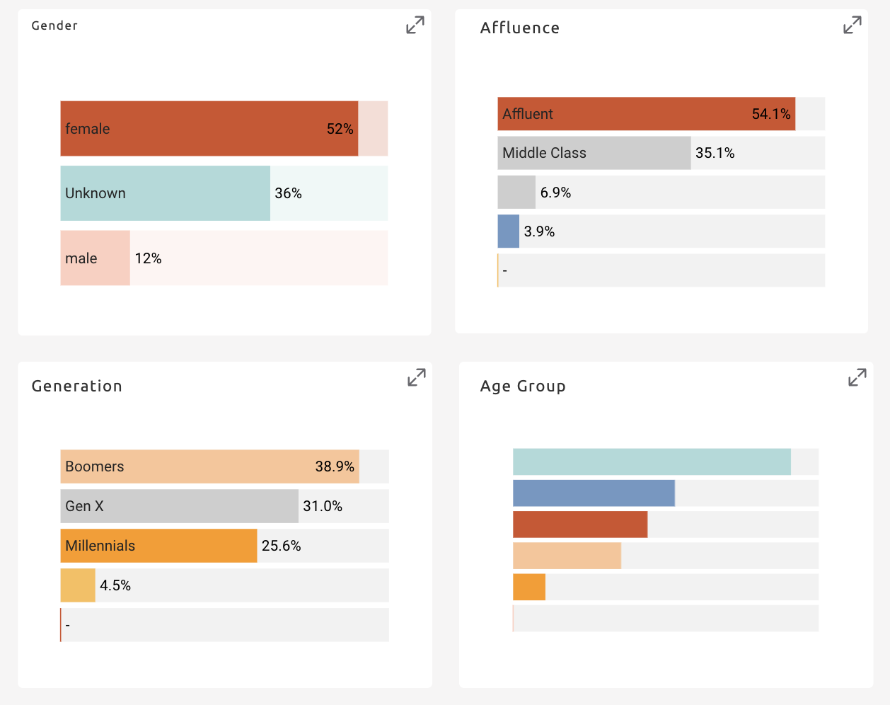
Leverage DTC Data for Wholesale Markets
Cathy Huyghe | Enolytics

Slide 16
Leverage DTC Data for Wholesale Markets
Cathy Huyghe | Enolytics

Slide 17
Leverage DTC Data for Wholesale Markets
Cathy Huyghe | Enolytics

Slide 18
Leverage DTC Data for Wholesale Markets
Cathy Huyghe | Enolytics

Slide 19
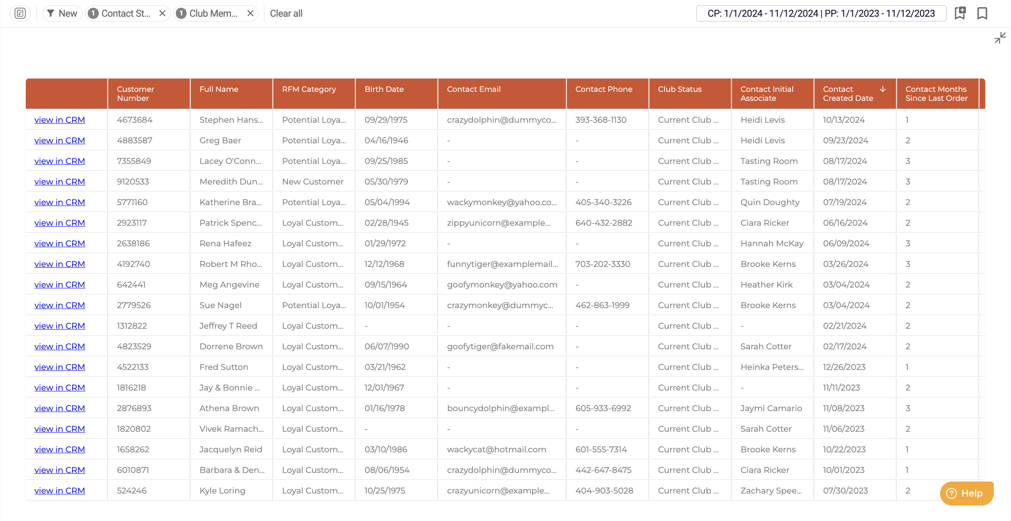
Leverage DTC Data for Wholesale Markets
Cathy Huyghe | Enolytics

Slide 20
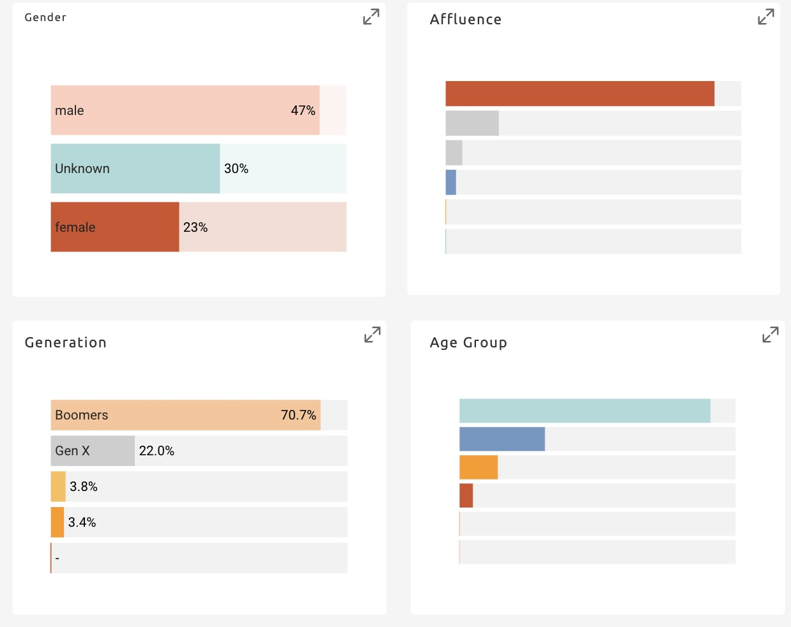
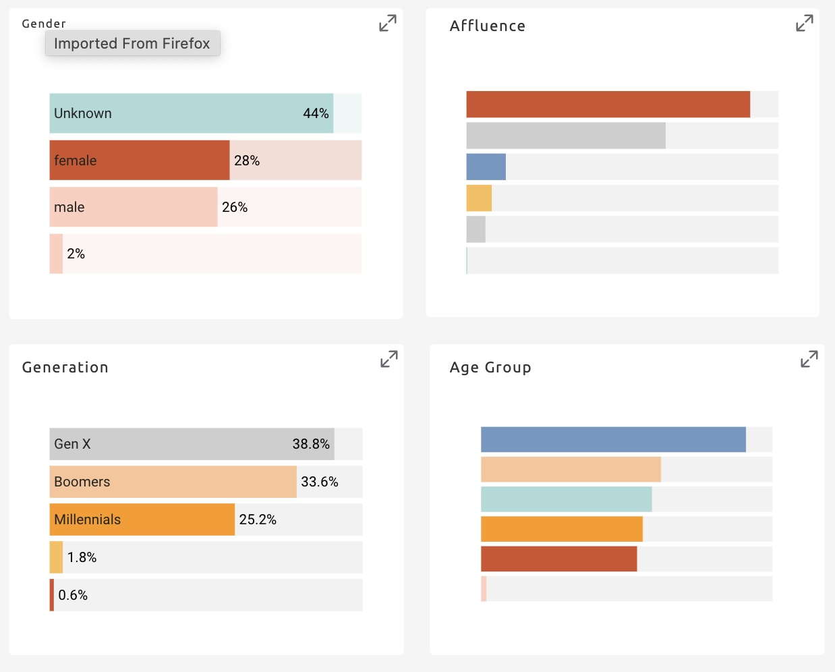
Leverage DTC Data for Wholesale Markets
Cathy Huyghe | Enolytics
State
Website

Slide 21
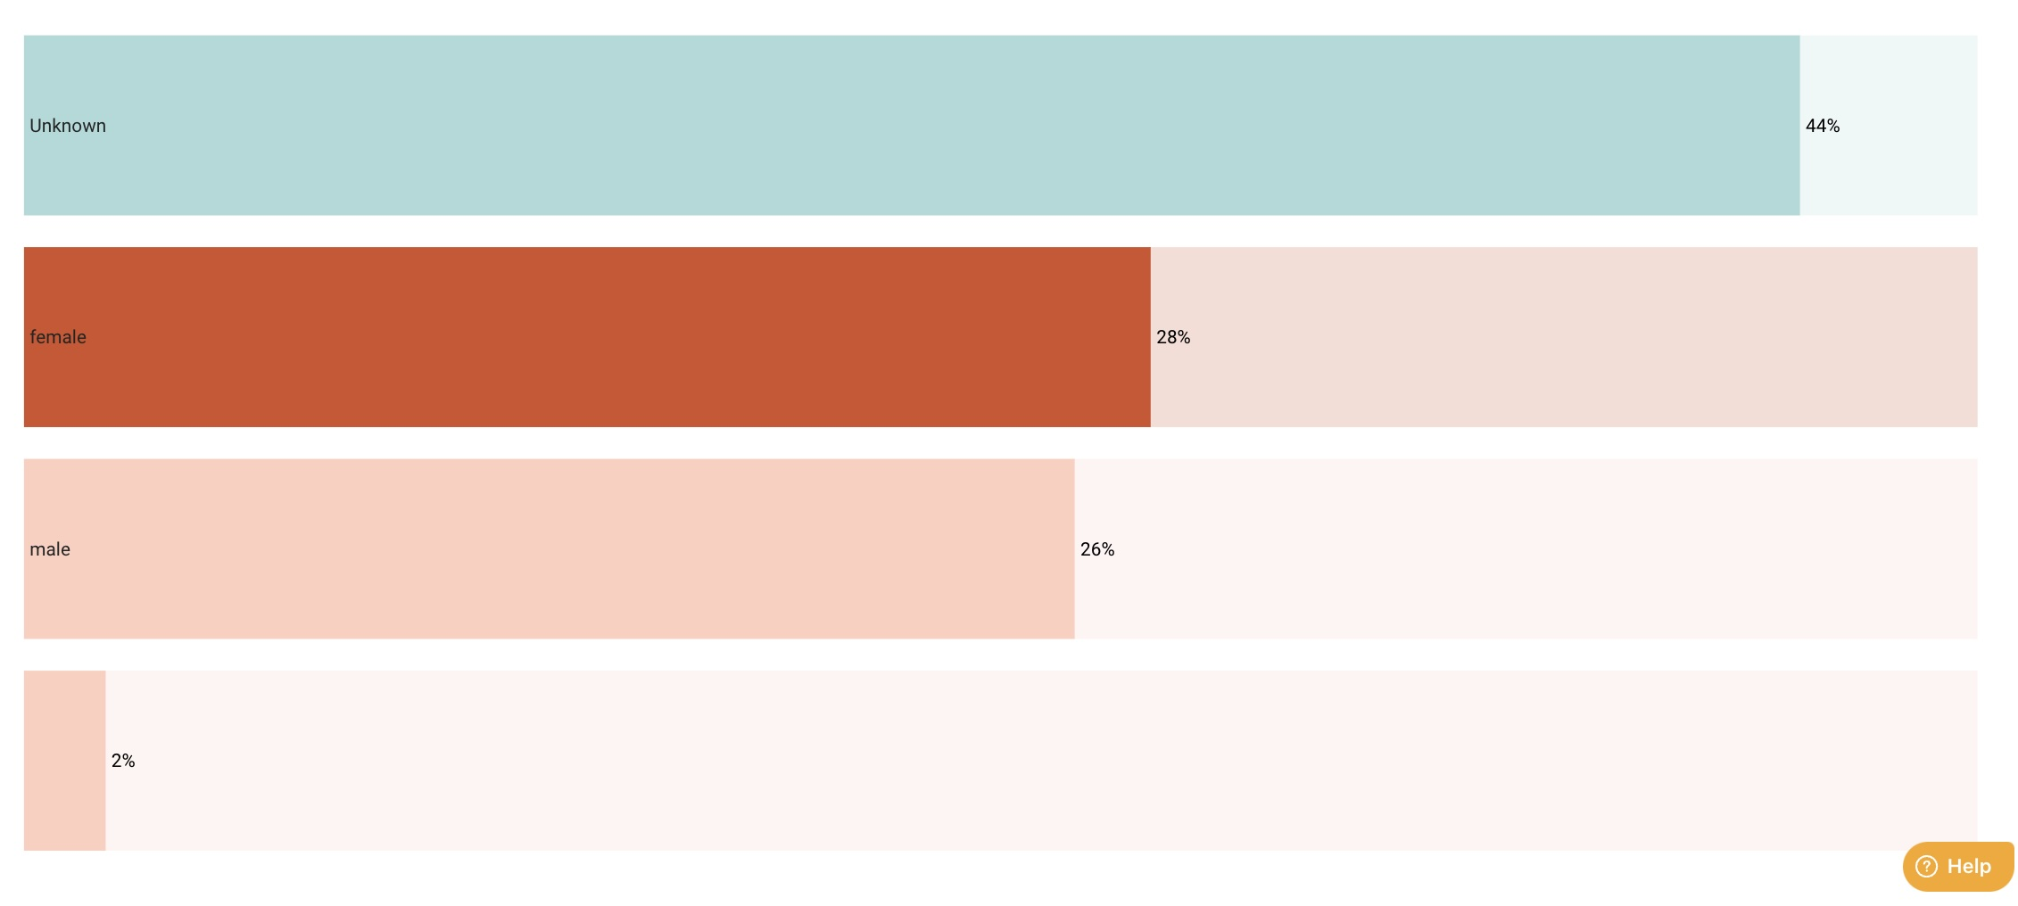
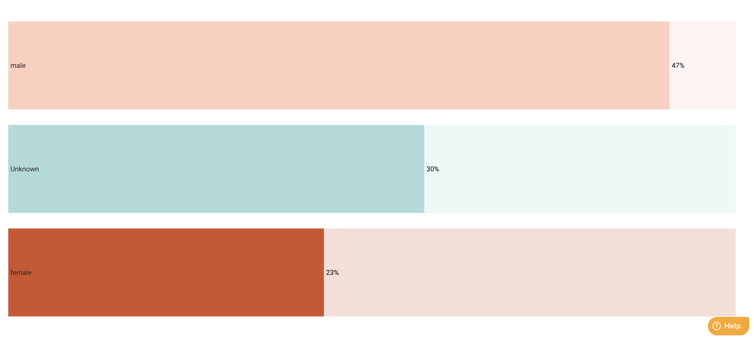
Leverage DTC Data for Wholesale Markets
Cathy Huyghe | Enolytics
State
Website

Slide 22
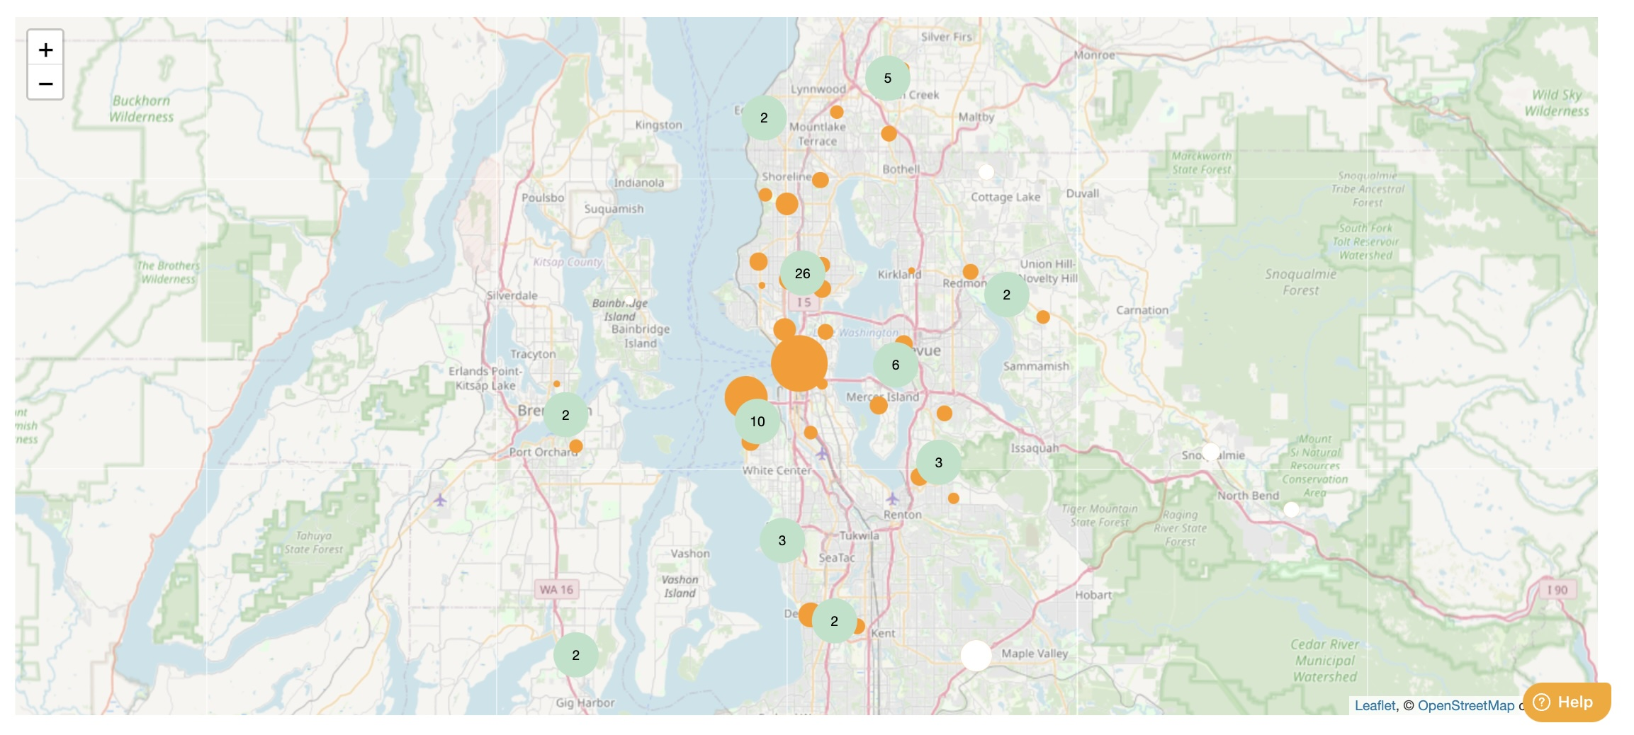
Leverage DTC Data for Wholesale Markets
Cathy Huyghe | Enolytics

Slide 23
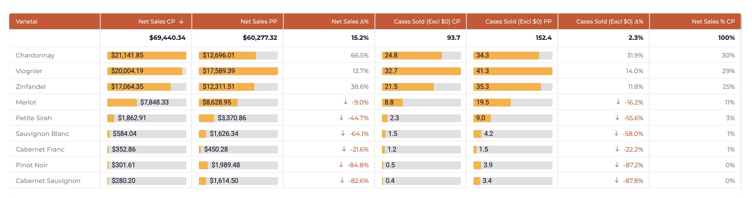
Leverage DTC Data for Wholesale Markets
Cathy Huyghe | Enolytics

Slide 24
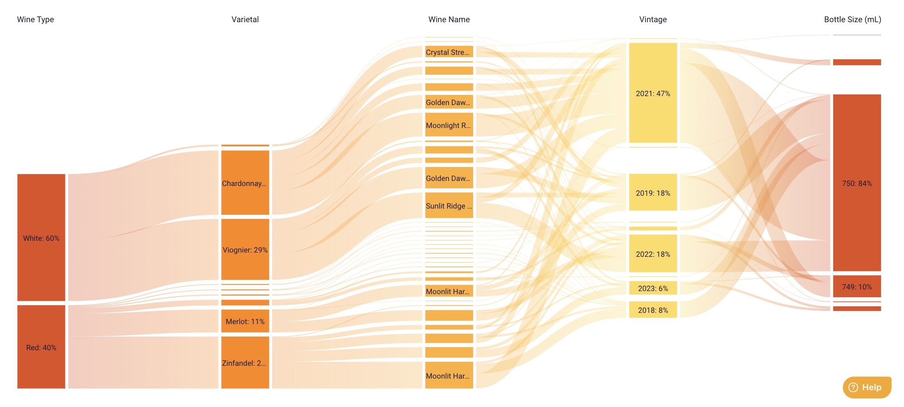
Leverage DTC Data for Wholesale Markets
Cathy Huyghe | Enolytics

Slide 25
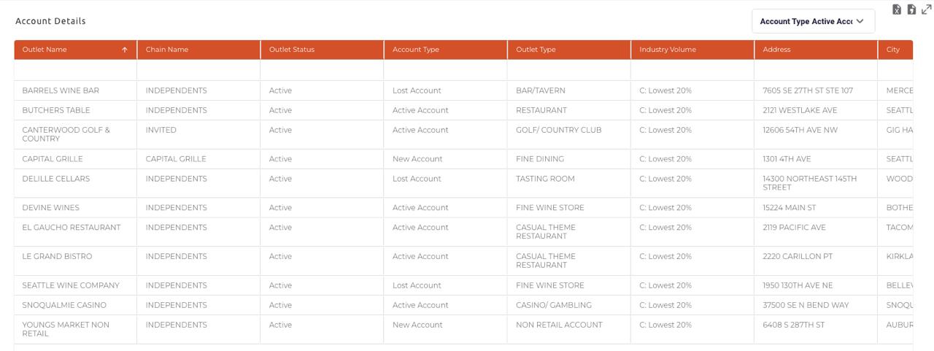
Leverage DTC Data for Wholesale Markets
Cathy Huyghe | Enolytics
Current Accounts

Slide 26
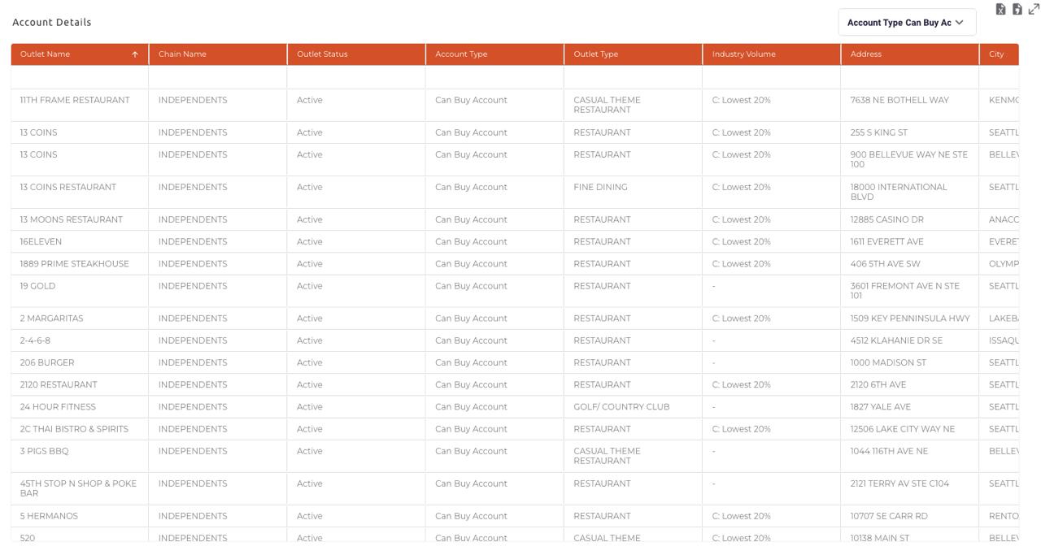
Leverage DTC Data for Wholesale Markets
Cathy Huyghe | Enolytics
Potential Accounts

Slide 27
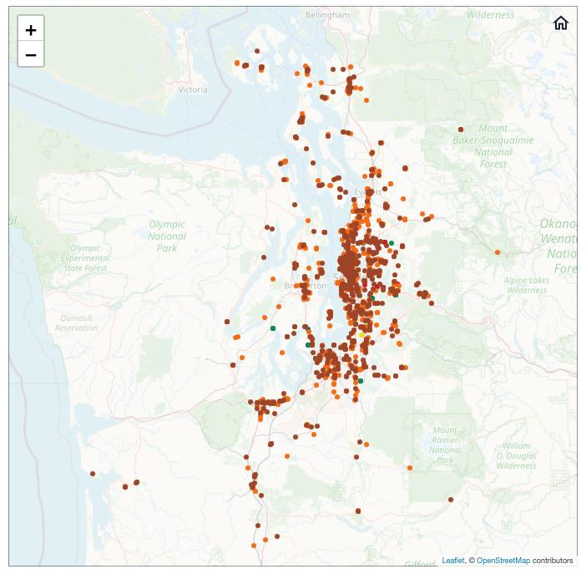
Leverage DTC Data for Wholesale Markets
Cathy Huyghe | Enolytics
Current and Potential Accounts

Slide 28
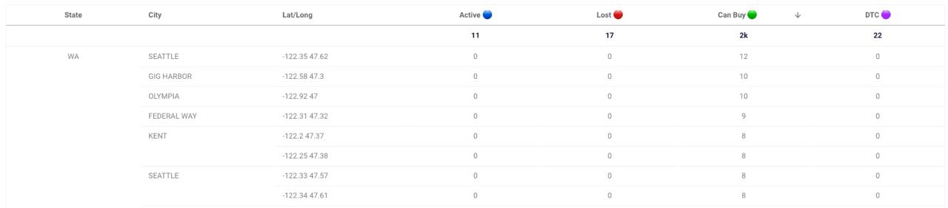
Leverage DTC Data for Wholesale Markets
Cathy Huyghe | Enolytics

Slide 29
Create Magical Meta Ad Campaigns
Molly Bossardt | Bread & Butter Digital Marketing

Slide 30
Meta Strategy for Popular!
Molly Bossardt | Bread & Butter Digital Marketing
Budget Allocation
  Primary Goal: Increase direct sales of Popular! Sauvignon Blanc.
    Target CPP: > $30
    Target ROAS: 5:1
  Secondary Goal: Grow the email list to support long-term customer retention.
    Target CPL: >$10.00
  Budget: $5,000/month
Month | Sales Testing | Sales Scaling | Lead Gen | Daily Total
Month 1 | $100/day | $73/day starting on day 15 | $30/day | $166/day
Month 2 | $50/day for 21 days (3 tests, 7 days each) | $101/day | $30/day | $166/day
Month 3 | $50/day for 12 days (2 tests, 7 days each) | $116/day | $30/day | $166/day
Beyond | $50/day for 7 days (1 test) | $125/day | $30/day | $166/day

Slide 31
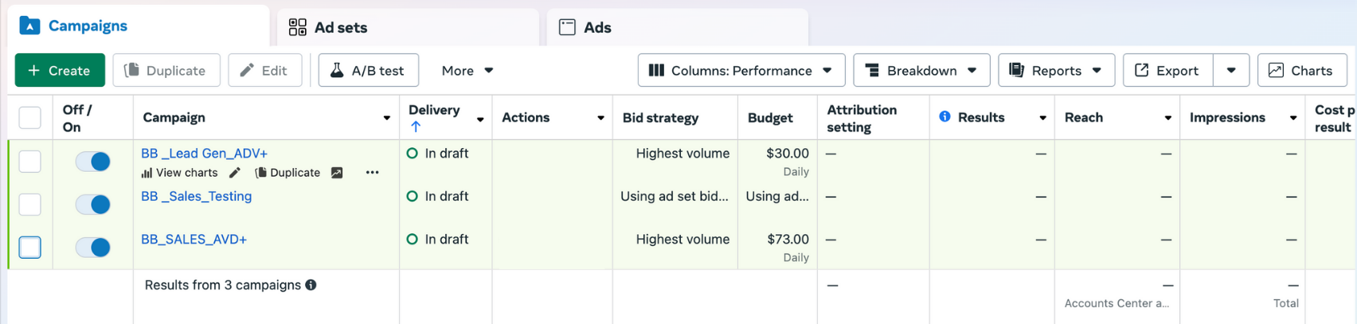
Building Effective Campaigns
Molly Bossardt | Bread & Butter Digital Marketing
Campaign Structure
  Sales Testing Campaign: Test different creatives, formats, and new offers.
  Sales Scaling Campaign: Amplify high-performing ads to maximize ROAS
  Lead Gen Campaign: Test top performing ad creative with gated offer for email sign ups.

Slide 32
Smart Targeting Strategies
Molly Bossardt | Bread & Butter Digital Marketing
Targeting Parameters for Lead Gen and Sales Scaling Campaigns:
  Meta Advantage+
  Location: Across all current shipping areas
  Exclusions: Current mailing list, existing customers, wine club members.
  Audience: 21+
TARGET
DEMOGRAPHIC
MIDDLE AGE WOMEN
Targeting Parameters Sales Testing Campaign:
  Broad targeting
  Location: Across all current shipping areas
  Exclusions: Current mailing list, existing customers, wine club members.
  Audience: 21+

Slide 33
Laying the Groundwork: Messaging and USP
Molly Bossardt | Bread & Butter Digital Marketing
Prep Work
  Unique Selling Proposition (USP):
    Bold Sauvignon Blanc inspired by the magic of Wicked
  Top Performing Organic Content: Behind-the-scenes production video featuring the founder.
  Customer Review Highlight: "I’m obsessed! Popular! is the perfect blend of elegance and rebellion. It’s like Elphaba and Glinda in a bottle—bold green apple and zesty citrus with a smooth, buttery finish. This wine truly stands out, just like its inspiration." – Rachel M.
Offers
Lead Gen
Sales

Slide 34
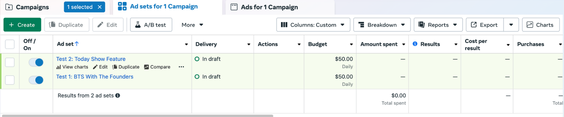
Ad Testing Framework
Molly Bossardt | Bread & Butter Digital Marketing

Slide 35
BTS Creative Overview
Molly Bossardt | Bread & Butter Digital Marketing
Headlines:
  “Women Founded, Wicked Inspired: Behind the Scenes at Popular!”
  “From Broadway to Bottling: The Bold Spirit of Popular!”
  “Defy Gravity with Popular! Sauvignon Blanc.”
Body Copy:
  ✨What happens when Broadway stars bring their magic to winemaking? Our founders— original Wicked cast members—crafted Popular! Sauvignon Blanc to celebrate bold women and bold flavors.
  Drink like a Broadway legend and discover how rebellion and elegance come together in every bottle of Popular! Sauvignon Blanc. Crafted by our founders—two original Wicked cast members—this wine celebrates fearless women and bold flavors.
Offer:
  🎉 Use code WICKED15 at checkout to enjoy 15% off your first order.

Slide 36
Press Hit Creative Overview
Molly Bossardt | Bread & Butter Digital Marketing
Static
Video
Headlines:
  “From Broadway to Bottling: Popular! Sauvignon Blanc Takes Center Stage!”
  “As Seen on the Today Show: Popular! Sauvignon Blanc Shines.”
  “Women Founded, Broadway Approved: Popular! Sauvignon Blanc.”
Body Copy:
  ✨Critically acclaimed and a fan favorite! As seen on the Today Show, Popular! Sauvignon Blanc delivers bold flavors crafted by our founders — two original Wicked cast members.
  From standing ovations on Broadway to rave reviews in wine glasses everywhere, Popular! Sauvignon Blanc is both critically acclaimed and a fan favorite. As seen on the Today Show, this bold, unforgettable wine celebrates fearless women with flavors crafted by our founders— two original Wicked stars.
Offer:
  🎉 Use code WICKED15 at checkout to enjoy 15% off your first order.

Slide 37
7-Day Performance Comparison
Molly Bossardt | Bread & Butter Digital Marketing
Ad Set | Amount Spent | Purchases | Cost per Purchase | Purchase ROAS | Frequency | Reach | Impressions | Conversion Rate | CPM | Unique Outbound Clicks | CTR | CPC | Hook Rate | Hold Rate | Video Average Play Time
BTS | $350 | 18 | $19.44 | 5.14 | 2.2 | 5,455 | 16,227 | 5.1% | $21.56 | 353 | 2.18% | $0.99 | 15% | 18% | 15 seconds
Press | $350 | 6 | $58.33 | 1.71 | 2.5 | 7,200 | 23,532 | 2.8% | $14.87 | 214 | 0.91% | $1.64 | 22% | 8% | 9 seconds
Benchmark | n/a | n/a | $69.00 | 1.83 | n/a | n/a | n/a | 2.28% | $17.15 | n/a | 1.42% | $1.20 | 25% | 20% | 6 seconds

Slide 38
Insights and Next Steps
Molly Bossardt | Bread & Butter Digital Marketing
Key Takeaway: The Today Show Press Clip captured more attention with high views and clicks but didn’t convert. BTS Content drove more purchases at a lower cost, making it the winner.
Next Steps:
  Scale BTS Ad
  Test Hybrid Video Ad: Combine the Today Show hook with BTS messaging and visuals.
  Test Carousel Ad: Showcase both messages to broaden appeal.

Slide 39
Top Ad Formats
Molly Bossardt | Bread & Butter Digital Marketing

Slide 40
Dynamic Creative for Lead Gen
Molly Bossardt | Bread & Butter Digital Marketing
Headlines:
  "Love Wicked? Love Wine? Join Today!"
  "A Broadway Offer You Can’t Resist."
  "Raise a Glass to Bold Flavors and Free Wicked Magic!"
Body Copy:
  🎭 What happens when Broadway legends bring their magic to winemaking? 🍷 Our founders—original Wicked cast members—crafted Popular! Sauvignon Blanc to celebrate bold women and bold flavors. 🎁 Join our email list today and unlock an exclusive offer: 🌟 A FREE signed Wicked poster with your first purchase! 🌟📩 Sign up now and sip boldly. 🍇✨
  🎭 Join our email list and unlock an exclusive offer: a free signed Wicked poster with your first purchase of Popular! Sauvignon Blanc. Celebrate bold women, bold flavors, and Broadway magic. Don’t wait—this offer is wickedly limited! 🍇✨
Offer:
🎉 Join our email list now and use code WICKEDPOSTER at checkout to claim your free gift!

Slide 41
Lead Gen Results and Learnings
Molly Bossardt | Bread & Butter Digital Marketing
Metric | Dynamic Creative Test | Benchmark
Impressions | 14,000 | n/a
Click-Through Rate (CTR) | 1.5% | 1.42%
Clicks | 210 | n/a
Cost Per Click (CPC) | $1.67 | $1.20
Signups | 10 | n/a
Cost Per Lead (CPL) | $35 | $12.91
Key Observations and Next Steps:
  CTR is low, and high CPL suggests offer or creative needs improvement.
  Next step: Test a "20% off your first order" offer and refine creative.

Slide 42
Harnessing Data to Send Emails That Fly
Erica Walter | Email Mavens

Slide 43
Our Email Strategy for Popular! Sauvi B
Launch to existing list
  Goal of converting X to first time buyer
  Targeted WA subscriber version
  Targeted existing wine club member version

Slide 44
Our Email Strategy for Popular! Sauvi B
Nurture
First time purchase onboarding
Generating the first time purchase

Slide 45
Our Email Strategy
Advocacy
After a customer has purchased, encouraging them to re-buy
After a customer re-buys, encouraging them to share!

Slide 46
Who are we talking to
Our existing customers who haven’t purchased
New leads from Meta ads (new to our brand)
  Leveraging targeted pop-up to capture leads generated by Meta Ad Traffic
New Popular! Customers

Slide 47
Deploy. Analyze. Optimize.
Our initial launch generated $10K!
Notes:
Our initial launch to subscribers generated $10K in ecommerce, proving there’s an inherent market within our total DB

Slide 48
A/B Testing
Postcard style
vs.
Descriptive

Slide 49
Targeting
Pause Emails / categorical opt-out for Popular! comms
Notes:
Used opt-out link for customers not interested in LoLanta who want to remain engaged with the rest of our content

Slide 50
Nurture programming
5% conversion
Sales came from testimonials
Notes:
new leads has a conversion rate of 5%, most sales coming from the third message in the cadence with customer testimonials. Revised strategy to prioritize the Voice of Customer Data in the first send and capture more in subsequent nurture programs

Slide 51
Replenish Emails
Built on what we learned from launch A/B Testing
Added a customer testimonial
Notes:
new leads has a conversion rate of 5%, most sales coming from the third message in the cadence with customer testimonials. Revised strategy to prioritize the Voice of Customer Data in the first send and capture more in subsequent nurture programs

Slide 52
Advocacy Programming
Requesting Reviews
Soliciting social engagement
Increasing reviews & visitation!
Notes:
Requesting reviews and social engagement from first time buyers
Started to see more reviews and visitation driven by discovery of LoLanta

Slide 54
How to Know if You’re a Data Wizard
Cathy Huyghe | Enolytics
  1. Y’all. The data is already there. It’s YOURS. The DTC data is yours and accessible. The wholesale data is also yours and accessible.
  2. It’s 2025. The times are demanding that we work differently. The tools are also now here and ready for you to work with that data. The education is here too. So is the community, and it’s growing.
  3. Brands are already — in real life — doing exactly what we’re describing here in this Wicked hypothetical situation. Those are the brands that are WINNING.

Slide 55
How to Know if You’re a Data Wizard
Molly Bossardt | Bread & Butter Digital Marketing
  4. If your ads aren’t working, they need a bit more magic—refine the offer or creative to make them “Popular.”
  5. Data holds the map to “Defy Gravity”—use it to see the bigger picture.
  6. In marketing, there are no failures—only valuable lessons to guide your next move.

Slide 56
Next Steps
Molly Bossardt | Bread & Butter Digital Marketing
  Monitor Performance
  Test New Creatives Weekly
  Scale Winning Creatives
  Refine Offers
  Optimize Landing Pages

Slide 57
Make these insights your own
Use the Data You Have
  For segmentation with your campaigns
  For nurture & advocacy programming
  To make every email better than the last

Slide 58
The data you want to have…
GET IT!

Slide 59
The data you inspect
Do something with what you learn.

Slide 60
How to Know if You’re a Data Wizard
Erica Walter | Email Mavens
  7. Use the Data you have.
  8. The Data you want to have, get it.
  9. The Data you inspect, do something with what you learn.

Slide 61
How to Know if You’re a Data Wizard
  10. Everyone deserves the chance to fly.

Slide 62
Thank You!

Slide 63
Data Q&A

