Slide 1

The State of the Industry 2025
Notes:
1

Slide 2
Wine & the Age of Uncertainty
Notes:
2

Slide 3
But it’s Always the “Age of Uncertainty” in the Wine Business!
Rumsfeld’s Rule
Known Knowns
Known Unknowns
Unknown Knowns
Unknown Unknowns
Notes:
3

Slide 4

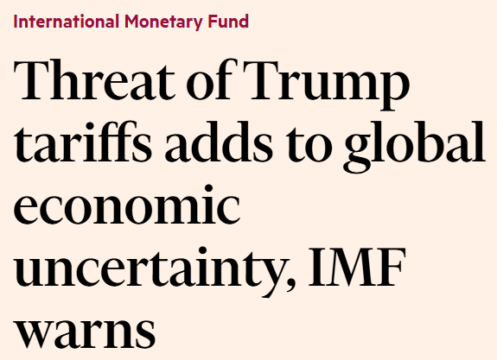
What Makes 2025 Different?
International Economic Uncertainty
Tariffs?
The Dollar?
Migrants/Deportation?
Notes:
4

Slide 5
Tariffs: the Known Unknowns
On whom? How much? How long? All stuff, or just some stuff? Who really pays it? Direct effects? Indirect effects? How much revenue is raised? What is the strategy? Protectionism? Escalate to de-escalate? How will other countries react? Bargain? Tit for tat? How will the tariffs affect growth? Inflation? Interest rates? The deficit? Investment? The dollar? Exports? What are the risks?
Notes:
5

Slide 6
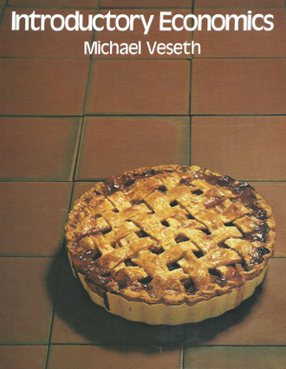
Pie Economics: Worst Case Scenario?
Large Scale Tit-for-Tat Tariffs
US producers get a bigger share of a smaller wine market pie
Losers?
Winners?
Age of Uncertainty
Notes:
6

Slide 7
What Makes 2025 Different?
Tariffs?
The Dollar?
Migrants/Deportation?
Health Guidelines?
Duty-Drawbacks?
Notes:
7

Slide 8




Who Ya Gonna Call?
Jeff Bitter,
Allied Grape Growers
Glen Proctor,
The Ciatti Company
Stephen Rannekleiv,
Rabobank
Danny Brager,
Brager Beverage Alcohol Consulting
Notes:
8

Slide 9
The State of the Industry 2025
Notes:
9

