Slide 1
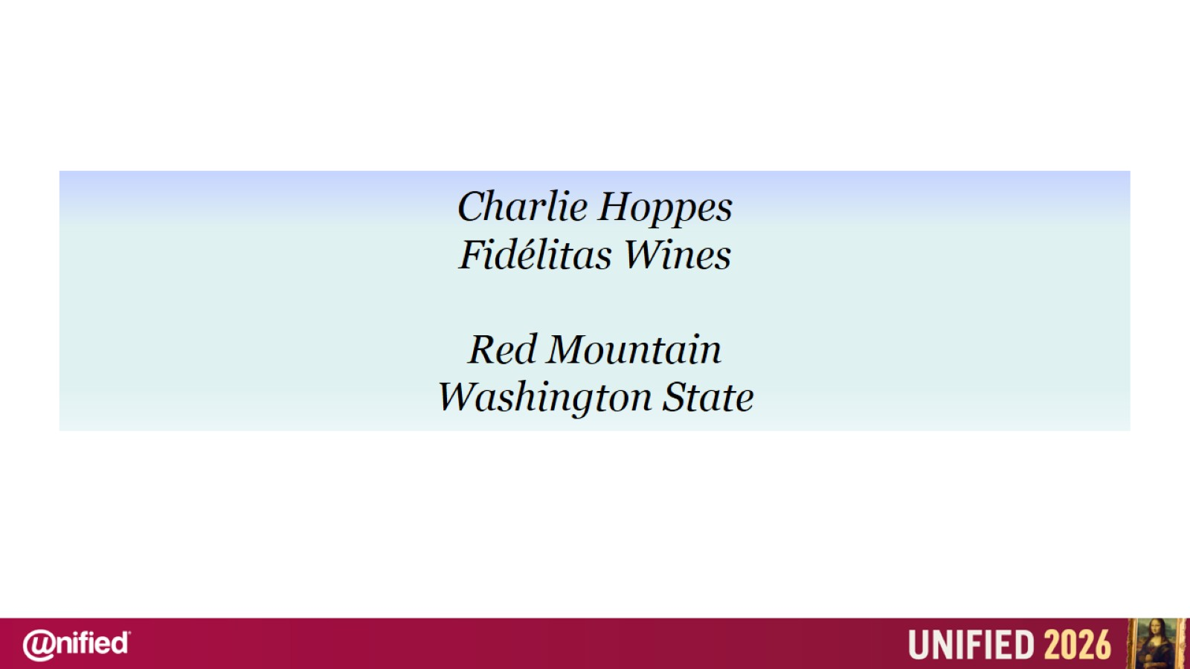
Charlie Hoppes
Fidélitas Wines
Red Mountain
Washington State

Slide 2
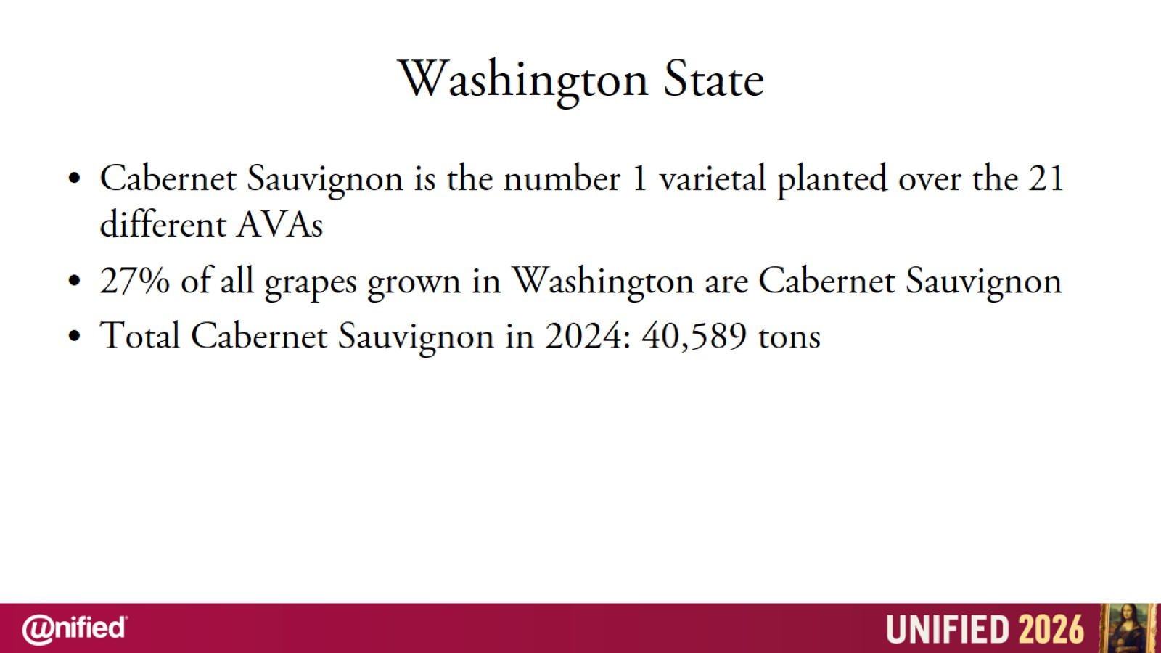
Washington State

Slide 3
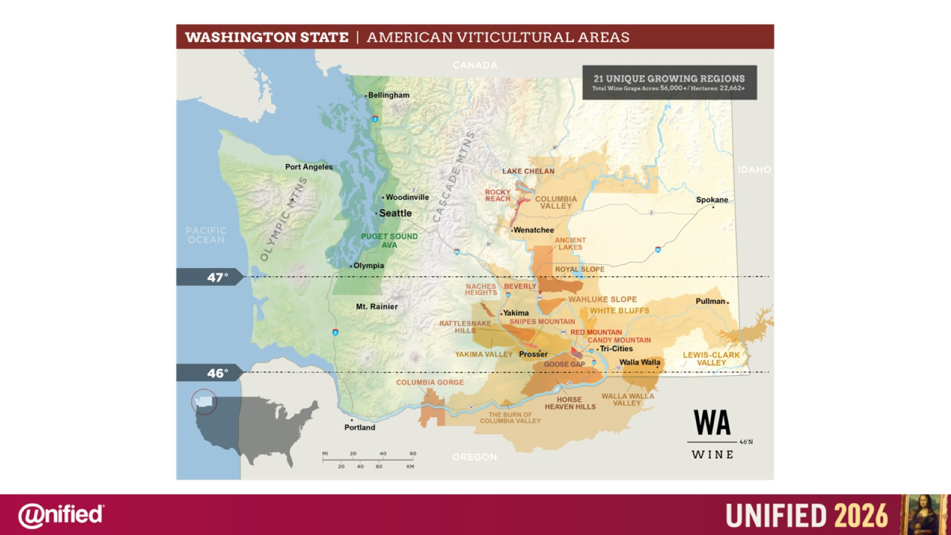

Slide 4
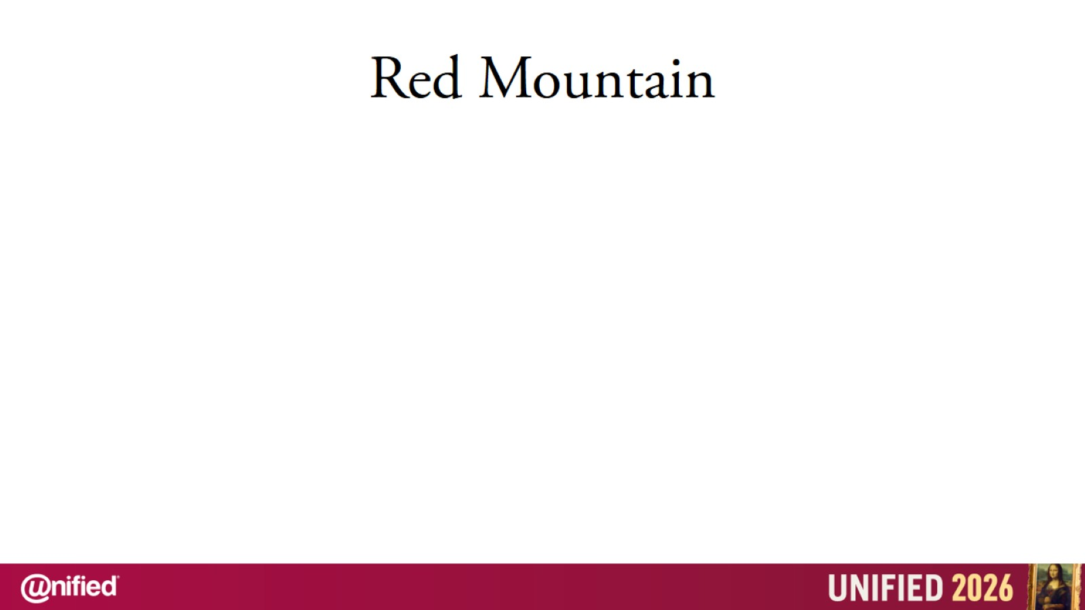

Slide 5
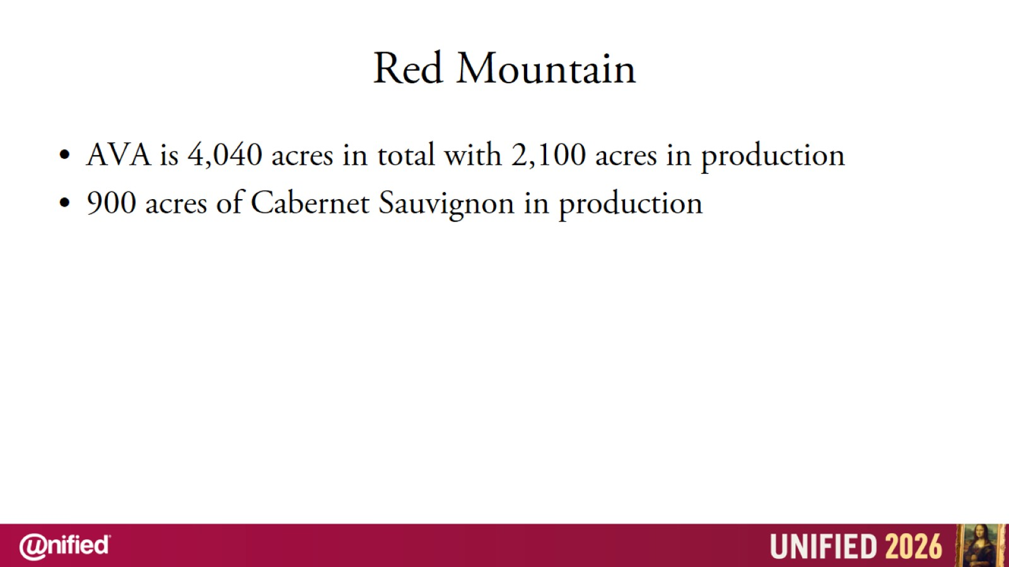
Red Mountain

Slide 6
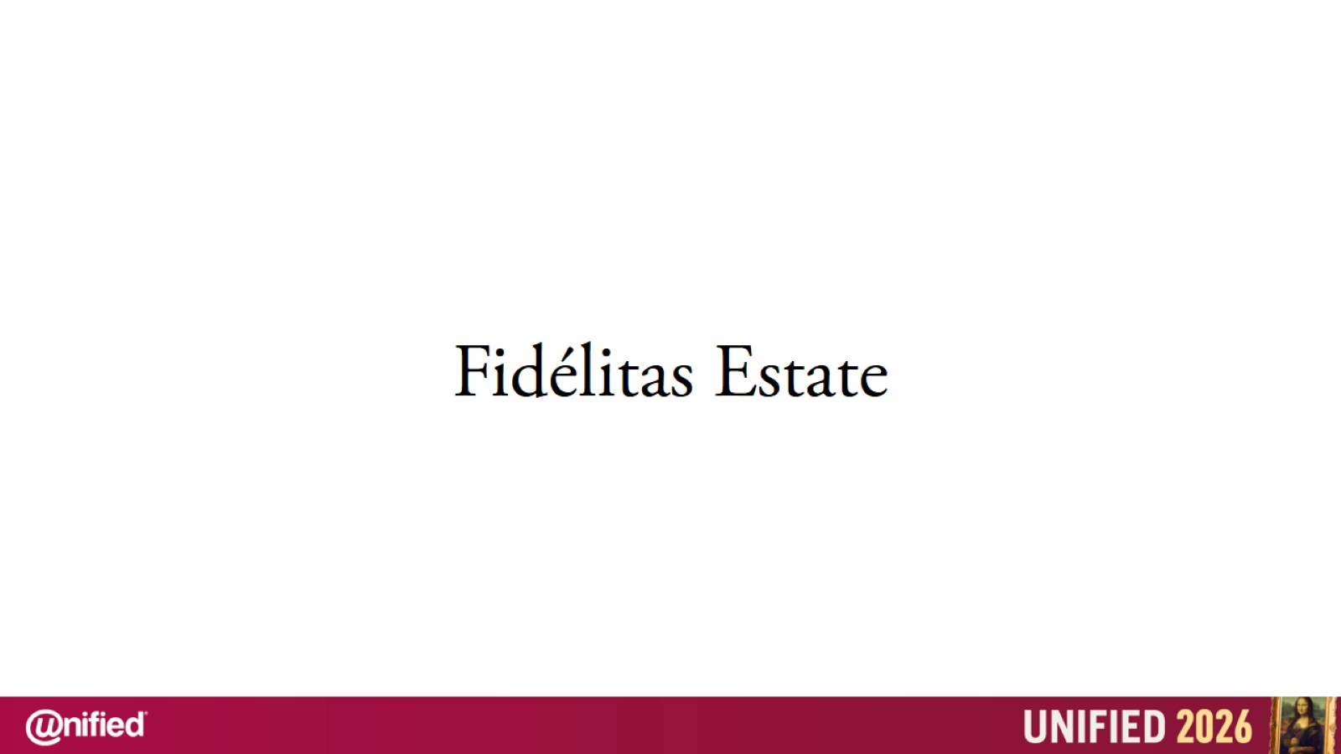

Slide 7
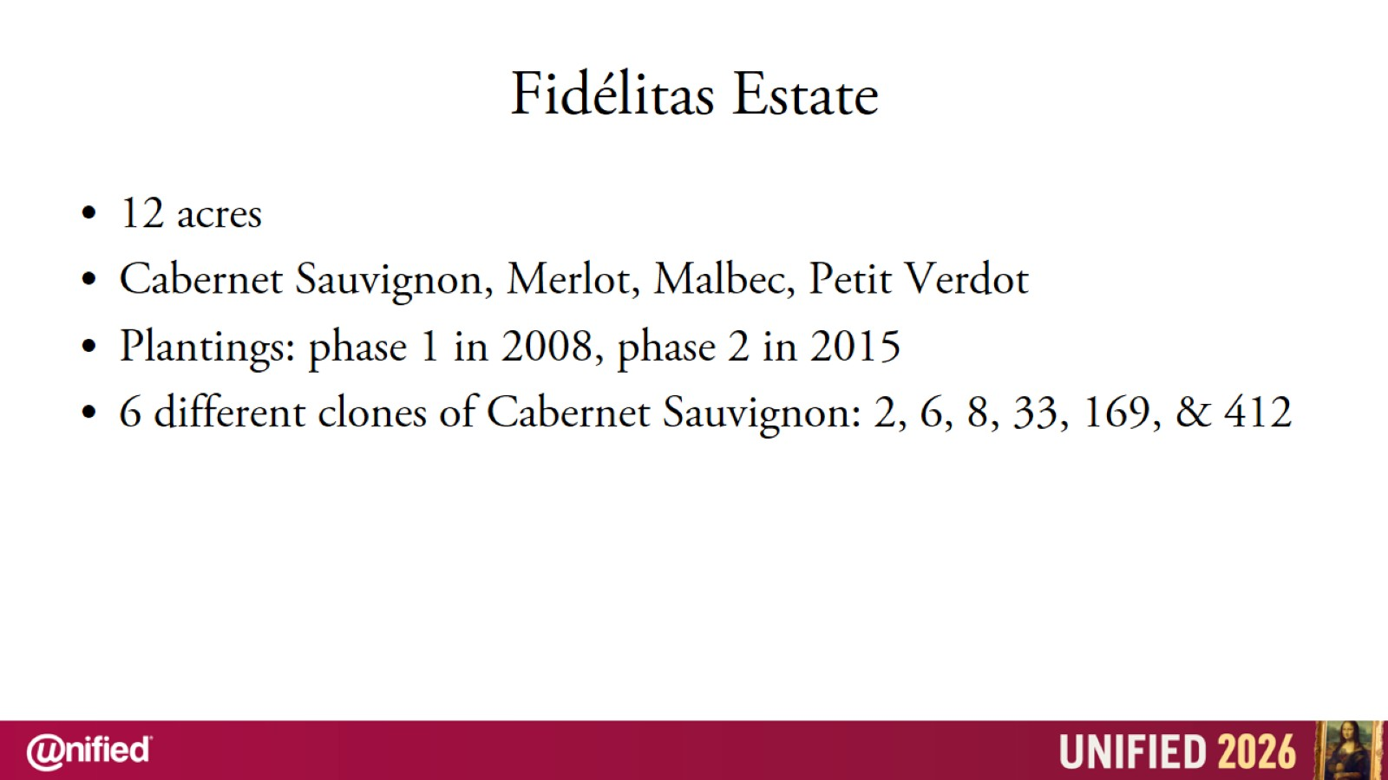
Fidélitas Estate

Slide 8
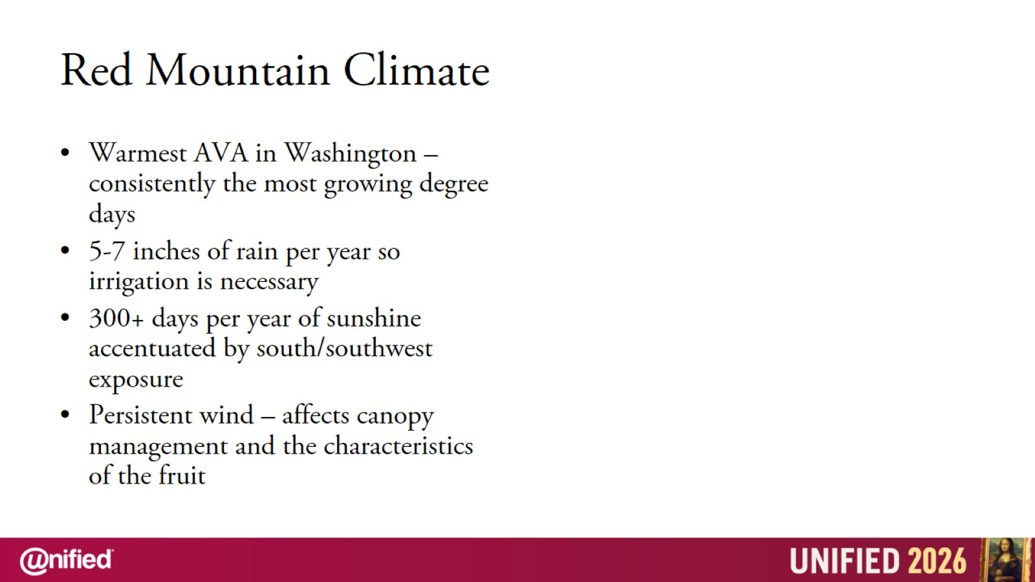
Red Mountain Climate

Slide 9
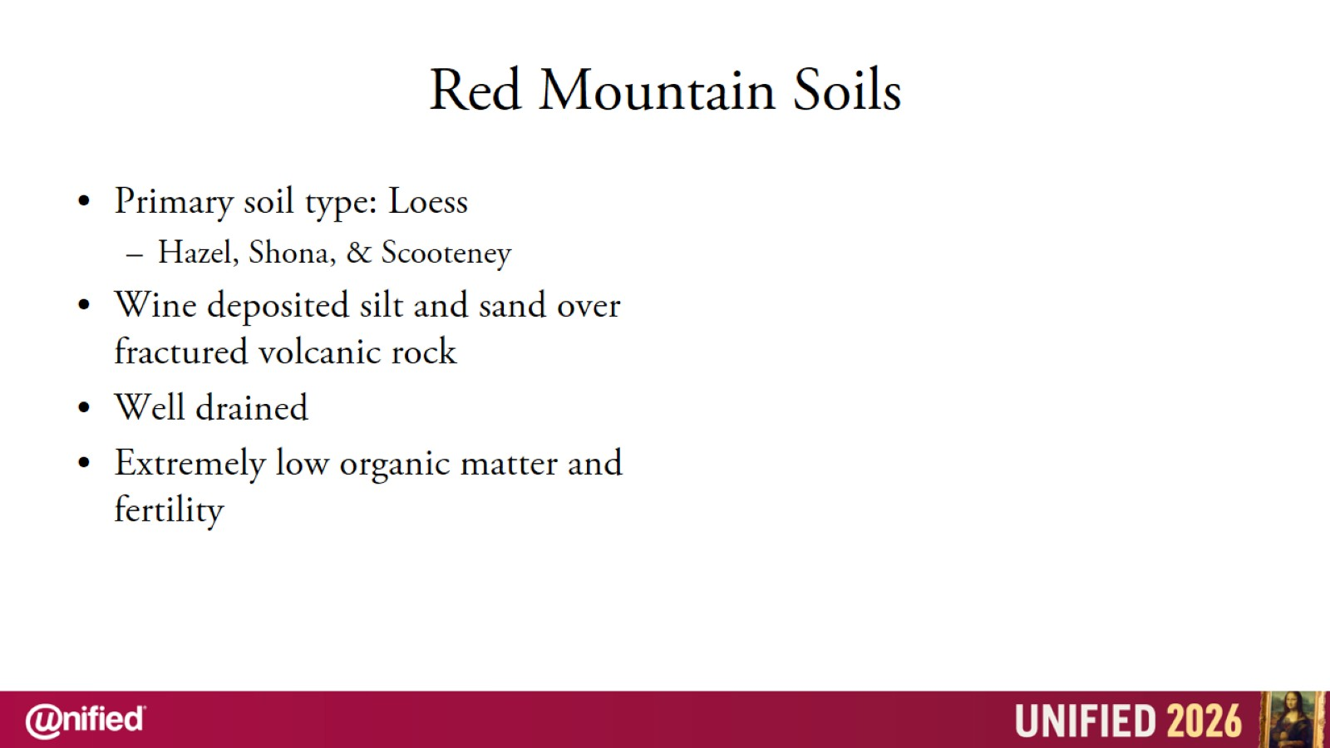
Red Mountain Soils

Slide 10
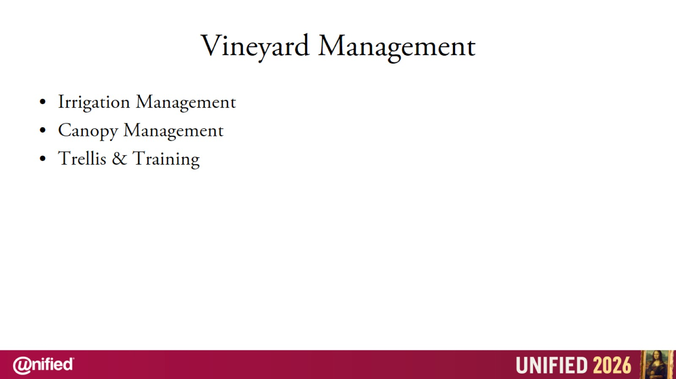
Vineyard Management

Slide 11
Vineyard Management

Slide 12
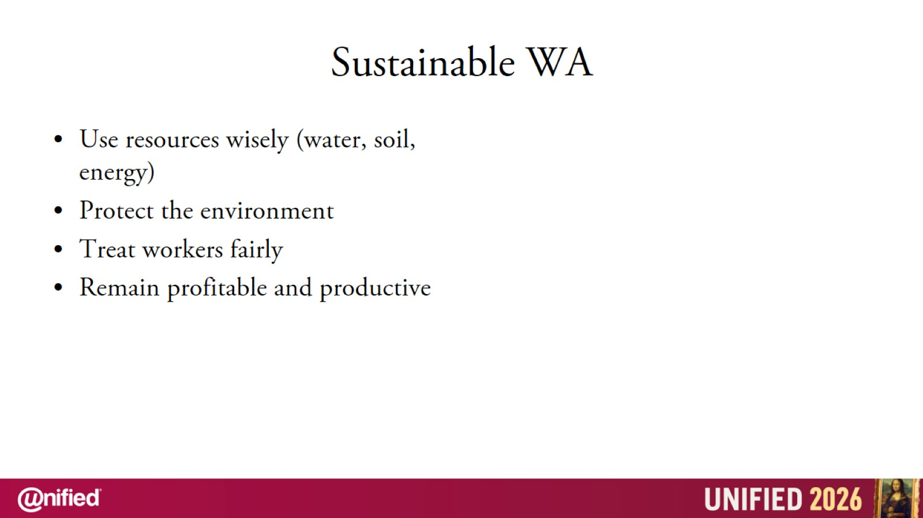
Sustainable WA

Slide 13
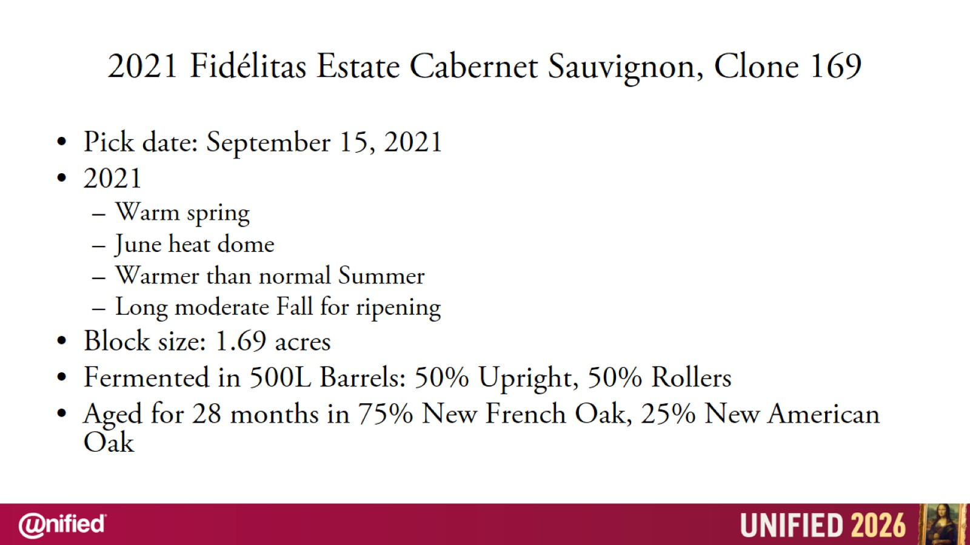
2021 Fidélitas Estate Cabernet Sauvignon, Clone 169

