Slide 1
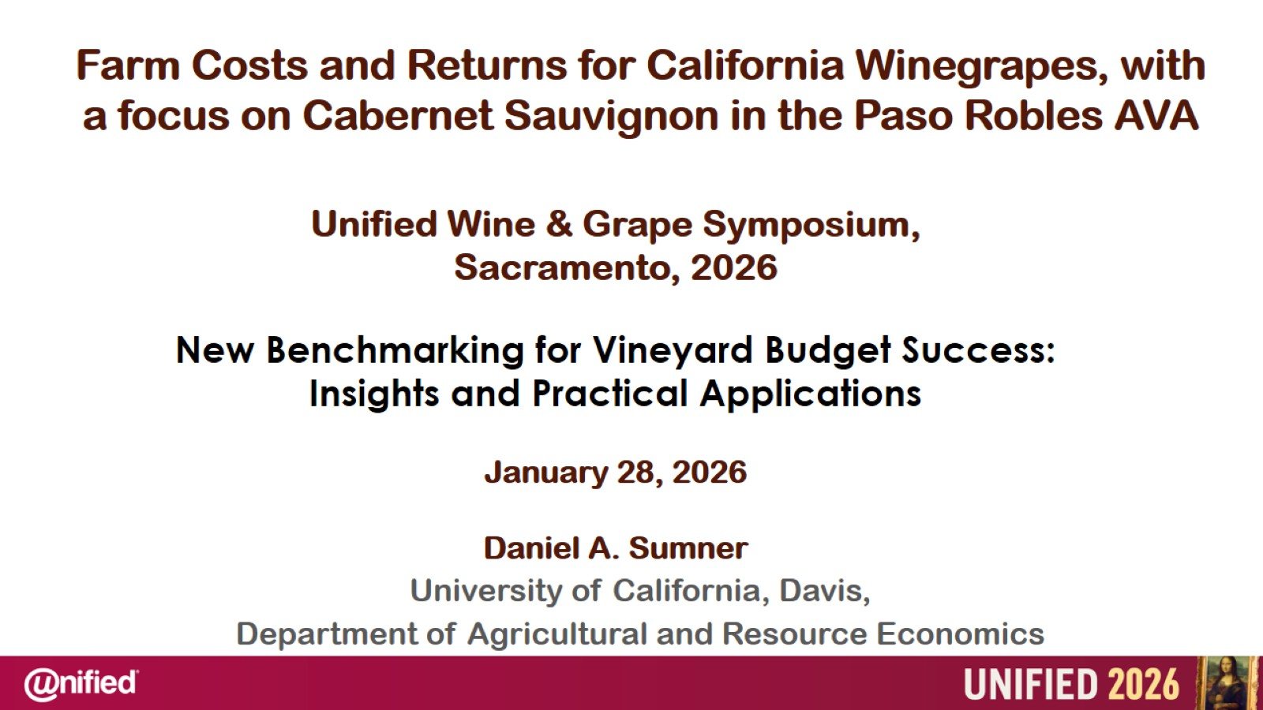
Farm Costs and Returns for California Winegrapes, with a focus on Cabernet Sauvignon in the Paso Robles AVA

Slide 2
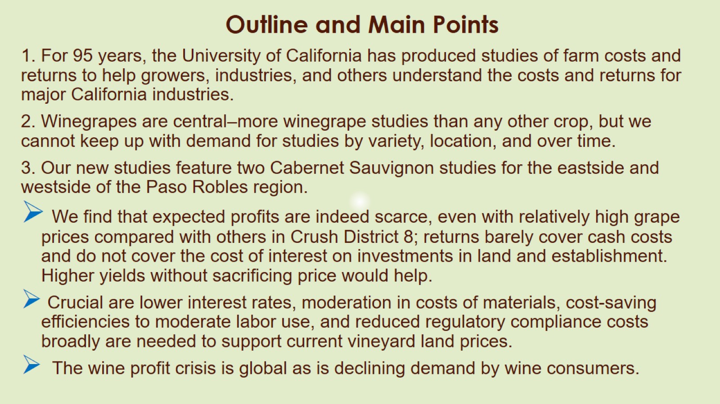
Outline and Main Points

Slide 3
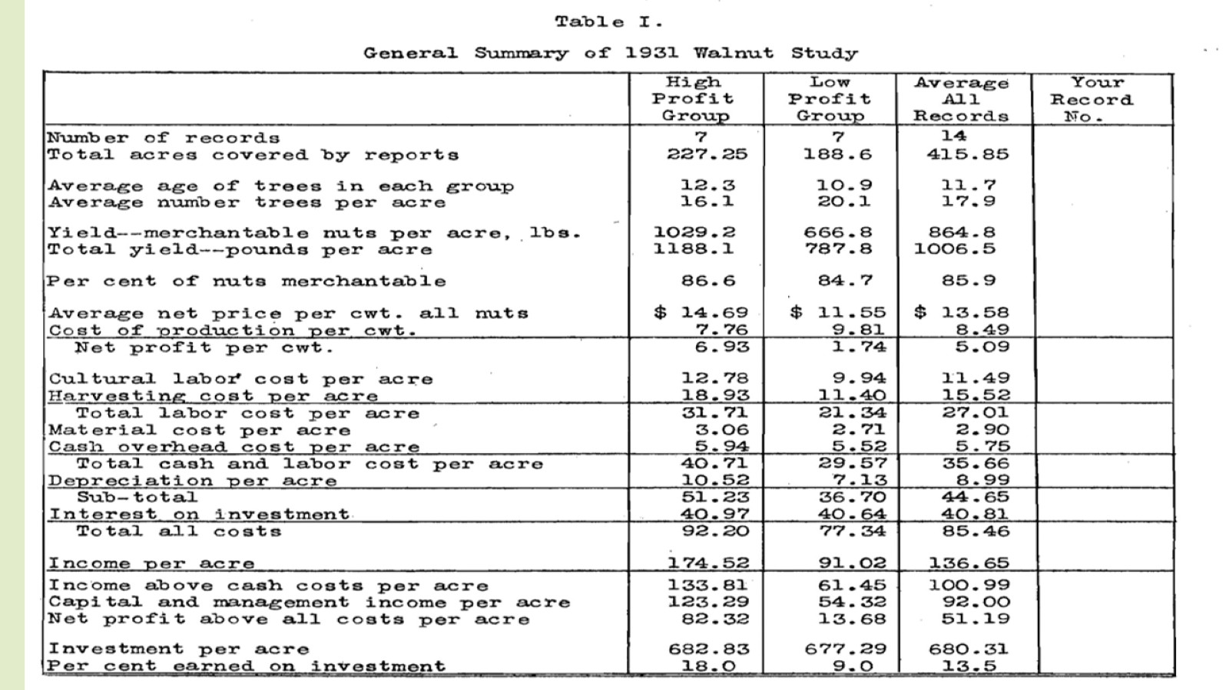

Slide 4
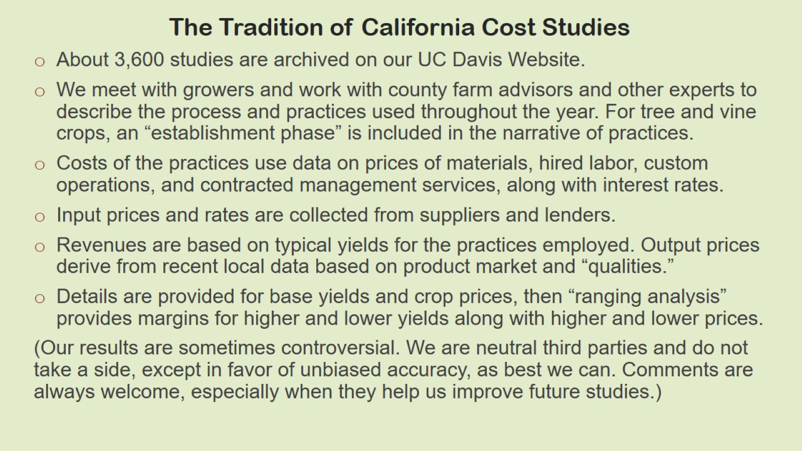
The Tradition of California Cost Studies

Slide 5
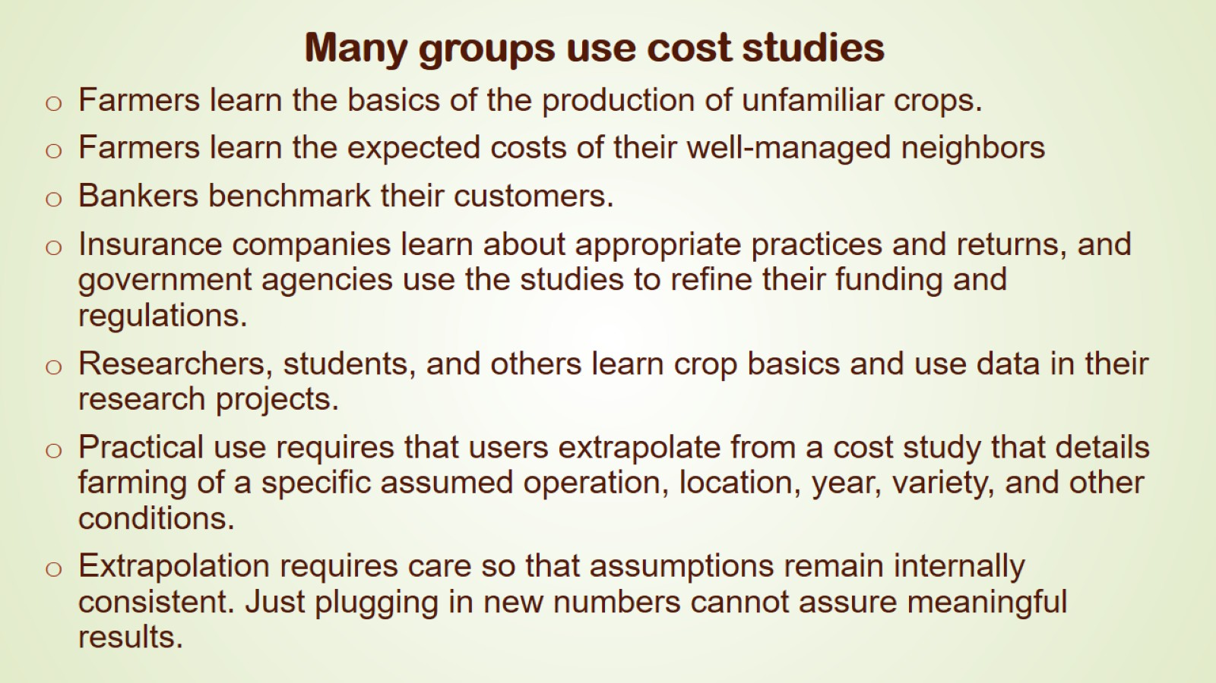
Many groups use cost studies

Slide 6
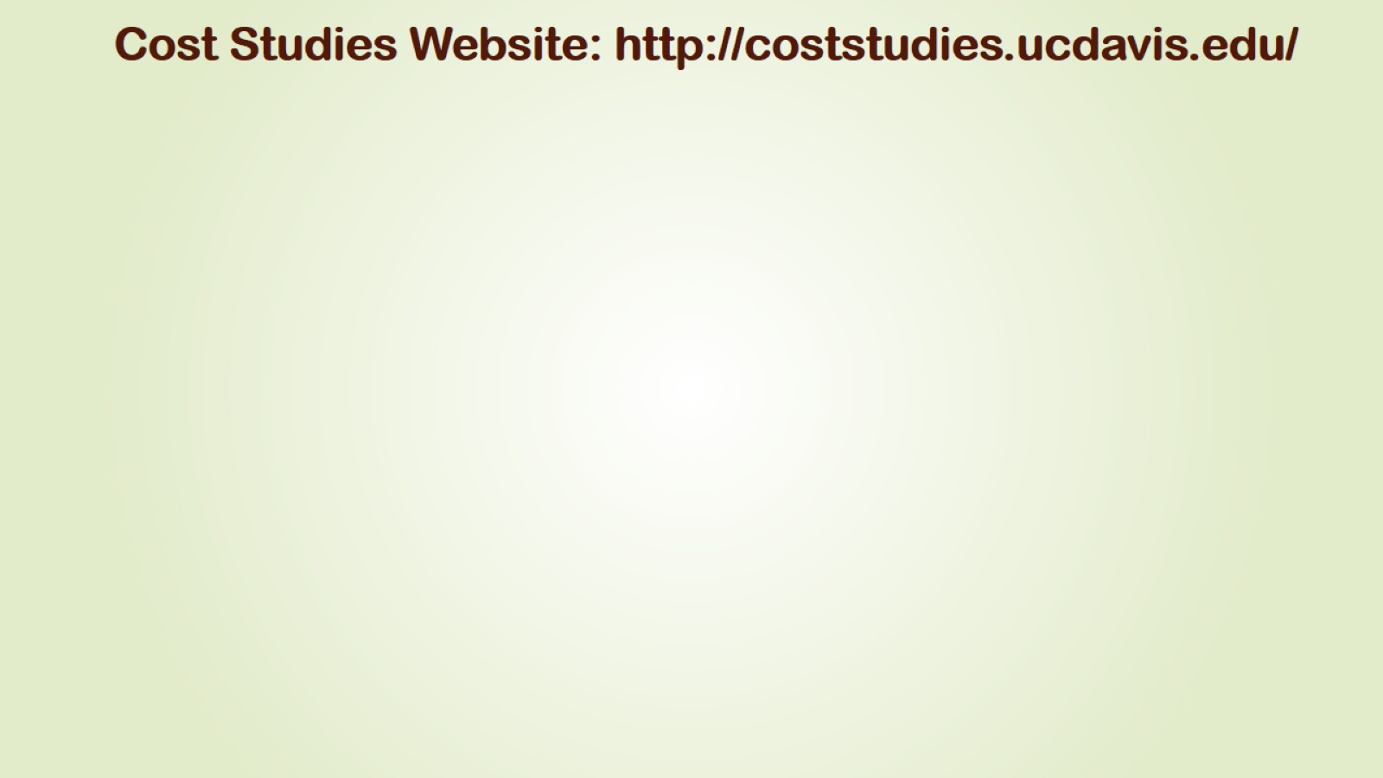
Cost Studies Website: http://coststudies.ucdavis.edu/

Slide 7
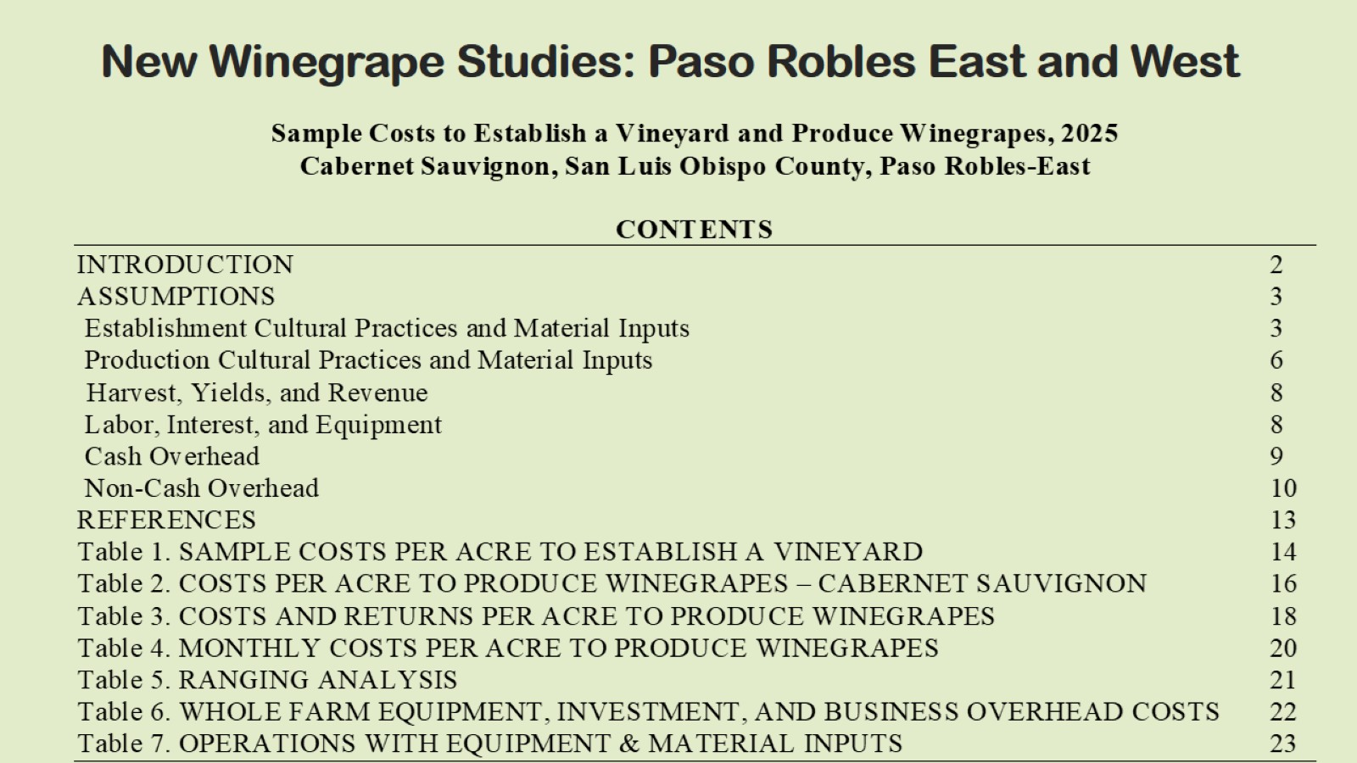
New Winegrape Studies: Paso Robles East and West

Slide 8
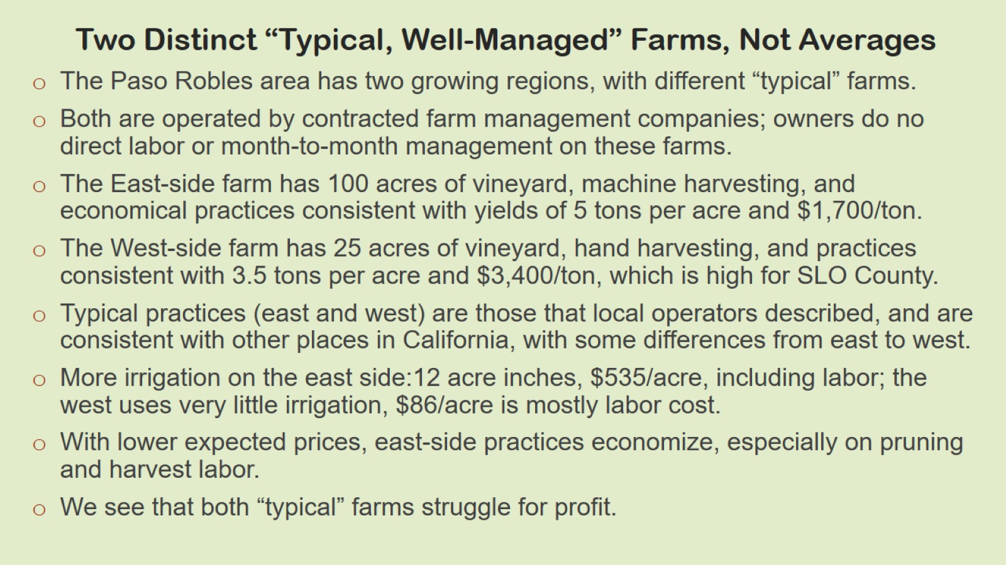
Two Distinct “Typical, Well-Managed” Farms, Not Averages

Slide 9
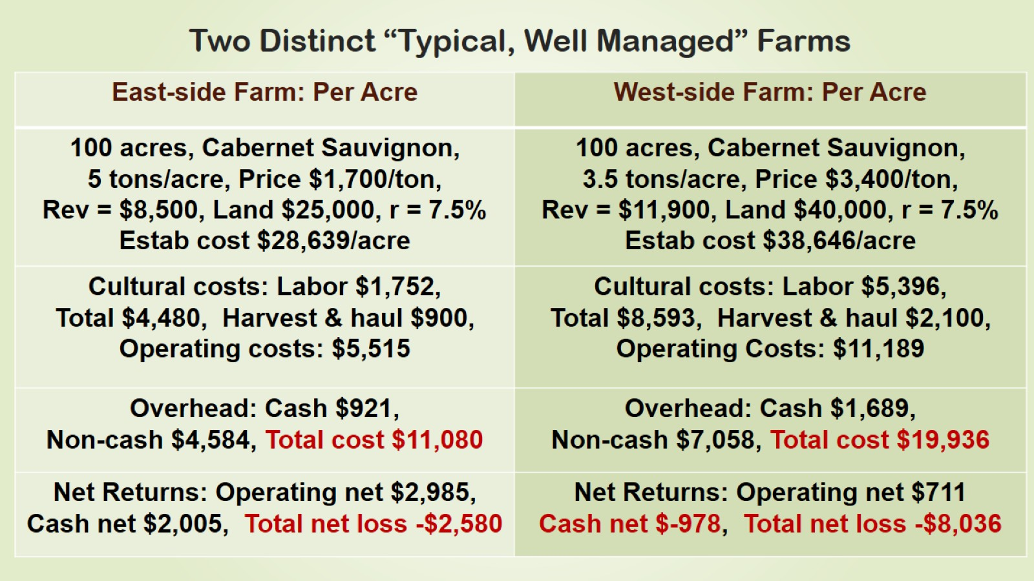
Two Distinct “Typical, Well Managed” Farms

Slide 10
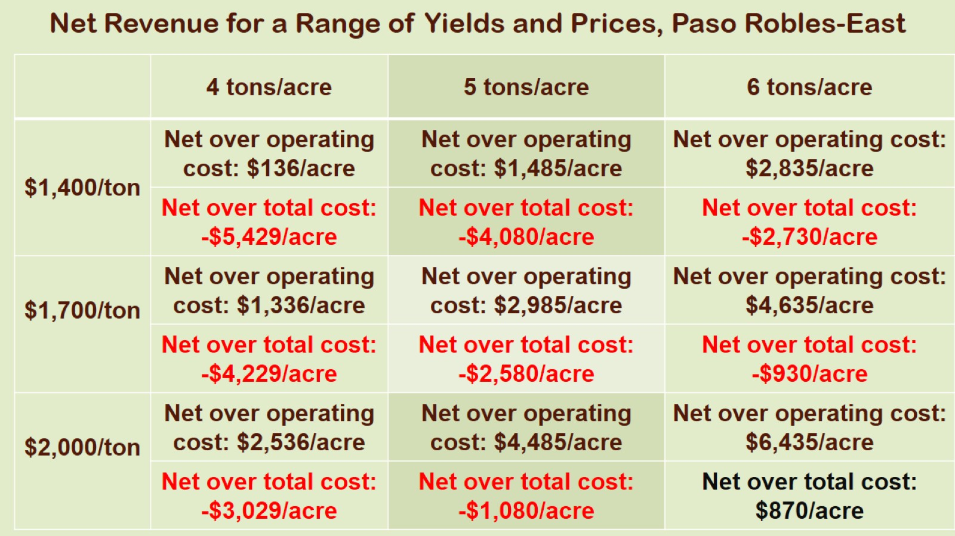
Net Revenue for a Range of Yields and Prices, Paso Robles-East

Slide 11
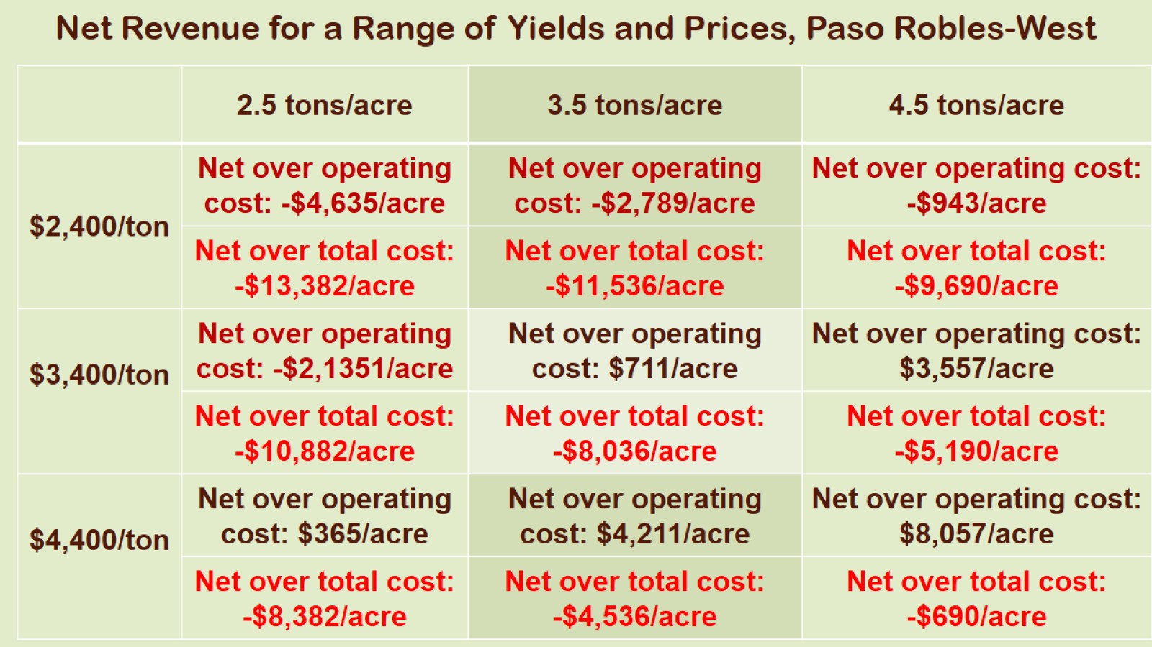
Net Revenue for a Range of Yields and Prices, Paso Robles-West

Slide 12
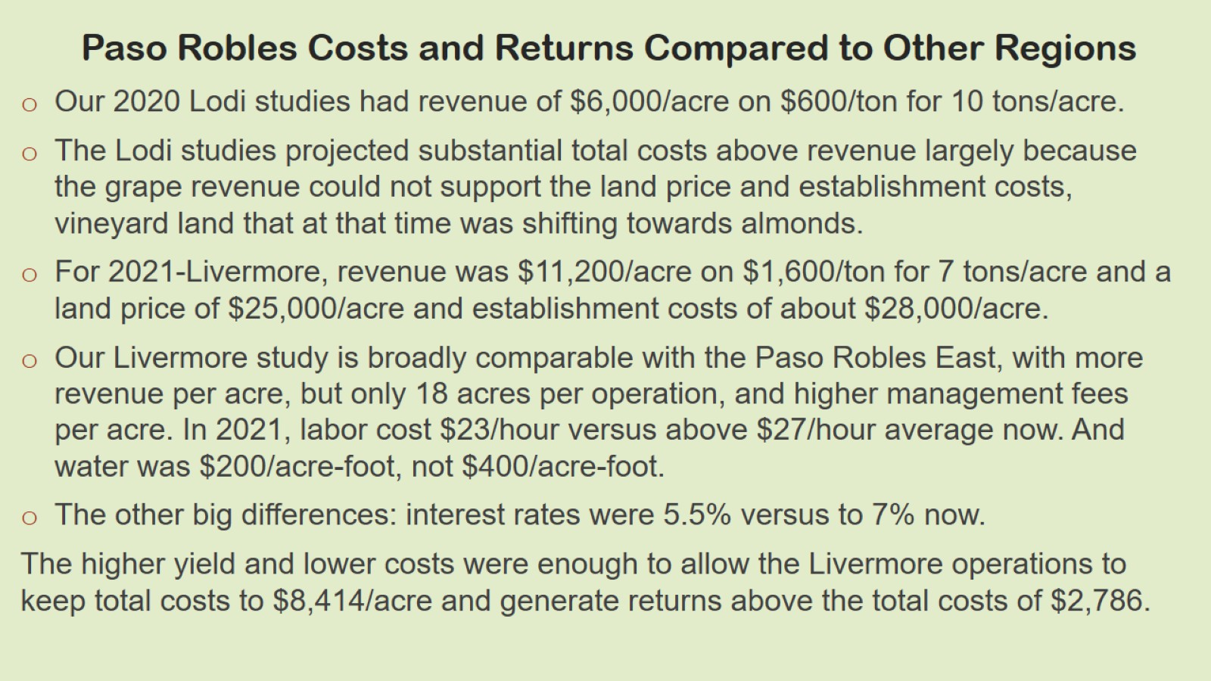
Paso Robles Costs and Returns Compared to Other Regions

Slide 13
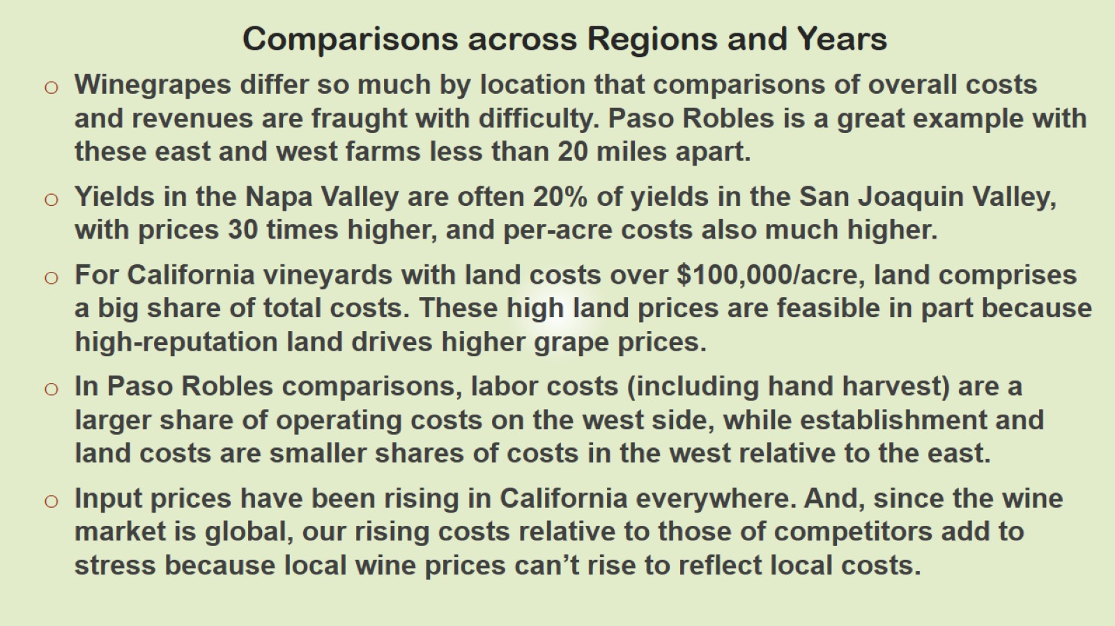
Comparisons across Regions and Years

Slide 14
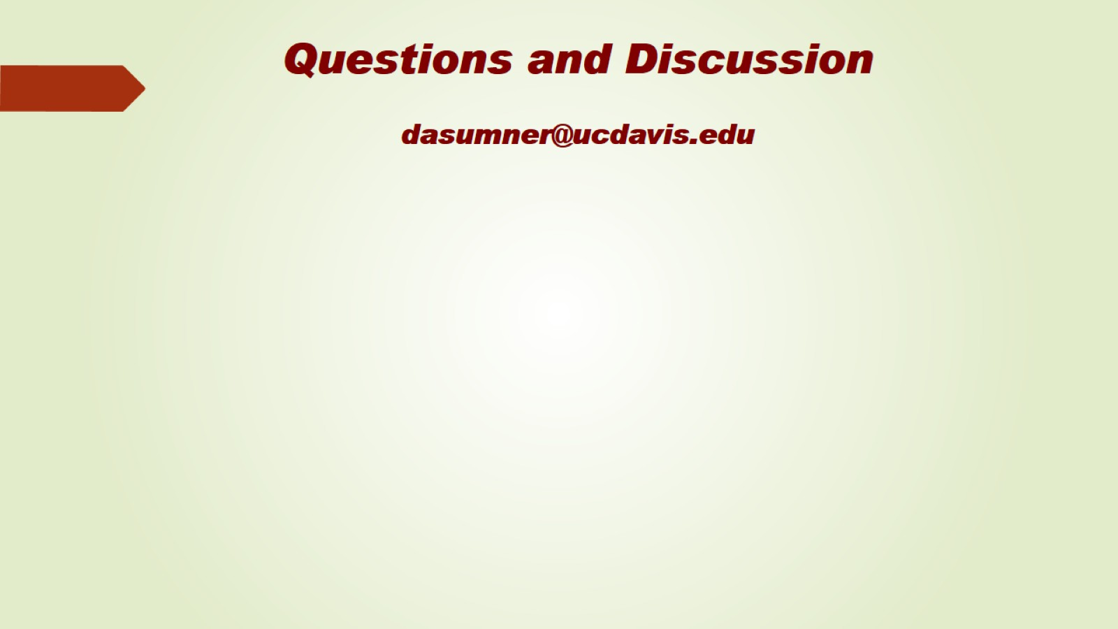
Questions and Discussion dasumner@ucdavis.edu

