Slide 1


Slide 2
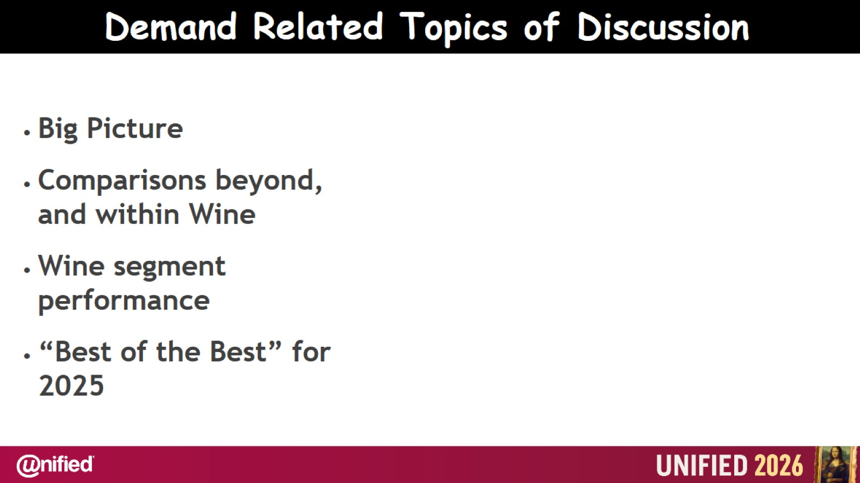

Slide 3
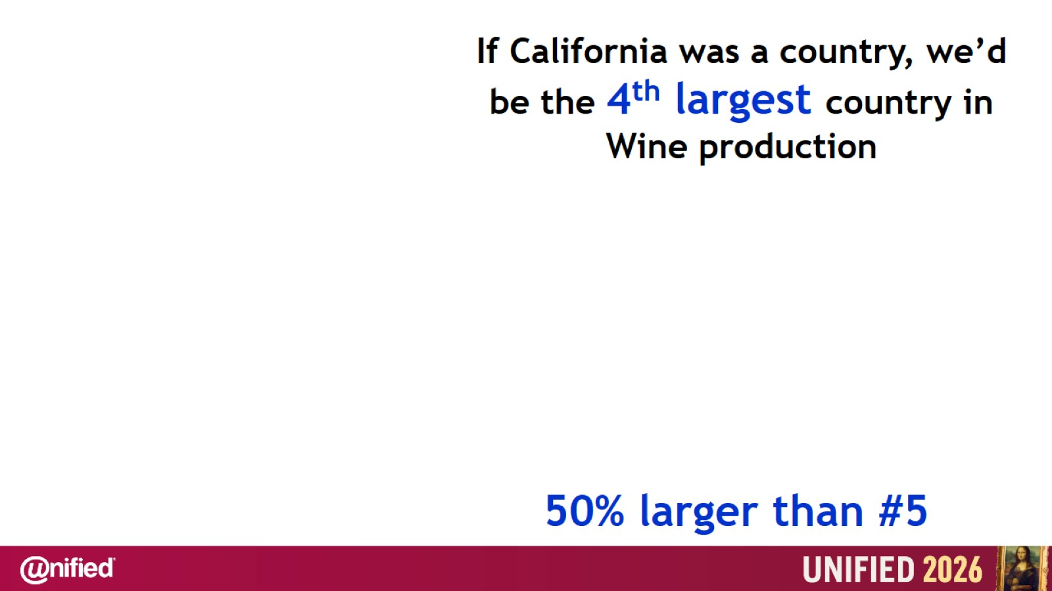

Slide 4
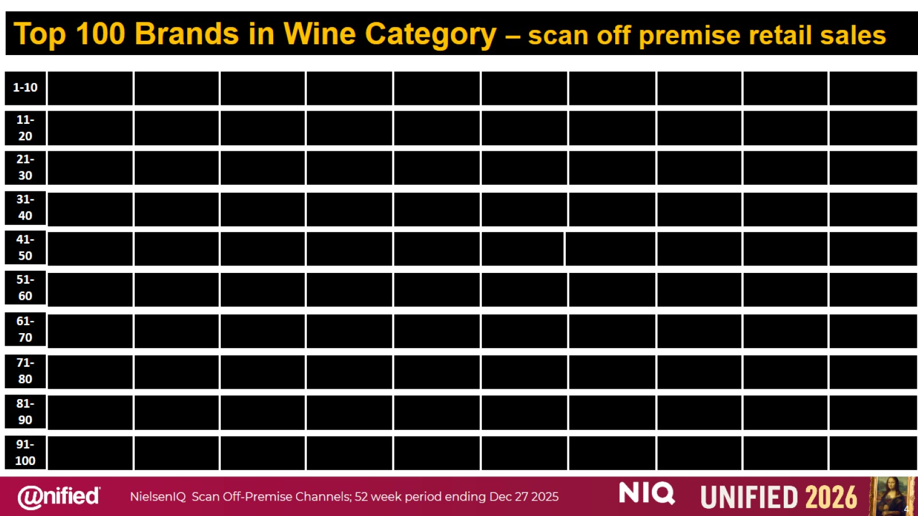

Slide 5
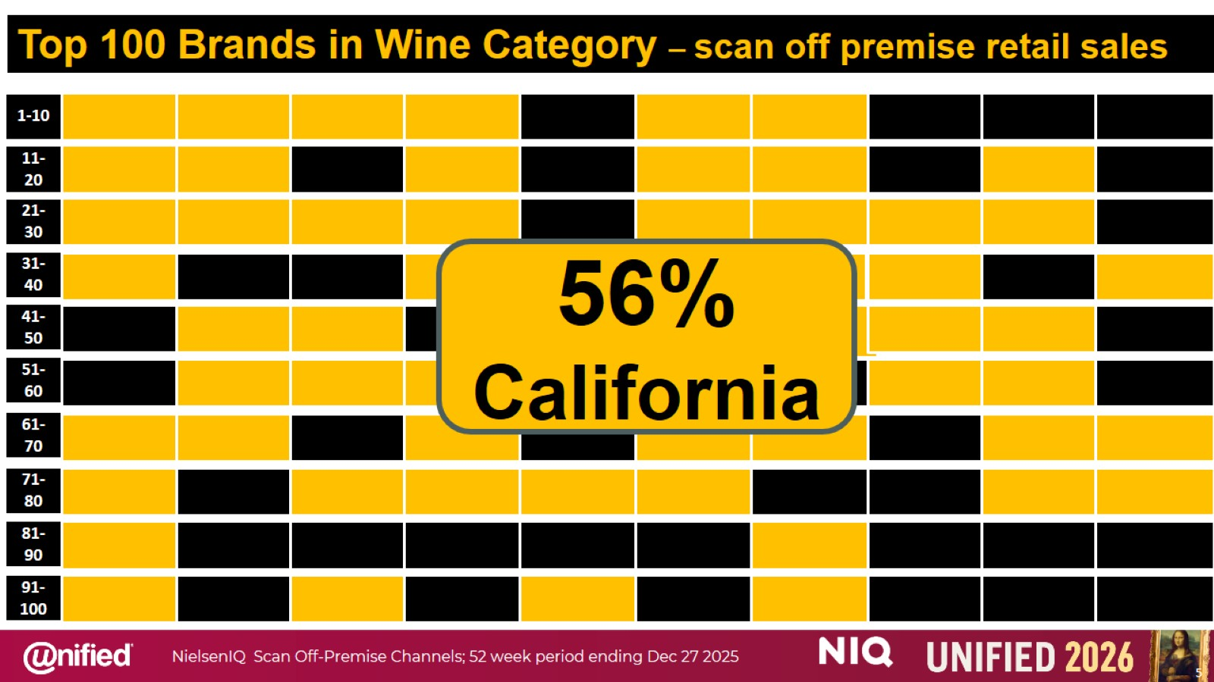

Slide 6


Slide 7
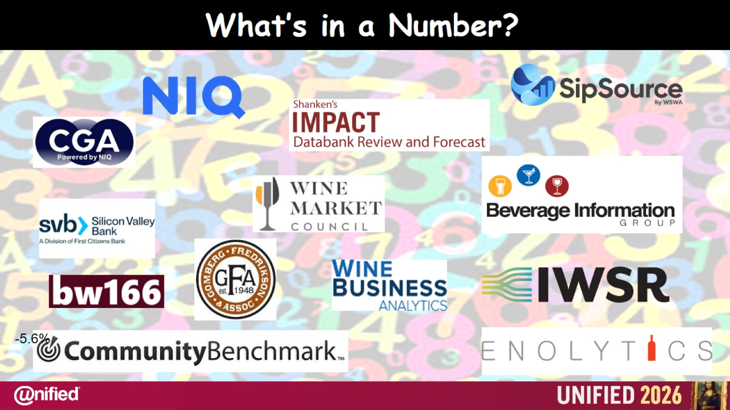
What’s in a Number?

Slide 8
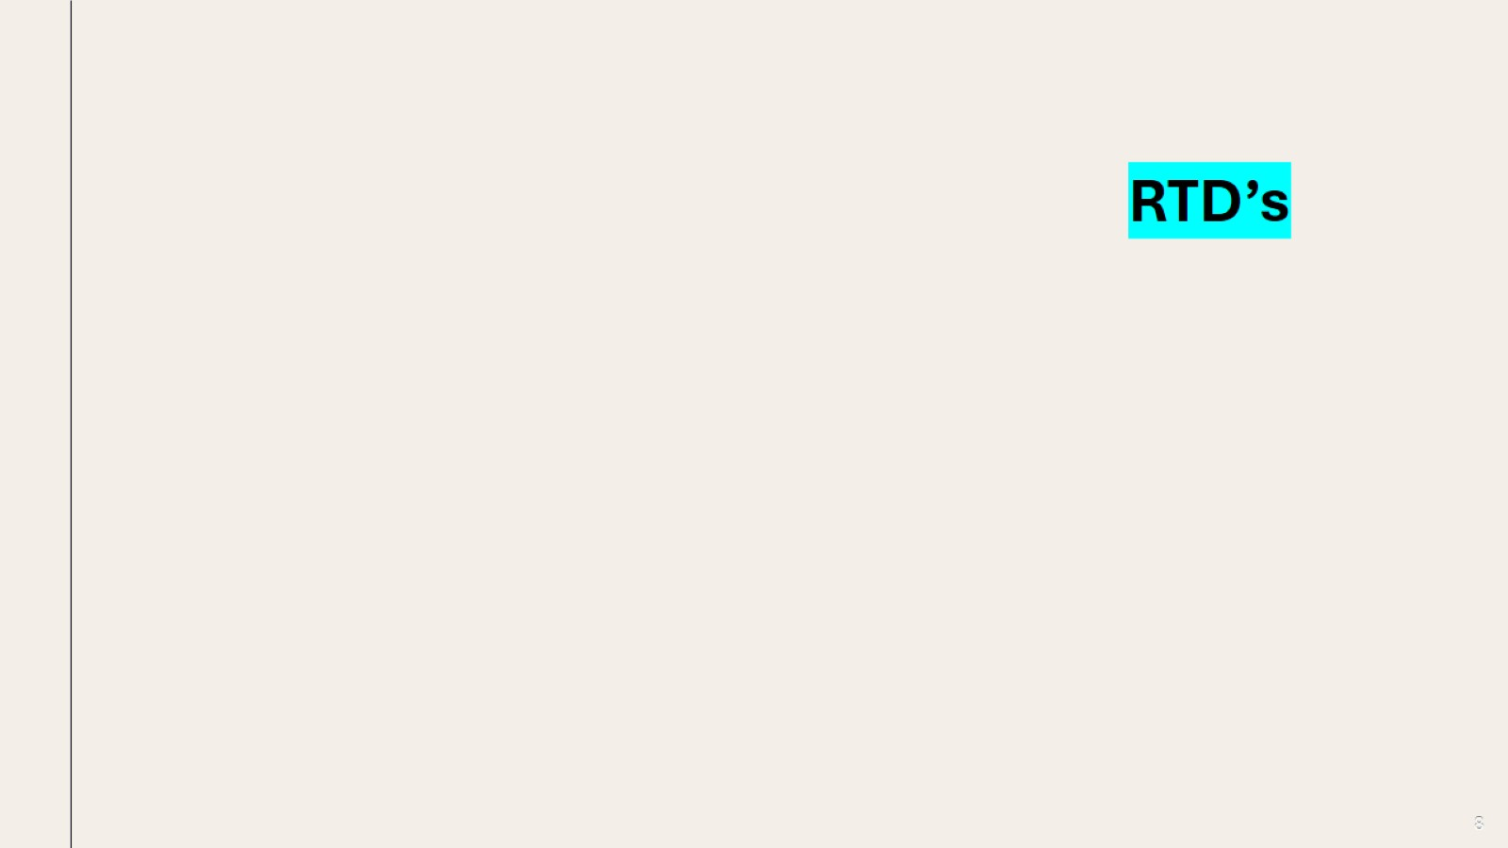

Slide 9
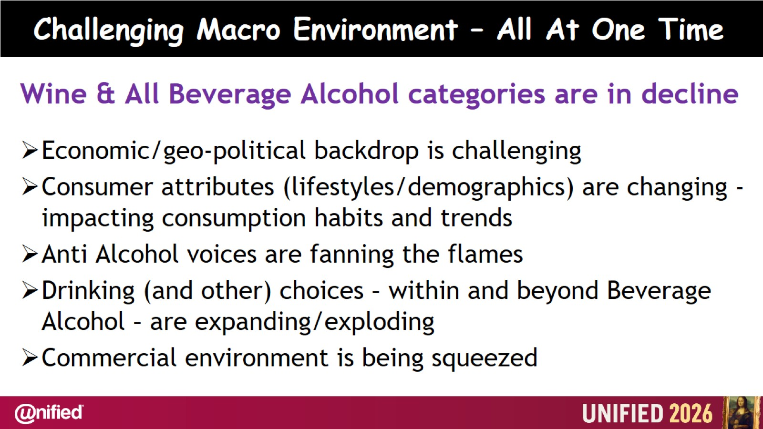
Challenging Macro Environment – All At One Time

Slide 10


Slide 11
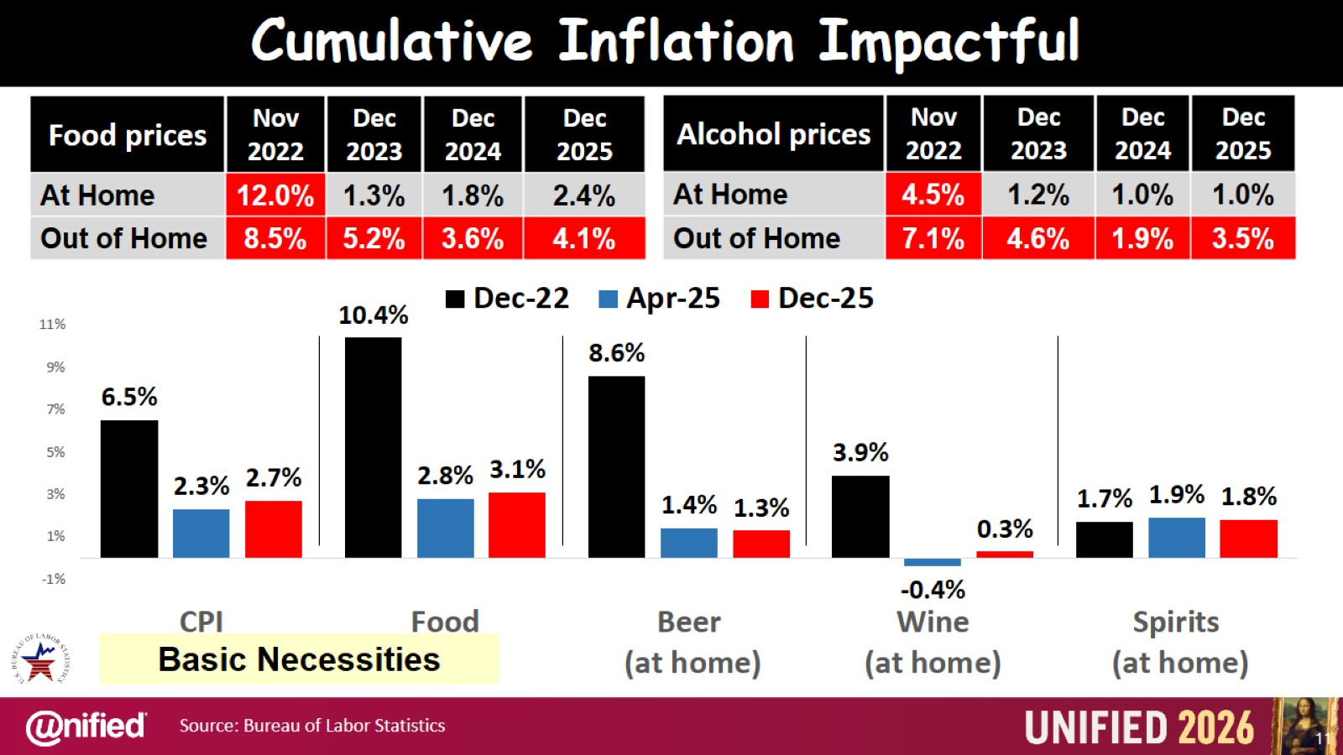

Slide 12
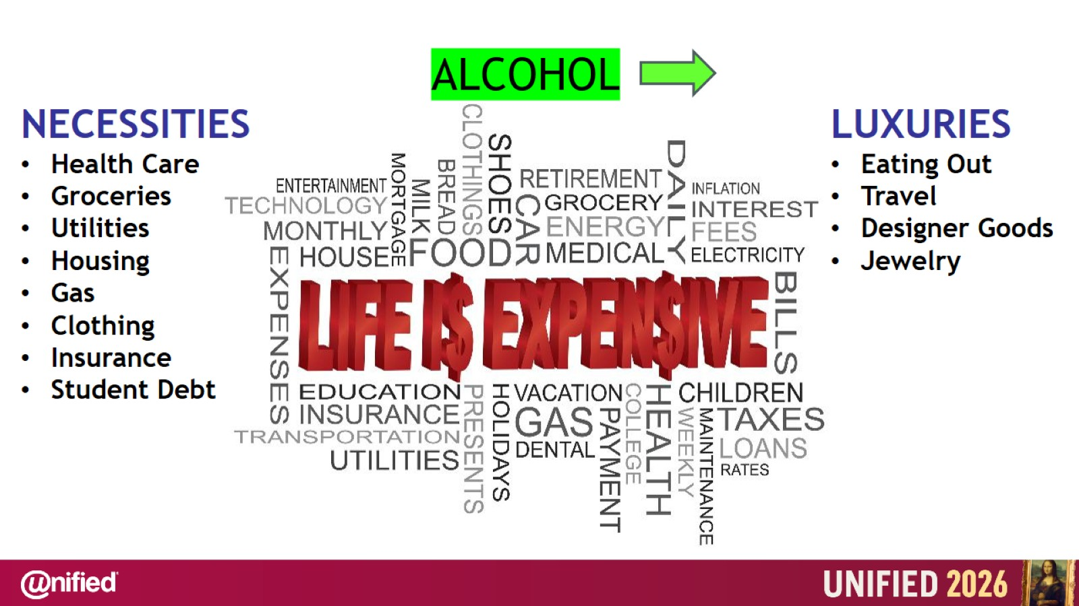

Slide 13
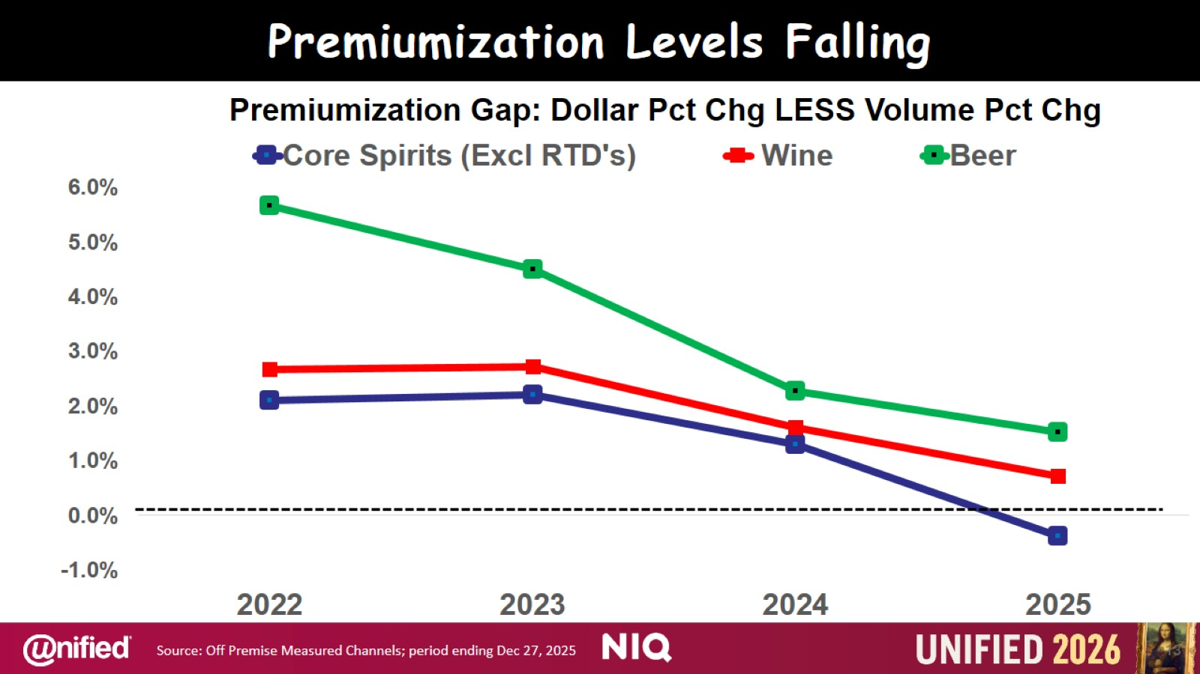

Slide 14
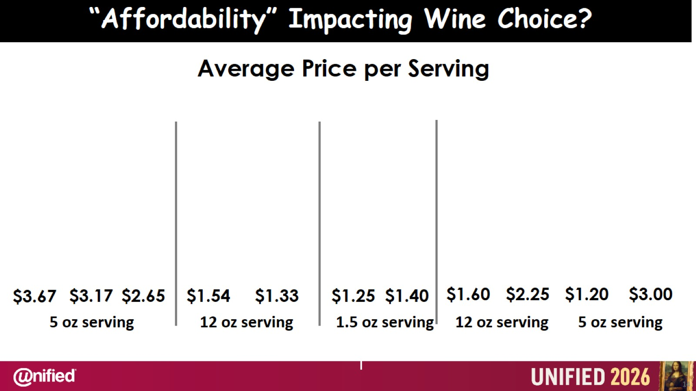

Slide 15
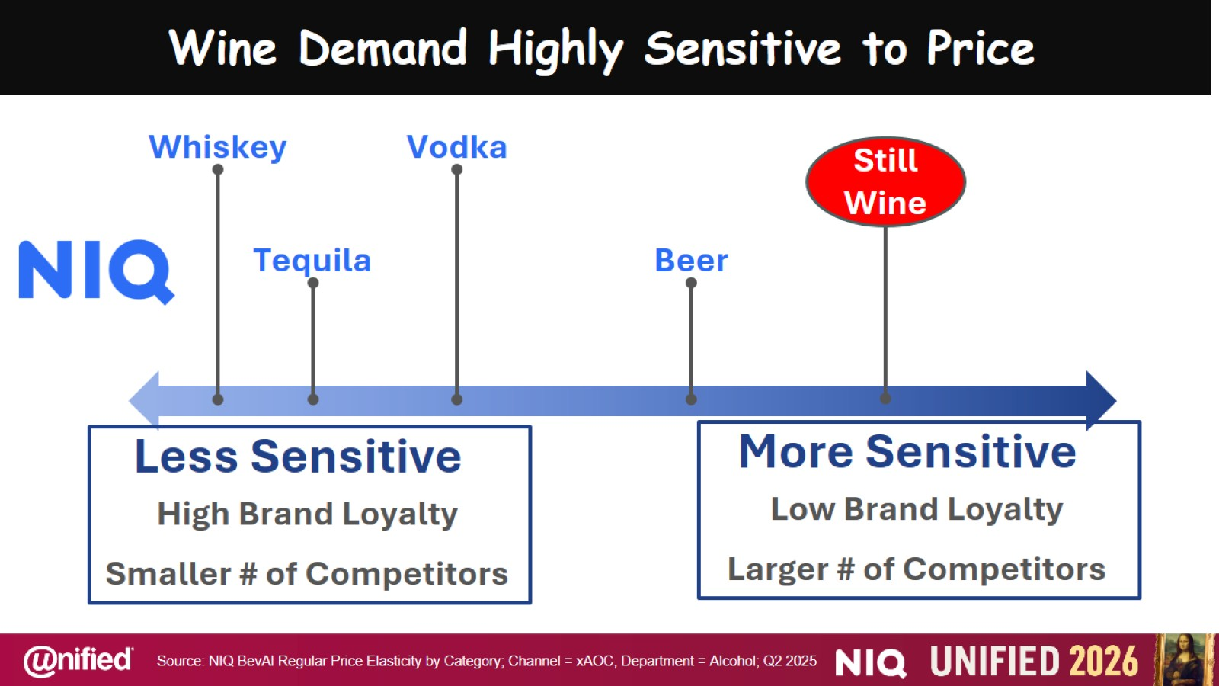
Wine Demand Highly Sensitive to Price

Slide 16
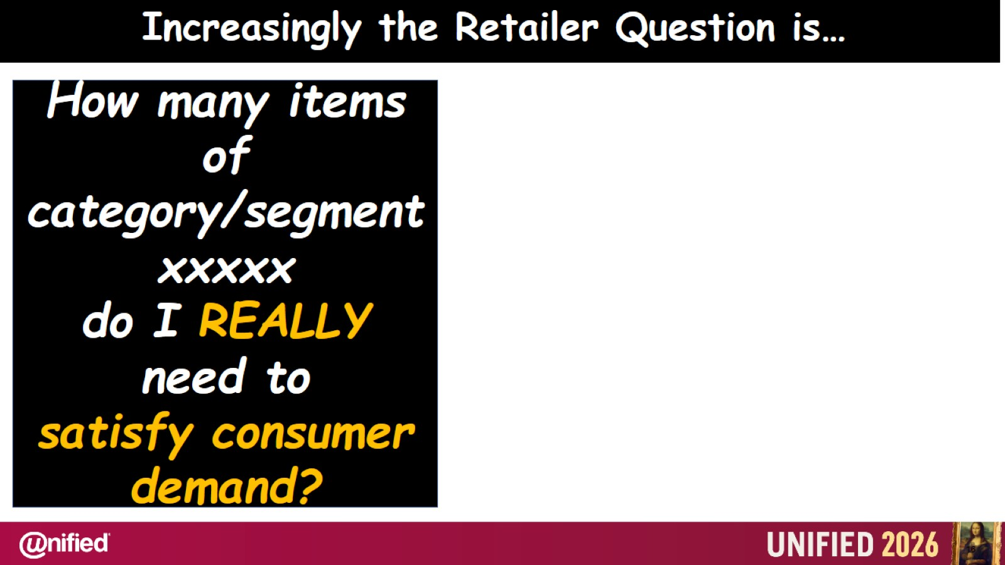

Slide 17
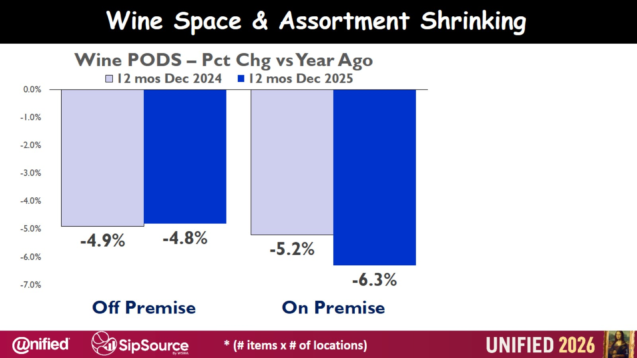

Slide 18

Consumer Choice Has And Will Continue To Explode

Slide 19
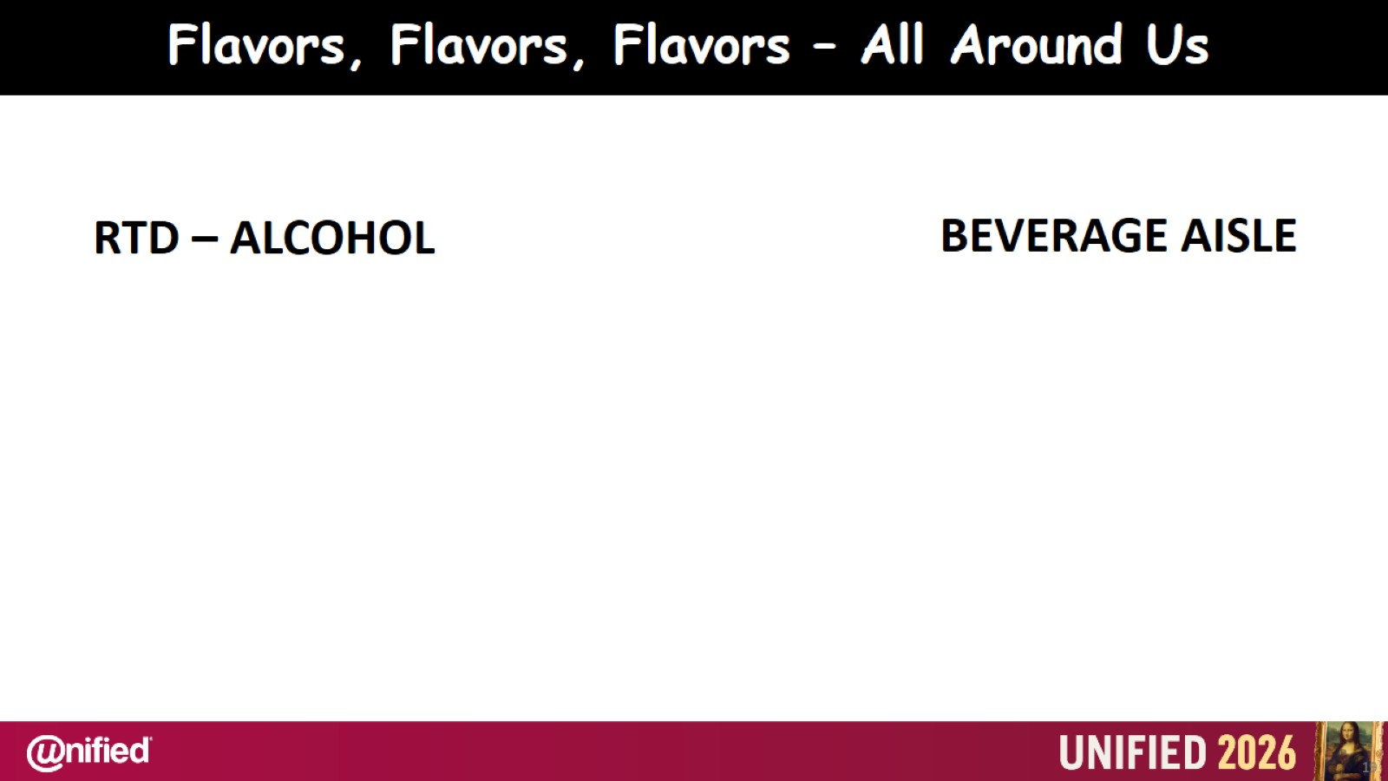

Slide 20
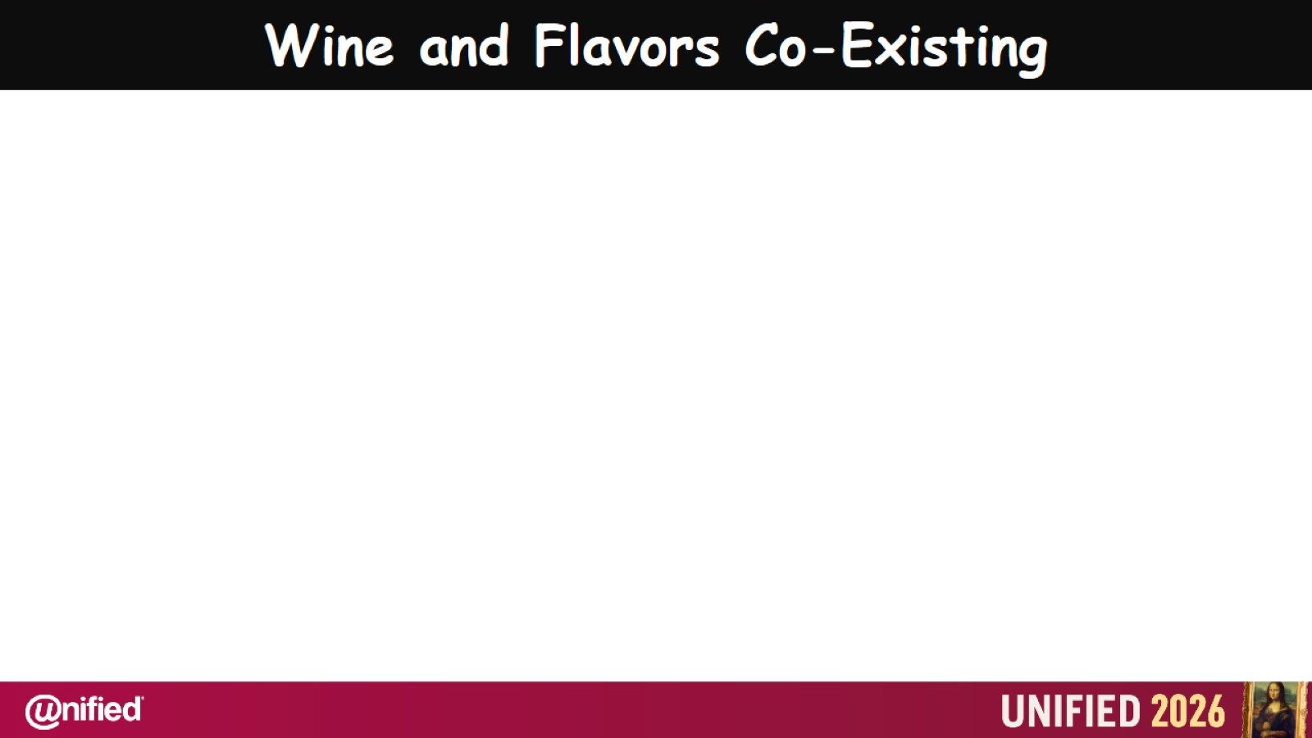

Slide 21
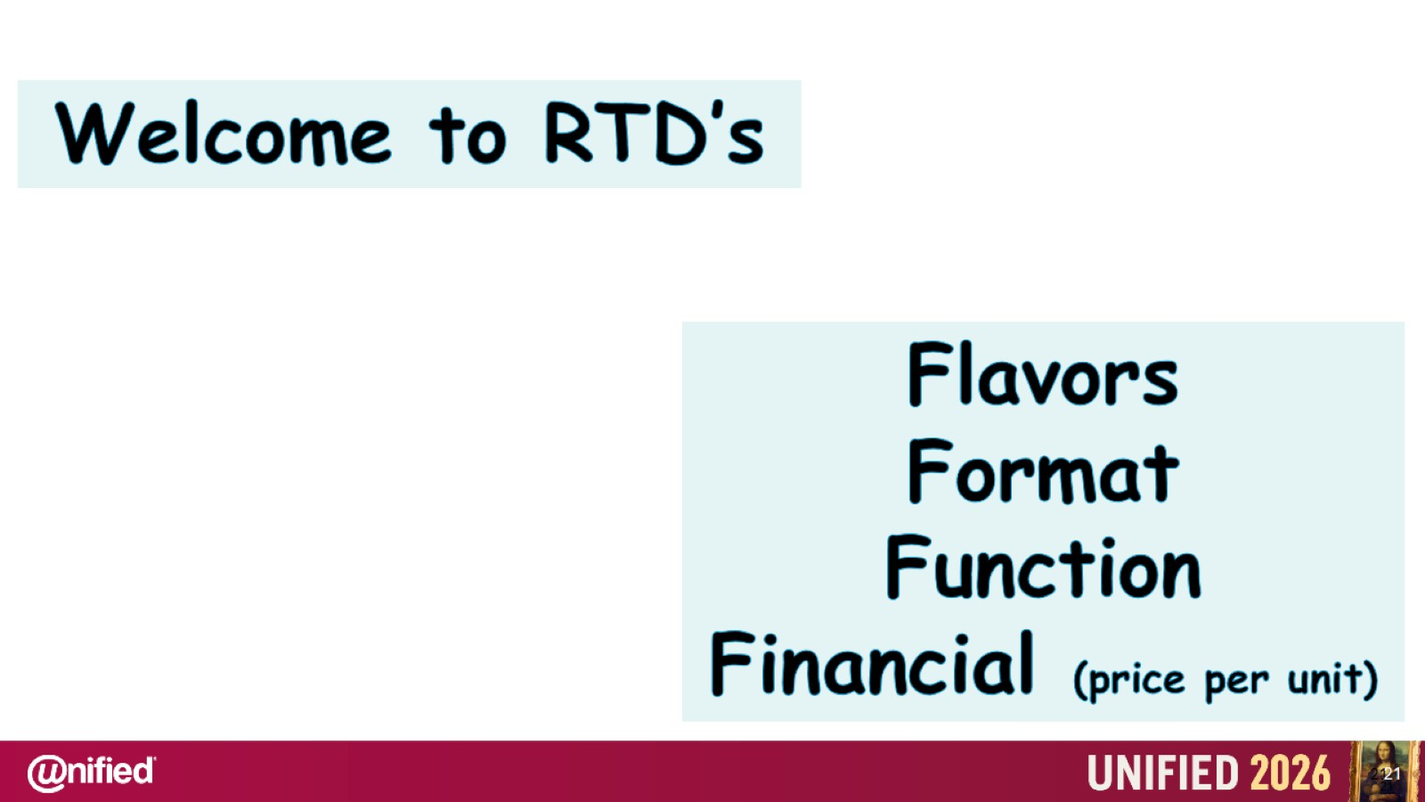

Slide 22
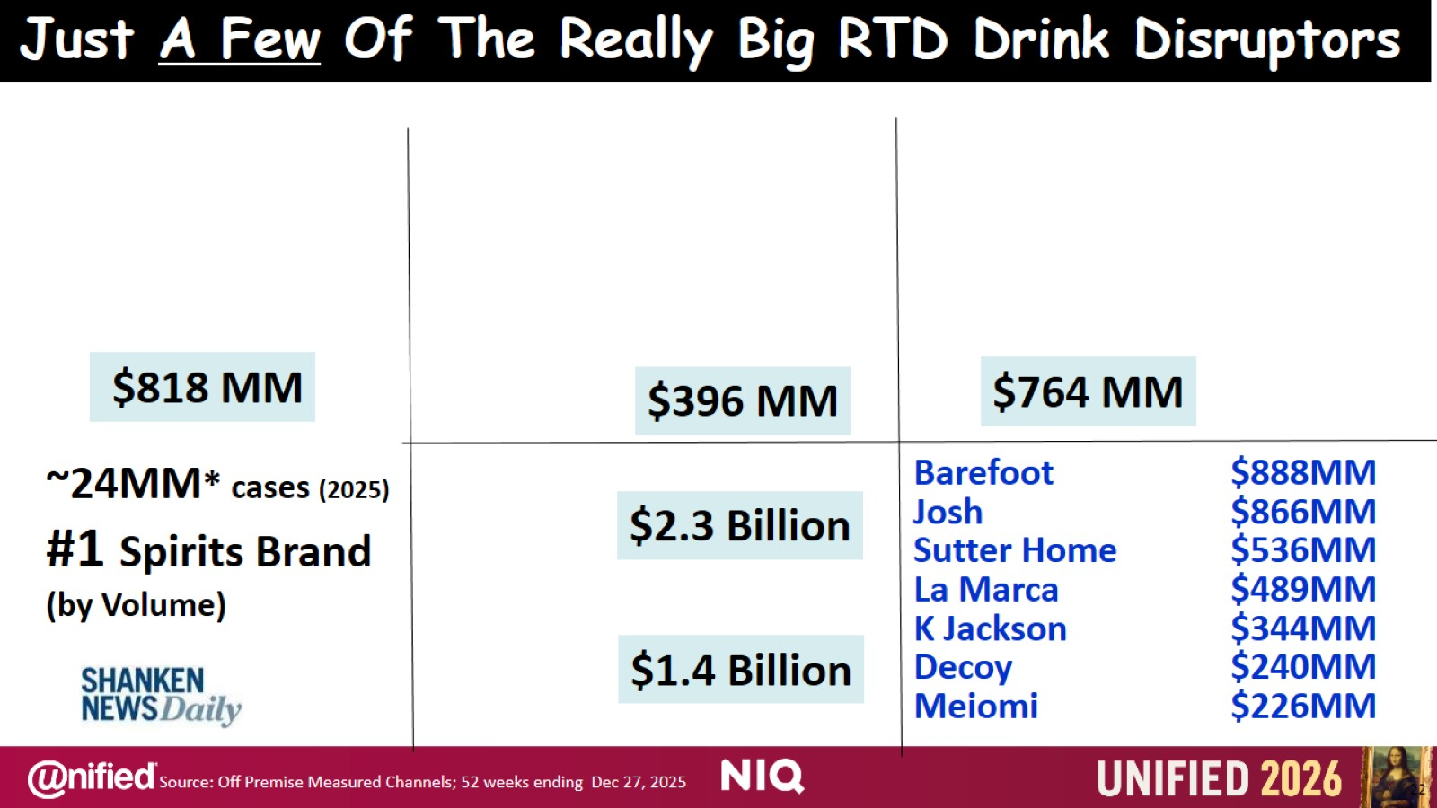
Just A Few Of The Really Big RTD Drink Disruptors

Slide 23
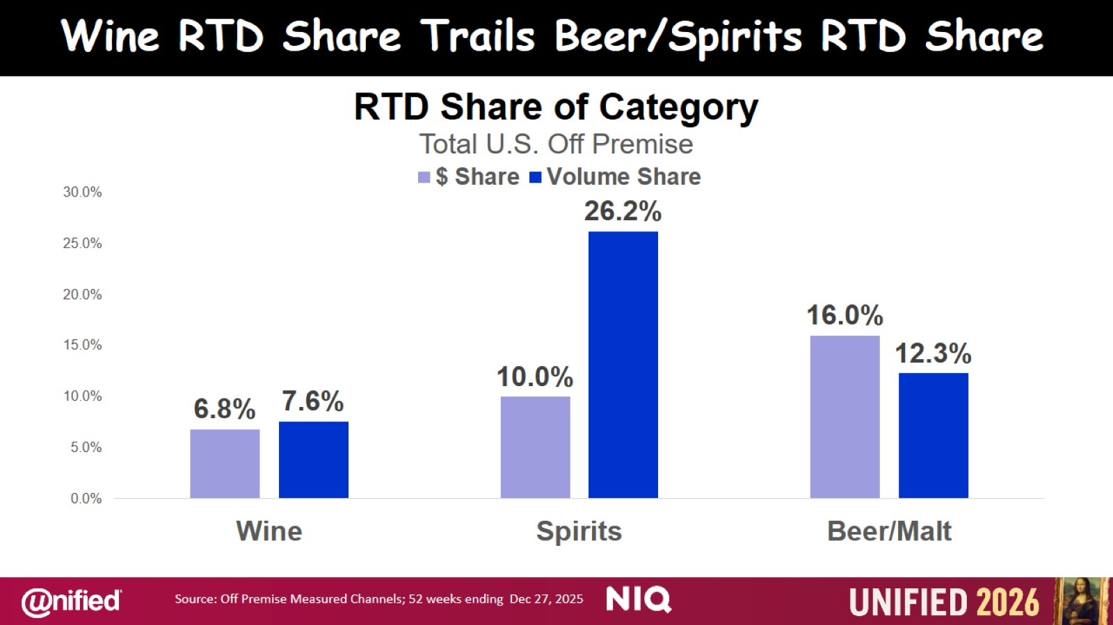
Wine RTD Share Trails Beer/Spirits RTD Share

Slide 24
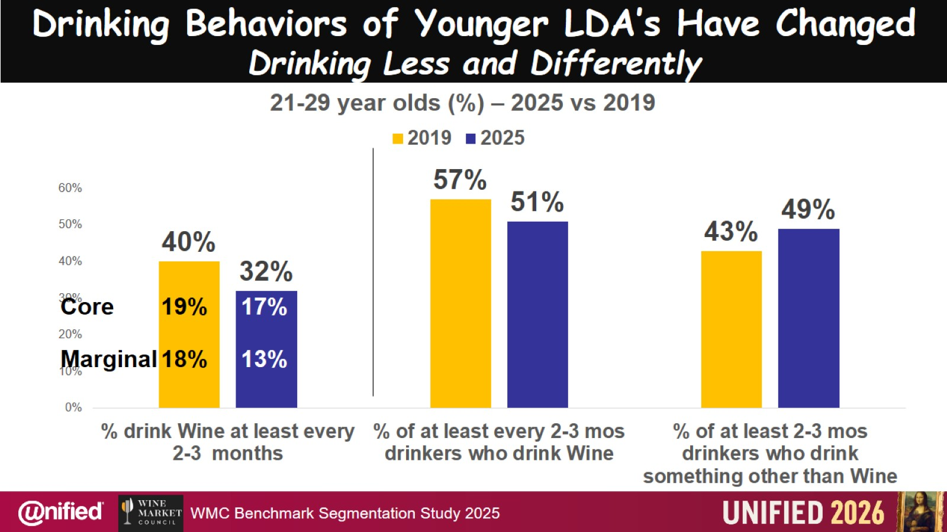
Drinking Behaviors of Younger LDA’s Have Changed Drinking Less and Differently

Slide 25


Slide 26
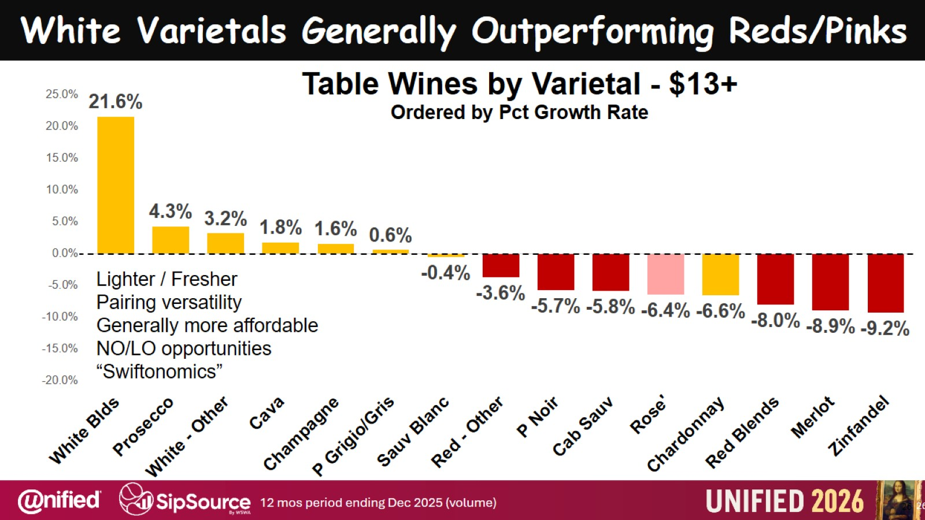

Slide 27
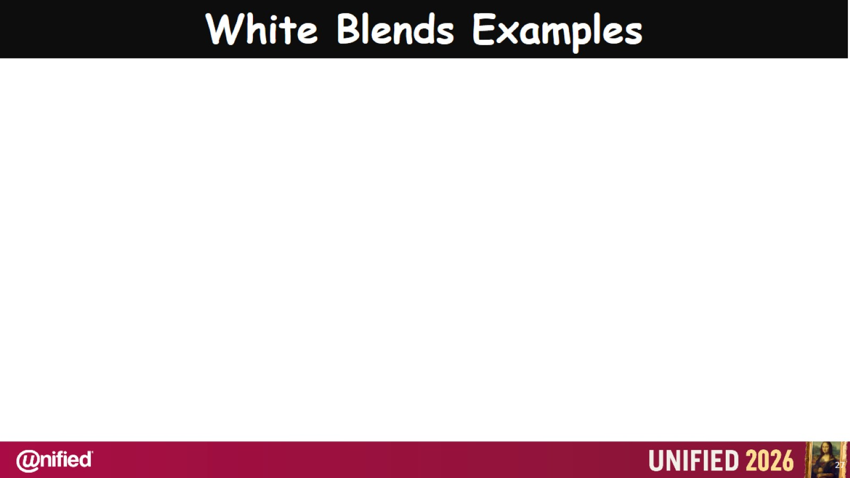

Slide 28
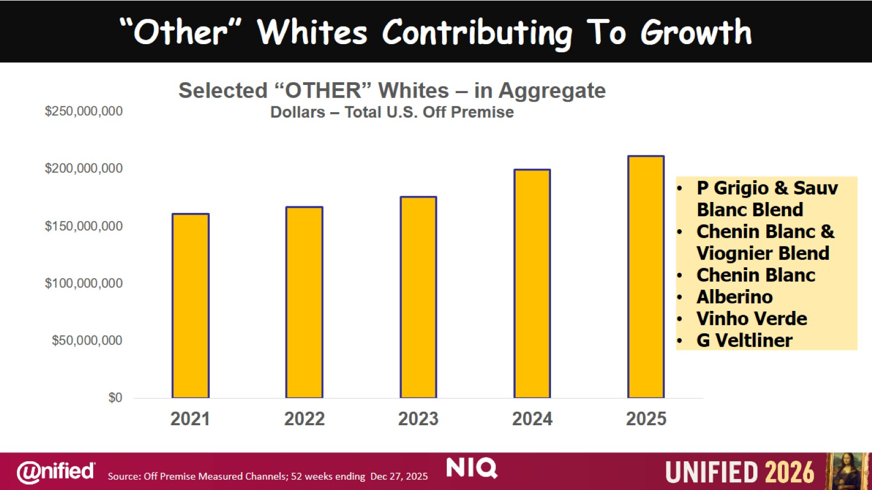
“Other” Whites Contributing To Growth

Slide 29
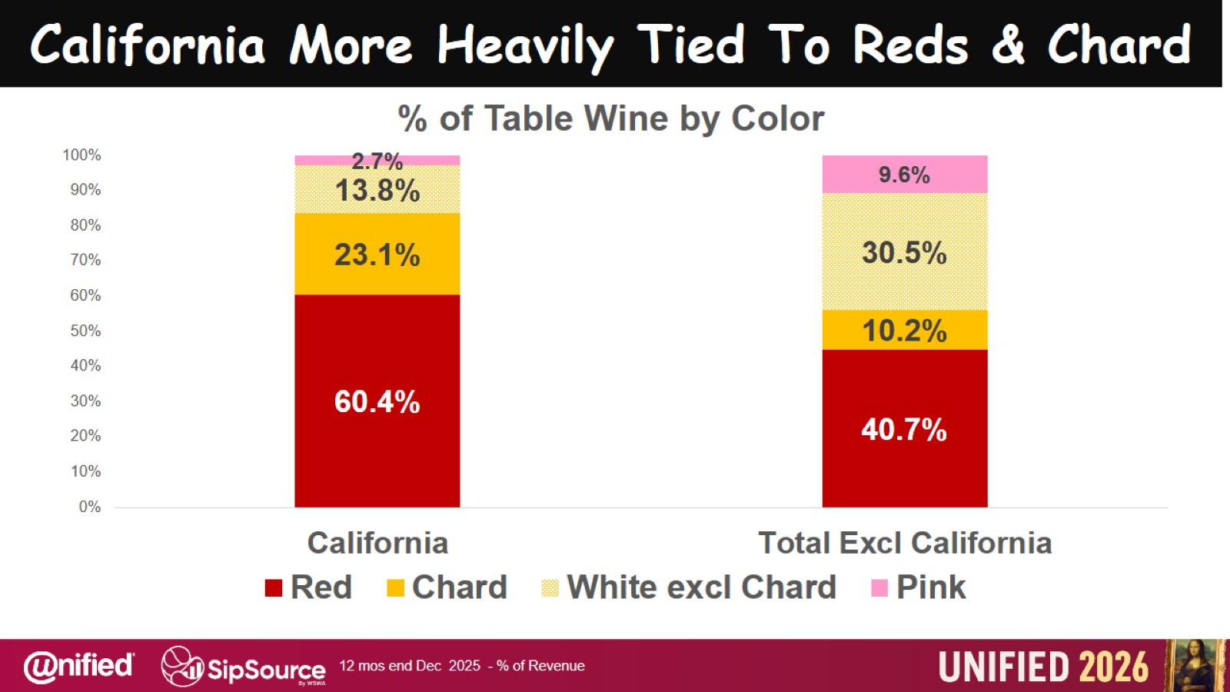
California More Heavily Tied To Reds & Chard

Slide 30
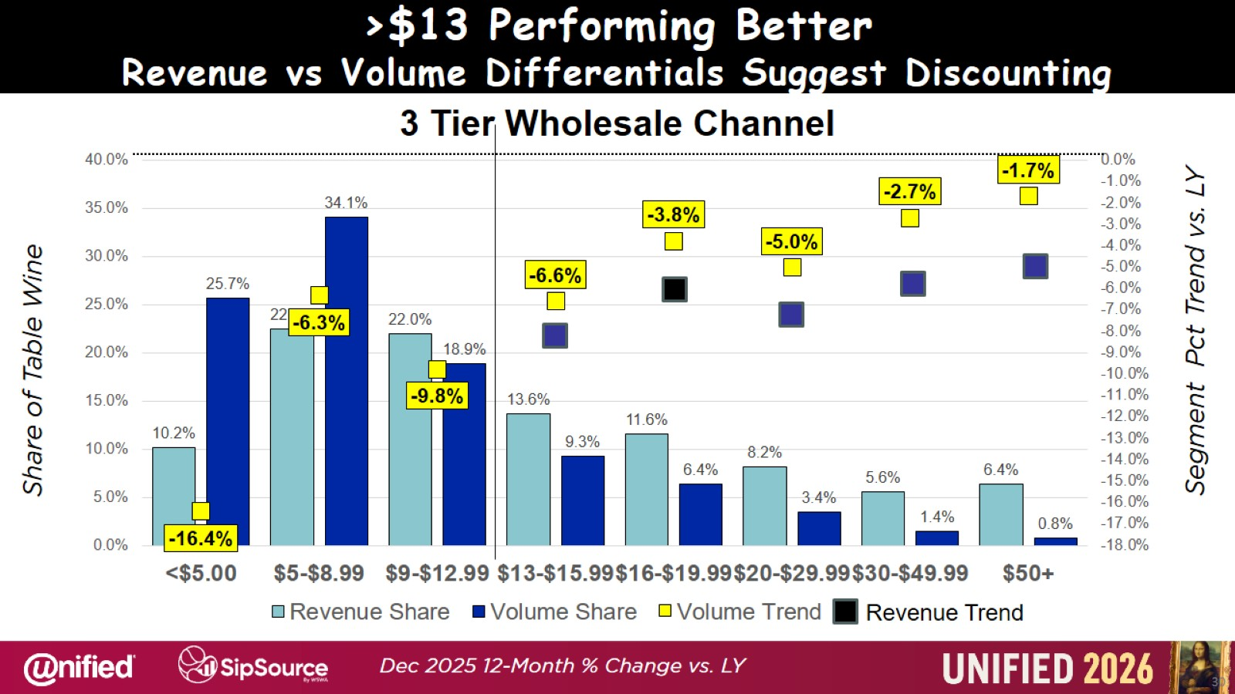
>$13 Performing Better Revenue vs Volume Differentials Suggest Discounting

Slide 31
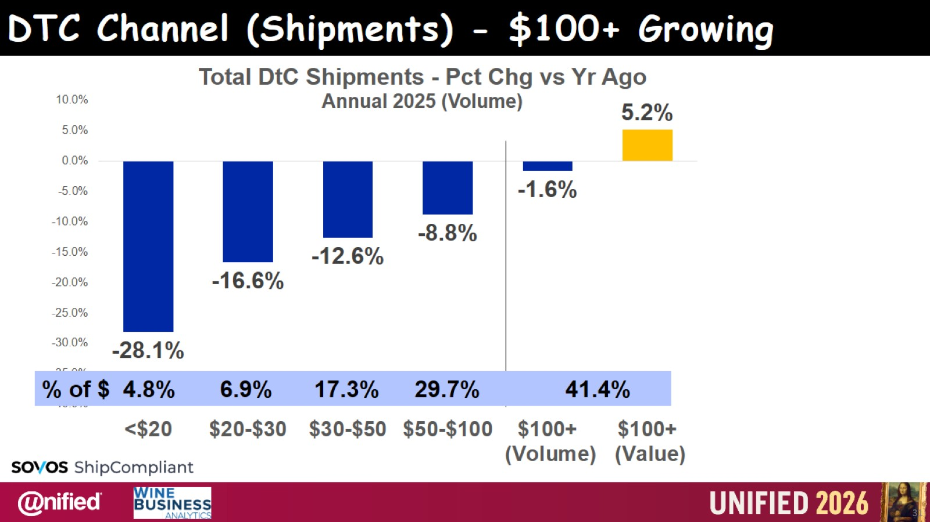
DTC Channel (Shipments) - $100+ Growing

Slide 32
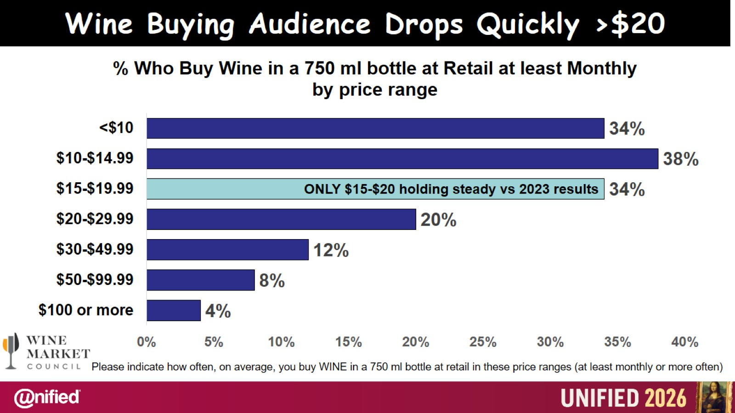

Slide 33
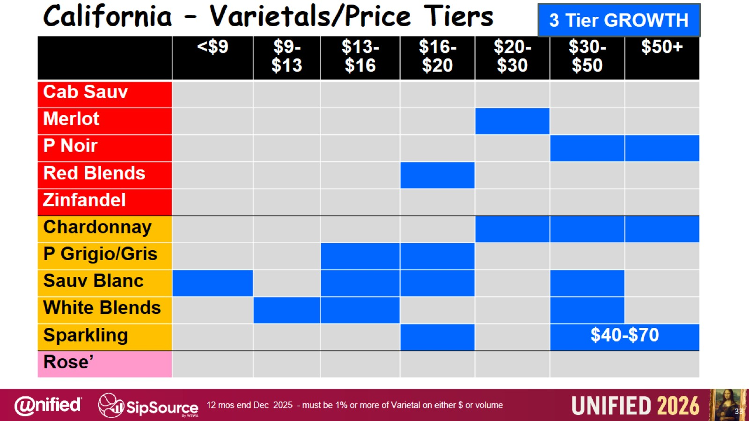
California – Varietals/Price Tiers

Slide 34
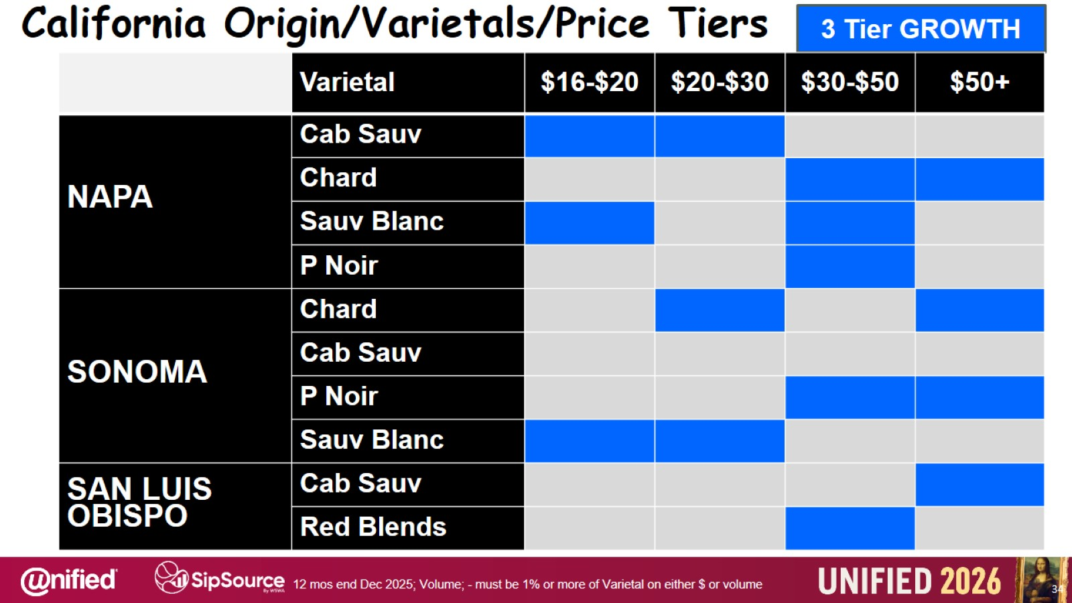
California Origin/Varietals/Price Tiers

Slide 35
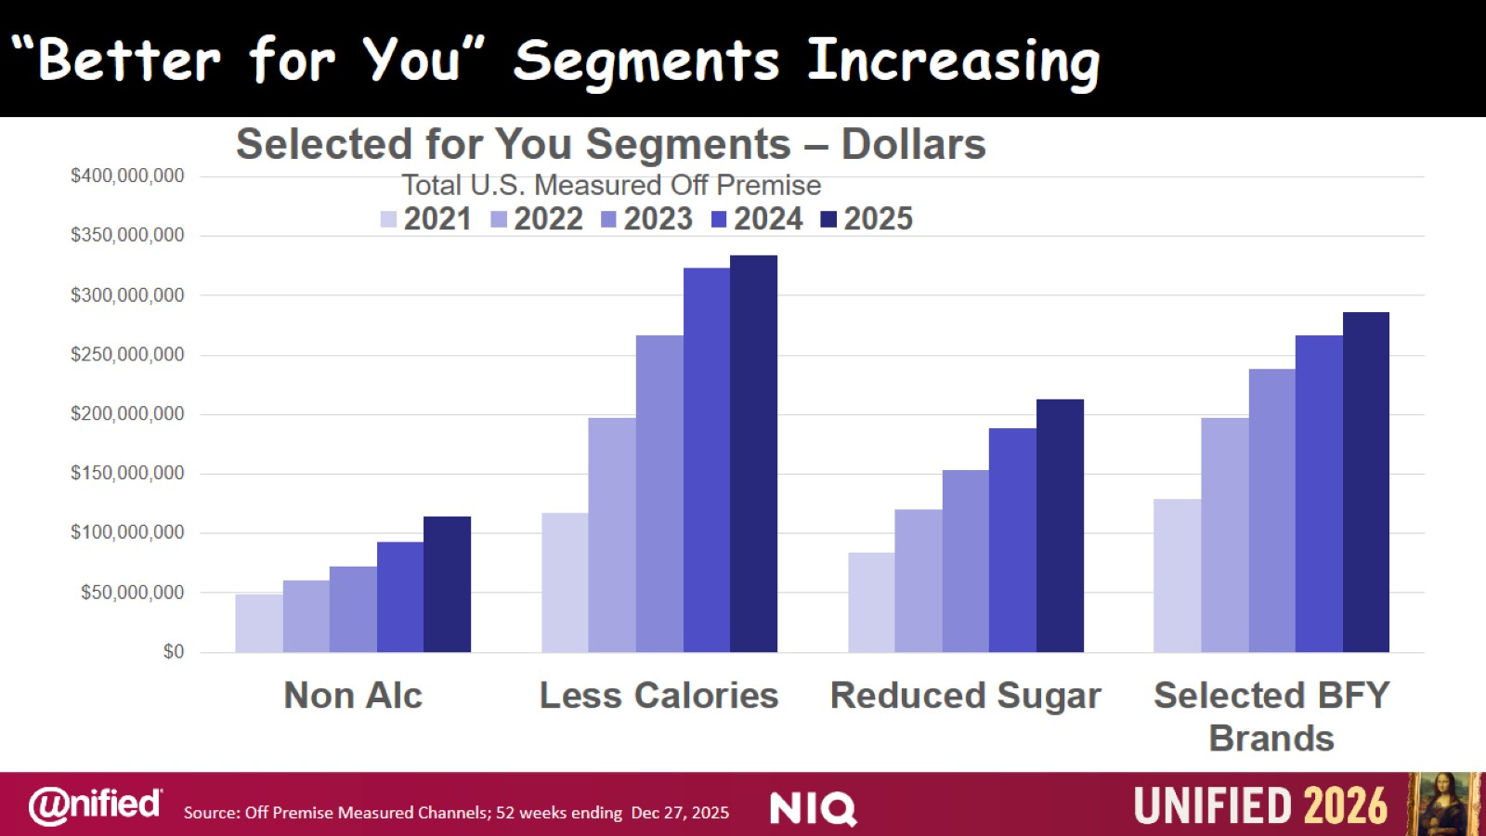
“Better for You” Segments Increasing

Slide 36
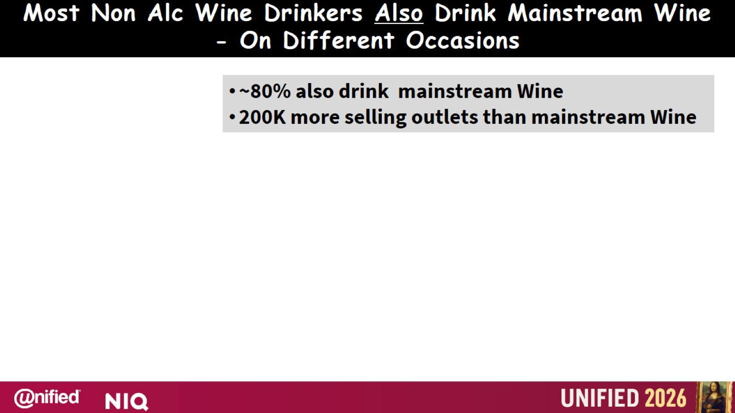

Slide 37


Slide 38
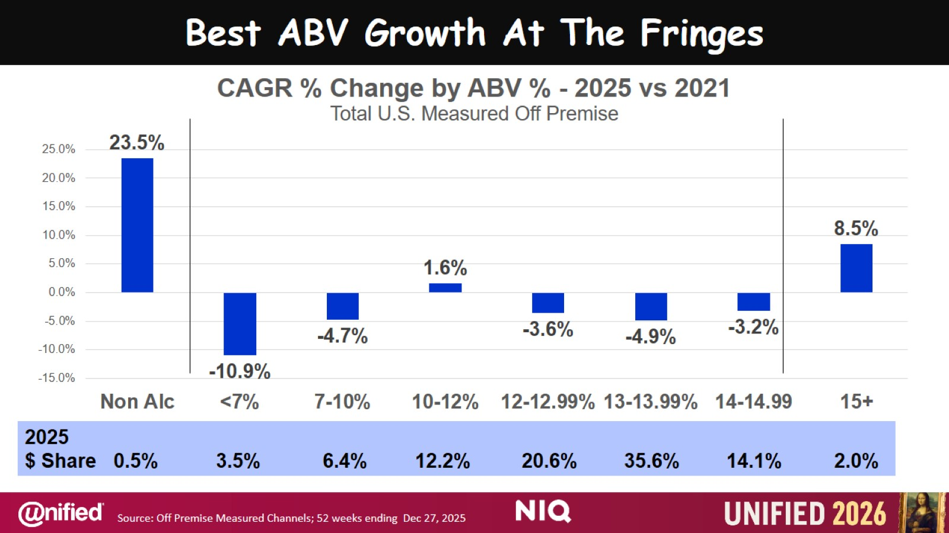
Best ABV Growth At The Fringes

Slide 39
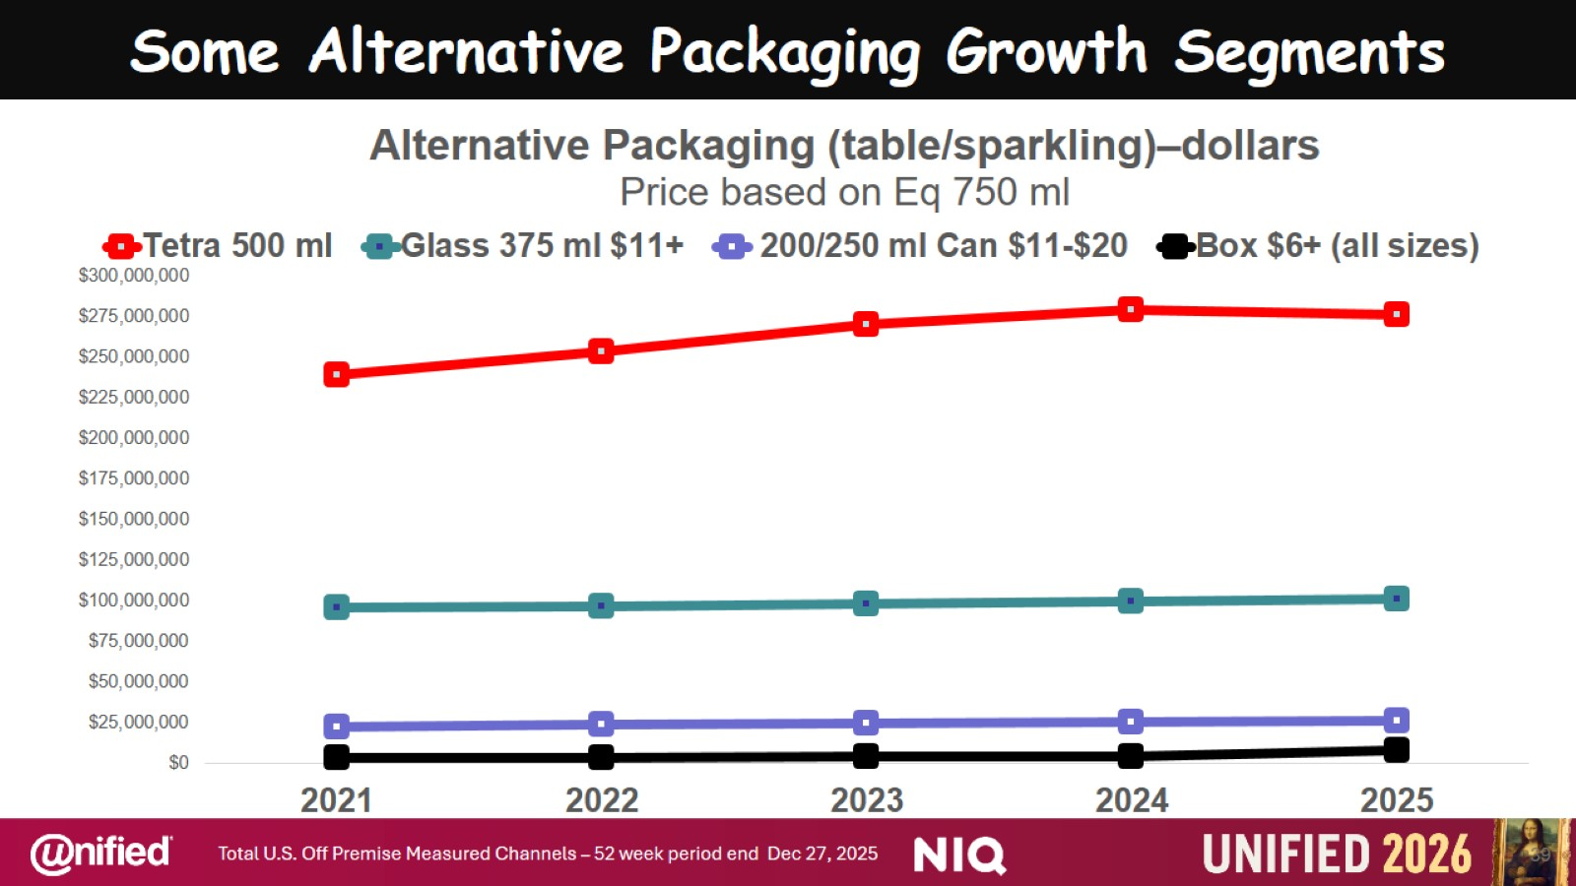
Some Alternative Packaging Growth Segments

Slide 40
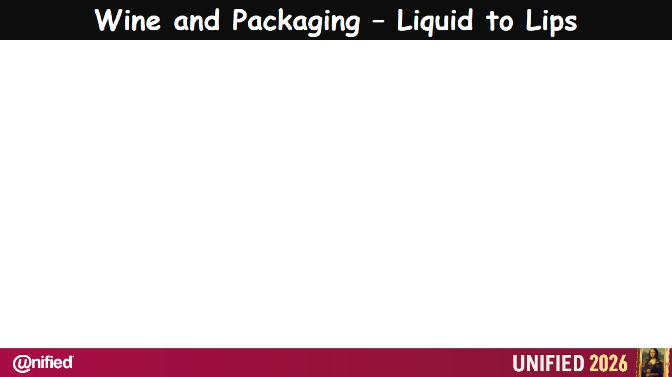

Slide 41
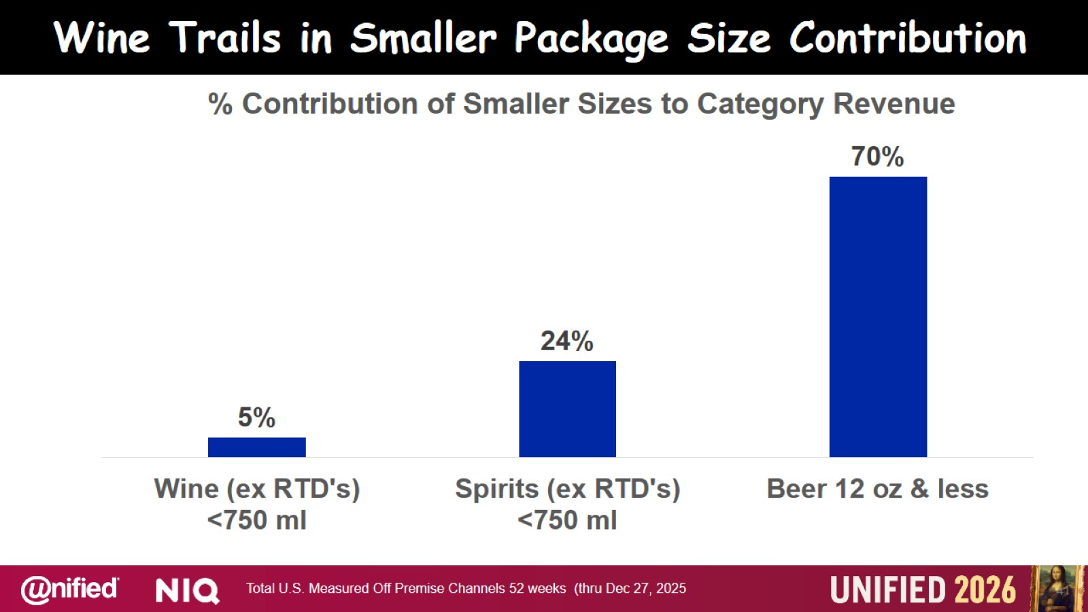
Wine Trails in Smaller Package Size Contribution

Slide 42


Slide 43
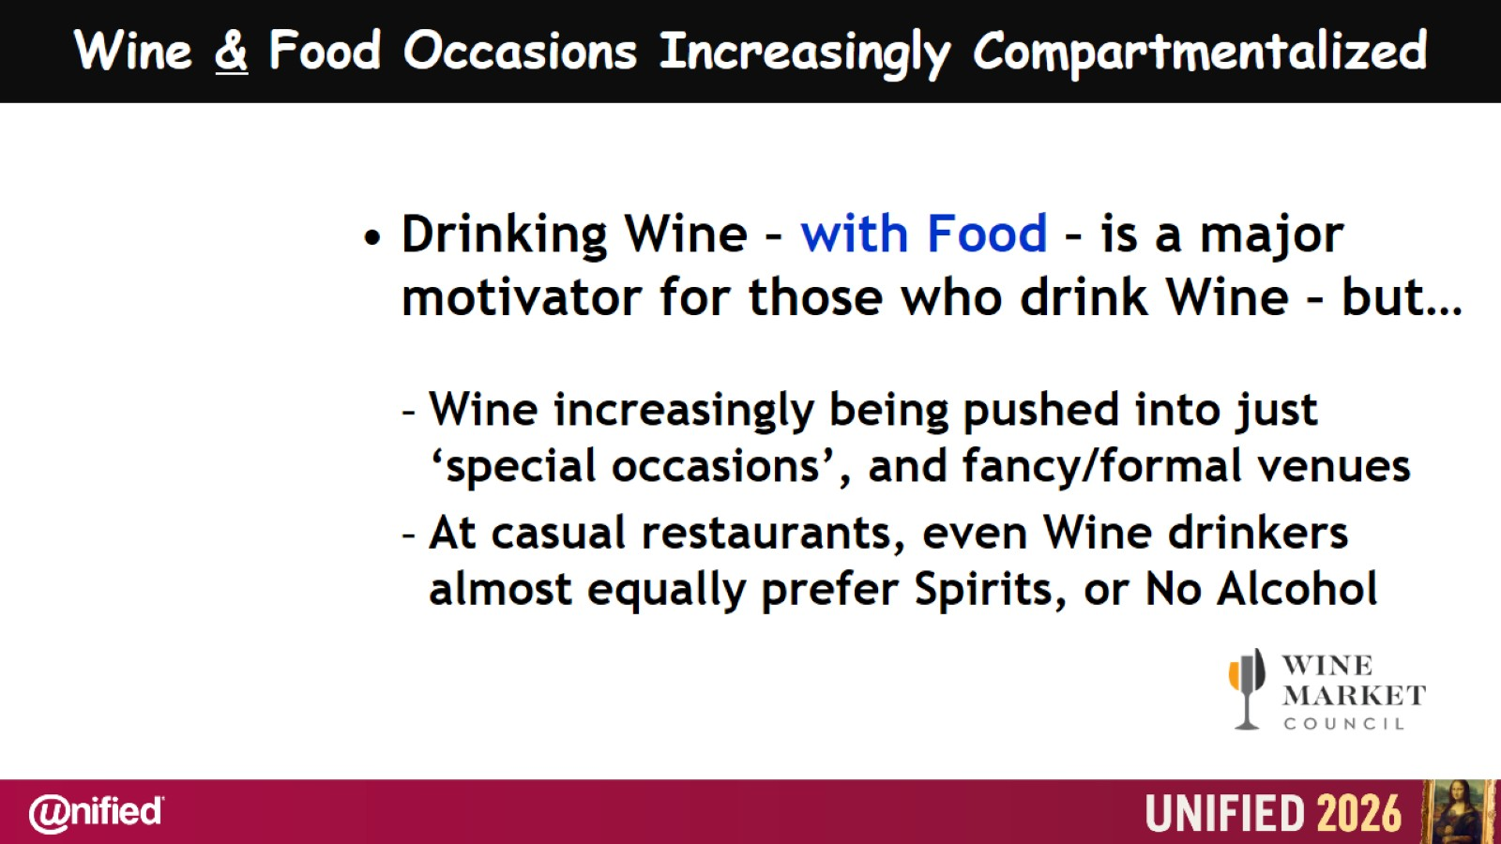
Wine & Food Occasions Increasingly Compartmentalized

Slide 44
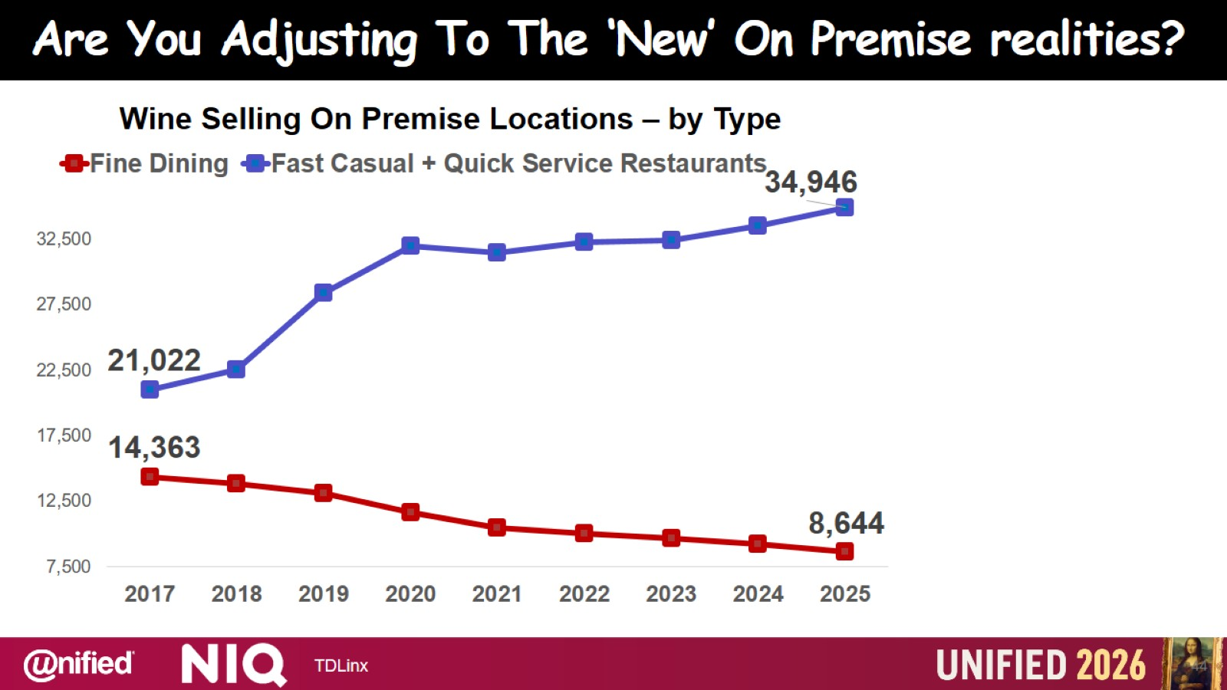

Slide 45
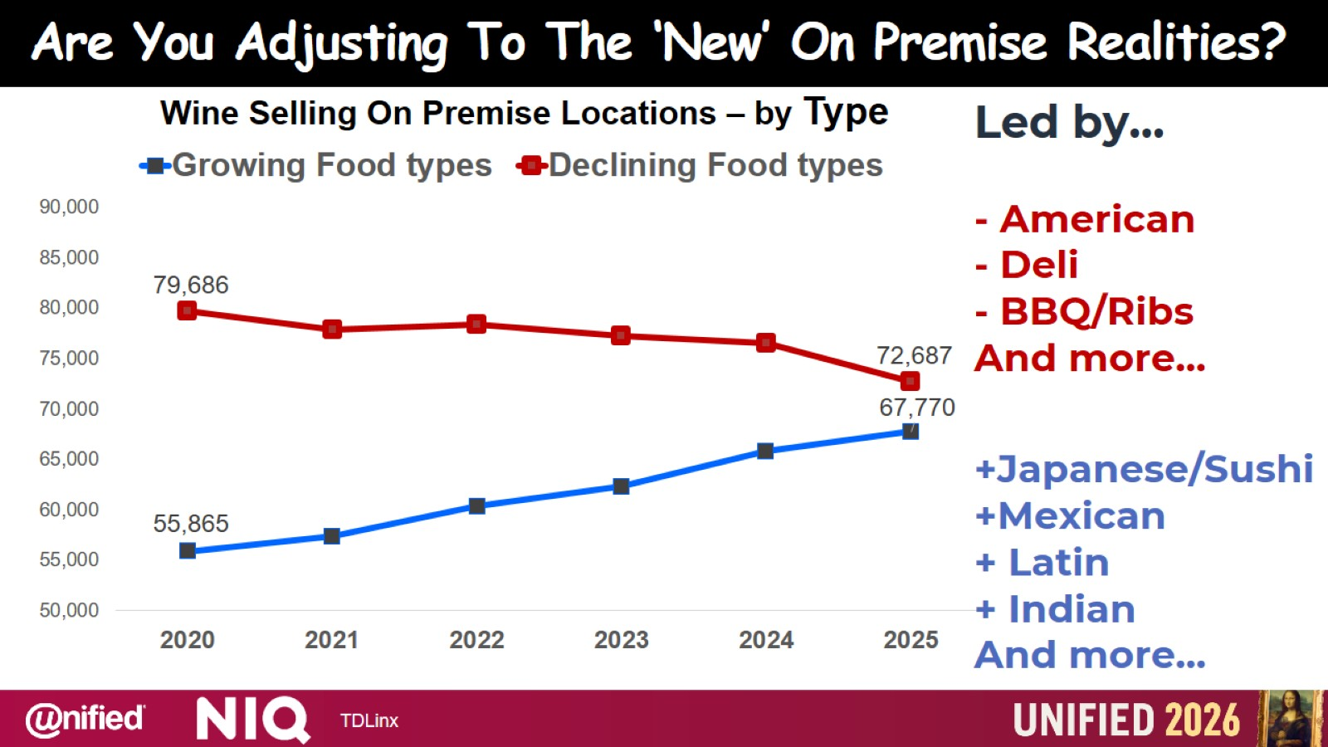

Slide 46

Build a Better Burger

Slide 47
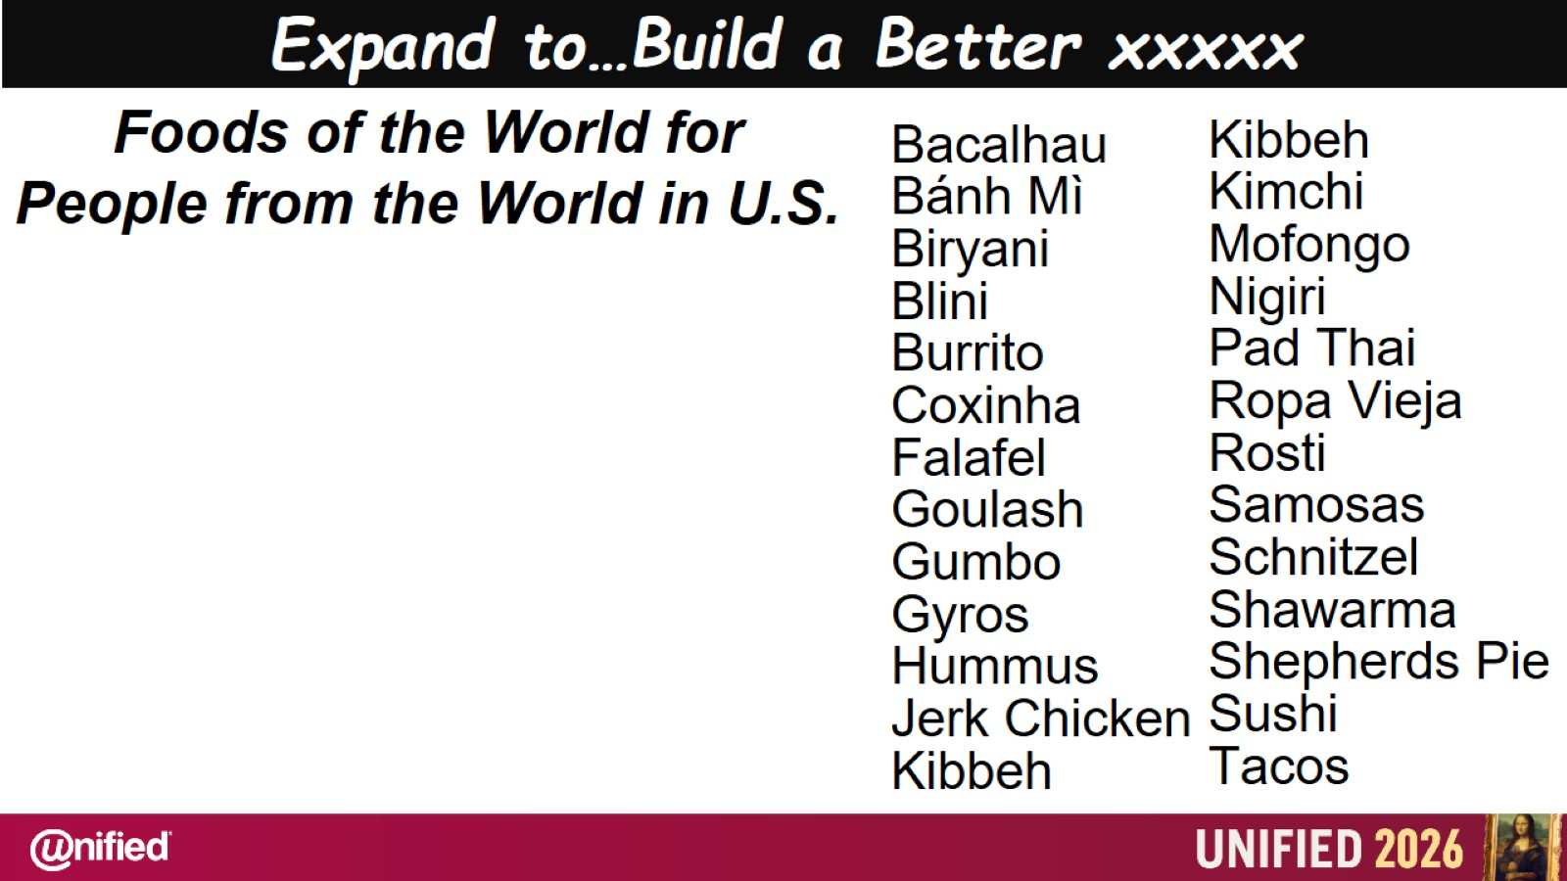
Expand to…Build a Better xxxxx

Slide 48
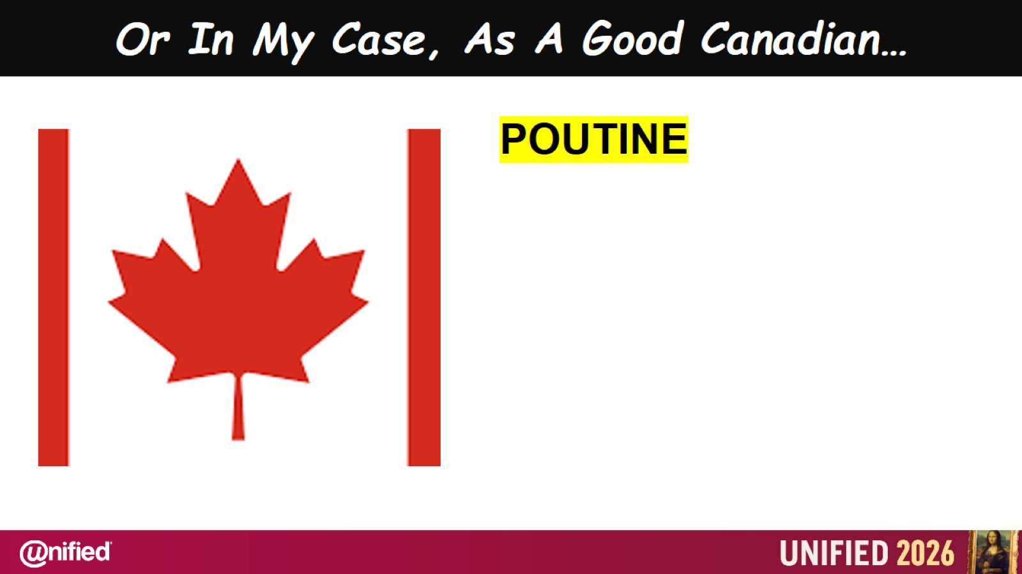
Or In My Case, As A Good Canadian…

Slide 49
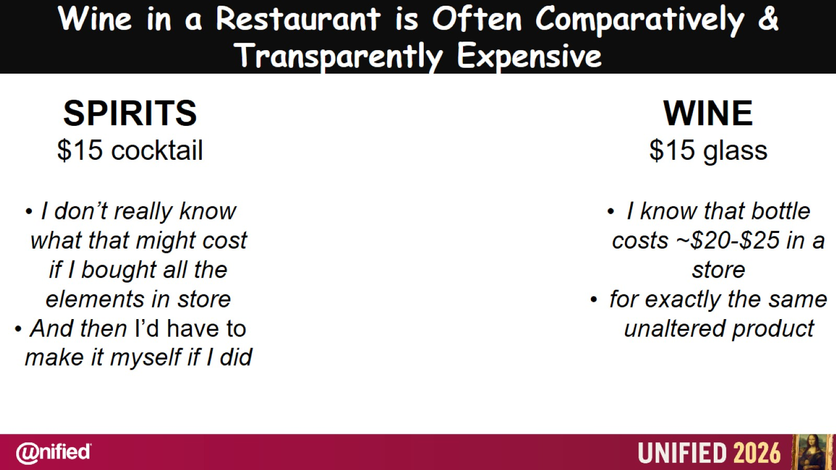
Wine in a Restaurant is Often Comparatively & Transparently Expensive

Slide 50


Slide 51


Slide 52
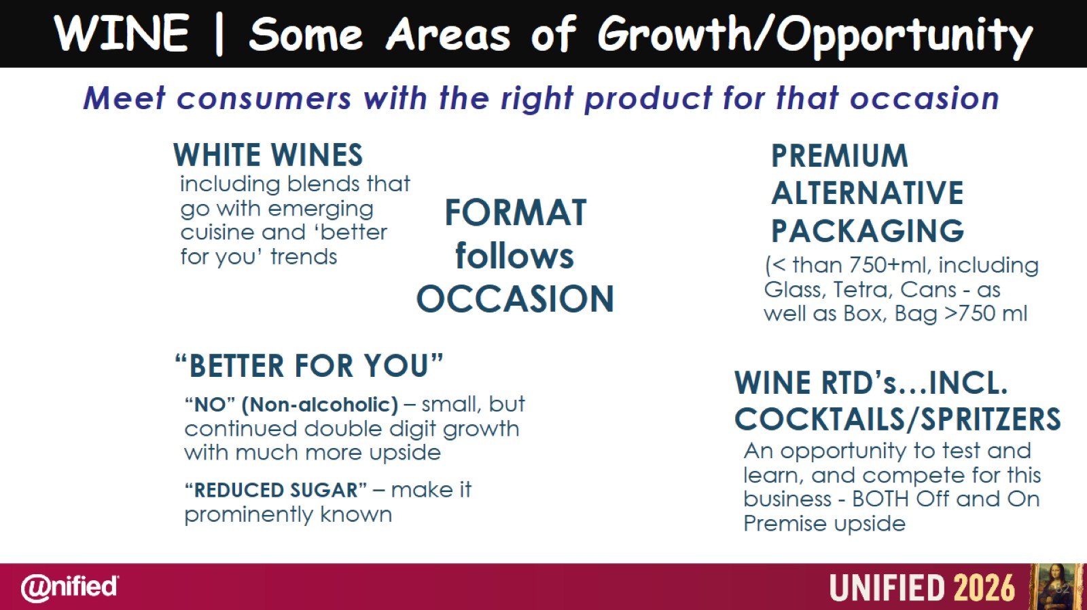

Slide 53


Slide 54
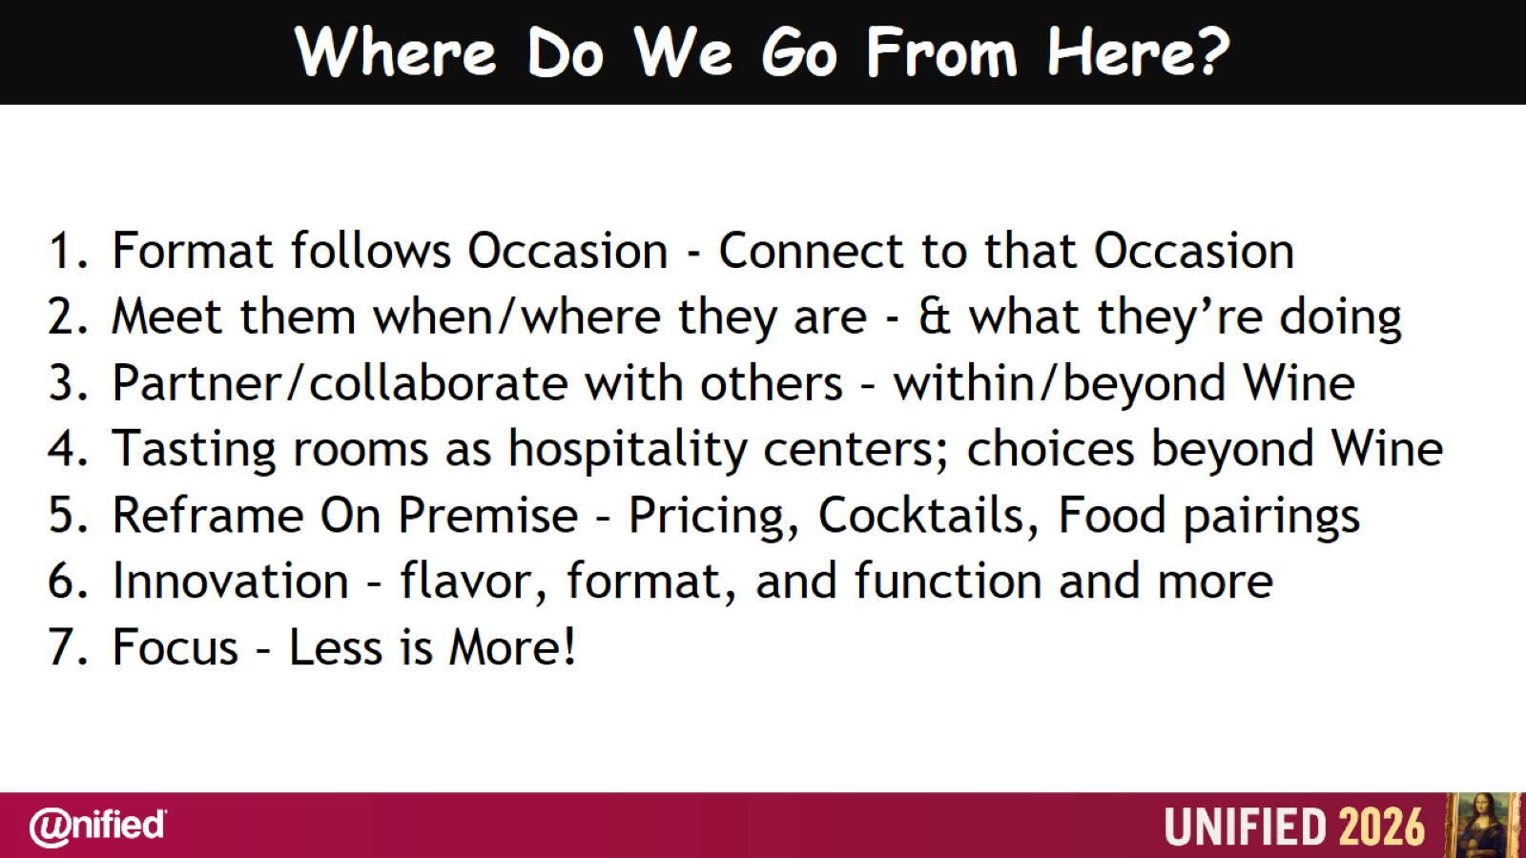
Where Do We Go From Here?

Slide 55
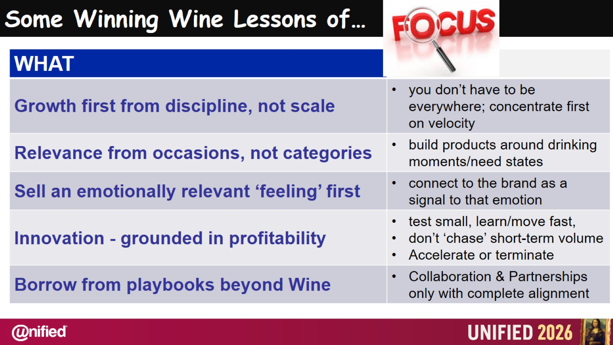
Some Winning Wine Lessons of…

Slide 56
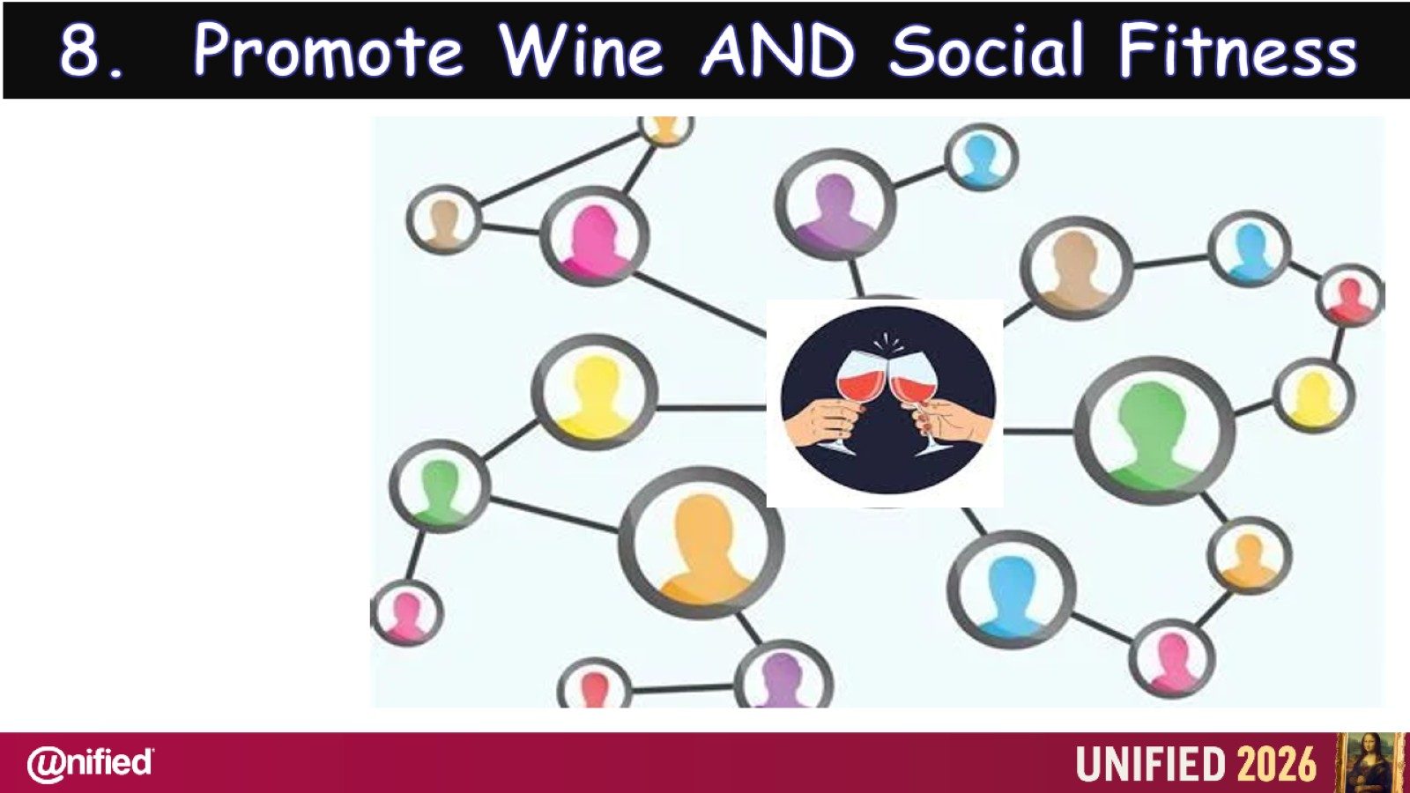

Slide 57
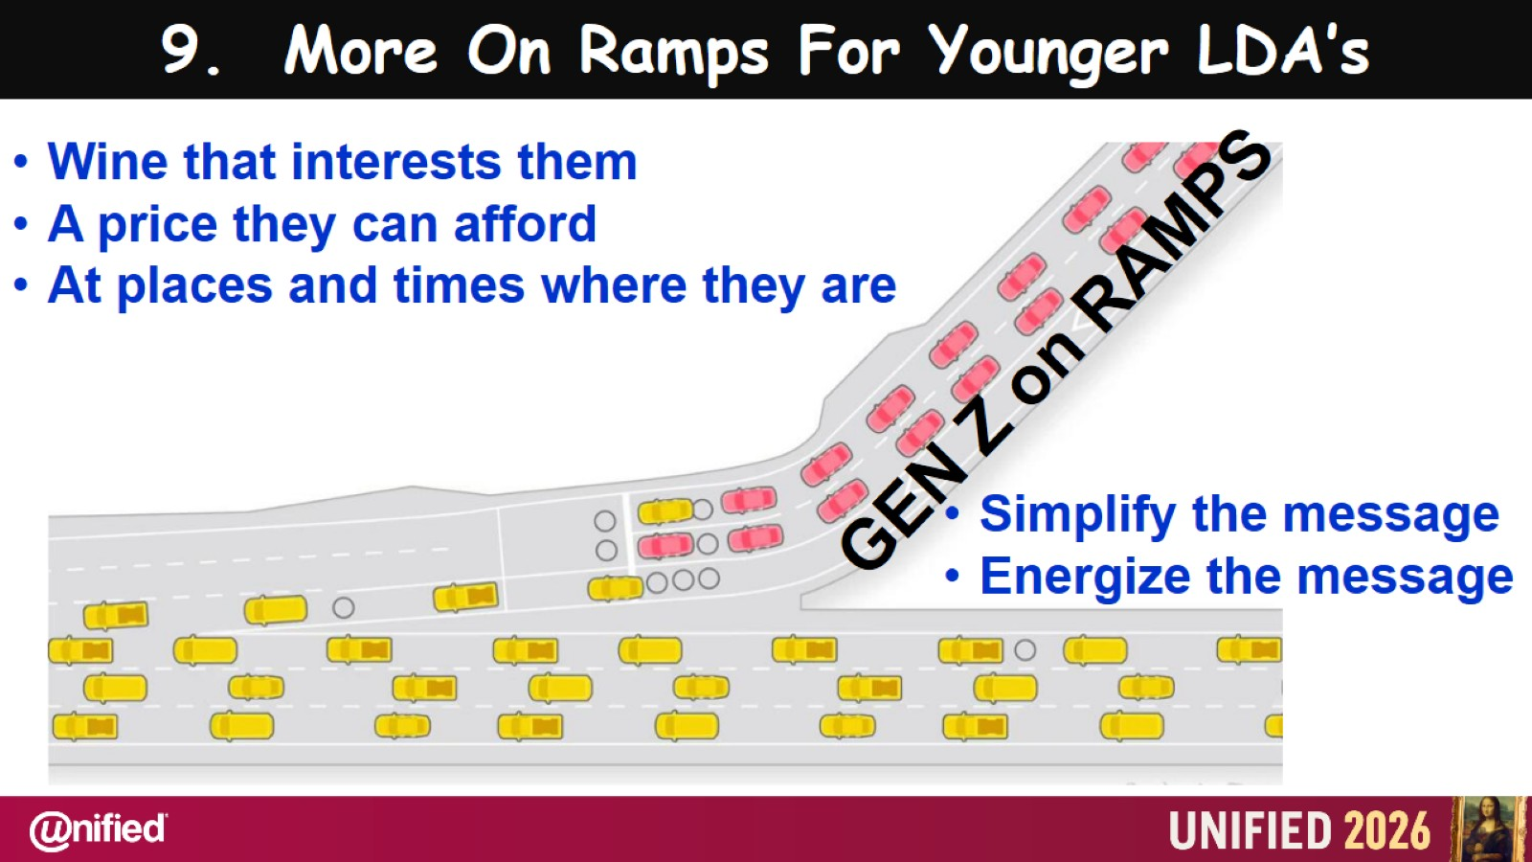

Slide 58
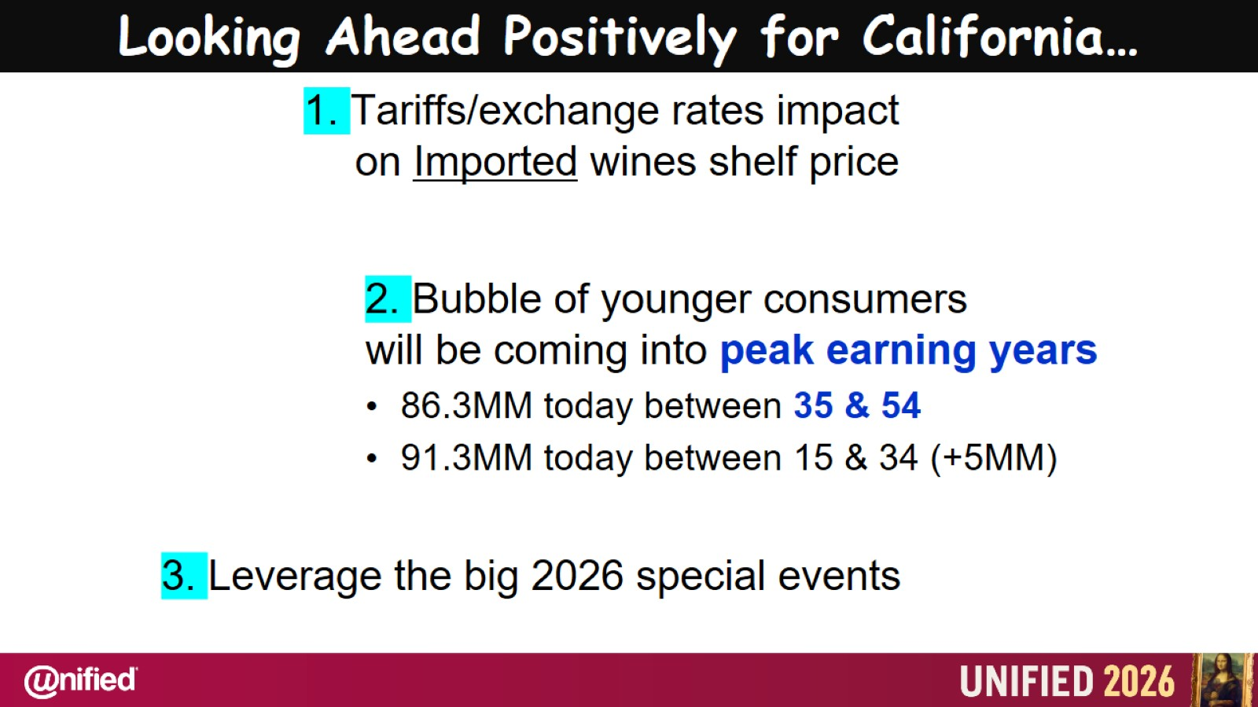
Looking Ahead Positively for California…

Slide 59


Slide 60
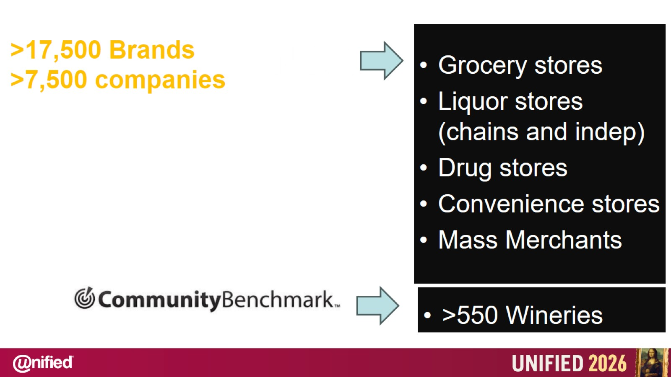

Slide 61
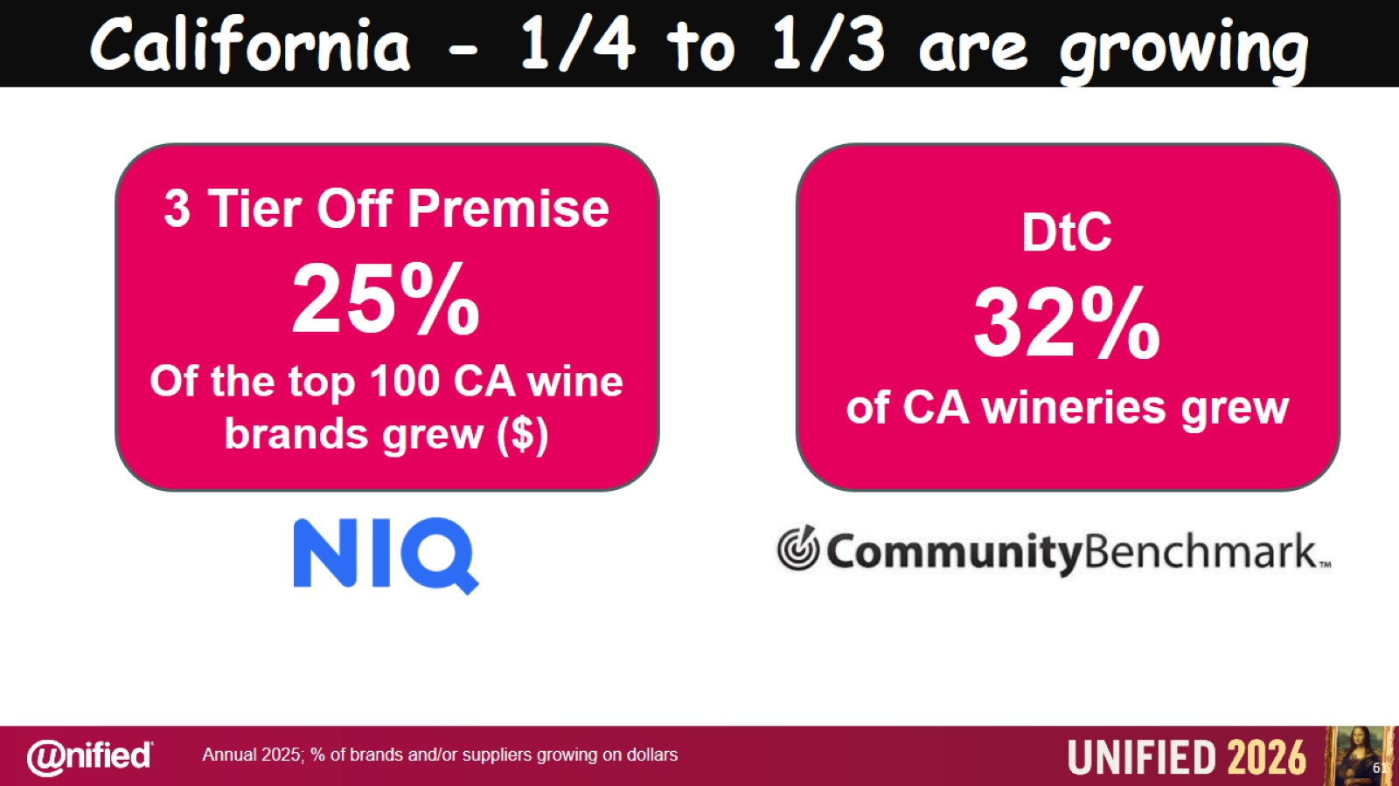
California - 1/4 to 1/3 are growing

Slide 62
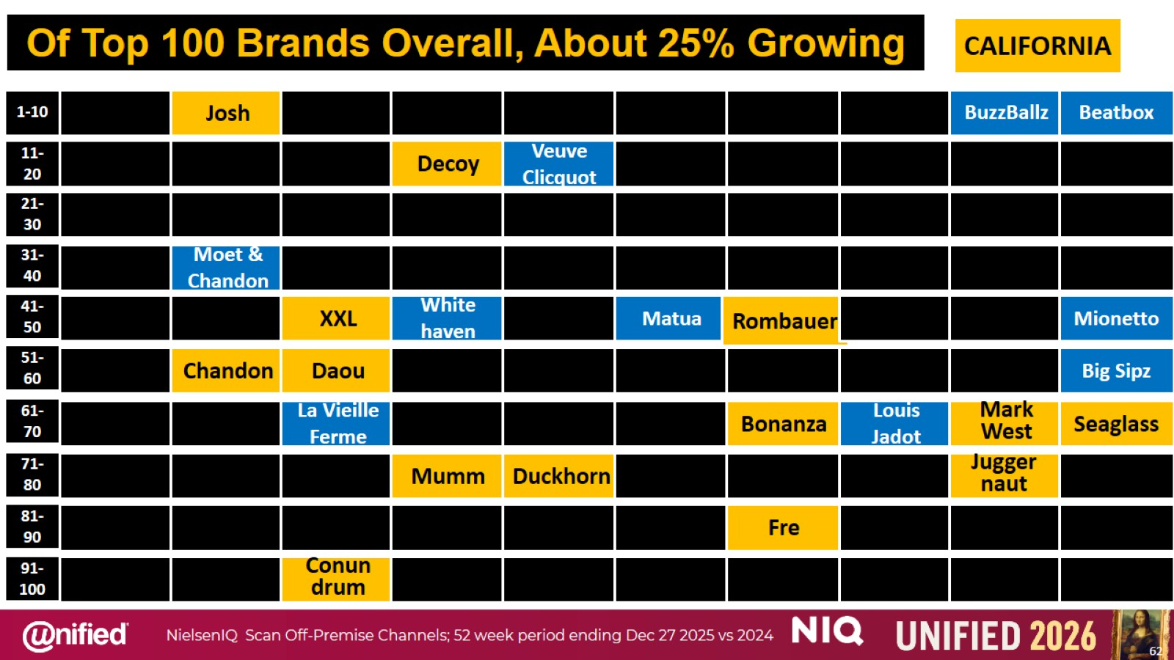

Slide 63


Slide 64


Slide 65


Slide 66


Slide 67

Thank you BE UNIFIED!!!!

