Slide 1


Slide 2
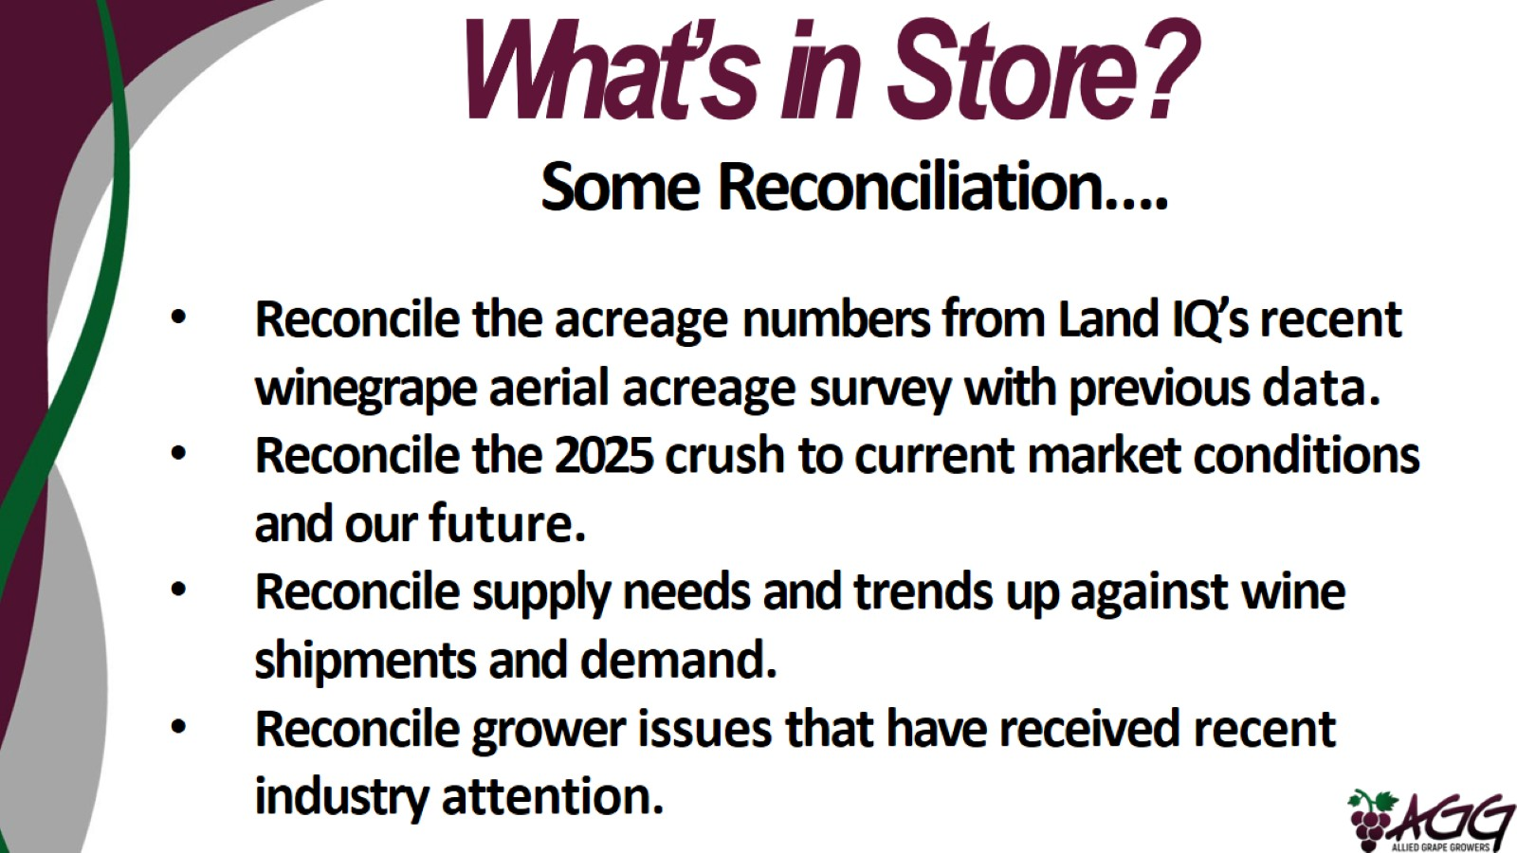
What’s in Store?

Slide 3
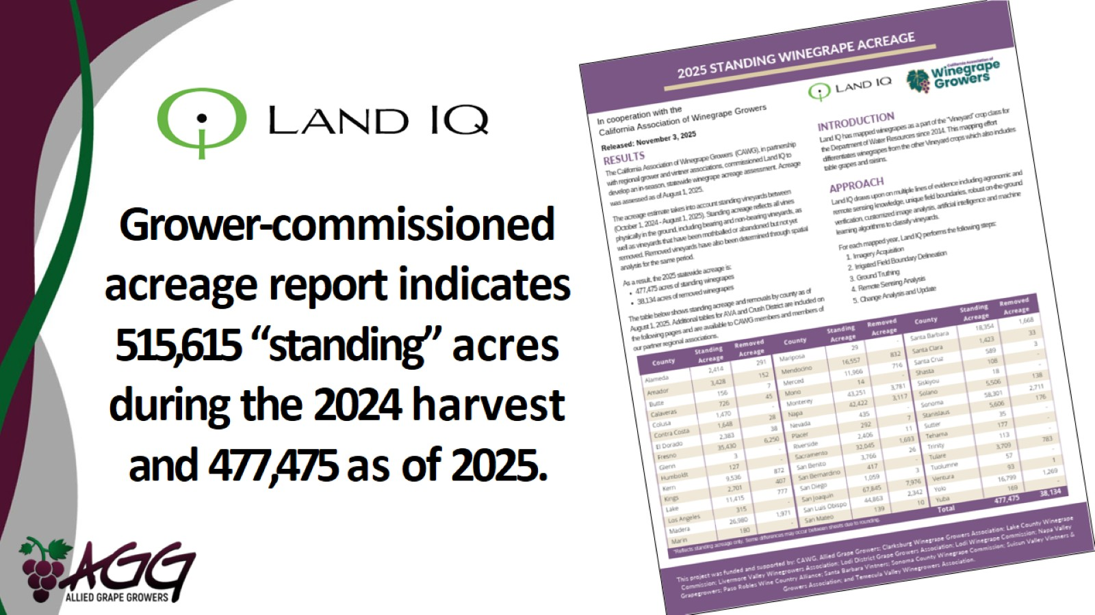
Grower-commissioned acreage report indicates 515,615 “standing” acres during the 2024 harvest and 477,475 as of 2025.

Slide 4
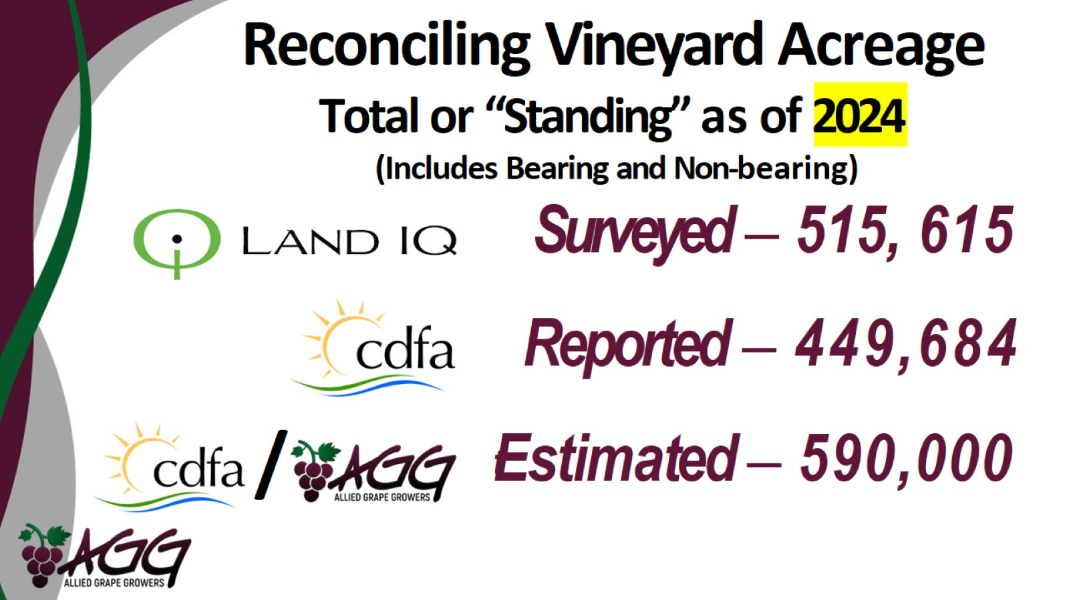
Reconciling Vineyard Acreage

Slide 5
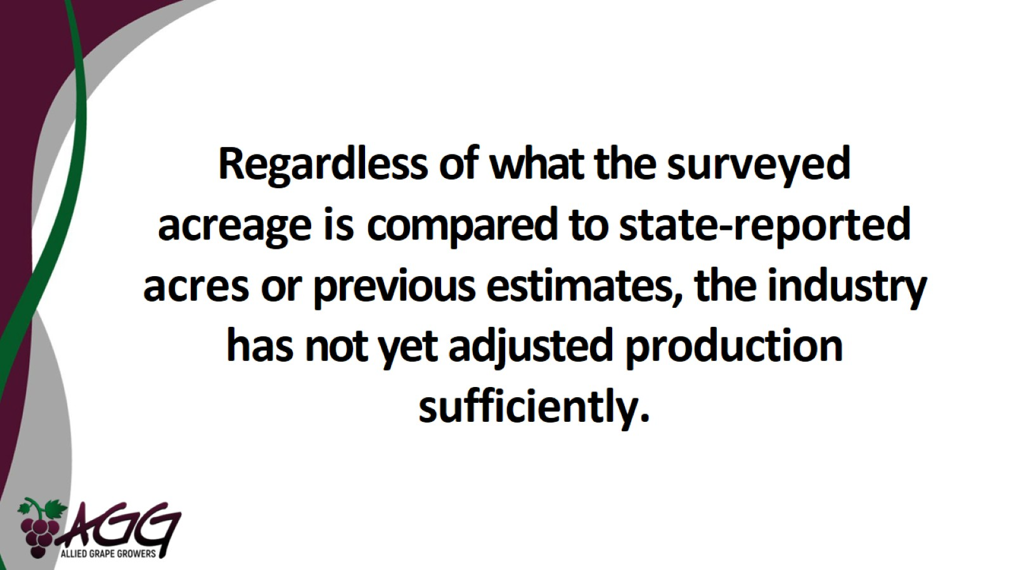

Slide 6
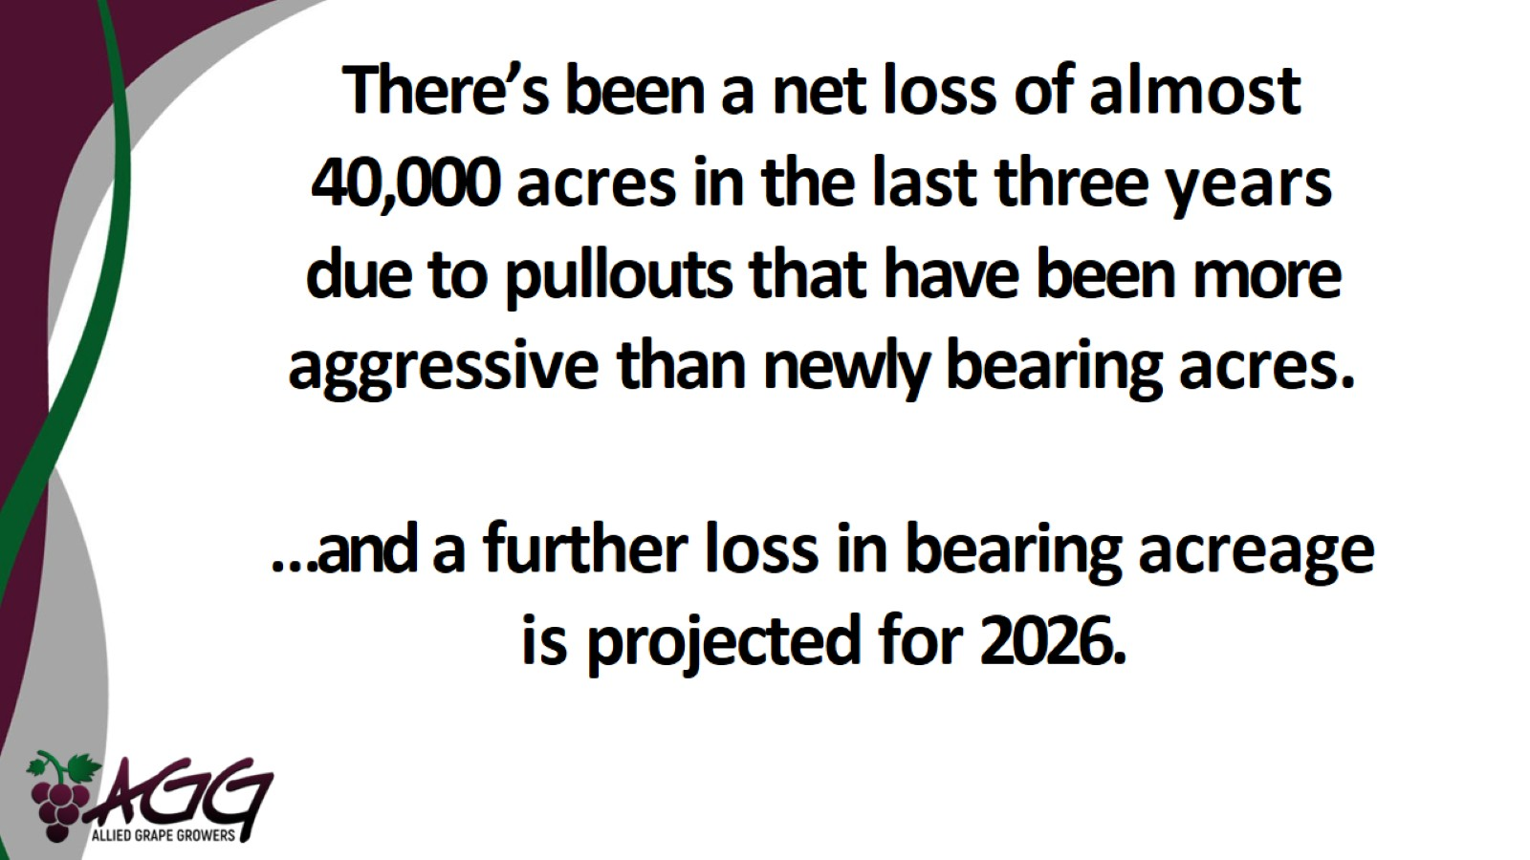

Slide 7
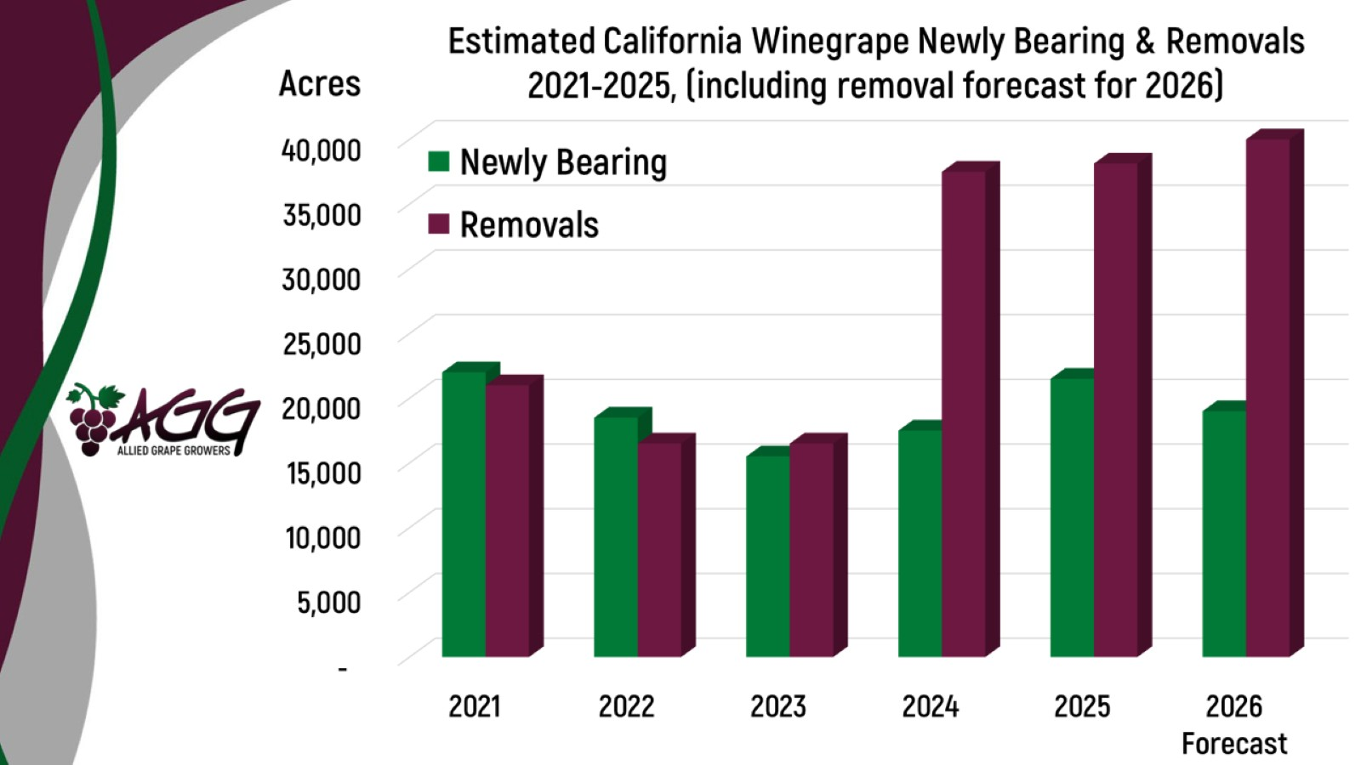

Slide 8
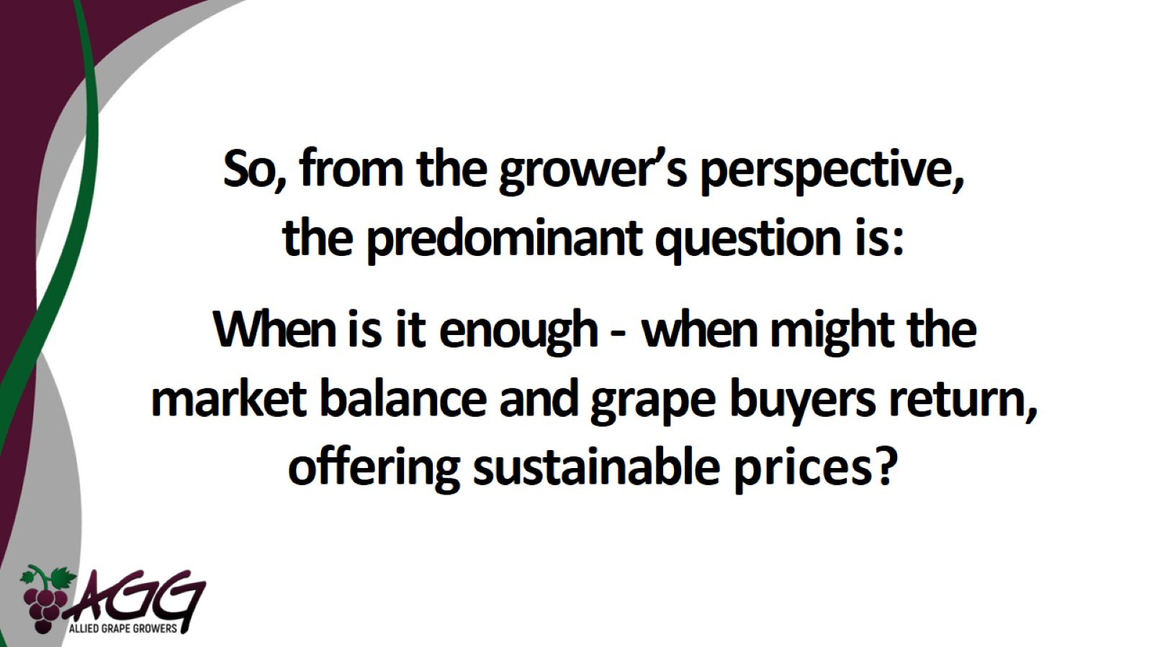

Slide 9
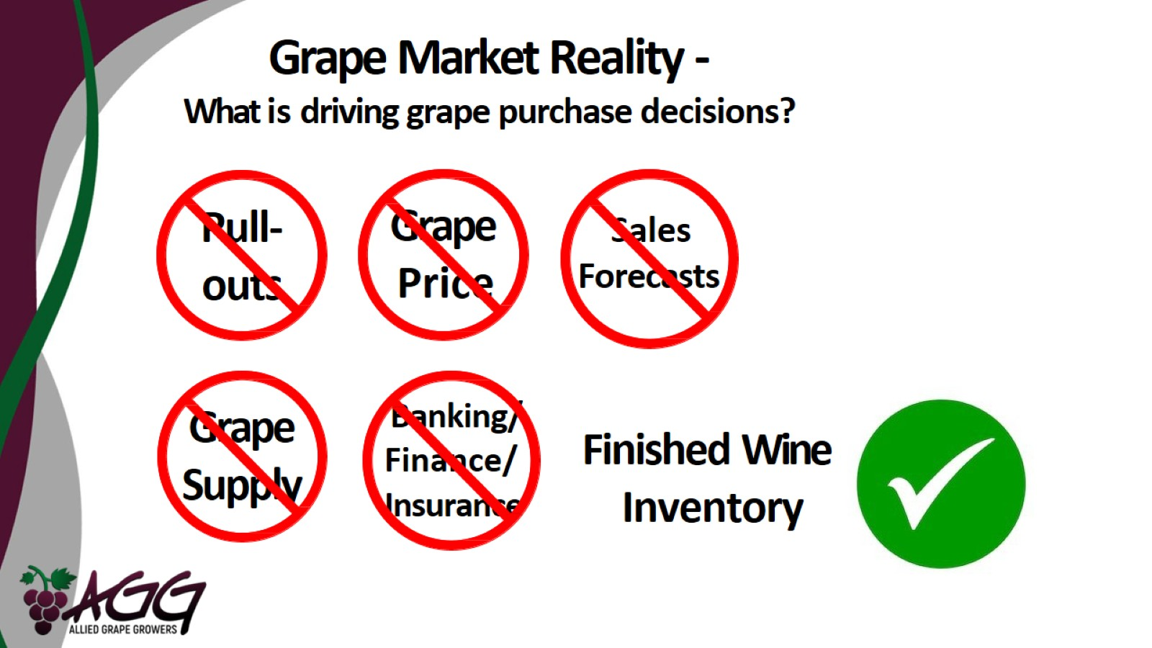
Grape Market Reality -
What is driving grape purchase decisions?

Slide 10
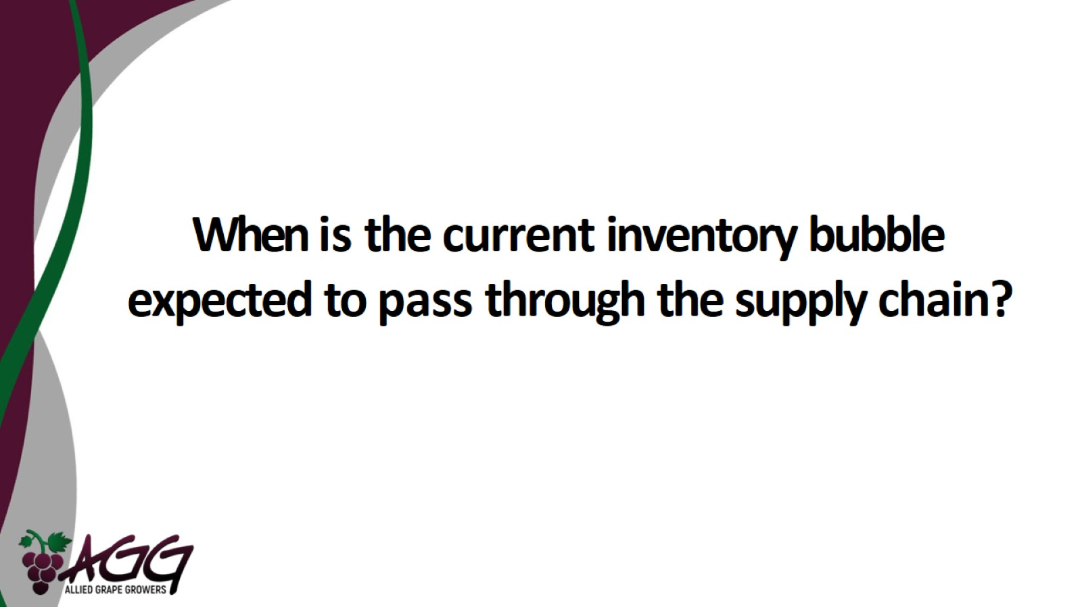
When is the current inventory bubble expected to pass through the supply chain?

Slide 11
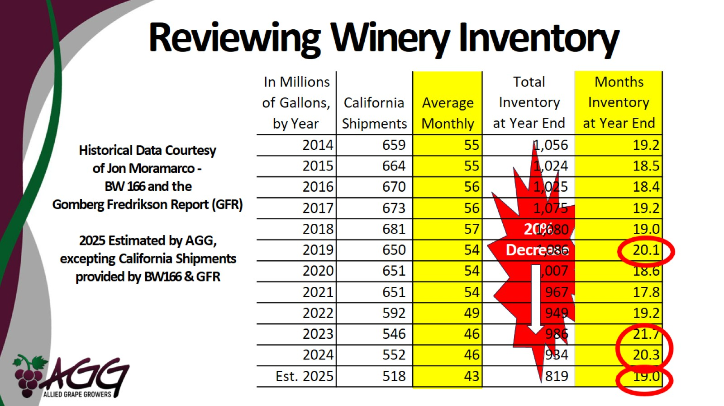
Reviewing Winery Inventory

Slide 12
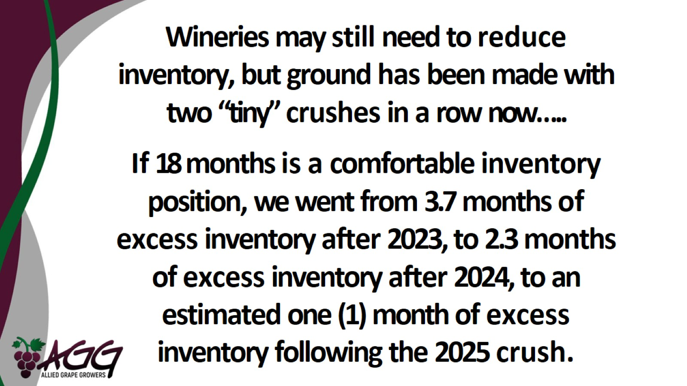

Slide 13
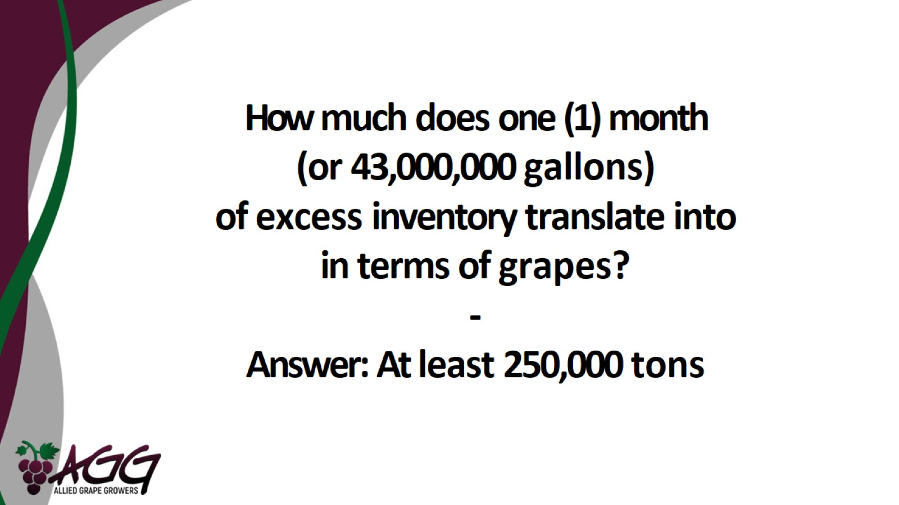

Slide 14
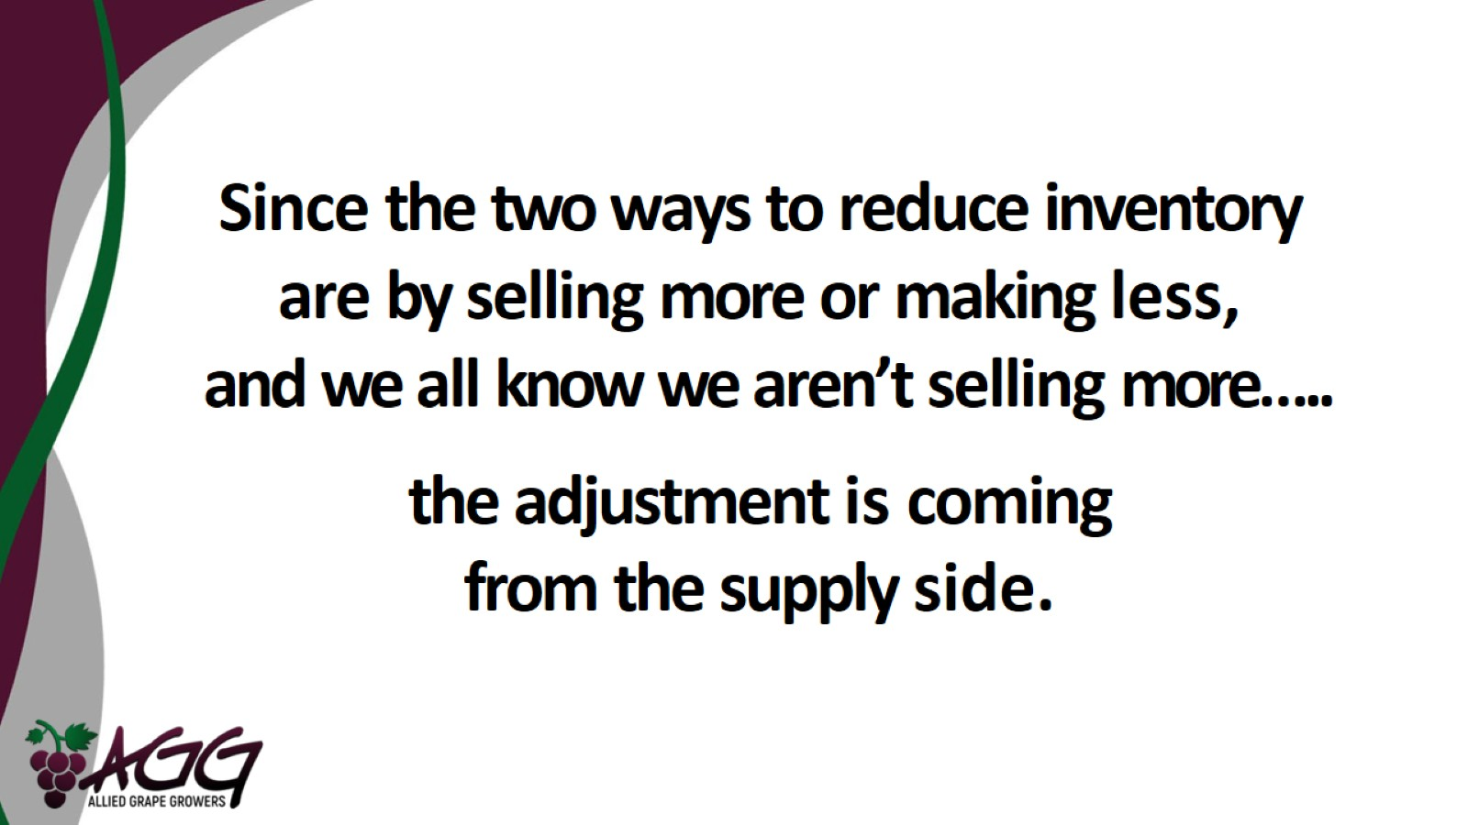

Slide 15
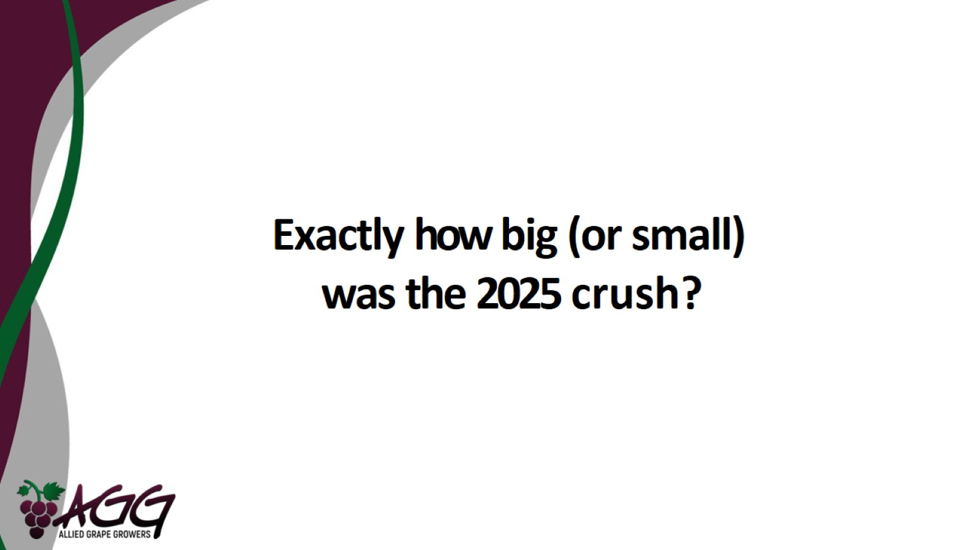
Exactly how big (or small) was the 2025 crush?

Slide 16
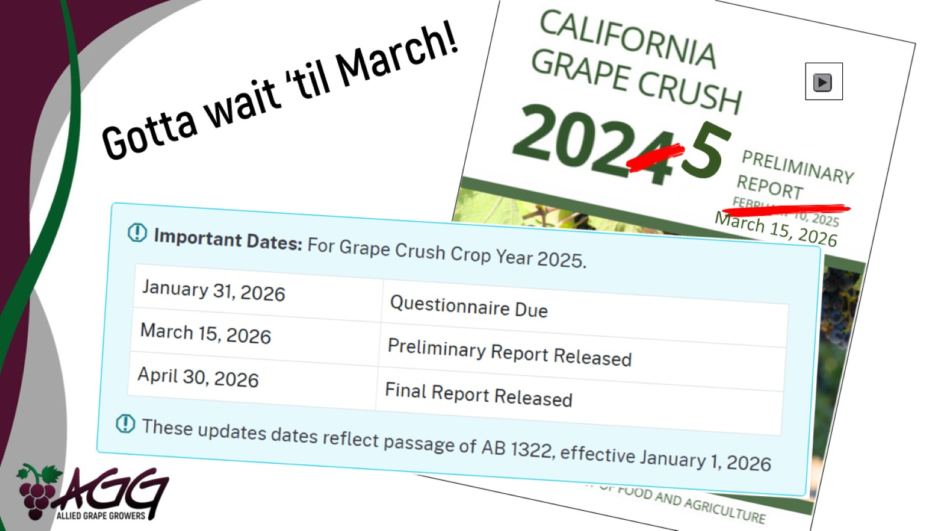

Slide 17
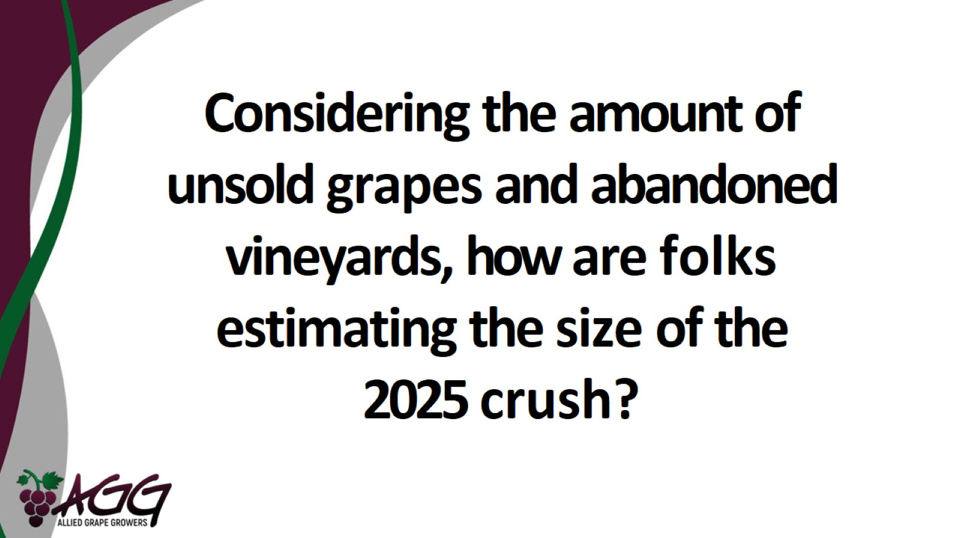

Slide 18
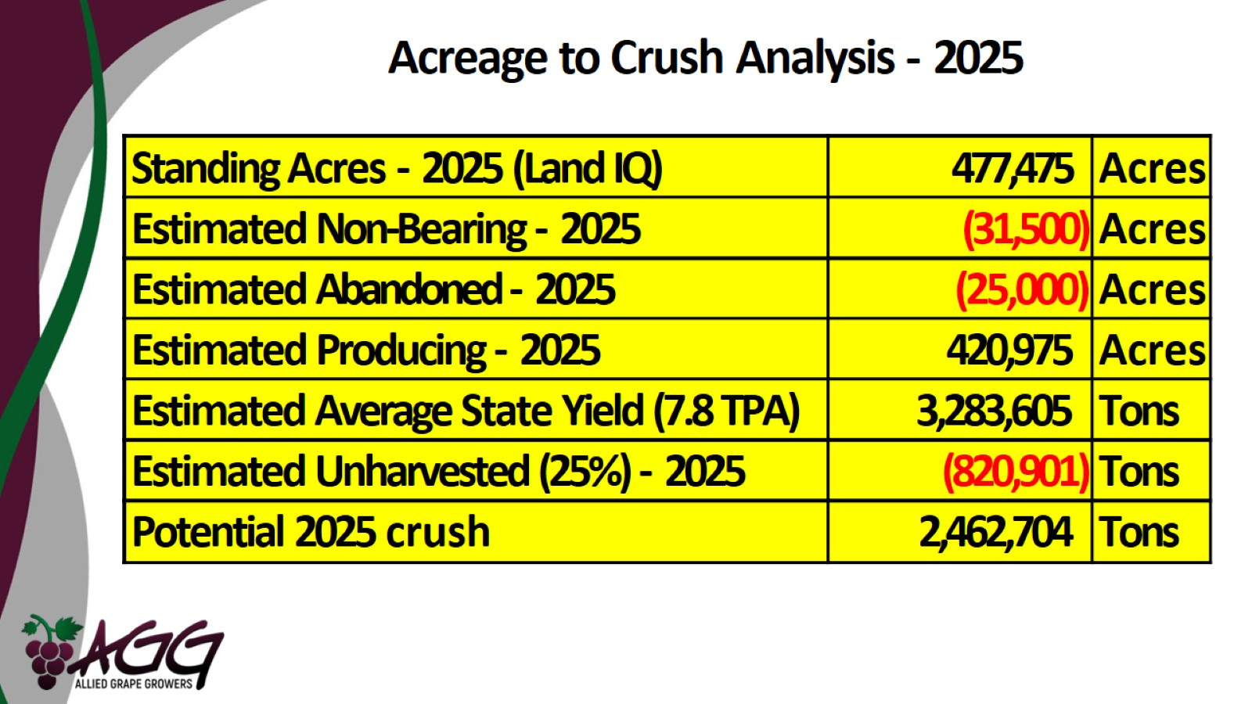
Acreage to Crush Analysis - 2025

Slide 19
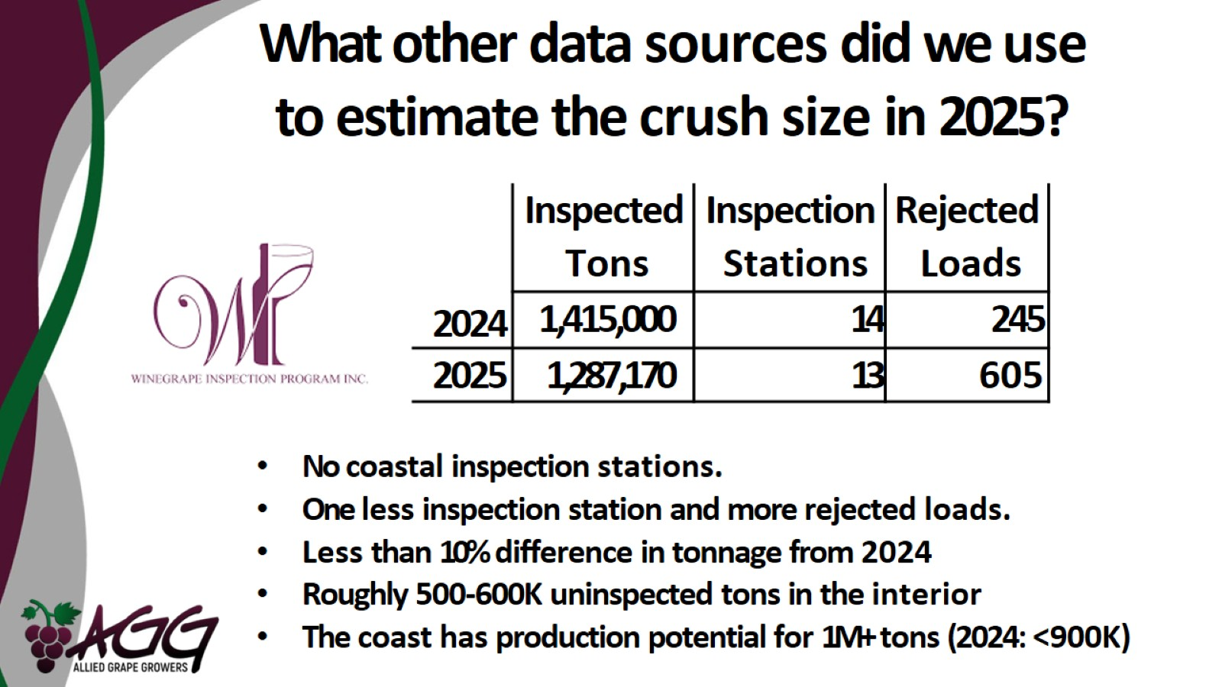
What other data sources did we use to estimate the crush size in 2025?

Slide 20
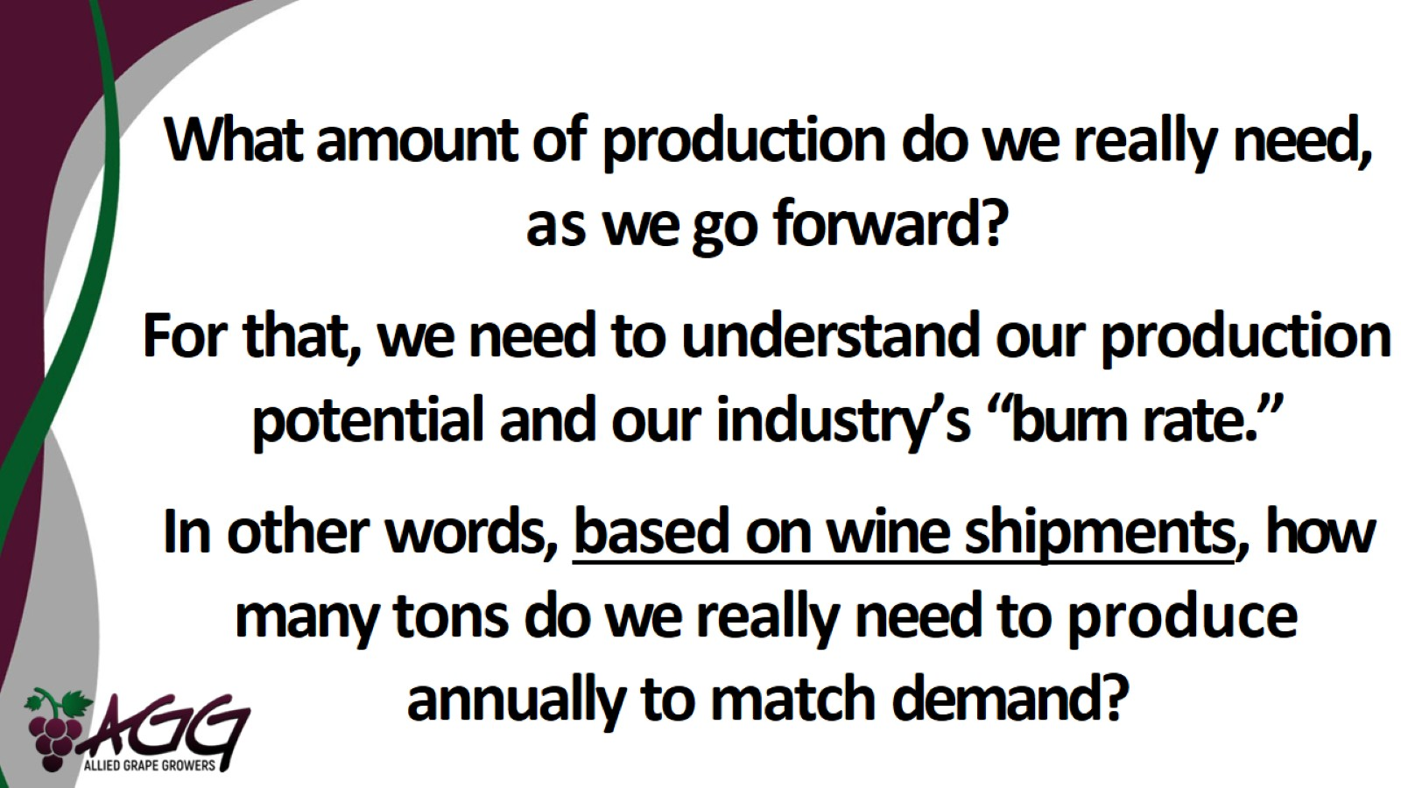

Slide 21
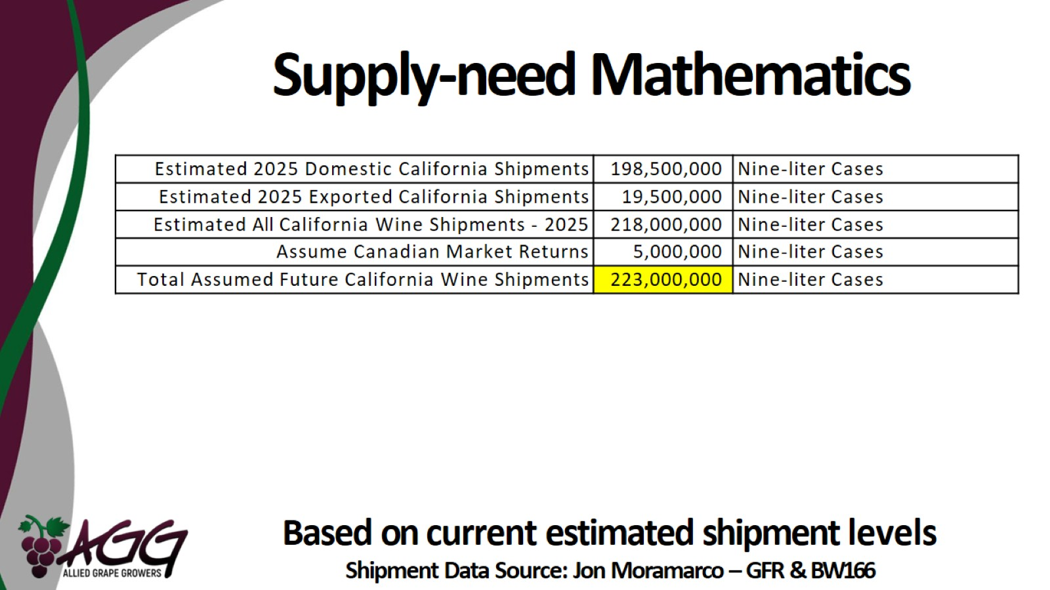
Supply-need Mathematics

Slide 22
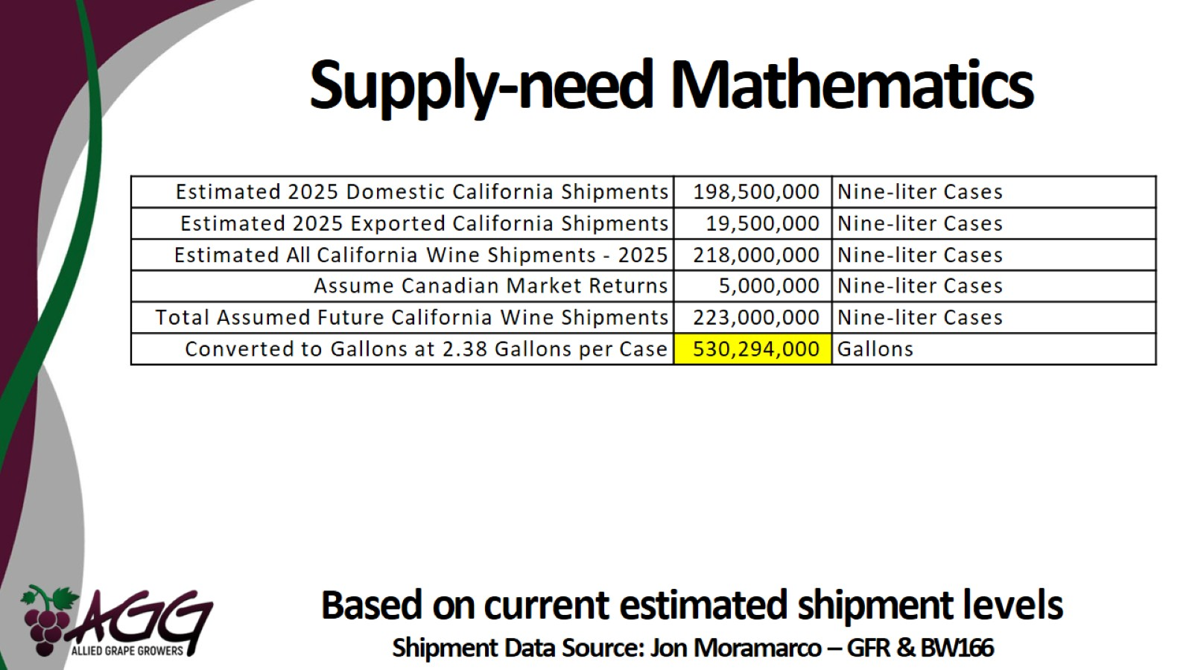
Supply-need Mathematics

Slide 23
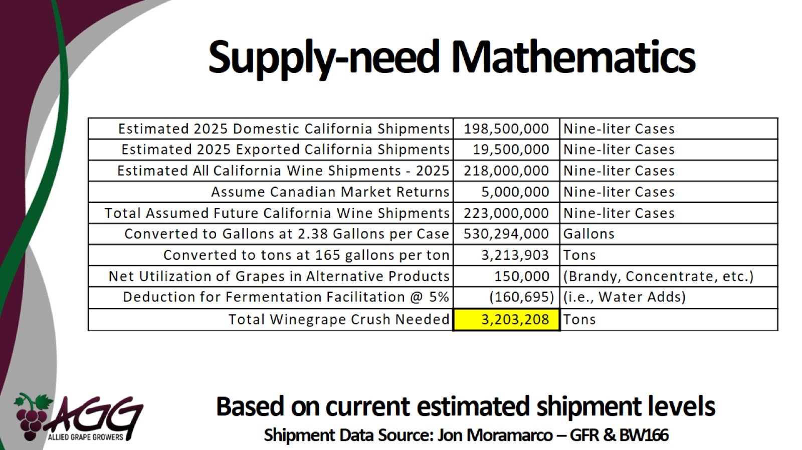
Supply-need Mathematics

Slide 24
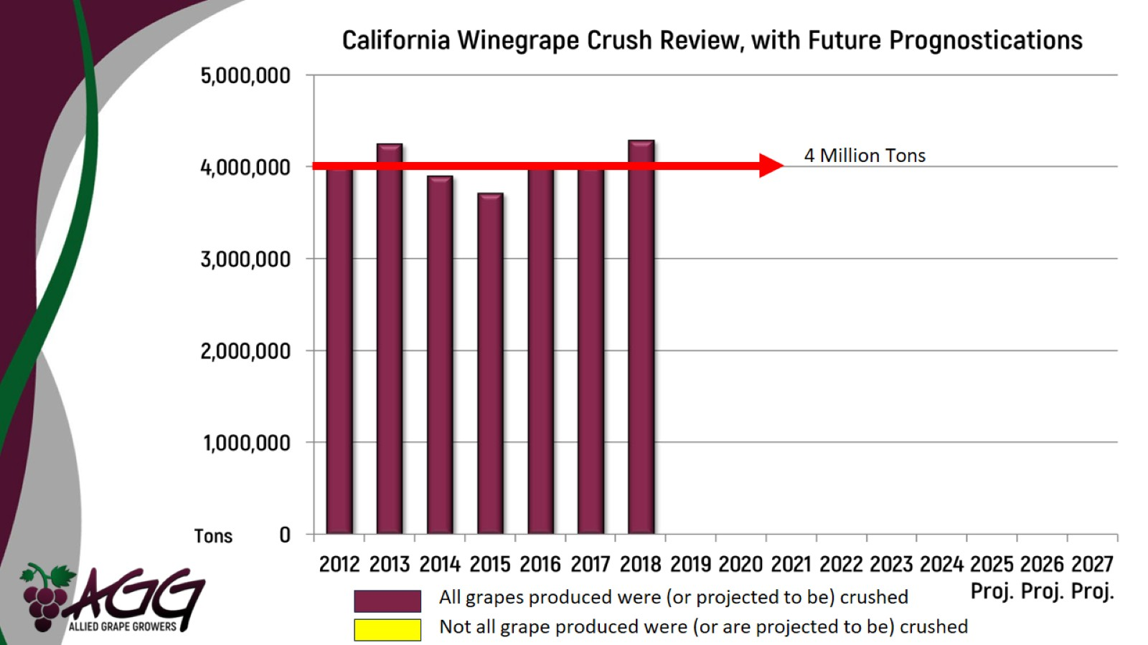
4 Million Tons

Slide 25
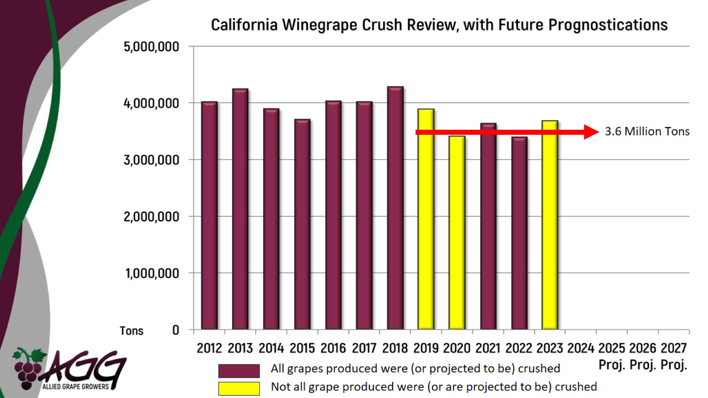
3.6 Million Tons

Slide 26
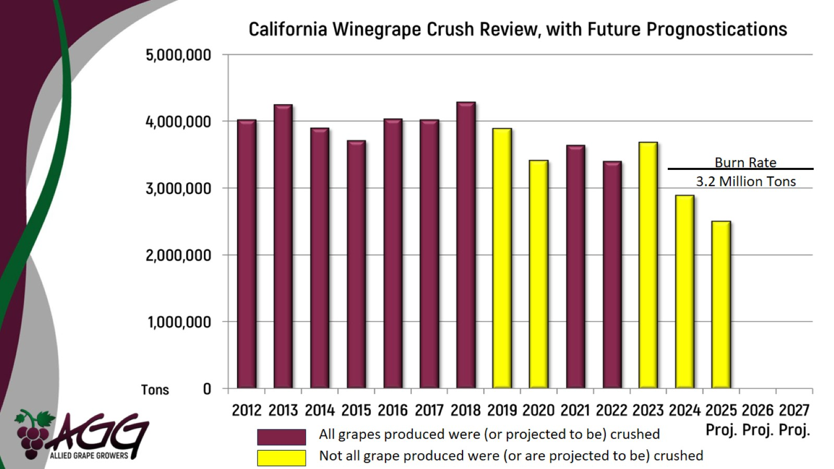

Slide 27
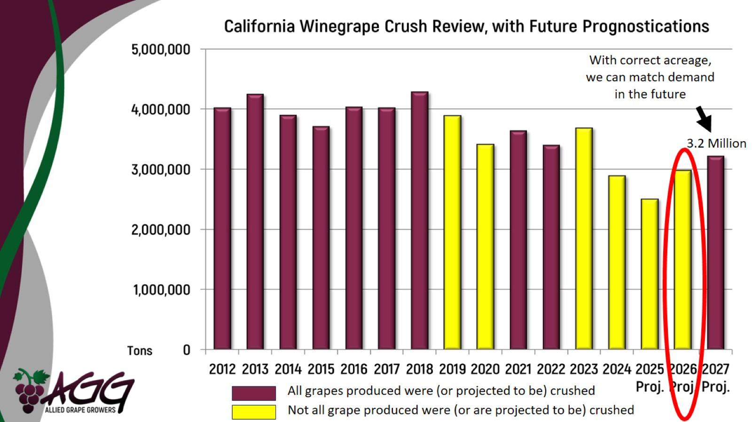
With correct acreage, we can match demand in the future

Slide 28
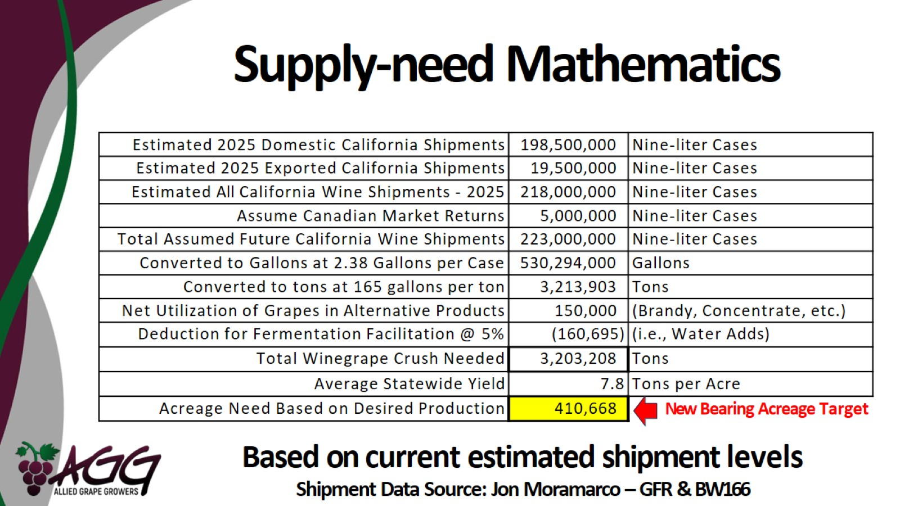
Supply-need Mathematics

Slide 29
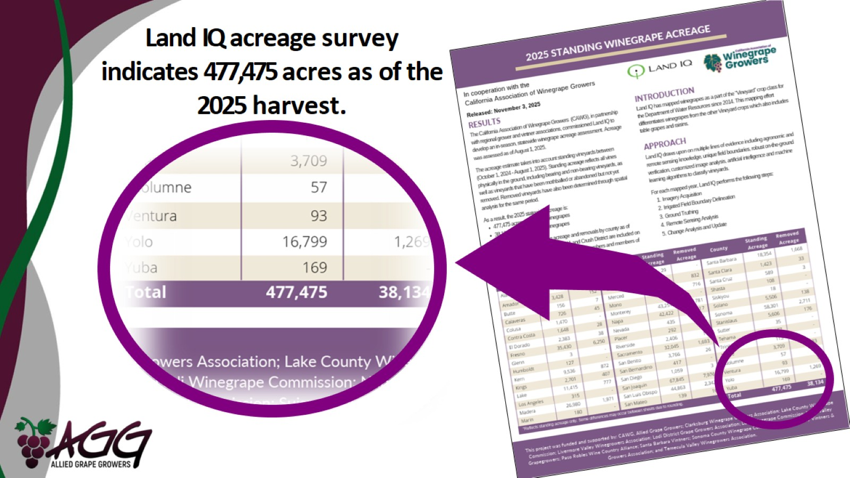
Land IQ acreage survey indicates 477,475 acres as of the 2025 harvest.

Slide 30
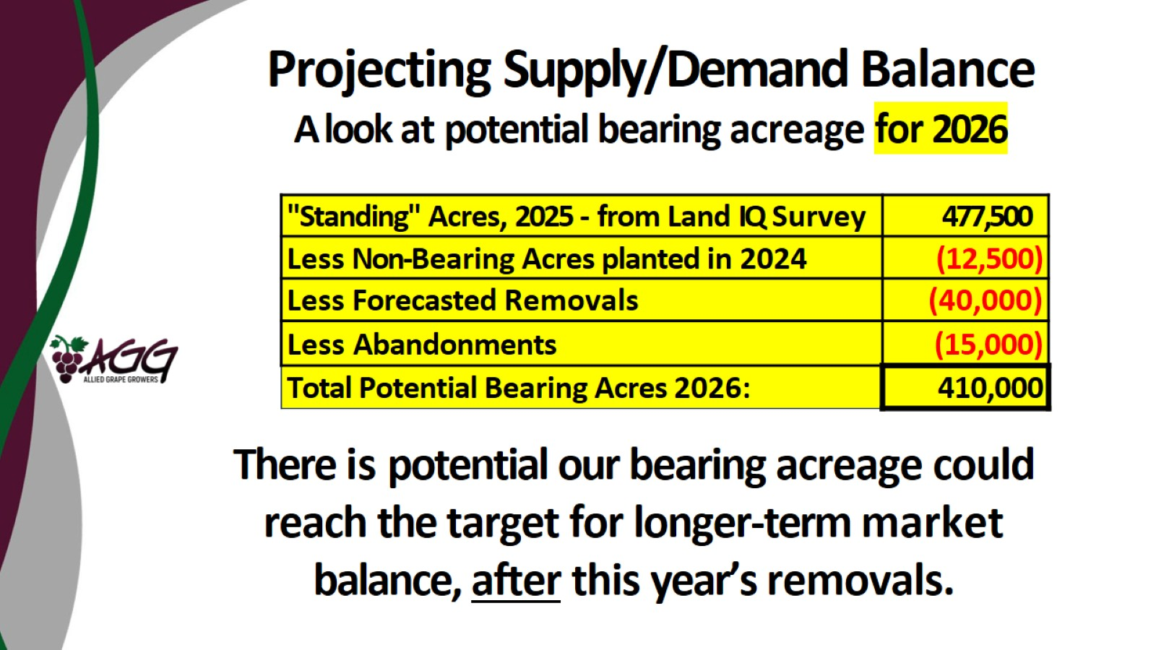
Projecting Supply/Demand Balance

Slide 31
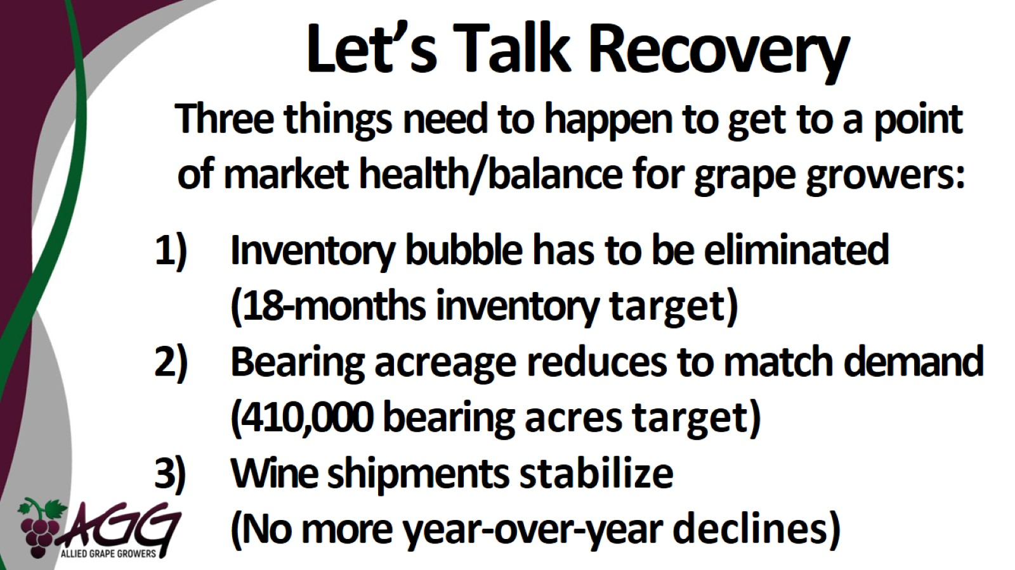
Let’s Talk Recovery

Slide 32
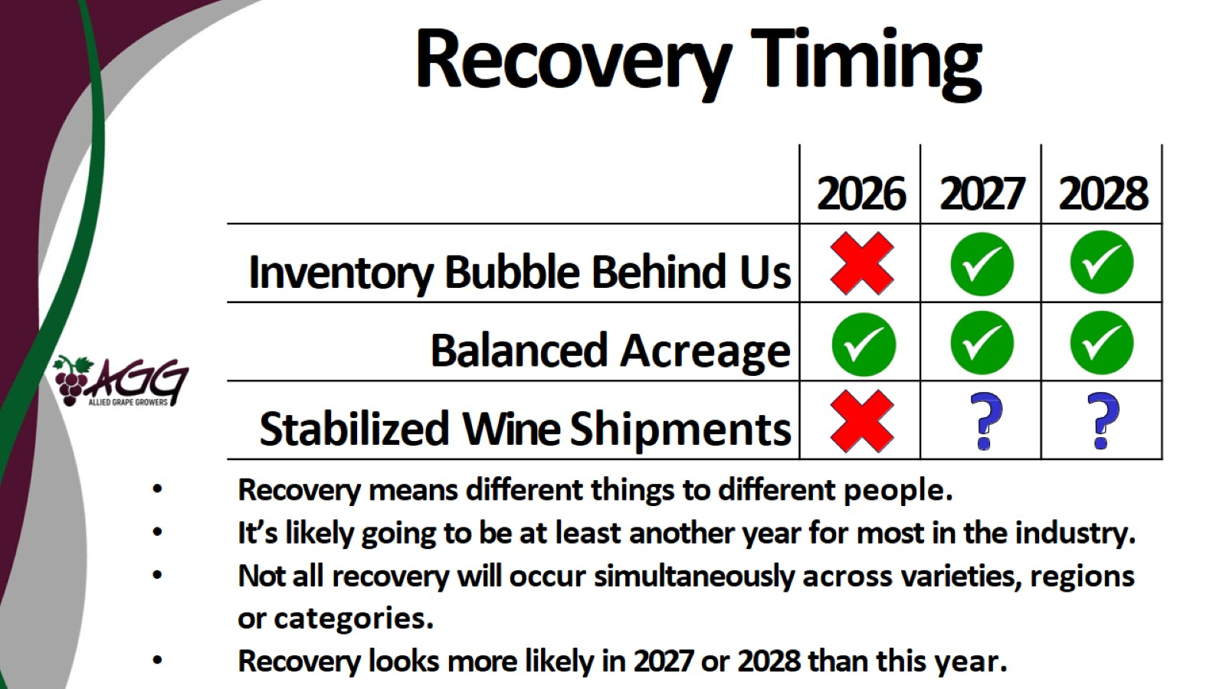
Recovery Timing

Slide 33

Vine Sales and Planting 2025

Slide 34

AGG Nursery Survey Participants

Slide 35
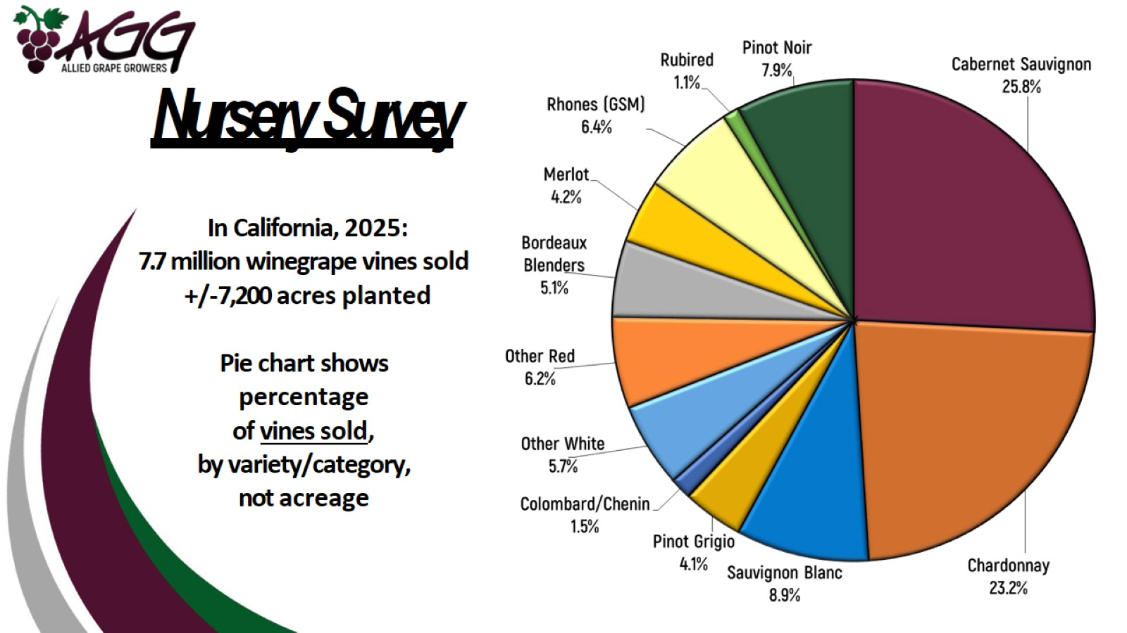
Nursery Survey

Slide 36
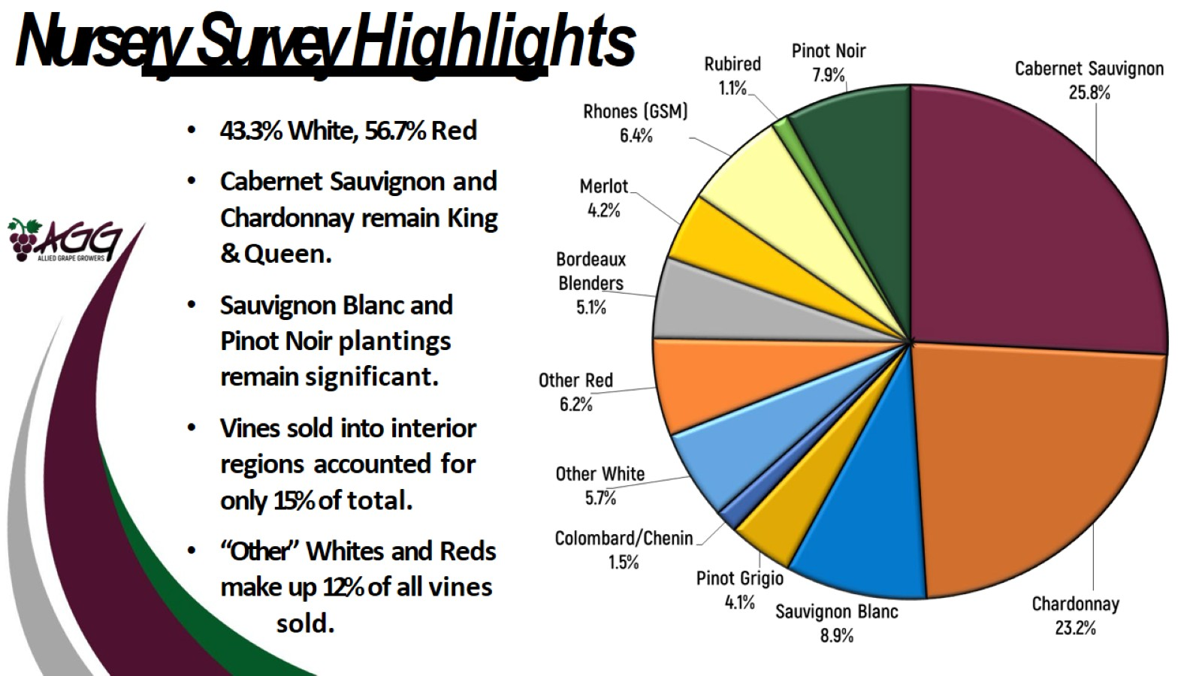
Nursery Survey Highlights

Slide 37
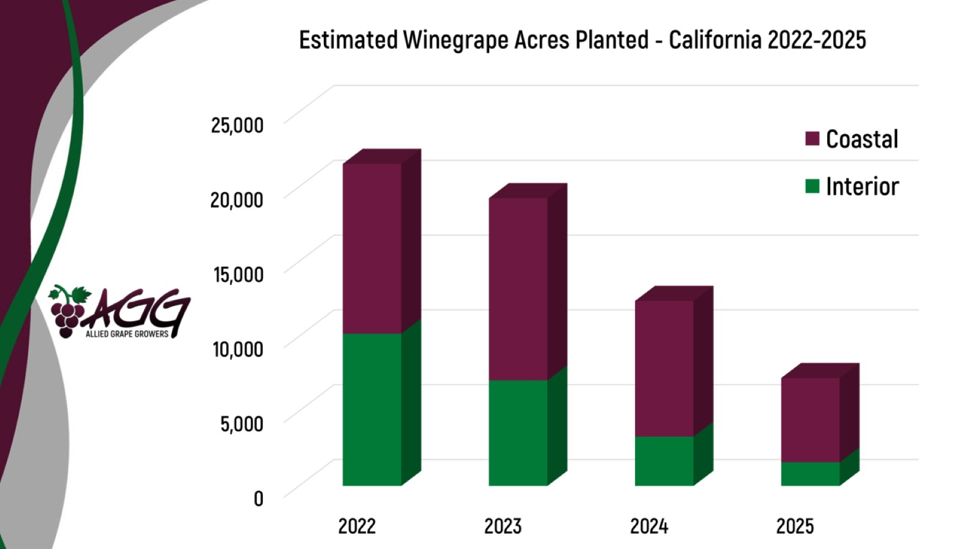

Slide 38
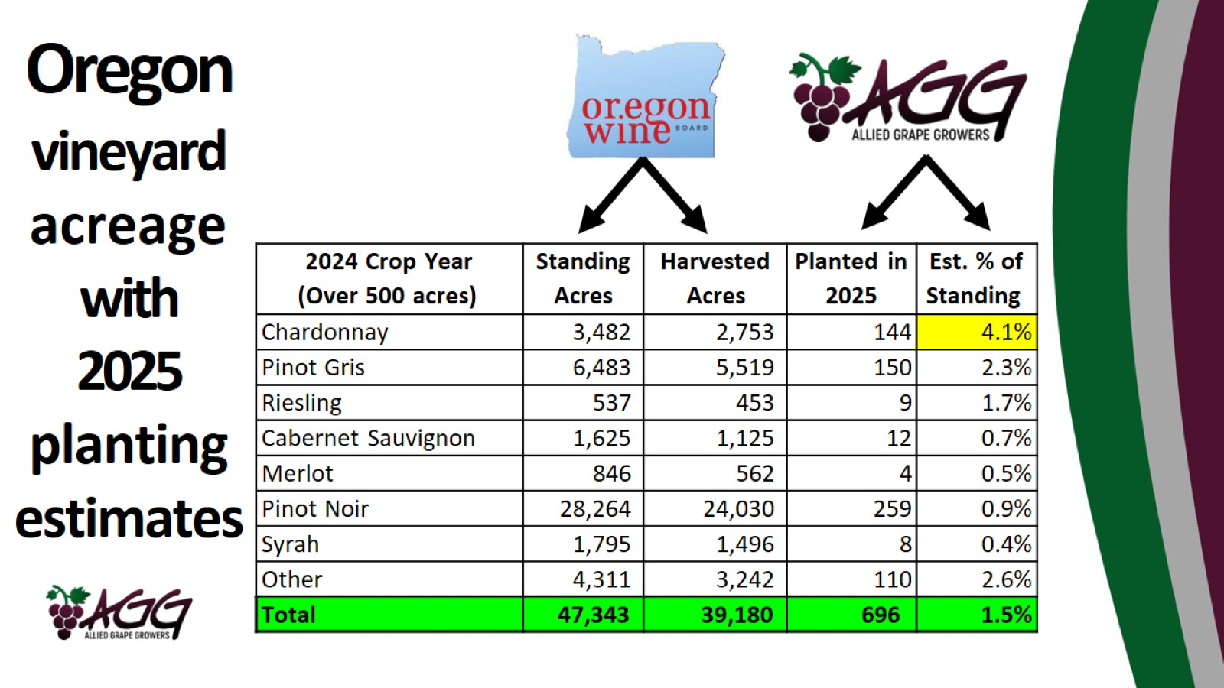

Slide 39
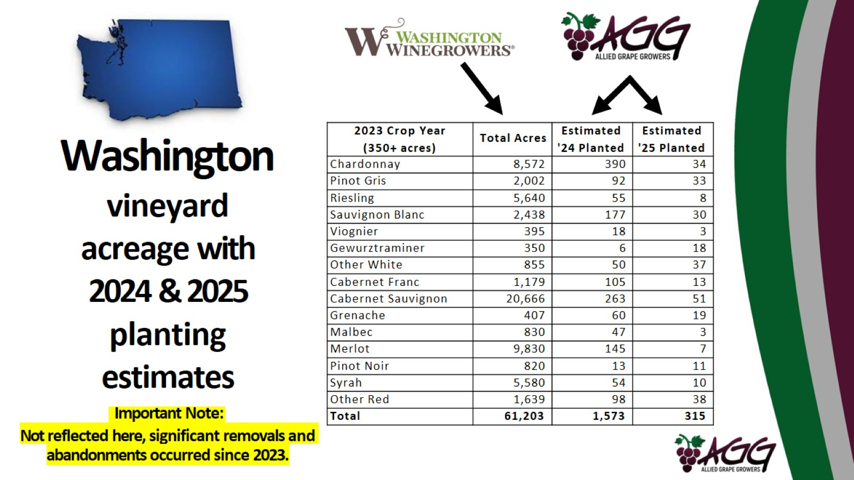
Washington

Slide 40
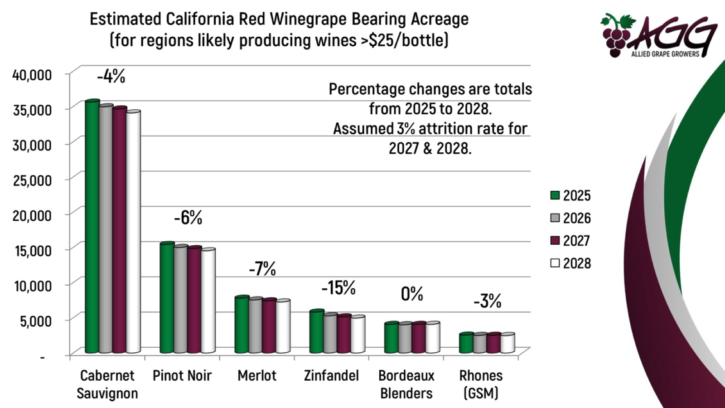

Slide 41
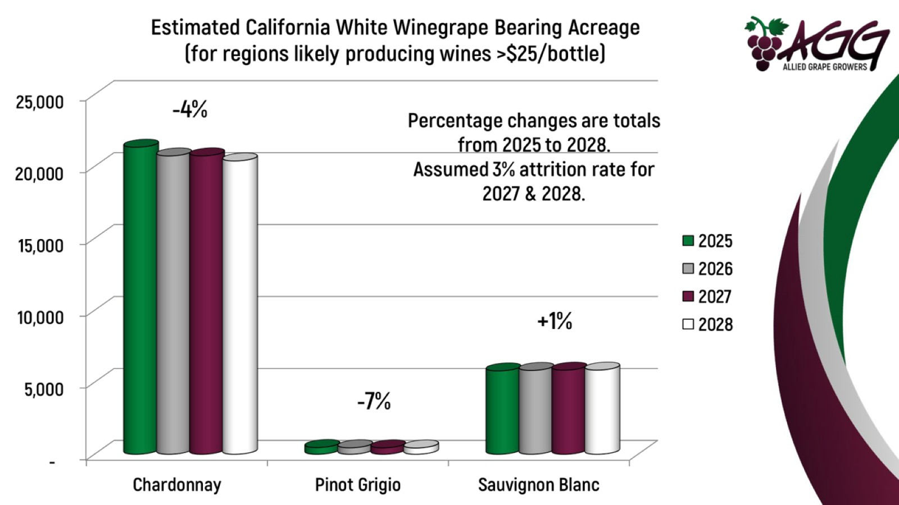

Slide 42
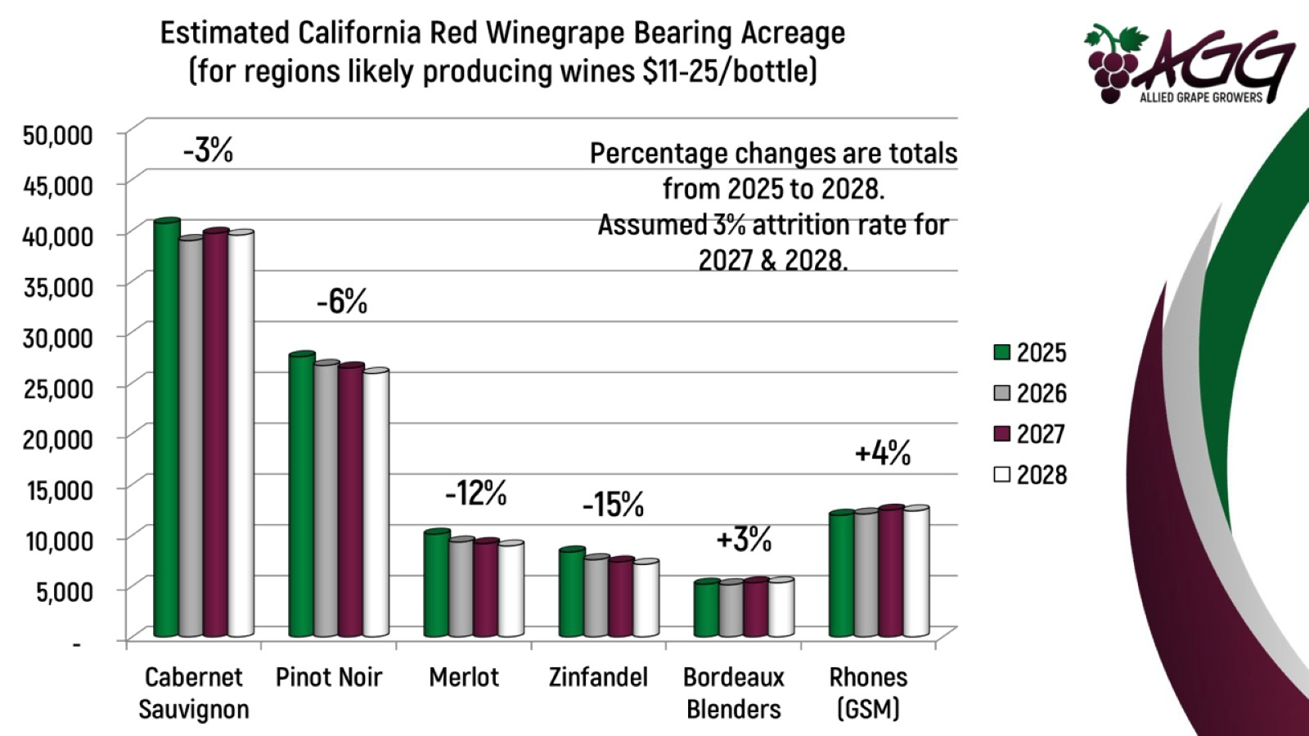

Slide 43
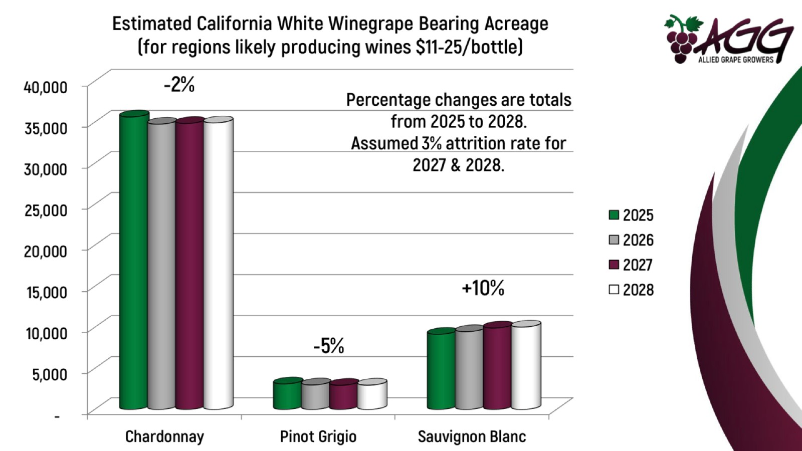

Slide 44
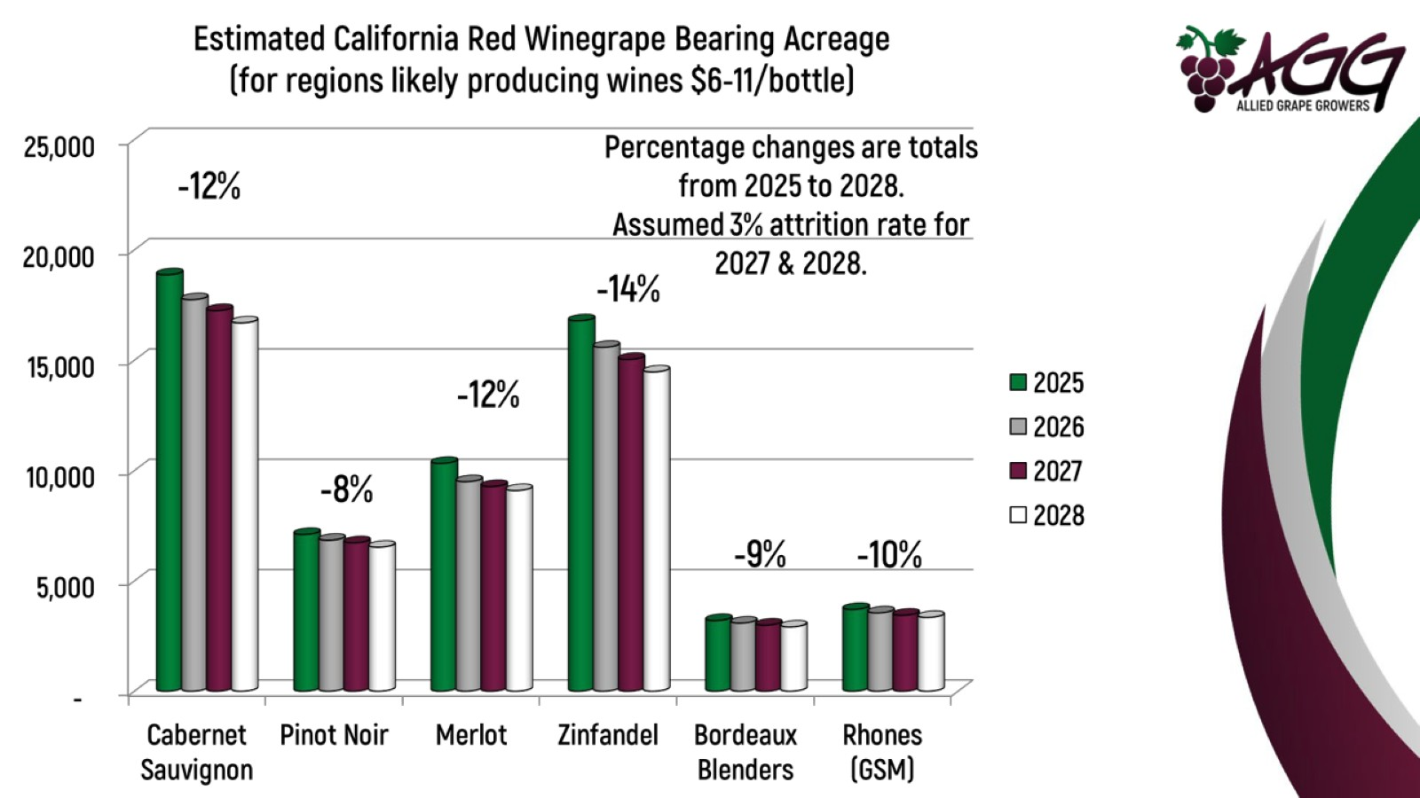

Slide 45
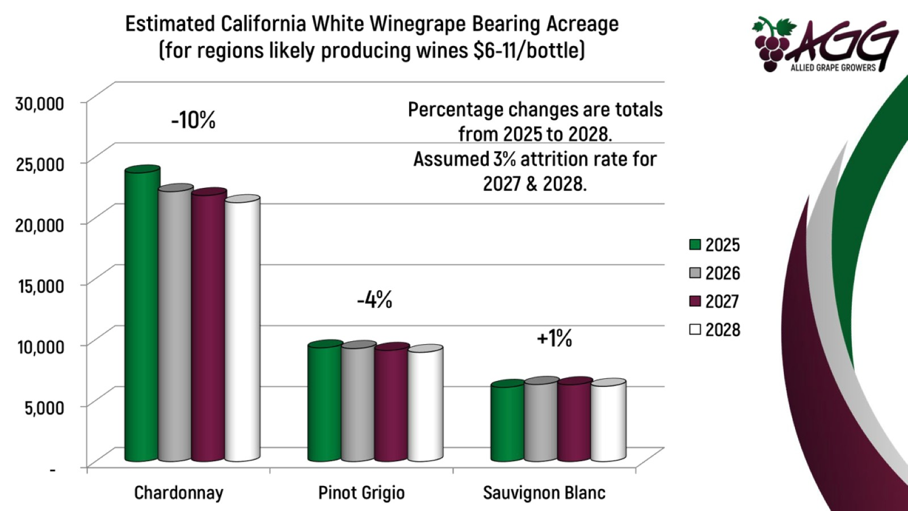

Slide 46
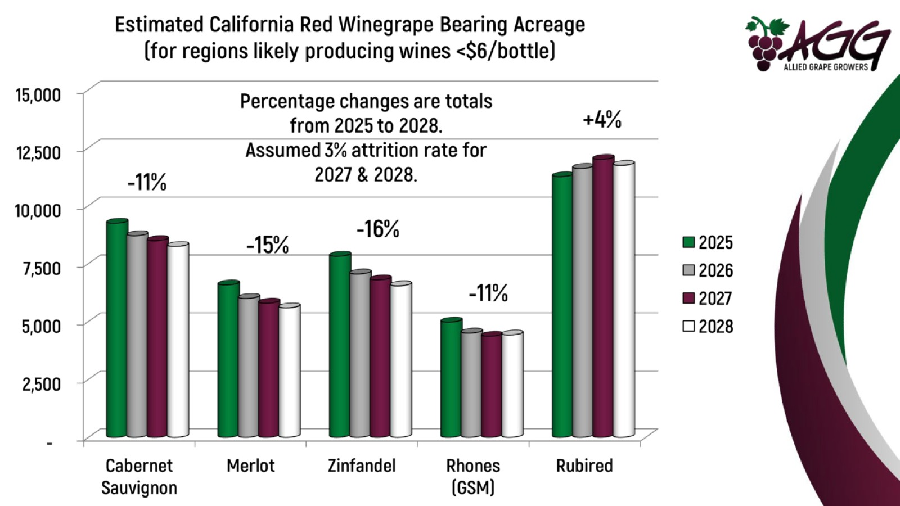

Slide 47
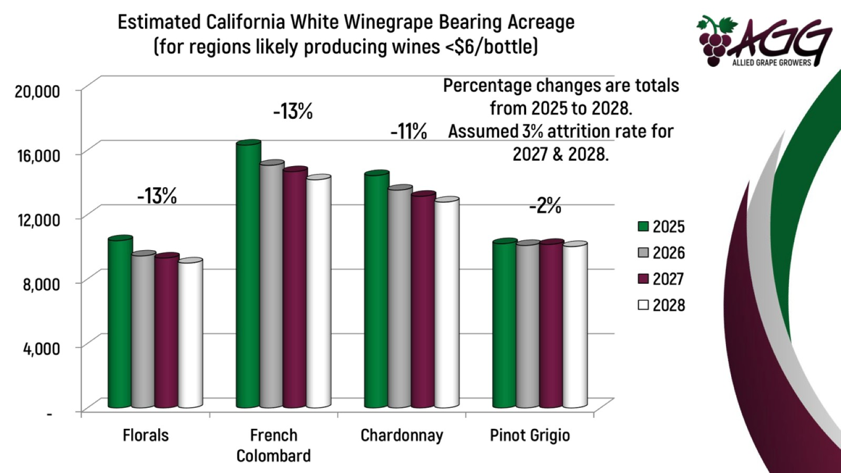

Slide 48
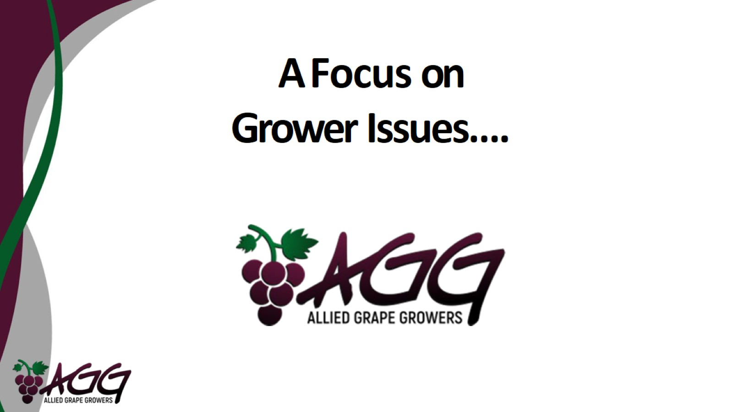
A Focus on Grower Issues….

Slide 49
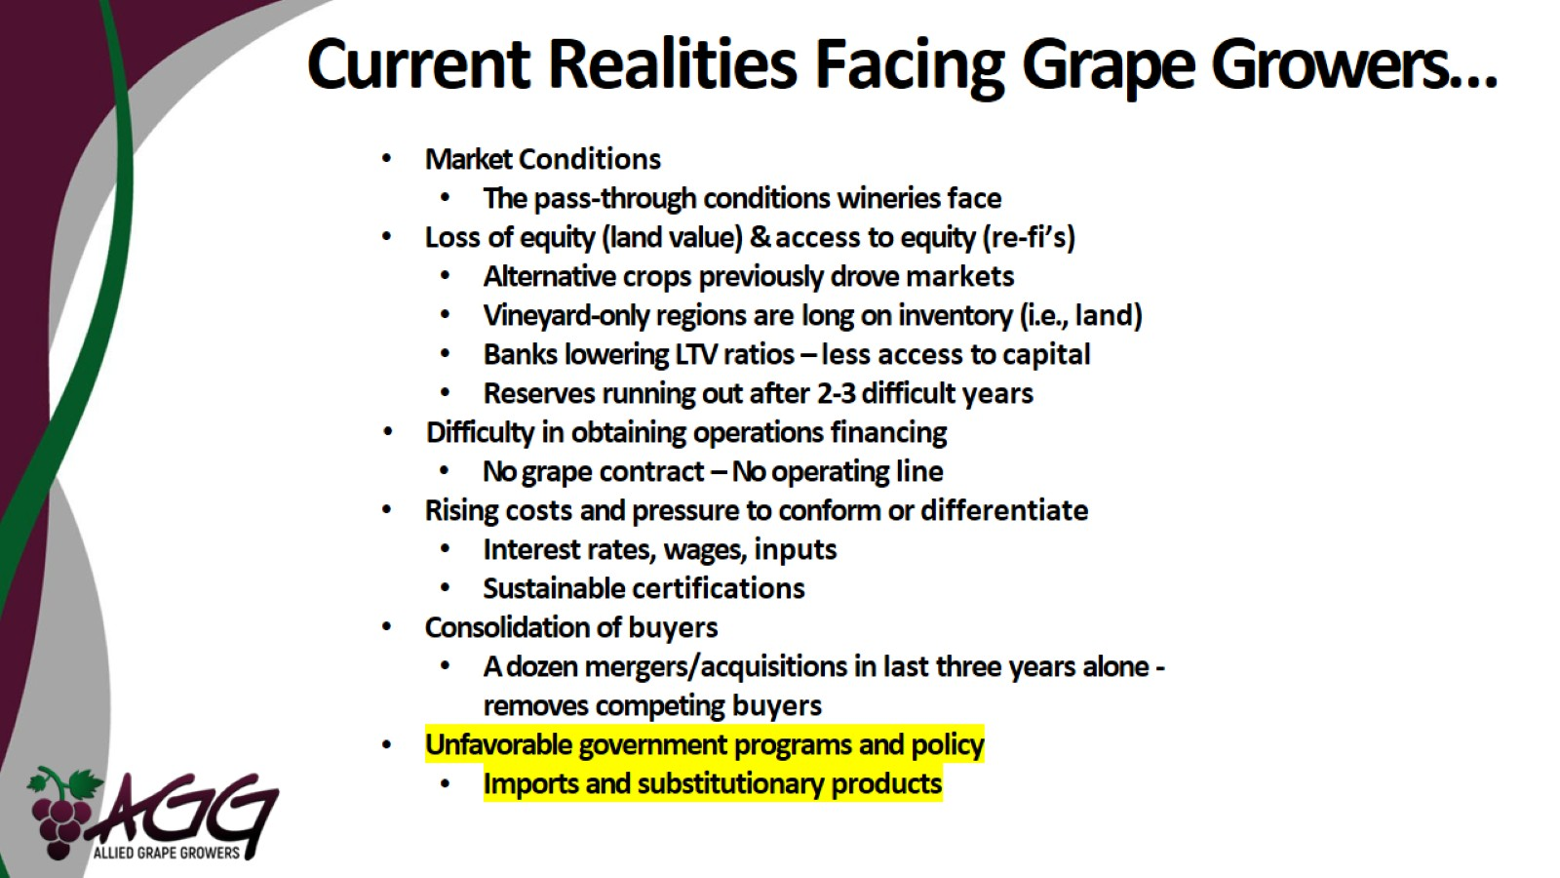
Current Realities Facing Grape Growers…

Slide 50
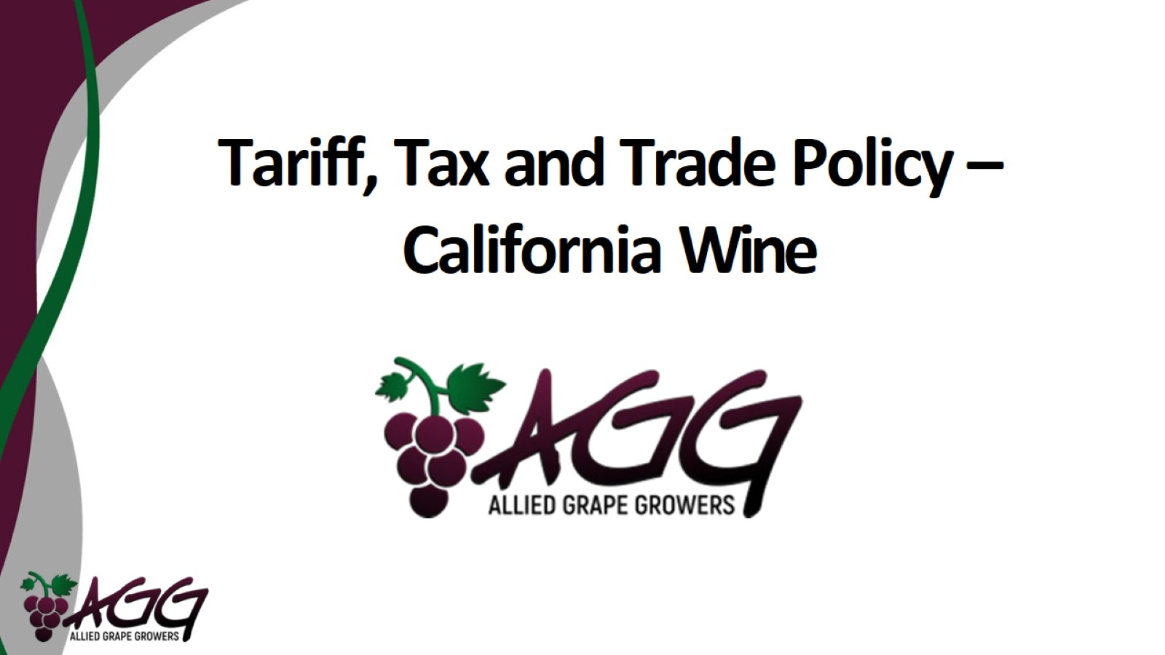
Tariff, Tax and Trade Policy – California Wine

Slide 51
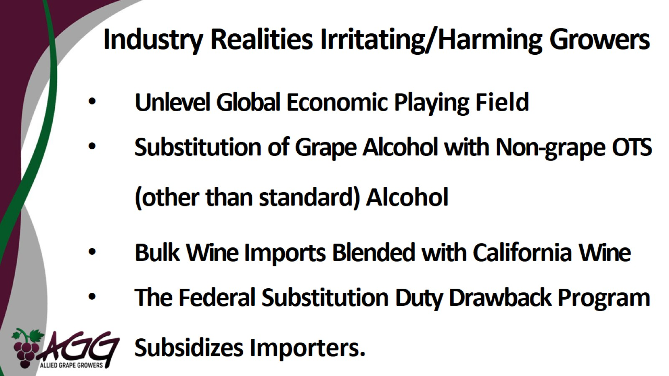
Industry Realities Irritating/Harming Growers

Slide 52
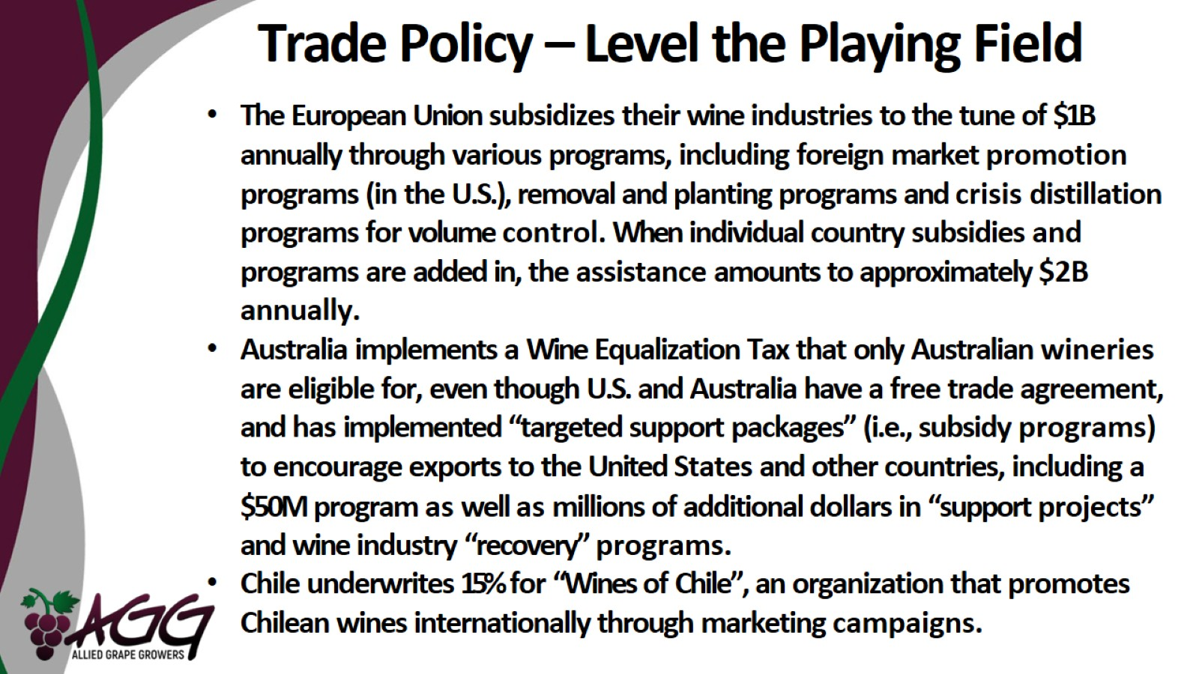
Trade Policy – Level the Playing Field

Slide 53
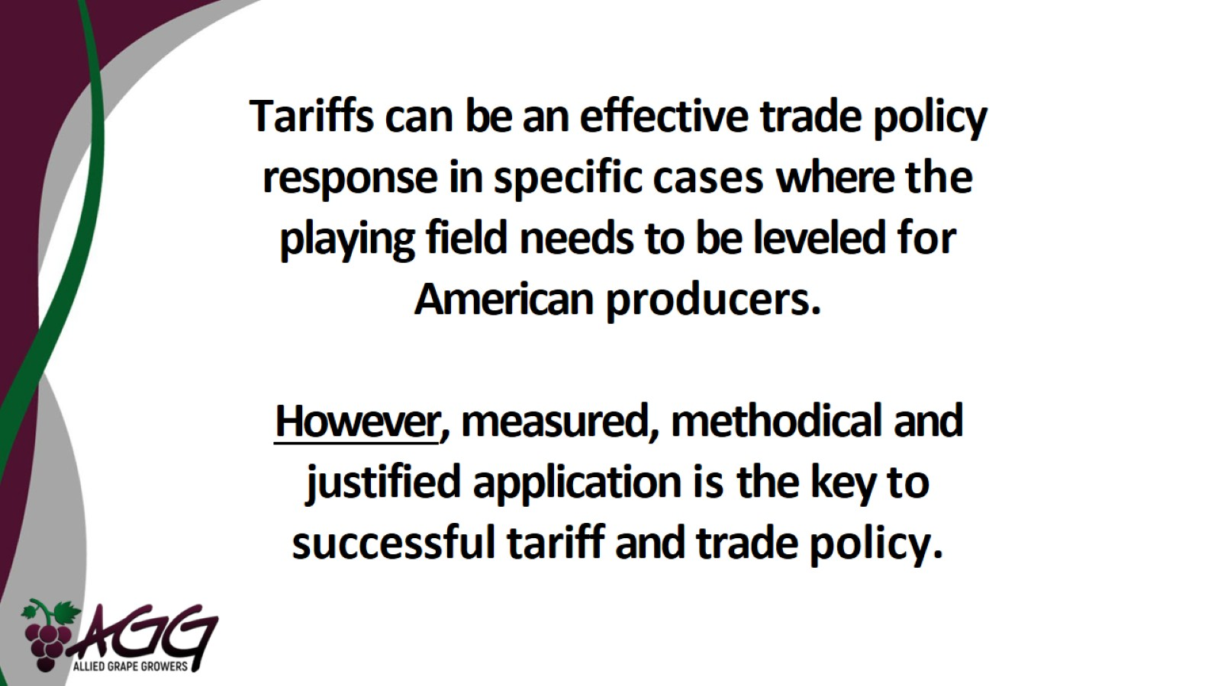

Slide 54

Trade Policy – Level the Playing Field

Slide 55

Today’s Hot Brands Using OTS Alcohol

Slide 56

The “American” Appellation

Slide 57

Substitution Duty Drawback

Slide 58

Why Growers Feel Duty Drawback is Bad for Them….

Slide 59

Final Thoughts…

Slide 60

For more information, come see us at Booth 210
or www.alliedgrapegrowers.org

