Slide 1

“Wine AND ?”

Slide 2
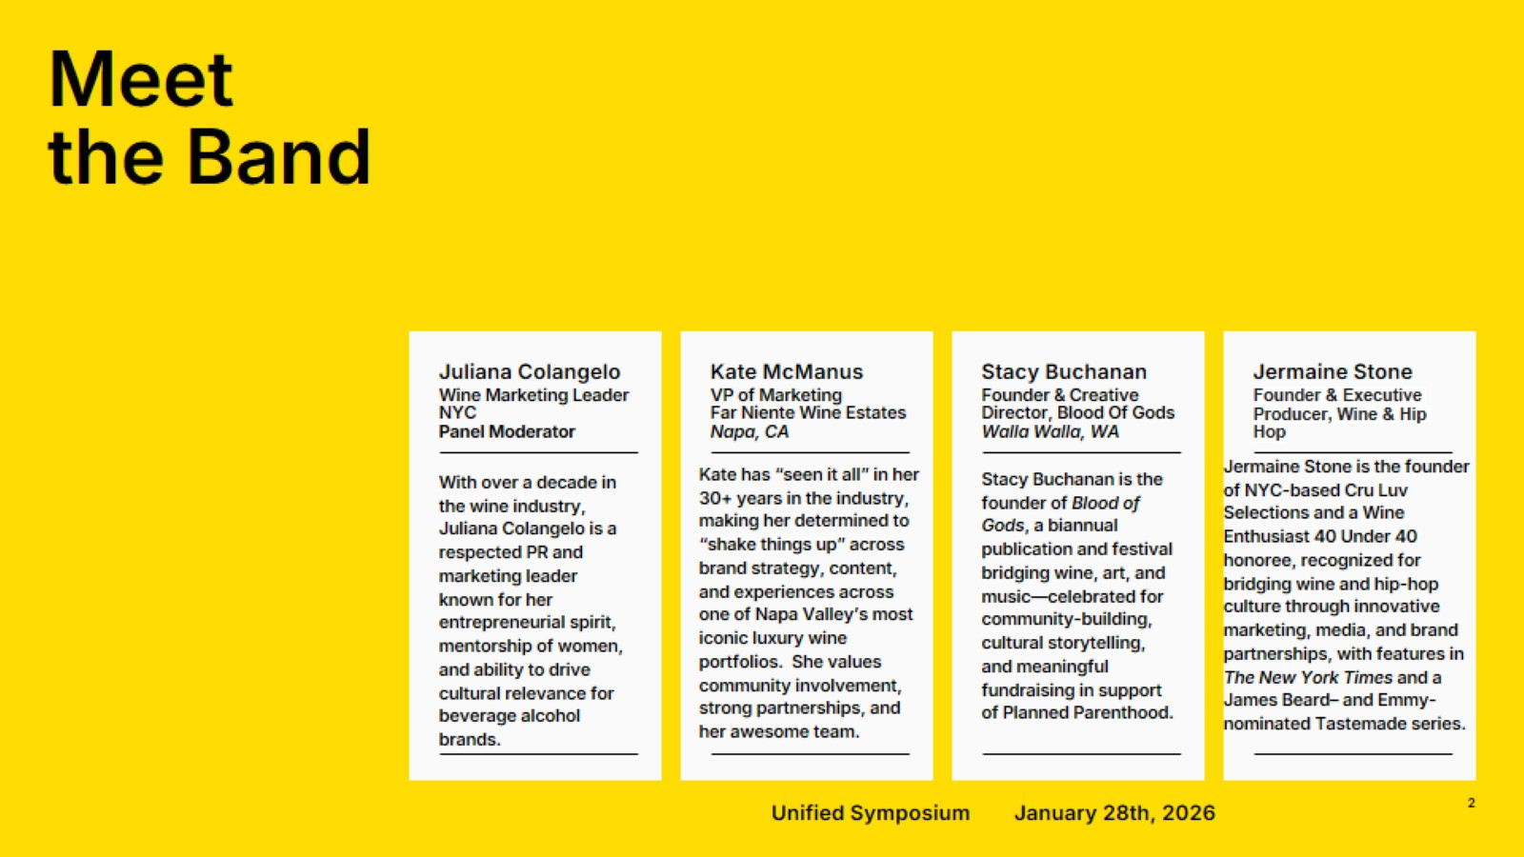
Meet
the Band

Slide 3
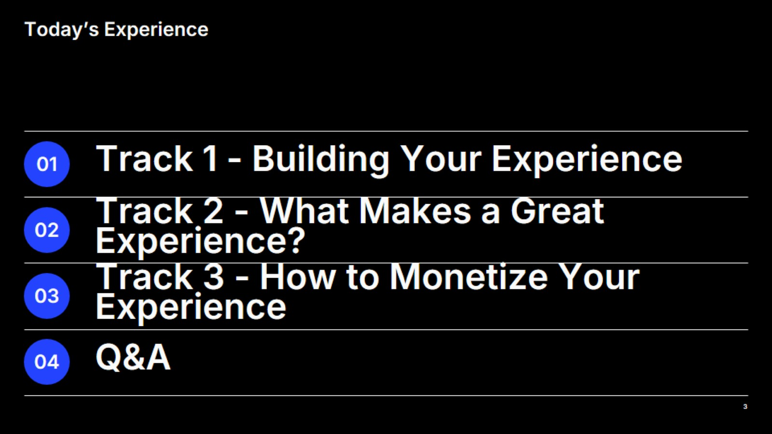
Today’s Experience

Slide 4
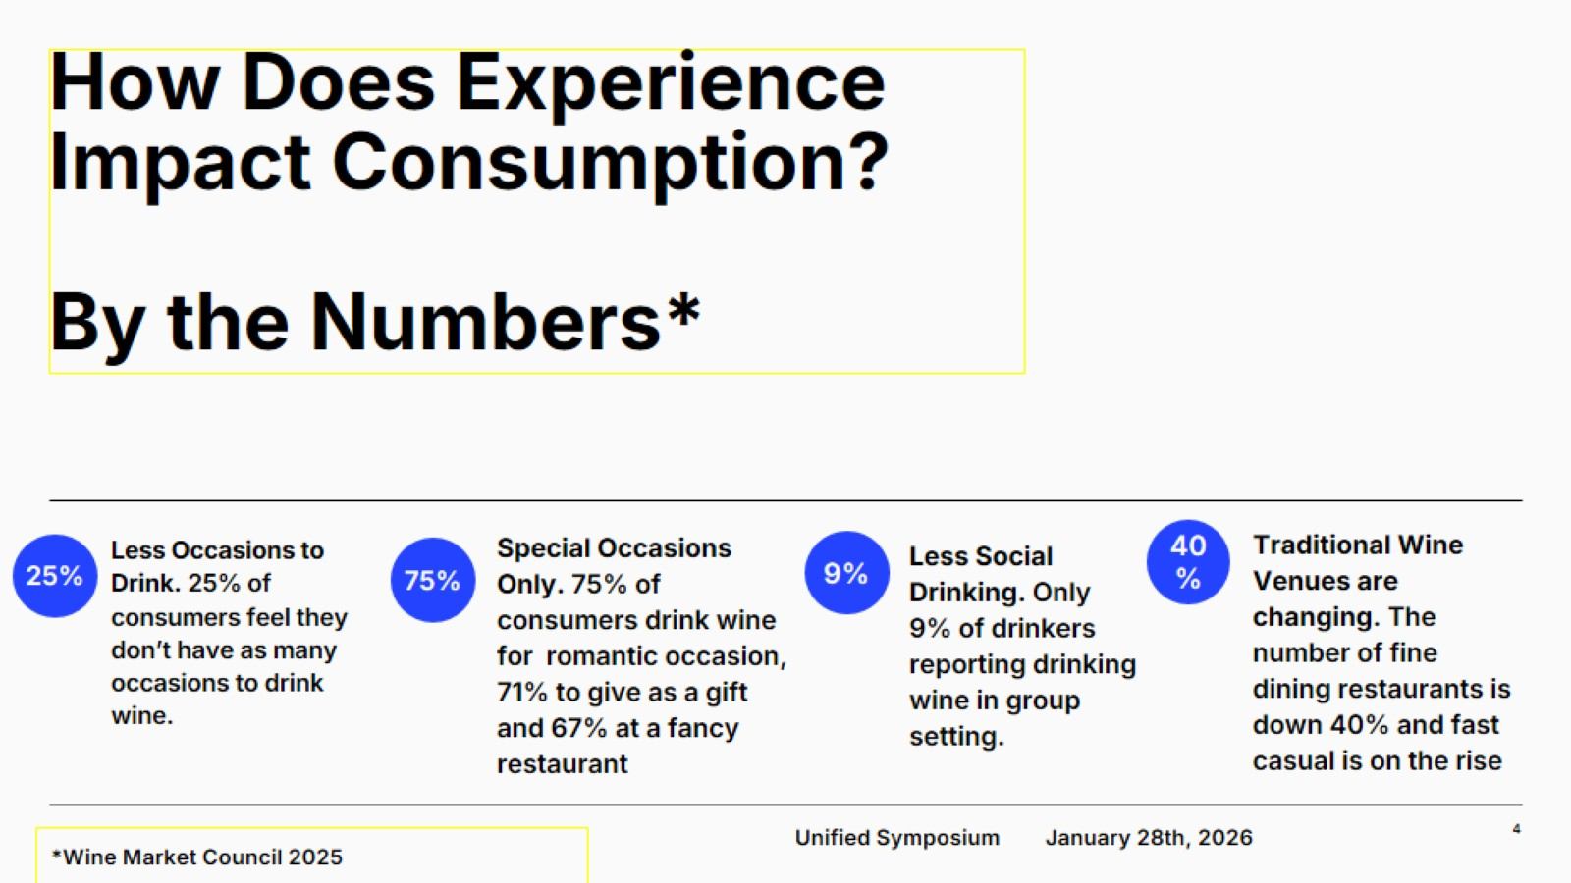
How Does Experience Impact Consumption?
By the Numbers*

Slide 5
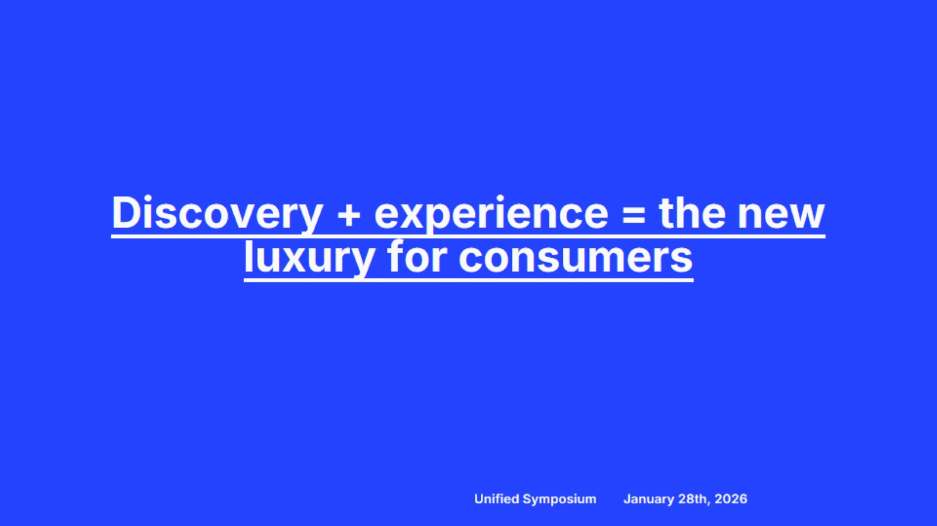
Discovery + experience = the new luxury for consumers

Slide 6
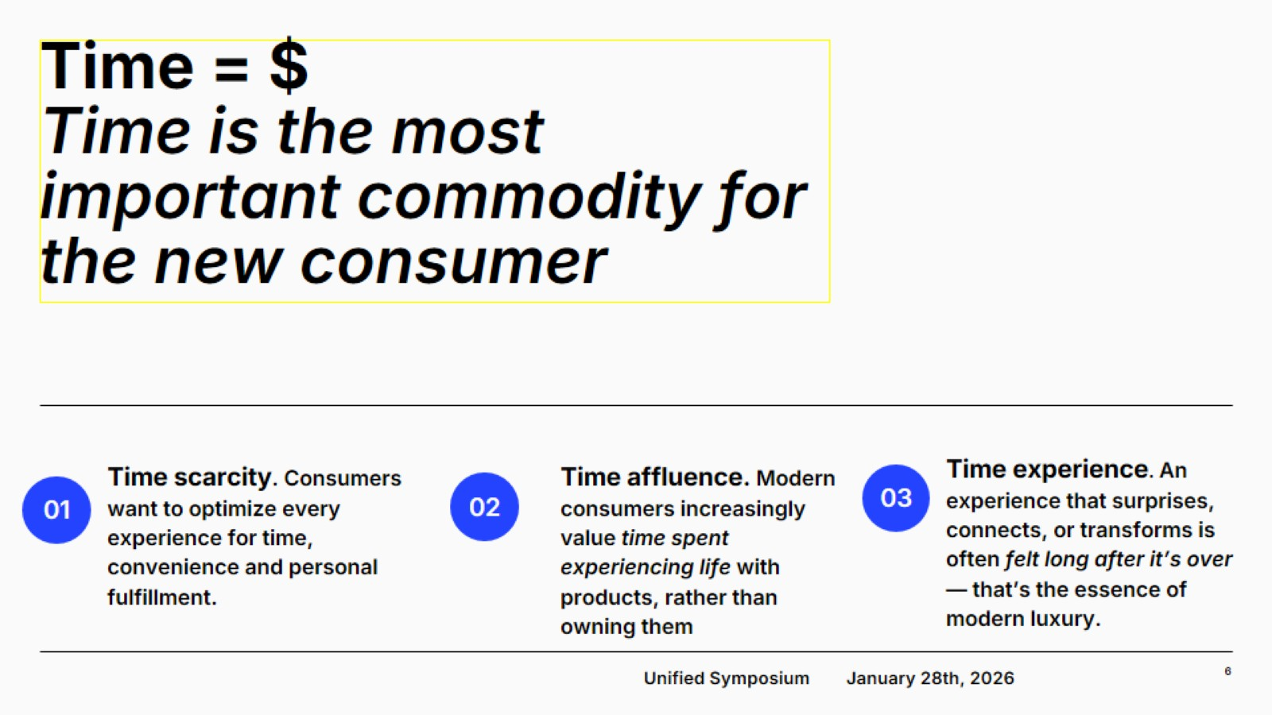
Time = $
Time is the most important commodity for the new consumer

Slide 7
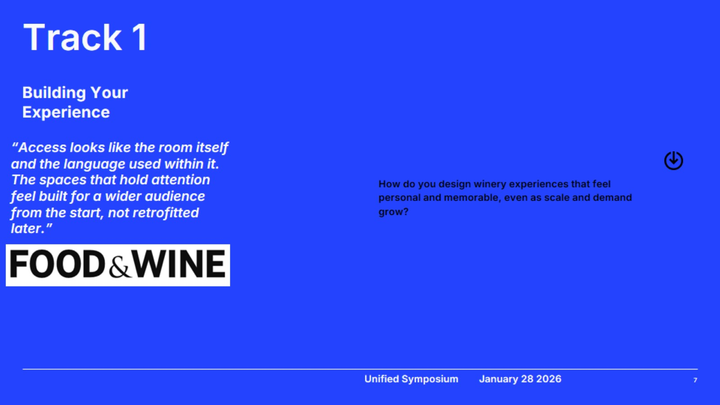
Track 1

Slide 8
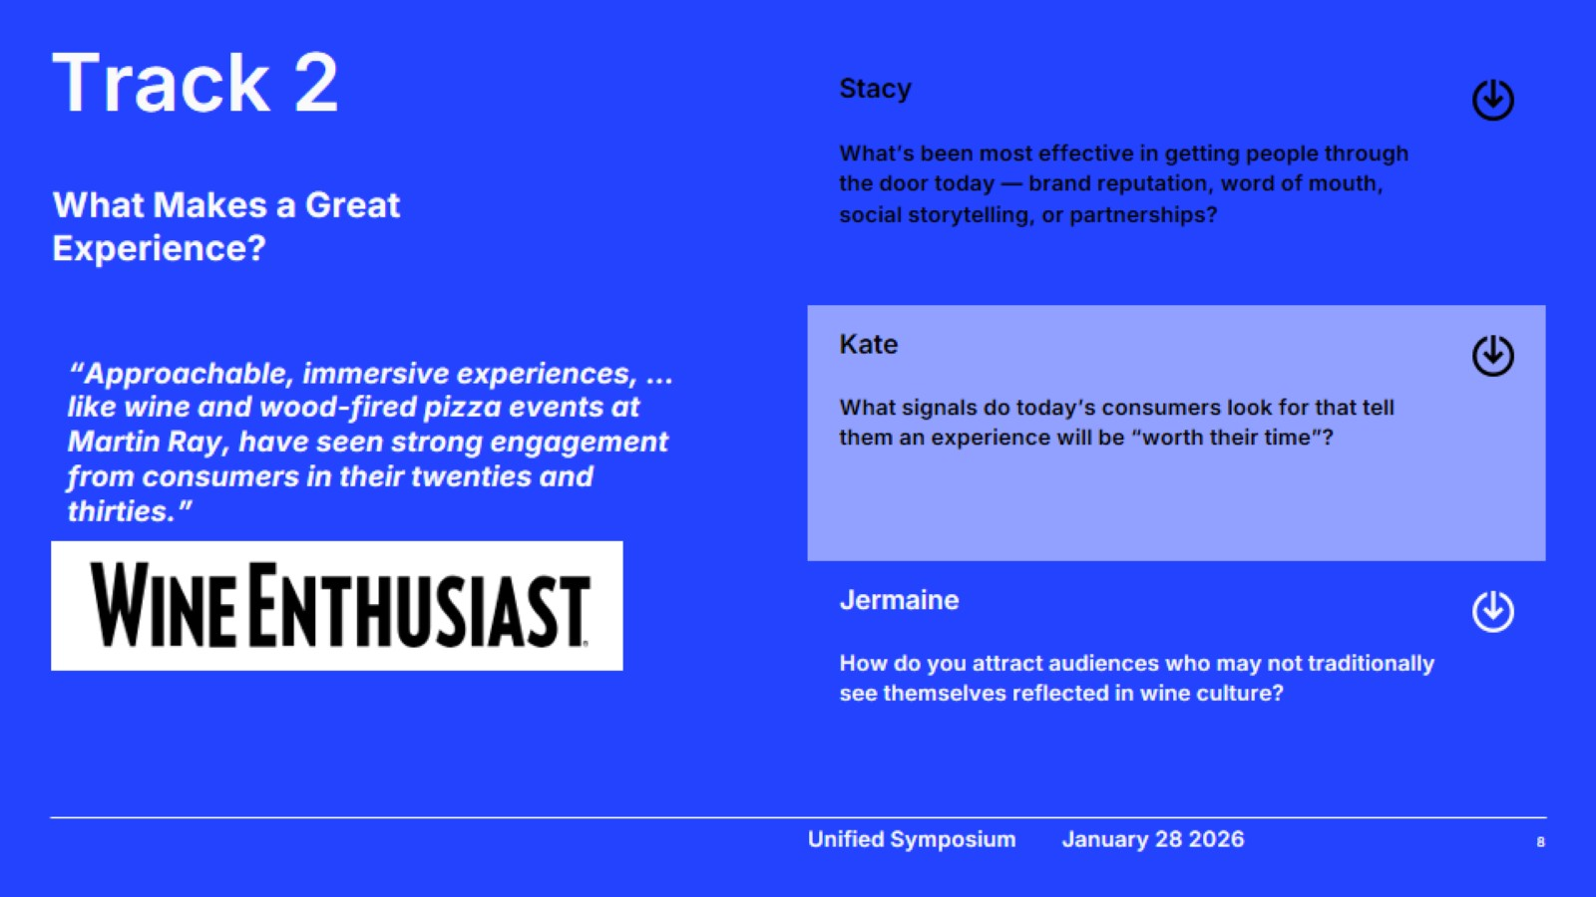
Track 2

Slide 9
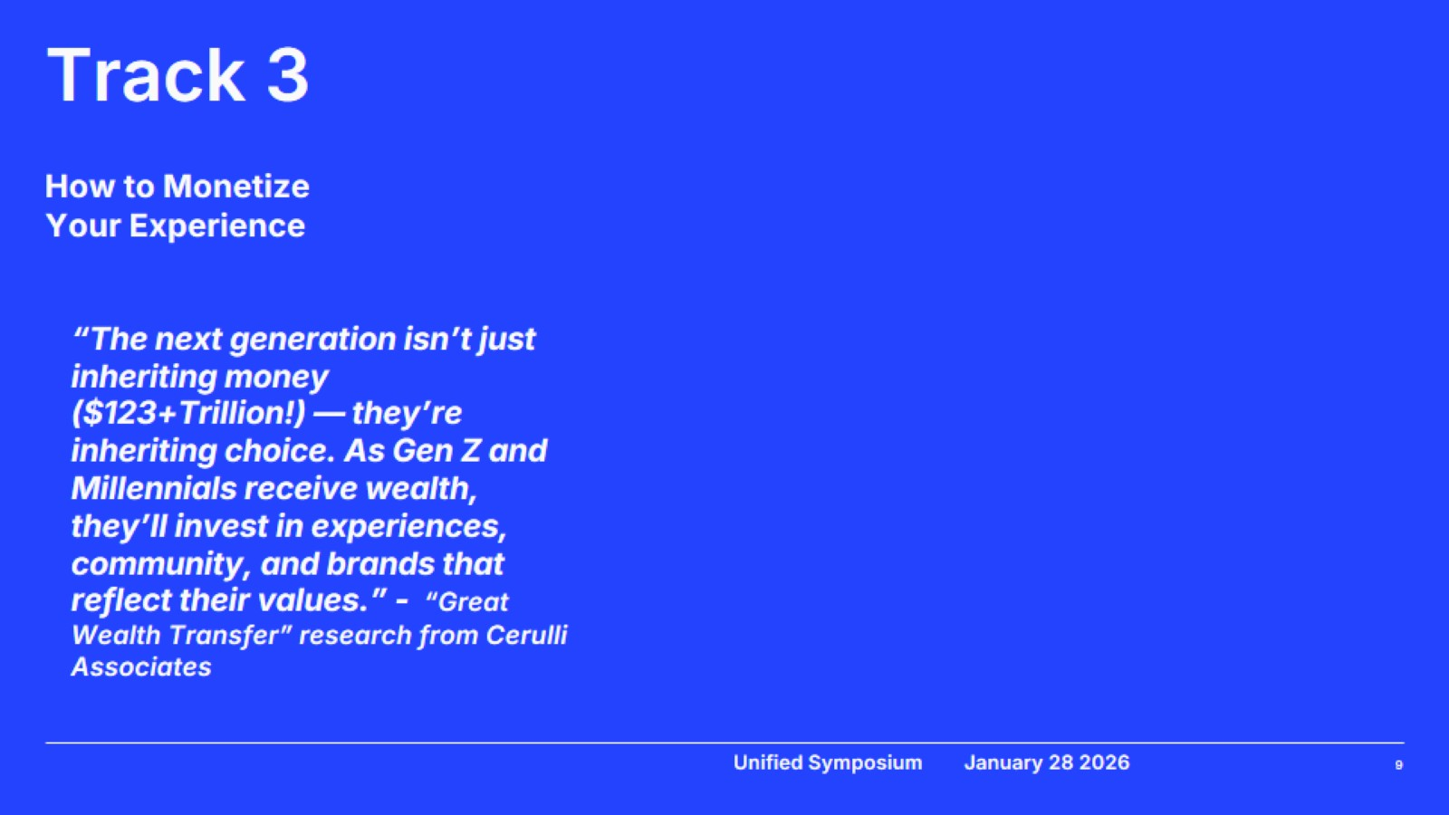
Track 3

Slide 10
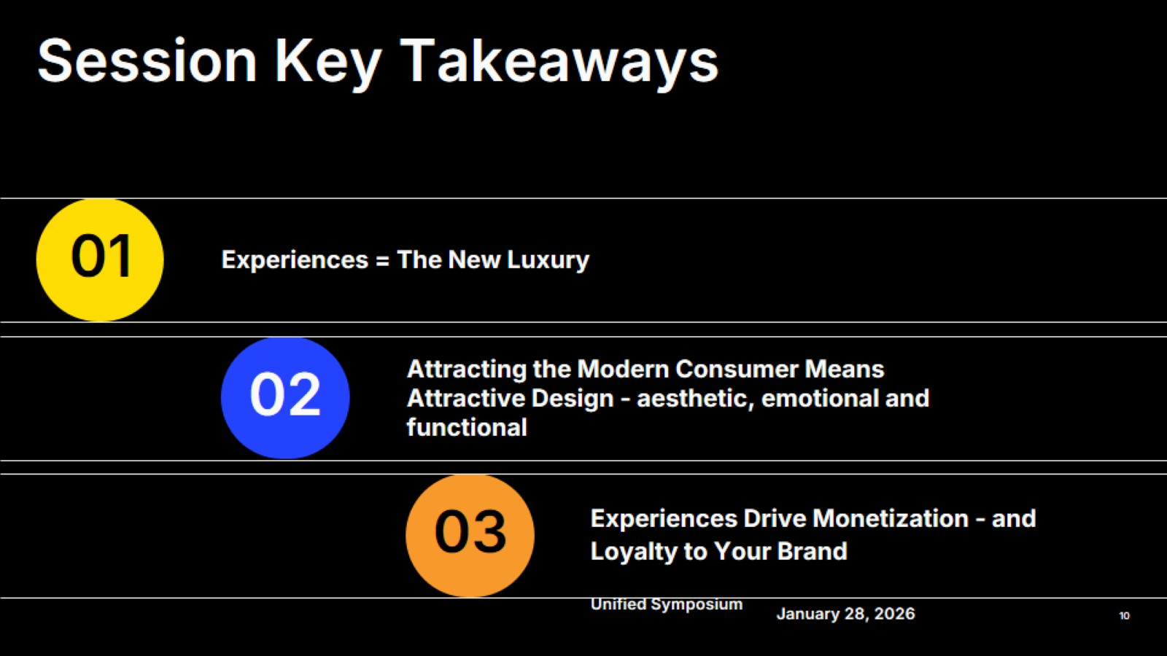
Unified Symposium

Slide 11

Unified Symposium

Slide 12
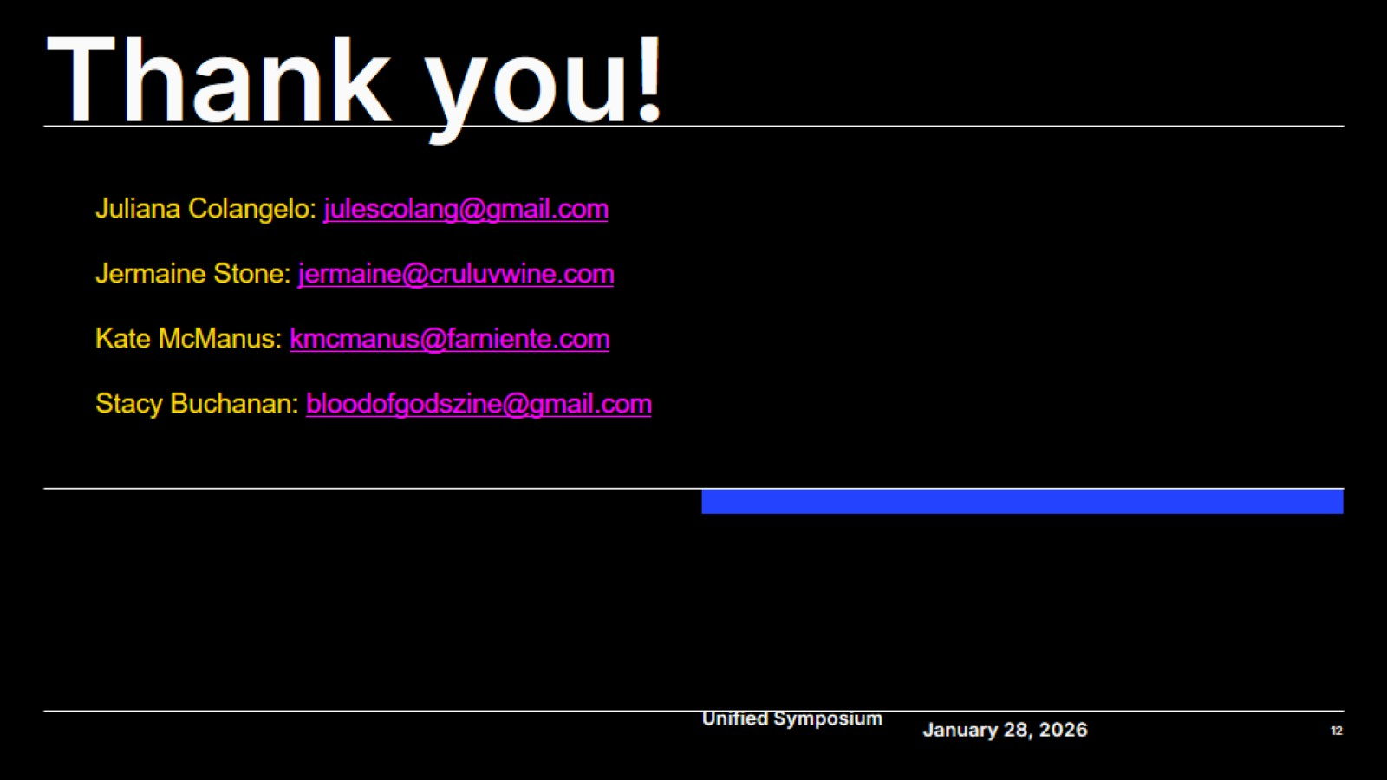
Thank you!

