Slide 1


Slide 2
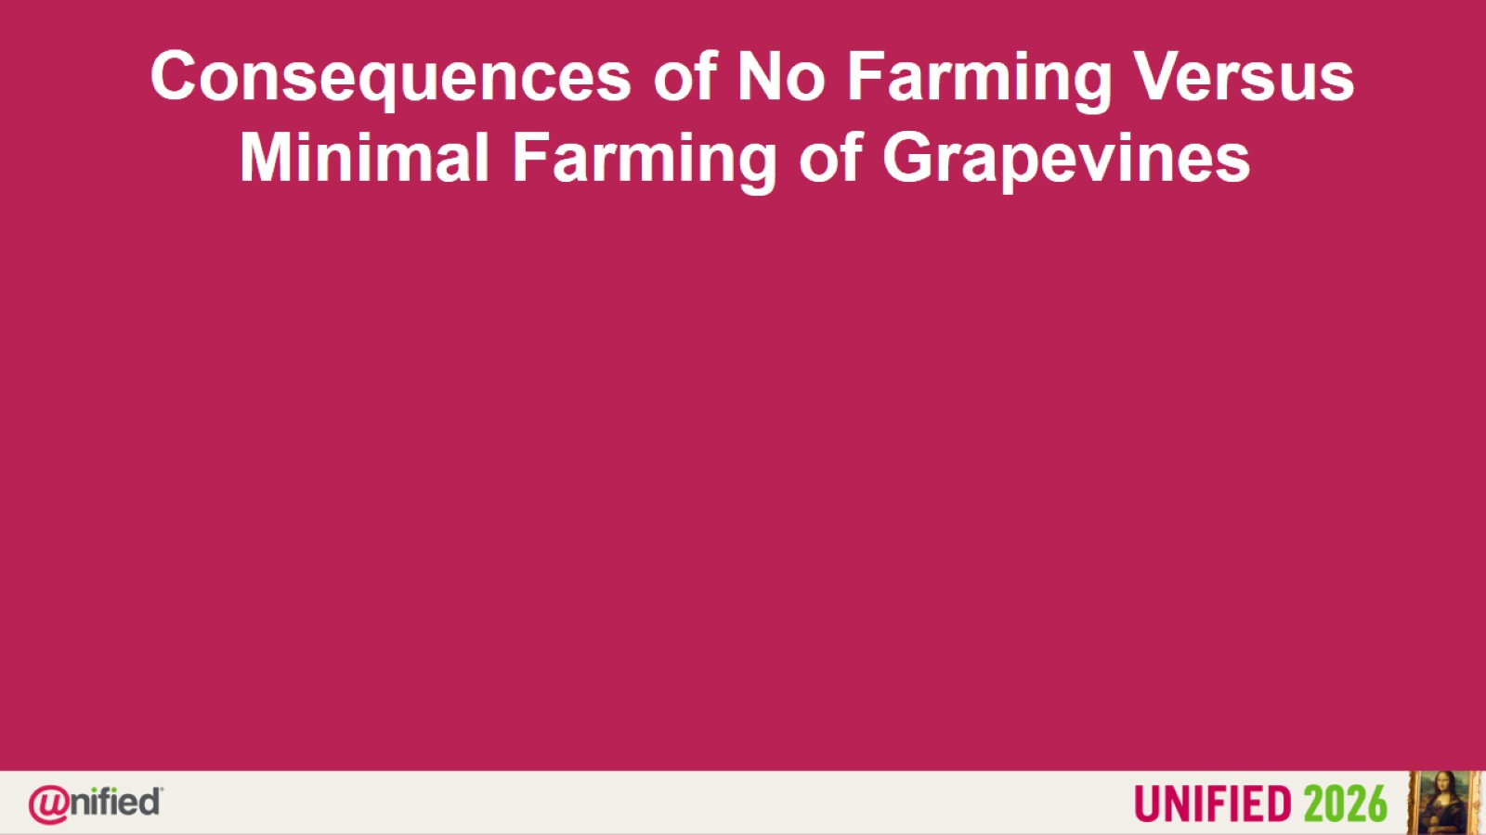

Slide 3
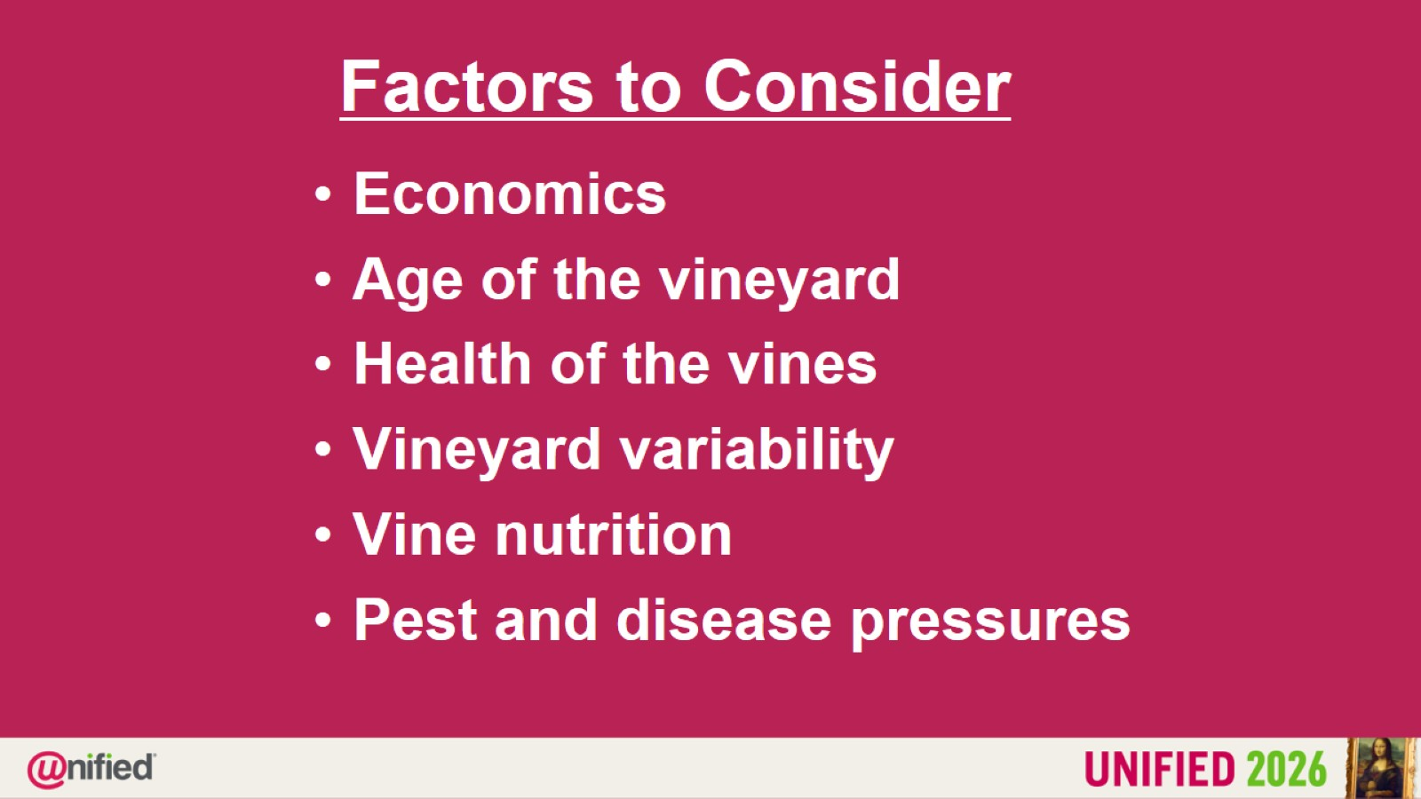
Factors to Consider

Slide 4
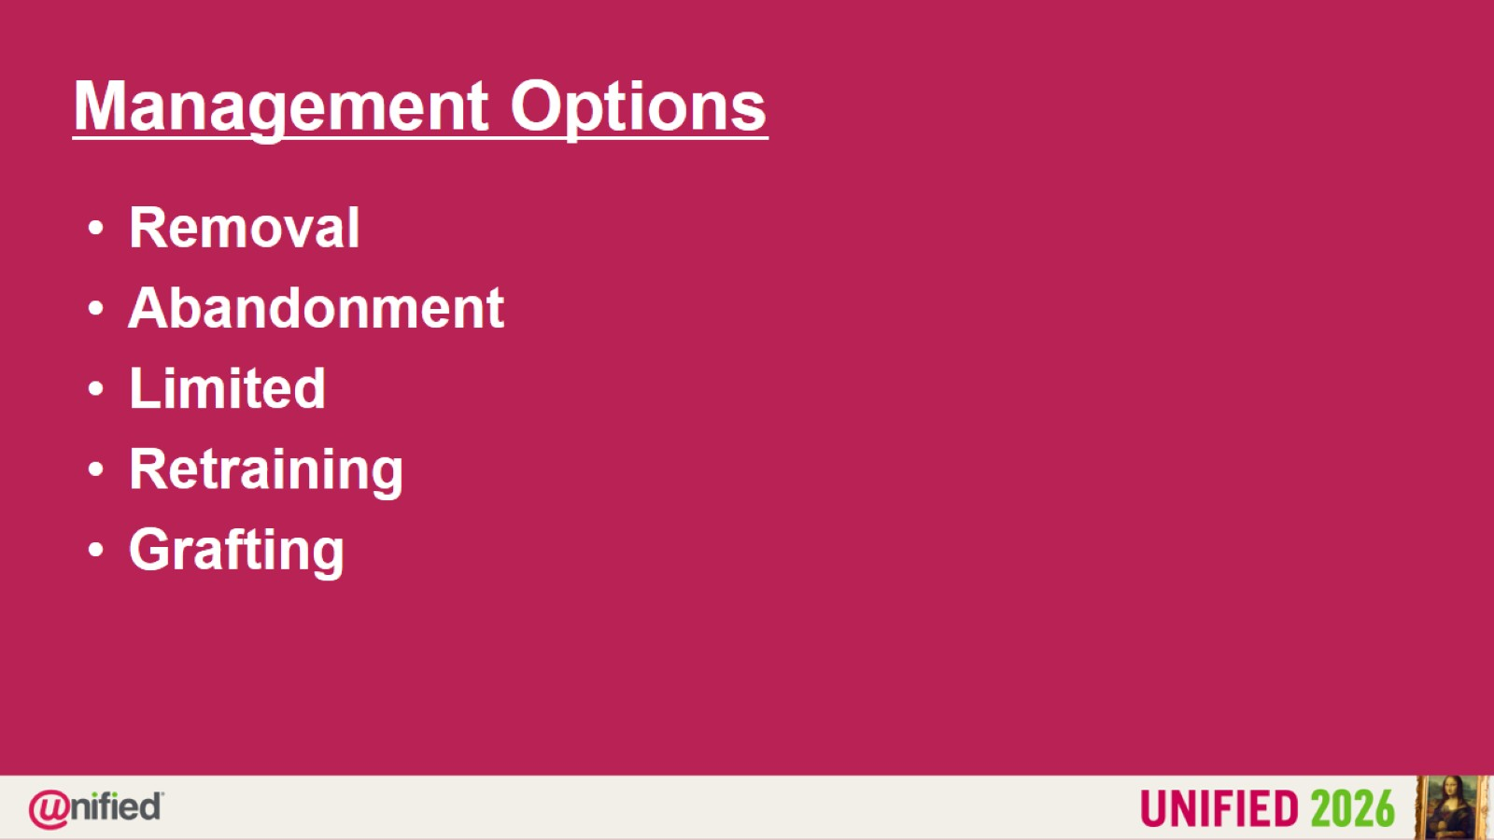
Management Options

Slide 5
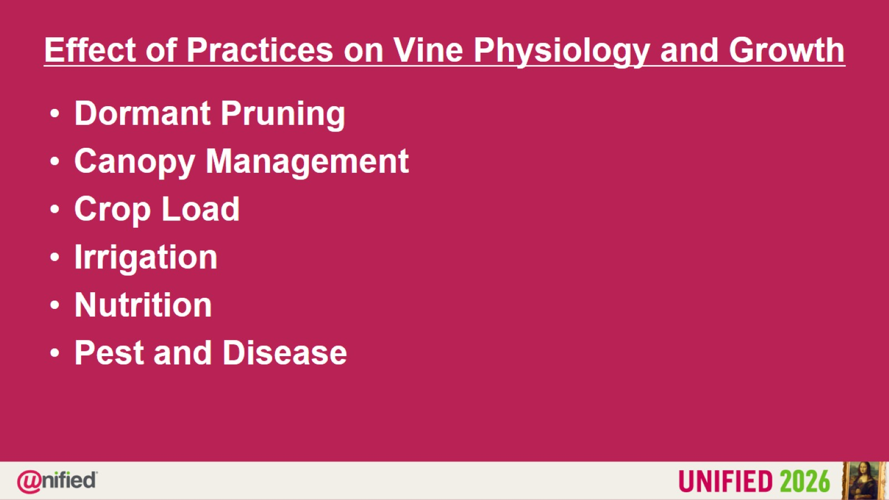
Effect of Practices on Vine Physiology and Growth

Slide 6
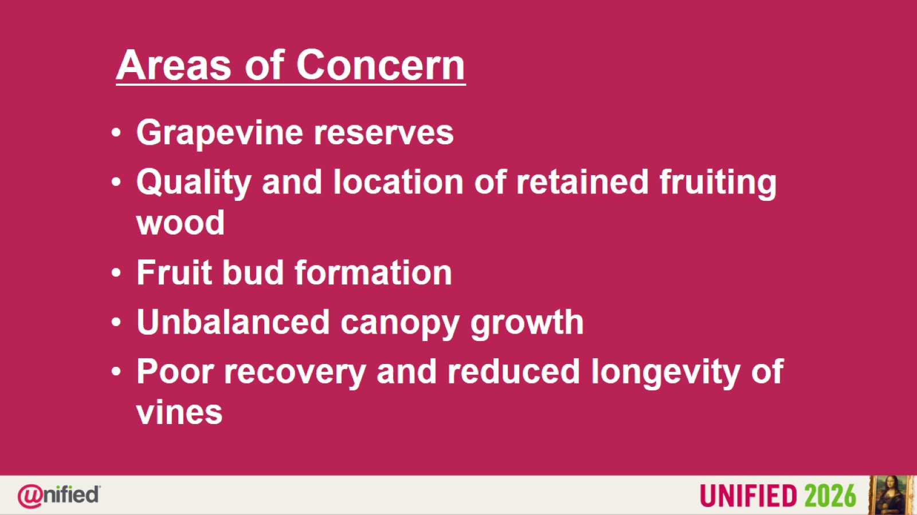
Areas of Concern

Slide 7


Slide 8


Slide 9
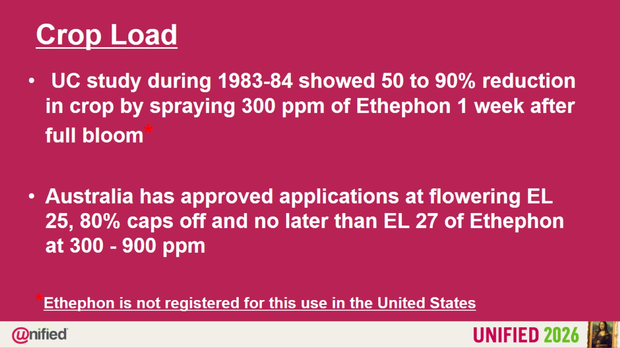
Crop Load

Slide 10
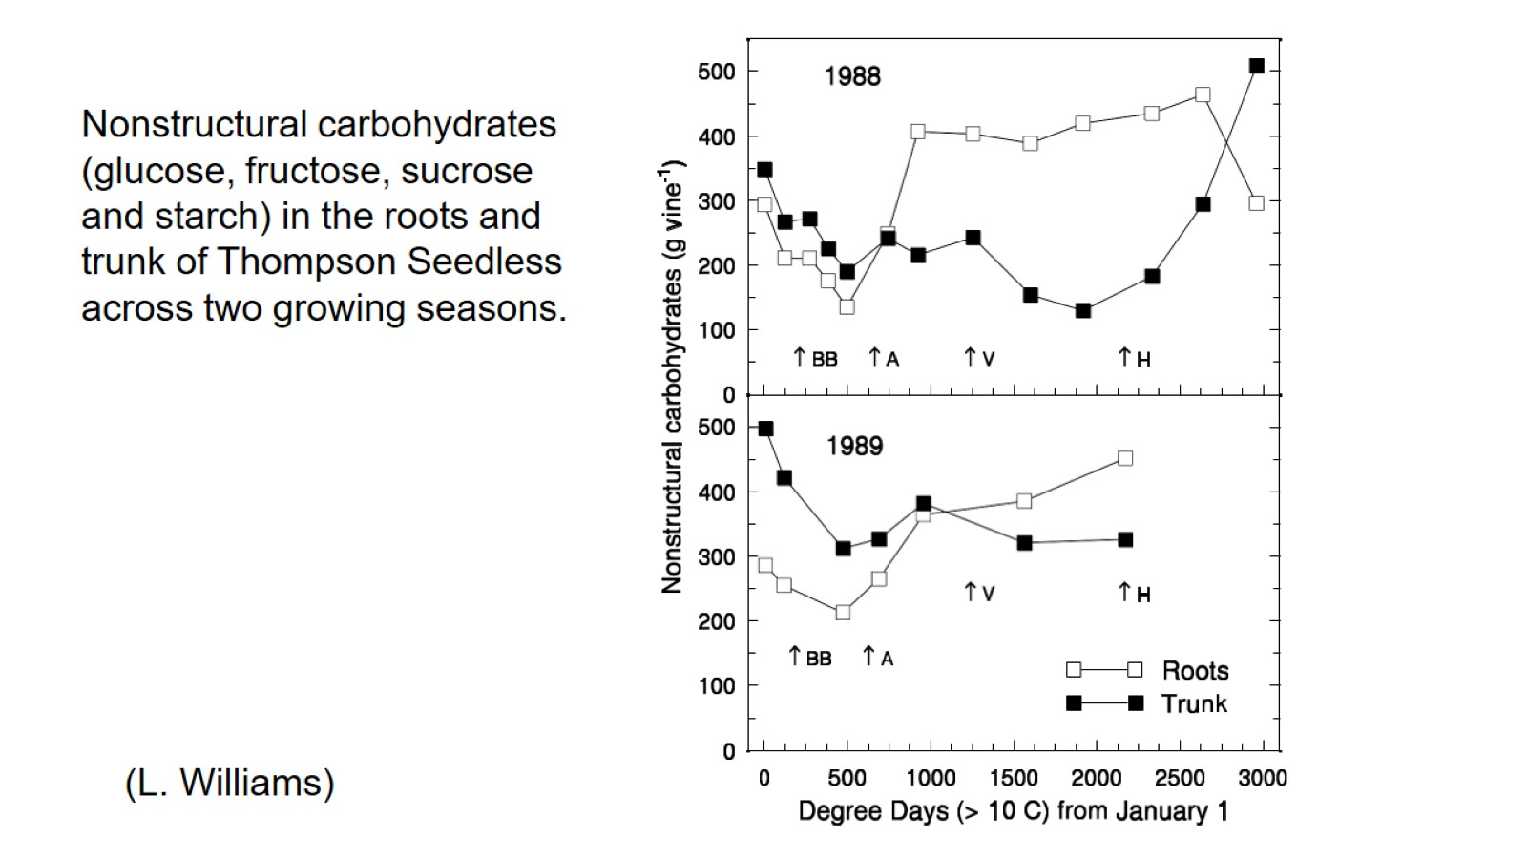
Nonstructural carbohydrates (glucose, fructose, sucrose and starch) in the roots and trunk of Thompson Seedless across two growing seasons.

Slide 11
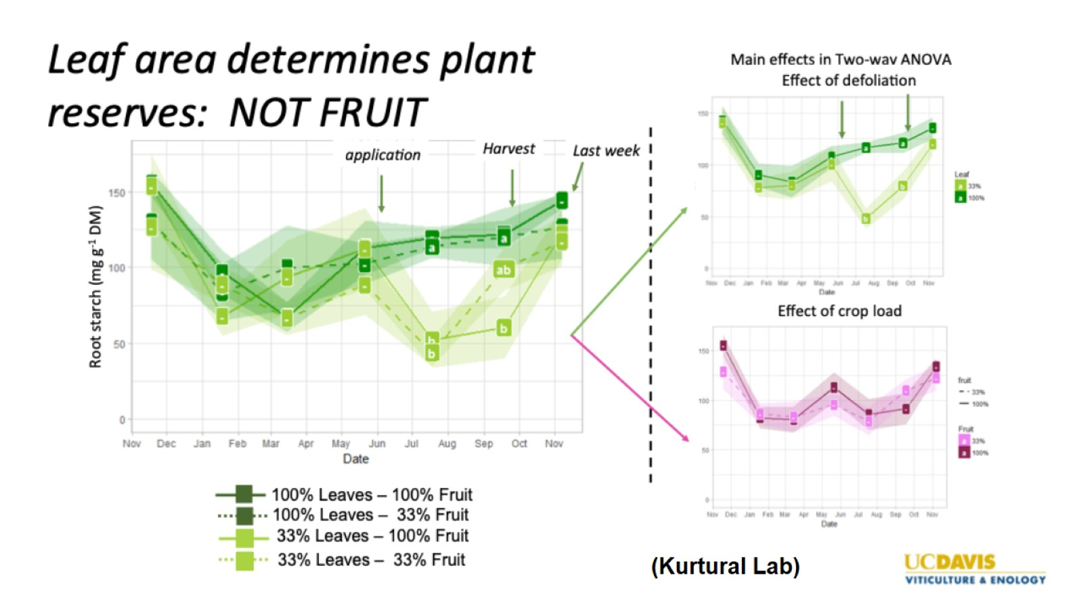

Slide 12


Slide 13
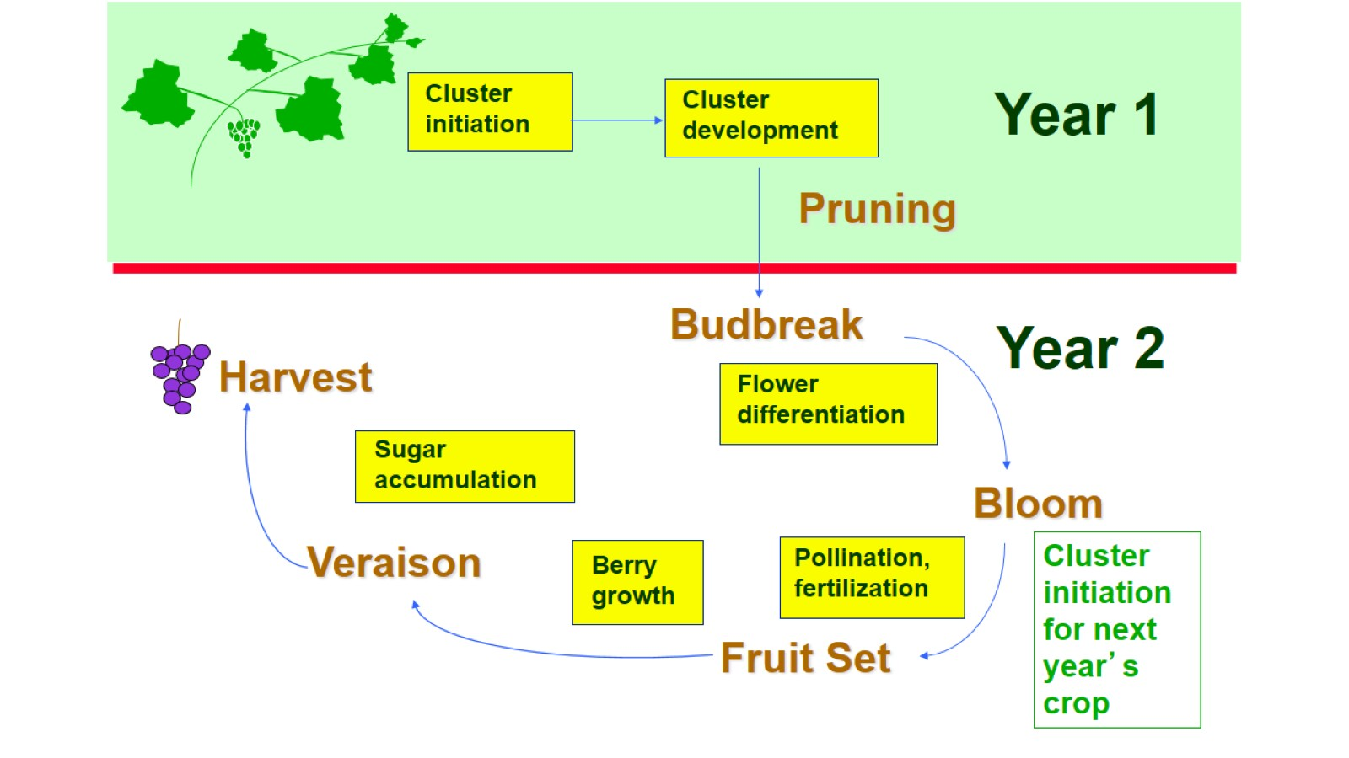

Slide 14

Questions

