Slide 1
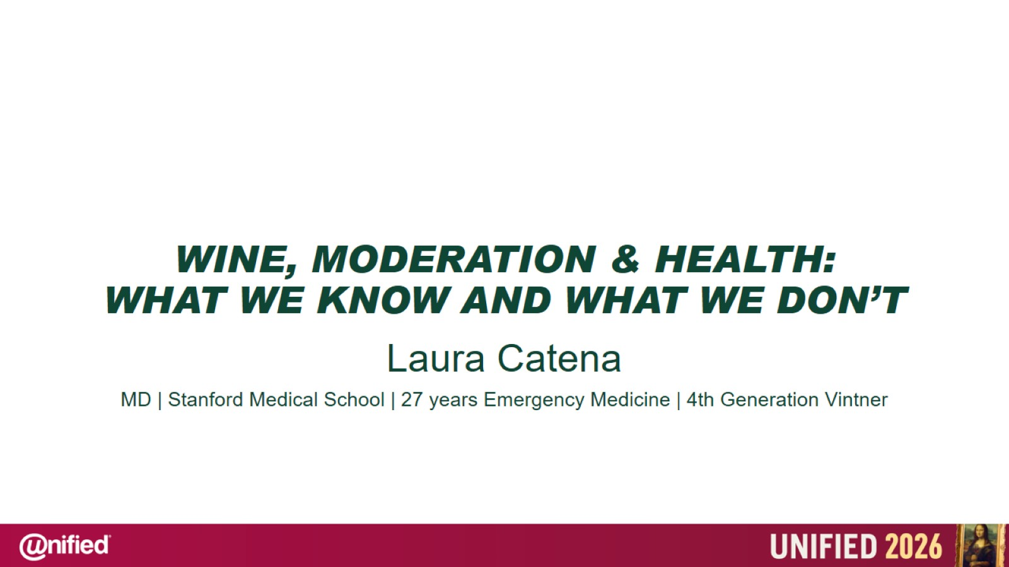
WINE, MODERATION & HEALTH:
WHAT WE KNOW AND WHAT WE DON’T

Slide 2
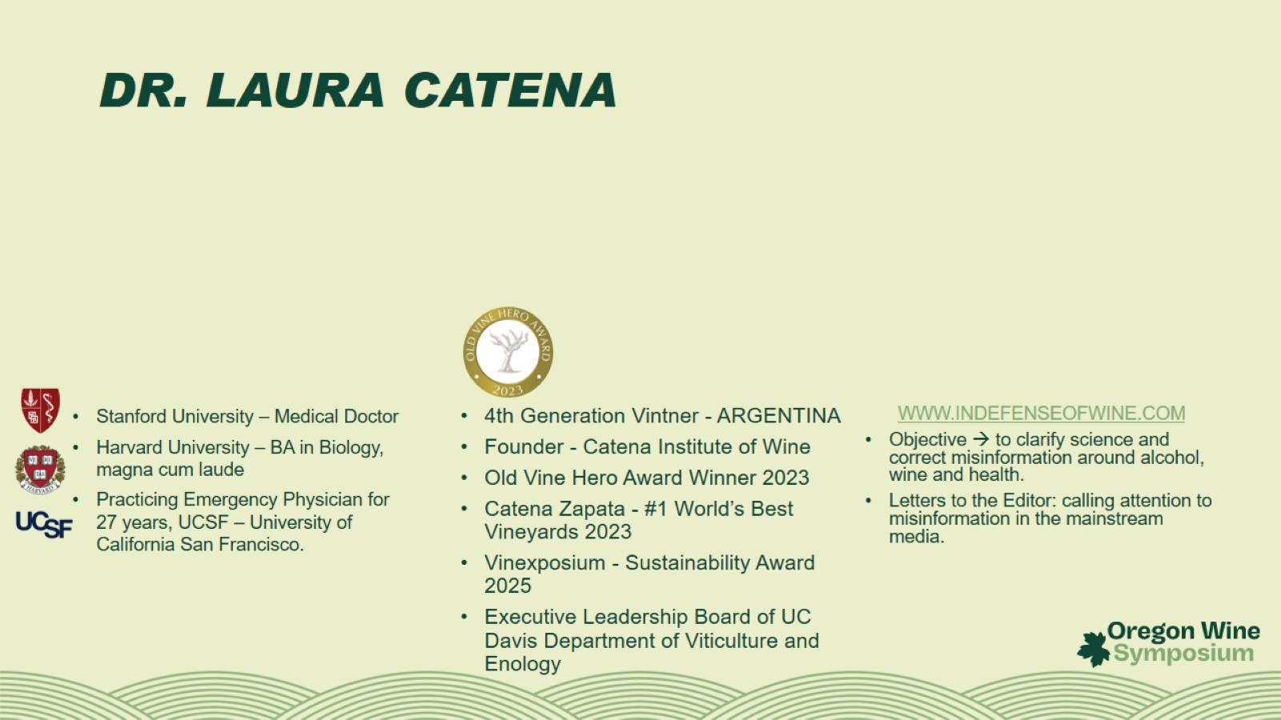
DR. LAURA CATENA

Slide 3
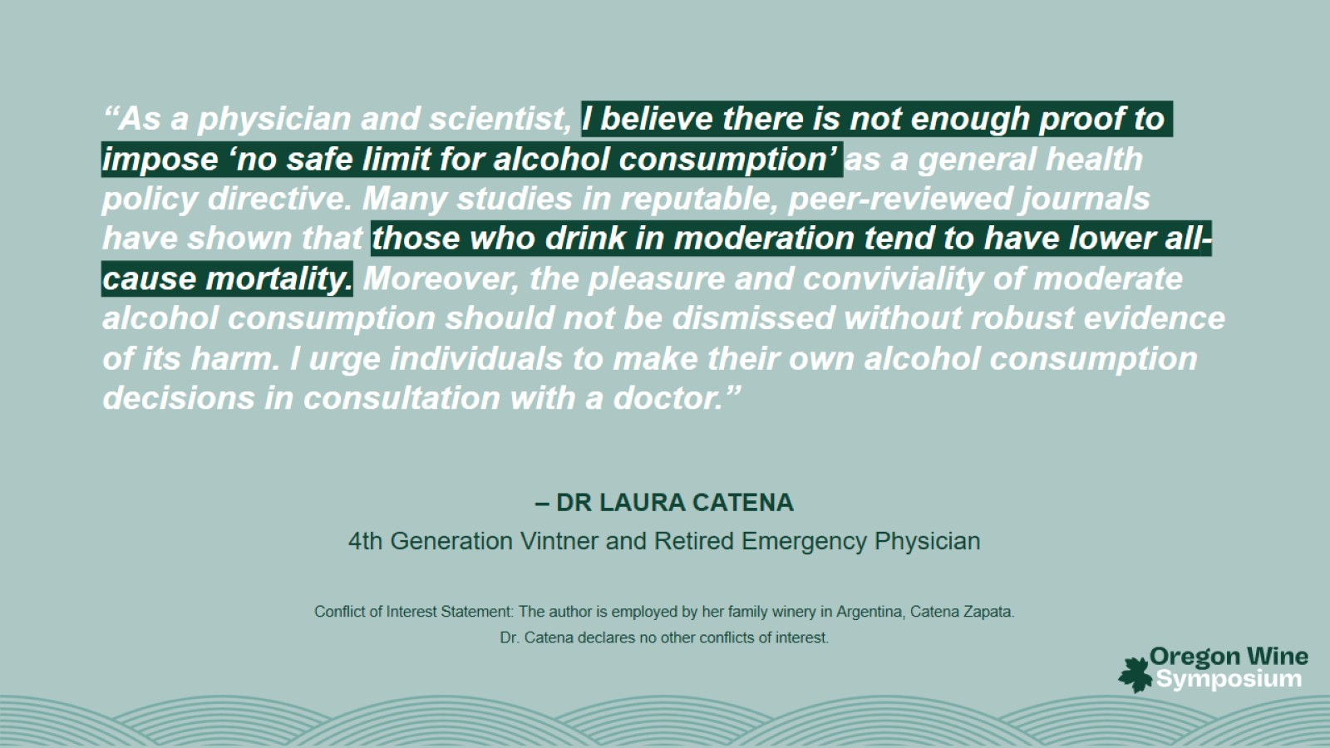

Slide 4
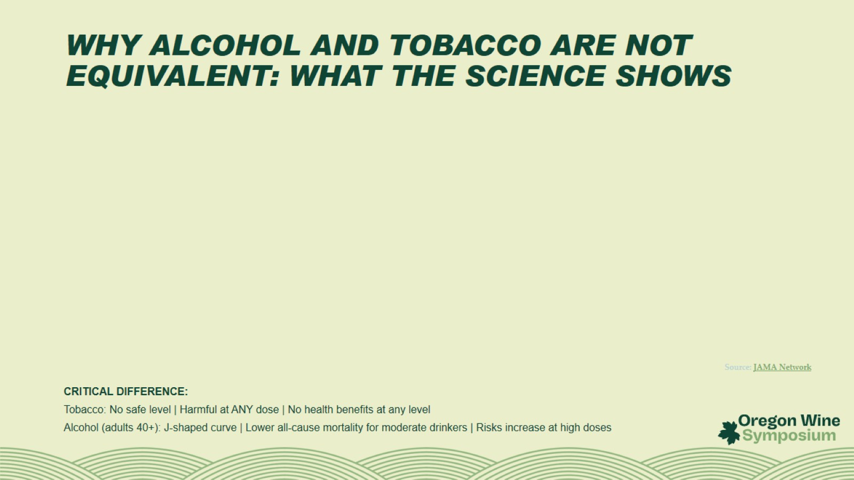
WHY ALCOHOL AND TOBACCO ARE NOT EQUIVALENT: WHAT THE SCIENCE SHOWS

Slide 5
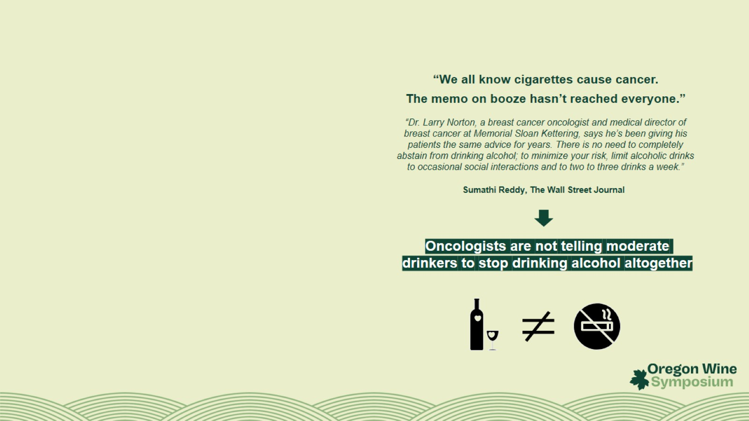

Slide 6
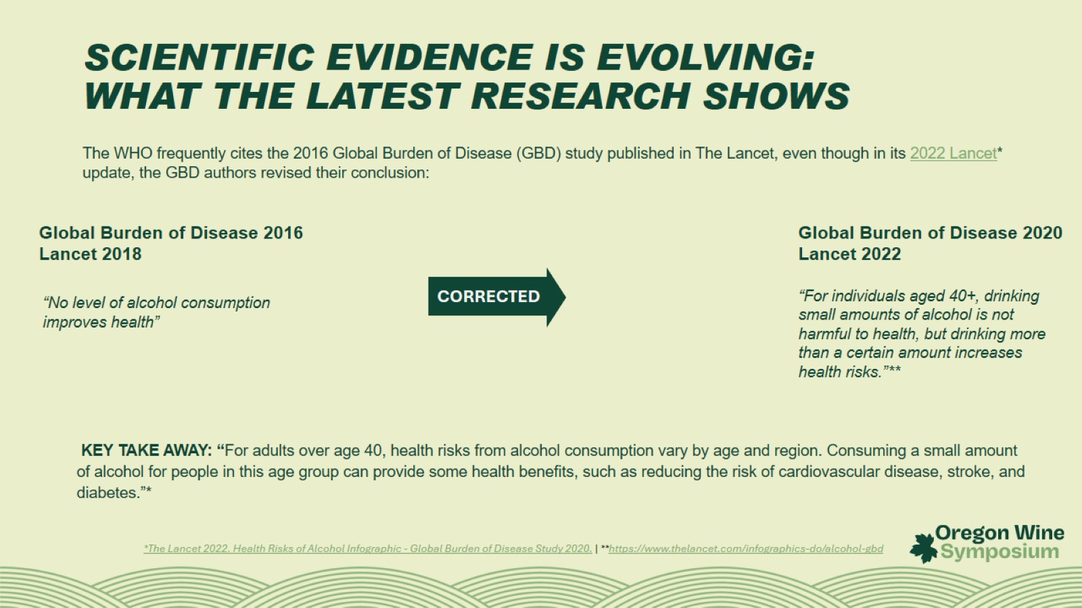
SCIENTIFIC EVIDENCE IS EVOLVING:
WHAT THE LATEST RESEARCH SHOWS

Slide 7
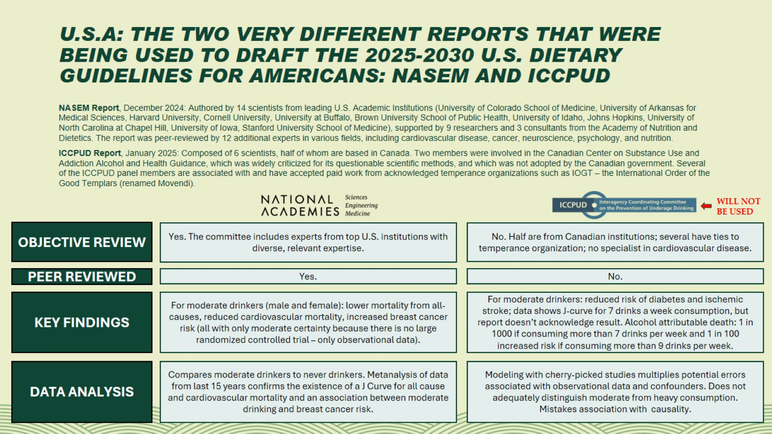
U.S.A: THE TWO VERY DIFFERENT REPORTS THAT WERE BEING USED TO DRAFT THE 2025-2030 U.S. DIETARY GUIDELINES FOR AMERICANS: NASEM AND ICCPUD

Slide 8
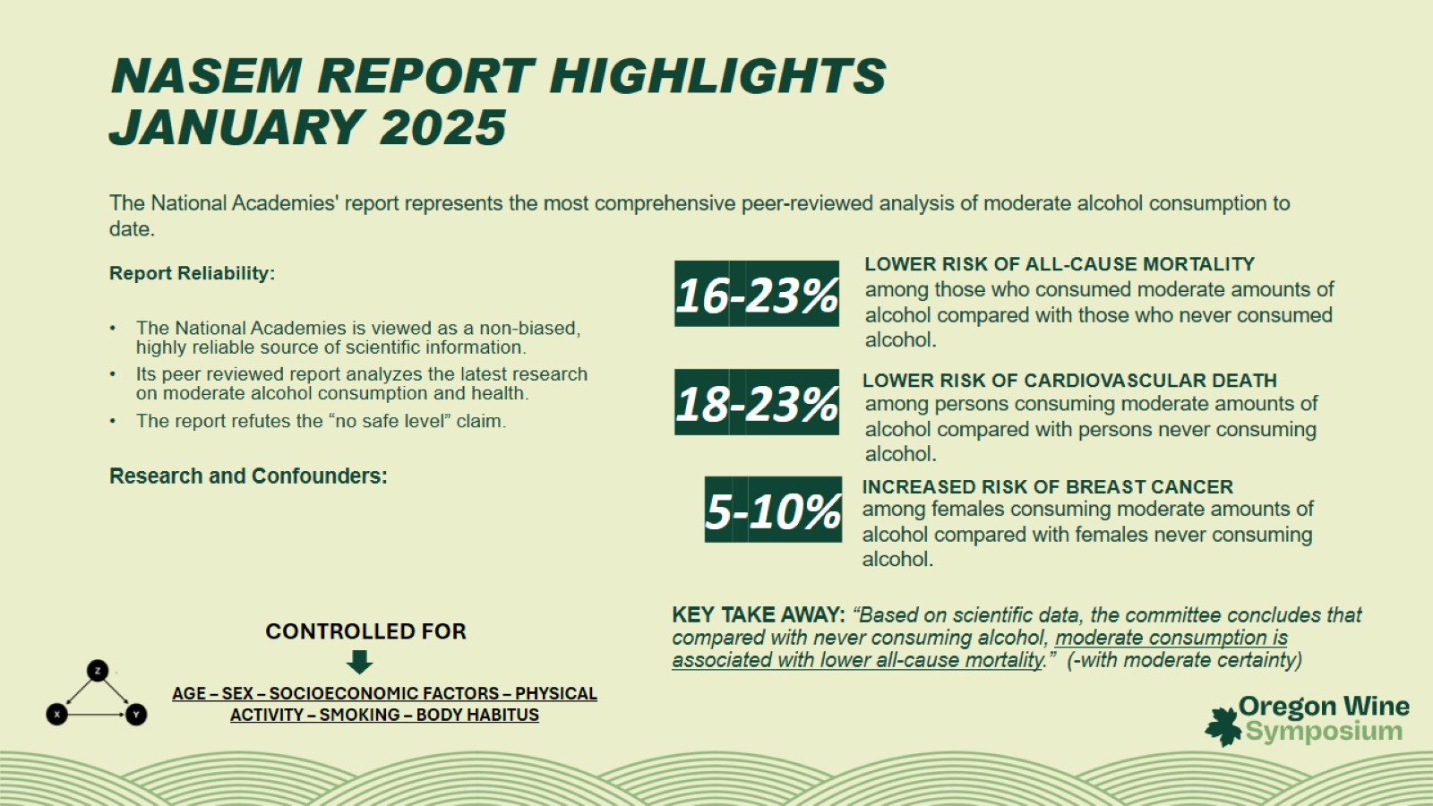
NASEM REPORT HIGHLIGHTS
JANUARY 2025

Slide 9
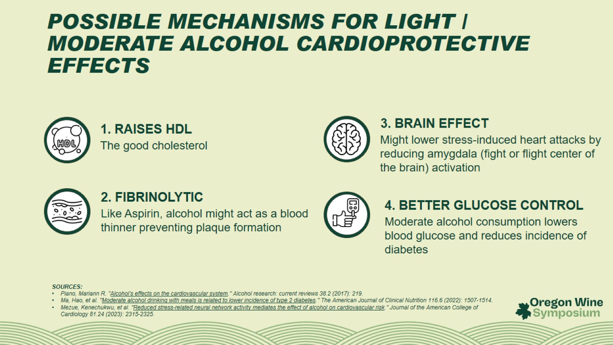
POSSIBLE MECHANISMS FOR LIGHT / MODERATE ALCOHOL CARDIOPROTECTIVE EFFECTS

Slide 10
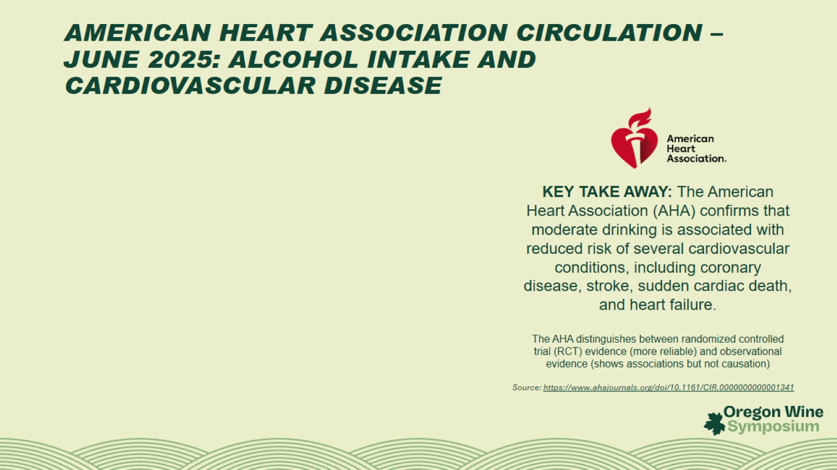
AMERICAN HEART ASSOCIATION CIRCULATION – JUNE 2025: ALCOHOL INTAKE AND CARDIOVASCULAR DISEASE

Slide 11
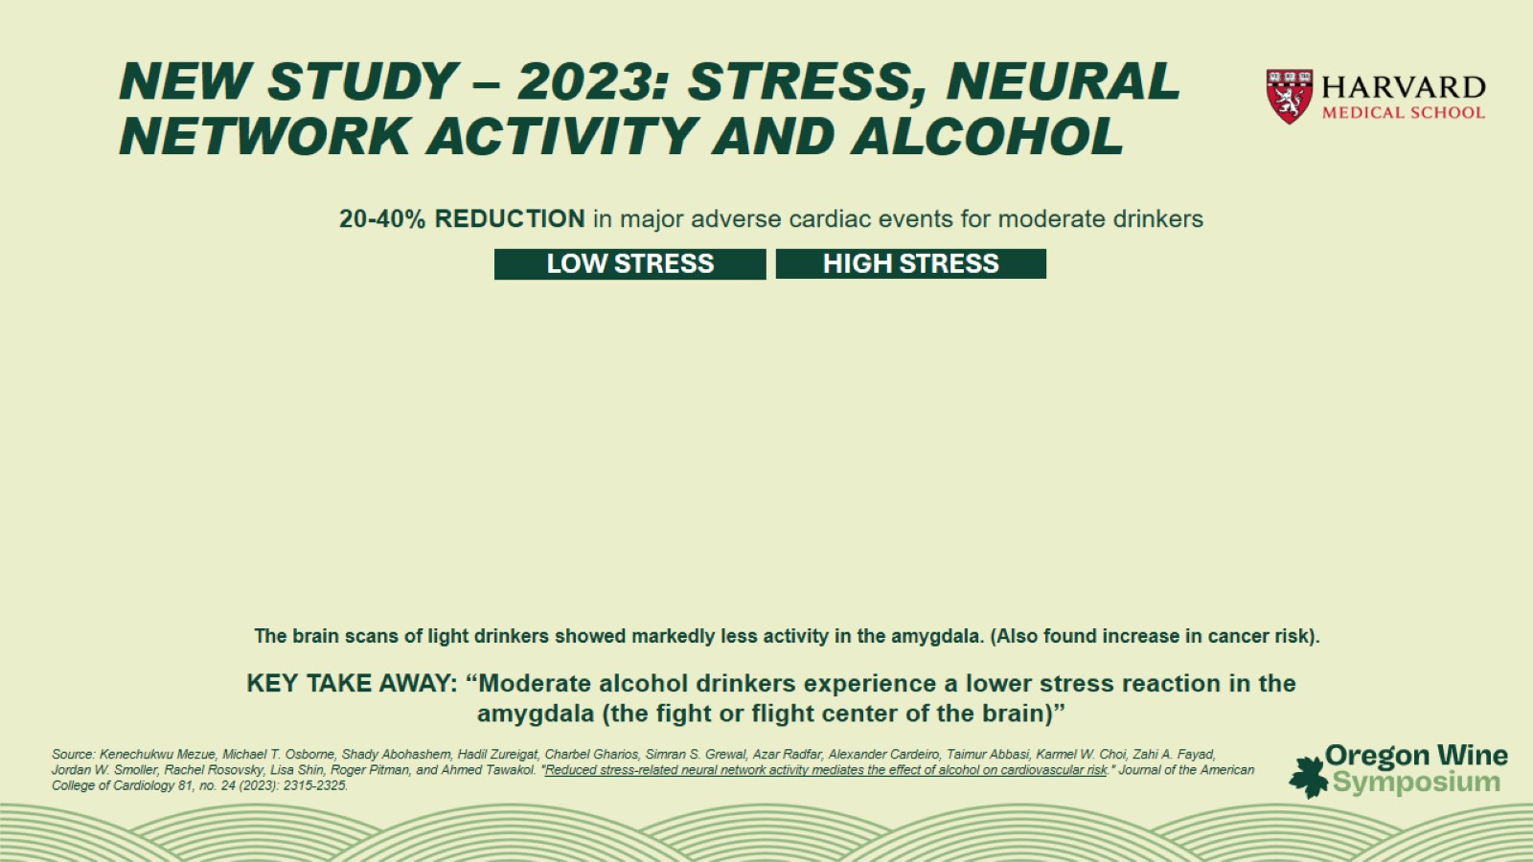
NEW STUDY – 2023: STRESS, NEURAL NETWORK ACTIVITY AND ALCOHOL

Slide 12
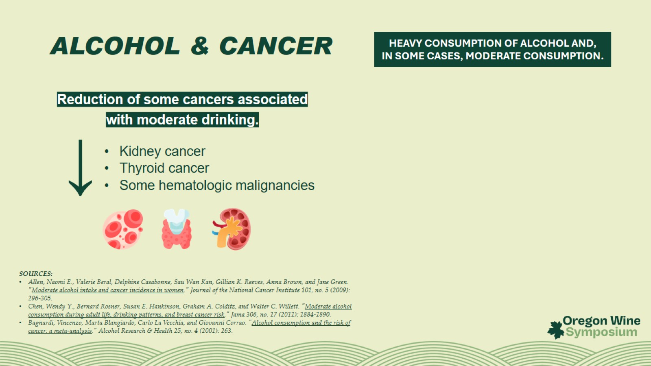
ALCOHOL & CANCER

Slide 13
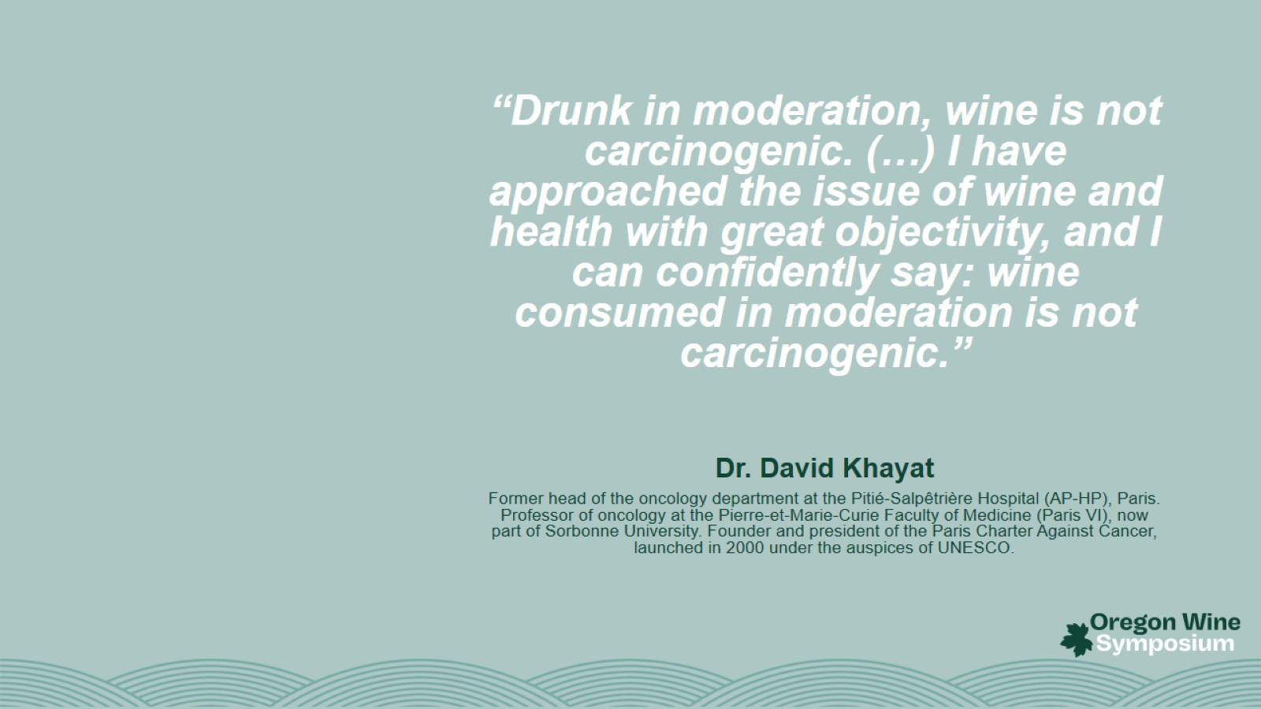

Slide 14


Slide 15
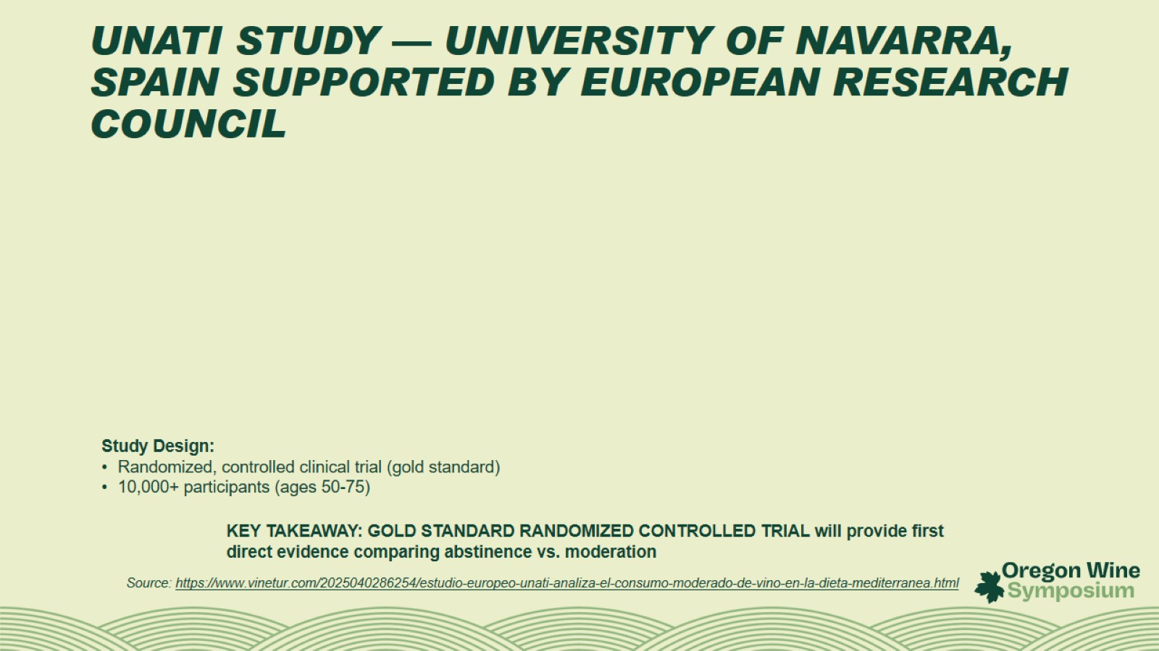
UNATI STUDY — UNIVERSITY OF NAVARRA, SPAIN SUPPORTED BY EUROPEAN RESEARCH COUNCIL

Slide 16
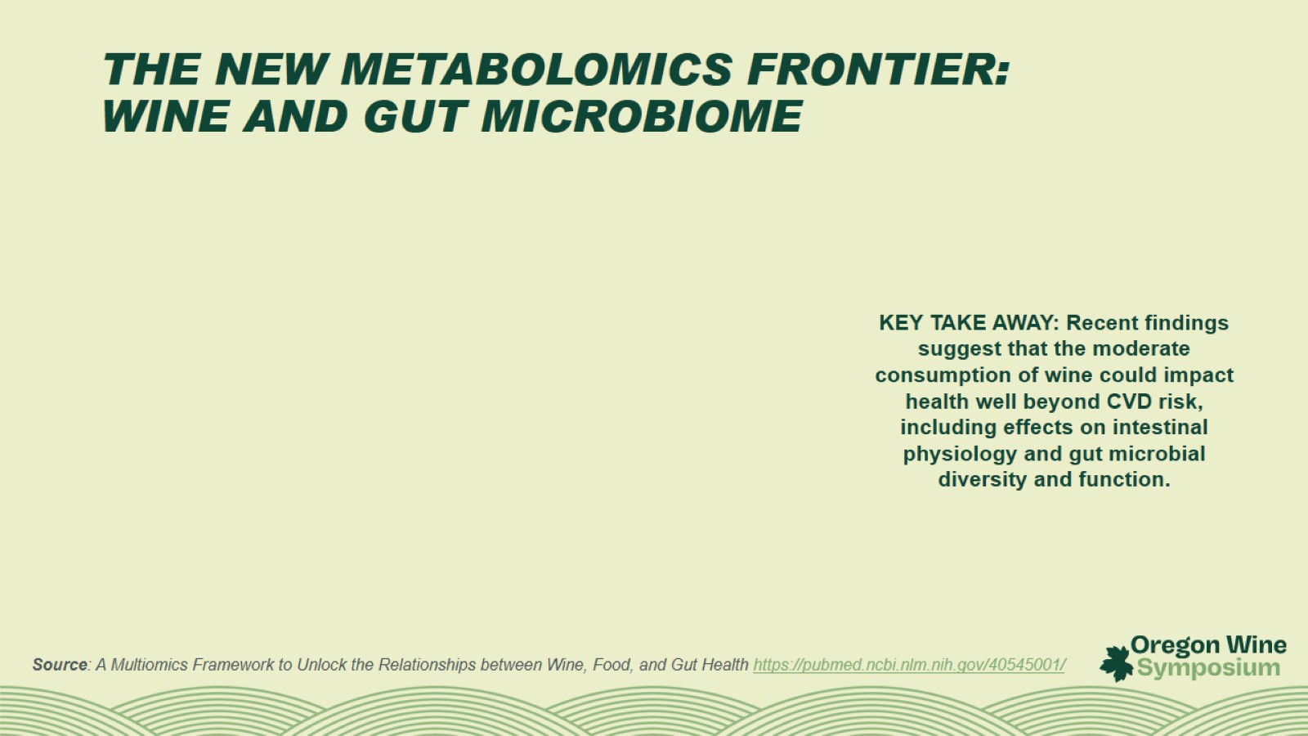
THE NEW METABOLOMICS FRONTIER:
WINE AND GUT MICROBIOME

Slide 17
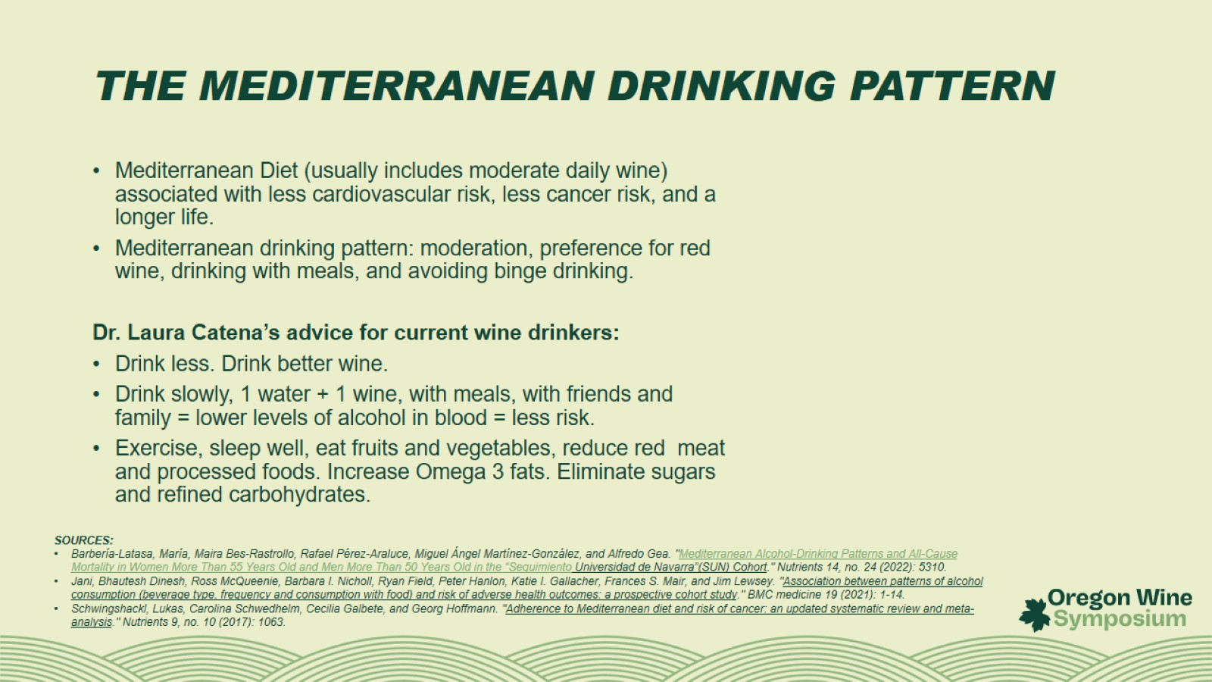
THE MEDITERRANEAN DRINKING PATTERN

Slide 18
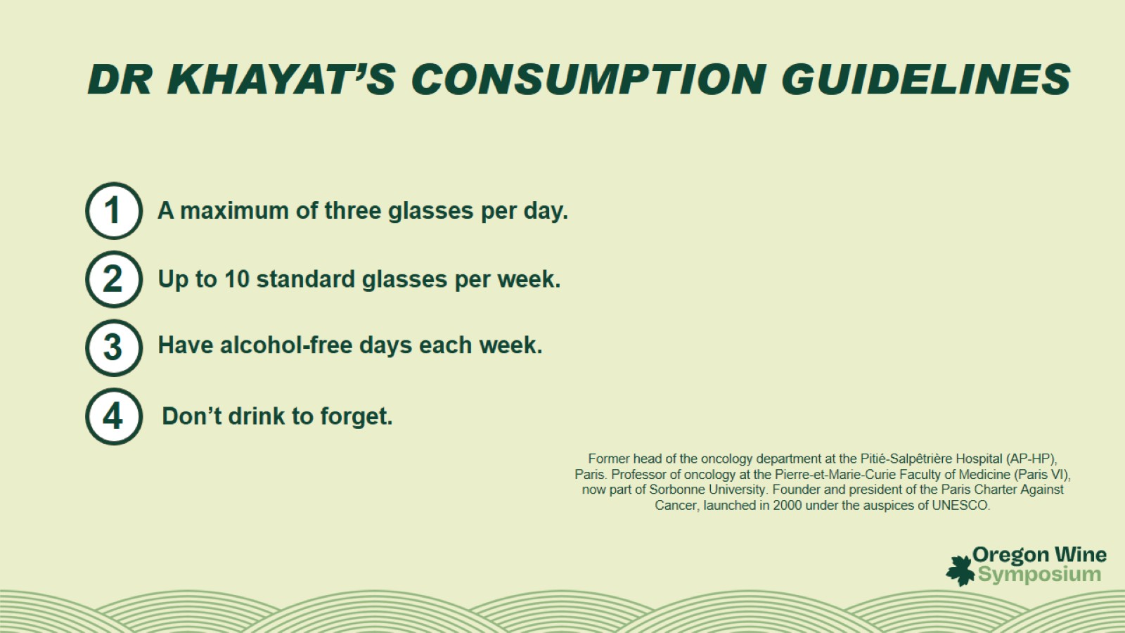
DR KHAYAT’S CONSUMPTION GUIDELINES

Slide 19
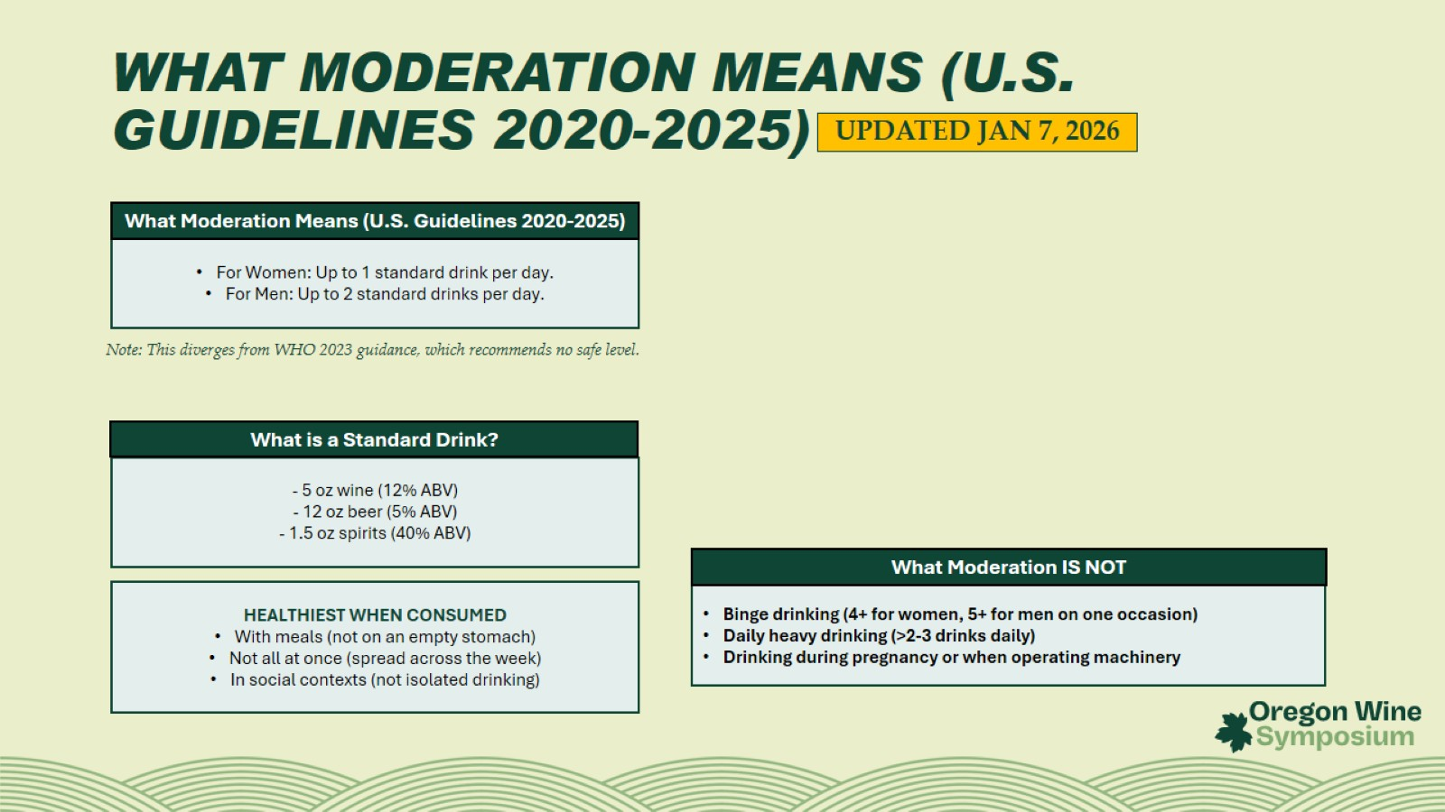

Slide 20
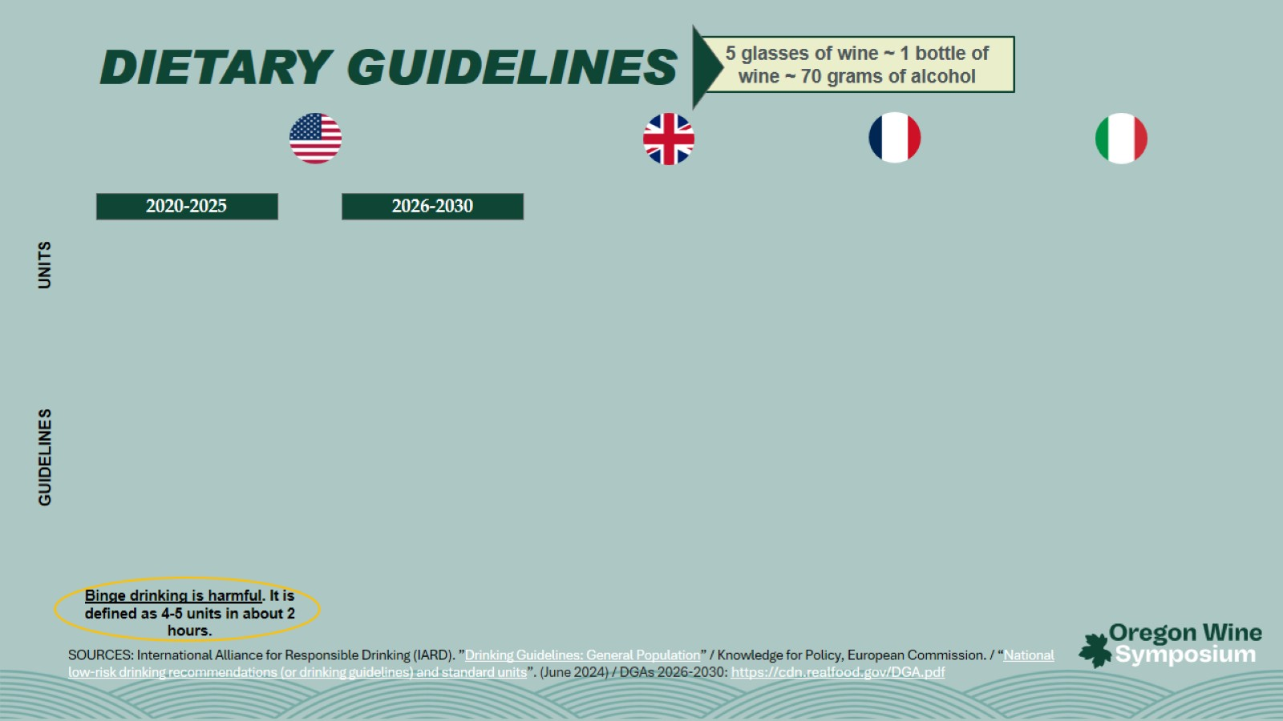
DIETARY GUIDELINES

Slide 21
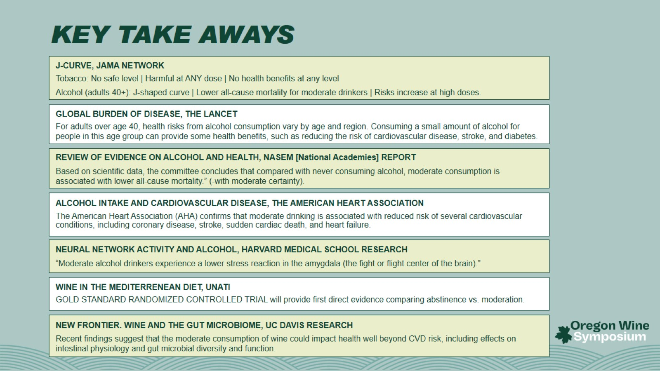
KEY TAKE AWAYS

Slide 22


