Slide 1
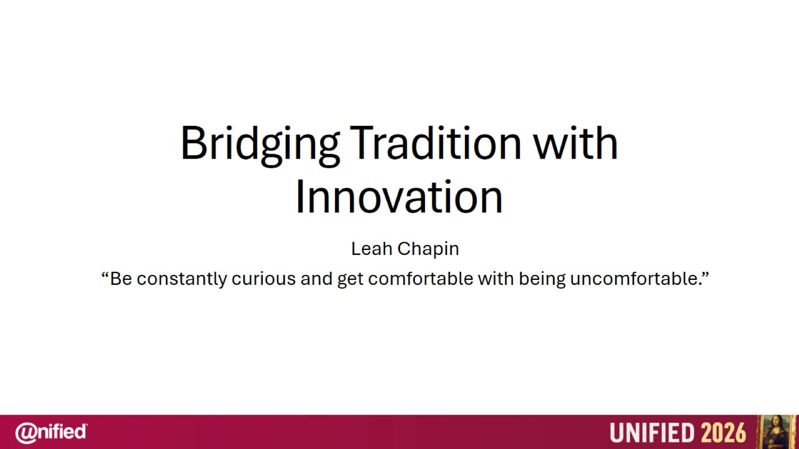
Bridging Tradition with Innovation

Slide 2
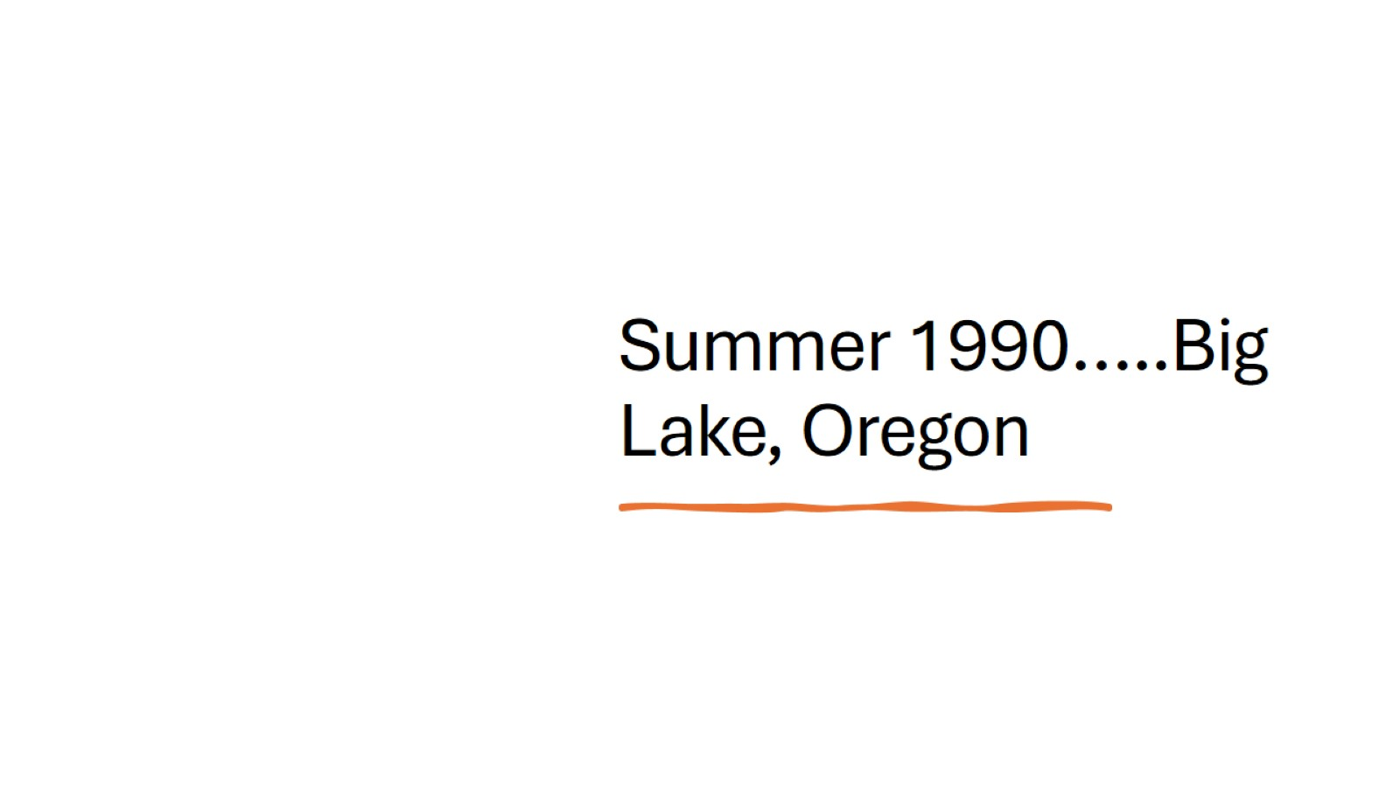
Summer 1990…..Big Lake, Oregon

Slide 3
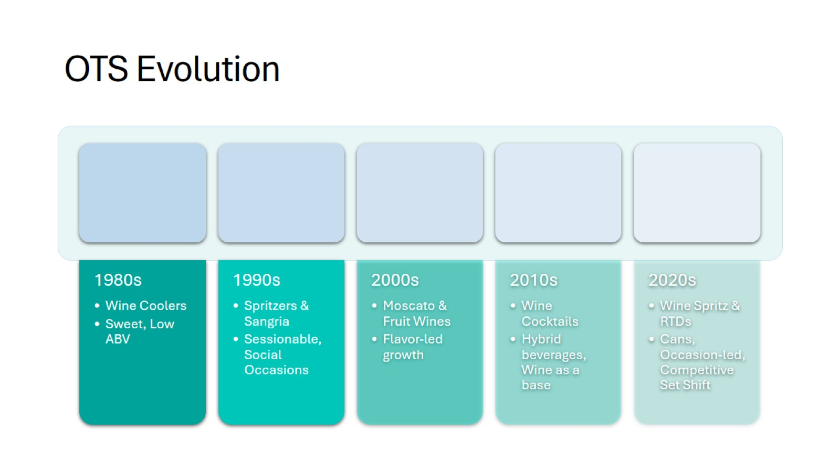
OTS Evolution

Slide 4
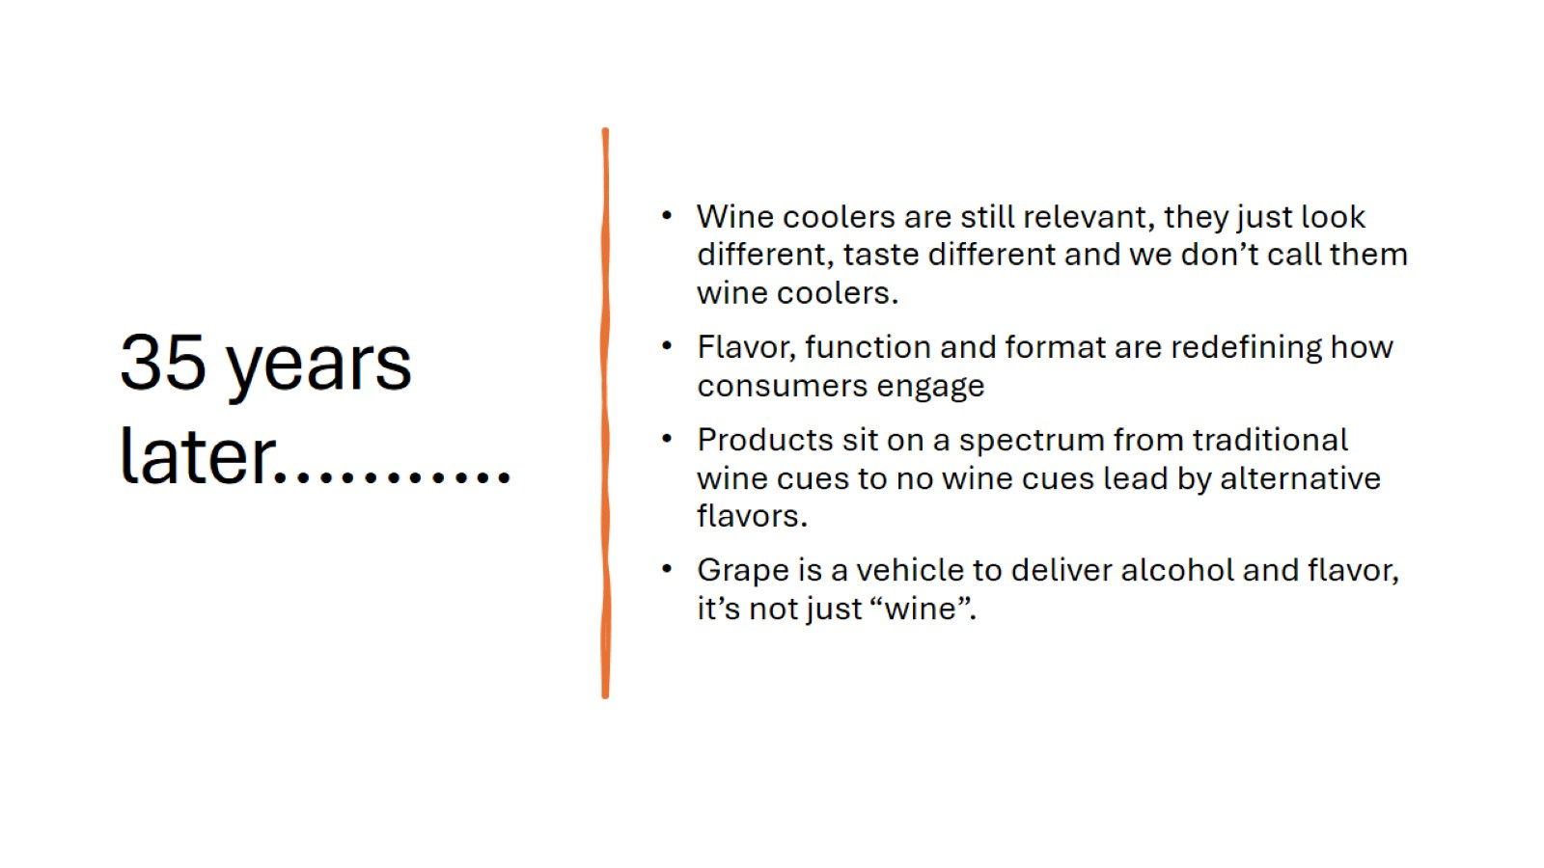
35 years later………..

Slide 5
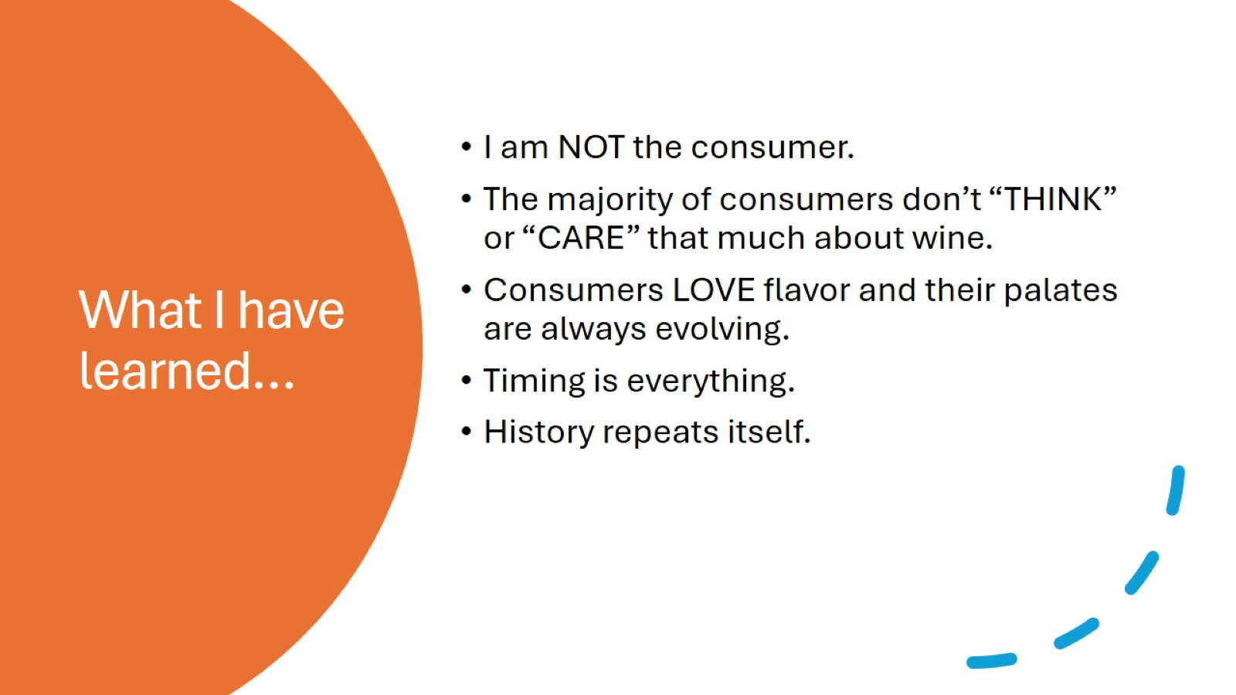
What I have learned…

Slide 6
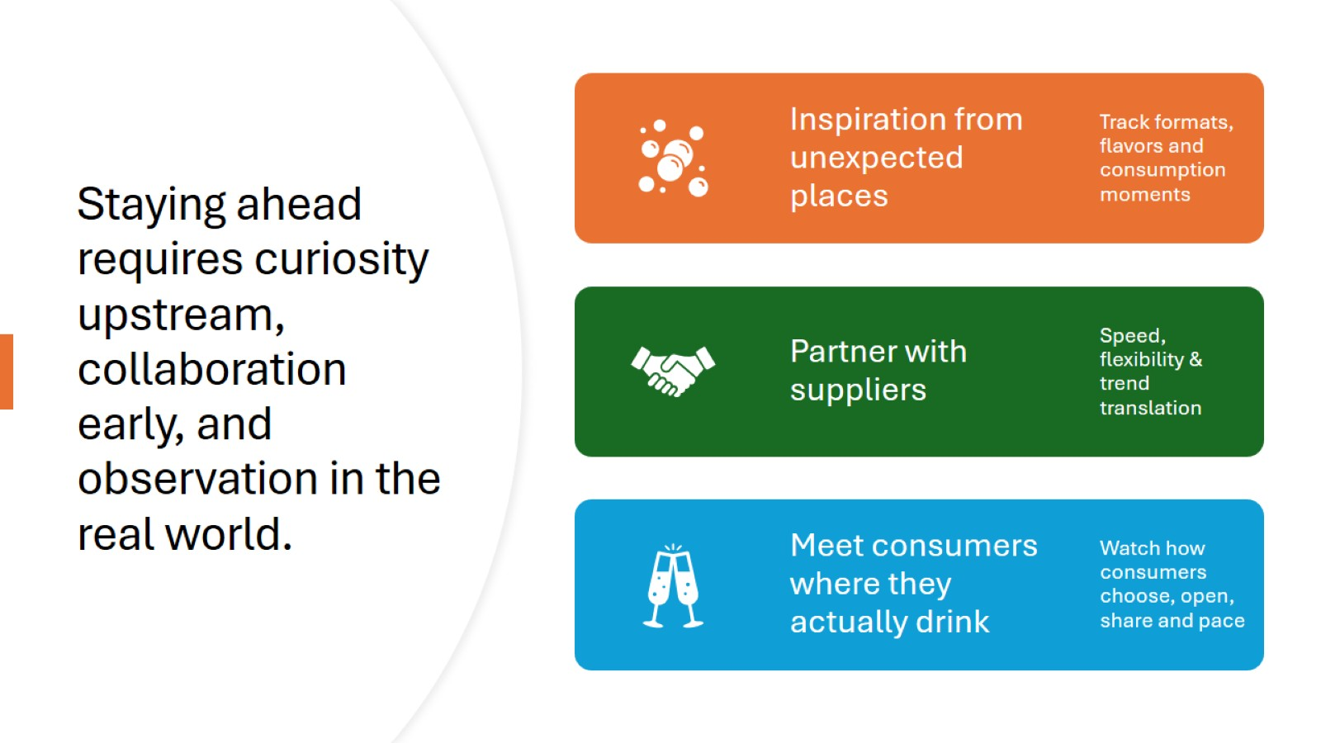
Staying ahead requires curiosity upstream, collaboration early, and observation in the real world.

Slide 7
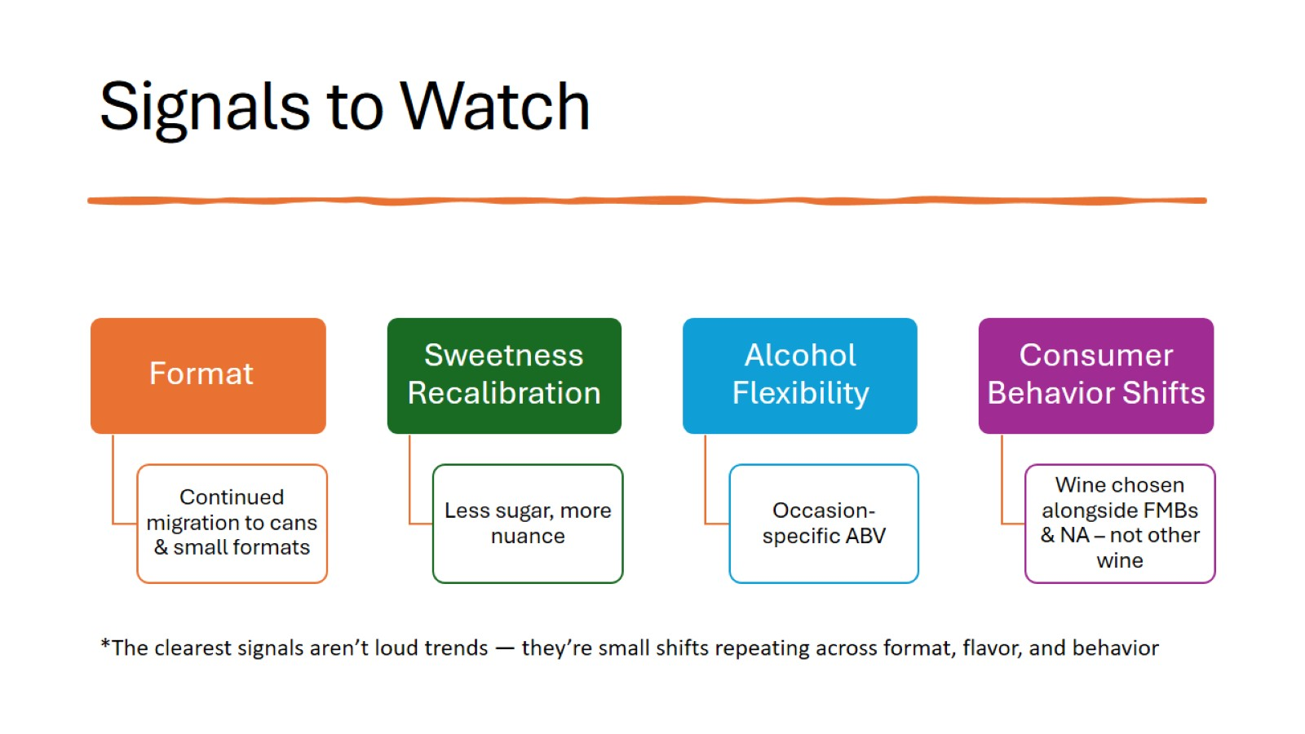
Signals to Watch

Slide 8
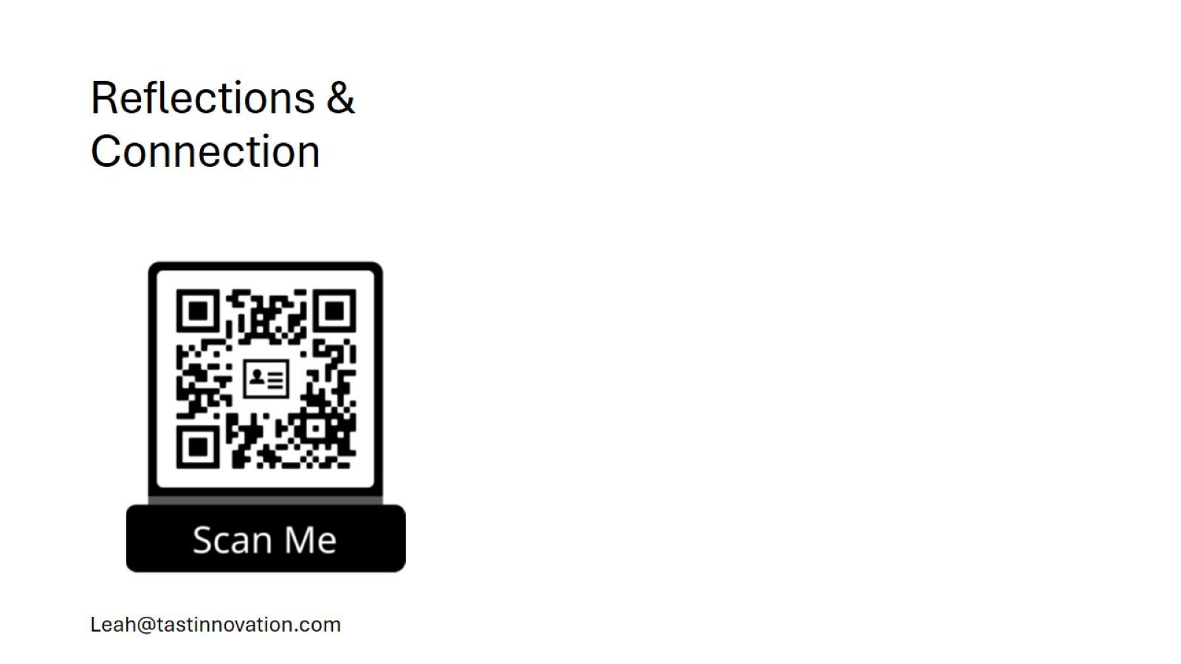
Reflections & Connection

