Slide 1
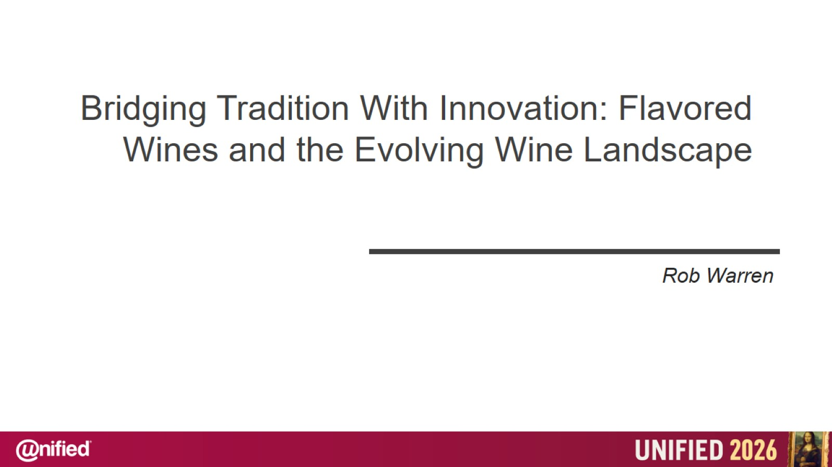

Slide 2
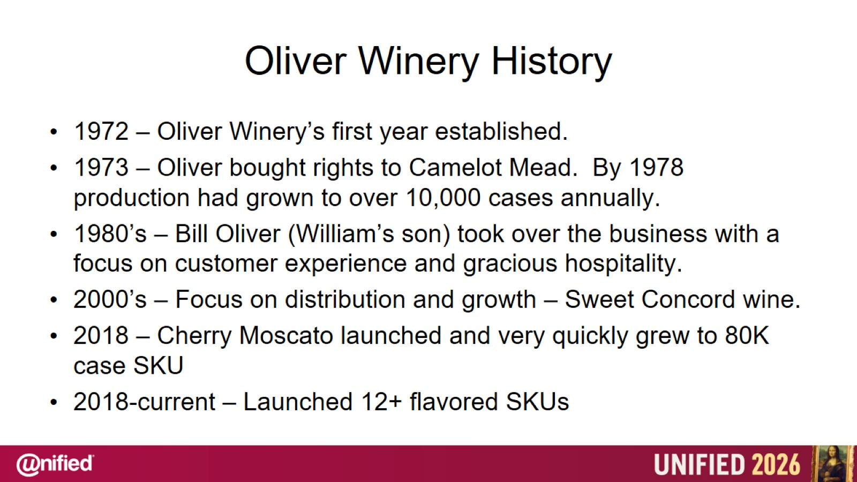
Oliver Winery History

Slide 3
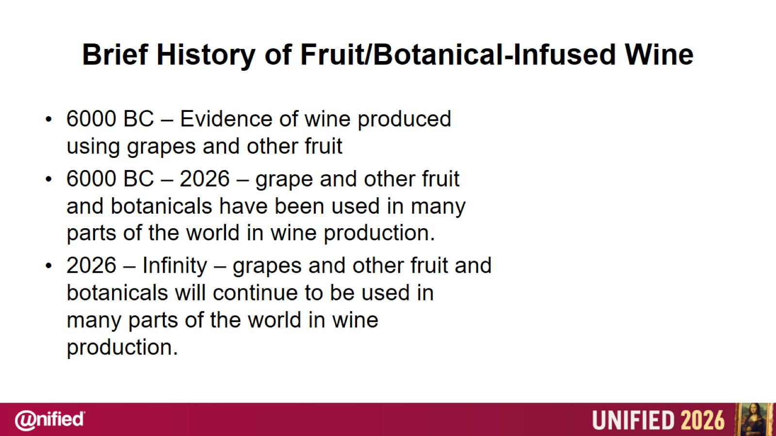
Brief History of Fruit/Botanical-Infused Wine

Slide 4
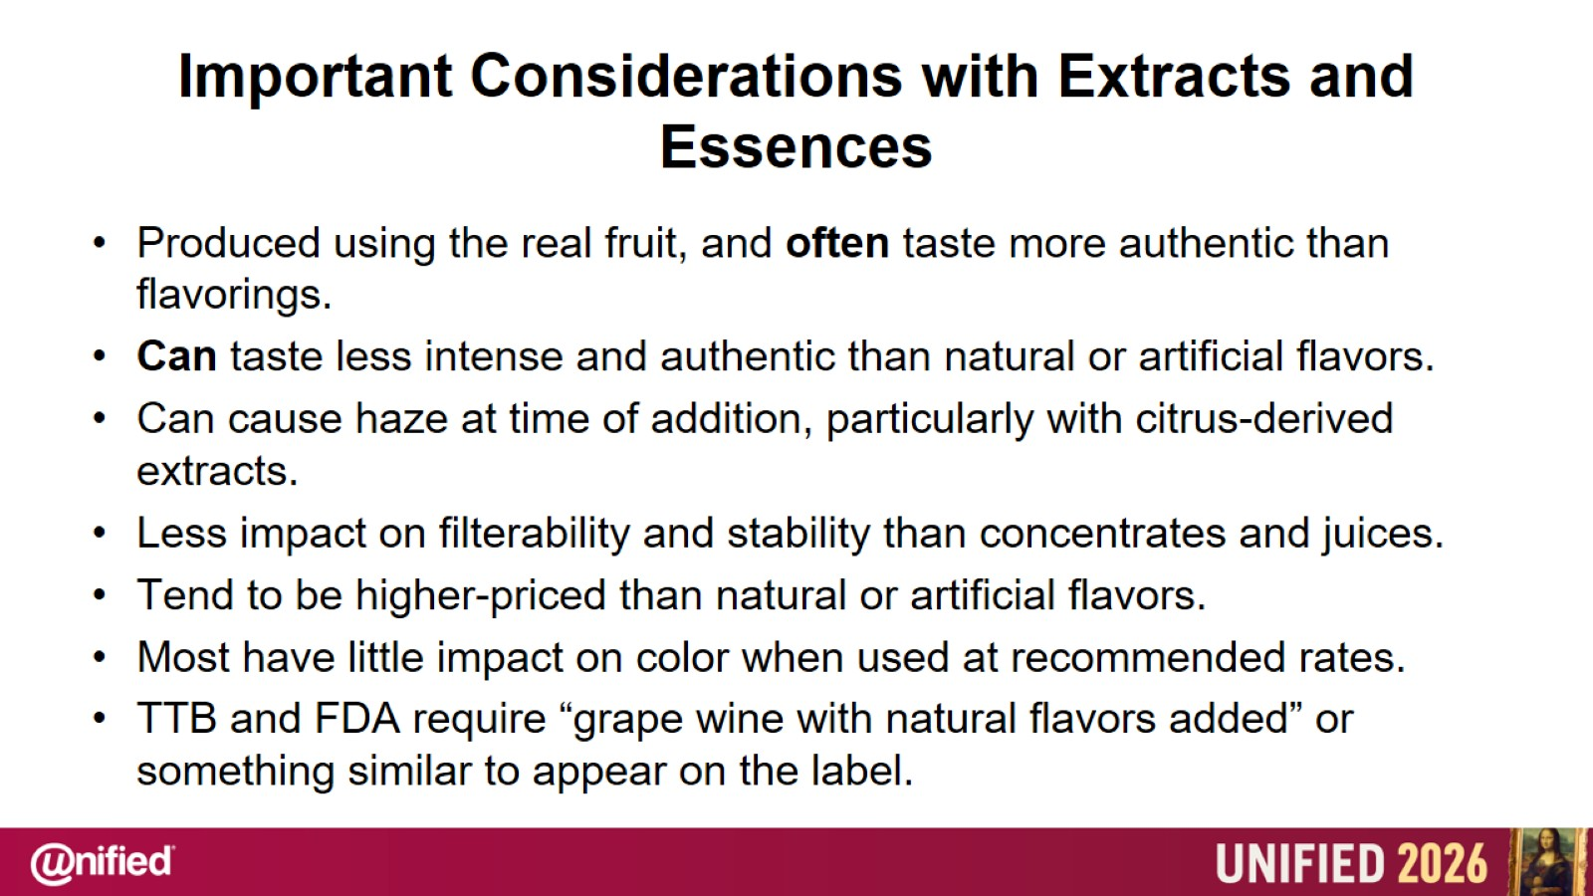
Important Considerations with Extracts and Essences

Slide 5
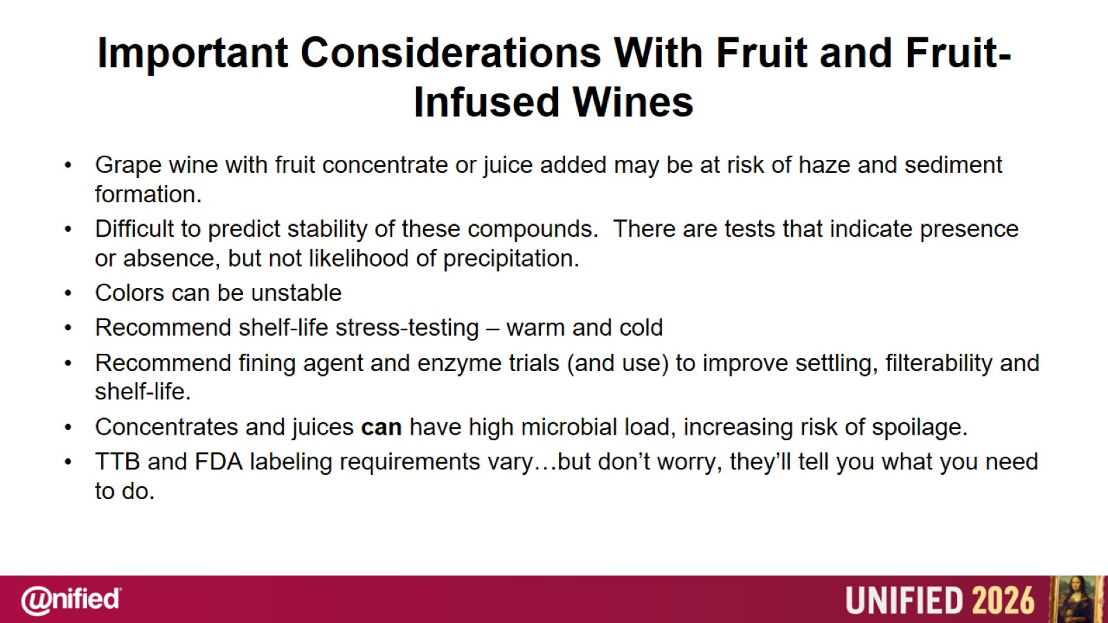
Important Considerations With Fruit and Fruit-Infused Wines

Slide 6
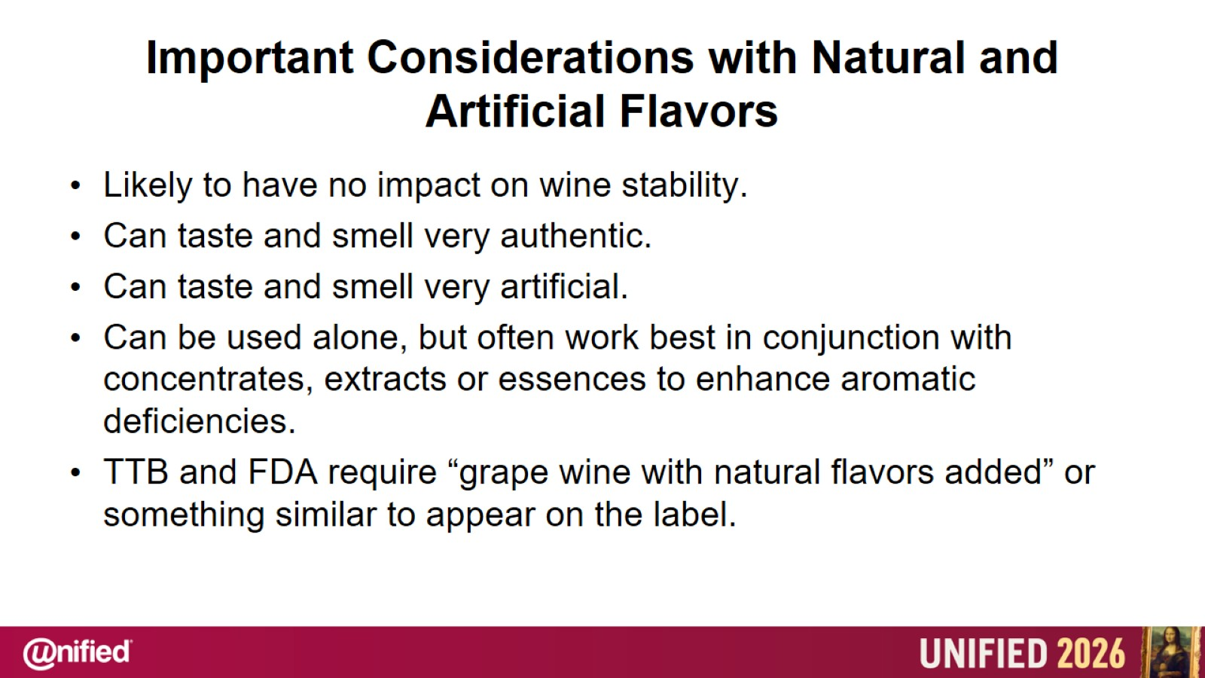
Important Considerations with Natural and Artificial Flavors

Slide 7
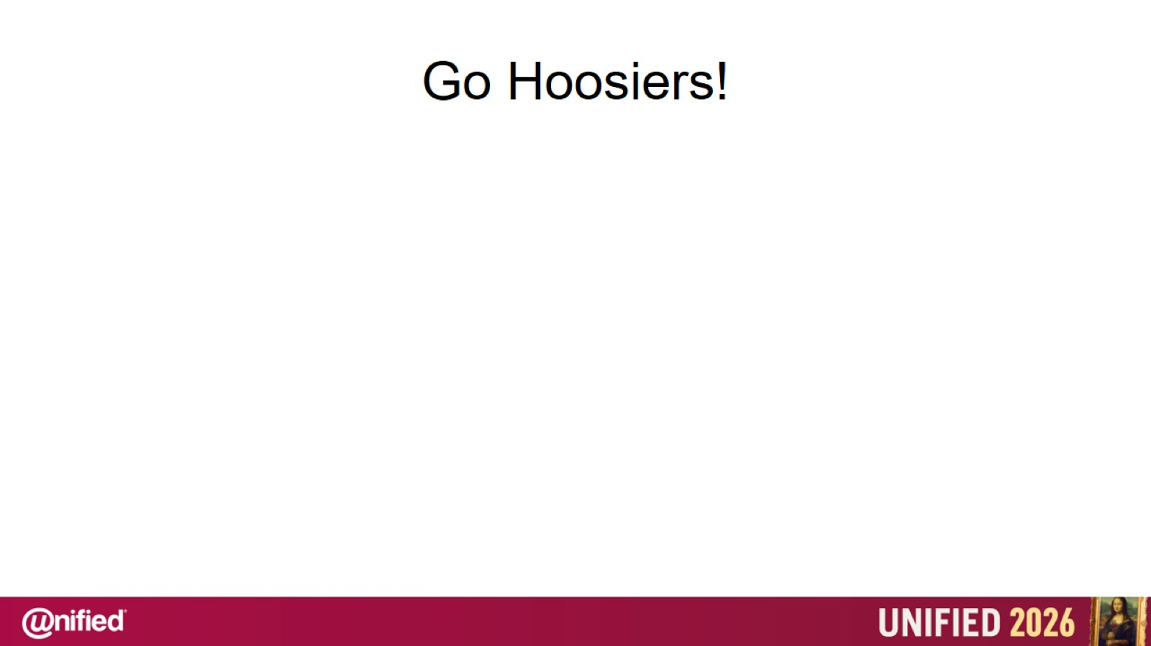
Go Hoosiers!

