Slide 1
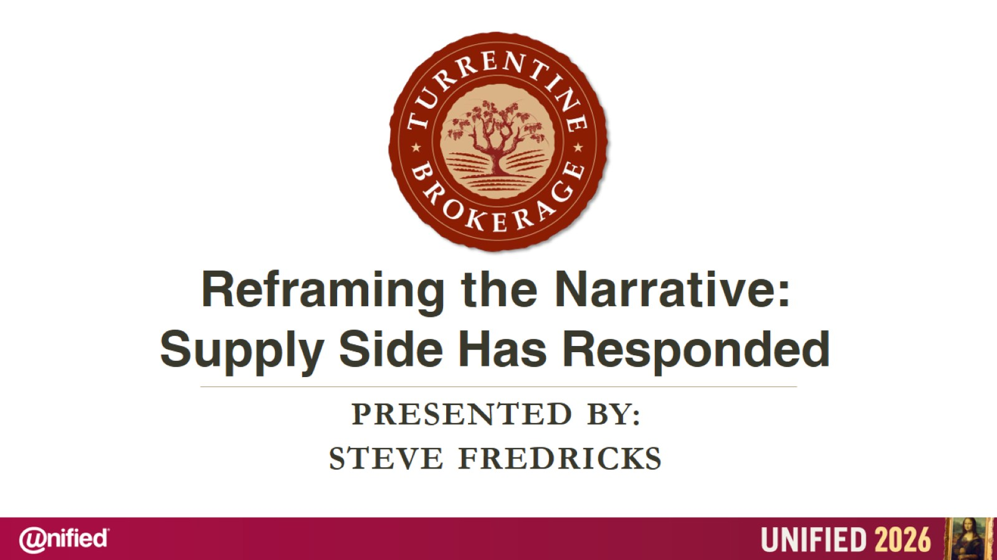

Slide 2
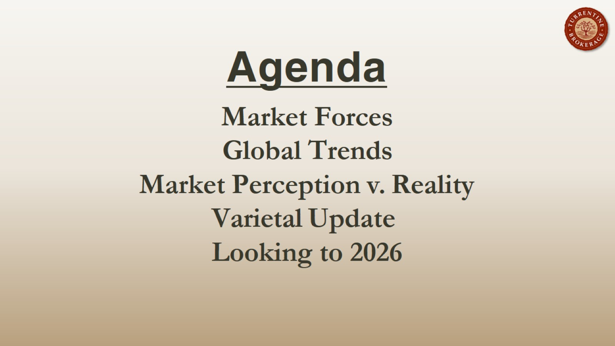
Agenda

Slide 3
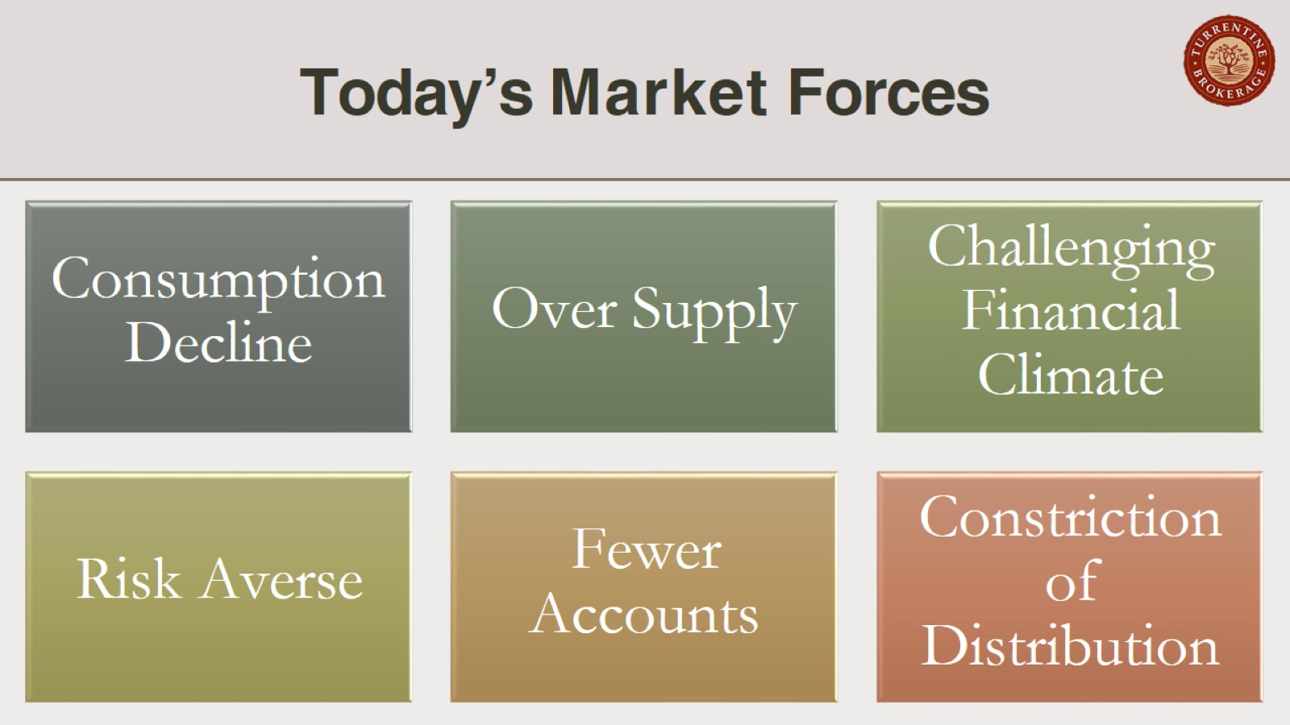
Today’s Market Forces

Slide 4
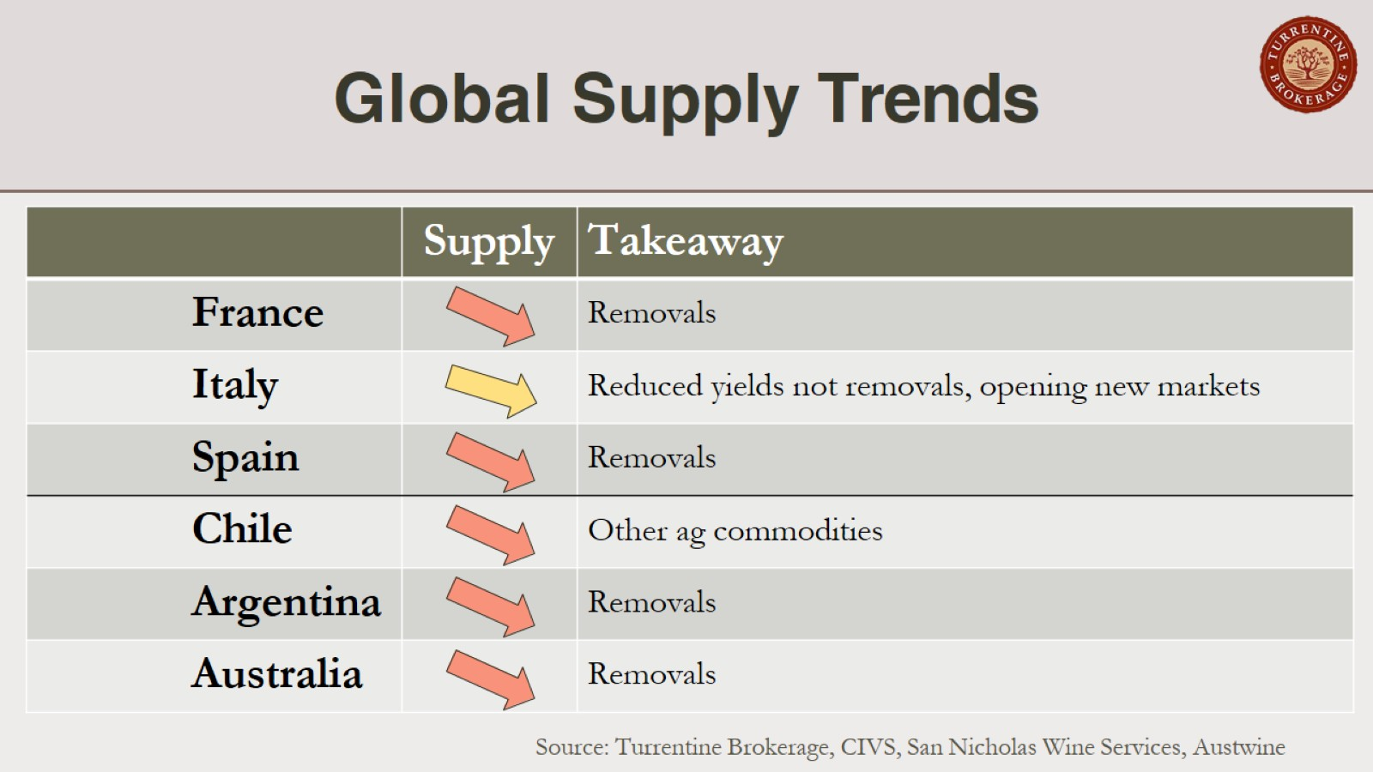
Global Supply Trends

Slide 5
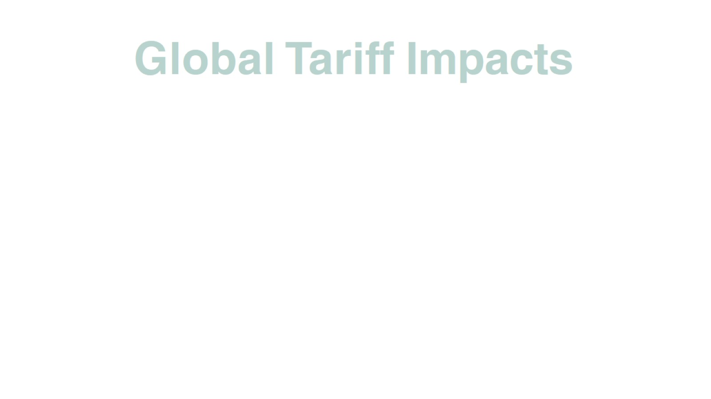
Global Tariff Impacts

Slide 6
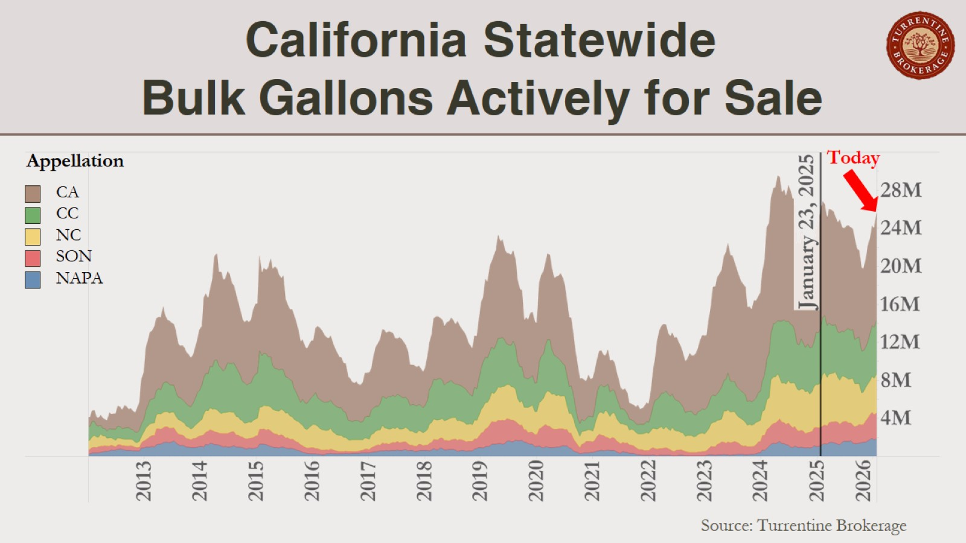
California Statewide Bulk Gallons Actively for Sale

Slide 7
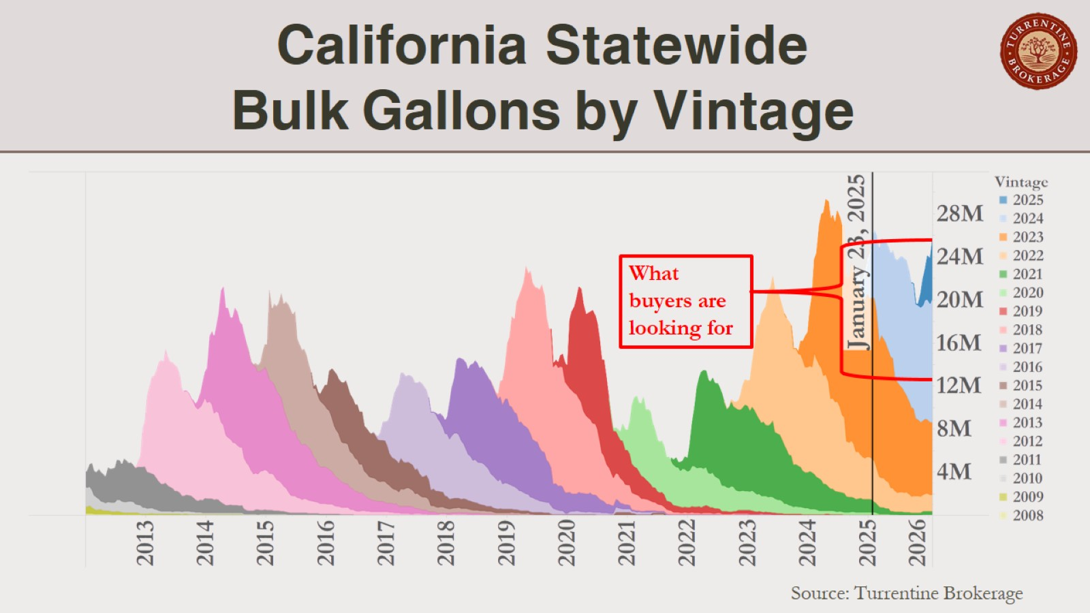
California Statewide Bulk Gallons by Vintage

Slide 8
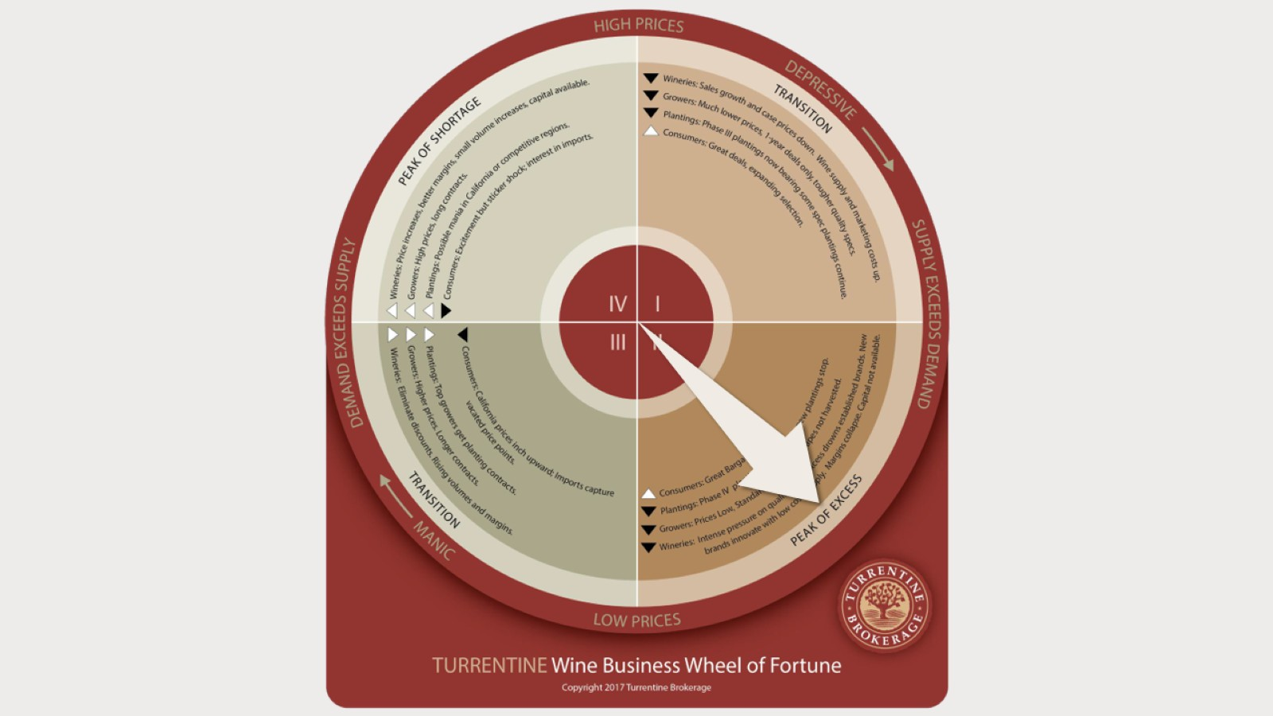

Slide 9
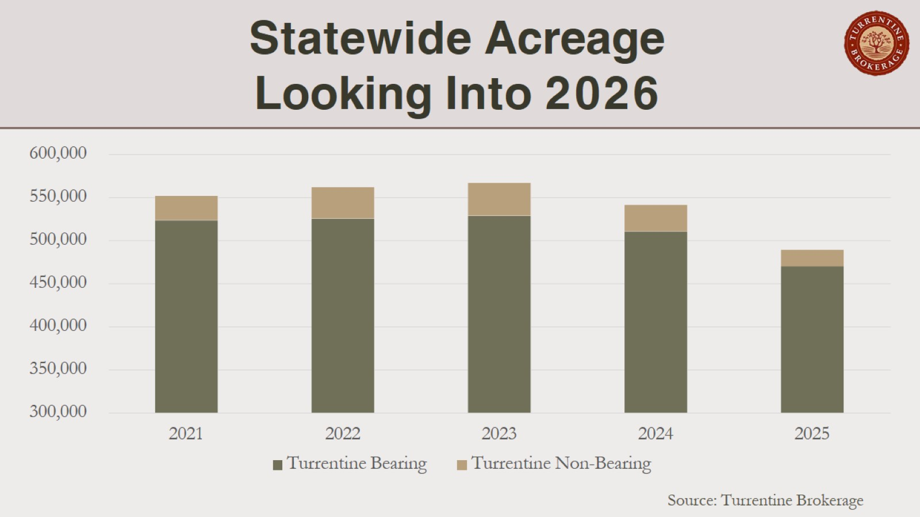
Statewide Acreage Looking Into 2026

Slide 10
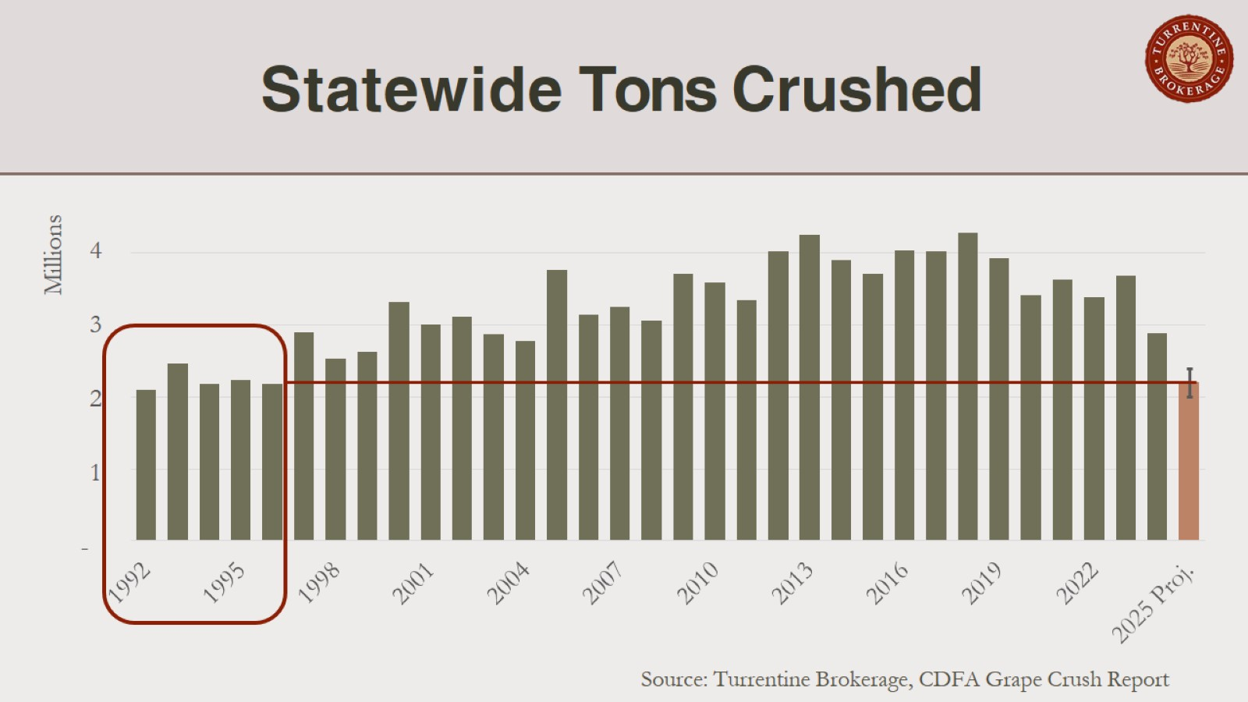
Statewide Tons Crushed

Slide 11
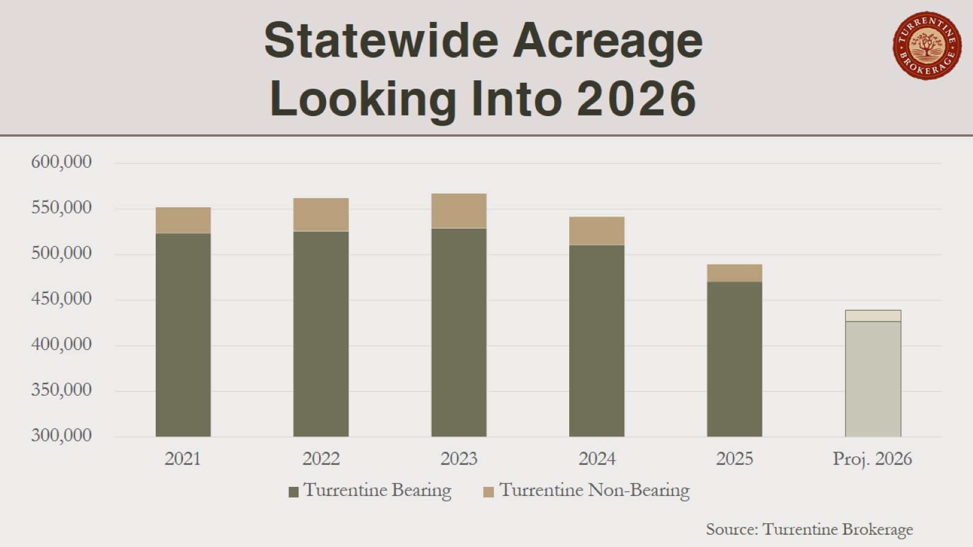
Statewide Acreage Looking Into 2026

Slide 12
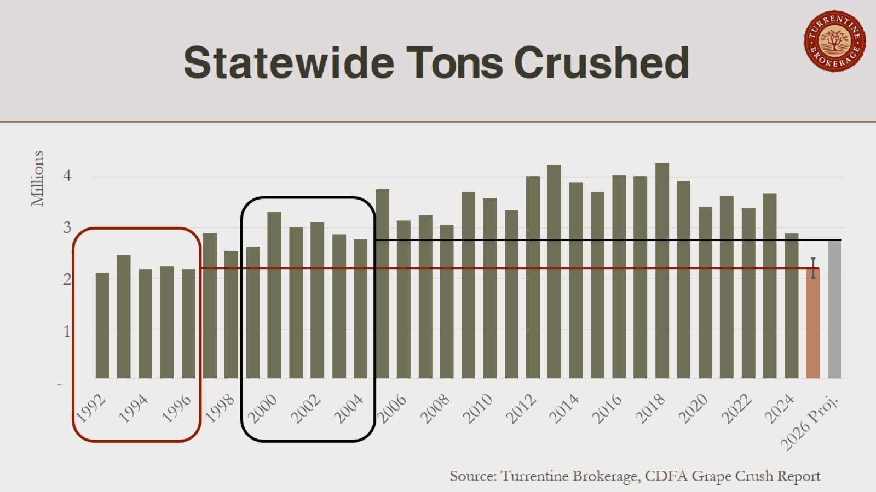
Statewide Tons Crushed

Slide 13
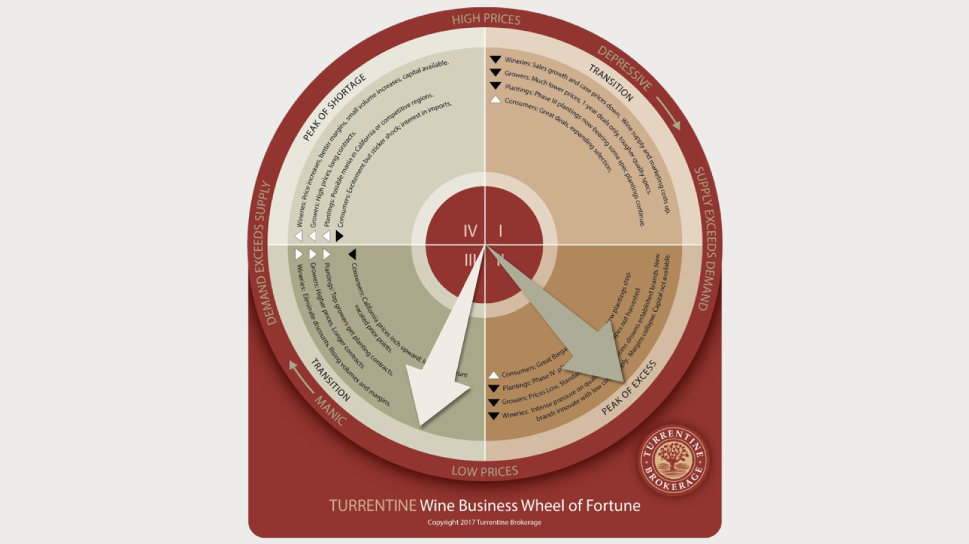

Slide 14
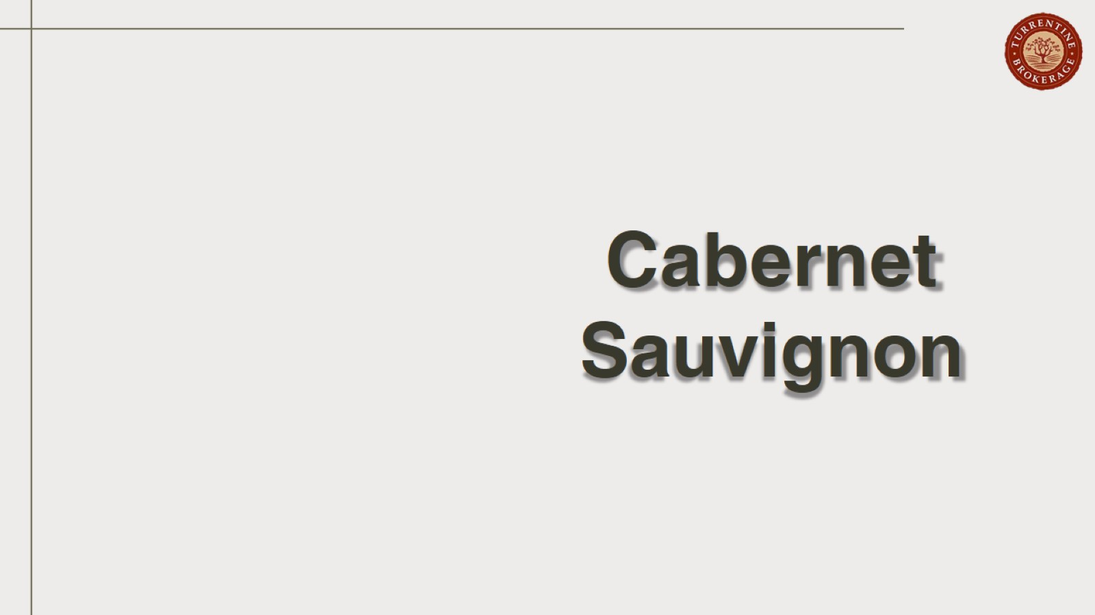
Cabernet Sauvignon

Slide 15
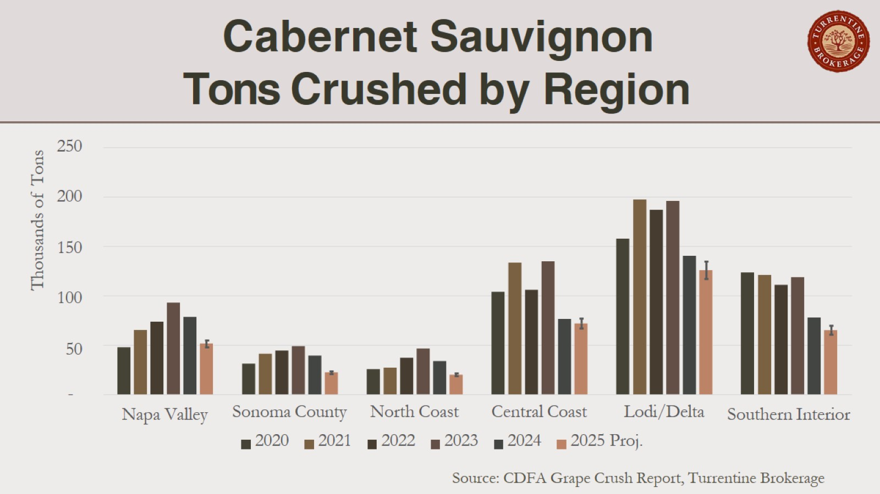
Cabernet Sauvignon Tons Crushed by Region

Slide 16
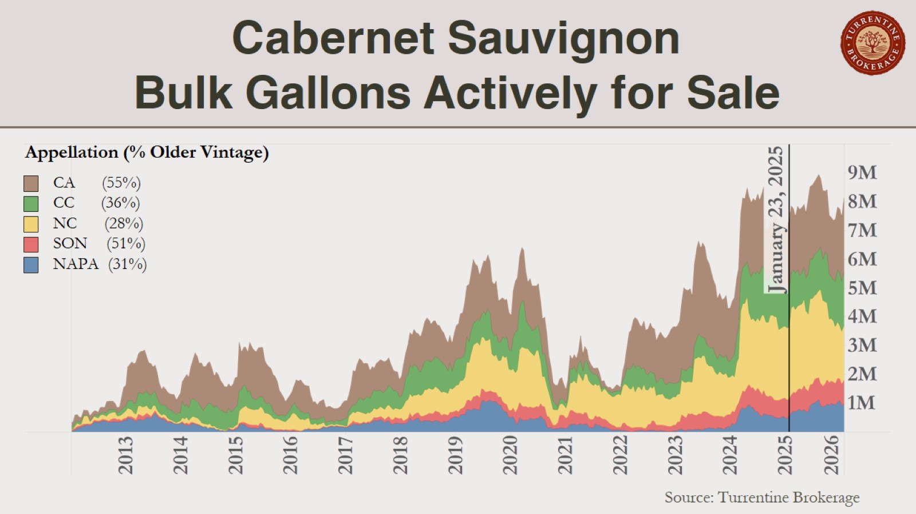
Cabernet Sauvignon Bulk Gallons Actively for Sale

Slide 17
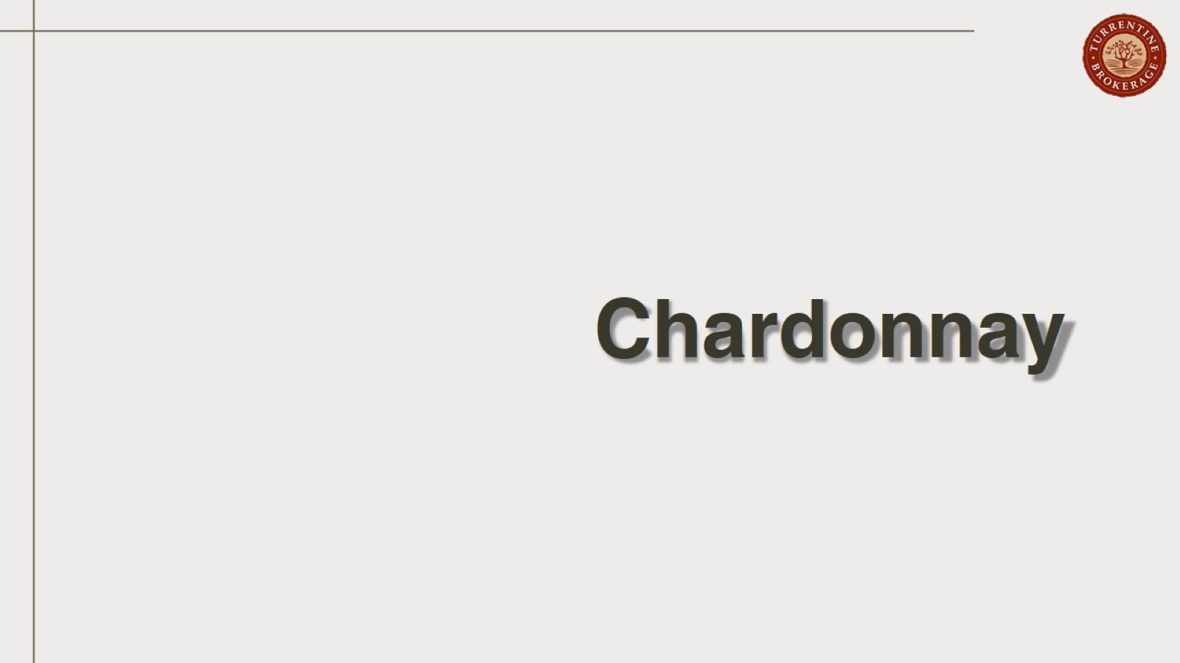
Chardonnay

Slide 18
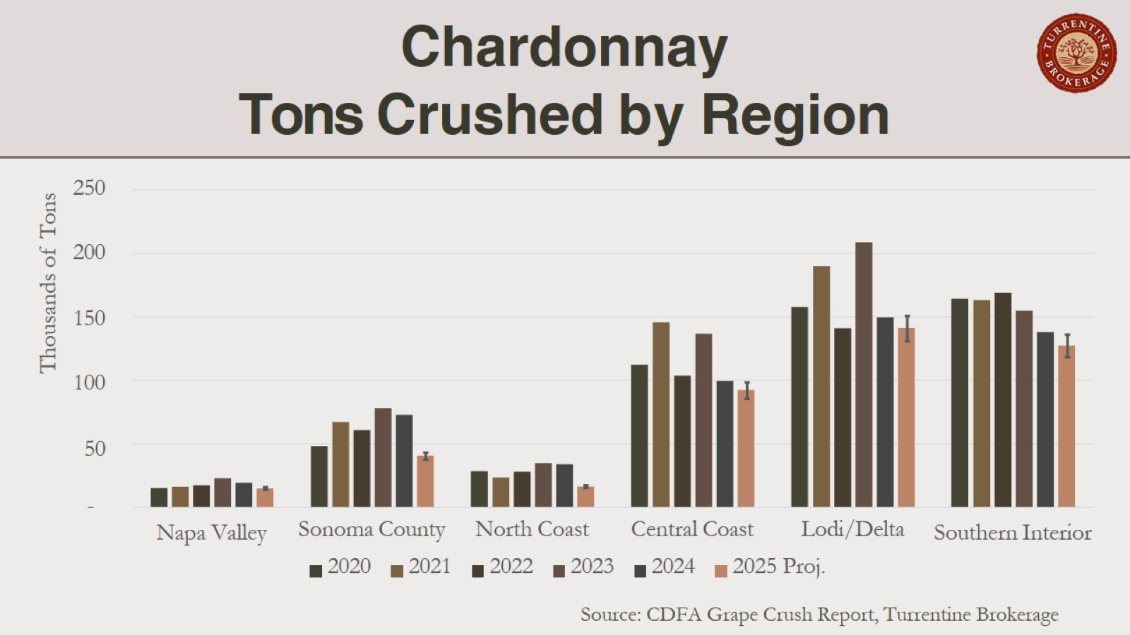
Chardonnay
Tons Crushed by Region

Slide 19
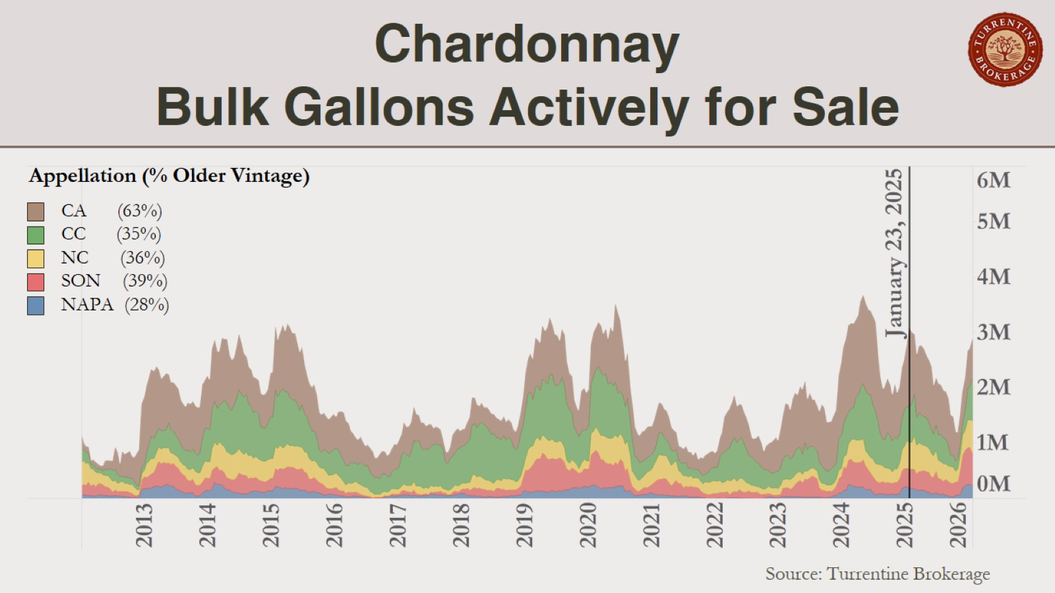
Chardonnay
Bulk Gallons Actively for Sale

Slide 20
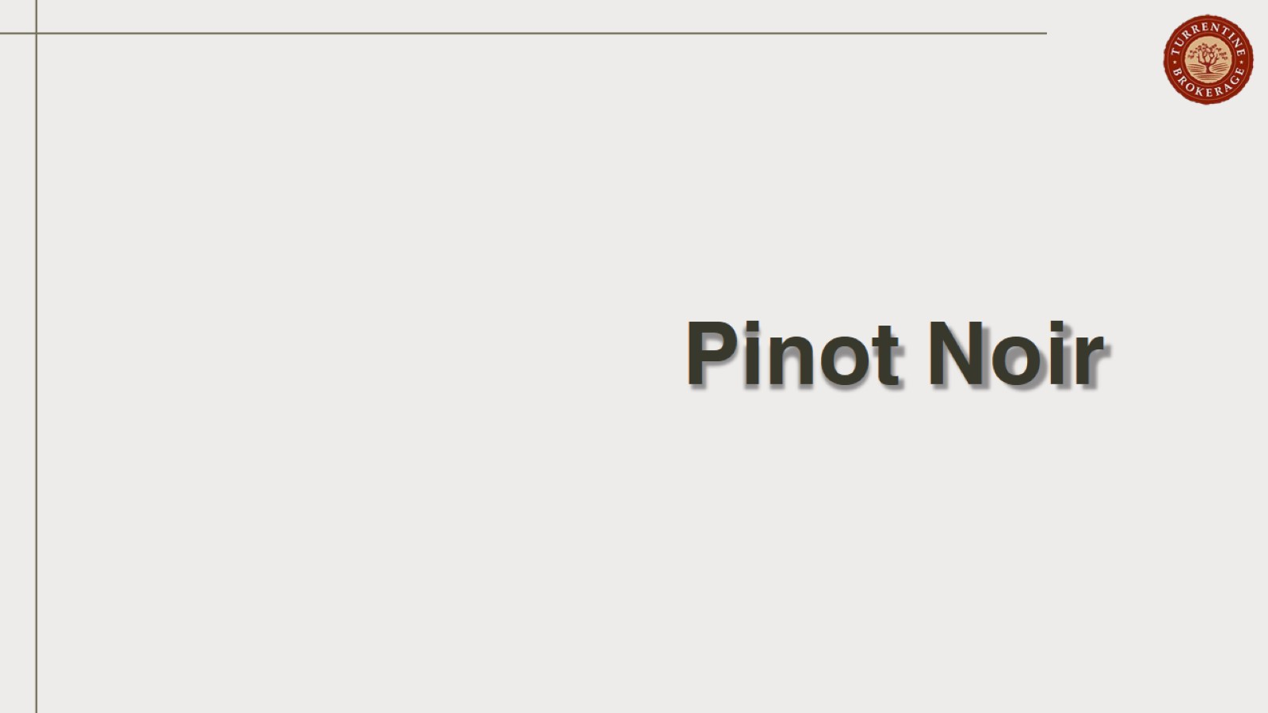
Pinot Noir

Slide 21
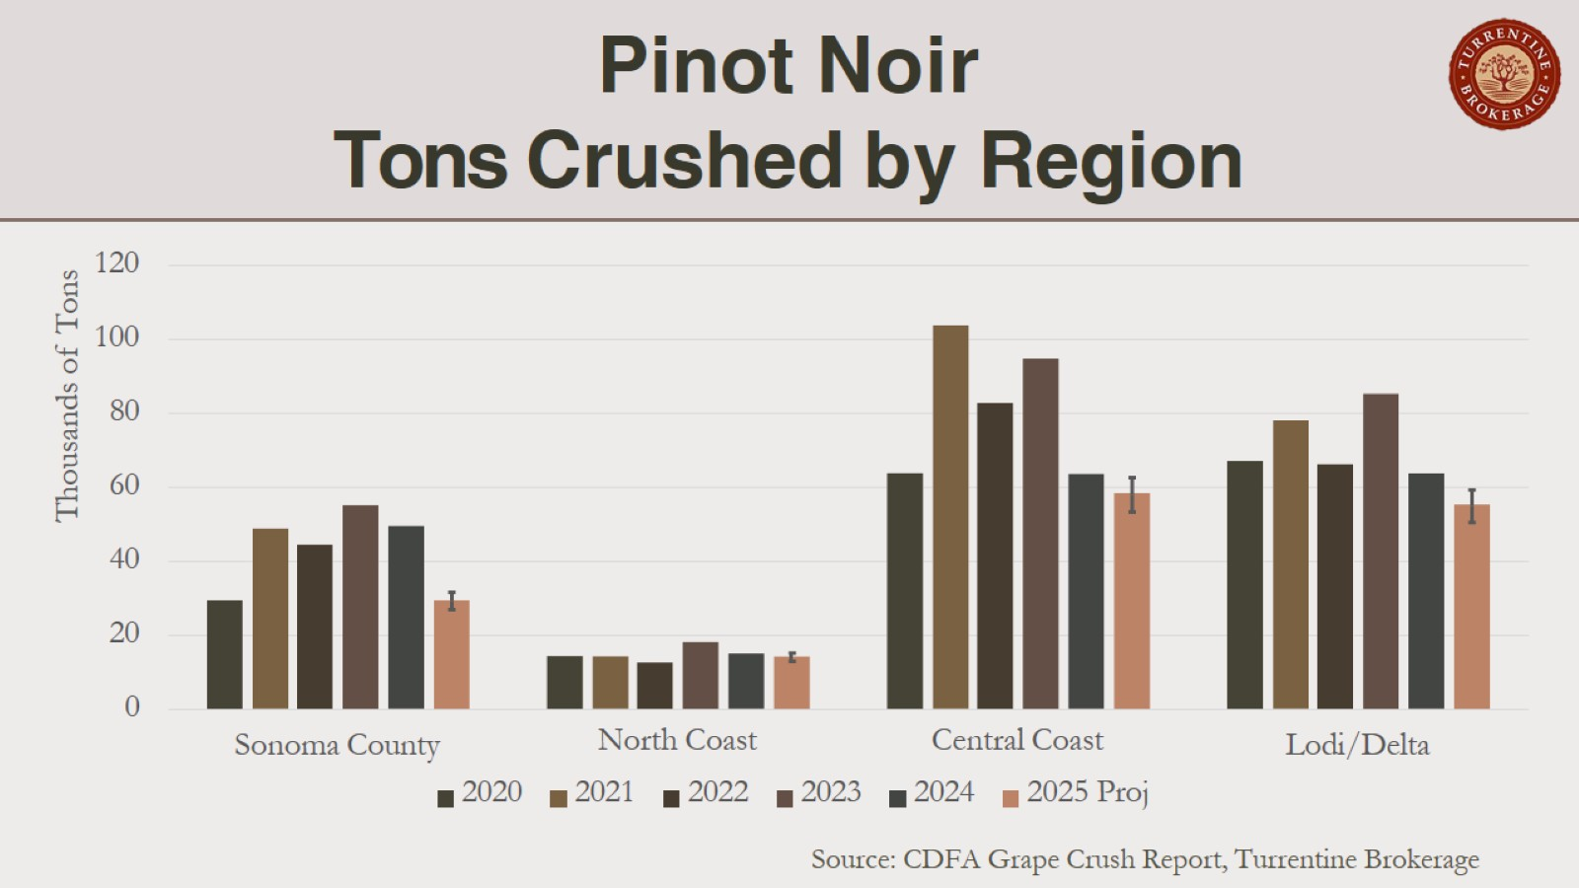
Pinot Noir
Tons Crushed by Region

Slide 22
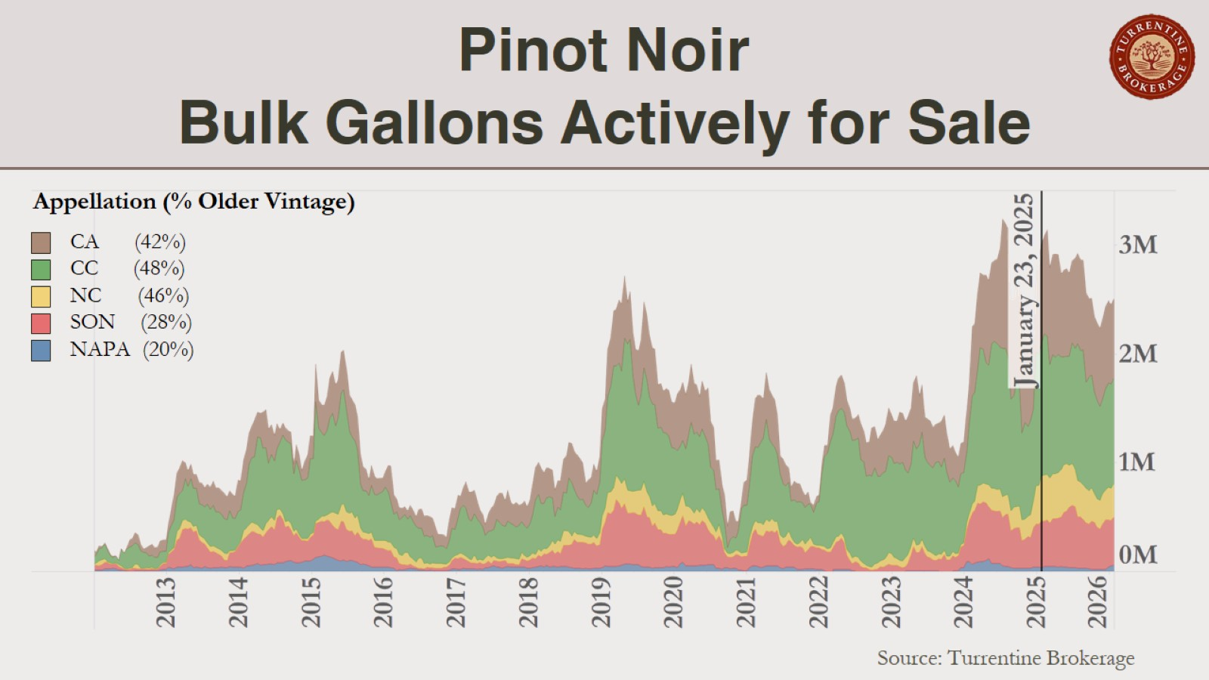
Pinot Noir
Bulk Gallons Actively for Sale

Slide 23
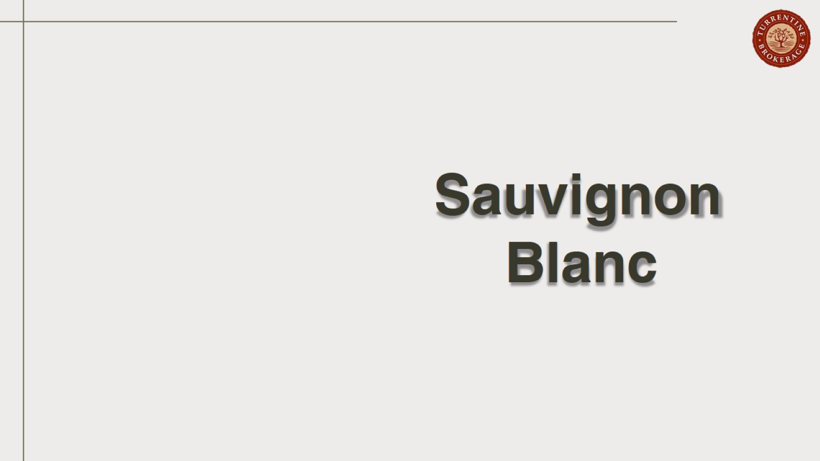
Sauvignon Blanc

Slide 24
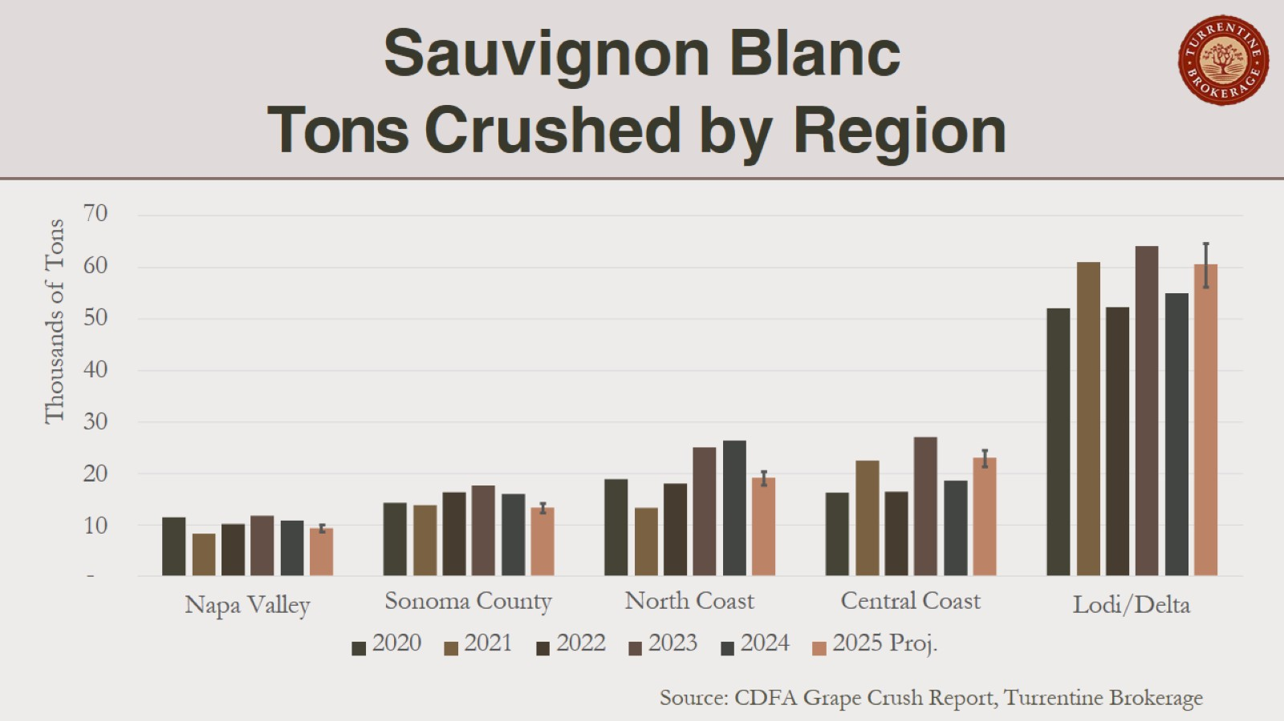
Sauvignon Blanc Tons Crushed by Region

Slide 25
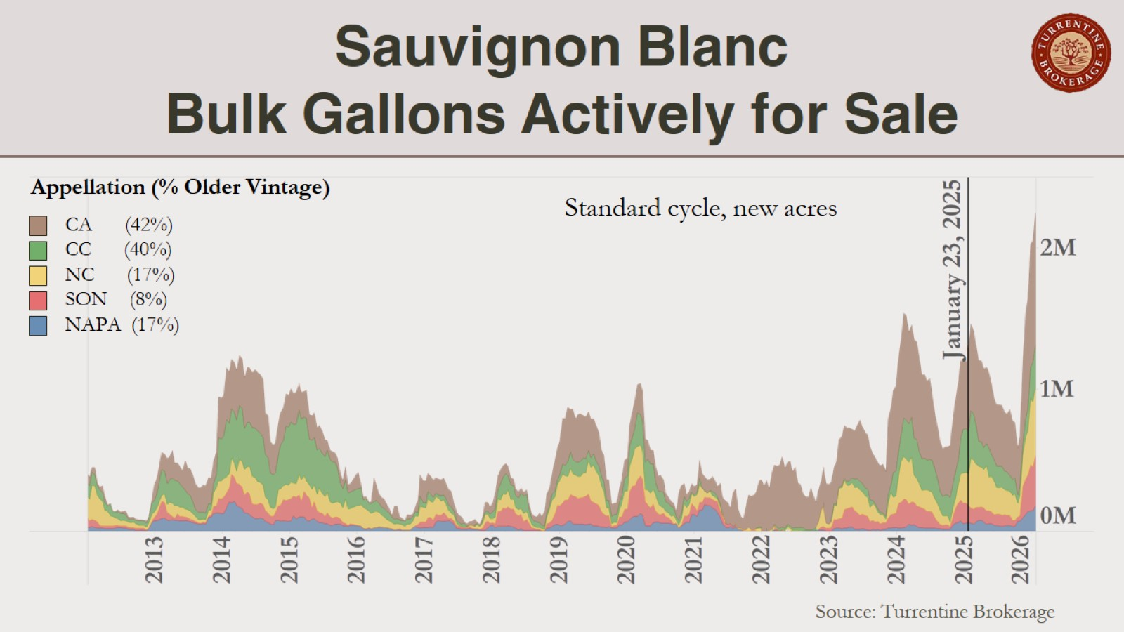
Sauvignon Blanc
Bulk Gallons Actively for Sale

Slide 26
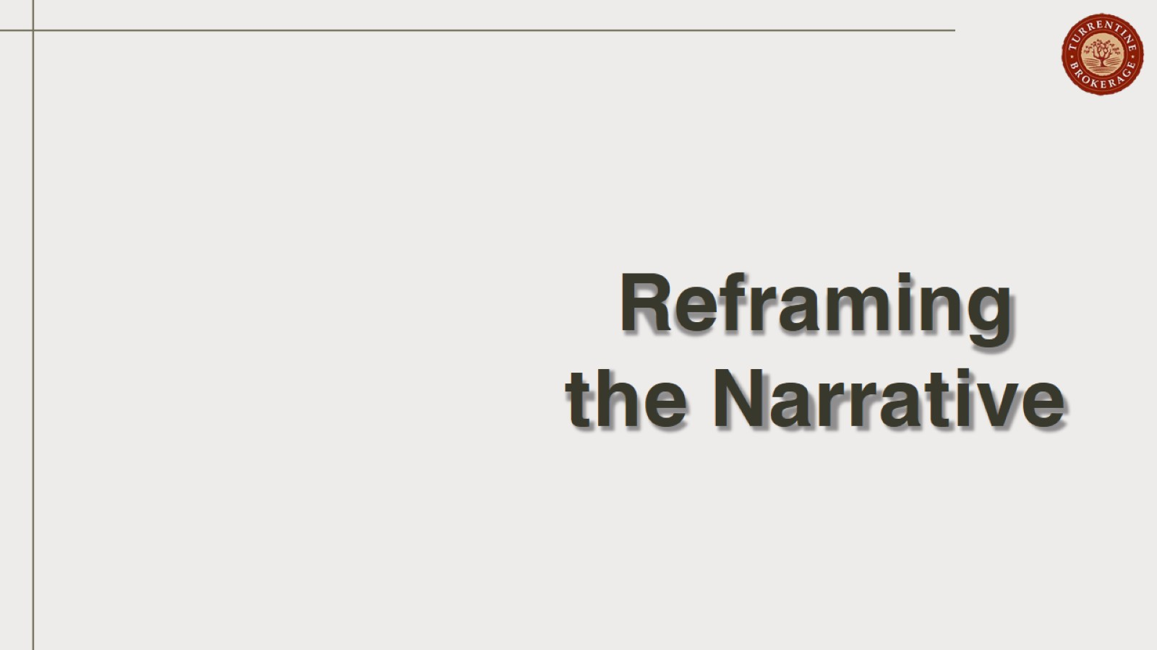

Slide 27


Slide 28
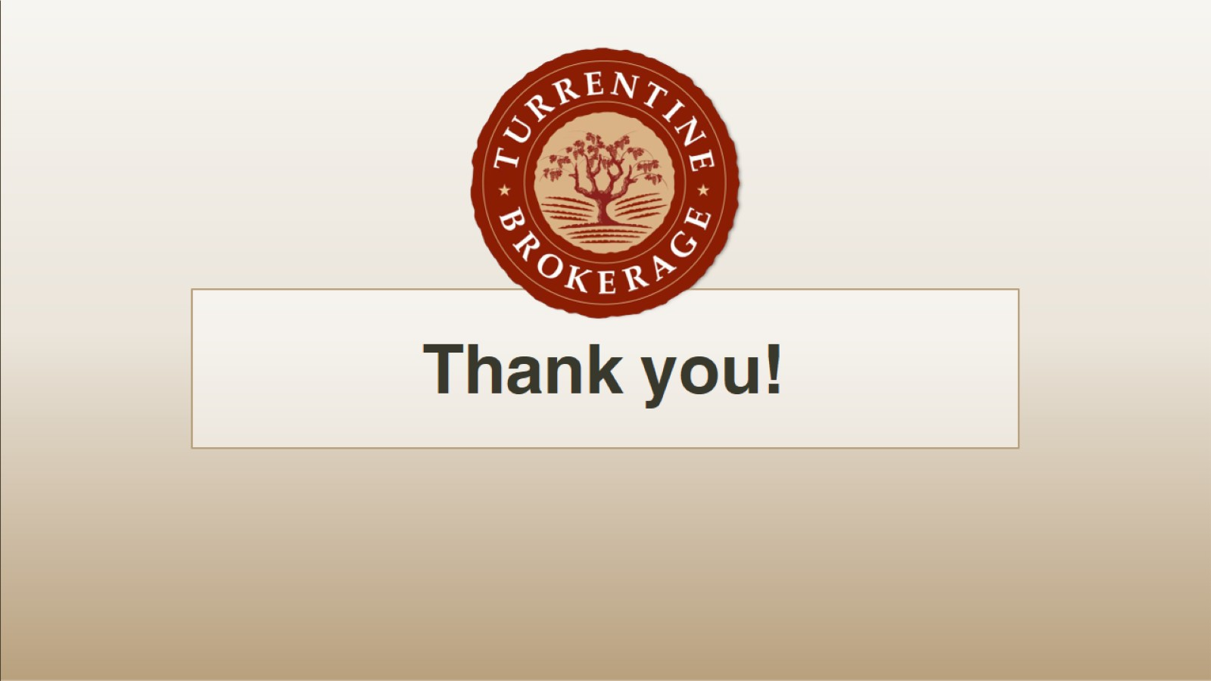
Thank you!

