Slide 1
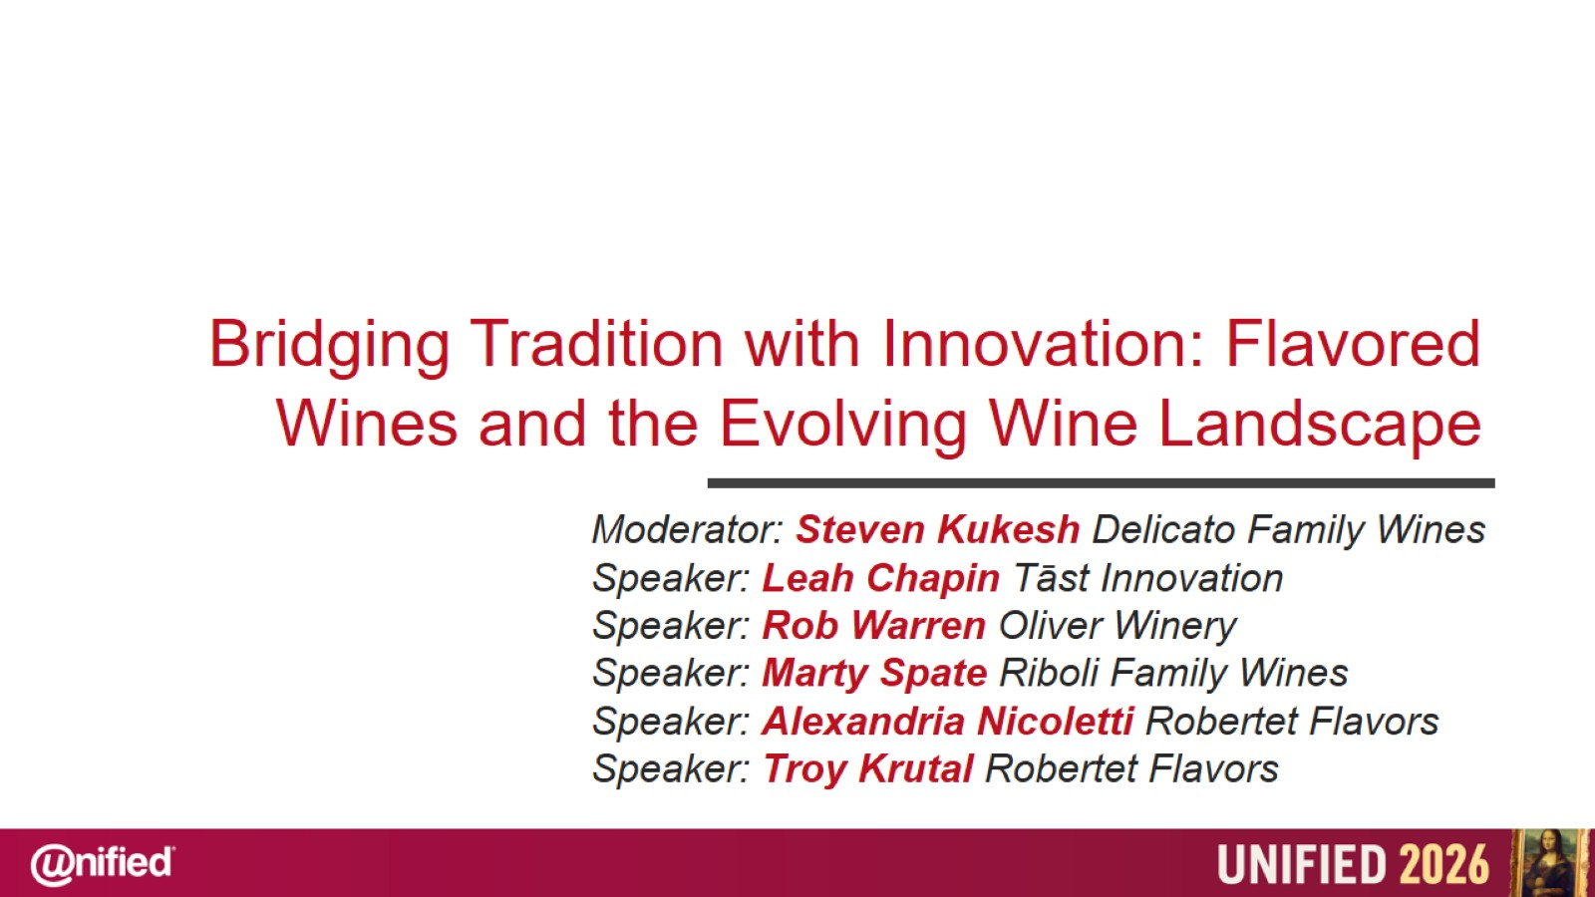

Slide 2
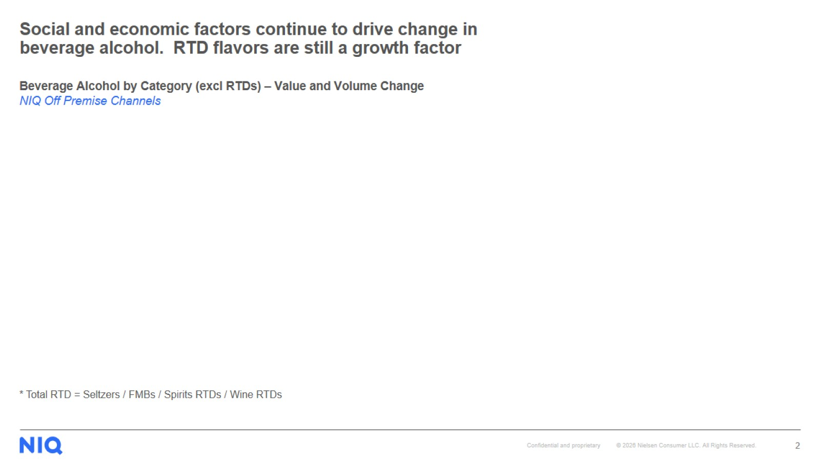
Social and economic factors continue to drive change in beverage alcohol. RTD flavors are still a growth factor

Slide 3
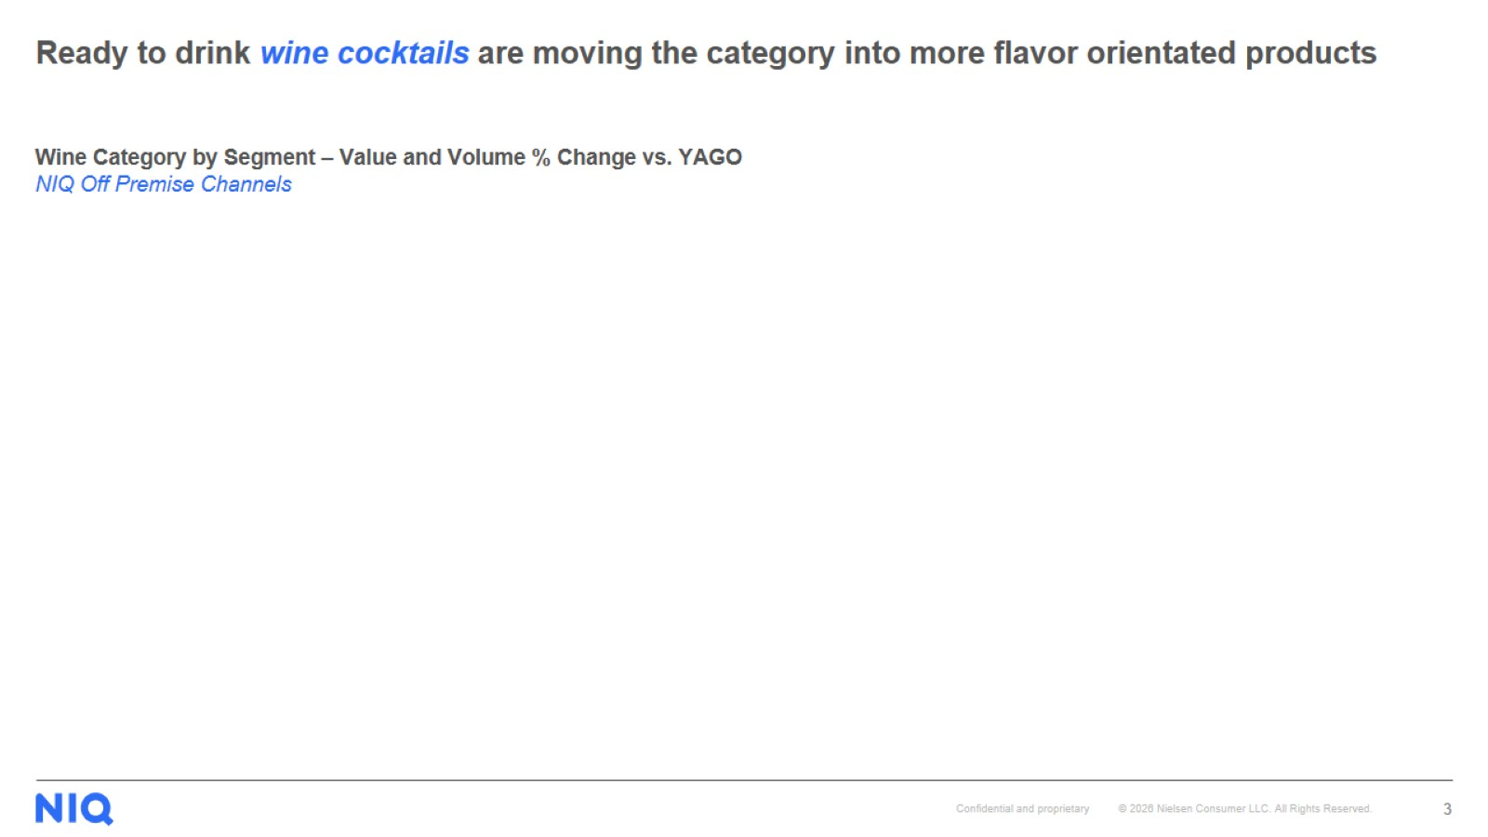
Ready to drink wine cocktails are moving the category into more flavor orientated products

Slide 4
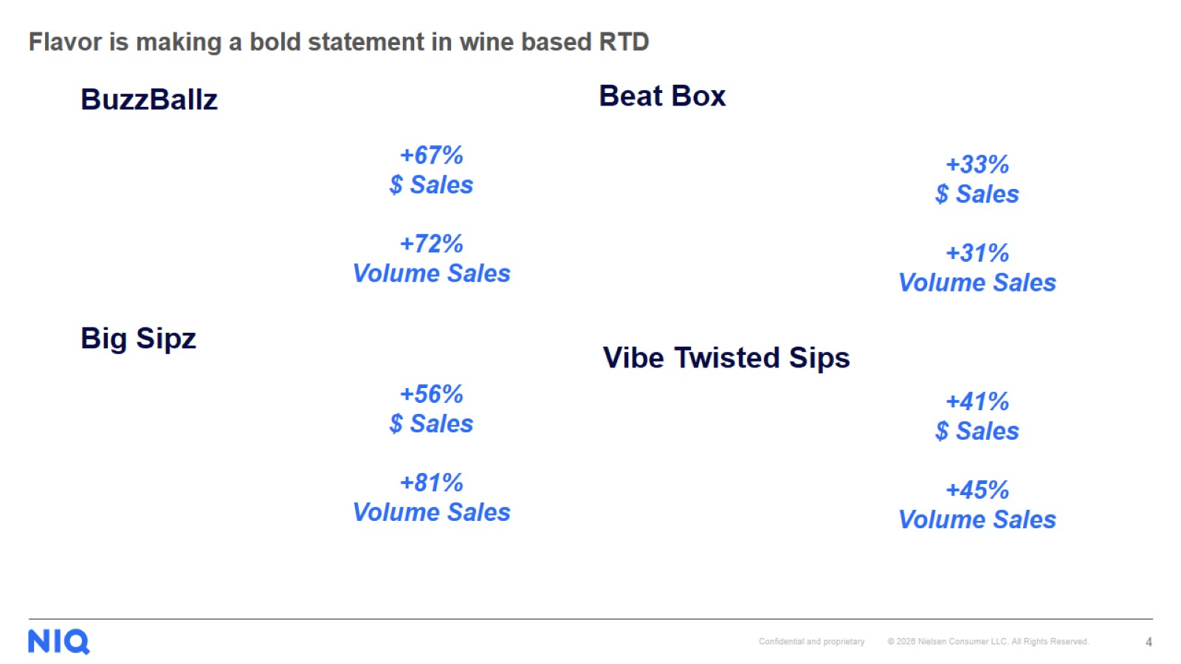
Flavor is making a bold statement in wine based RTD

Slide 5
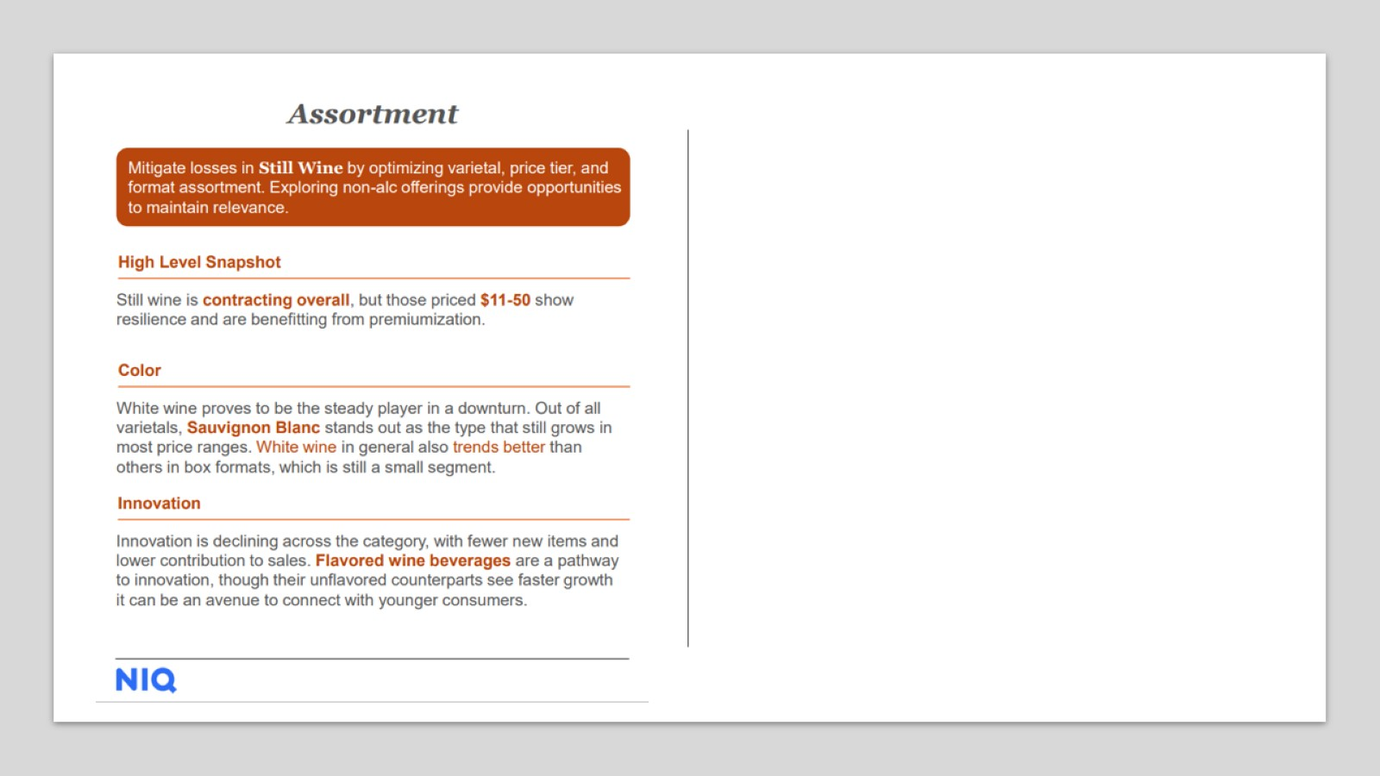

Slide 6
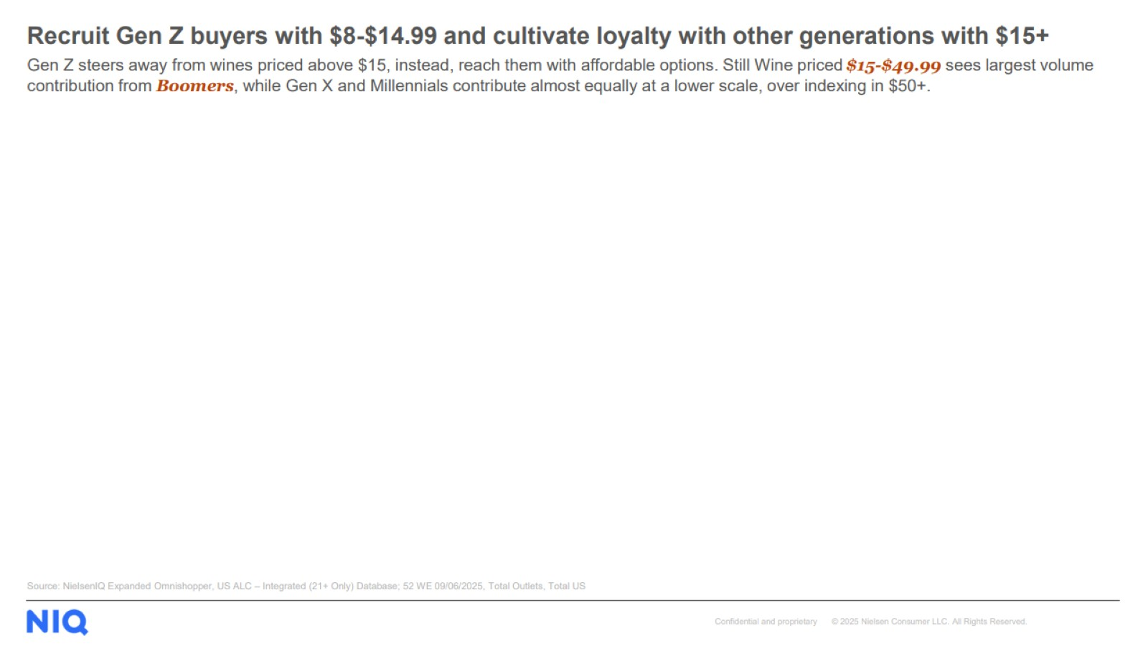

Slide 7
