Slide 1
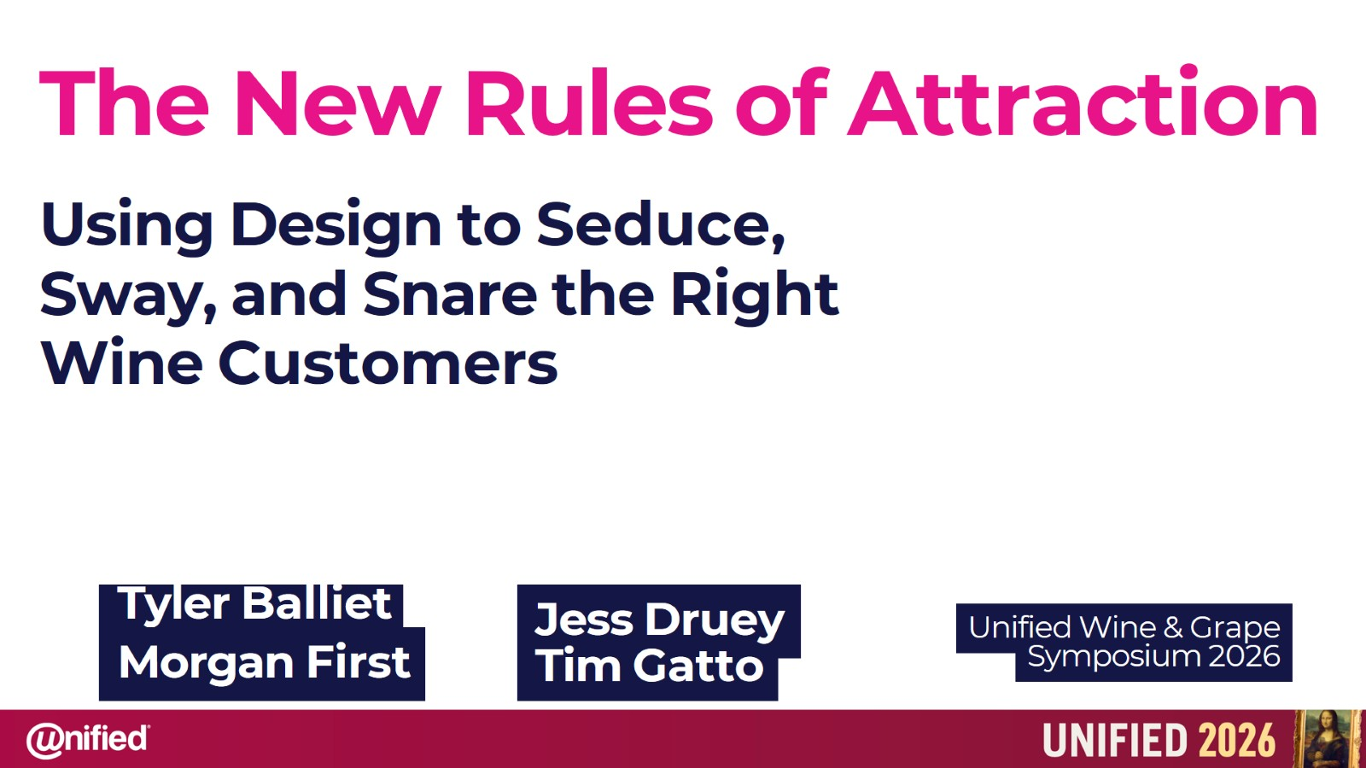
The New Rules of Attraction

Slide 2
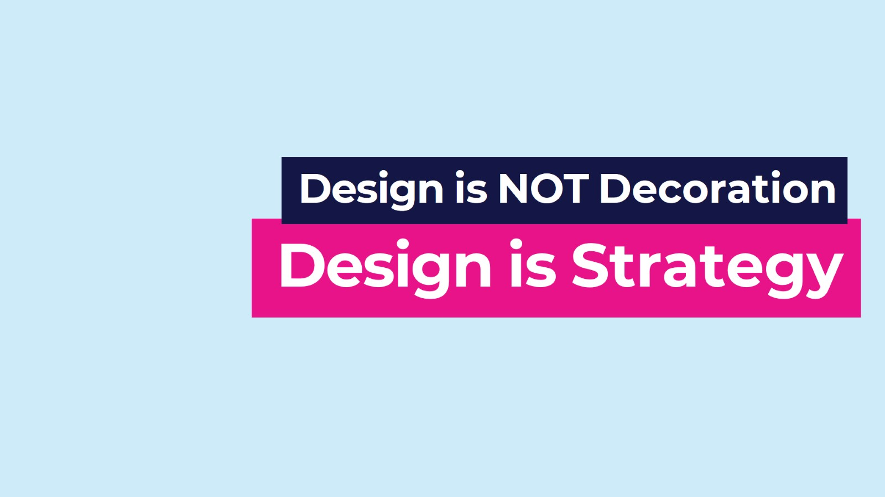

Slide 3
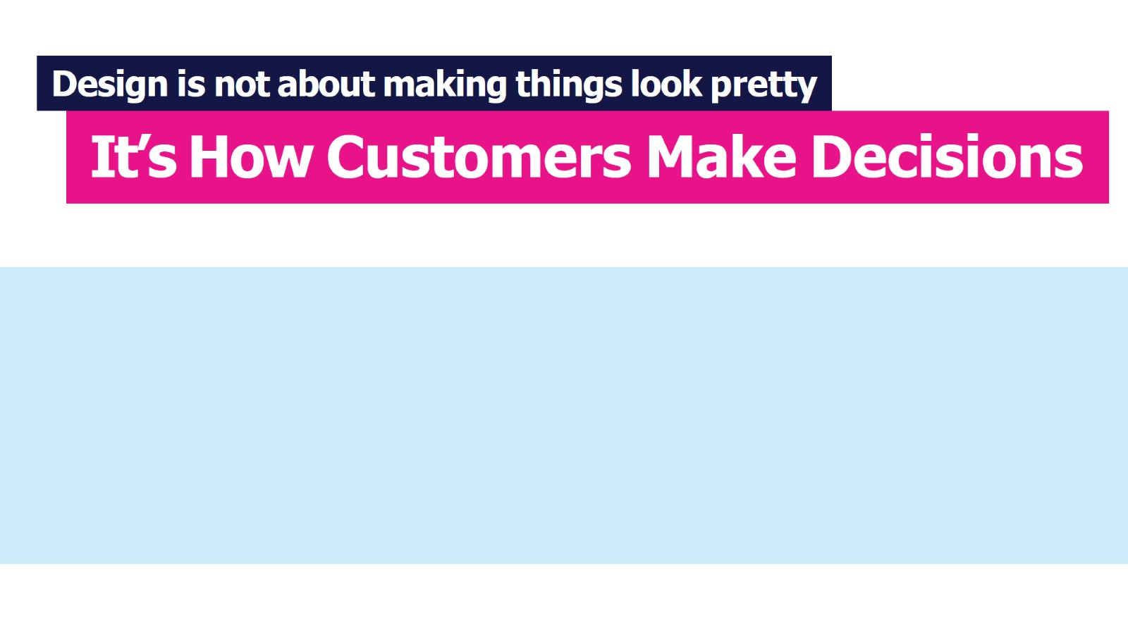

Slide 4
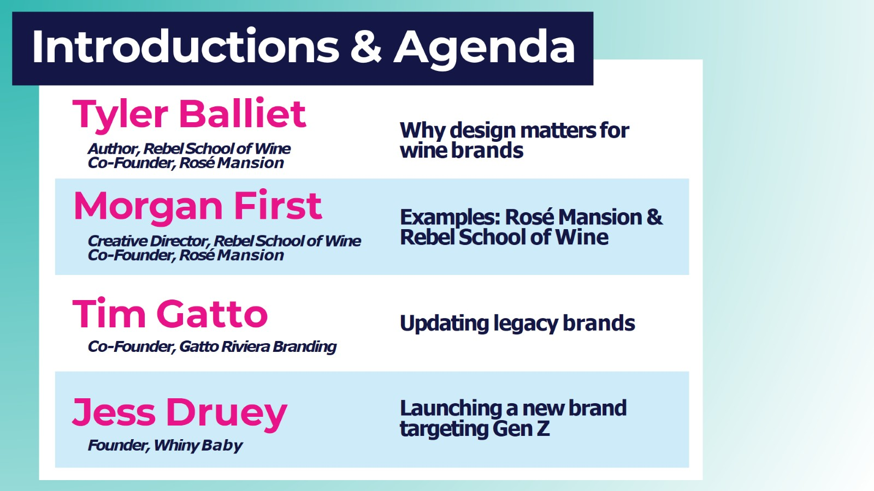
Introductions & Agenda

Slide 5
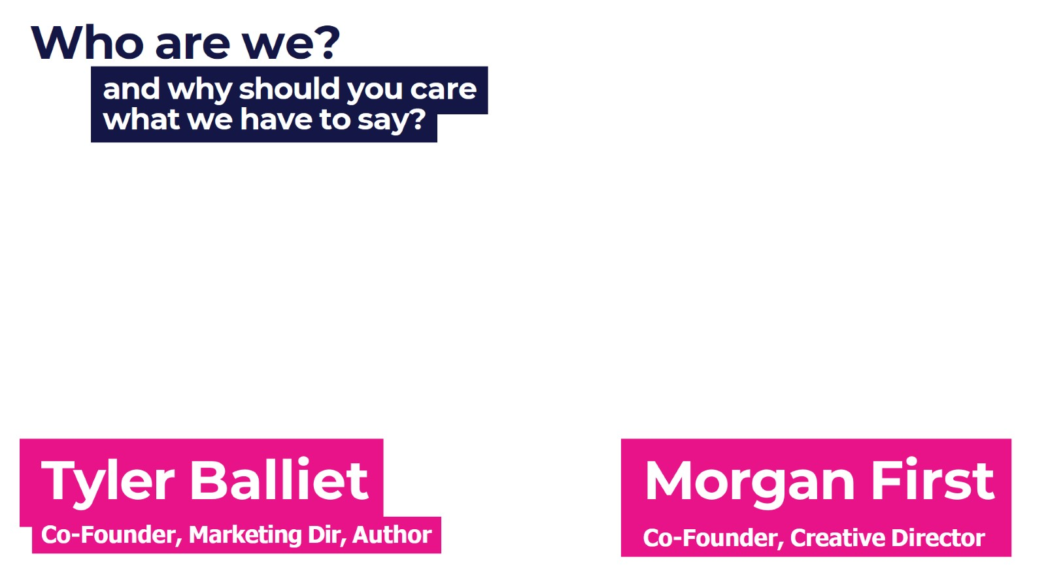
Who are we?

Slide 6
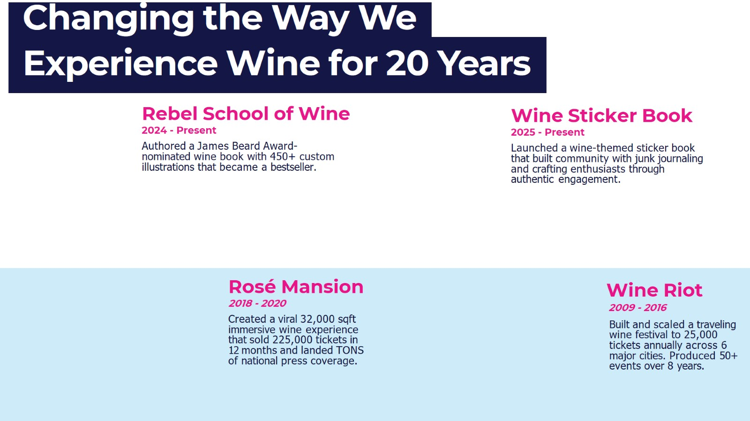
Changing the Way We

Slide 7
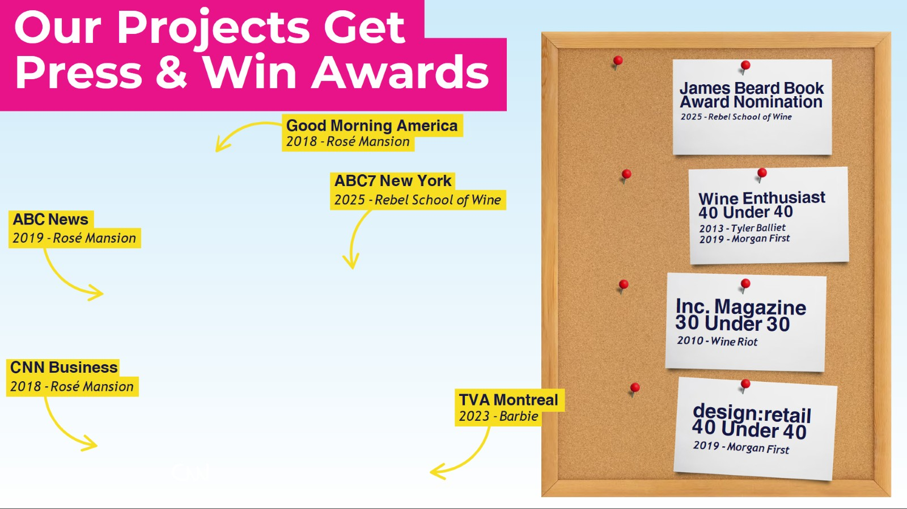
Our Projects Get

Slide 8
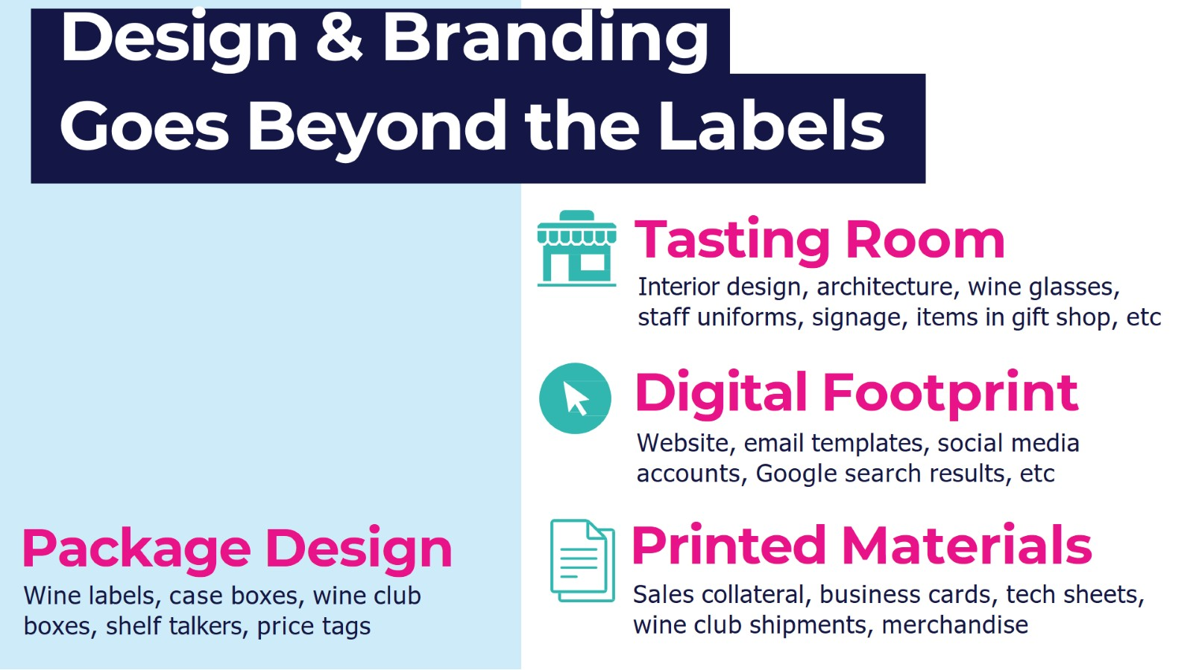
Design & Branding

Slide 9
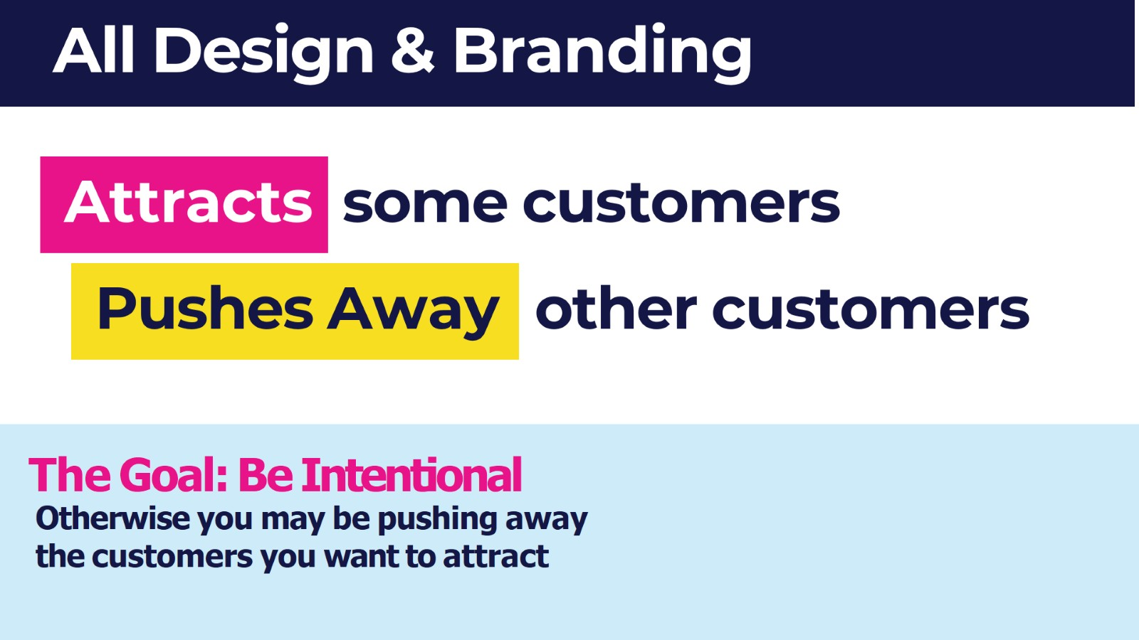
All Design & Branding

Slide 10
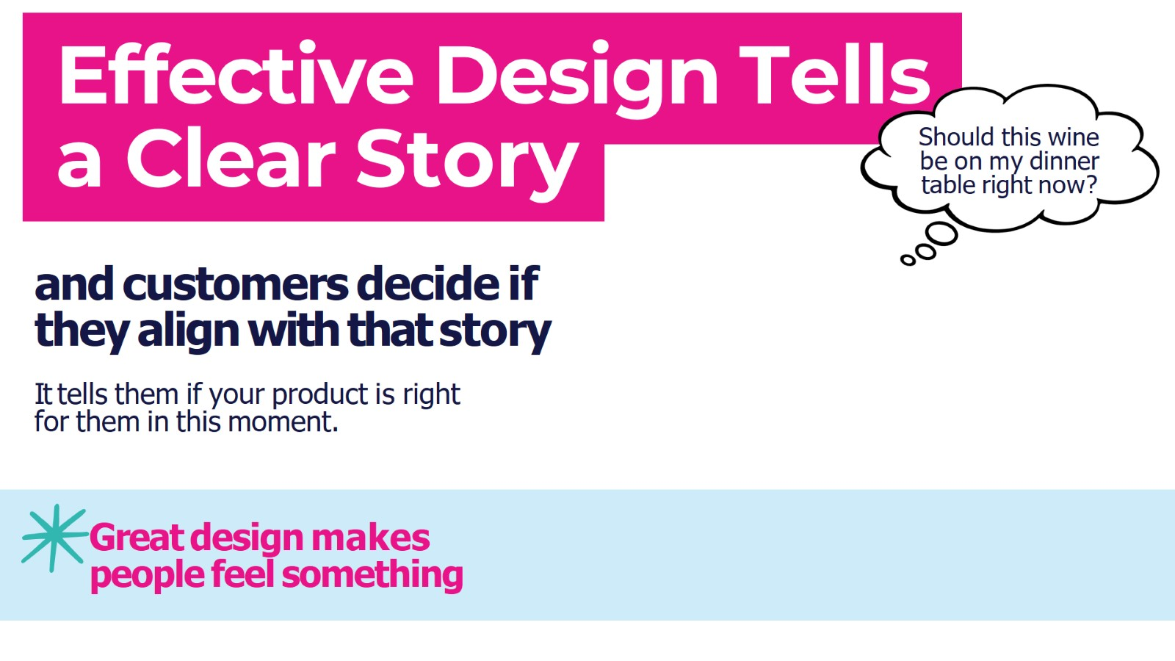
Effective Design Tells

Slide 11
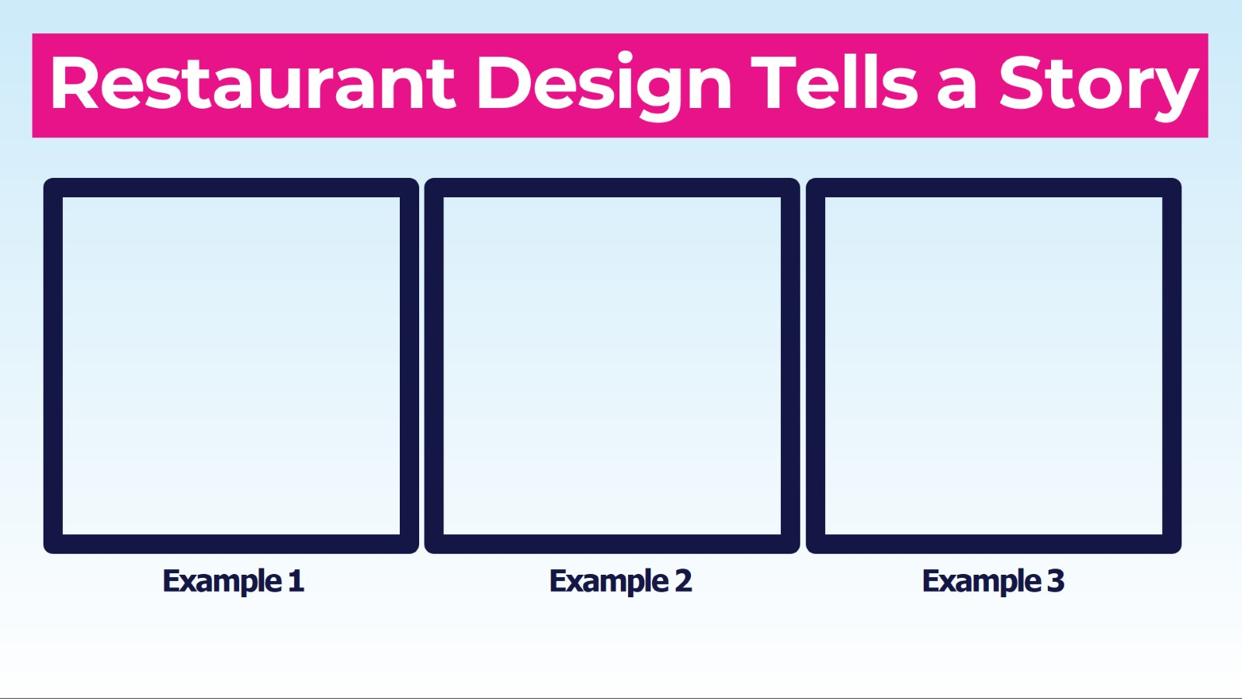
Restaurant Design Tells a Story

Slide 12
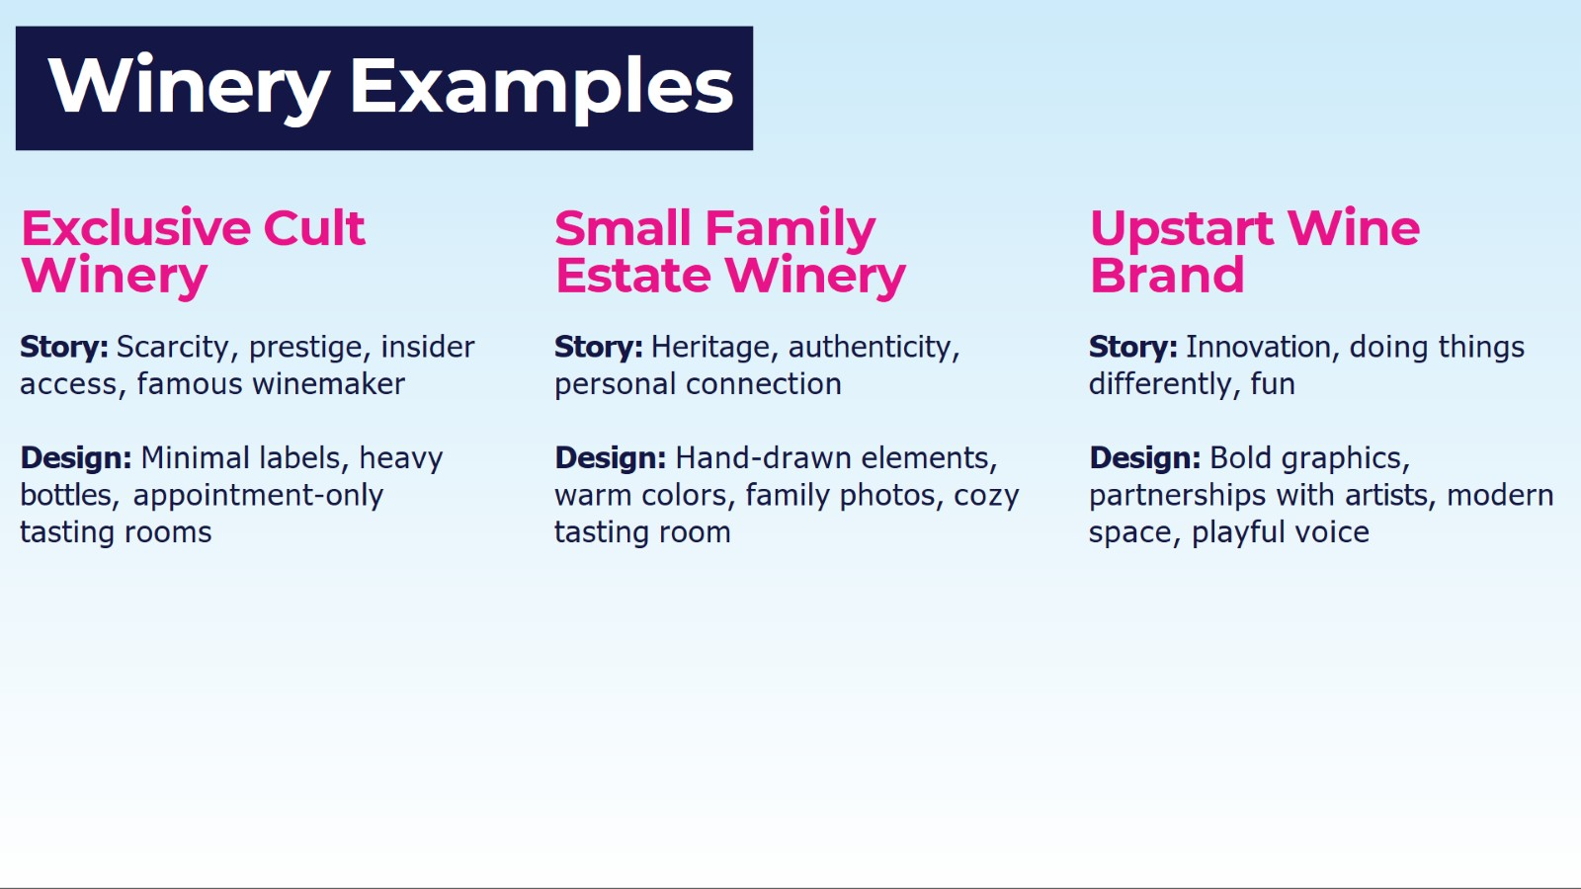
Winery Examples

Slide 13
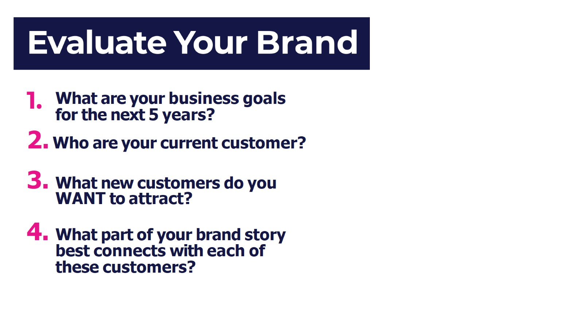
Evaluate Your Brand

Slide 14
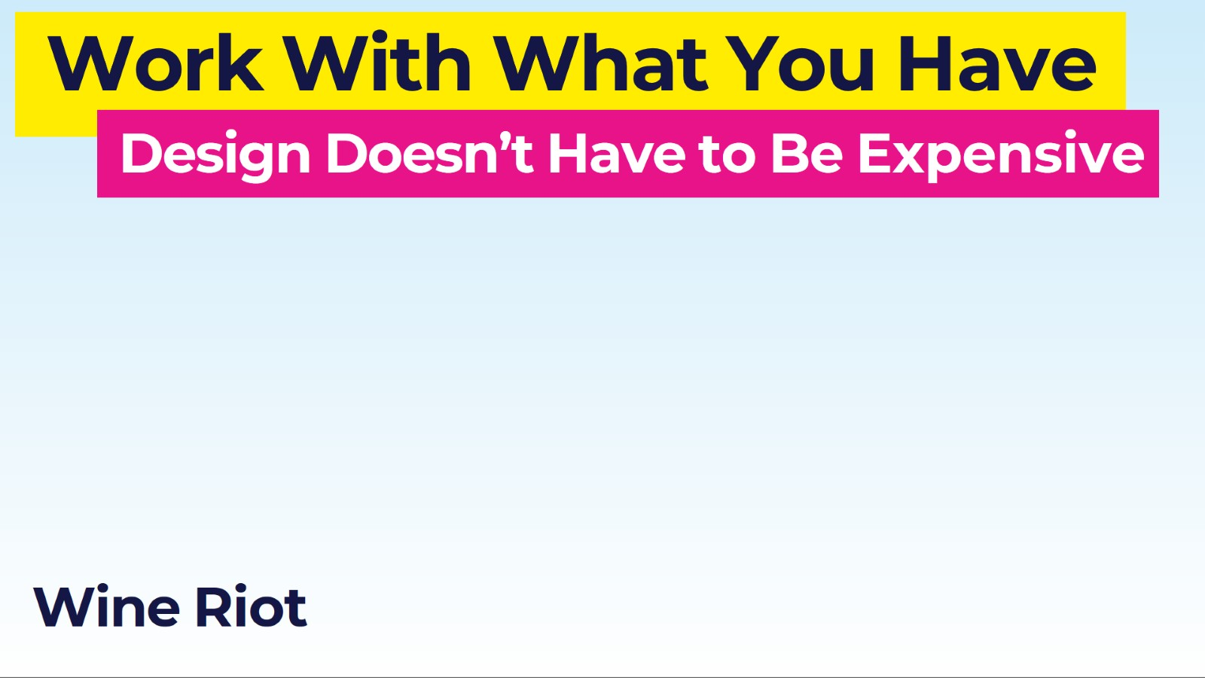
Work With What You Have

Slide 15
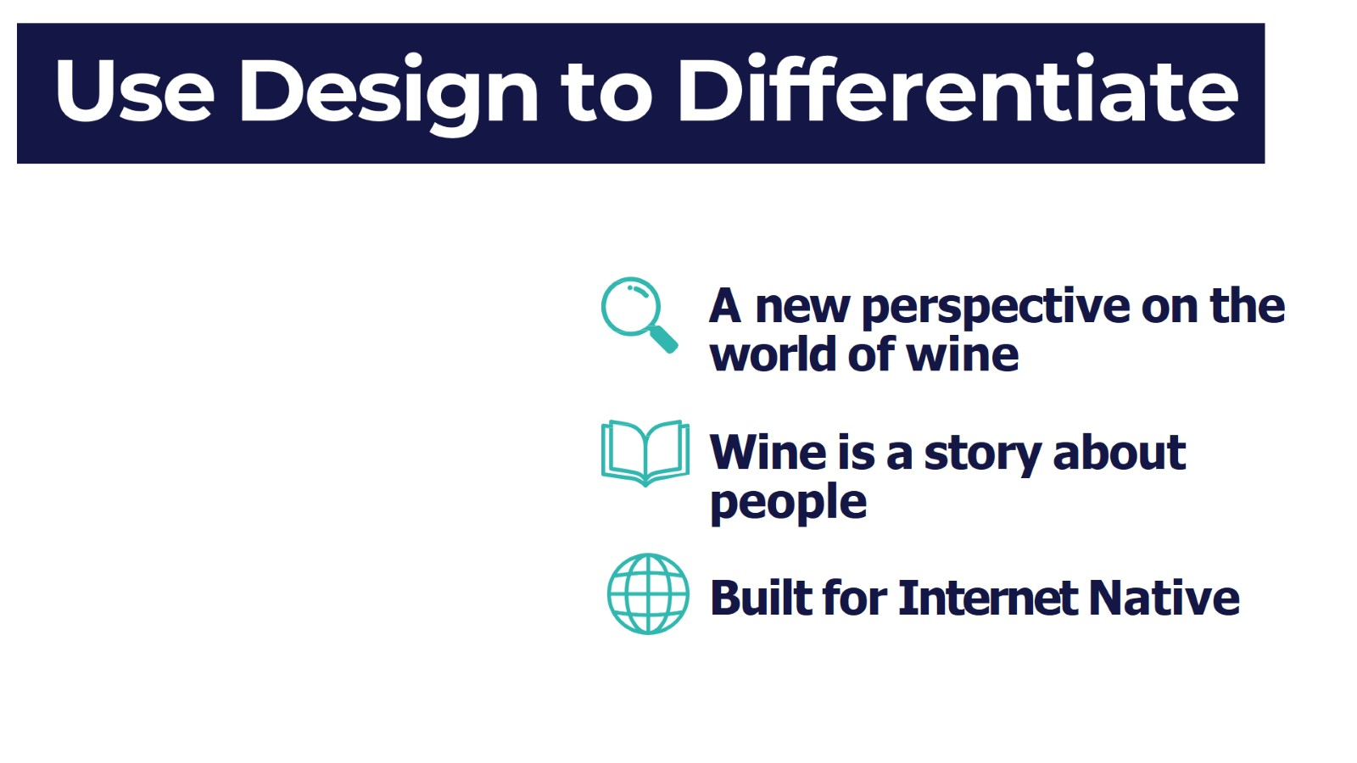
Use Design to Differentiate

Slide 16
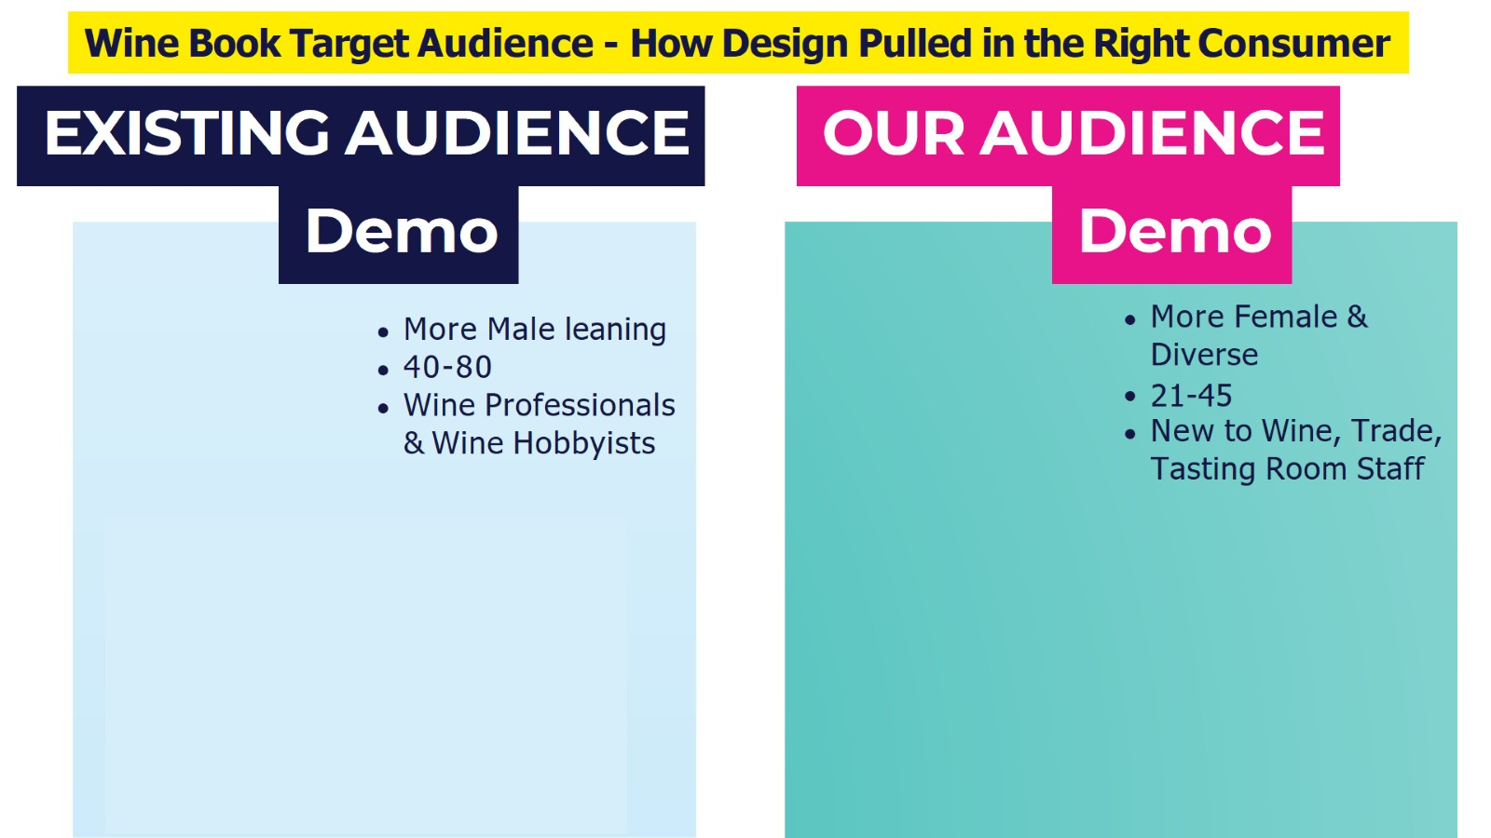
Wine Book Target Audience - How Design Pulled in the Right Consumer

Slide 17
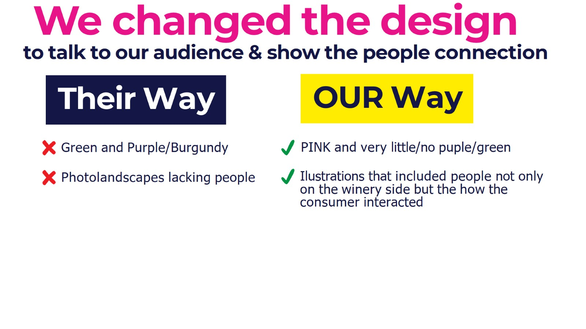
We changed the design

Slide 18


Slide 19
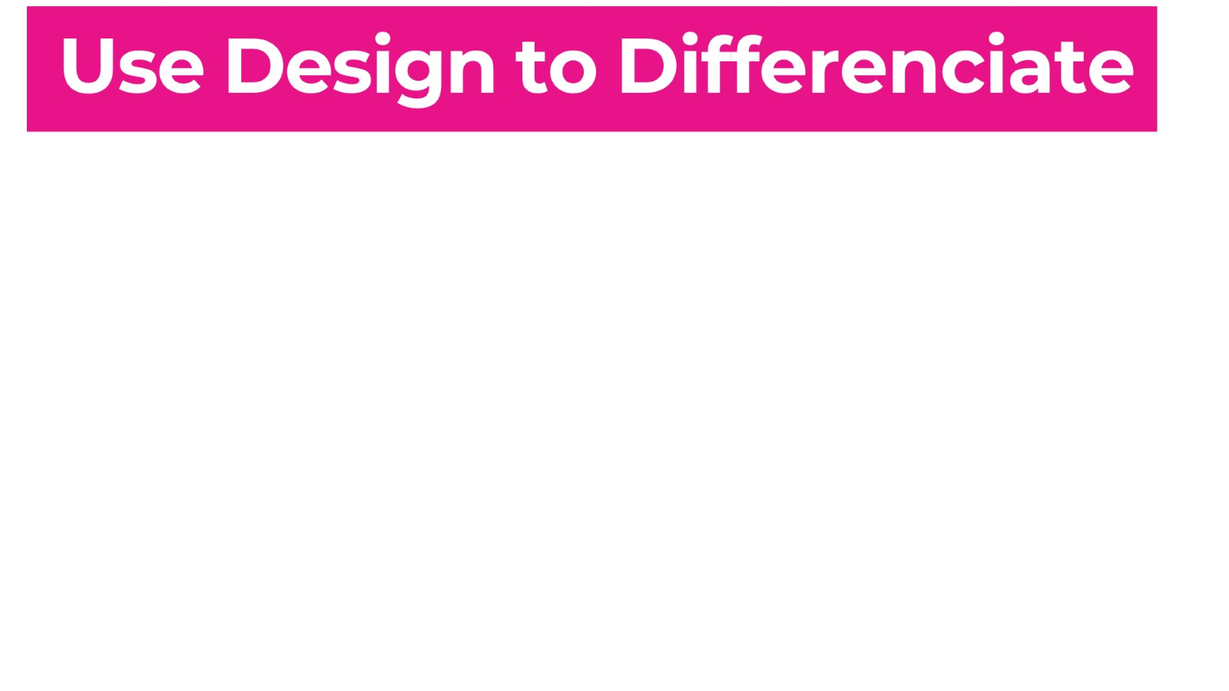
Use Design to Differenciate

Slide 20
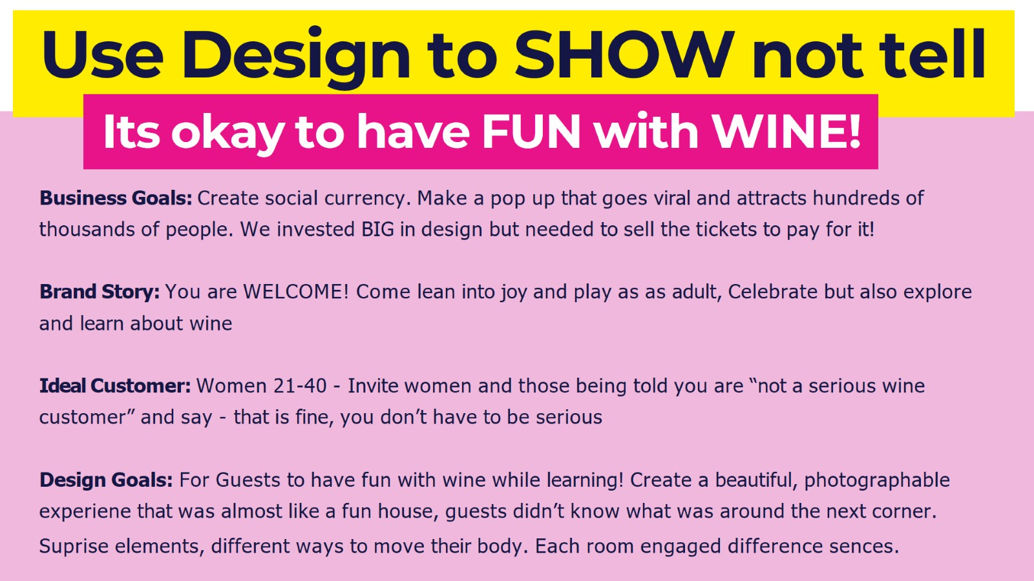
Use Design to SHOW not tell

Slide 21


Slide 22


Slide 23
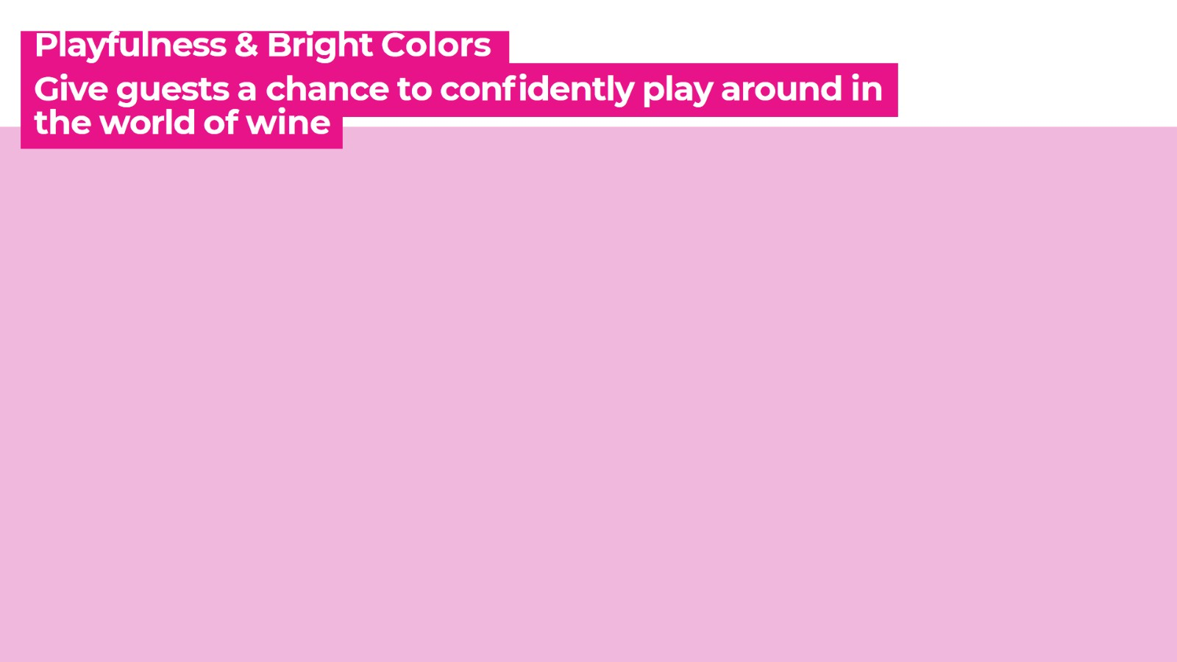

Slide 25
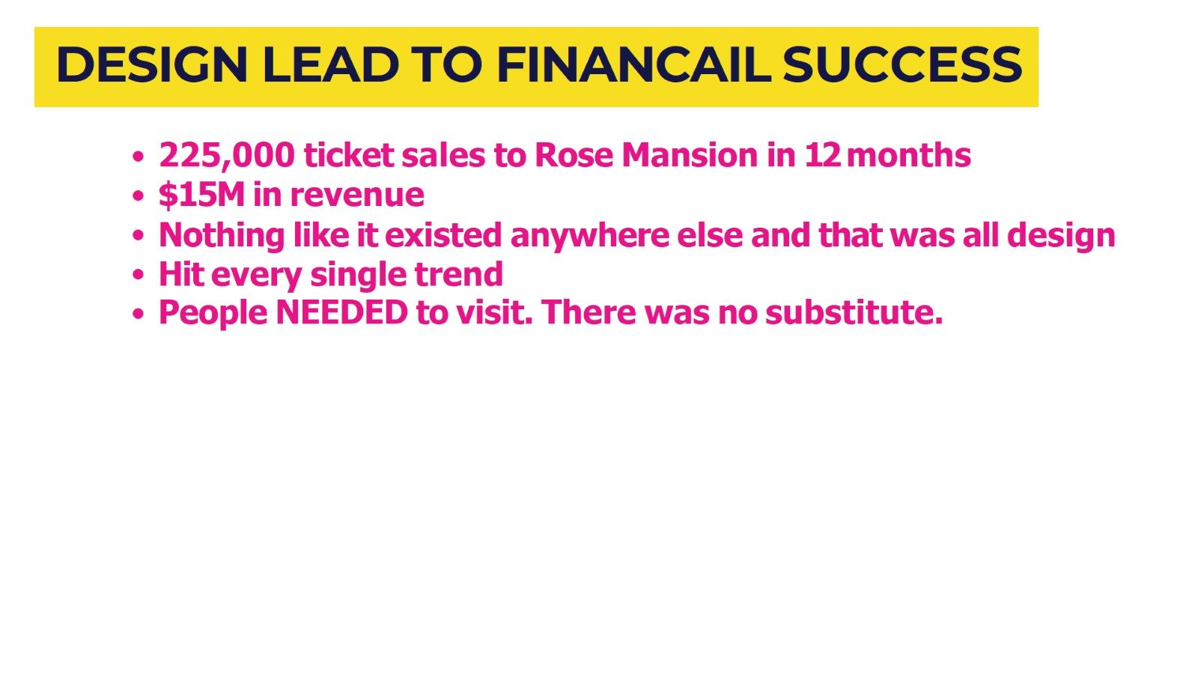
DESIGN LEAD TO FINANCAIL SUCCESS

Slide 26
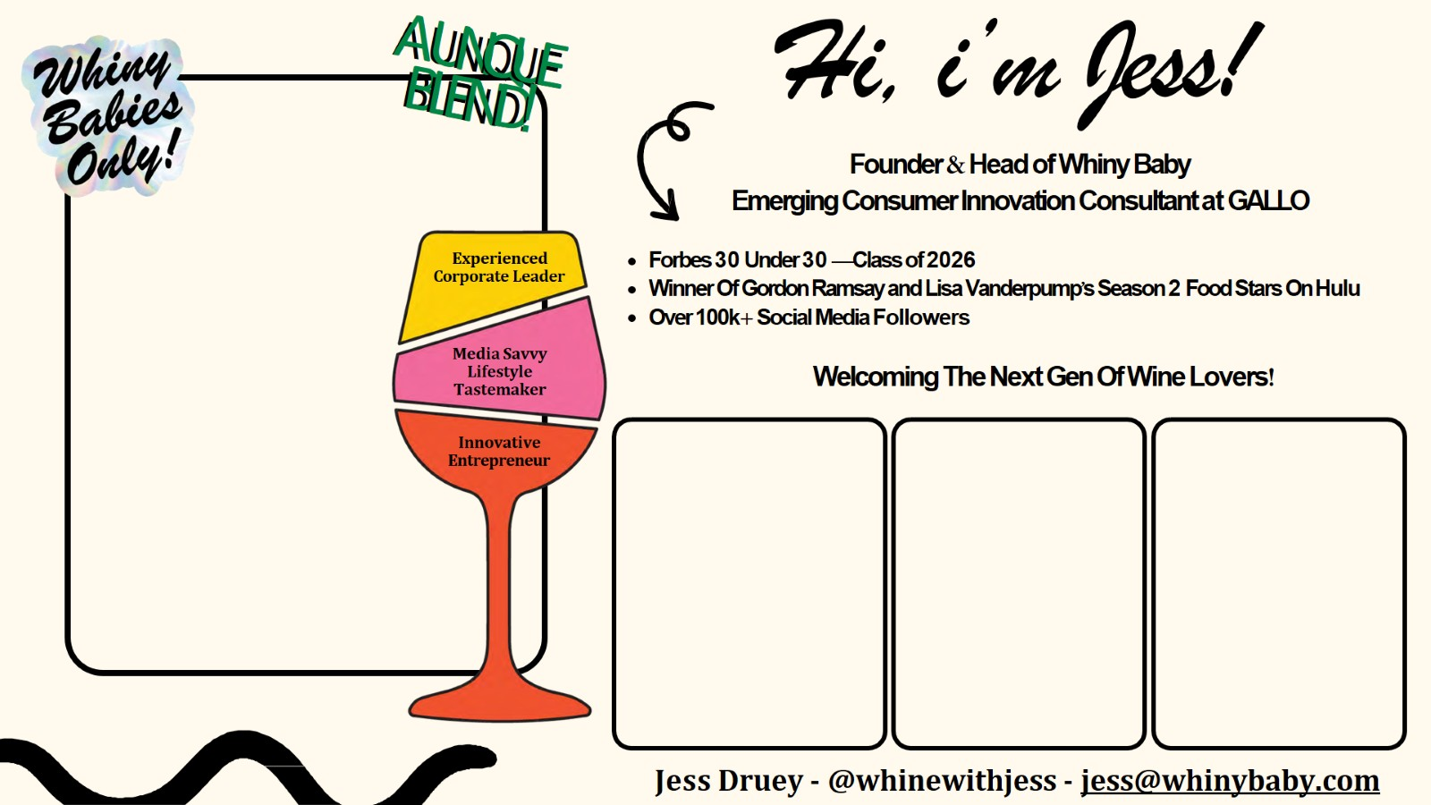
Hi, i’m Jess!

Slide 27
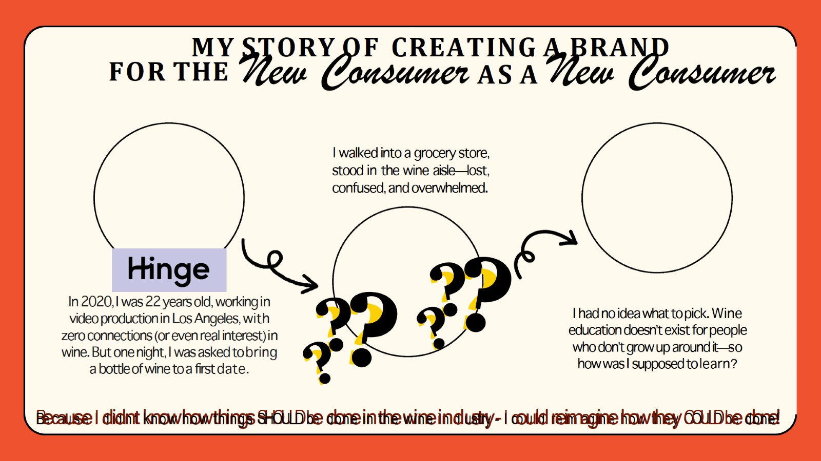
MY STORY OF CREATING A BRAND

Slide 28
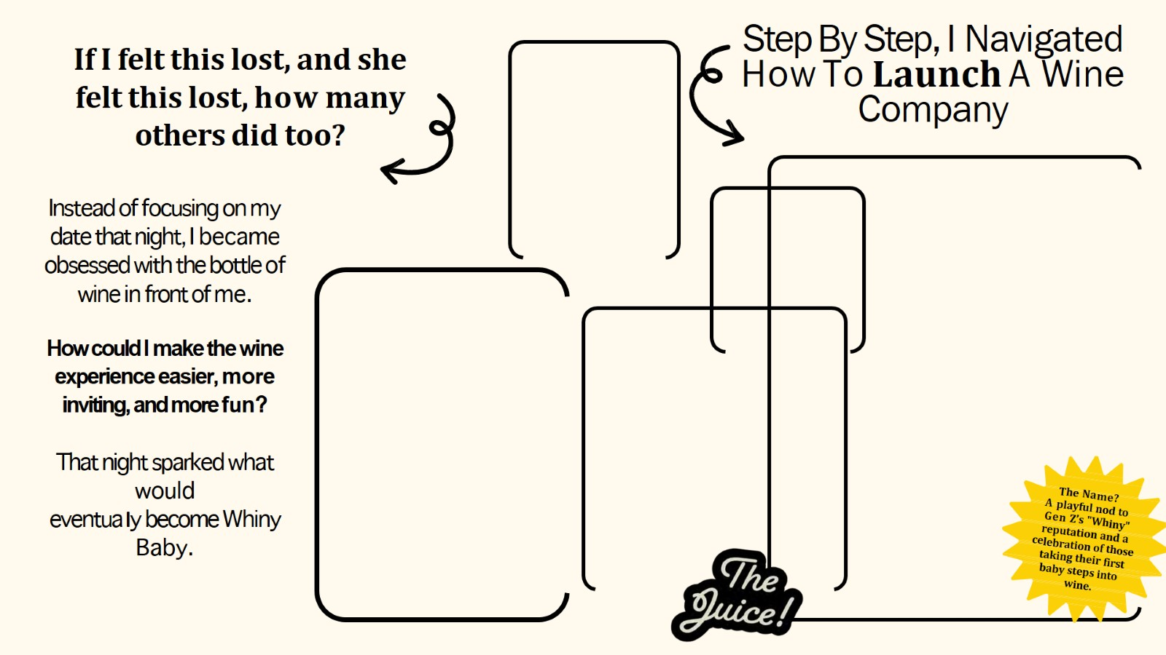
Step By Step, I Navigated How To Launch A Wine Company

Slide 29
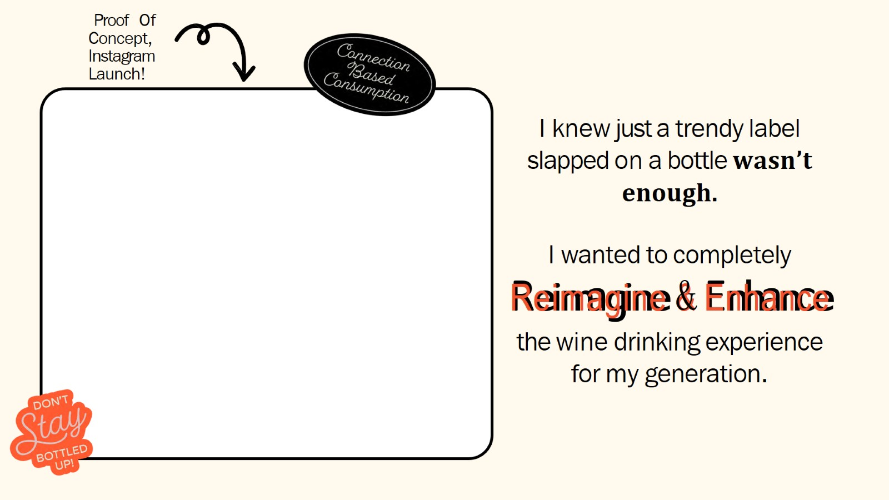
I knew just a trendy label slapped on a bottle wasn’t enough.

Slide 30
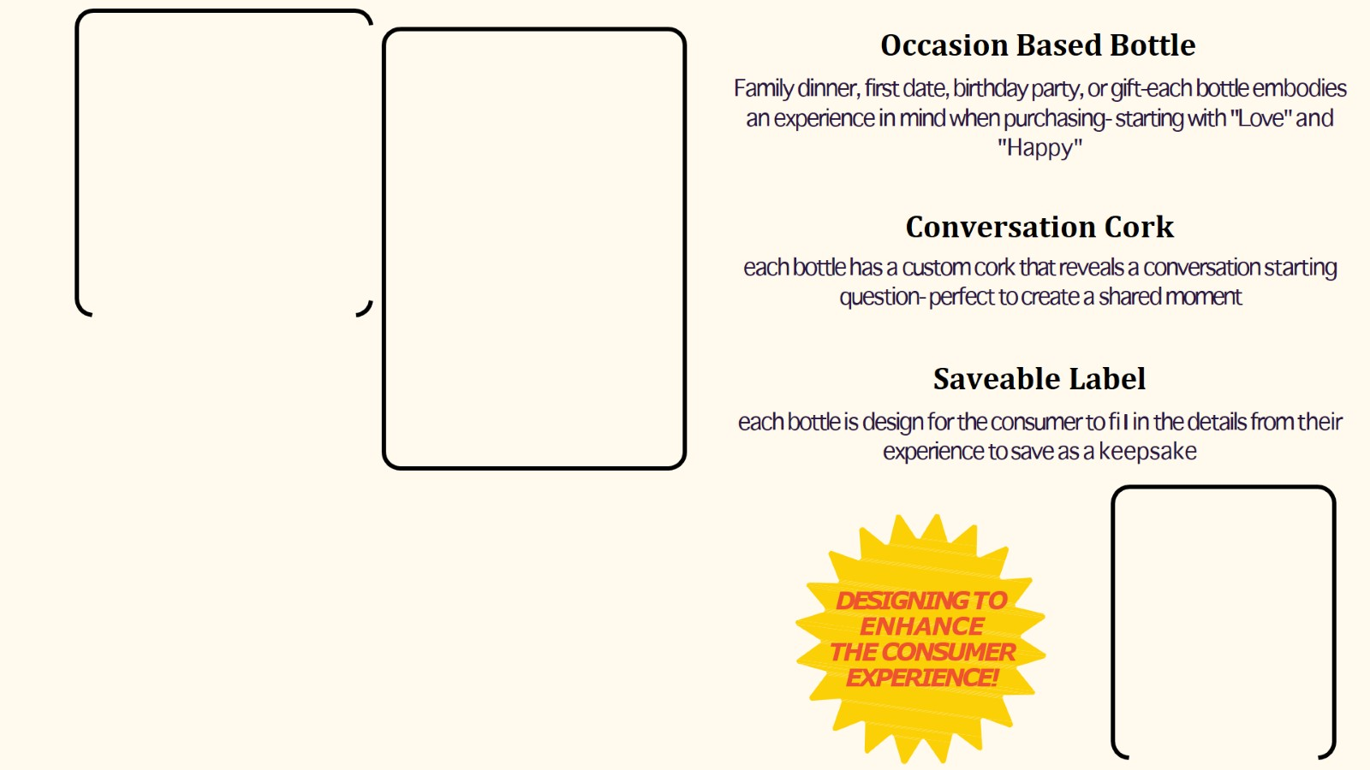
Occasion Based Bottle

Slide 31
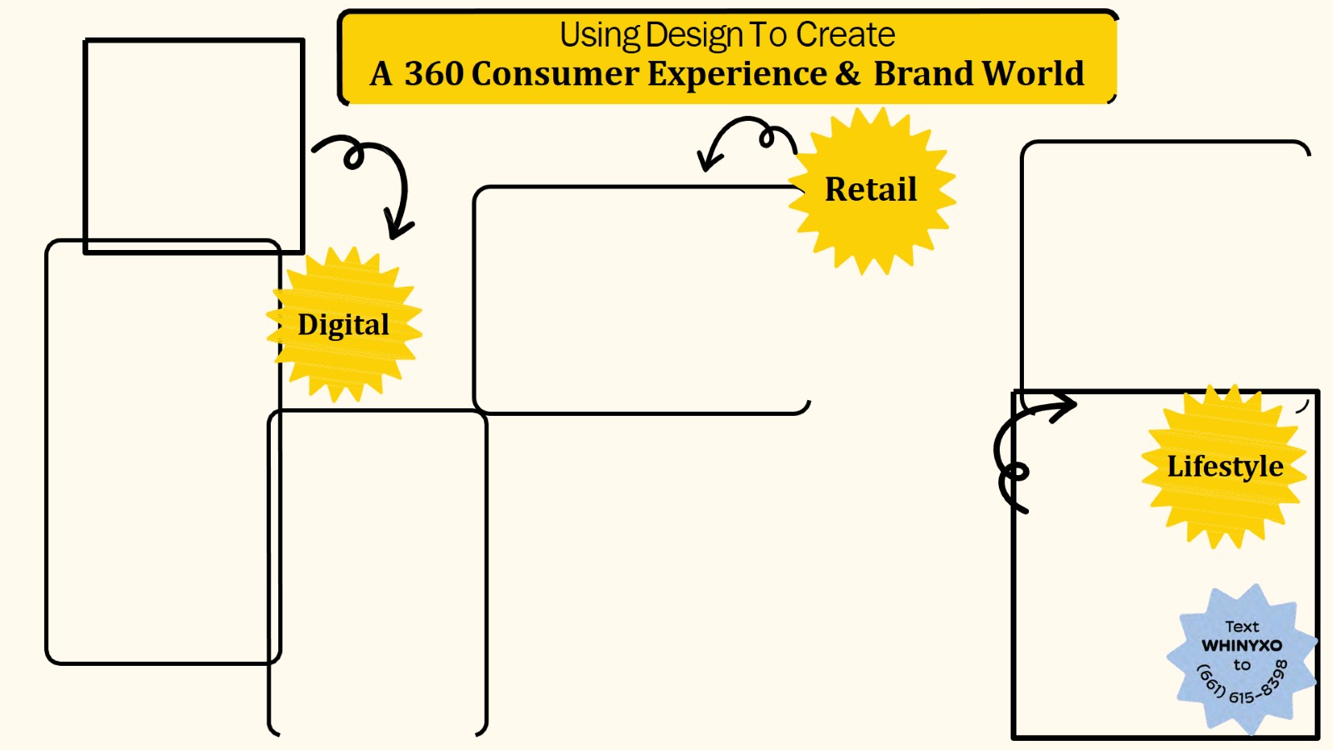
Using Design To Create
A 360 Consumer Experience & Brand World

Slide 32

Questions

